Slide 1
Predicting Seriousness of Injury in a Traffic Accident: A New Imbalanced Dataset and Benchmark Paschalis Lagias, George D. Magoulas, Ylli Prifti, and Alessandro Provetti
Birkbeck College, University of London, UK

Slide 2
UK Department for Transport Road Safety Data
Available to the public via UK Government Open Data webpage: Road Safety Data link
Records available since 1979.
3 datasets published per year:
Accidents: Incident conditions.
Vehicles: Vehicle characteristics, driver details, action before the incident.
Casualties: Details about injured individuals.
STATS 20: Associated Documentation

Slide 3
UK Department for Transport Road Safety Data
Accidents ID: Accident Index
Accident
Vehicles ID: Vehicle Reference Foreign Key: Accident Index
Vehicle 1
Vehicle 2
Casualties ID: Casualty Reference Foreign Key: Accident Index Foreign Key: Vehicle Reference
Casualty 1 (Driver)
Casualty 2 (Passenger)
Casualty 3 (Pedestrian)

Slide 4
UK Department for Transport Road Safety Data
Accident / Casualty Severity:
Slight: E.g., collisions in parking lots or with very low speed. About 89% of all records.
Serious: Incidents where hospitalization is required. About 10% of all records.
Fatal: About 1% of all records.
Most data variables are nominal and encoded with integers that represent a category.
Missing values are encoded with -1.

Slide 5
Past Work with UK Road Safety Data
Research Focus:
Exploratory data analysis
Prediction of Accident Severity
Features derived mostly from Accidents dataset
Challenges:
Class distribution for Accident Severity is heavily imbalanced
Low accuracy achieved for minority classes (serious, fatal)
Missing values

Slide 6
Data Preparation Data merging
Merging Accidents, Vehicles and Casualties
Stage 1:
Vehicles + Casualties join on Vehicle Reference.
Vehicles not matched with a casualty were removed.
Stage 2:
Stage 1 + Accidents join on Accident Index.
Output:
2,915,883 rows and 66 features.
Casualty severity class distribution heavily imbalanced.

Slide 7
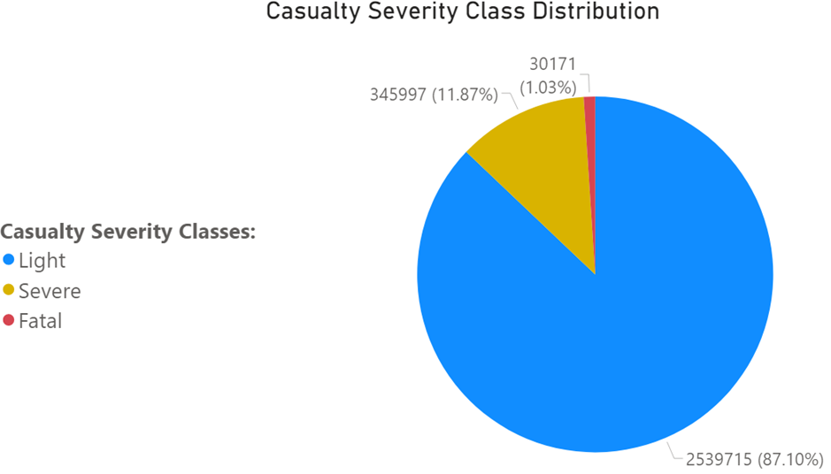
Data Preparation Casualty Severity imbalanced distribution

Slide 8
Data Preparation Features dropped
Accident Index, Vehicle Ref. and Casualty Ref:
Features used only for data joins.
Age Band of Driver and Age Band of Casualty:
Data already include ages for casualties and drivers.
Latitude, Longitude and LSOA of Accident Location:
Data already include Eastings and Northings.
Did Police attend Accident Scene, Accident Severity and No of Casualties:
Post-accident information was removed from the research.
Road Maintenance Worker, Journey Purpose of Driver and Engine Capacity:
Excessive number of missing values, “unknown” and “not applicable”. Engine Capacity data inconsistent with Vehicle Types.

Slide 9
Data Preparation Correction for “unknown” values
Values for “unknown” were re-encoded as missing with -1:
Urban or Rural Area
Sex of Casualty
Sex of Driver
Pedestrian Location
Pedestrian Movement
Light Conditions

Slide 10
Data Preparation Missing value imputation based on domain knowledge
Car Passenger:
Missing values related to buses and vans were replaced with “Not car passenger”.
Car Passenger:
Missing values related to buses and vans were replaced with “Not car passenger”.
Car Passenger:
Missing values related to buses and vans were replaced with “Not car passenger”.

Slide 11
Data Preparation Time processing
Merging Accidents, Vehicles and Casualties
Stage 1:
Vehicles + Casualties join on Vehicle Reference.
Vehicles not matched with a casualty were removed.
Stage 2:
Stage 1 + Accidents join on Accident Index.
Output:
2,915,883 rows and 66 features.
Casualty severity class distribution heavily imbalanced.

Slide 12
Data Preparation Feature correlation and importance
Merging Accidents, Vehicles and Casualties
Stage 1:
Vehicles + Casualties join on Vehicle Reference.
Vehicles not matched with a casualty were removed.
Stage 2:
Stage 1 + Accidents join on Accident Index.
Output:
2,915,883 rows and 66 features.
Casualty severity class distribution heavily imbalanced.

Slide 13
Data Preparation Imputation with missForest
Merging Accidents, Vehicles and Casualties
Stage 1:
Vehicles + Casualties join on Vehicle Reference.
Vehicles not matched with a casualty were removed.
Stage 2:
Stage 1 + Accidents join on Accident Index.
Output:
2,915,883 rows and 66 features.
Casualty severity class distribution heavily imbalanced.

Slide 14
Baseline Models Multi-layered Perceptron
Merging Accidents, Vehicles and Casualties
Stage 1:
Vehicles + Casualties join on Vehicle Reference.
Vehicles not matched with a casualty were removed.
Stage 2:
Stage 1 + Accidents join on Accident Index.
Output:
2,915,883 rows and 66 features.
Casualty severity class distribution heavily imbalanced.

Slide 15
Baseline Models Reinforcement Learning Deep Q Network
Merging Accidents, Vehicles and Casualties
Stage 1:
Vehicles + Casualties join on Vehicle Reference.
Vehicles not matched with a casualty were removed.
Stage 2:
Stage 1 + Accidents join on Accident Index.
Output:
2,915,883 rows and 66 features.
Casualty severity class distribution heavily imbalanced.

Slide 16
UK Department for Transport Traffic Accident Data
Available to the public

