Slide 1

Predicting Seriousness of Injury in a Traffic Accident: A New Imbalanced Dataset and Benchmark Paschalis Lagias, George D. Magoulas, Ylli Prifti, and Alessandro Provetti
Birkbeck College, University of London, UK

Slide 2
UK Department for Transport Road Safety Data
Available to the public via UK Government Open Data webpage: Road Safety Data link
Records available since 1979.
STATS 20 associated documentation.
Accident / Casualty Severity:
Slight
Serious
Fatal
Mainly nominal variables encoded with integers that represent a category.
Missing values encoded with -1.

Slide 3
UK Department for Transport Datasets per year
Accidents ID: Accident Index
Accident
Vehicles ID: Vehicle Reference Foreign Key: Accident Index
Vehicle 1
Vehicle 2
Casualties ID: Casualty Reference Foreign Key: Accident Index Foreign Key: Vehicle Reference
Casualty 1 (Driver)
Casualty 2 (Passenger)
Casualty 3 (Pedestrian)

Slide 4
Past Work Research focus and challenges
Past research focus
Exploratory data analysis.
Prediction of Accident Severity.
Features derived mostly from Accidents dataset.
Challenges
Class distribution for Accident Severity is heavily imbalanced.
Low accuracy achieved for minority classes (serious, fatal).
Missing values.

Slide 5
Project Overview Stages and workflow
Dataset Merging (2005 – 2018)
Exploratory Analysis
Data Correction
Data Imputation: MissForest
Multi-layered Perceptron
Casualties
Vehicles
Accidents
Feature correlation
Missing values
DfT documentation
Fields with missing values more than 50% were dropped
Reinforcement Learning
Training / Validation data (2005 – 2018) imputed
Test data (2019) imputed
Double Q network
Architecture from perceptron sensitive to fatal casualties.
Empirical feature selection
Class weights used in loss function

Slide 6
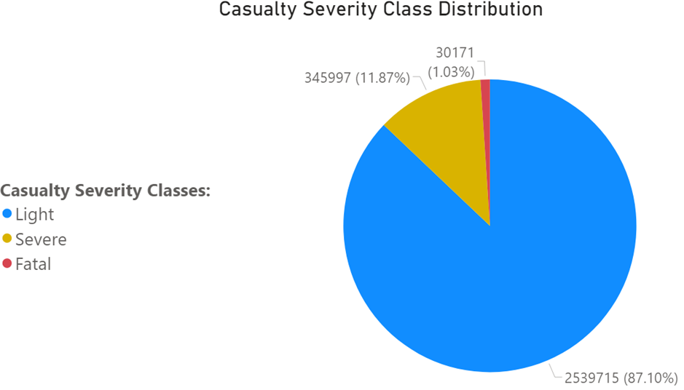
Data Preparation Casualty Severity imbalanced distribution

Slide 7
Data Preparation Missing values before and after manual imputation
Before
After
Total rows | 2,915,883
Total columns | 66
Number of full rows | 411,158
Number of rows where at least one value is missing | 2,504,725
Percentage of rows with missing values (%) | 85.9
Total rows | 2,915,387
Total columns | 53
Number of full rows | 1,443,492
Number of rows where at least one value is missing | 1,471,895
Percentage of rows with missing values (%) | 50.49

Slide 8
Data Preparation Feature correlation and importance
Numerical variables – Casualty Severity
ANOVA F – statistic
Categorical variables – Casualty Severity
X² – squared statistic
Correlation ratio coefficient
Mutual information
Theil’s U coefficient (anti-symmetrical)
Cramer’s V coefficient
Categorical - Categorical
Mutual information
Cramer’s V coefficient
Categorical – Numerical
Correlation ratio coefficient
Numerical – Numerical
Pearson’s correlation coefficient
Theil’s U coefficient

Slide 9
Data Preparation Feature correlation results
Categorical variables
Important features: Casualty Type, Vehicle Type and Vehicle Maneuver.
Least important features: Carriageway Hazards, Was Vehicle Left Hand Drive and Pedestrian Crossing-Human Control.
Numerical variables
Important features: Number of Vehicles and Speed Limit.
Least important features: Eastings and Northings.

Slide 10
Data Preparation Imputation with MissForest
Algorithm suitable for high dimensional data with mixed data types.
Memory capacity.
Speed Limit and Weather Conditions had minimal percentage of missing values. Imputed first to expand the number of complete features.
Junctions and Road Classes
Pedestrians
Vehicle-Site Interaction
Drivers-Vehicles
Age of Vehicle
Driver IMD Decile
Imputed Datasets
2005 – 2018
2019
49 features
* Stekhoven, D.J., Bühlmann, P.: MissForest—non-parametric missing value imputation for mixed-type data.

Slide 11
Data Preparation Imputation with MissForest – key parameters
Maximum Iterations | 20
Number of grown trees per iteration | 100
Split quality criterion for numerical variables | MSE
Split quality criterion for categorical variables | Gini
Random state for repeatability | 10
Class weights | Balanced: inversely proportional to class frequencies

Slide 12
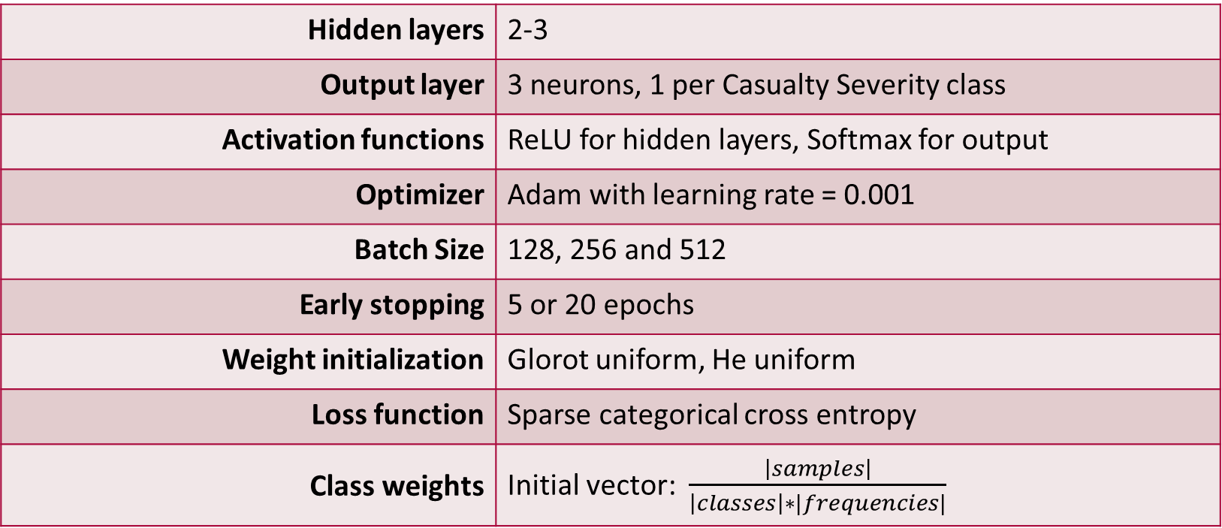
Baseline Predictive Models Artificial Neural Network
Hidden layers | 2-3
Output layer | 3 neurons, 1 per Casualty Severity class
Activation functions | ReLU for hidden layers, Softmax for output
Optimizer | Adam with learning rate = 0.001
Batch Size | 128, 256 and 512
Early stopping | 5 or 20 epochs
Weight initialization | Glorot uniform, He uniform
Loss function | Sparse categorical cross entropy
Class weights | Initial vector: $\frac{\left|samples\right|}{\left|classes\right|∗|frequencies|}$

Slide 13
Baseline Predictive Models Reinforcement Learning – Q Network
Adopted the approach from Lin, Chen and Qi paper.
Expanded problem formulation to a multi-class classification problem.
Model units
Environment
Episode
Reward function
Memory
Transition
Agent
* Lin, E., Chen, Q., Qi, X.: Deep reinforcement learning for imbalanced classification.

Slide 14
Baseline Predictive Models Reinforcement Learning – Environment
Environment: Traffic accident data
Observation space: Data sample size.
Action space: Action represents class prediction – 3 possible actions.
Step counter: Number of steps tracker within an episode.
Weighted action rewards: Different reward returned per class sample correct prediction.
Reset function: Reshuffles data, resets counter and draws the first training sample.
Step: Predicts class, collects reward and checks if the episode is done.

Slide 15
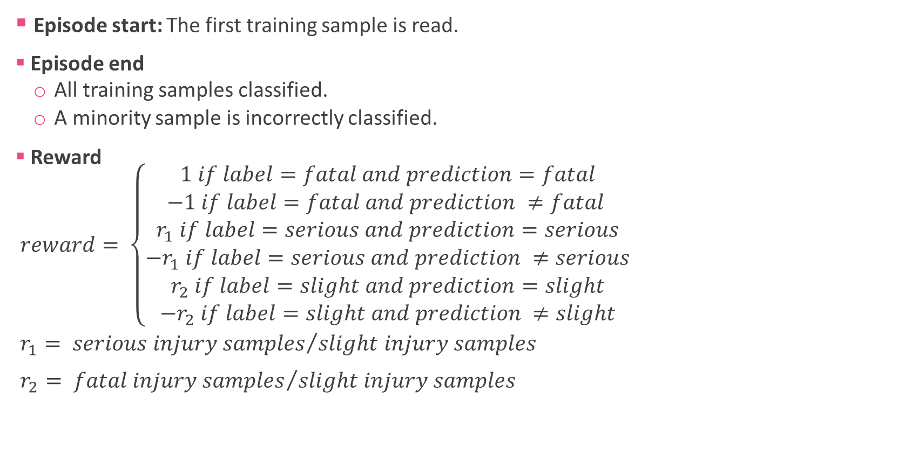
Baseline Predictive Models Reinforcement Learning – Episode and Reward
Episode start: The first training sample is read.
Episode end
All training samples classified.
A minority sample is incorrectly classified.
Reward
$reward= \left\{\begin{matrix}1 if label=fatal and prediction=fatal \\ −1 if label=fatal and prediction ≠fatal \\ \begin{matrix}r_{1} if label=serious and prediction=serious \\ −r_{1} if label=serious and prediction ≠serious \\ \begin{matrix}r_{2} if label=slight and prediction=slight \\ −r_{2} if label=slight and prediction ≠slight\end{matrix}\end{matrix}\end{matrix}\right.$
$r_{1}= {serious injury samples}/{slight injury samples}$
$r_{2}= {fatal injury samples}/{slight injury samples}$

Slide 16
Baseline Predictive Models Reinforcement Learning – Memory and Transition
Memory: Saves transitions and samples batches of saved transitions for Q-Network training.
Transition
Current state: Current data sample.
New state: Next data sample.
Action taken: Predicted Casualty Severity class.
Reward: Value returned based on predicted class and actual label.
Episode done flag: Boolean.

Slide 17
Baseline Predictive Models Reinforcement Learning – Agent
Memory
Evaluation and target networks
Action space: Set of available actions.
Hyperparameters
Save / Load: Save or load network weights and Memory.
Training: Updates training / target network weights.
Action selection: predicts Casualty Severity for a training sample.
* Hasselt, H.v., Guez, A., Silver, D.: Deep reinforcement learning with double q-learning.

Slide 18
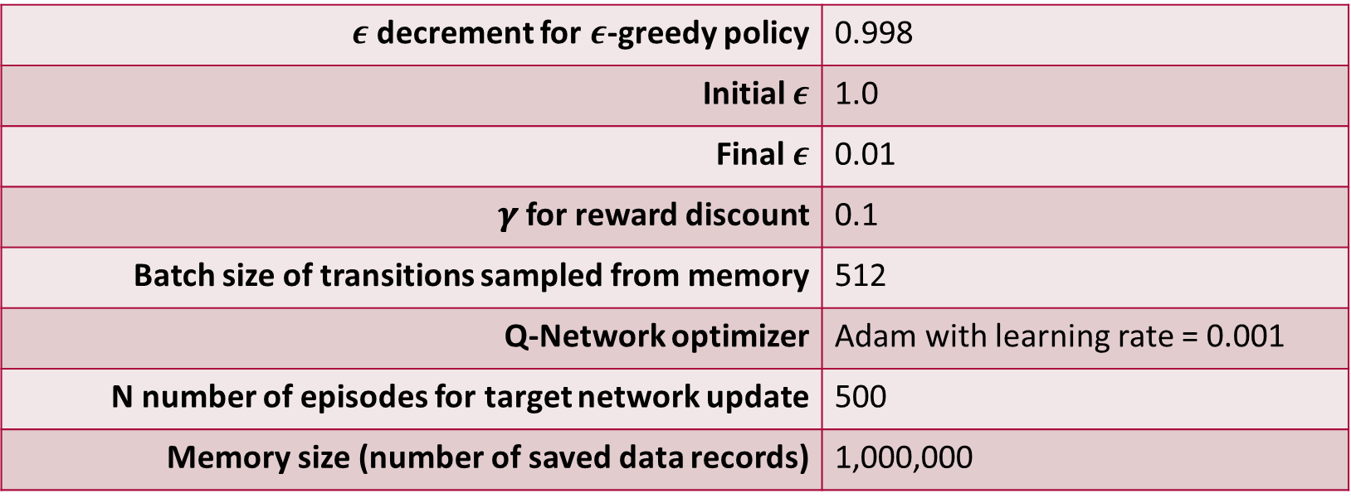
Baseline Predictive Models Reinforcement Learning – Agent Hyperparameters
$ε$ decrement for $ε$-greedy policy | 0.998
Initial $ε$ | 1.0
Final $ε$ | 0.01
𝜸 for reward discount | 0.1
Batch size of transitions sampled from memory | 512
Q-Network optimizer | Adam with learning rate = 0.001
N number of episodes for target network update | 500
Memory size (number of saved data records) | 1,000,000

Slide 19
Baseline Predictive Models Reinforcement Learning – Episode Cycle
Environment is reset ad the Agent checks the first training sample.
Agent predicts Casualty Severity with 𝝐-greedy policy.
Reward, new training sample and episode done flag are returned.
Prediction compared against actual label. Training network weights updated by back-propagation with Stochastic Gradient Descent.
If a minority sample is classified incorrectly the episode ends. Otherwise, the agent takes a new step.

Slide 20
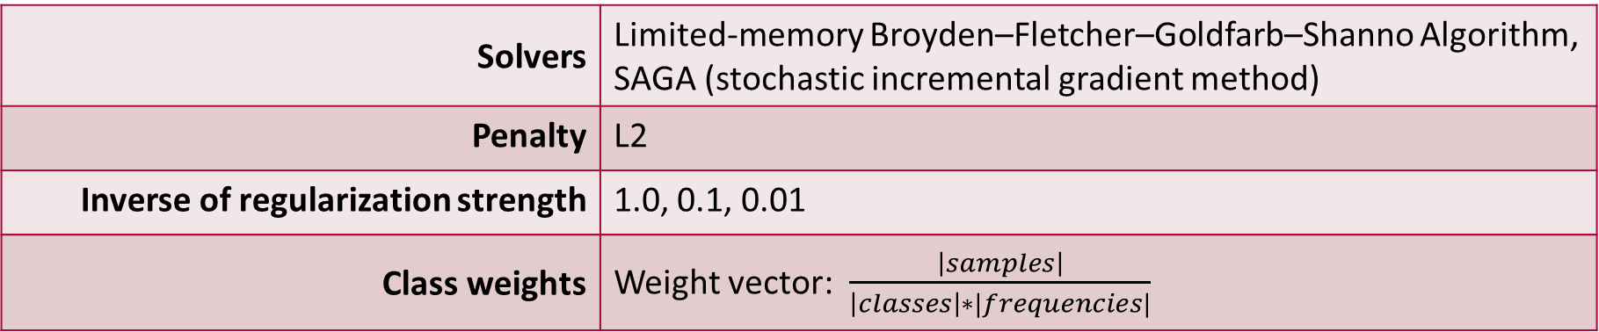
Baseline Predictive Models Logistic Regression
Solvers | Limited-memory Broyden–Fletcher–Goldfarb–Shanno Algorithm, SAGA (stochastic incremental gradient method)
Penalty | L2
Inverse of regularization strength | 1.0, 0.1, 0.01
Class weights | Weight vector: $\frac{\left|samples\right|}{\left|classes\right|∗|frequencies|}$

Slide 21
Experiments and Evaluation Data splits and metrics
Training / validation data: 2005-2018 data with a 75% - 25% split.
Test data: 2019 data.
Metrics:
Overall classification accuracy
Individual class accuracy.

Slide 22
Experiments and Evaluation Supervised learning experiments – Experiment 1
Only full 2005-2018 records used for training and validation (411k data points)
No imputation or resampling
Metric Description | Result | Hidden Layers | Neurons | Class weights Fatal | Serious | Slight
Best accuracy for fatal injuries | 53% | 3 | 1,000 per layer | 17.5 | 2.44 | 0.69
Best accuracy for serious injuries | 66% | 2 | Layer 1: 2,000 Layer 2: 500 | 31.83 | 3.04 | 0.38
Best overall accuracy | 77% | 3 | 1,200 per layer | 19.5 | 3.44 | 0.69
Best accuracy per class on average | 56%* | 3 | 1,200 per layer | 19.5 | 3.44 | 0.69
* 44% for fatal, 43% for serious, and 82% for slight injuries

Slide 23
Experiments and Evaluation Supervised learning experiments – Experiment 2
Only full 2005-2018 records used for training and validation (411k data points)
Synthetic Minority Over-sampling Technique (SMOTE) applied
3 neighbors used for generating synthetic samples
Output dataset had equal number of observations per class
Metric Description | Result | Hidden Layers | Neurons | Class weights Fatal | Serious | Slight
Best accuracy for fatal injuries | 25% | 3 | 1,200 per layer | 1.23 | 1.07 | 0.89
Best accuracy for serious injuries | 63% | 3 | 1,200 per layer | 1.0 | 0.85 | 0.5
Best accuracy per class on average | 52%* | 3 | 1,200 per layer | 1.0 | 0.85 | 0.5
* 25% for fatal, 63% for serious, and 67% for slight injuries
* Chawla, N.V., Bowyer, K.W., Hall, L.O., Kegelmeyer, W.P.: SMOTE: synthetic minority over-sampling.

Slide 24
Experiments and Evaluation Supervised learning experiments – Experiment 3
Fully imputed 2005-2018 records used for training and validation.
Fully imputed 2019 records used for testing.
Metric Description | Result | Hidden Layers | Neurons | Class weights Fatal | Serious | Slight
Best accuracy for fatal injuries | 48% | 3 | 1,000 per layer | 19.5 | 3.44 | 0.69
Best accuracy for serious injuries | 64% | 2 | Layer 1: 2,000 Layer 2: 500 | 32.1 | 2.81 | 0.38
Best accuracy per class on average | 56%* | 3 | 1,200 per layer | 31.83 | 3.04 | 0.38
* 45% for fatal, 57% for serious, and 66% for slight injuries

Slide 25
Experiments and Evaluation Supervised learning experiments – Logistic Regression
Solver | Limited-memory Broyden–Fletcher–Goldfarb–Shanno Algorithm
Inverse of regularization strength | 0.1
Accuracy for fatal injuries | 63%
Accuracy for serious injuries | 44%
Accuracy for slight injuries | 62%
Average accuracy per class | 57%
Overall model accuracy | 59%

Slide 26
Experiments and Evaluation Reinforcement learning experiments
Only full 2005-2018 records used for training and testing
Training / target network architecture adopted from supervised learning.
No softmax activation needed for output (networks compute Q values).
Softmax activation added to output layer only for predictions.
Massive number of training episodes leads to overestimation.
Metric Description | Result | Hidden Layers | Neurons | Episodes run
Best accuracy for fatal injuries | 37% | 3 | 1,200 per layer | 3,400
Best accuracy for serious injuries | 69% | 3 | 1,200 per layer | 4,700
Best accuracy per class on average | 46%* | 3 | 1,200 per layer | 5,800
* 29% for fatal, 49% for serious, and 58% for slight injuries

Slide 27
Conclusion Challenges and Future Work
Scoring high accuracy for minority classes compromises the majority class.
MissForest imputation
Hyperparameter tuning.
Full run with the entire dataset on stronger infrastructure.
Supervised learning
Hyperparameter tuning.
Reinforcement learning:
Hyperparameter tuning.
Reward function improvement.
Regularisation

Slide 28

Thank you for your attention! Any questions?

