Slide 1
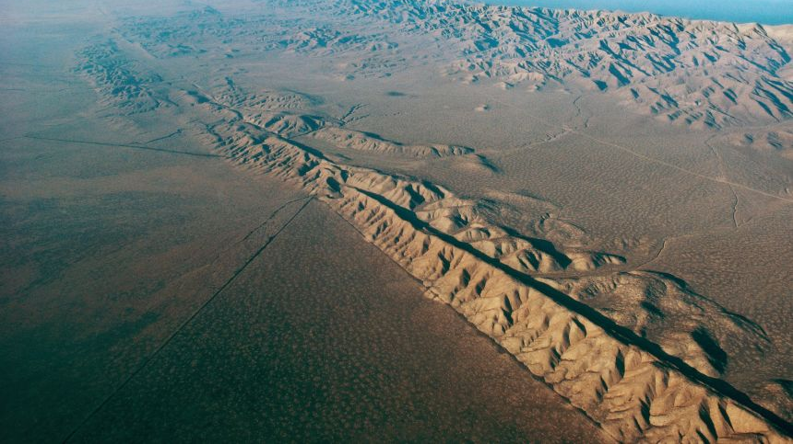
D.E.E.P. Detecting Earthquakes and Extracting Phases
Unified Deep Learning for Simultaneous Seismic Event Detection and Phase Picking.
by Cattaneo Alessandro & Melchionna Alessandra

Slide 2
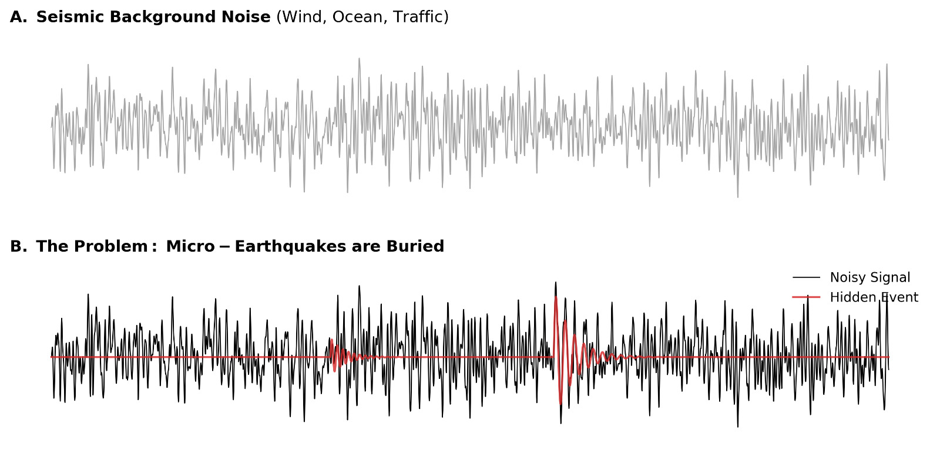
The Why: Introduction & Problem
Daily Volume: Terabytes of raw continuous data.
The Bottleneck: Manual analysis is unscalable and subjective.
STA/LTA (Short-Term Average / Long-Term Average) triggers.
Sensitivity to anthropogenic noise (traffic, industry).
Failure on micro-earthquakes (low SNR).
Unified Tasking: One model for Detection + Picking.
High Temporal Resolution: Precision within milliseconds.
Probabilistic Output: Predicting likelihood, not just a single point.

Slide 3
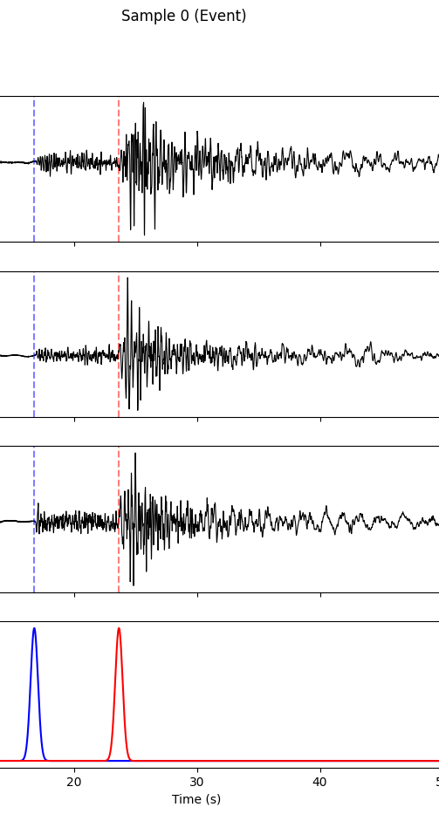


The Data
Source: INGV (Istituto Nazionale di Geofisica e Vulcanologia).
Data Format: 3-Component waveforms (East, North, Vertical).
Sampling: 100 Hz (6000 samples per 60-second window).
The 50/50 Strategy.
The problem with "Dirac Delta" (single point) targets.
Gaussian standard deviation ($σ=0.3s$).

Slide 4
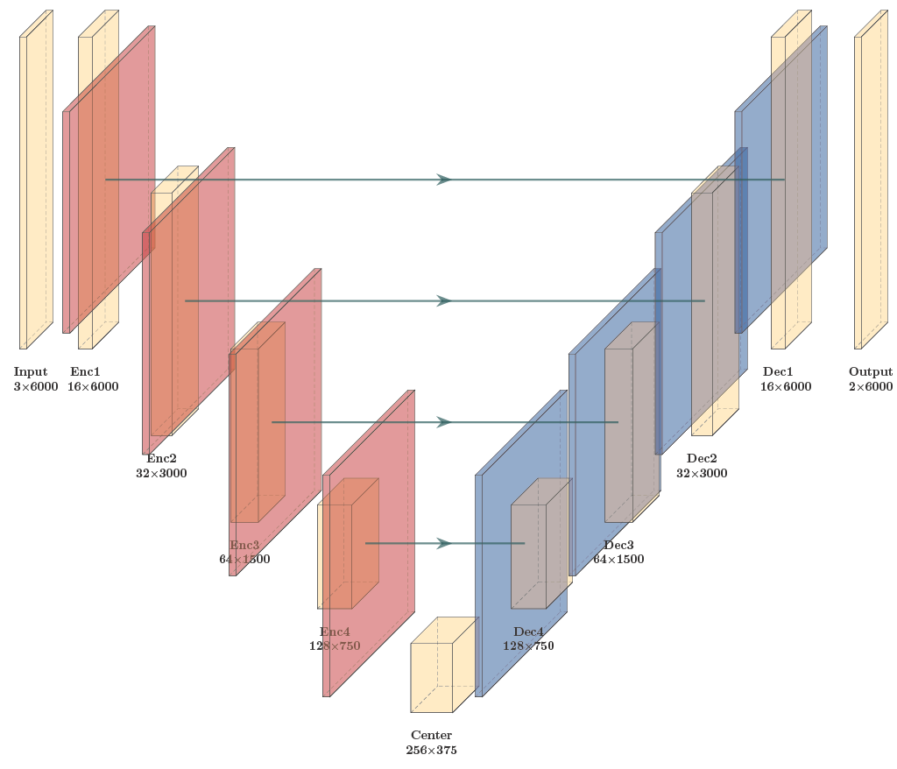
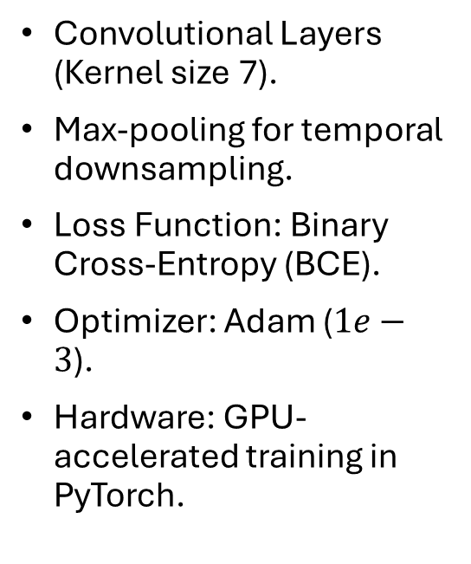
The Engine
Convolutional Layers (Kernel size 7).
Max-pooling for temporal downsampling.
Loss Function: Binary Cross-Entropy (BCE).
Optimizer: Adam ($1e−3$).
Hardware: GPU-accelerated training in PyTorch.

Slide 5
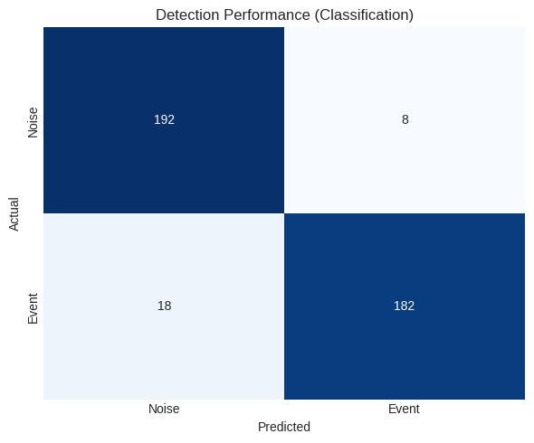
Results & Performance

Slide 6
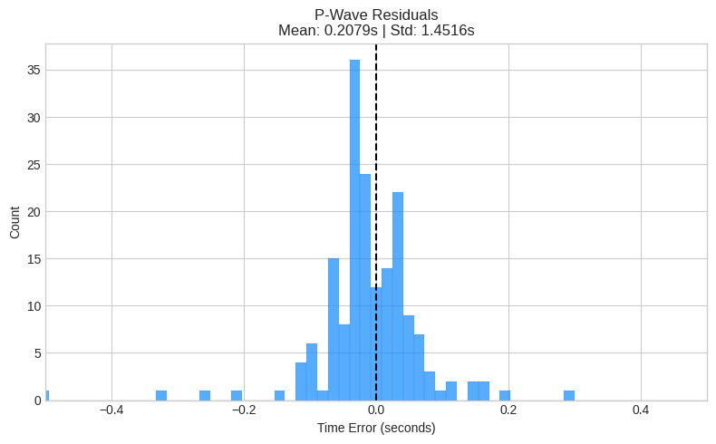
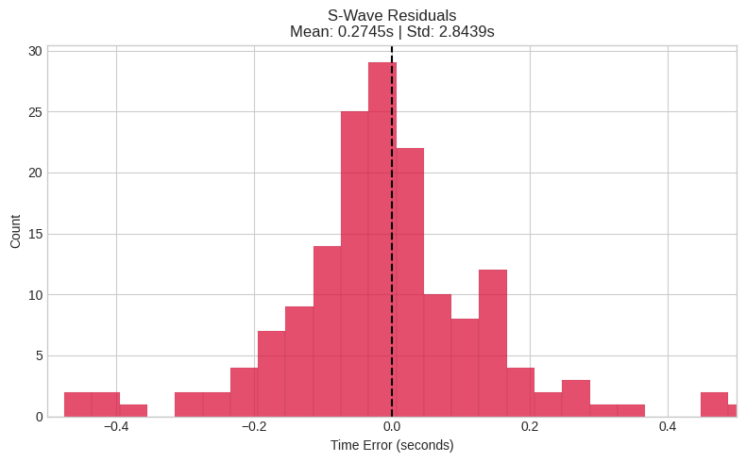
Results & Performance

Slide 7

The Seismic Agente (Live Application)
The "Seismic Agent" Python tool.
Integration with Obspy and global data centers.
The 5-Minute Lag Strategy.
Real-time data instability vs. archival stability.
Testing on diverse tectonic environments.
User-defined INGV station codes.

