Slide 1
Notes about the Flame Transfer Function optimisation
Alessandro Giannotta
25/11/2025

Slide 2
Outline
Implementation of a time varying inlet
Implementation of the Discrete Fourier Transform for the objective function.
Gradient of the harmonic amplitude with respect to geometry
Implementation of the global heat release rate as a cost function

Slide 3
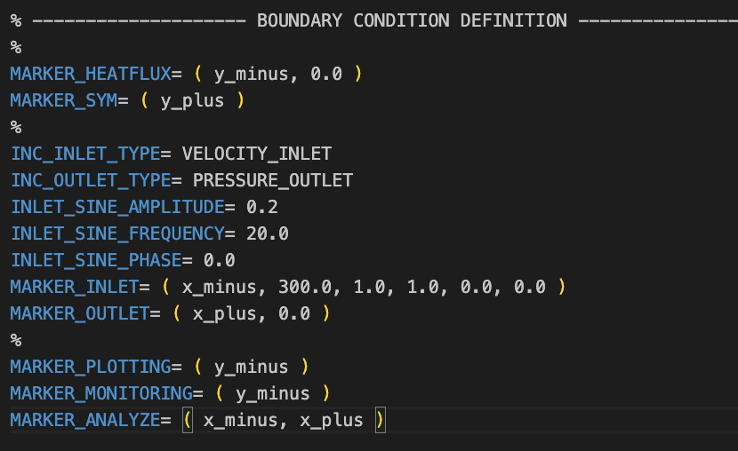
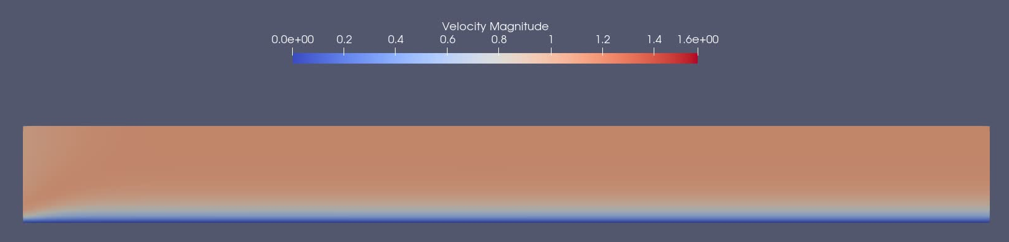
Implementation of the Time Varying inlet
Sinusoidal time varying inlet in the config file, not in the pywrapper
specify amplitude, frequency and phase of the inlet

Slide 4
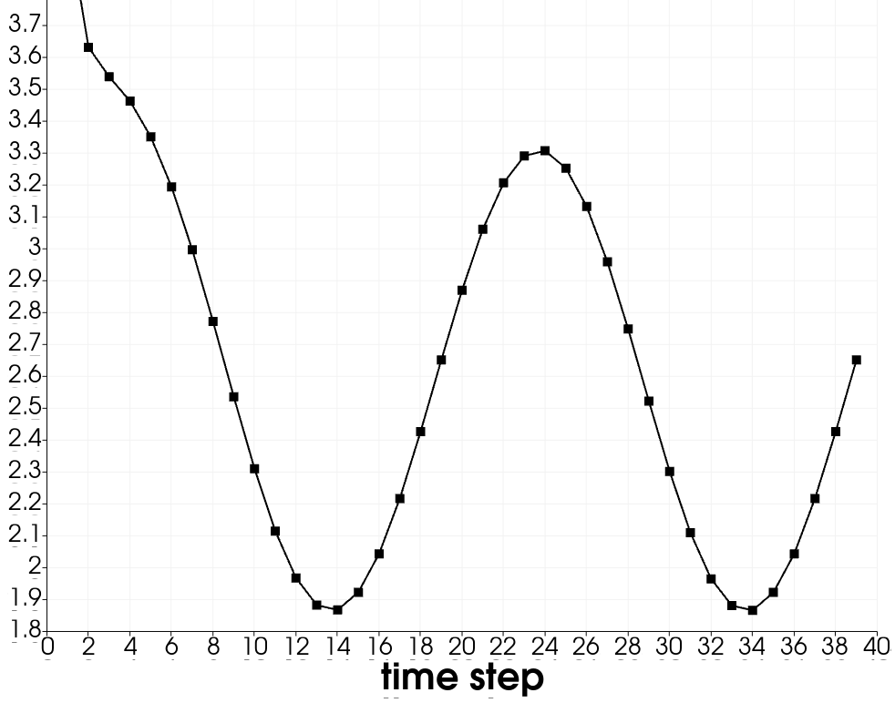
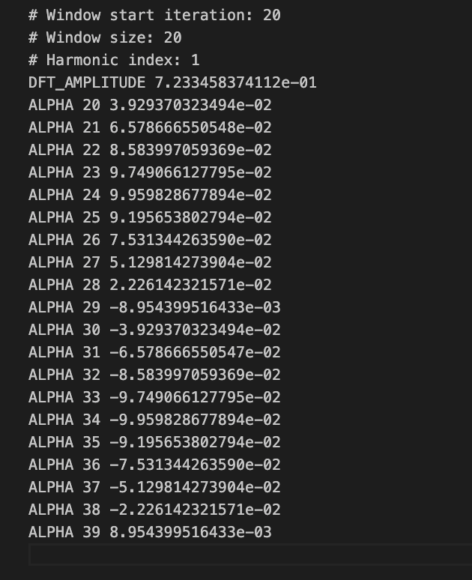
Implementation of the DFT
Implementation of a time varying inlet
Implementation of the Discrete Fourier Transform for the objective function. For example, We set the drag coefficient CD as the objective function and compute the first amplitude of the Fourier Transform
Square Window
0.72

Slide 5
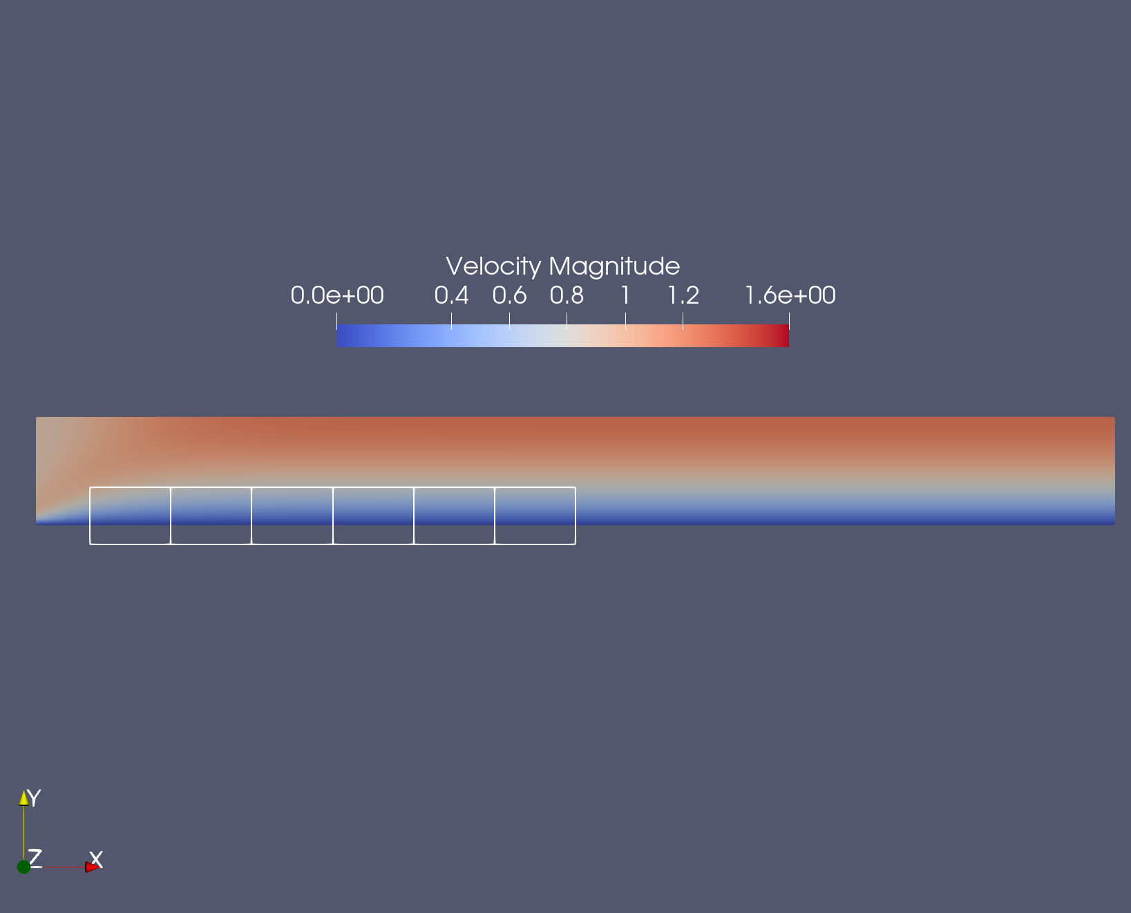
Calculation of the gradient with respect to FFD Boxes
10 Design Variables
Using the Discrete Adjoint method we can calculate the gradient of the amplitude of first harmonic of the DRAG oscillations with respect to the FFD boxes nodes di

