Slide 1
Constructing Intelligent Agents Using Java : Chap04
J.P.Bigus & J.Bigus
Mokdong Chung
Pukyong National University mdchung@pknu.ac.kr
Computer Security & Artificial Intelligence Lab.

Slide 2

Reasoning Systems
In this chapter
  How the various knowledge representations can be used for reasoning
  Java application that uses both forward-and backward-chaining algorithms
  A forward-chaining using fuzzy logic
  Several AI techniques
Chap 4. Reasoning Systems CS&AI Lab.

Slide 3
Reasoning with Rules
If-then rules
  The most popular form
  Easily understandable
  Easily added
  Easily changed
Forward chaining
  Used to produce new facts
Backward chaining
  Deduce whether statements are true or not
Chap 4. Reasoning Systems CS&AI Lab.

Slide 4
Reasoning with Rules
Expert system or knowledge-based system
  Common term used to describe a rule-based processing system
  Consists of three major elements
    Knowledge base
    Working memory or database of derived facts and data
    Inference engine which contains reasoning logic
Chap 4. Reasoning Systems CS&AI Lab.

Slide 5
Reasoning with Rules
Antecedent clauses
  if num_wheels = 4 and motor = yes
Consequent clauses
  then vehicleType = automobile
Forward chaining
  If we know that a vehicle has four wheels and a motor
    We can conclude that the vehicleType is an automobile
Backward chaining
  If we are trying to prove that the vehicleType is an automobile
    We need to find out whether the vehicle has four wheels and a motor
Chap 4. Reasoning Systems CS&AI Lab.

Slide 6
Reasoning with Rules
Disjunction(or) between antecedent clauses
  Shorthand that reduces the size of a rule base
  Rule3 could replace Rule1 and Rule2 : p.84
  Allow Boolean condition operators
  Rewrite Rule3:
    Rule4 : if (num_wheels >1) and (num_wheels < 4) then vehicleType = cycle
Uncertainty
  Rule 5
Sensors
  Functions called from the antecedent clauses
Effectors
  Functions called from the consequent clauses
Chap 4. Reasoning Systems CS&AI Lab.

Slide 7
Forwarding Chaining
Forward chaining
  Data-driven reasoning process
    A set of rules is used to derive new facts from an initial set of data
  Used in a real-time monitoring and diagnostic systems where a quick identification and response to problems are required
  The several tools were developed
    The OPS5 language and the later OPS83 were developed at CMU
Chap 4. Reasoning Systems CS&AI Lab.

Slide 8
Forwarding Chaining
Forward chaining cycle
  1. Load the rule base into the inference engine and load any facts from the knowledge base into the working memory
  2. Add the initial data into the working memory
  3. Match the rules against the data in the working memory
    This set of triggered rules is called the conflict set
  Conflict resolution
  Fire
  Repeat 3,4, and 5 until the conflict set is empty
Chap 4. Reasoning Systems CS&AI Lab.

Slide 9
Forwarding Chaining
More than one rule that is triggered. Which rule?
  The first rule
  The highest specificity or number of antecedent clauses
  Changed most recently
  If the rule has fired on the previous cycle, do not add
  There is a tie, select a rule randomly
Chap 4. Reasoning Systems CS&AI Lab.

Slide 10
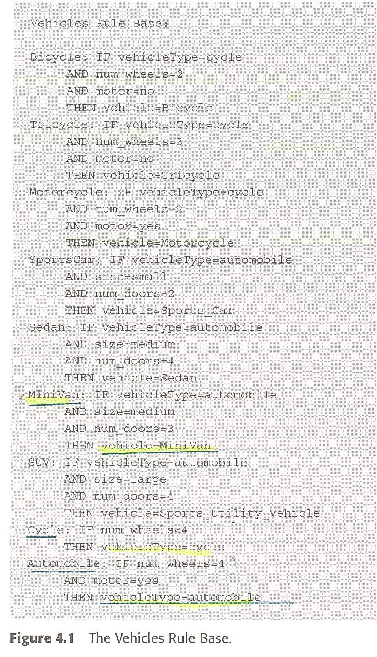
Forwarding Chaining
Chap 4. Reasoning Systems CS&AI Lab.

Slide 11
A Forward-Chaining Example
Load our Vehicle rule base into the inference engine and define a set of initial values for variables in the working memory
Match phase
  The first seven rules are not triggered
  The last two rules are candidates
  The Automobile: rule is triggered
    Bind the value “automobile” to the vehicleType variable
    Add it to our working memory : p. 89
  Fire the MiniVan: rule and add the new information vehicle = MiniVan to the working memory
Chap 4. Reasoning Systems CS&AI Lab.

Slide 12
Backward Chaining
Backward chaining
  Often called goal-directed inferencing
    Goal clause is evaluated first
    Then, go backward through the rules
  Unlike forward chaining, answer questions about whether a goal clause is true or not
  Used for advisory expert systems
    Users ask questions
    MYCIN used backward chaining
  One advantage of backward chaining
    Information can be requested from the user when it is needed
Chap 4. Reasoning Systems CS&AI Lab.

Slide 13
Backward Chaining
Backward chaining cycle
  1. Load the rule base into the inference engine and load any facts from the knowledge base into the working memory
  2. Add the initial data into the working memory
  3. Specify a goal variable
  4. Find the set of rules that refer to the goal variable in a consequent clause. Put each rule on the goal stack
  5. If the goal stack is empty, halt.
  6. Take the top rule off the goal stack
  7. Try to prove the rule is true by testing all antecedent clauses
Chap 4. Reasoning Systems CS&AI Lab.

Slide 14
Backward Chaining
How the backward chaining algorithm works
  Find out whether the vehicle we have is MiniVan
  Following rule must be satisfied
MiniVan : IF vehicleType = automobile
AND size = medium
AND num _doors = 3
THEN vehicle = MiniVan
Chap 4. Reasoning Systems CS&AI Lab.

Slide 15
Backward Chaining
Start with an empty working memory
To see vehicle = Minivan is already true
If not, then all of the antecedents must be true
Test if vehicleType = automobile is true
  Look for a rule that has vehicleType = automobile in its consequent. That is Automobile: rule.
  We need to know if num_wheels = 4
    Look for a rule that has num_wheels = 4 as a consequent
    There are none. we ask the user. Suppose answer = 4
  Similarly, suppose motor = yes is true.
  The Automobile: rule is true.
Automobile: IF num_wheels = 4
AND motor = yes
THEN vehicleType=automobile
Chap 4. Reasoning Systems CS&AI Lab.

Slide 16
Backward Chaining
Set vehicleType = automobile
Our working memory contains the following facts
Going back to the original rule,
  We know the first antecedent is true
  Next need to find values for size and num_doors
  Using the same process, we know all the antecedents are true
    Conclude that the vehicle is MiniVan
  The working memory : p 91
num_wheels = 4
motor = yes
vehicleType=automobile
num_wheels = 4
motor = yes
vehicleType=automobile
Chap 4. Reasoning Systems CS&AI Lab.

Slide 17
Fuzzy Rule Systems
Fuzzy logic
  An alternative to Boolean logic-based systems
  Not just probability
    Probability deals with the chance or likelihood
      Tomorrow there is a 50% chance that it will rain
    Fuzzy logic deals with the degree to which an event occurs
      Tomorrow it will rain hard
        People talk that way
        Whether it rained hard is a matter of degree
  Deals with truth values which ranges from 0.0 to 1.0
  Clauses in fuzzy rules are real-valued functions called membership functions
Chap 4. Reasoning Systems CS&AI Lab.

Slide 18
Fuzzy Rule Systems
Membership functions
  Map the fuzzy set hot onto the domain of the fuzzy variable temperature and produce a truth value
Reasoning in fuzzy rule systems
  Forward-chaining procedure
    The initial numeric data values are fuzzified, that is turned into fuzzy values using membership functions
    All rules evaluated, because every fuzzy rule can be true to some degree
Two methods for inferencing in fuzzy systems
  Min-max
  Fuzzy additive
Chap 4. Reasoning Systems CS&AI Lab.

Slide 19
From Lee’s Textbook
fuzzy theory : 인간의 애매한 표현을 처리할 수 있는 이론적인 바탕 제공
- 1965년, L.A.Zadeh 교수 처음 소개
- fuzzy set, fuzzy logic, fuzzy number 개념 포함
fuzzy set
- e.g. “사과 두어개 ” = {(2,1.0), (3,0.5)} ; 1.0, 0.5는 포함 가능성
- cf "두개 또는 세개“ = {2,3} ; 일반 집합
fuzzy 집합의 연산
- fuzzy 덧셈 : “두어개” +“두어개” = {(4,1.0), (5,0.5), (6,0.5)}
; 포함 가능성은 최소값 선택
- fuzzy 뺄셈, 곱셈, 나눗셈 등이 존재
=> 애매한 자료를 애매한 상태로 입력하여 유용한 자료 얻음
Chap 4. Reasoning Systems CS&AI Lab.

Slide 20
From Lee’s Textbook
fuzzy 이론의 응용
1) 전문가 시스템 : 불확실한 지식 표현 => approximate reasoning
2) Fuzzy Database : query “젊은 사람”
3) 공학 문제 : 일반적인 제어 e.g. “온도가 낮으면 밸브를 열어라.”
4) Robot 개발 연구
5) 수학 분야 적용 : fuzzy matrix theory, fuzzy entropy, fuzzy number
6) 산업공학, 경영과학 : fuzzy decision making, 선형 계획법, 동적 계획법
7) fuzzy logic을 이용한 컴퓨터 개발 : fuzzy 회로, 컴퓨터 구조 제안
8) 기타 : fuzzy programming language (fuzzy Prolog, fuzzy Lisp) 제안
fuzzy algorithm연구, 패턴 인식에 이용
Chap 4. Reasoning Systems CS&AI Lab.

Slide 21
홍대선, Introduction to Fuzzy Systems for Engineers, 문운당, 2010.

Slide 22
5. 고전논리와 퍼지논리
Goals - to learn the followings:
  고전논리(classical logic)
  다치논리(multi-valued logic)와 언어변수(linguistic variables)
  고전추론(classical inference)과 퍼지추론(fuzzy inference)
  ‘If-then’형식의 암시(implication)에 대한 관계
고전논리 ➔ {다치논리, 언어변수} ➔ {고전추론, 퍼지추론} ➔ {If-then 형식의 암시}

Slide 23
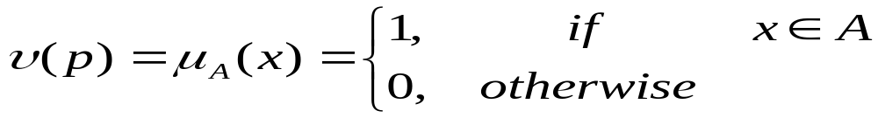
5.1 명제와 고전논리
[Def] 고전논리에서 명제(proposition)
  참(true)이나 거짓(false)을 구분할 수 있는 문장.
  Binary logic or Boolean logic : between 1 or 0
Examples of statement
  1) 태양은 항성이다.
  2) 2와 3을 더하면 6이다.
  3) 17세인 민수는 젊다. // multi-valued or fuzzy logic
  4) 4는 작은 정수이다.
  5) 내일은 비가 온다. // No statement

Slide 24
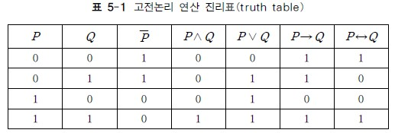
5.1 명제와 고전논리
Operators bet. Proposition P and Q, where P and Q are different propositions
  [Thm-1] 부정(negation) : ¬p , ~p로 나타냄
  [Thm-2] 논리곱(conjunction) : p∧q
  [Thm-3] 논리합(disjunction) : p∨q
  [Thm-4] 암시 또는 함의(implication) : p→q
  [Thm-5] 동등(equivalence) : p↔q

Slide 25
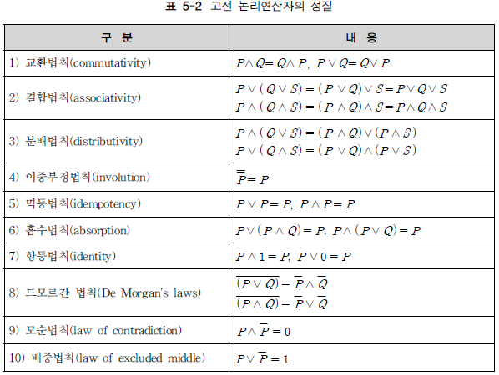
5.1 명제와 고전논리

Slide 26


5.2 다치논리 (multi-valued logic)
3치 논리(three-valued logic)도 고려할 수 있다.
v(p) = {0, 0.5, 1}인 경우를 3치 논리
  진리값이 0.5라 함은 명제가 참인지 거짓인지 결정이 곤란한 경우
이 개념을 확장하면 다치논리(multi-valued logic)나 무한치논리(infinite-valued logic)도 고려

Slide 27
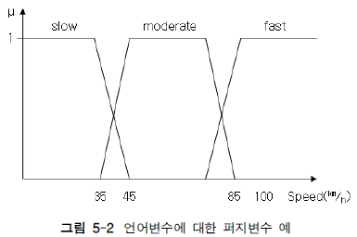
5.3 언어변수 (linguistic variable)
[Def] 언어변수
  변수값이 언어의 단어(words)나 문장(sentences)로 나타남
[e.g.] 자동차 속력
  저속(slow), 중속(moderate), 고속(fast)
  1km/h, …, 10km/h등의 수치로 속력을 표현한 것이 수치변수
  저속, 중속, 고속 등의 어로 표현한 것이 언어변수

Slide 28
5.4 고전추론과 퍼지추론
[Def] 추론(inference or reasoning)
  사전에 습득한 지식이나 경험을 바탕으로 새로운 지식을 얻는 것
고전논리학에서 기본이 되는 대표적인 추론방법
  전향추론(modus ponens)
  후향추론(modus tollens)
  삼단논법(law of syllogism)
전향추론과 후향추론은 expert system 구성의 기본
퍼지추론
  근사추론(approximate reasoning)
  일반화된 전향추론과 일반화된 후향추론 사용

Slide 29
5.4.1 고전추론
전향추론(forward-chaining inference, modus ponens)
  ‘If P ‘ : 전건부 (antecendent), ‘then Q’ : 후건부 (consequent)
  Truth of a proposition P is expressed as follows
    P = ‘x is A’ or ‘x ∈ A’
    Q = ‘y is B’ or ‘y ∈ B’
  (P and (P→Q))→Q = (P ^ (P →Q))→Q
Fact | P
Rule | If P, then Q(즉, P→Q)
Conclusion | Q
P | Q | P→Q | P^(P→Q) | (P^(P→Q))→Q
0 | 0 | 1 | 0 | 1
0 | 1 | 1 | 0 | 1
1 | 0 | 0 | 0 | 1
1 | 1 | 1 | 1 | 1

Slide 30
5.4.1 고전추론
후향추론(backward-chaining inference, modus tollens)
  - 전향추론의 대우(contraposition)
  (~Q and (P→Q))→~P = (~Q ^ (P →Q))→ ~P
Fact | ~Q
Rule | If P, then Q(즉, P→Q)
Conclusion | ~P
P | Q | ~Q | P→Q | ~Q^(P→Q) | (~Q^(P→Q))→~P
0 | 0 | 1 | 1 | 1 | 1
0 | 1 | 0 | 1 | 0 | 1
1 | 0 | 1 | 0 | 0 | 1
1 | 1 | 0 | 1 | 0 | 1

Slide 31
5.4.1 고전추론
삼단논법(law of syllogism)
  ((P→Q) and (Q→R)) → (P→R)
  = ((P→Q) ^ (Q→R)) → (P → R)
  Tautology, irregardless of P, Q, and R
Fact | If P, then Q (P→Q)
Rule | If Q, then R (Q→R)
Conclusion | If P, then R (P→R)

Slide 32
5.4.2 퍼지추론
일반화된 전향추론(GMP : generalized modus ponens)
일반화된 후향추론(GMT : generalized modus tollens)
Fact | P’[전건부 P와 약간의 차이가 존재하는 Fact]
Rule | If P, then Q(즉, P→Q)
Conclusion | Q’
Fact | ~Q’[후건부 Q와 약간 다른 Q’가 사용]
Rule | If P, then Q(즉, P→Q)
Conclusion | ~P’

Slide 33
5.4.2 퍼지추론
[예제5.4, GMP]
  very big이 전건부에 없더라도 ‘big’이 사실(fact)와 유사하다는 점을 이용하여 근사적 추론
Fact | x is very big
Rule | If error x is big, then control input y is big
Conclusion | y is very big

Slide 34
5.4.2 퍼지추론
[예제5.4, GMP]
  very big이 전건부에 없더라도 ‘big’이 사실(fact)와 유사하다는 점을 이용하여 근사적 추론
Fact | x is very big
Rule | If error x is big, then control input y is big
Conclusion | y is very big

Slide 35
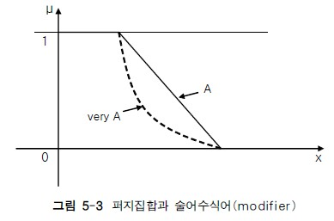
5.4.2 퍼지추론
Fuzzy set A : slow
Fuzzy set A² : very slow

Slide 36
5.5 암시(implication)에 대한 관계 … 1
To show that Max-min OP.
  퍼지추론을 하기 위해서는 암시 ‘IF P, then Q’에 대한 연산 수행
  명제 P, Q는..
    P = ‘x is A’ (or ‘x ∈ A’)
    Q = ‘y is B’ (or ‘y ∈ B’)
    여기서 규칙 P → Q와 사실(fact)가 주어지면
    결론 Q’ = `y is B’ (일반화된 전향 추론)
    이 경우 B’ = A’ • (P→Q) = A’ • R 는 합성을 통해 구할 수 있다.
    R 은 암시 P→Q에 관한 relation을 의미, 합성은 MAX-min 합성 또는 MAX-product 합성을 사용한다.
  relation R 을 구하는 법

Slide 37
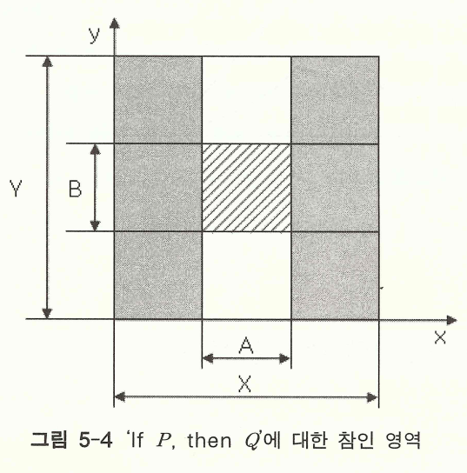
5.5 암시(implication)에 대한 관계 … 1
R을 구하는 방법
  집합 A, B가 크리스프 집합인 경우를 고려 ➔ 확장하여 퍼지집합인 경우에 대한 관계를 구함.
  R = (P → Q) = (A X B)∪(~A X Y)
    P→Q에서 P가 참일 때는 Q가 참이어야 함.
    P→Q에서 P가 거짓이면 Q와 관계없이 참.

Slide 38
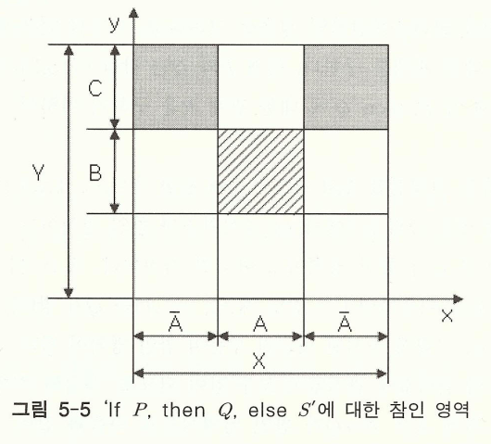
5.5 암시(implication)에 대한 관계 … 1
  암시에 관한 명제 ‘If P, then Q, else S’에 대한 관계 R
  S = ‘y is C’ or ‘y ∈C’ (C ⊆ Y)
  If P, then Q, else S ⇔ (If P, then Q) or (If ~P, then S)
  ⇔ (P→Q) V (~P→S)
  관계 R은… If P, then Q과 마찬가지 방법으로 좌표계 이용
  R = (P→Q) V (~P→S) = (A X B) ∪ (~A X C)

Slide 39
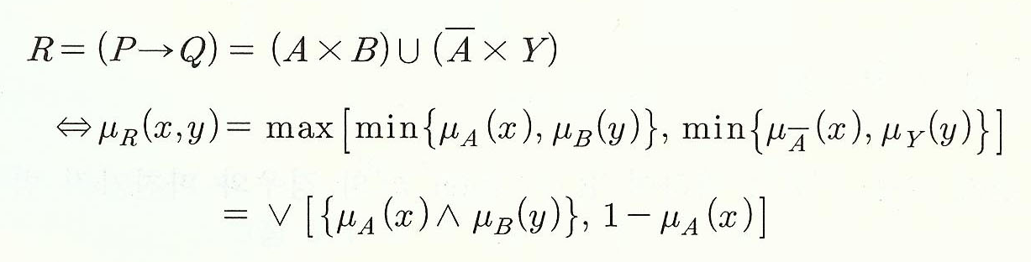
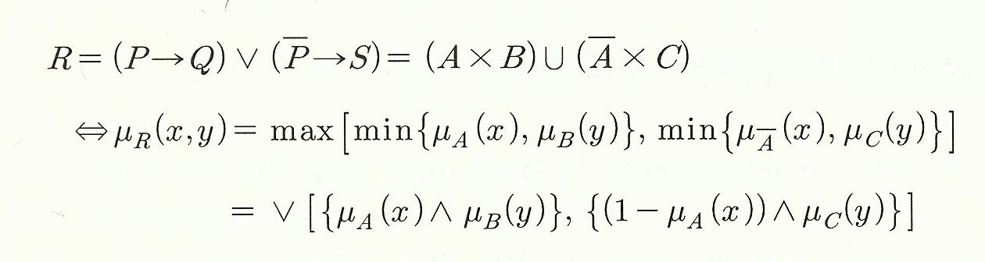
5.5 암시(implication)에 대한 관계 … 1
  암시에 관한 관계식을 확장하면 다음과 같다.

Slide 40
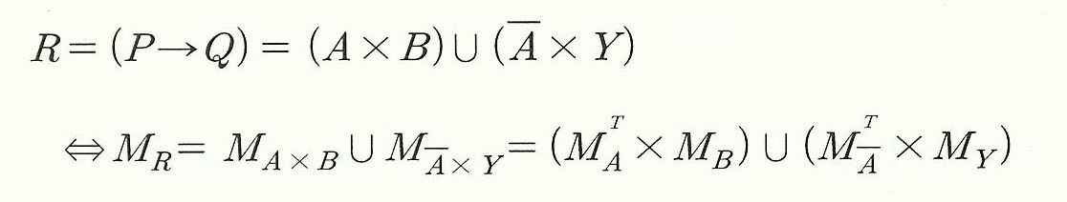
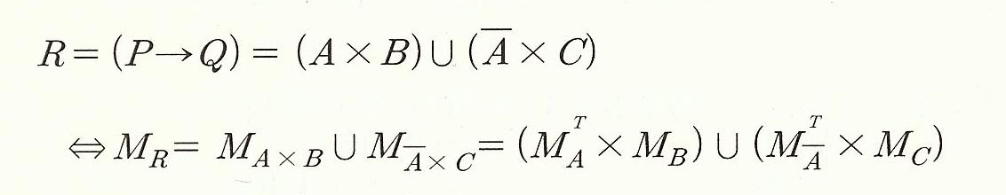
5.5 암시(implication)에 대한 관계 … 1
  일반화된 전향/후향 추론이 가능하며, 이를 행렬로 표기하면 다음과 같다.(이를 고전적인 추론 방법이라 한다.)

Slide 41
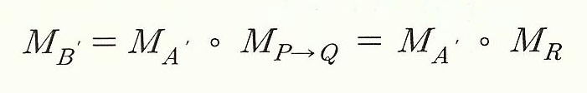
5.5 암시(implication)에 대한 관계 … 1
P → Q에 대한 일반화된 전향추론식을 행렬로 표기

Slide 42
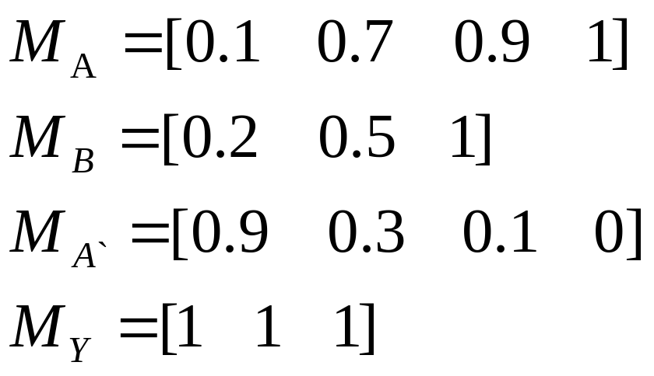
예제5.6] Rule(P→Q)
: If temperature is High, then turn the fan fast. by Matrix
To show That (P → Q)에 대한 연산 R.
  집합 A,B는 각각 다음과 같다.

Slide 43
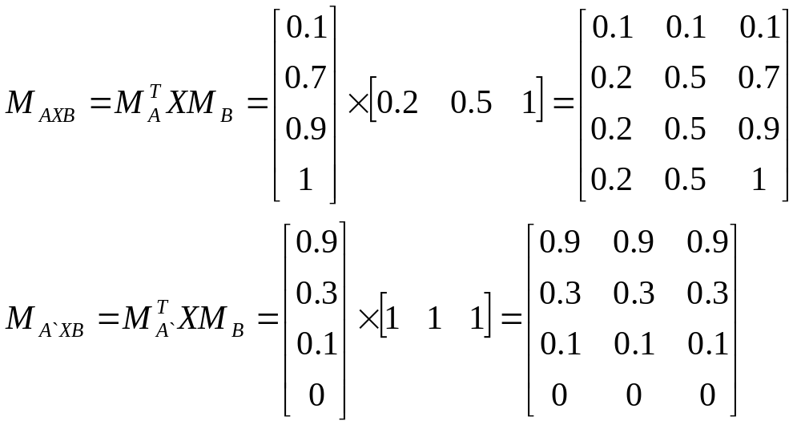
예제5.6] Rule(P→Q) :
If temperature is High, then turn the fan fast. by Matrix
  R을 구한다.

Slide 44
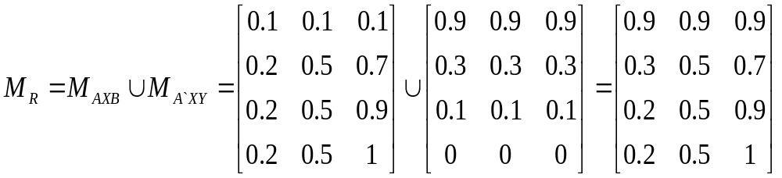
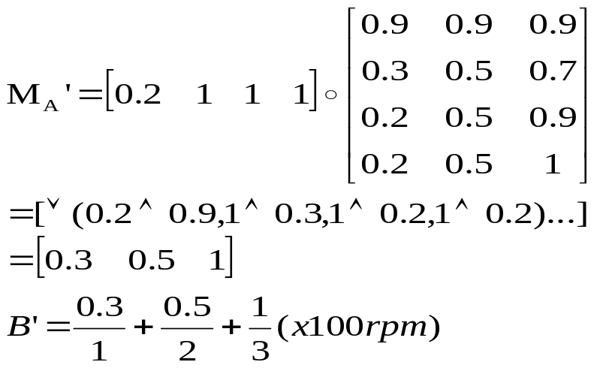
예제5.6] Rule(P→Q) : If temperature is High, then turn the fan fast. by Matrix
  R에 대한 행렬을 구한다.
  ‘Moderato Hot’ 인 A’가 주어지면

Slide 45
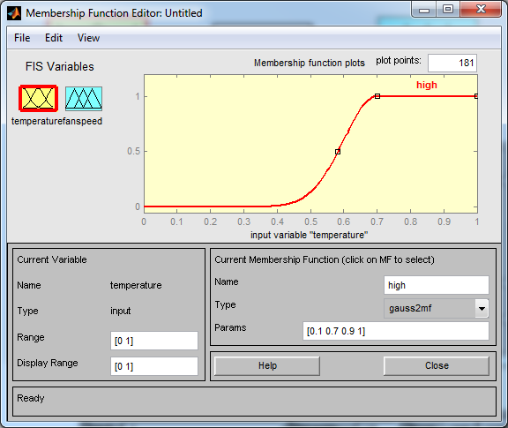
예제5.6] Rule(P→Q) : If temperature is High, then turn the fan fast. by MatLAB
temperature High

Slide 46
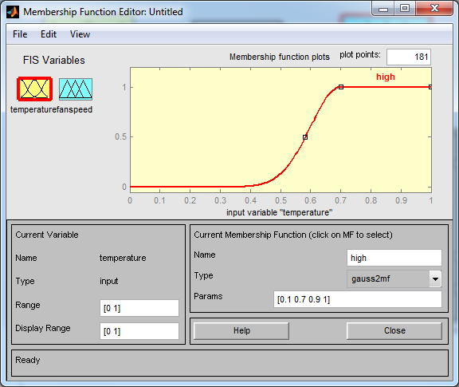
예제5.6] Rule(P→Q) : If temperature is High, then turn the fan fast.
fan fast

Slide 47
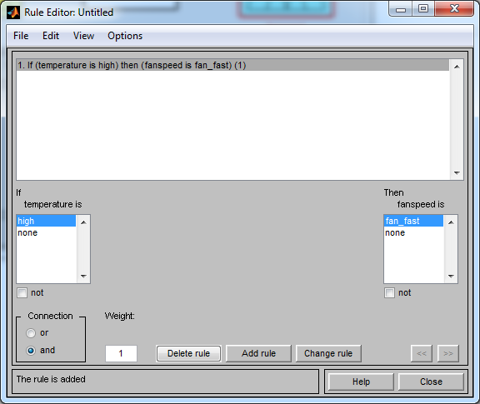
예제5.6] Rule(P→Q) : If temperature is High, then turn the fan fast.
Rule(P→Q)

Slide 48
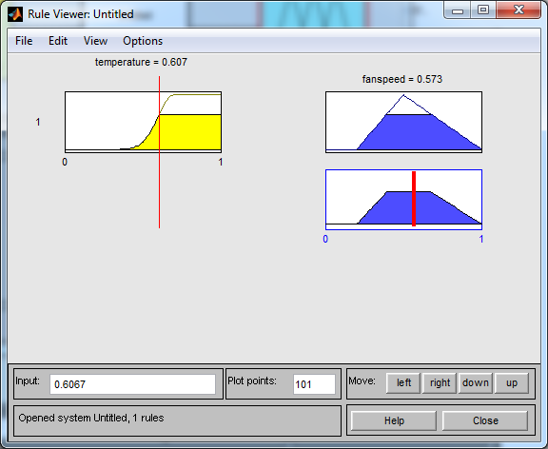
예제5.6] Rule(P→Q) : If temperature is High, then turn the fan fast.
Rule View

Slide 49
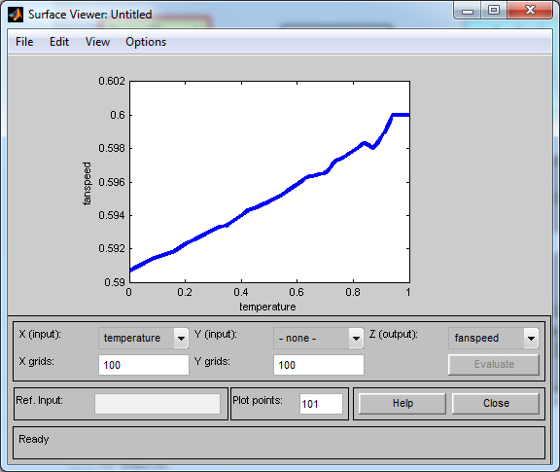
예제5.6] Rule(P→Q) : If temperature is High, then turn the fan fast.
Surface

Slide 50
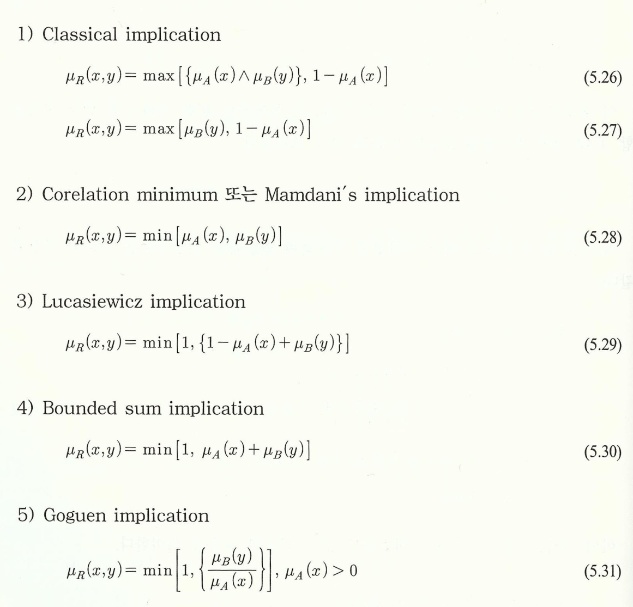
5.6 암시(implication)에 대한 관계 … 2
R을 구하는 다양한 방법에 대한 소개

Slide 51
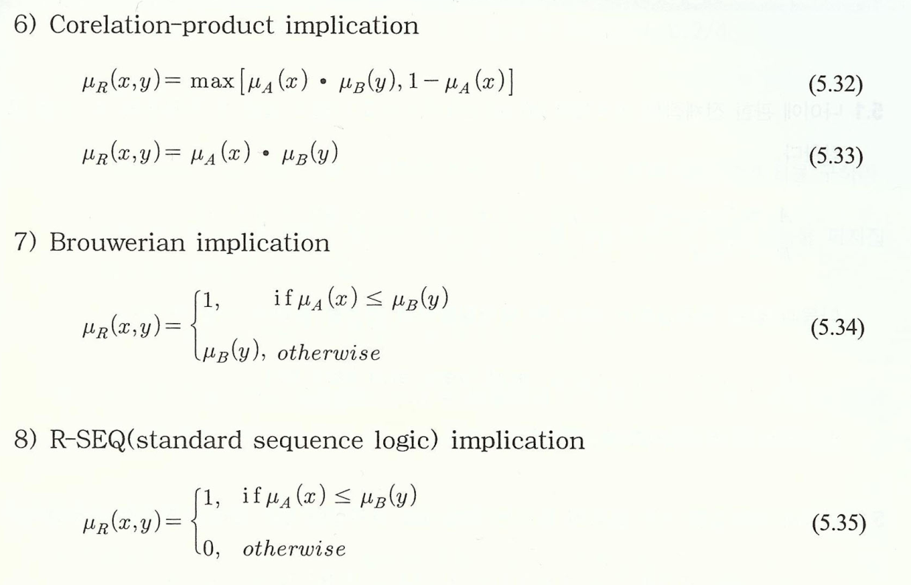
5.6 암시(implication)에 대한 관계 … 2
  이와 같이 여러 가지 방법이 있지만, 고전적인 추론방법이 주로 사용되고 있음.
  그러나, 주어진 문제에 따라 분석을 통하여 결정.

Slide 52
The Rule Application
The rule package UML diagram : Fig4.4 (p.95)
The Rule application window : Fig4.5(p.96)
Chap 4. Reasoning Systems CS&AI Lab.

Slide 53
package rule; import java.util.*; import java.io.*; import java.awt.*; import javax.swing.*; public class Rule { BooleanRuleBase rb; String name; Clause antecedents[]; // allow up to 4 antecedents for now Clause consequent; //only 1 consequent clause allowed Boolean truth; // states = (null=unknown, true, or false) boolean fired = false; public Rule(BooleanRuleBase rb, String name, Clause lhs, Clause rhs) { this.rb = rb; this.name = name; antecedents = new Clause[1]; antecedents[0] = lhs; lhs.addRuleRef(this); consequent = rhs; rhs.addRuleRef(this); rhs.setConsequent(); rb.ruleList.addElement(this); // add self to rule list truth = null; } public Rule(BooleanRuleBase rb, String name, Clause[] lhsClauses, Clause rhs) { this.rb = rb; this.name = name; antecedents = new Clause[lhsClauses.length]; for (int i = 0; i < lhsClauses.length; i++) { antecedents[i] = lhsClauses[i]; antecedents[i].addRuleRef(this); } consequent = rhs; rhs.addRuleRef(this); rhs.setConsequent(); rb.ruleList.addElement(this); // add self to rule list truth = null; }
Chap 4. Reasoning Systems CS&AI Lab.

Slide 54
package rule; import java.util.*; import java.io.*; public class Clause { Vector ruleRefs; RuleVariable lhs; String rhs; Condition cond; boolean consequent; // true if clause is a consequent clause Boolean truth; // states = null(unknown), true or false public Clause(RuleVariable lhs, Condition cond, String rhs) { this.lhs = lhs; this.cond = cond; this.rhs = rhs; lhs.addClauseRef(this); ruleRefs = new Vector(); truth = null; consequent = false; // default is antecedent } public void addRuleRef(Rule ref) { ruleRefs.addElement(ref); } public Boolean check() { if (consequent == true) { return truth = null; } if (lhs.value == null) { return truth = null; // can't check truth, if variable value is undefined } else { Double lhsNumericValue = null; Double rhsNumericValue = null; boolean bothNumeric = true; ….
Chap 4. Reasoning Systems CS&AI Lab.

Slide 55
package rule; import java.util.*; import java.io.*; public class Condition { int index; String symbol; public Condition(String symbol) { this.symbol = symbol; if (symbol.equals("=")) { index = 1; } else if (symbol.equals(">")) { index = 2; } else if (symbol.equals("<")) { index = 3; } else if (symbol.equals("!=")) { index = 4; } else { index = -1; } } public String toString() { return symbol; } }
Chap 4. Reasoning Systems CS&AI Lab.

