Slide 1
Constructing Intelligent Agents Using Java : Chap05
J.P.Bigus & J.Bigus
Mokdong Chung
Pukyong National University mdchung@pknu.ac.kr
Computer Security & Artificial Intelligence Lab.

Slide 2

Learning Systems
In this chapter
  Adaptive software and machine learning techniques
  different paradigms for performing machine learning
    Supervised learning
    Unsupervised learning
    Reinforcement learning
  General introduction to neural networks
  detailed discussion of back propagation and Kohonen maps
  information theory to construct decision trees from data
이 장에서
적응 형 소프트웨어 및 기계 학습 기술
기계 학습을 수행하기위한 다른 패러다임
감독 학습
자율 학습
강화 학습
신경 네트워크에 대한 일반적인 소개
역 전파 및 Kohonen지도에 대한 자세한 설명
데이터로부터 결정 트리를 구성하는 정보 이론
Chap 5. Learning Systems CS&AI Lab.

Slide 3
Overview
One central element of intelligent behaviors
  To adapt or learn from experience
Agent that can learn has an advantage
  Being able to adapt to changes in the environment or to get better at tasks through experience
  A learning agent can recognize situations it has been in before and improve its performance based on prior experience
지적인 행동의 핵심 요소
경험에 적응하거나 배우려면
배울 수있는 에이전트는 장점이 있습니다.
환경 변화에 적응하거나 경험을 통해 업무를 개선 할 수있는 능력
학습 에이전트는 이전 상황을 인식하고 이전 경험을 토대로 성능을 향상시킬 수 있습니다.
Chap 5. Learning Systems CS&AI Lab.

Slide 4
Many forms of learning
Rote learning
  An example is given
  => and the student (int. agent) copies the example
  => and exactly reproduces the behavior
  Simple but still can be powerful
기계적 학습
보기는 주어진다
=> 학생 (대리인)이 예제를 복사합니다
=> 정확하게 행동을 재현합니다.
간단하지만 여전히 강력 할 수 있습니다.
Chap 5. Learning Systems CS&AI Lab.

Slide 5
Many forms of learning
Parameter or weight adjustment
  Adjust the weighting factors over time
  Know a priori what factors are important but we
  do not know how to weight their contribution to the
  answer
  Improve the likelihood of a correct decision or output
  Basis for neural network learning
매개 변수 또는 무게 조정
시간이 지남에 따라 가중치 요소 조정
어떤 요인이 중요한지 선험적으로 알지만
그들의 기부에 무게를 달 방법을 모른다.
대답
올바른 결정이나 결과의 가능성을 높입니다.
신경망 학습의 기초
Chap 5. Learning Systems CS&AI Lab.

Slide 6
Many forms of learning
Induction
  Process of learning by example
    Extract the important characteristics of the problem
    Generalize to novel situations or inputs
  Decision trees and neural nets perform induction and can be used for inputs
Another type of learning
  Clustering, chunking, or abstraction of knowledge
  Similarity based on some criterion
  The ability to detect common patterns and generalize to new situations
유도
예제를 통한 학습 과정
문제의 중요한 특성 추출
새로운 상황이나 입력에 일반화
의사 결정 트리 및 신경망은 유도를 수행하고
입력에 사용할 수 있습니다.
다른 유형의 학습
지식의 클러스터링, 청킹 또는 추상화
어떤 기준에 기초한 유사성
일반적인 패턴을 감지하고 새로운 상황으로 일반화 할 수있는 능력
Chap 5. Learning Systems CS&AI Lab.

Slide 7
Many forms of learning
Clustering
  Type of chunking
    Look at high-dimensional data (data with many attributes) and score them for similarity based on some criterion
    E.g. examination of the customers
      Interests (types of product they buy)
      Purchasing patterns (num. of visits, sales totals, profitability)
      Some other criterion (may not have been apparent from the original data at a glance)
Data mining
  Extracting valuable, non-obvious info. from large collections
  The contribution is to find patterns which were not known to exist, that is, to discover new info. or knowledge
클러스터링
청킹의 유형
고차원 데이터 (많은 특성을 가진 데이터)를보고 어떤 기준에 따라 유사성을 평가합니다.
예 : 고객의 시험
관심 분야 (구매하는 제품 유형)
구매 패턴 (방문수, 판매 총액, 수익성)
일부 다른 기준 (한눈에 원본 데이터에서 분명하지 않을 수도 있음)
데이터 수집
귀중하고 분명한 정보를 추출합니다. 대규모 컬렉션에서
기여는 존재하지 않는 패턴, 즉 새로운 정보를 발견하는 것입니다. 지식
Chap 5. Learning Systems CS&AI Lab.

Slide 8
Many forms of learning
Learning, as applied to data mining
  Some people refer to data mining as knowledge-discovery
Learning, as applied to data mining
  Intelligent agents to automatically discover knowledge, rather than having it predefined using predicate logic, rules, or some other knowledge representation
데이터 마이닝에 적용된 학습
어떤 사람들은 데이터 마이닝을 지식 발견이라고 부릅니다.
데이터 마이닝에 적용된 학습
지능형 에이전트가 술어 논리, 규칙 또는 기타 지식 표현을 사용하여 사전 정의하지 않고 지식을 자동으로 발견합니다.
Chap 5. Learning Systems CS&AI Lab.

Slide 9
Learning paradigms
Several major paradigms to ML
  Supervised
  Unsupervised
  Reinforcement
  Combination of two or these learning approaches
ML에 대한 몇 가지 주요 패러다임
감독자
감독되지 않은
보강
두 가지 또는이 학습 방법의 결합
Chap 5. Learning Systems CS&AI Lab.

Slide 10
Learning paradigms
Supervised learning
  most common,
  Sometimes called programming by example
  ALGORITHM
    1) The learning agent is trained by showing it examples of the problem state or attributes along with the desired output or action
    2) The learning agent makes a prediction based on the inputs
    3) If the output differs from the desired output, then the agent is adjusted or adopted to product the correct output
    4) This process is repeated over and over until the agent learns to make a accurate classifications or predictions
감독 학습
가장 흔한,
때로는 예제로 프로그래밍이라고도합니다.
연산
1) 학습 에이전트는 원하는 출력이나 행동과 함께 문제의 상태 나 속성의 예를 보여줌으로써 학습된다
2) 학습 에이전트는 입력을 기반으로 예측을한다.
3) 출력이 원하는 출력과 다른 경우 에이전트가 조정되거나 채택되어 올바른 출력을 산출합니다
4)이 과정은 에이전트가 정확한 분류 또는 예측을 할 때까지 반복됩니다.
Chap 5. Learning Systems CS&AI Lab.

Slide 11
Learning paradigms
교육 또는 예제 데이터
DB의 과거 데이터
센서 로그
추적 로그
이 장의 사례 연구
역전 신경망
의사 결정 트리
Training or example data
  Historical data from DB
  Sensor logs
  Trace logs
  Case studies in this chapter
  Backprogation neural network
  Decision tree
Chap 5. Learning Systems CS&AI Lab.

Slide 12
Learning paradigms
Unsupervised learning
  The learning agent needs to recognize similarities between inputs or to identify features in the input data
  ALGORITHM
    1) The data is presented to the agent
    2) It adapts so that it partitions the data into groups
    3) The clustering process continues until the agent places the same data into the same group on the successive pass
  Case study in this chapter
    Kohonen map
자율 학습
학습 에이전트는 입력 간의 유사성을인지하거나 입력 데이터의 특징을 식별 할 필요가있다
연산
1) 데이터가 상담원에게 제공됩니다.
2) 데이터가 그룹으로 분할되도록 적응합니다.
3) 클러스터링 프로세스는 에이전트가 연속적으로 동일한 그룹에 동일한 데이터를 배치 할 때까지 계속됩니다
이 장의 사례 연구
코호 넨지도
Chap 5. Learning Systems CS&AI Lab.

Slide 13
Learning paradigms
Reinforcement learning
  Type of supervised learning used when explicit input/output pairs are not available
  Can be used in in cases where there is a sequences of inputs and the desired output is only known after the specific sequence occurs
  Temporal credit assignment
    Identifying the relationship between a series of input values and a later output values
  Less specific error information
    Takes longer than supervised learning and is less efficient
  Having exact prior information about desired outcome is not possible, Reinforcement learning is realistic
  Case studies : temporal difference learning, Q-learning
강화 학습
명시 적 입력 / 출력 쌍을 사용할 수 없을 때 사용되는 감독 학습 유형
입력 시퀀스가 ​​있고 특정 시퀀스가 ​​발생한 후에 만 ​​원하는 출력을 알 수있는 경우에 사용할 수 있습니다.
임시 크레딧 할당
일련의 입력 값과 이후 출력 값 간의 관계 확인
덜 구체적인 오류 정보
감독 학습보다 시간이 오래 걸리고 효율성이 떨어집니다.
원하는 결과에 대한 정확한 사전 정보를 얻는 것이 불가능합니다. 강화 학습은 사실적입니다.
사례 연구 : 시간차 학습, Q- 학습
Chap 5. Learning Systems CS&AI Lab.

Slide 14
Learning paradigms
  Distinction in learning agents : on-line vs. off-line
  On-line learning
    The agent is sent out to perform its tasks
    Learn or adapt after each transaction is processed
    Fast and stable
  Off-line learning
    Like business seminar
    After a suitable training period, they are sent out to apply their newfound knowledge and skills
    Gather data from situations that the agent have experienced
학습 에이전트의 구별 : 온라인 대 오프라인
온라인 학습
에이전트가 작업을 수행하기 위해 발송됩니다.
각 거래가 처리 된 후에 배우거나 적응하십시오.
빠르고 안정적인
오프라인 학습
비즈니스 세미나처럼
적절한 훈련 기간을 거친 후에 그들은 새로운 지식과 기술을 적용하기 위해 파견됩니다.
에이전트가 경험 한 상황의 데이터 수집
Chap 5. Learning Systems CS&AI Lab.

Slide 15
Neural networks
  Neural network applications
    can replace expert systems where sufficient data is available for training
Chap 5. Learning Systems CS&AI Lab.

Slide 16
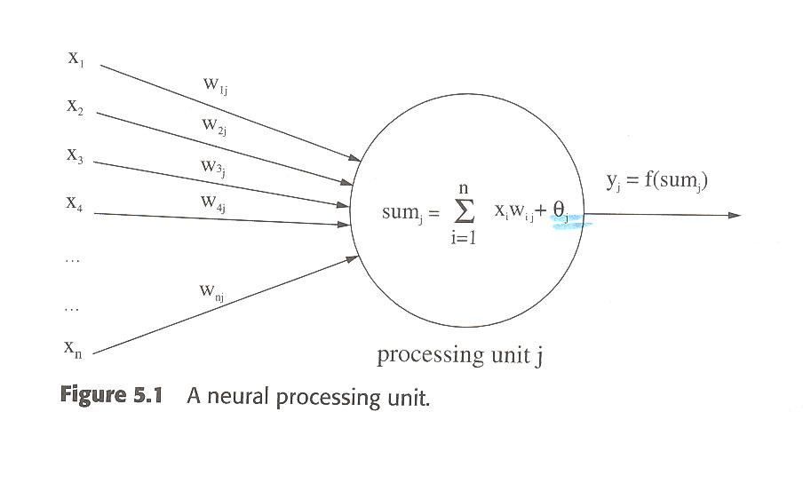
Neural networks
  Fig. 5.1
    A parallel computer
    Adaptive weights are adjusted and form the memory of the neural net computer, like the synapse in the brain
    neural net processors are analog, not digital
Chap 5. Learning Systems CS&AI Lab.

Slide 17
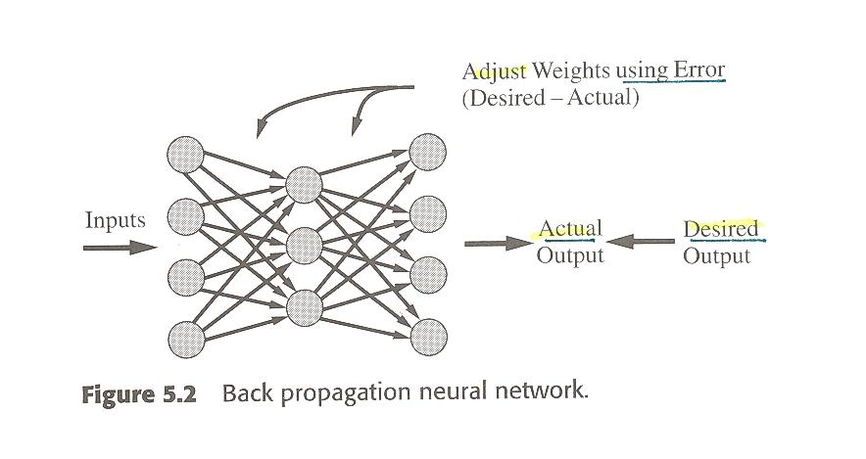
Back Propagation
The most popular for supervised learning
Chap 5. Learning Systems CS&AI Lab.

Slide 18
Back Propagation
The most popular for supervised learning
Applications of BP
  Prediction
  Classification
Fig.5.2
  Input data is presented to input layer
  Activations or values of the output unit
    Presented to the net
  The difference bet. The desired and the actual output
    Network error : backwards through the network
Chap 5. Learning Systems CS&AI Lab.

Slide 19
Back Propagation (src: Wikipedia)
For better understanding, the backpropagation learning algorithm can be divided into two phases: propagation and weight update.
Phase 1: Propagation
  Each propagation involves the following steps:
  Forward propagation of a training pattern's input through the neural network in order to generate the propagation's output activations.
  Backward propagation of the propagation's output activations through the neural network using the training pattern target in order to generate the deltas of all output and hidden neurons.
Chap 5. Learning Systems CS&AI Lab.

Slide 20
Back Propagation (src: Wikipedia)
Phase 2: Weight update
  For each weight-synapse follow the following steps:
  Multiply its output delta and input activation to get the gradient of the weight.
  Bring the weight in the opposite direction of the gradient by subtracting a ratio of it from the weight.
  This ratio influences the speed and quality of learning; it is called the learning rate. The sign of the gradient of a weight indicates where the error is increasing, this is why the weight must be updated in the opposite direction.
Repeat phase 1 and 2 until the performance of the network is satisfactory
Chap 5. Learning Systems CS&AI Lab.

Slide 21
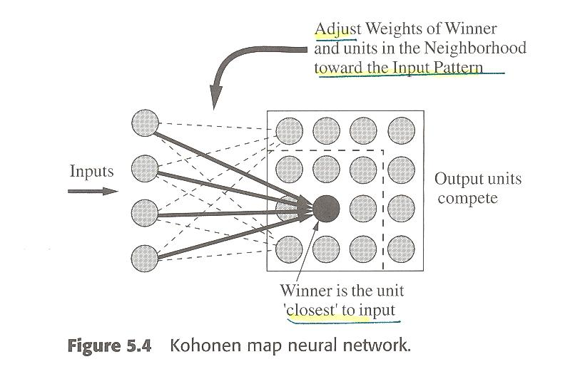
Kohonen Map
Unsupervised learning
Chap 5. Learning Systems CS&AI Lab.

Slide 22
Kohonen Map
Unsupervised learning
Fig. 5.4
  Inputs are presented to the input layer
  Distance of the input pattern is computed using Euclidean distance formula
  The output unit j with the min value y_{j} is the winner
Chap 5. Learning Systems CS&AI Lab.

Slide 23
Kohonen Map (src: Wikipedia)
A self-organizing map (SOM) or self-organizing feature map (SOFM)
  is a type of artificial neural network (ANN) that is trained using unsupervised learning to produce a low-dimensional (typically two-dimensional), discretized representation of the input space of the training samples, called a map. Self-organizing maps are different from other artificial neural networks in the sense that they use a neighborhood function to preserve the topological properties of the input space.
  This makes SOMs useful for visualizing low-dimensional views of high-dimensional data, akin to multidimensional scaling. The model was first described as an artificial neural network by the Finnish professor Teuvo Kohonen, and is sometimes called a Kohonen map or network.^{[1][2]}
자체 구성지도 (SOM) 또는 자체 구성지도 (SOFM)
지도라고 불리는 트레이닝 샘플의 입력 공간에 대한 저 차원 (일반적으로 2 차원)의 이산화 된 표현을 생성하기 위해 자율 학습을 사용하여 훈련 된 인공 신경망 (ANN)의 한 유형입니다. 자기 조직화 맵은 입력 공간의 토폴로지 특성을 보존하기 위해 인접 함수를 사용한다는 점에서 다른 인공 신경망과 다릅니다.
따라서 SOM은 다차원 스케일링과 마찬가지로 고차원 데이터의 저 차원 뷰를 시각화하는 데 유용합니다. 이 모델은 핀란드의 Teuvo Kohonen 교수에 의해 인공 신경 네트워크로 처음 기술되었으며, Kohonen지도 또는 네트워크라고도합니다. [2]
Chap 5. Learning Systems CS&AI Lab.

Slide 24
Kohonen Map (src: Wikipedia)
A self-organizing map
  consists of components called nodes or neurons.
  Each node is a weight vector of the same dimension as the input data vectors and a position in the map space.
  The usual arrangement of nodes is a two-dimensional regular spacing in a hexagonal or rectangular grid.
  The self-organizing map describes a mapping from a higher dimensional input space to a lower dimensional map space. The procedure for placing a vector from data space onto the map is to find the node with the closest (smallest distance metric) weight vector to the data space vector.
  Large SOMs display emergent properties. In maps consisting of thousands of nodes, it is possible to perform cluster operations on the map itself.^{[5]}
Chap 5. Learning Systems CS&AI Lab.

Slide 25
Deep reinforcement learning (Wikipedia)
As opposed to other AIs, such as IBM's Deep Blue or Watson, which were developed for a pre-defined purpose and only function within its scope, DeepMind claims that their system is not pre-programmed: it learns from experience, using only raw pixels as data input. Technically it uses deep learning on a convolutional neural network, with a novel form of Q-learning, a form of model-free reinforcement learning.^{[2][34]} They test the system on video games, notably early arcade games, such as Space Invaders or Breakout.^{[34][35]}
Chap 5. Learning Systems CS&AI Lab.

Slide 26
Deep reinforcement learning (Wikipedia)
Without altering the code, the AI begins to understand how to play the game, and after some time plays, for a few games (most notably Breakout), a more efficient game than any human ever could.^{[35]} For most games though (Space Invaders, Ms Pacman, Q*Bert for example), DeepMind plays well below the current World Record. The application of DeepMind's AI to video games is currently for games made in the 1970s and 1980s, with work being done on more complex 3D games such as Doom, which first appeared in the early 1990s.^{[35]}
Chap 5. Learning Systems CS&AI Lab.

