Slide 1
Constructing Intelligent Agents Using Java : Chap06
J.P.Bigus & J.Bigus
Mokdong Chung
Pukyong National University mdchung@pknu.ac.kr
Computer Security & Artificial Intelligence Lab.
Chap 6. Agents and Multiagent Systems CS&AI Lab.

Slide 2

Agents and Multiagent Systems
In this chapter
  Relationship between AI and IA(Intelligent Agents)
  How AI topics can be combined to construct intelligent agents
  Requirements for autonomous intelligent agents
  Issues raised by multiagent systems
    RoboCup example
  Requirements for agent communications
이 장에서
AI와 IA (지능형 에이전트) 간의 관계
AI 주제를 결합하여 지능형 에이전트를 구성하는 방법
자율 지능형 에이전트 요구 사항
멀티 에이전트 시스템에 의해 제기 된 문제점들
RoboCup 예제
에이전트 통신 요구 사항
Chap 6. Agents and Multiagent Systems CS&AI Lab.

Slide 3
Transition from AI to IA
In the preceding chapters
  The major topics in AI
    search techniques
    Knowledge representations
    Reasoning algorithms
    Learning
In this section
  Explicit links between the basic AI technologies and the corresponding IA behaviors
Chap 6. Agents and Multiagent Systems CS&AI Lab.

Slide 4
Perception
In order for a SW agent to take intelligent action
  Able to perceive what is going on around it
For animals
  By the senses of touch, smell, taste, hearing, and sight
Intelligent agent have an equivalent source of information
  Comes in through its sensors
  Does not need to have senses in the same way we do
SW 에이전트가 지능적인 조치를 취하기 위해서는
주변에서 일어나는 일들을 감지 할 수있다.
동물 용
접촉, 냄새, 맛, 청각 및 시력의 감각으로
지능형 에이전트에는 동일한 정보 소스가 있습니다.
센서를 통해 들어옴
우리가하는 것과 같은 방식으로 감각을 가질 필요는 없습니다.
Chap 6. Agents and Multiagent Systems CS&AI Lab.

Slide 5
Perception
Agent works in the e-mail or news group monitor
  Recognize when new documents arrive
  Whether the user is interested in the matter or not
  Whether interrupt the user
All of this falls into the realm of perception
If the perception is the ability to recognize the patterns
  We are entering
    the machine learning and
    pattern recognition
Complex env. with a large num. of possible situations,
  Learning may be only viable option
Chap 6. Agents and Multiagent Systems CS&AI Lab.

Slide 6
Action
Once the agent has recognized some events
  The next step is to take some action
Like people, agents take actions through effectors
  For people, muscles are effectors
에이전트가 일부 이벤트를 인식하면
다음 단계는 몇 가지 조치를 취하는 것입니다.
사람들과 마찬가지로 에이전트는 효과기를 통해 행동을 취합니다.
사람의 경우 근육은 이펙터입니다.
Chap 6. Agents and Multiagent Systems CS&AI Lab.

Slide 7
Multiagent systems
Multiagents
  Multiple agents working together toward a common goal
Two autonomous, intelligent beings try to communicate
  Have to speak the same language that uses the same symbols
    Must agree on what those symbols mean
  Develop a way to exchange communications in that language
멀티 에이전트
공동의 목표를 향해 함께 일하는 여러 요원
2 명의 자발적이고 지적인 존재가 의사 소통을 시도한다.
동일한 기호를 사용하는 동일한 언어를 사용해야합니다.
그 상징이 의미하는 것에 동의해야합니다.
해당 언어로 커뮤니케이션을 교환하는 방법 개발
Chap 6. Agents and Multiagent Systems CS&AI Lab.

Slide 8
Multiagent systems
FIRA Cup (http://www.fira.net/)
  The first Fira Cup was in 1996 and offers a challenging arena to the younger generation and researchers working with autonomous mobile robotic systems.
    1996, Micro-Robot World Cup Soccer Tournament (organizer : KAIST)
    2002 FIRA Cup Korea
    2003 FIRA Austria
    In 2013, 18th RoboWold cup attracted teams from Singapore, Indonesia, Taiwan, India, China, South Korea, the United Kingdom, Mexico, Canada, Russia and Malaysia.
      It saw the participation of 80 teams from 11 countries.
    The 2015 RoboWold Cup was held in Hefei in China, with more than 500 teams taking part from 45 different countries.
Chap 6. Agents and Multiagent Systems CS&AI Lab.

Slide 9
Multiagent systems
RoboCup soccer competitions (http://www.robocup2016.org/en/)
  Held annually since 1997 IJCAI
Recent RoboCup local events
  2017[edit]
    RoboCup Iran Open 2017 Tehran, Iran
    RoboCup German Open 2017 Magdeburg, Germany
    RoboCup Russia Open 2017 Tomsk, Russia
    RoboCup US Open 2017 Miami, United States
  2016[edit]
    RoboCup China Open 2016 Hefei, China
  RoboCup European Open 2016 Eindhoven, Nederlands
Chap 6. Agents and Multiagent Systems CS&AI Lab.

Slide 10
Blackboards
The blackboard
  Data structure that is used as the general communication mechanism for the multiple knowledge sources and managed by a controller
Knowledge sources or agents
  Tightly coupled through blackboard data structures and interfaces
여러 지식 소스에 대한 일반적인 통신 메커니즘으로 사용되며 컨트롤러에 의해 관리되는 데이터 구조
지식 소스 또는 에이전트
칠판 데이터 구조 및 인터페이스를 통해 밀접하게 결합
Chap 6. Agents and Multiagent Systems CS&AI Lab.

Slide 11
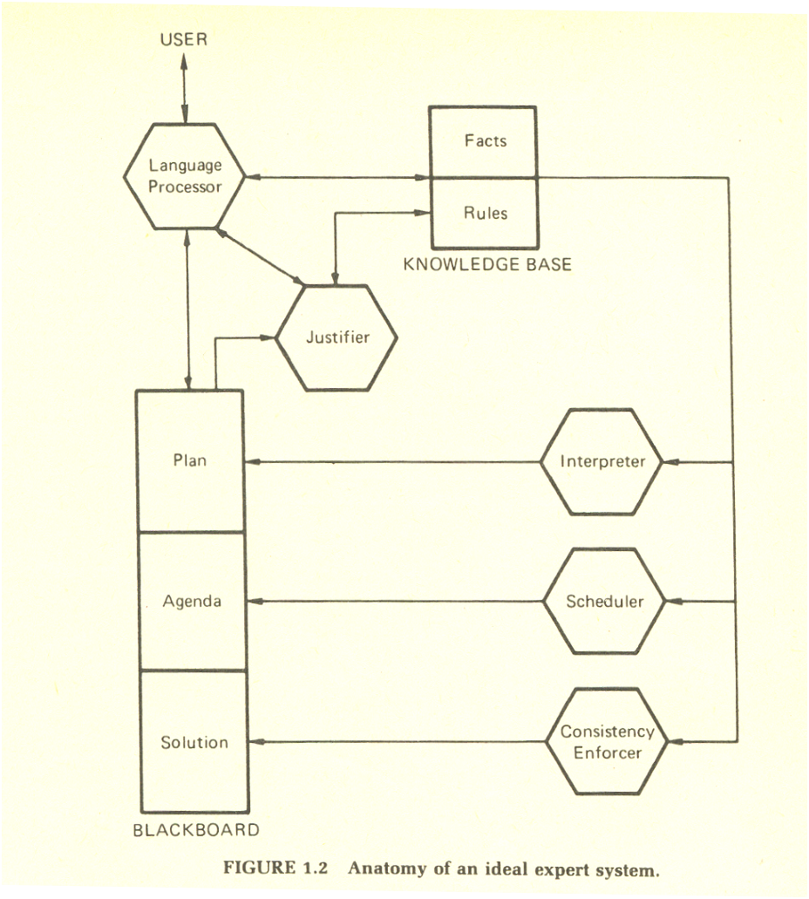
Frederick Hayes-Roth et al., Building Expert Systems, Addison-Wesley, 1983.
Chap 6. Agents and Multiagent Systems CS&AI Lab.

Slide 12
Blackboards
Ideal expert system
  Language processor for problem-oriented comm.
  Blackboard for recording intermediate results such as intermediate hypotheses and decisions.
  Knowledge base comprising facts as well as heuristic planning and problem solving rules
  Interpreter that applies these rules
  Scheduler to control the order of rule processing
  Consistency enforcer that adjusts previous conclusions
  Justifier that rationalizes and explains the system’s behavior
Chap 6. Agents and Multiagent Systems CS&AI Lab.

Slide 13
Blackboards
Single large app. & modularize the KB
  Blackboards are a fine communication mechanism
Agents with different structures and with no centralized blackboard
  More formal interfaces such as those described in the next section
Chap 6. Agents and Multiagent Systems CS&AI Lab.

Slide 14
Communication
Agents talk to each other in a variety ways
  Directly, provided they speak the same language
  Talk through an interpreter or facilitator
    Provided they know how to talk to the interpreter
    And the interpreter can talk to the other agent
Level of basic
  Syntax and format
Deeper level
  The meaning or semantics
Chap 6. Agents and Multiagent Systems CS&AI Lab.

Slide 15
Communication
Ontology
  Shared vocabulary of words
    Medical ontology
    Automobile ontology, …
Agent negotiate about or plan for a task
  They use common ontology to ensure that no doubts about semantics of the message terms
XML
  Acceptance in industry and across the Internet
  DTD : is used to define a particular ontology
  RosettaNet : for computer components
Chap 6. Agents and Multiagent Systems CS&AI Lab.

Slide 16
KQML
KQML
  A framework for programs and agents to exchange information and knowledge
  Message formats and message handling protocols between running agents
KIF
  Deals with knowledge representations
KQML
  Uses ontologies
  Messages encode information at three different architectural levels
    Content
    Message
    communication
Chap 6. Agents and Multiagent Systems CS&AI Lab.

Slide 17
Ontology
Ontology
  philosophical study of the nature of being, becoming, existence, or reality, as well as the basic categories of being and their relations.
  what entities exist, and how such entities can be grouped, related within a hierarchy, and subdivided according to similarities and differences.
  practical application in information science and information technology, where it informs ontologies with chosen taxonomies.
Some philosophers, notably of the Platonic school,
  contend that all nouns (including abstract nouns) refer to existent entities.
Other philosophers contend
  that nouns do not always name entities, but that some provide a kind of shorthand for reference to a collection of either objects or events.
Chap 6. Agents and Multiagent Systems CS&AI Lab.

Slide 18
KQML
KQML
  KQML performative is ask-one
  The receiver is an agent named stock-server
  The :content parameter defines the content level
  The :reply-with, :sender, and :receiver specify information at the communication level
  The :language, and :ontology are part of the message level
(ask-one
: sender joe
: content (real price = sun.price())
: receiver stock-server
: reply-with sun-stock
: language java
: ontology NYSE-TICKS)
Chap 6. Agents and Multiagent Systems CS&AI Lab.

Slide 19
KQML
Two agents who want to communicate using KQML
  Require the service of a KQML facilitator or matchmaker
Not everyone working on multiagent systems
  Believes KQML is the best
  But, in fact, the most widely used technique
KQML is extended and modified
  ACL in FIPA
  Java implementation of this framework, called JACKAL
Chap 6. Agents and Multiagent Systems CS&AI Lab.

Slide 20
Agent Standards
Two major efforts at standardization
  Foundation for Intelligent Physical Agents(FIPA)
    Focused primarily on agent-level issues
  OMG
    The standards body that created the CORBA
    Focus on object-level interoperability and management
표준화에 대한 두 가지 주요 노력
지능형 물리적 에이전트 (FIPA) 기반
주로 상담원 수준의 문제에 초점을 맞 춥니 다.
오 세상에
CORBA를 만든 표준 단체
객체 수준의 상호 운용성 및 관리에 중점
Chap 6. Agents and Multiagent Systems CS&AI Lab.

Slide 21
Agent Standards
FIPA
  FIPA97 specifications
    CORBA IIOP as the communication protocol
    A speech-act based agent communication language
    A set of interaction protocols
    Several major weaknesses
    Java RMI and HTTP as alternative communication protocol
  FIPA2000
    Definition of an abstract architecture, allowing alternative implementations
FIPA
FIPA97 사양
통신 프로토콜 인 CORBA IIOP
연설 - 행동 기반 에이전트 통신 언어
일련의 상호 작용 프로토콜
몇 가지 주요 약점
Java RMI 및 HTTP를 대체 통신 프로토콜로 사용
FIPA2000
대체 아키텍처 구현을 허용하는 추상 아키텍처의 정의
Chap 6. Agents and Multiagent Systems CS&AI Lab.

Slide 22
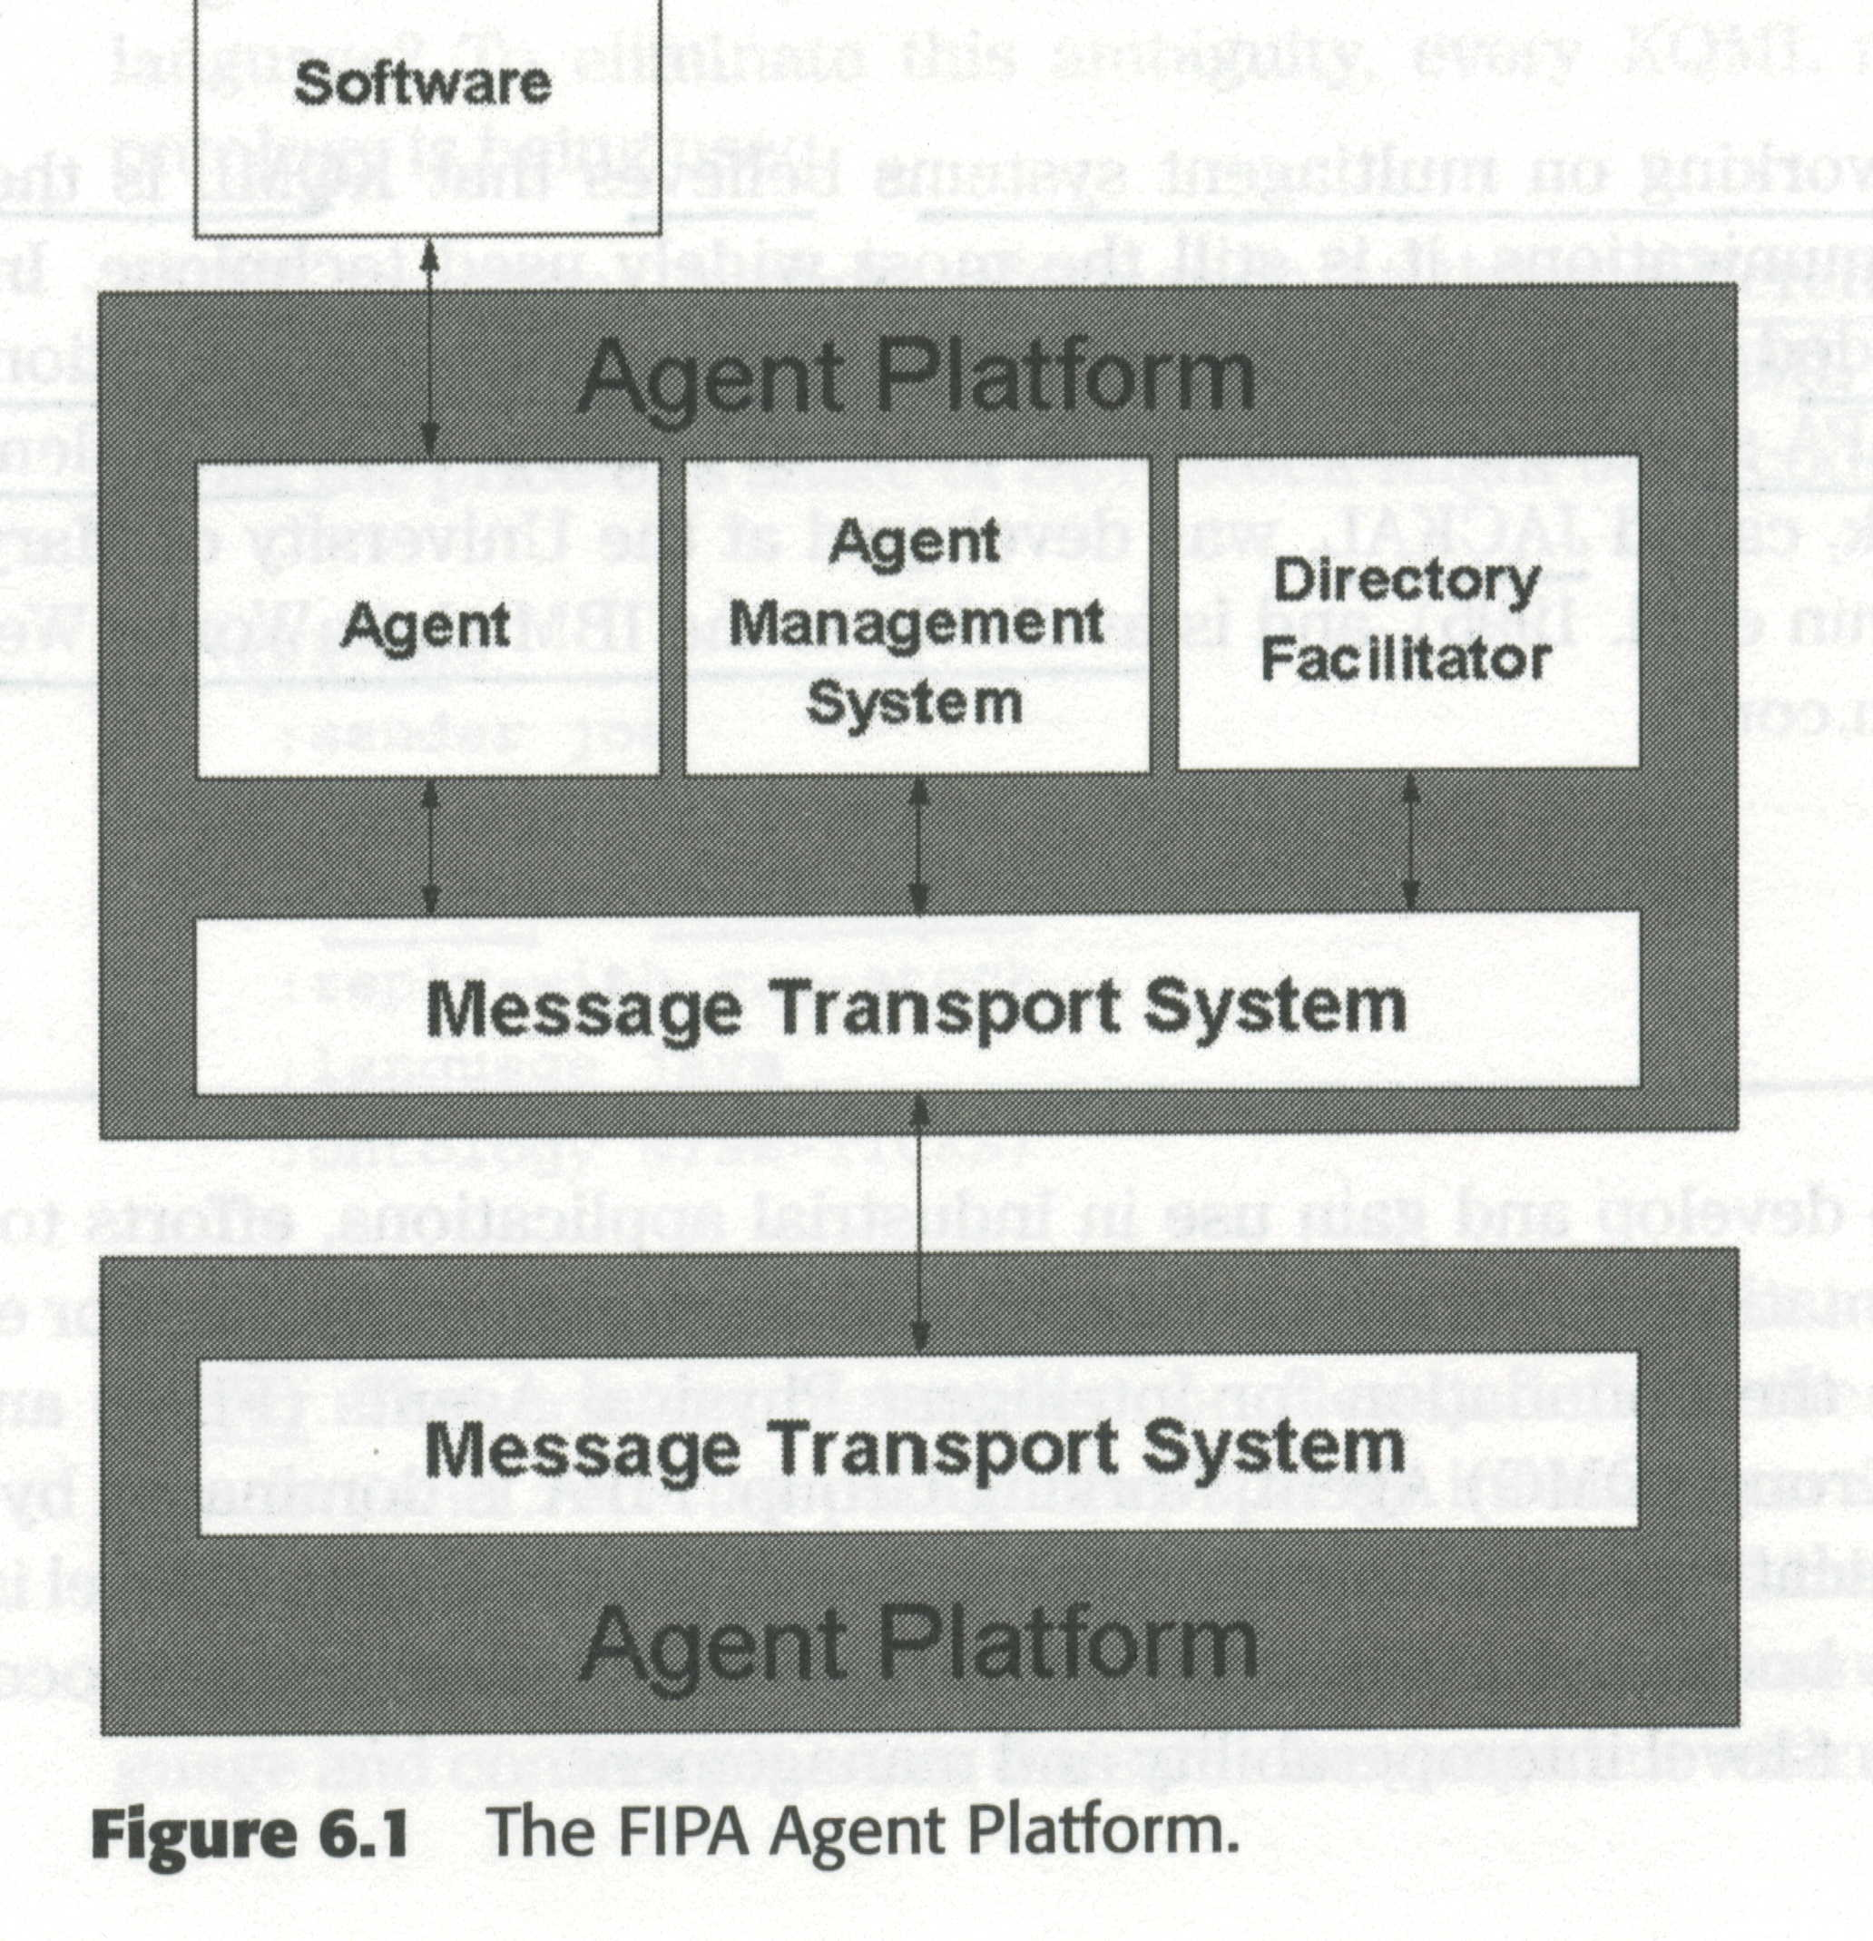
Agent Standards
FIPA
Chap 6. Agents and Multiagent Systems CS&AI Lab.

Slide 23
Agent Standards
Fig 6.1
  AMS : controls the agent life cycle
  DF : yellow-page lookup service (직업별 전화번호부 서비스)
  〖컴〗 yellow-page : 인터넷 사이트들의 주소목록을 알려주는 인터넷 서비스》
  〖컴〗 white-page 백서《인터넷 사용자들에 대한 기본적인 정보를 제공하는
  정보 서비스 또는 이들 정보를 제공하는 데이터베이스》
  MTS : internal agent-to-agent communication as well as external messaging with other FIPA-compliant agent
OMG
  Lead in the area mobile agent systems
  Mobile Agent Systems Interoperability Facilities
    Defines how agents can migrate between platforms using CORBA interface IDL, CORBA security, naming, and the life-cycle services
MTS : 내부 에이전트 간 통신 및 다른 FIPA 호환 에이전트와의 외부 메시징
모바일 에이전트 시스템 분야의 리드
모바일 에이전트 시스템 상호 운용성 기능
에이전트가 CORBA 인터페이스 IDL, CORBA 보안, 이름 지정 및 라이프 사이클 서비스를 사용하여 플랫폼간에 마이그레이션하는 방법을 정의합니다.
Chap 6. Agents and Multiagent Systems CS&AI Lab.

