Slide 1
Day Ahead Market Forecast Applied Statistics project proposal presentation – A.Y. 2022/23
Dr. Bovera Filippo – filippo.bovera@polimi.it
Matteo Spiller – matteo.spiller@polimi.it
06/03/23

Slide 2

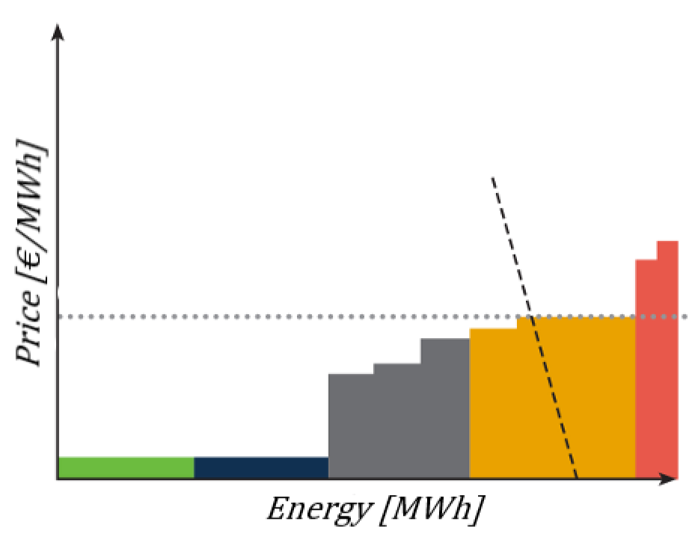
Day Ahead Market
Day Ahead Market (DAM):
it is the most liquid energy market in Europe. It hosts most of the electricity sales and transactions.
The outcome, computed the day ahead at noon, is the price of the energy for the 24 hours of the next day.
Energy producers and consumers submit bids to satisfy their needs. Each offer is characterized by a given amount of energy and price
The price is obtained as the intersection between the cumulative demand and offer curves.

Slide 3
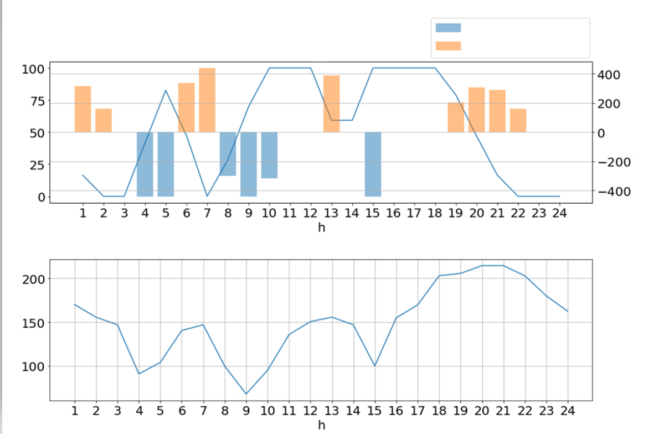
Research rationale
DAM forecasting is fundamental for energy traders to create an optimal bidding strategy to submit.
Moreover, new assets, such as storage systems, highly benefit from an optimal forecast for services like energy arbitrage.
SOC
Energy bought
Energy sold
SOC [%]
Energy [MWh]
DAM prices
Prices [€/MWh]

Slide 4
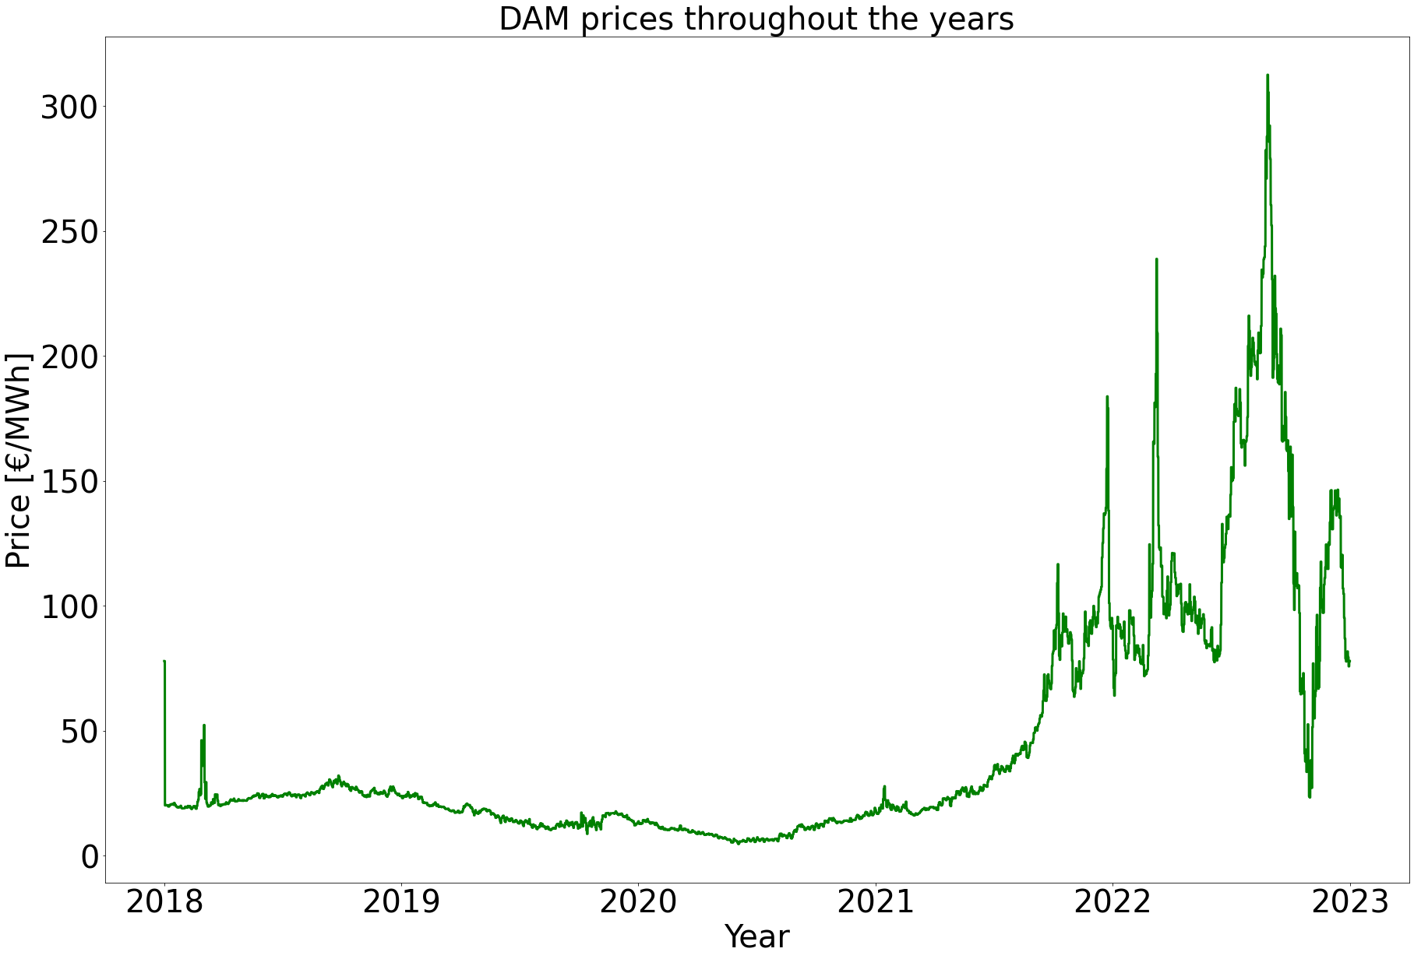
Research rationale
UKRAINIAN WAR
In literature, a large interest is given to DAM forecast with overall positive results.
However, the events of the last years have strongly impacted the energy market.
These phenomena have not been deeply investigated. Therefore 2023 DAM forecast represents an innovative research topic.
COVID-19

Slide 5
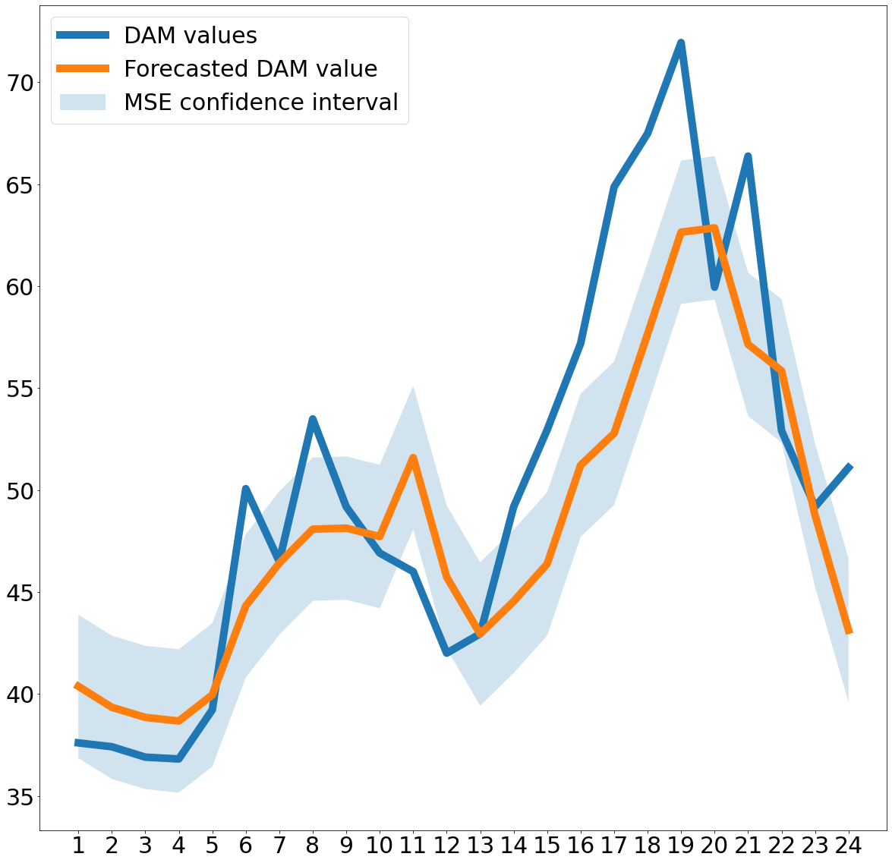
First Results - 2019
Reasonable outcomes.
DAM PRICES [€/MWh]
HOURS [H]

Slide 6
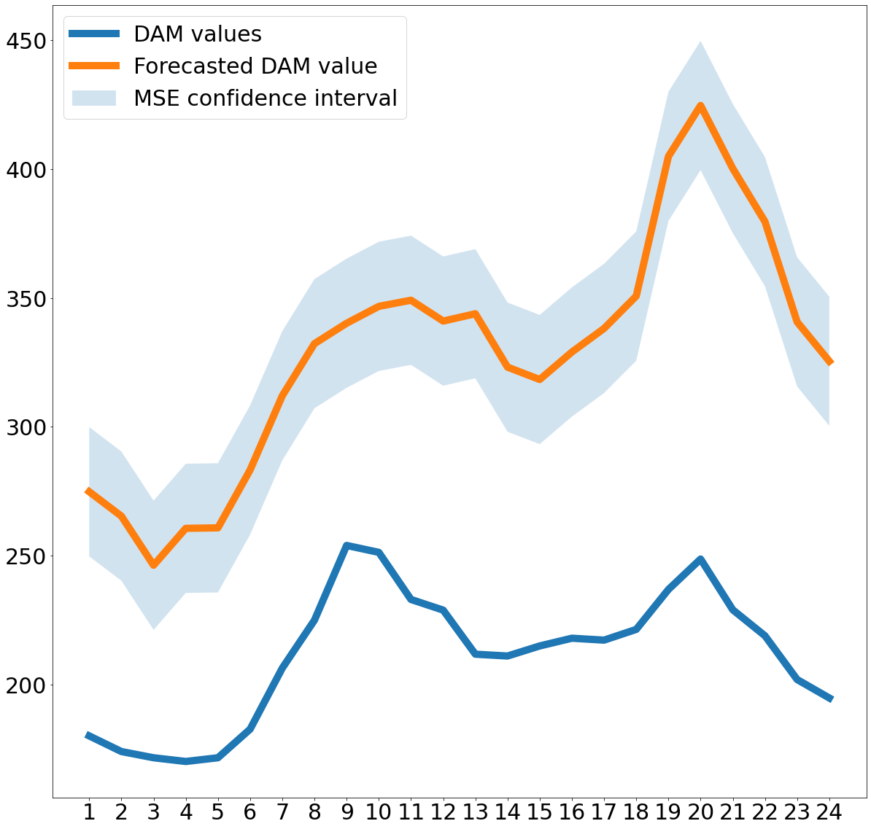
First Results - 2022
Difficulties in identifying an optimal forecast.
DAM PRICES [€/MWh]
HOURS [H]

Slide 7
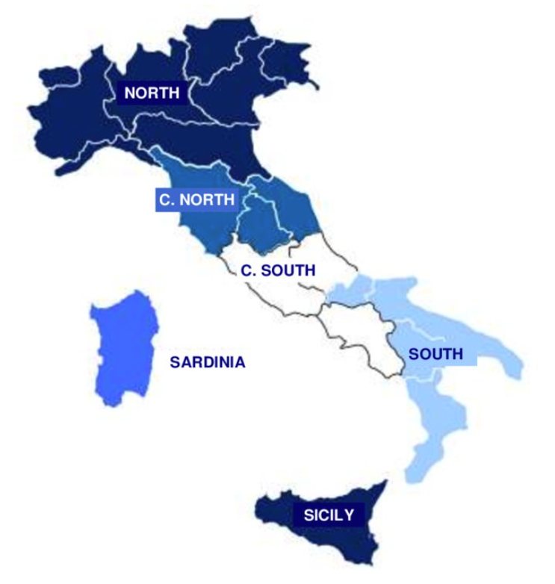
Data Set
The starting point of the project is represented by a database that contains the DAM prices of the North area between January 2018 and December 2022. Each market price is associated with the following features (open access data):
Variable | Source
Valley load (D-1) | Terna
Production at 9 (D-1) | Terna
Peak load (D-1) | Terna
Gas price (D-1) | GME
Production at 10 (D-1) | Terna
Hour/day/month/weekday | Data
Variable | Source
DAM prices | GME
Forecasted load (D-1) | Terna
Swiss import/export (D-1) | Terna
Austria import/export (D-1) | Terna
France import/export (D-1) | Terna
Slovenia import/export (D-1) | Terna

Slide 8

Conclusions
Project Goal
The project aims to develop a model capable to grasp the daily fluctuation of the DAM price in 2023.
Programming language
Datasets and analysis have been executed with Python but other coding languages are welcome.
Possible methodologies
Data decomposition: wavelet transform, empirical mode decomposition.
Dimensionality reduction techniques: principal component analysis.
Hyperparameters regularization: cross-validation, Akaike information criteria, Bayesian information criteria.
Model ensembles.
Data clustering to identify specific dataset to train different models.

Slide 9
Thank you
filippo.bovera@polimi.it
matteo.spiller@polimi.it
Notes:
Rivedere

