Slide 1
C2- Task2
Guido has asked you to start your analysis with a full exploration of the Credit One data.
This task requires you to prepare an Exploratory Data Analysis report that should include the following:
Exploratory Data Analysis Report
Jupyter Notebook format
Hosted on GitHub
Use of numpy, pandas, matplotlib
Summary of your findings.
Any observations you've made throughout your analysis.
Any future recommendations
Your report should be written for a Data Science audience that is concerned with what can be gleaned from the data.

Slide 2
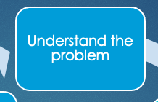
Customer Loan Repayment Behavior
Desired outcome: Minimize Credit One’s partners risk exposure
Questions to answer: How do you ensure that customers can/will pay their loans? Can we do this?
Notes:
Problem:
Increase in customer default rates - This is bad for Credit One since we approve the customers for loans in the first place.
Revenue and customer loss for clients and, eventually, loss of clients for Credit One
Investigative Questions:
How do you ensure that customers can/will pay their loans? Can we do this?
____________________________
As you progress through the tasks at hand, begin thinking about how to solve this problem. Here are some lessons we learned form a similar problem we addressed last year:
We cannot control customer spending habits
We cannot always go from what we find in our analysis to the underlying "why"
We must focus on the problem(s) we can solve: What attributes in the data can we deem to be statistically significant to the problem at hand?
What concrete information can we derive from the data we have?
What proven methods can we use to uncover more information and why?

Slide 3
Notes:
Problem:
Increase in customer default rates - This is bad for Credit One since we approve the customers for loans in the first place.
Revenue and customer loss for clients and, eventually, loss of clients for Credit One
Investigative Questions:
How do you ensure that customers can/will pay their loans? Can we do this?
____________________________
As you progress through the tasks at hand, begin thinking about how to solve this problem. Here are some lessons we learned form a similar problem we addressed last year:
We cannot control customer spending habits
We cannot always go from what we find in our analysis to the underlying "why"
We must focus on the problem(s) we can solve: What attributes in the data can we deem to be statistically significant to the problem at hand?
What concrete information can we derive from the data we have?
What proven methods can we use to uncover more information and why?

Slide 4
C2- Task1

Slide 5
TASK
Credit One, which is a third-party credit rating authority that provides retail customer credit approval services to Blackwell.
Credit One has tasked you with examining current customer demographics to better understand what traits might relate to whether or not a customer is likely to default on their current credit obligations. Understanding this is vital to the success of Credit One because their business model depends on customers paying their debts.
Your job as a Data Scientist will be to identify which customer attributes relate significantly to customer default rates and to build a predictive model that Credit One can use to better classify potential customers as being ‘at-risk’, compared to previously implemented models. You will use machine learning regression methods in Python for this task.

Slide 6
Guido asked you to create two deliverables for this task:
1. Create a Data Science framework report in the form of a PowerPoint presentation. Your report should include the following and be uploaded to your GitHub account so you can share it with Guido:
A written statement of the goal(s)
A well-defined data science process framework and the reasons you are proposing it
Descriptions and location of related data sources
An explanation of how you will manage the data for the project
Any known issues with the data and how you plan to address them
A flowchart visualizing the detailed process you will follow, annotated with any potential pitfalls you’ve identified and your proposed solutions to such pitfalls.
Any initial insights you can glean from your quick look at the data. (Recall that you were previously ask to recommend three management-level decisions on the basis of your initial analysis.)
2. It is a good idea to set up your GitHub account so you can submit a link to your GitHub account using the 'Submit your Work' tab above.

Slide 7
Credit One Default Risk Analysis
- A data Science Process Framework -

Slide 8
Overview
Credit One Main facts:
A third-party credit rating authority that provides retail customer credit approval services to Blackwell Electronics and other partners
The number of customers who have defaulted on their loans have increased over the past year
As a credit scoring service provider, Credit One could risk losing business
Desired outcome: Minimize Credit One’s partners risk exposure
Questions to Answer
Which customer attributes might relate to whether or not a customer is likely to default on their current credit obligations?
Notes:
Reporting Outline * Overview - What have you been asked to do? Are there specific questions you are trying to answer? What are the goals of the project? (Provides the context a reader needs to understand your analysis)

Slide 9
Data Science Process Framework
Define the Goal
Collect and Manage Data
Build the Model
Evaluate the Model
Present Results
Deploy and Maintain the model
(*) Based on Zumel and Mount, Practical Data Science with R, chapter 1
Notes:
Chose this framework because is closer to the Data Science Process we are accustomed to.

Slide 10
Goals
Define a Data Science Process to understand how much credit should CREDIT ONE allow someone to use or, if someone should not be approved
Identify which customer attributes might relate to whether or not a customer is likely to default on their current credit obligations
Notes:
Why do the stakeholders want to do the project?
What do they need from it?
Why is their current solution inadequate?
What resources do you need?
How will the result of your project be deployed?

Slide 11
Collect and Manage Data
Data Available: Credit.csv file saved to local computer
Owner: Credit One. Access limited to Data Science team
Data shape: 30.000 + observations
25 attributes. See data dictionary
Data Types: All attributes are objects. Conversions are necessary
Other Preprocessing tasks:
Will drop these from the data set:
- First observation corresponds to the attribute description
- Erase the first observation, once column names have been changed
- Observation with a Null values (1), and observations with non complaint values (e.g. gender = ‘sex’)
Will convert categorical attributes (gender, education and default) to a numerical representation
Notes:
Collect and manage data This step includes identifying the data you need, then exploring and conditioning it. This is often the most time consuming step.
What data is available?
Will it help to solve the problem? Is it enough?
Is the data quality good enough?

Slide 12
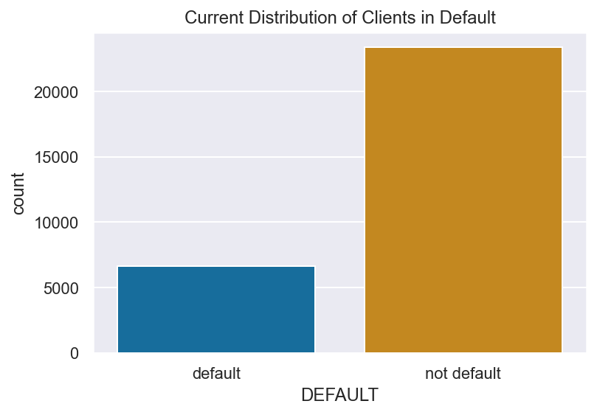
Credit Data Summary
23364 clients in good standing
6636 clients in default (22%)
See CreditProfile for more details
Notes:
Collect and manage data This step includes identifying the data you need, then exploring and conditioning it. This is often the most time consuming step.
What data is available?
Will it help to solve the problem? Is it enough?
Is the data quality good enough?

Slide 13
Build and Evaluate the model
Plan to use Machine Learning Regression methods to predict the clients default behavior
The Number of models to implement will depend on the results obtained. (Evaluation) This is an iterative process
There is no budget constrain, but it is urgent to solve the issue
Notes:
Build the model Here is where you try to extract useful insights from the data in order to achieve your goals.
Which techniques might I apply to build the model?
How many techniques should I apply?
Evaluate and critique the model Once you have derived a model, you need to determine whether it meets your goals. If not, it’s time to loop back to the modeling step.
Is the model accurate enough to meet the stakeholders’ needs?
Does it perform better than "the obvious guess" and any techniques being used currently?
Do the results of the model make sense in the context of the real-world problem domain?

Slide 14
Present Results and Document
The the Data Science Process and its results will be presented to the stakeholders
The report will include recommendations for its deployment and maintenance
Notes:
Present results and document Once you have a model that meets your criteria, you will present your results to your project sponsor and other stakeholders.
How should stakeholders interpret the model?
How confident should they be in its predictions?
When should they potentially overrule the model’s predictions?
Deploy and maintain the model Finally the model is put into production, but you still need to ensure that the model will run smoothly. In many cases this requires enhancement of the requirements based on customer feedback or in some cases fixing bugs.
How is the model to be handed off to "production"?
How often, and under which circumstances, should the model be revised?

Slide 15
Data Dictionary
Attribute | Description
ID | Unique identifier
LIMIT_BAL | Credit amount
GENDER(1) | 0 = female 1 = male
EDUCATION(2) | 0 = other 1 = high school 2 = university 3 = graduate school
MARRIAGE | 0 = other 1 = married 2 = single 3 = divorced
AGE | Year
Attribute | Description
PAY_1 – PAY_6 | Monthly Repayment Status: PAY_1 = September 2005 … PAY_6 = April 2005 Key: -2 = No consumption -1 = Paid in full 0 = Use of revolving credit 1 = 1 month payment delay 2 = 2 months payment delay … 8 = 8 months payment delay 9 = 9 months payment delay or more
BILL_AMT_1 - BILL_AMT_6 | Monthly bill statement: BILL_AMT1 = September 2005… BILL_AMT5 = April 2005
PAY_AMT1 - PAY_AMT6 | Amount previous payment PAY_AMT1 = September 2005… PAY_AMT6 = April 2005
DEFAULT | client's behavior 0 = not default, 1 = in default
(1) Changed order to reflect categorical encoding output
(2) Changed order to reflect educational level
Notes:
Original dicts:
X2: Gender (1 = male; 2 = female).
X3: Education (1 = graduate school; 2 = university; 3 = high school; 0, 4, 5, 6 = others).

Slide 16
C1 - Tasks

Slide 17
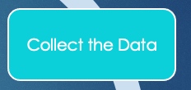
Customer Purchase Behavior
Desired outcome: Maximize the amount of revenue generated from eCommerce sales
Optimize online marketing efforts
Questions to answer: Who currently spends the most, and how can we find more people like them? (*)
How to optimize Online marketing efforts?
DataSet Info
(*) Paraphrasing A Data Scientist’s Real Job/ Storytelling by Jeff Bladt and Bob Filbin
Notes:
Collect Data suggestions:
Assigning unique identifiers to customers, to understand if the transactions are new or returning ones
Collect additional data: gender, family size, income? Zip code … These features could help make predictions about the customer purchase behavior
Having the profit information per transaction is also important

Slide 18
Data Mining Approach
Understand the problem
Collect the Data
Process the Data
Explore the Data
In-depth Analysis
Communicate Results
Customer Age and Type of Sale Relationship
How the future can look like?
DataSet Info
(*) Based on AJGoldstein.com Data Science Deconstructed
Notes:
Other applications
Cost driver predictions
Returns predictions
Seasonality predictions
Product ordering

Slide 19
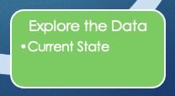
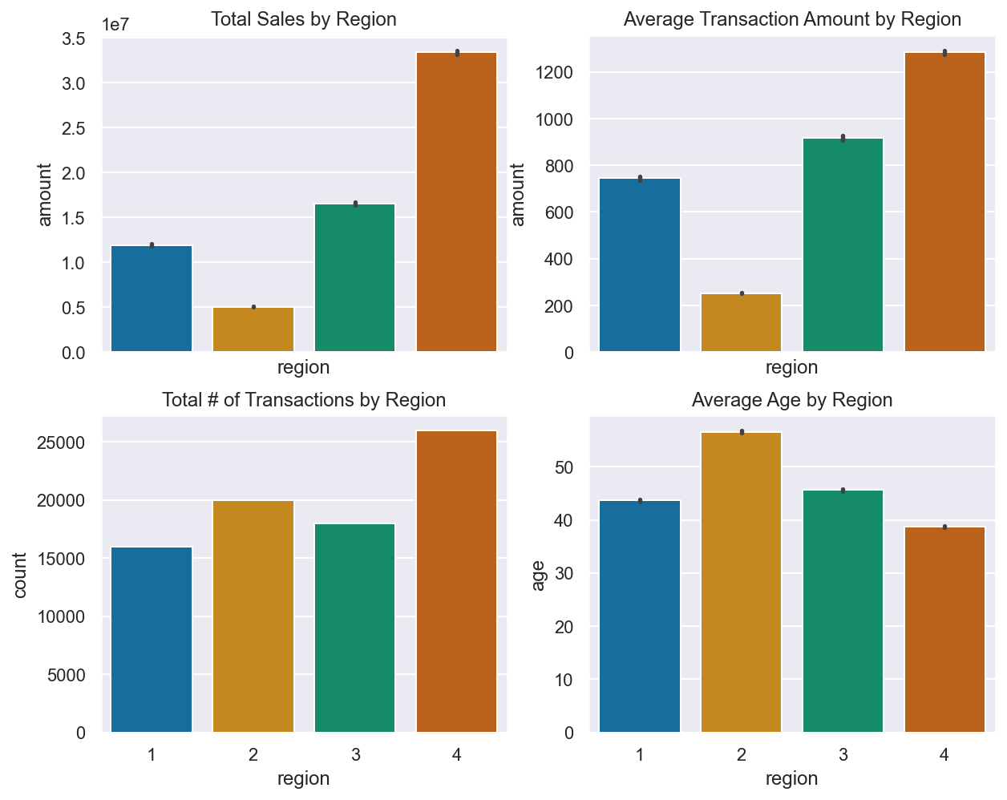
West Region is the best performer
West:
Total sales $33M,
# of transactions ~26k average transaction amount = $1280
South:
Total sales $ 5M
# of transactions ~20k, average transaction amount $252
Regions: 1 North 2 South 3 East 4 West
Notes:
West Sales = 50% of total sales
Other observations:
West Region average customer age is 39 yrs, South is 57
The average # of items is roughly the same in all regions 4-5 items per transaction
__________________-
Exploratory Data Analysis: Understand the Data, In this slide, find the common patterns

Slide 20
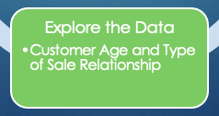
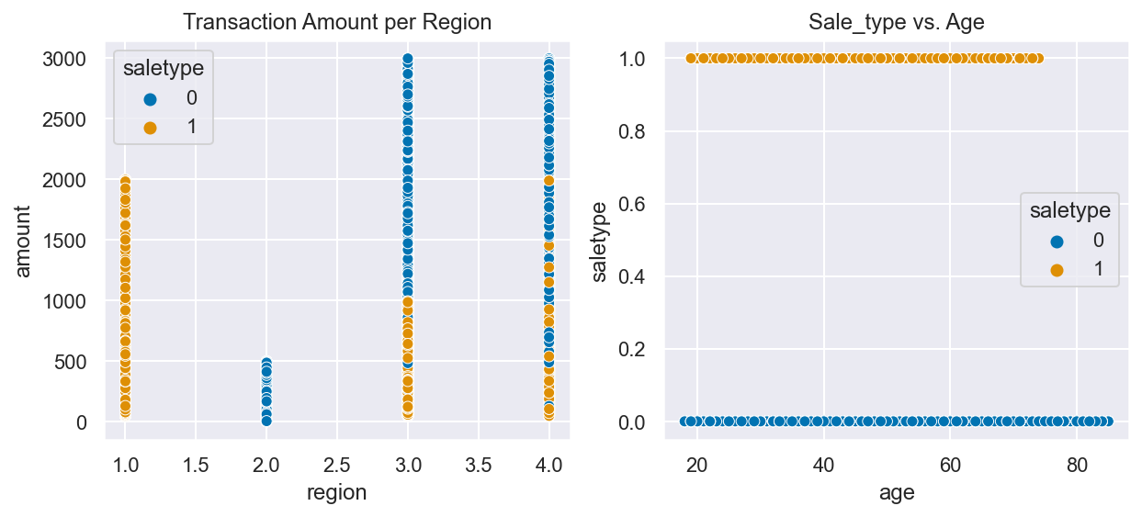
Best Type of Sale predictors are Region and Transaction amount
Sale Type:
0 = Online
1 = In-store
North South East West
The North only buys in-store. The South only buys online
In the East and West all purchases above $1000 are most likely online
Age and type of sale correlation is weak. Older customers prefer to shop online in the West, while younger people prefer to buy online than in-store in the East. Customers 74+ buy online only in the South
Notes:
Q: Is there any correlation between age of a customer and if the transaction was made online or in the store? Or do other factors correlate to an online or in-store transaction?
Martin’s Hypothesis: customers who shop in the store are older than customers who shop online and that older people spend more money on electronics than younger people
_________________
The best Online/In-store predictor is the Region where the customer buys, followed by the amount spend.
____________________
Exploratory Data Analysis: Understand the Data, deep dive into univariate and bivariate analysis
Machine Learning: Use different feature targets and ML algorithms, understand feature importance

Slide 21
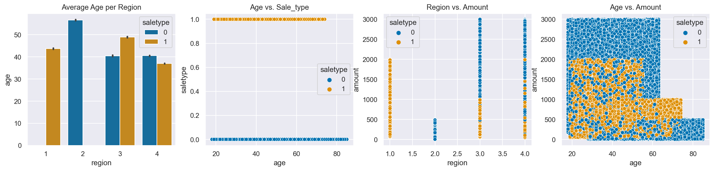
Best Type of Sale predictors are Region and Transaction amount
Regions: 1 North 2 South 3 East 4 West
Sale Type : 0 = Online 1 = In-Store
Age and type of sale correlation is weak. Older customers prefer to shop online in the West, while younger people prefer to buy online than in-store in the East. Customers 74+ buy online only in the South
The best Online/In-store predictor is the Region where the customer buys, followed by the amount spend. The North only buys in-store, while the South only does online
In the East and West all purchases above $1000 are most likely online
People 64+ maximum amount spend is $1000
Notes:
DO NOT SHOW THIS SLIDE
Q: Is there any correlation between age of a customer and if the transaction was made online or in the store? Or do other factors correlate to an online or in-store transaction?
Martin’s Hypothesis: customers who shop in the store are older than customers who shop online and that older people spend more money on electronics than younger people
____________________
Exploratory Data Analysis: Understand the Data, deep dive into univariate and bivariate analysis
Machine Learning: Use different feature targets and ML algorithms, understand feature importance

Slide 22
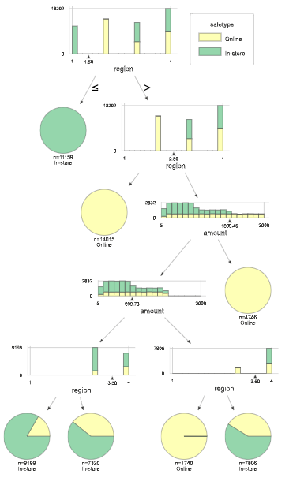
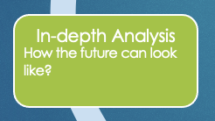
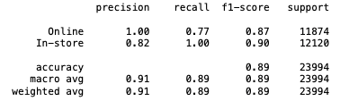
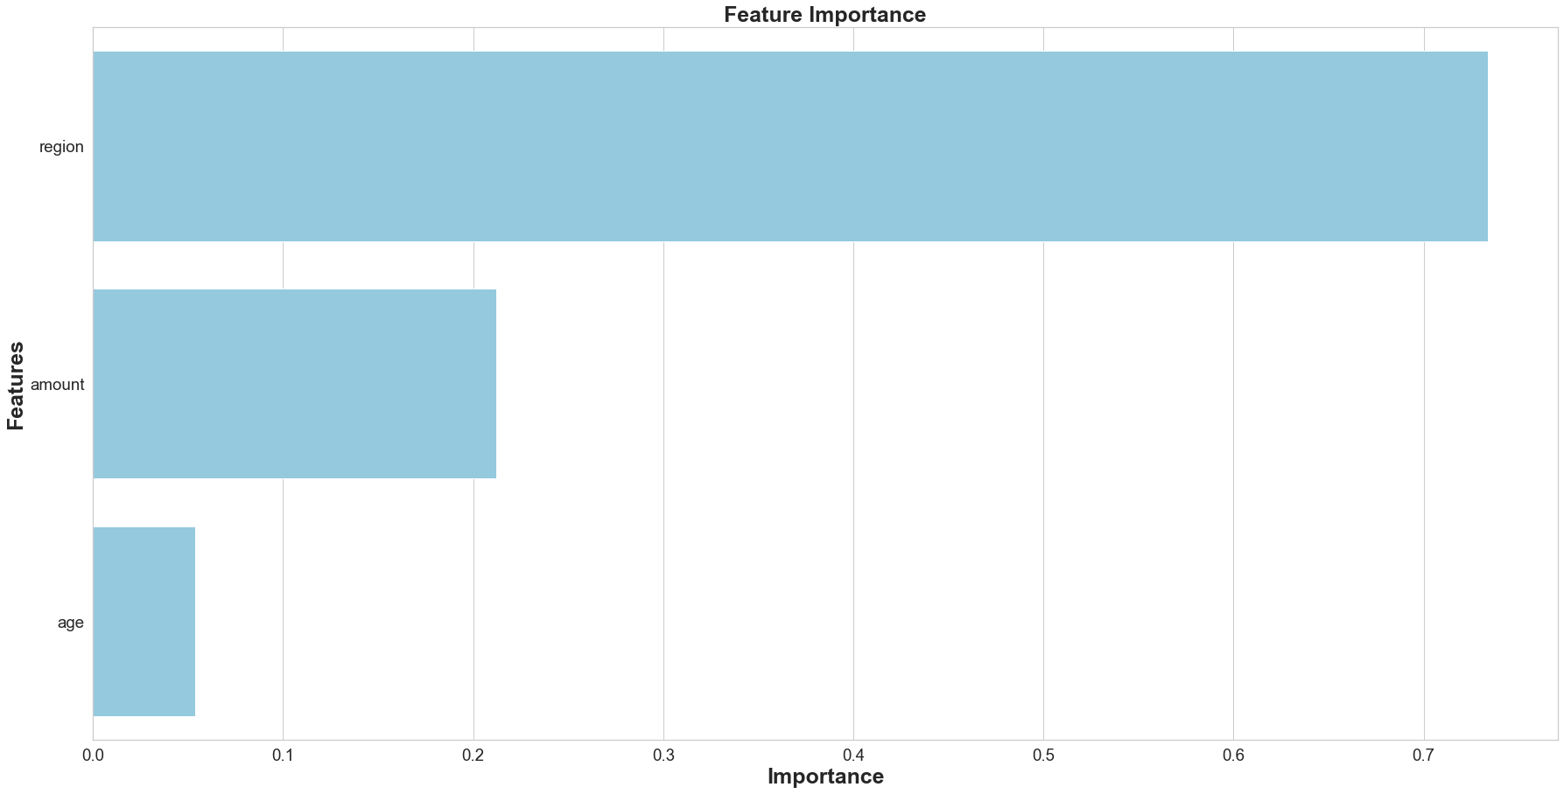
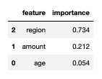
Type of sale predictions
Decision Tree Classifier Report
Max depth 6
Notes:
Optimize online marketing efforts to target 20-60 yrs. old population in regions North and South
19-28 yrs : Sales through college partnerships, easy payment offers, social media platforms?
29-60 yrs : leverage higher purchase power, educate to buy
All regions offer related products
_________________________
Exploratory Data Analysis: Go back to univariate and bivariate analysis to better visualize the data after ML process

Slide 23
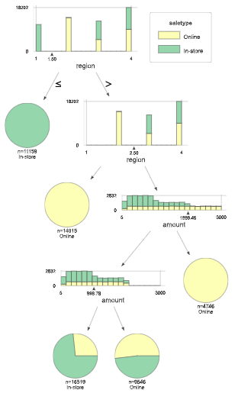
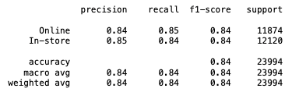
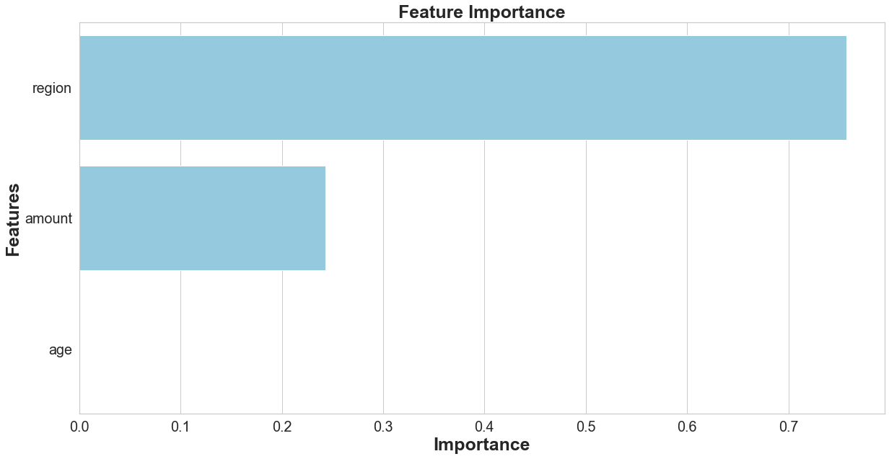
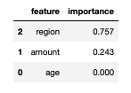
Type of sale predictions
Decision Tree Classifier Report
Max depth 4.
Notes:
Optimize online marketing efforts to target 20-60 yrs. old population in regions North and South
19-28 yrs : Sales through college partnerships, easy payment offers, social media platforms?
29-60 yrs : leverage higher purchase power, educate to buy
All regions offer related products
_________________________
Exploratory Data Analysis: Go back to univariate and bivariate analysis to better visualize the data after ML process

Slide 24
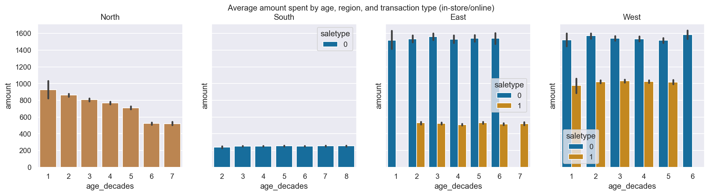
Focus on Regions North and South
Sale Type : 0 = Online 1 = In-Store
Relaunch site in the North, and market high end products in the South. Imagine if these regions had the same avg. transaction amount…
What else is the West doing right? Is it service? Follow up on purchases?
Next steps: Understand profit and market info, collect more demographic (gender, family size, geolocation, etc.), historic and online data to understand current picture better and make more accurate projections. Make dashboards available to all regions
Notes:
Optimize online marketing efforts to target 20-60 yrs. old population in regions North and South
19-28 yrs : Sales through college partnerships, easy payment offers, social media platforms?
29-60 yrs : leverage higher purchase power, educate to buy
All regions offer related products
_________________________
Exploratory Data Analysis: Go back to univariate and bivariate analysis to better visualize the data after ML process

Slide 25
Task 2

Slide 26
Overview
Blackwell Main facts:
Successful electronics retailer for three decades, with numerous stores in various locations.
Launched eCommerce website over a year ago
Want to leverage customer transaction data from the site to inform decisions about site-related activities
Desired outcome: Maximize the amount of revenue generated from eCommerce sales
Optimize online marketing efforts
Questions to Answer
Are there differences in the age of customers between regions? If so, can we predict the age of a customer in a region based on other demographic data?
Is there any correlation between age of a customer and if the transaction was made online or in the store? Or do other factors correlate to an online or in-store transaction?
DataSet Info
Notes:
Reporting Outline * Overview - What have you been asked to do? Are there specific questions you are trying to answer? What are the goals of the project? (Provides the context a reader needs to understand your analysis) Output:
Customer Demographics Report. A zip file that includes:
A 1-2 page Word document in which you:
Summarize your findings and conclusions regarding the questions posed about customer purchasing behavior
Explain how the results of each classifier you ran support your conclusions
A narrative explaining the results of each algorithm you ran, but the technical output is not needed in the report itself. Please only include it in a separate file so the mentors may review your work.

Slide 27
Customer Age and Type of sale Relationship
Regions: 1 North 2 South 3 East 4 West
Sale Type : 0 = Online 1 = In-Store
The correlation between age and type of sale is weak. Older customers prefer to shop online in the West, while younger people prefer to buy online than in-store in the East. Customers 74+ buy online only (South)
The best Online/In-store predictor is the Region where the customer buys, followed by the amount spend. The North only buy in-store, while the South only does online
In the East and West all purchases above $1000 are most likely online
People 64+ maximum amount spend is $1000
Notes:
Q: Is there any correlation between age of a customer and if the transaction was made online or in the store? Or do other factors correlate to an online or in-store transaction?
Martin’s Hypothesis: customers who shop in the store are older than customers who shop online and that older people spend more money on electronics than younger people

Slide 28
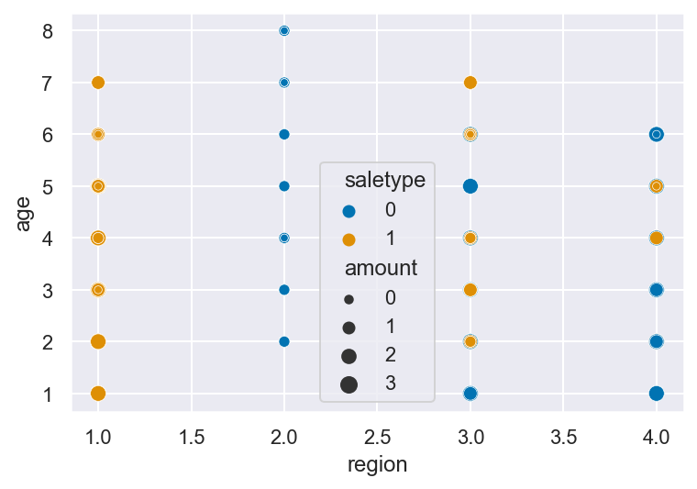
Can we predict the age of a customer in a region based on other demographic data?
Not really, but we should focus on type of sale, specifically online purchases and amount spend.

Slide 29
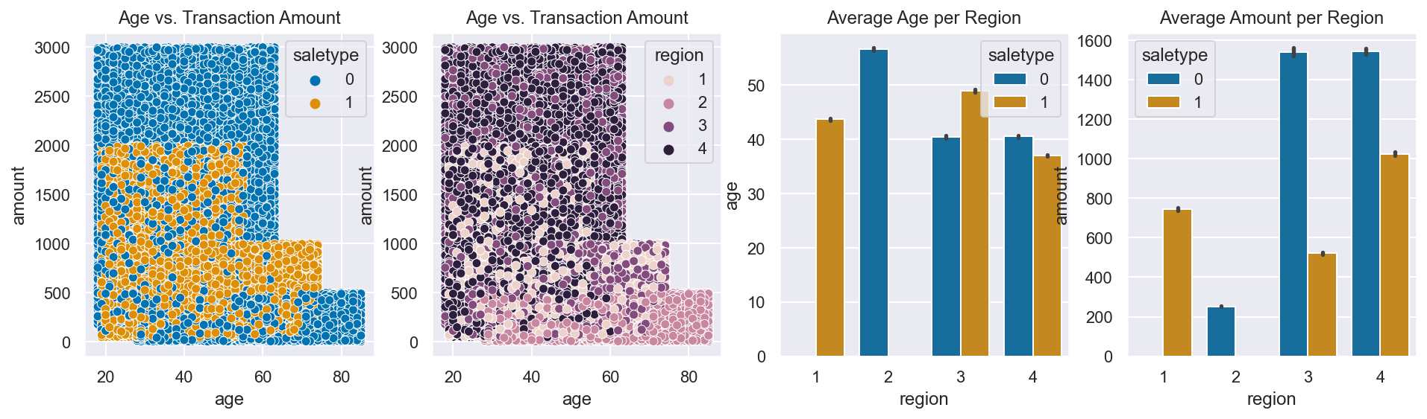
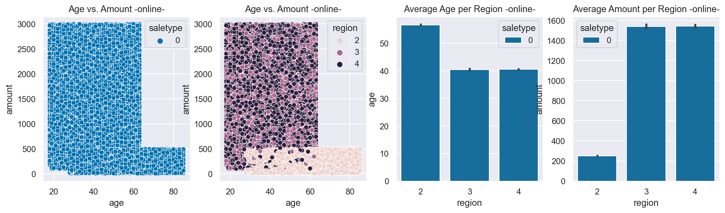
Buyer’s Age and Amount Spend relationship
Adjust the marketing strategy to target 20 - 60 yrs. Population in all regions
Huge effort in Regions North and South to revamp online sales
Regions: 1 North 2 South 3 East 4 West
Sale Type : 0 = Online 1 = In-Store
Notes:
Reporting Outline * Analysis - Address the goals of the project. Use visualizations to support your findings. Be succinct for business audiences (Visualizations are super important as they lend a credibility that text alone can’t achieve.)

Slide 30
Conclusions
Need to relaunch the eCommerce Platform in the North Region and revamp it in the South
Promote High-end products in the South region
Optimize online marketing efforts to target 20-60 yrs. old population in all regions
19-28 yrs : Sales through college partnerships, easy payment offers, popular social media platforms?
29-60 yrs : leverage higher purchase power, educate to buy
All regions offer related products
Next step: Analyze profit information
Notes:
Reporting Outline * Conclusions/Next Steps (optional) - Based on your findings, what should/could Blackwell do?

Slide 31
Task 1

Slide 32
Overview
Blackwell Main facts:
Successful electronics retailer for three decades, with over numerous stores in various locations.
Launched eCommerce website over a year ago
Want to leverage customer transaction data from the site to inform decisions about site-related activities
Desired outcome: Maximize the amount of revenue generated from eCommerce sales.
Questions to Answer
Do customers in different regions spend more per transaction? Which regions spend the most/least?
Is there a relationship between number of items purchased and amount spent?
DataSet Info
Notes:
Reporting Outline * Overview - What have you been asked to do? Are there specific questions you are trying to answer? What are the goals of the project? (Provides the context a reader needs to understand your analysis)

Slide 33
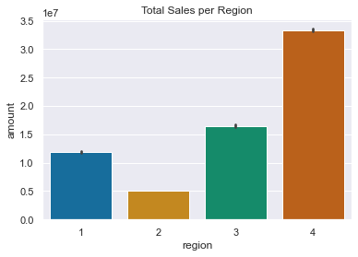
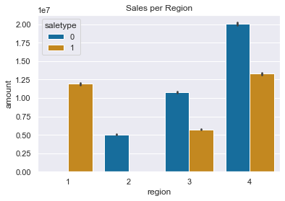
Which regions spend the most/least?
The West region has the highest revenue (total and online transactions), and is the leader in all categories of the analysis
It is necessary to analyse the profit and market landscape info for a 360 view
A relaunch of the online store is necessary in the North region ($0 Online revenue)
The North and South Region need to learn from Region 4
Go here for Online/In-store comparison
Regions: 1 North 2 South 3 East 4 West
(*) There are some outliers in the Amount feature, however these don’t distort the analysis. See here for details here
Sale Type : 0 = Online 1 = In-Store
Notes:
Reporting Outline * Analysis - Address the goals of the project. Use visualizations to support your findings. Be succinct for business audiences (Visualizations are super important as they lend a credibility that text alone can’t achieve.)

Slide 34
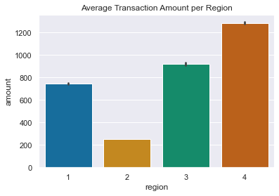
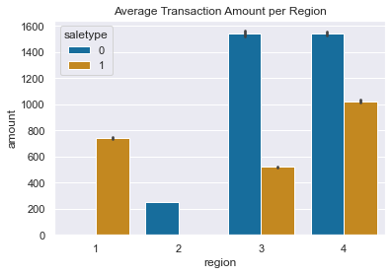
Do customers in different regions spend more per transaction?
The West region has the highest average transaction amount (total and online)
West and East customers spend the most in average per online transaction - What are these Regions doing right? -
The South Region needs to sell more high end products (same # of items in average)
The company needs to evaluate its strategy. In general In-store sales are dragging down the sales performance
Go here for Online/In-store comparison
Regions: 1 North 2 South 3 East 4 West
(*) There are outliers in the Amount feature, however these don’t distort the analysis. See here for details here
Sale Type : 0 = Online 1 = In-Store
Notes:
Reporting Outline * Analysis - Address the goals of the project. Use visualizations to support your findings. Be succinct for business audiences (Visualizations are super important as they lend a credibility that text alone can’t achieve.)

Slide 35
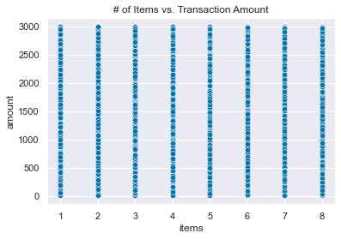
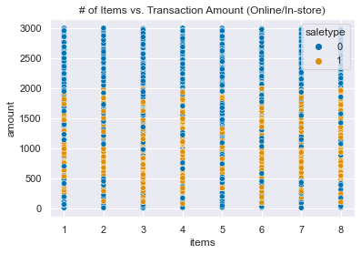
Is there a relationship between number of items purchased and amount spent?
There is practically no correlation (0.000384) between the number of items and the amount spend per transaction. This is true also for the covariance (0.57)
This behavoir is similar when looking at the Online and In-Store transactions subsets. Correlation = 0.002628, Covariance = 4.78
There are stronger relationships between the amount spend and other variables (see next slide)
The average items per transaction is 4.5, it is almost the same per Region, or while looking at Online vs In-store transactions
Go here for Online/In-store comparison
(*) There are outliers in the Amount feature, however these don’t distort the analysis. See here for details here
Sale Type : 0 = Online 1 = In-Store
Notes:
Reporting Outline * Analysis - Address the goals of the project. Use visualizations to support your findings. Be succinct for business audiences (Visualizations are super important as they lend a credibility that text alone can’t achieve.)

Slide 36




Correlation And Covariance Analysis (related to Amount)
Correlation Matrix
Covariance Matrix
Online Subset Correlation Matrix
Online Subset Covariance Matrix
The strongest positive correlation and covariance between the amount spend and any other variable is 0.4 and 327.87 respectively with the region. Meaning that the highest the region the highest is the revenue it could be expected. This relationship is even stronger (0.67, 532.66) when looking at the online subset of observations. This was evidenced graphically in this slide
There is a 0.28 (somewhat) negative correlation between the buyers’ age and the amount spend per transaction. Such correlation is even stronger in the Online transactions. Something similar happens with their covariance. Meaning that younger customers tend to spend more per transaction. This relation requires further exploring
Notes:
Reporting Outline * Analysis - Address the goals of the project. Use visualizations to support your findings. Be succinct for business audiences (Visualizations are super important as they lend a credibility that text alone can’t achieve.)

Slide 37
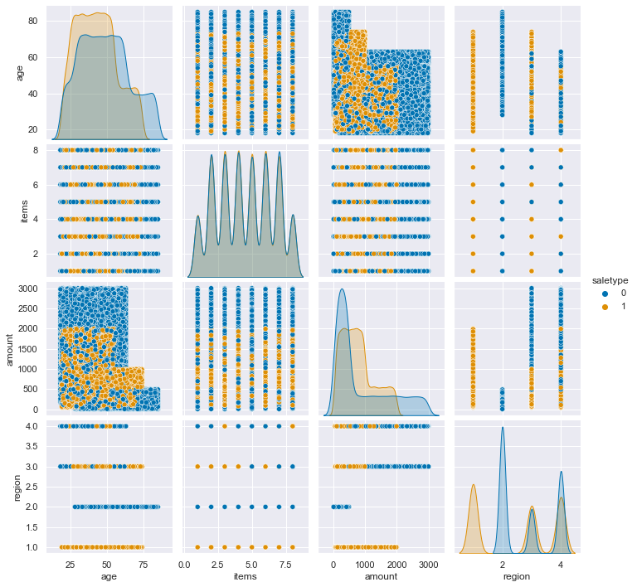
Bivariate matrix
Sale Type : 0 = Online 1 = In-Store
Visually, one could observe a positive correlation between the region and the amount spend
There is negative correlation between the buyers’ age and the amount spend per transaction. Such correlation is even stronger in the Online transactions.
Notes:
Reporting Outline * Analysis - Address the goals of the project. Use visualizations to support your findings. Be succinct for business audiences (Visualizations are super important as they lend a credibility that text alone can’t achieve.)

Slide 38
Buyer’s Age and Amount Spend relationship
Adjust the marketing strategy to target 20 - 60 yrs. Population in all regions
Regions: 1 North 2 South 3 East 4 West
Sale Type : 0 = Online 1 = In-Store
Notes:
Reporting Outline * Analysis - Address the goals of the project. Use visualizations to support your findings. Be succinct for business audiences (Visualizations are super important as they lend a credibility that text alone can’t achieve.)

Slide 39
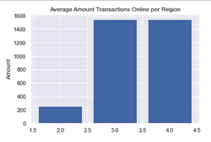
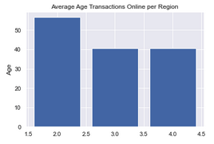
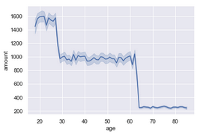
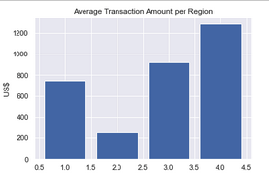
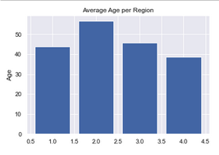
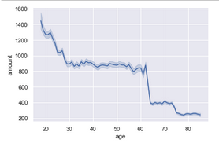
Buyer’s Age and Amount Spend relationship
Online Transactions Amount vs. Age
Transactions Amount vs. Age
Notes:
Reporting Outline * Analysis - Address the goals of the project. Use visualizations to support your findings. Be succinct for business audiences (Visualizations are super important as they lend a credibility that text alone can’t achieve.)

Slide 40
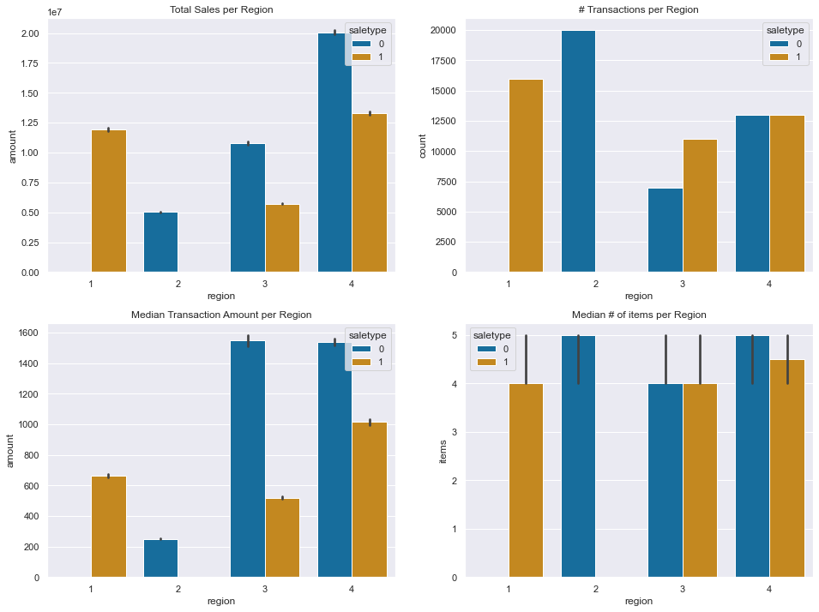
Customer Behavior: Online/In-store comparison
Customers in the East and West spend more per online transaction than in the other two regions
The average number of items per transaction are the same across all regions and type of sale
The South region has the lowest sales and yet second # of transactions. It is necessary to market more high end products there.
A relaunch of the online store is necessary in the North Region
It is necessary to evaluate if a brick and mortar store investment in the South Region is worthy
Regions: 1. North 2. South 3. East 4. West
Type : 0 = Online 1 = In-Store
Notes:
Reporting Outline * Analysis - Address the goals of the project. Use visualizations to support your findings. Be succinct for business audiences (Visualizations are super important as they lend a credibility that text alone can’t achieve.)

Slide 41
Conclusions
Need to relaunch the eCommerce Platform in the North Region
Promote High-end products in the South region
Optimize online marketing efforts to target 20-60 yrs. old population in all regions
19-28 yrs : Sales through college partnerships, easy payment offers, popular social media platforms?
29-60 yrs : leverage higher purchase power, educate to buy
All offer related products
Next step: Analyze profit information
Notes:
Reporting Outline * Conclusions/Next Steps (optional) - Based on your findings, what should/could Blackwell do?

Slide 42
Addendum

Slide 43
Data Set Info
Data set: Demographic_Data.csv
79979 Observations (Unduplicated)
Attributes:
SaleType*: 1= in store, 0 = online
Age
Items: # of items per transaction
Amount
Region: 1= North, 2 = South, 3= East, 4 = West
* Originally ‘In-store’
Notes:
Reporting Outline * Data - What data have you been given? How many observations are there? What are the features? If features are coded, what do the codes represent? (Provides the context a reader needs to understand your analysis)

Slide 44
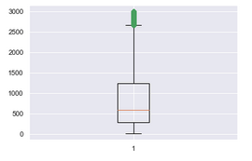
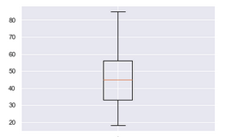
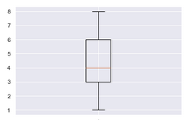
EDA – Checking for outliers
Averages are used for the analysis in this document. Here is how each feature distribution looks like:
Outliers are observed in the Amount feature. However, it could be that most of the outliers are in a specific region, or are all online or in-store, in which case the effect on the On-line and In-store Averages would not be critical.
See next page for details.
Amount Spend per Transaction
Customer Age
# Items bought per transaction
Notes:
Reporting Outline * Data - What data have you been given? How many observations are there? What are the features? If features are coded, what do the codes represent? (Provides the context a reader needs to understand your analysis)

Slide 45
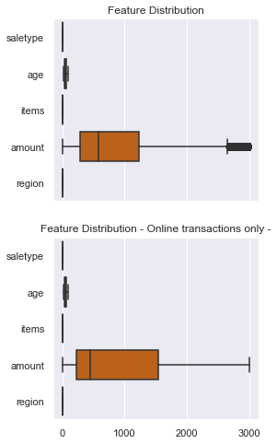
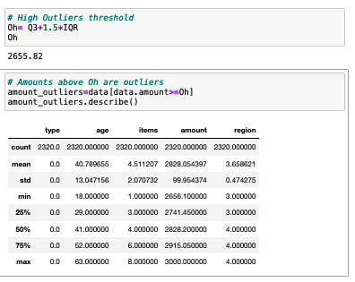
EDA – Analyzing Amount outliers
There are 2320 outlier observations, all are online transactions and more than 50% occur in the West Region (4)
We want these outliers to happen! It is important to understand what is Region 4 doing well
Notes:
Reporting Outline * Data - What data have you been given? How many observations are there? What are the features? If features are coded, what do the codes represent? (Provides the context a reader needs to understand your analysis)

