Slide 1


Belgian Real Estate Modelization 3D
Alexandre Le Begge

Slide 2







Our Mission
Provide the best modelization 3D for each building in Belgium.
Based on open-source data (LiDAR)
Fast and accurate
Adaptative
User friendly
Implementable quickly
Brussels and Flanders

Slide 3

How it works
Different steps
Downloading files (once)
Enter an address
Plot a map (optional)
3D modelization of the item

Slide 4
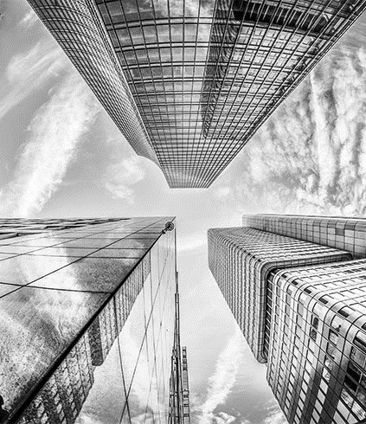
Quick Showcase
“A picture is worth a thousand words”

Slide 5

Road Map
Our furthers steps and improvements
Auto shape
GUI
Smoother
Features (m², POI, Price)
Wallonia

Slide 6

Thank You.
Alexandre Le Begge
0484 88 14 78
alexandre-le-begge@becode.xyz
www.github.com/alebegge/3Dplotting_houses

