Slide 1
Big O Notation
Tech-Talk
Alexandre Le Begge
February 21, 2022

Slide 2
How do we evaluate the efficiency of an algorithm ?

Slide 3
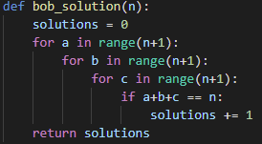
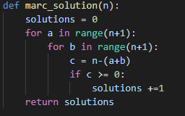
Example
The problem: a + b + c = n (nonnegative integers)
BOB | MARC
Try all combinaisons of (a,b,c) | Understand than n is given.
If a + b + c = n: print(a,b,c) | For (a,b) set c = n – (a+b) If c ≥ 0: print(a,b,c)
Which one is better ? Why ?

Slide 4
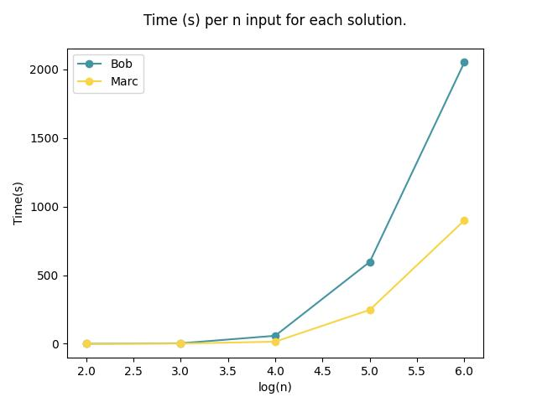
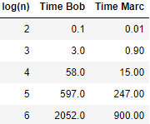
1. Time
Drawbacks:
Take a lot of effort and time
Machine dependence

Slide 5
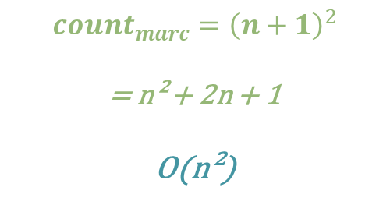
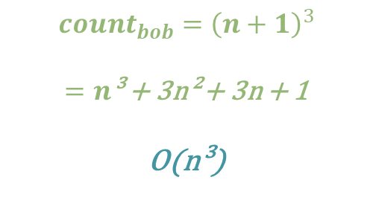
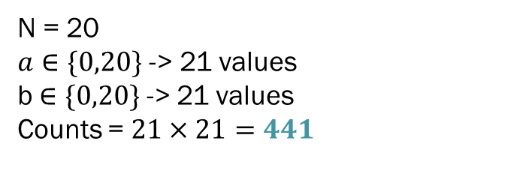
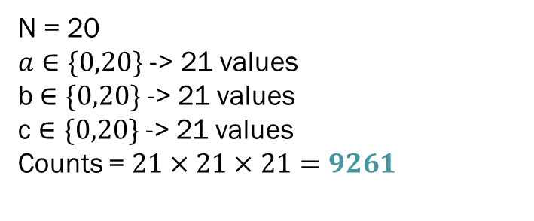
2. Number of actions
Drawbacks:
Easier to do
Machine independent
N = 20
$a∈\{0,20\}$ -> 21 values
b $∈\{0,20\}$ -> 21 values
c $∈\{0,20\}$ -> 21 values
Counts = $21×21×21=9261$
$$count_{bob}={\left(n+1\right)}^{3}$$
$=n$³ + 3n² + 3n + 1
O(n³)
$$count_{marc}={\left(n+1\right)}^{2}$$
= n² + 2n + 1
O(n²)
N = 20
$a∈\{0,20\}$ -> 21 values
b $∈\{0,20\}$ -> 21 values
Counts = $21×21=441$

Slide 6
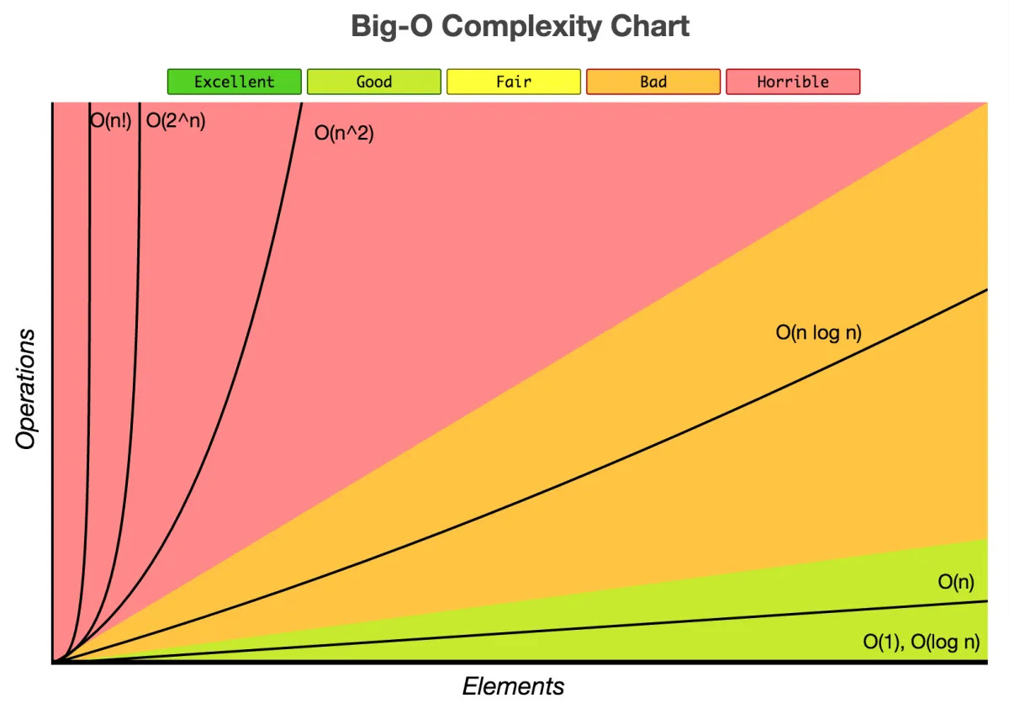


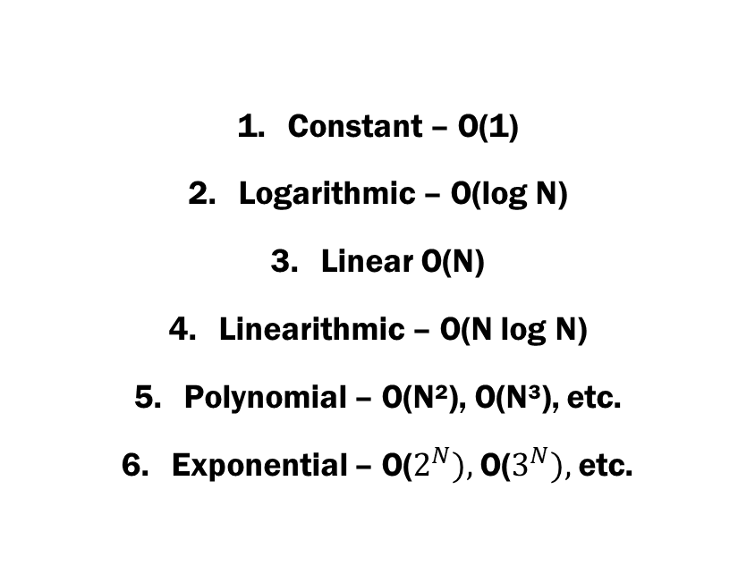
Type of time classes
Constant – O(1)
Logarithmic – O(log N)
Linear O(N)
Linearithmic – O(N log N)
Polynomial – O(N²), O(N³), etc.
Exponential – O($2^{N}),$O($3^{N}),$etc.

Slide 7

How to apply ?
Understand your algorithm (inputs ? purpose? outputs?)
Identify a basic unit to count (print, assignment, etc.)
Analyze the growth of our basic unit (linear, log, etc.)

Slide 8
Thank you!
If you have any questions or comments, now is the time !
Alexandre Le Begge
GitHub

Slide 9
https://www.youtube.com/watch?v=Q_1M2JaijjQ&ab_channel=Reducible https://slideplayer.com/slide/14952628/ https://medium.com/dataseries/how-to-calculate-time-complexity-with-big-o-notation-9afe33aa4c46 https://www.youtube.com/watch?v=6aDHWSNKlVw&ab_channel=TechWithTim https://www.youtube.com/watch?v=Mo4vesaut8g&ab_channel=freeCodeCamp.org

