Slide 1
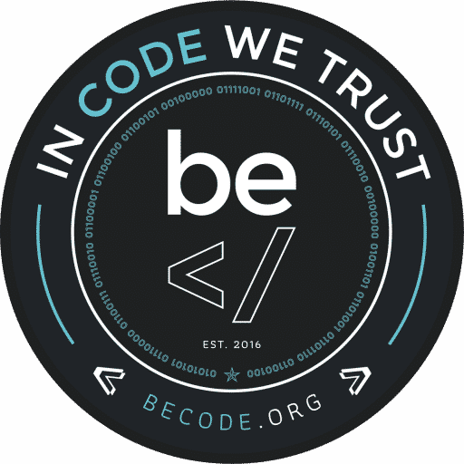
Ressources humaines : diapositive 1
ZERO-KNOWLEDGE PROOF
BeCode – TechTalk – 4/02/2022
Alexandre Le Begge

Slide 2
Ressources humaines : diapositive 2
WHAT ?
Zero-knowledge proof is a method which one party (the prover) can prove to another party (the verifier) that a given statement is true without giving any additional information apart from the fact that the statement is indeed true.
Goldwasser, S., Micali, S., & Rackoff, C. (1989). The knowledge complexity of interactive proof systems. SIAM Journal on computing, 18(1), 186-208.

Slide 3
Ressources humaines : diapositive 2
WHAT ?
Interactive Zero-Knowledge Proof:
require interactions between the individual. Proving to only one individual.
Non-Interactive Zero-Knowledge Proof:
Allow a larg number of observer to verify the proof

Slide 4

Ressources humaines : diapositive 8
WHY ?
More technologies
Give them personal data
Increased the risk
Lose the control

Slide 5
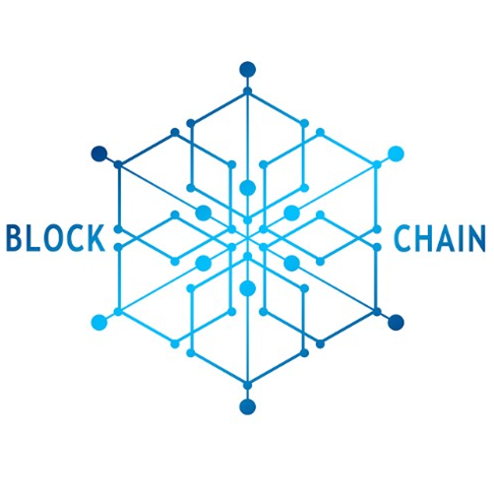
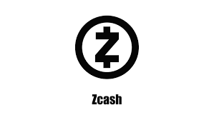
Ressources humaines : diapositive 8
HOW ?
1. BLOCKCHAINS
« A blockchain is a software that stores and transfers value or data via Internet, transparently, securely and without any central control body. »
L. Leloup (2017, p.13)
Zk-SNARK
Zero-Knowledge Succint Non-Interactive Argument of Knowledge

Slide 6
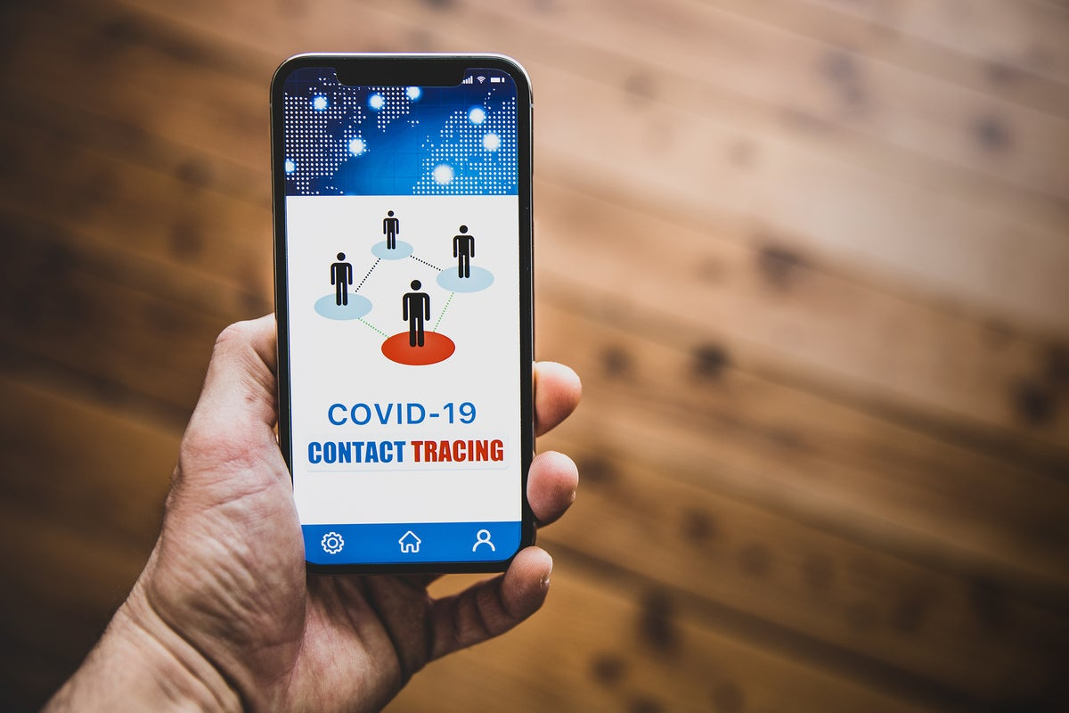
Ressources humaines : diapositive 8
HOW ?
2. COVID TRACING APP
« Using zero knowledge proof, our apps allows the notification of close contacts, without revealing the location and identification of these close contacts. »
Joseph K. Liu, Man Ho Au, Tsz Hon Yuen, & al.
(2020, p16)

Slide 7


Ressources humaines : diapositive 8
HOW ?
3. FINANCE
Zero-Knowledge Range Proof
18-65years
Location (Europe)
Salary range

Slide 8



Ressources humaines : diapositive 6
BUT ?
We can not guarantee a 100% true.
The information can be lost for ever.
Can be very demanding.

Slide 9
Ressources humaines : diapositive 2
To go further…
Zero Knowledge Proofs - Computerphile. (2017, November 8). [Video]. YouTube. https://www.youtube.com/watch?v=HUs1bH85X9I
Computer Scientist Explains One Concept in 5 Levels of Difficulty | WIRED. (2022, January 18). [Video]. YouTube. https://www.youtube.com/watch?v=fOGdb1CTu5c
Eloi, L. (2019). Economie de la confiance. Paris: La Découverte.
Goldwasser, S., Micali, S., & Rackoff, C. (1989). The knowledge complexity of interactive proof systems. SIAM Journal on computing, 18(1), 186-208.
https://www.wired.com/story/zero-knowledge-proofs/#:~:text=For%20example%2C%20zero%2Dknowledge%20proofs,how%20much%20currency%20changed%20hands
Leloup, L. (2017). Blockchain: La révolution de la confiance. Paris: Eyrolles.
Zcash. (2019). What are zk-SNARKs?. https://z.cash/technology/zksnarks/
Joseph K. Liu, Man Ho Au, Tsz Hon Yuen, & al. (2020). Privacy-Preserving COVID-19 Contact Tracing App: A Zero-Knowledge Proof Approach. Cryptology ePrint Archive, rep. 2020/528.
ING-Project, ZKRP. (2019), GitHub repository, https://github.com/ing-bank/zkrp
ING. (2017). Blockchain transactions just got a whole lot safer. https://www.ing.com/Newsroom/News/Blockchain-transactions-just-got-a-whole-lot-safer.html

Slide 10
Ressources humaines : diapositive 10
Thank you!
If you have any questions or comments, now is the time !

