Slide 1
prices predicting model in Belgium's real estate sales
Alexandre Le Begge

Slide 2
Our mission
Create the most accurate price prediction model for the Belgian real estate market.
Based on 13.618 items after cleaning extracted from the website ImmoVlan.

Slide 3
DATA CLEANING
Nominal variables
Removed when low correlation and a lot of missing values
One Hot Encoding (Postcodes -> Provinces)
Ordinal variables
Turn them into numerical variable (State of property)
Numeric variables
Compared and merged (Garden and Surface garden)
Replace missing values by the 1st quartile
OUTLIERS & missing values
Removed approx. 20%
(start: 17.347 items -> end: 13.618 items)

Slide 4
DATA SET CLEANED
Ordinal | Continuous | Binary | Discrete
State of property | Livable surface | Balcony | Number of bedrooms
Kitchen equipment | Surface of bedroom 1 | Furnished | Number of showers
 | Surface of living-room | Cellar | Number of bathrooms
 | Surface kitchen | Security door | Number of toilets
 | Surface terrace | Access for disabled | Number of showers
 | Surface garden | Sewer connection | Number of facades
 | Price | Garage
 |  | Provinces (for each)
 |  | Orientation South
Tot. 34 variables |  | Type property

Slide 5
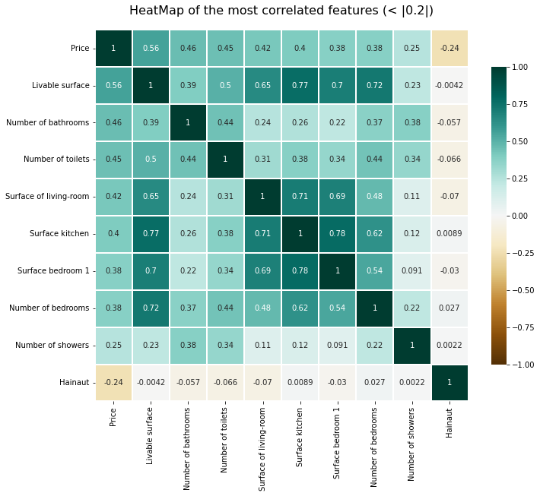
Correlation

Slide 6
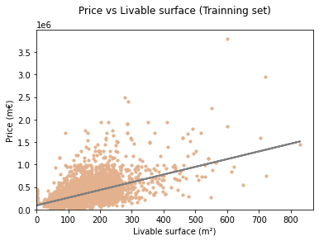

Linear regression model
A. Simple linear regression
Target Variable(y): Price
Independant variable(X): Livable surface
Very low accuracy level.
Tested on 20% of all datas.
0,29 R²-score

Slide 7
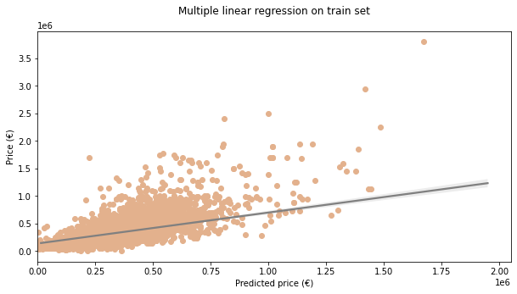
Linear regression model
B. Multiple linear regression
Target Variable(y): Price
Independant variable(X): 33 variables (p. 4)
Better accuracy but still pretty low.
Tested on 20% of all datas.
0,53 R²-score
P-Values > 0.05
Numbers of bedrooms | Surface of bedroom 1 | Cellar | Surface kitchen | Sewer Connection | Orientation South

Slide 8
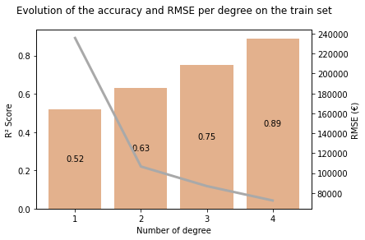
polynomial regression model
Target Variable(y): Price
Independant variable(X): 27 variables (33-6)
Degree = 4
Decent accuracy based on 20% as a test.
Still high RMSE (80000€)
Be aware of overfitting !
0,89 R²-score

Slide 9
Further steps
ADDING MORE DATA - historical
One hot encoding
Pre-processing
Clusters

Slide 10
HIGHLY VALUABLE
1. Improve your pricing fees
2. CREATE NEW features for the user
3. INTEGRATE NEW MARKETS

Slide 11
Thank you!
Alexandre LE BEGGE
GitHub Repository

