Slide 1
Java Security: Architecture and Primitives
Alessandro Buldini
alessandro.buldini@unibo.it

Slide 2
Java
First appeared 29th May 1995.
High-level OOP language developed by Sun Microsystems.
Platform-independent: Java Virtual Machines are built for most operating systems meaning Java programs can run pretty much everywhere without changing the code.
Robust, reliable, and safe: Java is a statically typed language that provides extensive compile-time checking, followed by a second level of run-time checking. There are no explicit programmer-defined pointer data types, no pointer arithmetic, and automatic garbage collection [1].

Slide 3
Safety vs. Security
Safety and Security are two related but distinct concepts:
Safety focuses on preventing accidental failures that could harm the application or the system the program is run on. Examples are garbage collection, static typing, exceptions handling, thread synchronization, impossibility to handle pointers, strong encapsulation (via private, public, protected).
Security, on the other hand, focuses on protecting from intentional attacks by malicious actors.

Slide 4
Java Security Architecture
Java Development Kit, JDK, defines a set of high-level APIs spanning over major security areas, including [2]:
Cryptography (Hash, Digital Signatures, Ciphers, MACS, PRNGs, …)
Public Key Infrastructure (X.509 certs, CRLs, path validation, …)
Authentication (secure login modules for LDAP, Kerberos, Windows NT, Unix, …)
Secure communication (TLS, Datagram-TLS, SSL, …)
Access control (permissions, security policies, AC enforcement, …)
These APIs allow developers to integrate security into their application code.

Slide 5
Java Security Overview
Security in Java is provided via several modules that contain security API [2]:
java.base: foundational security for Java Standard Edition. Includes: java.security, javax.crypto, javax.net.ssl, javax.security.auth.
java.smartcardio, provides smartcard secure I/O APIs.
java.jartool, provides tools to sign JAR files.
[…]

Slide 6
Java API
Java API are designed around the following principles [2]:
Implementation independence. Applications do not need to implement security themselves. They do so by requesting services from Cryptographic Service Providers (CSP) which are plugged into the JDK via a standard interface.
Implementation interoperability. Providers are interoperable across applications: a program is not bound to a specific provider if it does not rely on default values from it.
Algorithm extensibility: some applications may rely on emerging standards not yet implemented. The JDK supports the installation of custom providers that implement such services.

Slide 7
Cryptographic Service Providers [3]
Every CSP refers to a package or set of packages that implement one or more cryptographic services, such as digital signature algorithms, message digest algorithms, and key conversion services.
Providers may be updated transparently to the application, for example when faster or more secure versions are available.
Implementation interoperability means that various implementations can work with each other, use each other's keys, or verify each other's signatures.

Slide 8
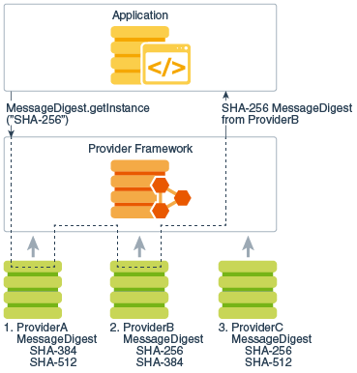
Why multiple providers?
I may want to implement my own provider or use my favorite one (bouncy-castle, IBM’s IBMJCEPlus, Microsoft’s MSCAPI …) instead of the default Oracle implementation.
Providers have priorities.
Some providers may perform cryptographic operations in software; others may perform the operations on a hardware cryptographic accelerator.

Slide 9
Achieving interoperability (1)
We likely won’t create a custom provider ourselves, so we’re not really interested in how to implement providers.
From a software engineering perspective, though, it’s very interesting to see how interoperability and modularity is achieved in OOP.
Algorithm independence is achieved by defining types of cryptographic services called engines and defining classes that provide the functionality of these services. These classes are called engine classes, and examples are the MessageDigest, Signature, and Cipher classes.

Slide 10
Achieving interoperability (2)
Engine classes are the abstract classes we will be working with. They extend a root abstract class which defines the behavior of the cryptographic component. These behavior-defining classes are called Service Provider Interface (SPI).
The engine class implementing a hashing algorithm, for example, must have a function to produce a digest: public byte[] digest();
Within the digest function, the customizable behavior is achieved by calling a method defined in the SPI parent class and implemented in the provider. The signature of the called method will be: protected abstract byte[] engineDigest();

Slide 11
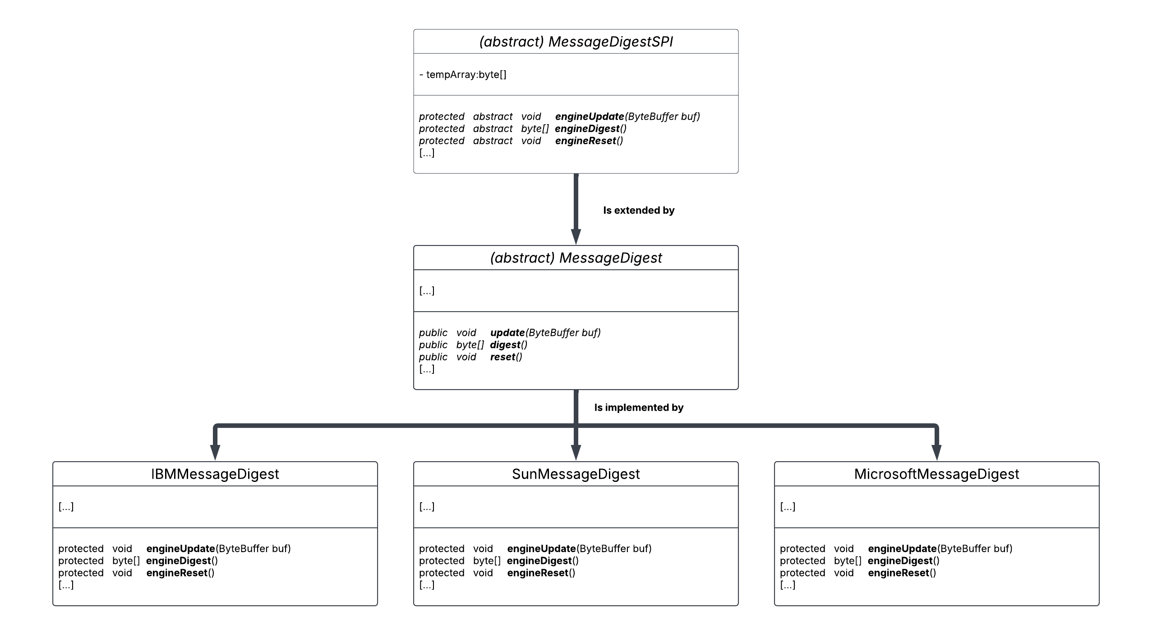
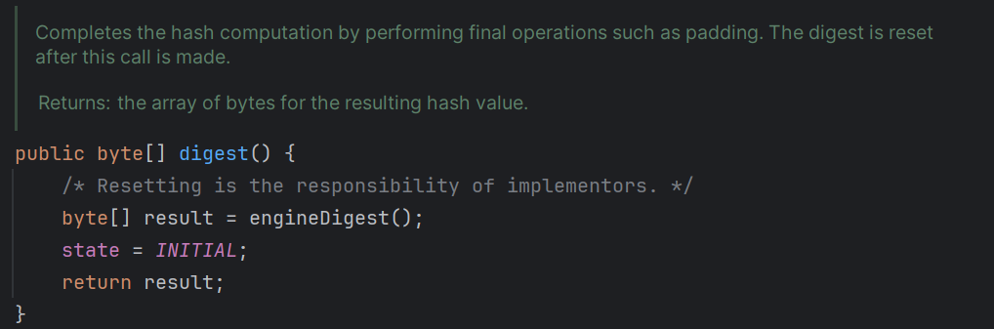
Achieving interoperability (3)

Slide 13
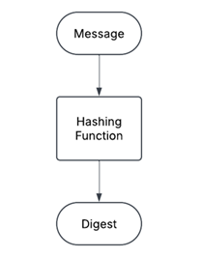
Hashing – Providing integrity (1)
To avoid modifications of the information in the unsafe channel, we need a hashing function that takes in input a string of information of any length and outputs a unique fingerprint of a fixed length.
Inputting the same string of information into a hashing function always outputs the same fingerprint.
The modification of a single bit must completely change the output fingerprint.

Slide 14
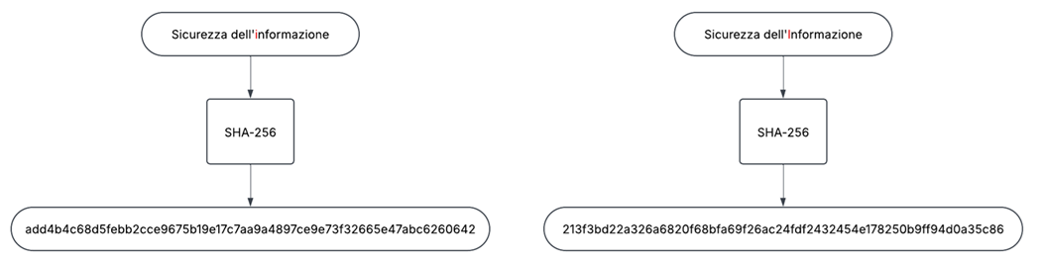
Hashing – Providing integrity (2)

Slide 15
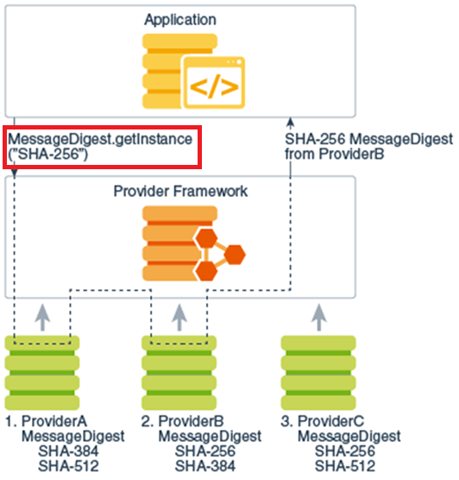
Hashing in Java (1) [4]
To use hashes (/digests/fingerprints) in our Java application, we have to employ the MessageDigest class.
Obtainable, like every other cryptographic object granted by CSPs, exclusively via the getInstance(String name) static method.
public static MessageDigest(String algorithm);
MessageDigest md = MessageDigest.getInstance(“SHA-256”)

Slide 16
Hashing in Java (2) [4]
The MessageDigest class provides three methods (and many overloading implementations) to manage digest creation:
public final void update(ByteBuffer input); Updates the input buffer by initializing it or appending input to it.
public final void reset(); Resets the input buffer.
public final byte[] digest(); Computes and returns the hash/digest/fingerprint of the input. It automatically resets the input buffer.

Slide 17
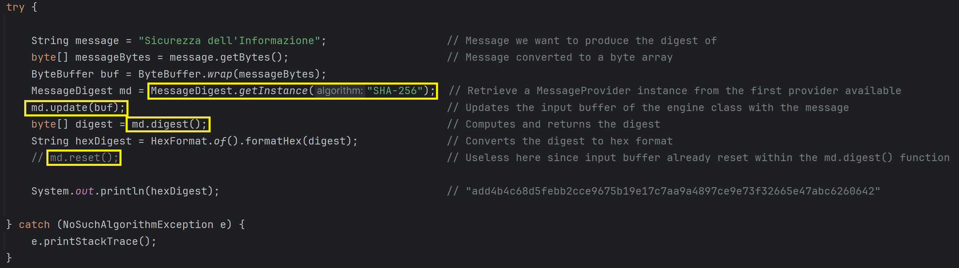
Hashing Example (1) - Explanation

Slide 18
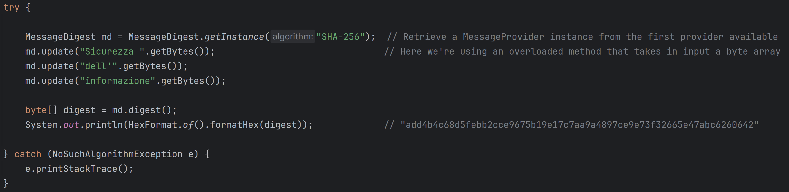
Hashing Example (2) - Update

Slide 19
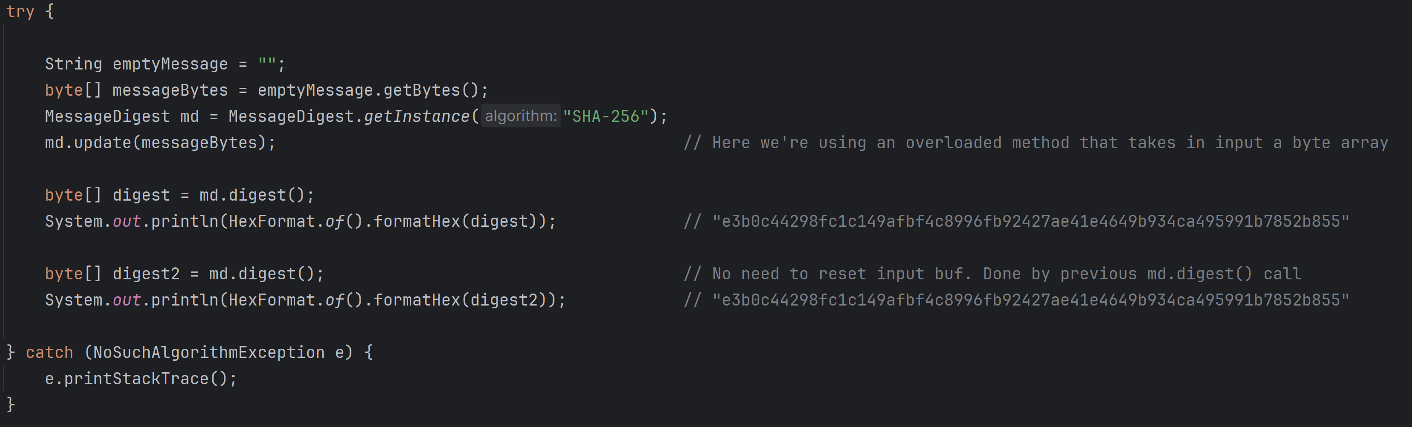
Hashing Example (3) – Empty Buffer

Slide 20
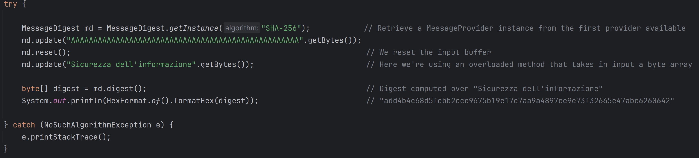
Hashing Example (4) – Reset

Slide 22
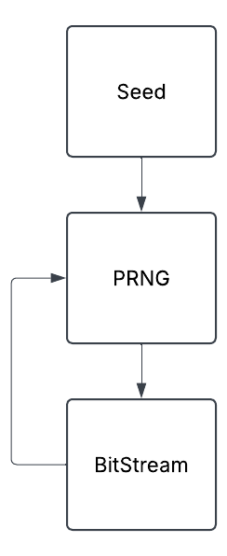
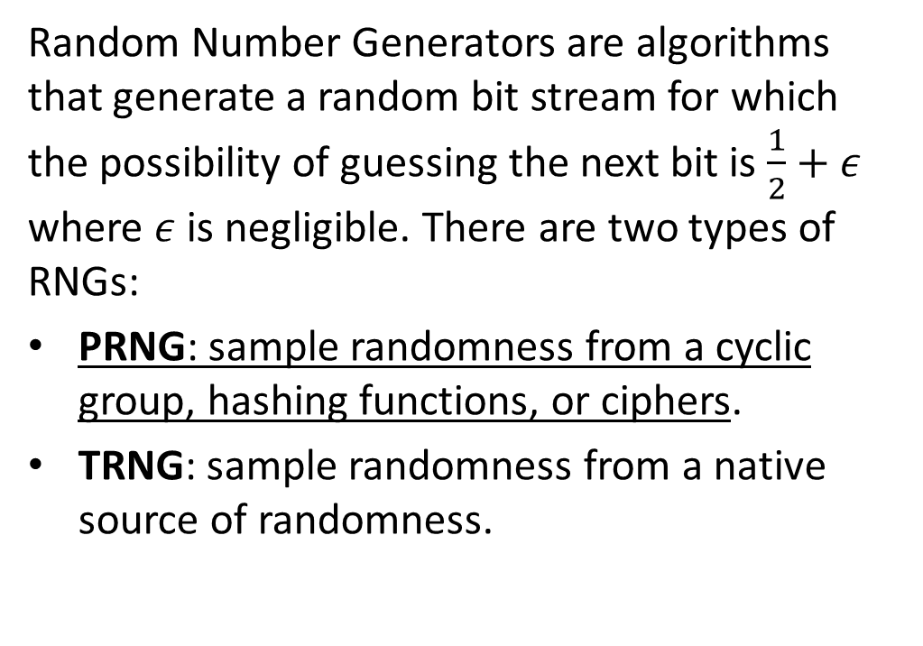
Pseudo Random Number Generators
Random Number Generators are algorithms that generate a random bit stream for which the possibility of guessing the next bit is $\frac{1}{2}+ε$ where $ε$ is negligible. There are two types of RNGs:
PRNG: sample randomness from a cyclic group, hashing functions, or ciphers.
TRNG: sample randomness from a native source of randomness.

Slide 23
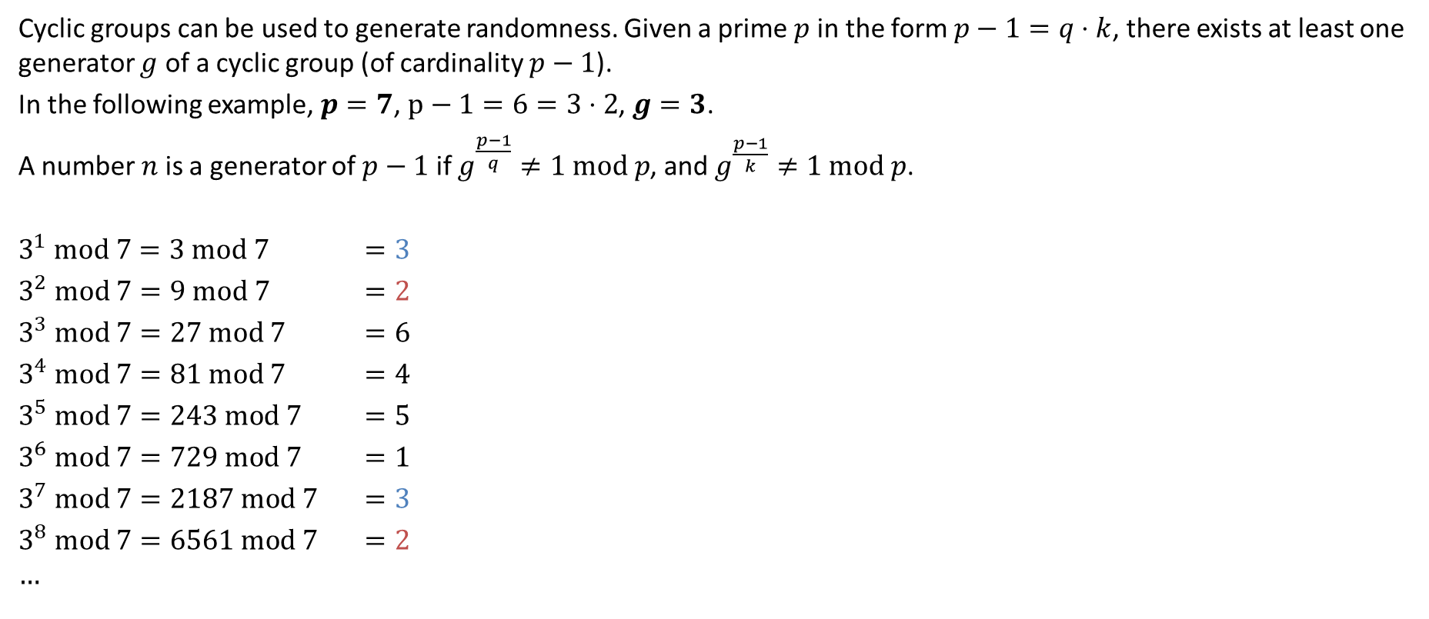
Non-Secure PRNG example
Cyclic groups can be used to generate randomness. Given a prime $p$ in the form $p−1=q⋅k$, there exists at least one generator $g$ of a cyclic group (of cardinality $p−1$).
In the following example, $p=7$, $p−1=6=3⋅2$, $g=3$.
A number $n$ is a generator of $p−1$ if $g^{\frac{p−1}{q}}≠1 mod p$, and $g^{\frac{p−1}{k}}≠1 mod p$.
$3^{1} mod 7=3 mod 7$ $=3$
$3^{2} mod 7=9 mod 7$ $=2$
$3^{3} mod 7=27 mod 7$ $=6$
$3^{4} mod 7=81 mod 7$ $=4$
$3^{5} mod 7=243 mod 7$ $=5$
$3^{6} mod 7=729 mod 7$ $=1$
$3^{7} mod 7=2187 mod 7$ $=3$
$3^{8} mod 7=6561 mod 7$ $=2$
$$…$$

Slide 24
RNGs in Java (1) [5]
Cryptographically secure Random Number Generators are available through the SecureRandom class.
They mainly rely on PRNGs, with some exceptions.
Algorithm SHA1PRNG leverages cryptographically secure hashing function properties of randomness to generate a random bit.
Algorithm DRBG (Deterministic Random Bit Generator) leverages hashing functions, ciphers, or elliptic curve cryptography and sample randomness through an entropy source.
All implementations are shown in [6].

Slide 25
RNGs in Java (2) [5]
The SecureRandom class overrides the java.util.Random class. It’s a fairly simple class:
To retrieve an instance of the SecureRandom object: public static SecureRandom getInstance(String algorithm); SecureRandom sr = SecureRandom.getInstance(“SHA1PRNG”);
public void setSeed(long seed); sets the seed in the SecureRandom PRNG.
Overridden java.util.Random methods:
public int nextInt(); Securely generates a random integer.
public int nextBoolean(); Securely generates a random boolean.
public int nextFloat(); Securely generates a random float.
[…]

Slide 26
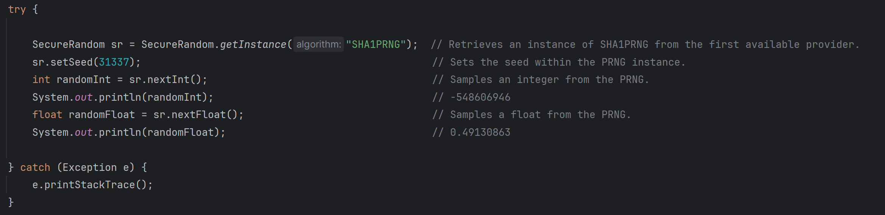
RNGs Example (1)

Slide 27
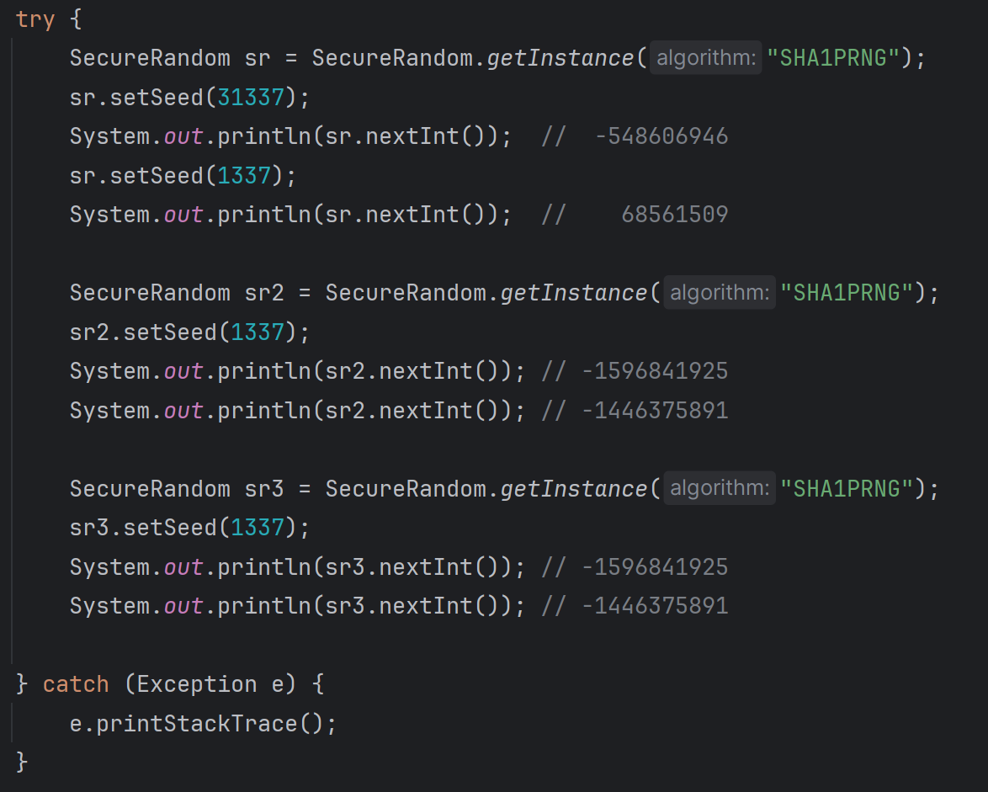
RNGs Example (2) – Different instances, same values

Slide 28
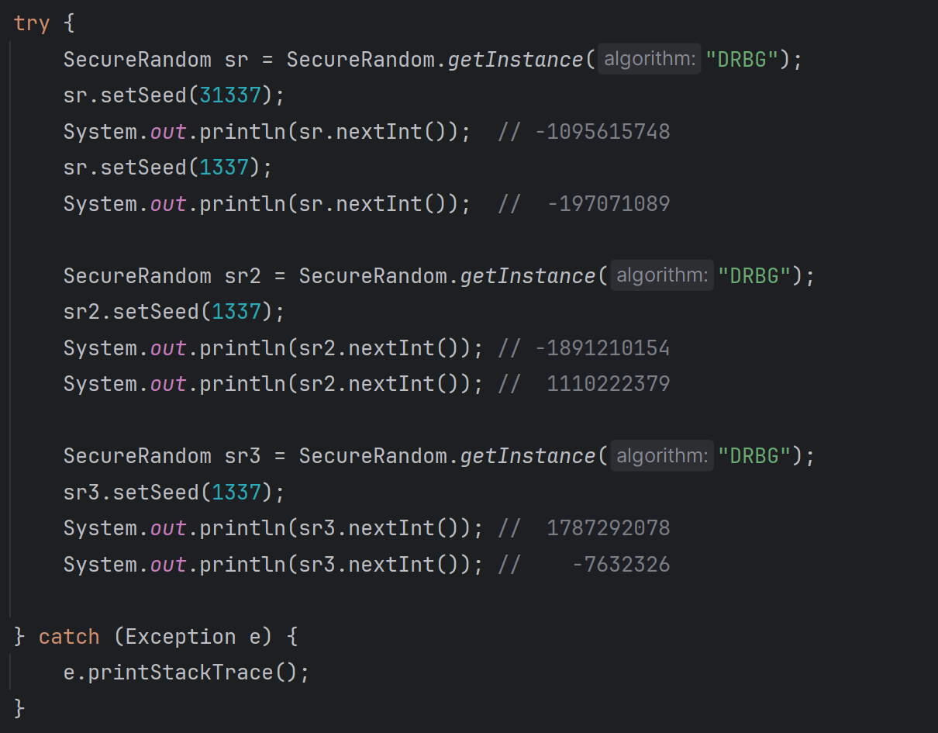
RNGs Example (3) – Different instances, different values

Slide 30
Symmetric Ciphers
Symmetric ciphers are ciphers in which the keys to encrypt and decrypt data are identical, similar, or easily computable the one from the other.
The participants must preemptively agree on the key.
Two types of symmetric ciphers exist:
Block ciphers.
Stream ciphers.

Slide 31
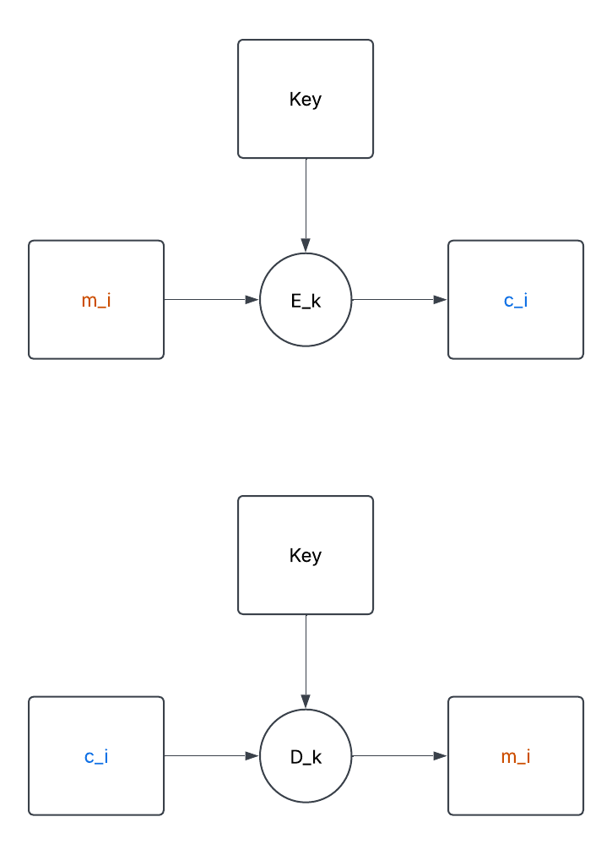
Block Ciphers
In block ciphers the message is subdivided into blocks of n bits. A transformation is then applied to each block both when encrypting and when decrypting.
Allows for different transformations (mode of operations):
Electronic Codebook – ECB (few cases only).
Cipher Block Chaining – CBC.
Output Feedback – OFB.
Cipher Feedback – CFB.
Counter – CTR.
Galois-Counter Mode – GCM (if you need black-box approach, always use this one*).
Counter with CBC-MAC Mode – CCM.
*pay attention to slide Disclaimer later.

Slide 32
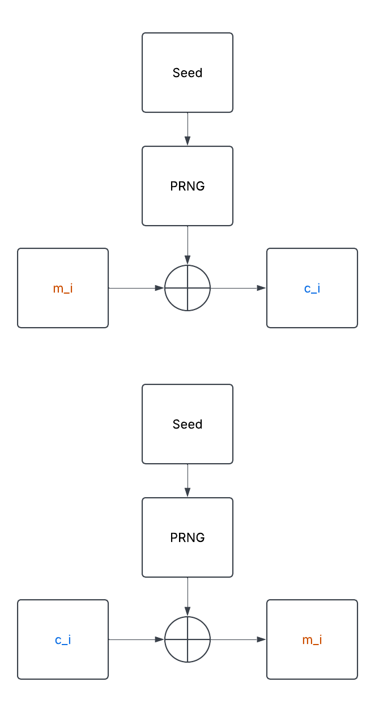
Stream Ciphers
Stream ciphers leverage the XOR operation between plaintext bits and random bits obtained from PRNGs to produce ciphertext.
Two types of Stream Ciphers exist:
Synchronous Stream Ciphers only depend on the keystream. (image on the side is a simplification of a Synchronous Stream cipher).
Self-Synchronizing Stream Ciphers depend on both the anteceding ciphertext and the keystream.

Slide 33
Ciphers in Java (1) [7]
One can use either stream or block ciphers in java by leveraging the engine class Cipher.
An instance of Cipher is obtainable through once again through public static Cipher getInstance(String transformation); Cipher cipher = Cipher.getInstance(“AES”); // block Cipher cipher = Cipher.getInstance(“ChaCha20”); // stream
For block ciphers only, to specify the Mode of Operations and the padding algorithm, the input string can contain additional information: Cipher c = Cipher.getInstance(“AES/ECB/PKCS5Padding”);

Slide 34
Modes of Operations (1) [7]
Depending on the mode of operations, some additional information might be required:
ECB: no additional information.
CBC: requires an Initialization Vector.
OFB: requires an Initialization Vector.
CFB: requires an Initialization Vector.
CTR: requires an Initialization Vector and No padding.
CCM: not implemented in the standard library, we would need to add BouncyCastle dependency through maven or gradle, then add the provider via Security.addProvider(new BouncyCastleProvider());
GCM: requires an Initialization Vector, the MAC dimension, and No padding.

Slide 35
Disclaimer
Initialization Vector management is paramount to provide security.
For GCM, the cipher class should be re-initialized with a different IV every time we need to encrypt data with the same key [7]. Failure to do so allows forgery attacks.
For CCM, failure to re-initialize the IV compromises authentication of encrypted data.
For CTR, OFB, CFB, where the IV is essential to generate a keystream, failure to re-initialize the IV compromises the privacy, allowing an easier retrieval of the plaintext.
In the following examples, we’ll supply a fixed-seed PRNG to always be able to compute the same data and produce the same results. In real life scenarios, other than re-initializing the cipher class for correct IV and nonce management, always make sure the PRNG never ever produces the same data. Do not set a fixed seed.

Slide 36
Modes of Operations (2) [7]
DISCLAIMER: Make sure you read correctly the previous slide.
First, create a PRNG and fill a byte array: SecureRandom sr = SecureRandom.getInstance(“SHA1PRNG”); sr.setSeed(1337); byte[] iv = new byte[16]; sr.nextBytes(iv);
To provide an Initialization Vector: IvParameterSpec spec = new IvParameterSpec(iv);
For GCM specifically, we also need to provide the length in bit of the MAC*. int macLen = 128; GCMParameterSpec spec = new GCMParameterSpec(macLen, iv);
*We’ll be back on this in a bit.

Slide 37
Generating private keys (1)
Of course, to use ciphers, we need cryptographic key material. To generate keys, we need a KeyGenerator object.
With no one’s surprise, available via: public static KeyGenerator getInstance(String algorithm); KeyGenerator kg = KeyGenerator.getInstance(“AES”);
Initialize the object using: public void init(int keySize); kg.init(256);
Obtain a secret key: public SecretKey generateKey(); SecretKey sk = kg.generateKey();

Slide 38
Disclaimer
In the following examples, we will be using an overloaded method to initialize the KeyGenerator object:
public void init(int keySize, SecureRandom sr); SecureRandom sr = SecureRandom(“SHA1PRNG”); sr.setSeed(1337); kg.init(256, sr);
In the following examples, we’ll supply a fixed-seed PRNG to always be able to compute the same data and produce the same results. In real life scenarios, when generating keys, always make sure the PRNG never ever produces the same data. Do not use PRNGs with a fixed set seed.

Slide 39
Ciphers in Java (2) [7]
Once we have set up all the necessary parameters, we can initialize the Cipher class: ECB: public final void init(int opmode, Key secretKey); Others: public final void init(int opmode, Key secretKey, AlgorithmParameterSpec spec);
cipher.init(Cipher.ENCRYPT_MODE, sk, spec); cipher.init(Cipher.DECRYPT_MODE, sk, spec);
In the signature of the init method, AlgorithmParameterSpec is a superclass of both IVParameterSpec, and GCMParameterSpec.
Depending on the mode of operation, every time we need to update the IV, we need to create new specs and re-call the init method.

Slide 40
Ciphers in Java (3) [7]
Finally, when the cipher object has been initialized, we can start encrypting or decrypting.
For one-shot encryption/decryption we use: public final byte[] doFinal(byte[] input);
For multi-part encryption/decryption, assuming we have n parts*: public final byte[] update(byte[] input); // for n-1 parts public final byte[] doFinal(byte[] input);// for last part
Do not use the overloaded method public void doFinal(); This method is not fully interoperable between modes of operations.
*Update returns a byte[] for compatibility with stream ciphers. Results before calling doFinal might not be consistent (or might be null).

Slide 41
AEAD
The GCM and CCM operating modes belong to the category of Authenticated Encryption with Additional Data ciphers (AEAD) as they both leverage a MAC to grant integrity. These ciphers not only grant the authenticity of the ciphertext, but also of some additional plaintext data.
GCM is encrypt-then-mac (integrity of the ciphertext).
CCM is mac-then-encrypt (integrity of the plaintext). Chosen for historical reasons, decrypting and verifying via MtE can cause a wide range of attacks. Still used in IoT.
Due to how the class Cipher calls engine methods, there is a strict limitation on the expressiveness of the doFinal() overloaded method in representing AEAD modes. Do not call the overloaded variant with no arguments.

Slide 42
AEAD in Java
There is no standard CCM implementation for Java.
About GCM, it handles every aspect of the authentication transparently. The only distinction with other operating modes is the parameterSpec passed to the init function.
To authenticate additional (non-encrypted) data, we can use the following function: public final void updateAAD(byte[] src);
Of course, this function must be called both when encrypting, and decrypting, in the same order.

Slide 43
Stream Ciphers
To employ stream ciphers like ChaCha20 we must supply additional parameters exactly as we did for modes of operations.
ChaCha20, for example, must be supplied with a nonce and a counter variable. byte[] nonce = new byte[12]; sr.nextBytes(nonce); int counter = sr.nextInt(); ChaCha20ParameterSpec spec = new ChaCha20ParameterSpec(nonce, counter);
Additionally, to fully enable the capabilities of stream ciphers it’s possible to wrap them into CipherInputStream and CipherOutputStream objects.

Slide 44
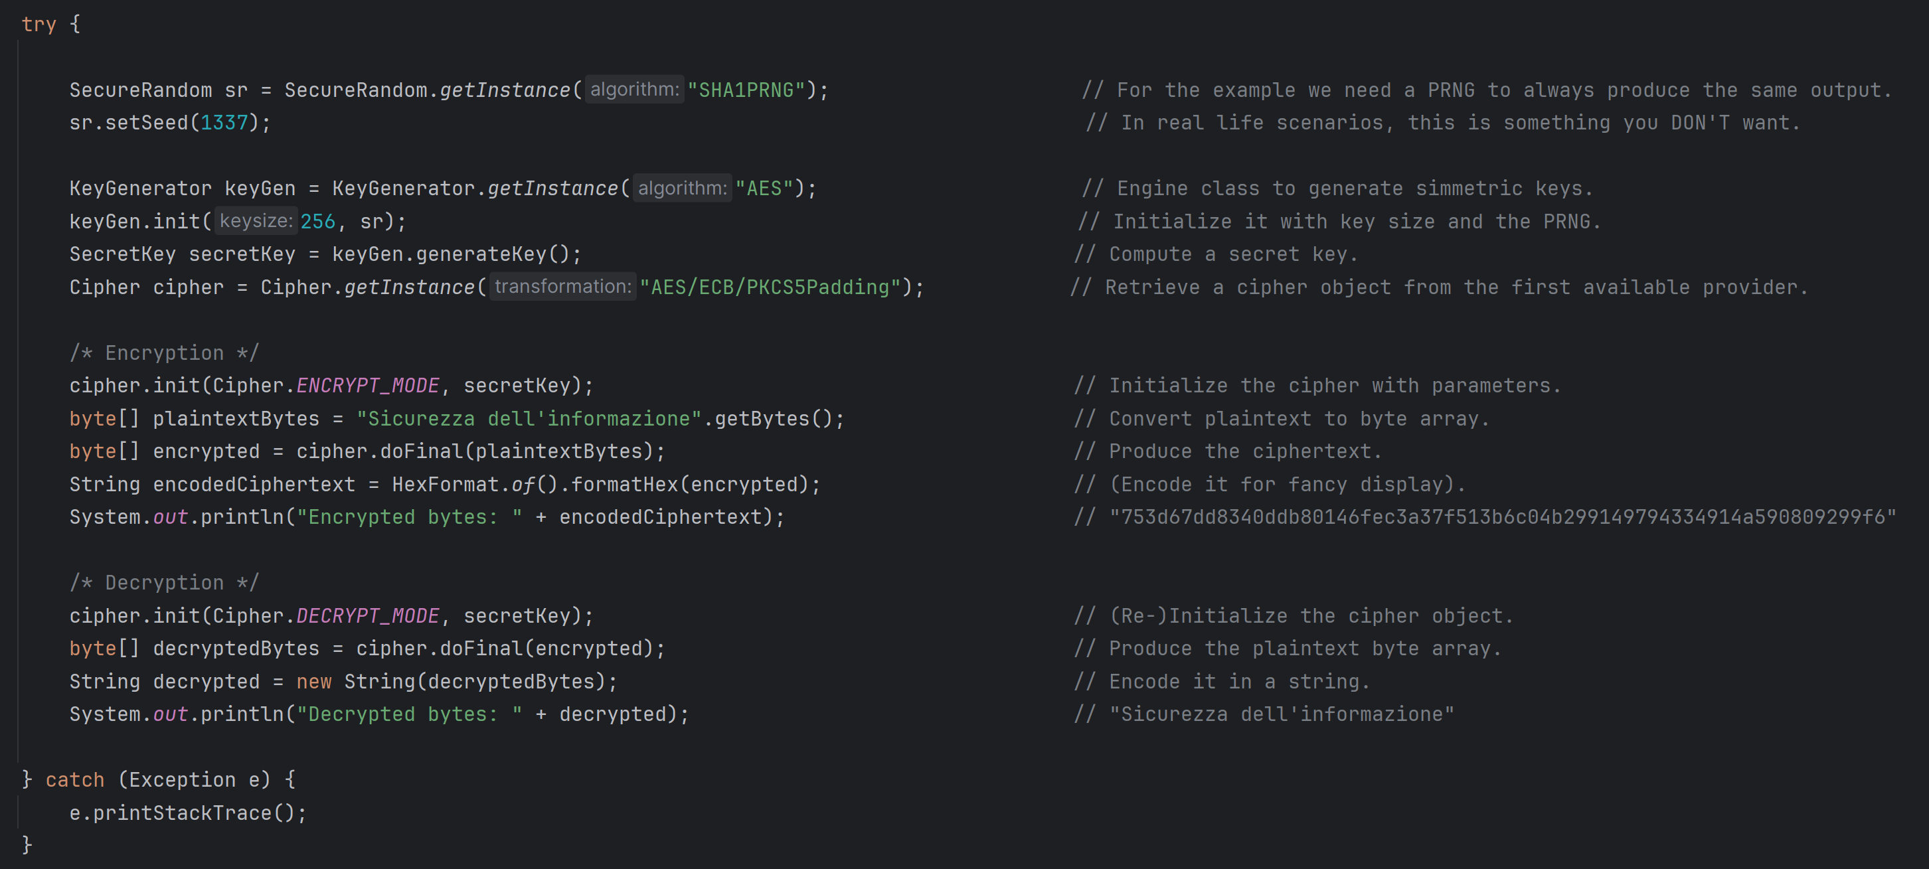
Ciphers Example (1) – Block Ciphers, ECB

Slide 45
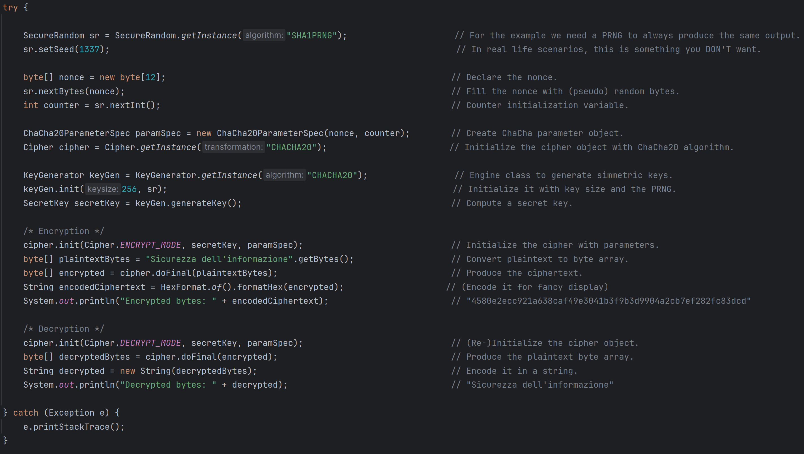
Ciphers Example (2) – Stream Ciphers, ChaCha20

Slide 46
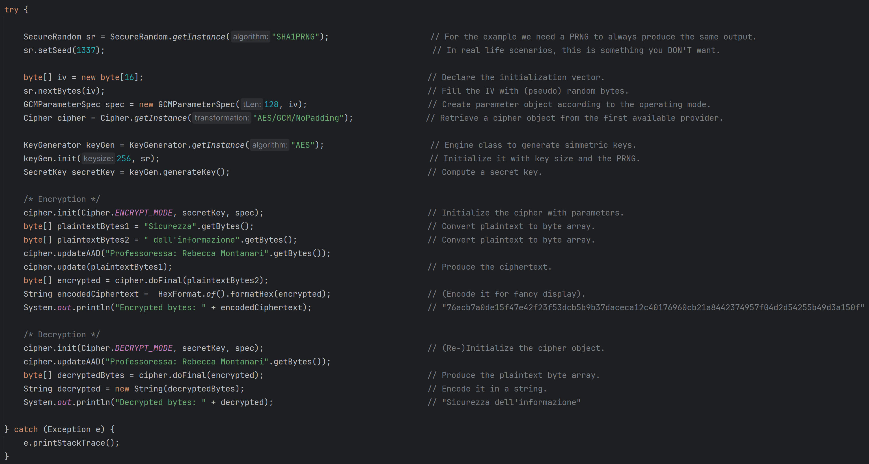
Ciphers Example (3) – AEAD

Slide 48
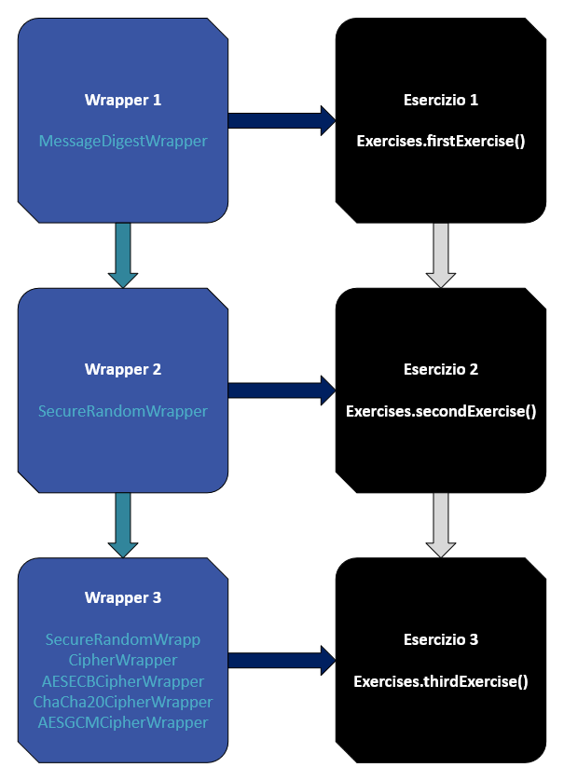

Slide 49
https://github.com/alebldn/Esercitazione2603

Slide 50
Bibliografia
[1]: Introduction to Java - https://www.oracle.com/java/technologies/introduction-to-java.html
[2]: Java Security Overview - https://docs.oracle.com/en/java/javase/23/security/java-security-overview1.html
[3]: Java Cryptograpy Architecture - https://docs.oracle.com/en/java/javase/23/security/java-cryptography-architecture-jca-reference-guide.html
[4]: MessageDigest - https://docs.oracle.com/en/java/javase/23/docs/api/java.base/java/security/MessageDigest.html
[5]: SecureRandom - https://docs.oracle.com/en/java/javase/23/docs/api/java.base/java/security/SecureRandom.html
[6]: SecureRandom implementations - https://docs.oracle.com/en/java/javase/11/security/oracle-providers.html#GUID-9DC4ADD5-6D01-4B2E-9E85-B88E3BEE7453
[7]: Cipher - https://docs.oracle.com/en/java/javase/23/docs/api/java.base/javax/crypto/Cipher.html
[8]: StreamCipher code variation- https://docs.oracle.com/en/java/javase/23/security/java-cryptography-architecture-jca-reference-guide.html#GUID-C0283BC0-8B88-480D-82B1-7B01EAC3D8DF

Slide 51
Alessandro Buldini
alessandro.buldini@unibo.it

