Slide 1

Unicycle project

Slide 2
TRAJECTORY TRACKING - OUTPUT ERROR FEEDBACK

Slide 3



Feedback linearization based on a reference point on the sagittal axis

Slide 4
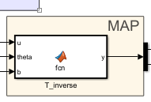
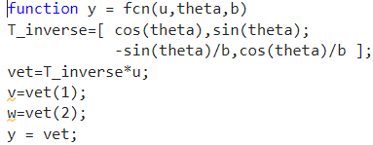


Map

Slide 5
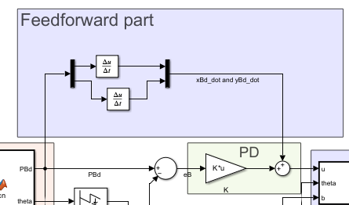

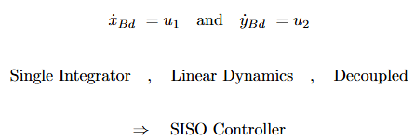
Controller design
Pro:

Slide 6
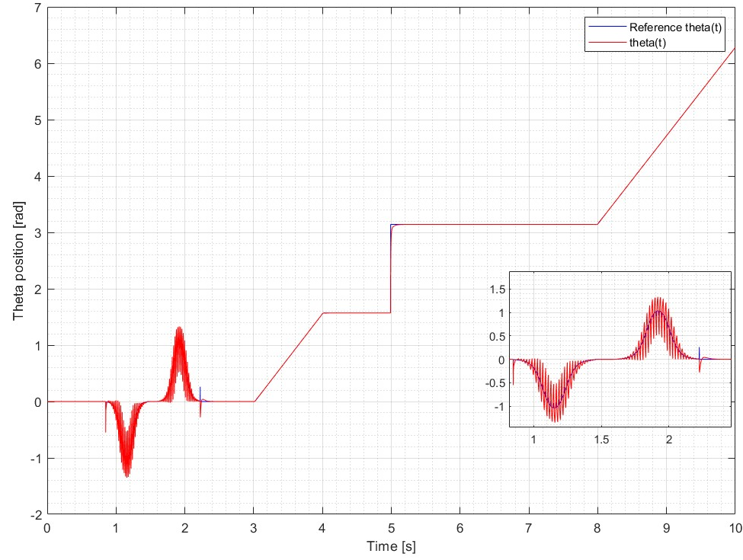

Plot

Slide 7



Feedback linearization based on second order derivatives

Slide 8
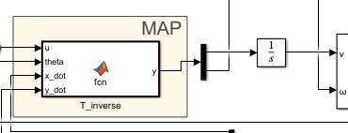
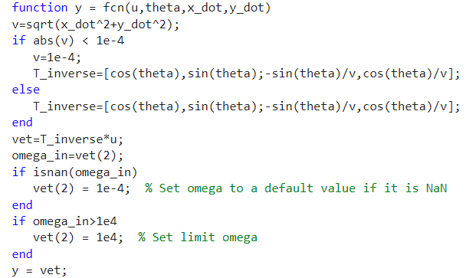


Map

Slide 9
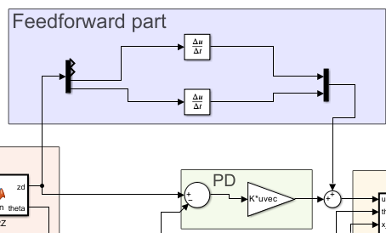


Controller design
Need:

Slide 10
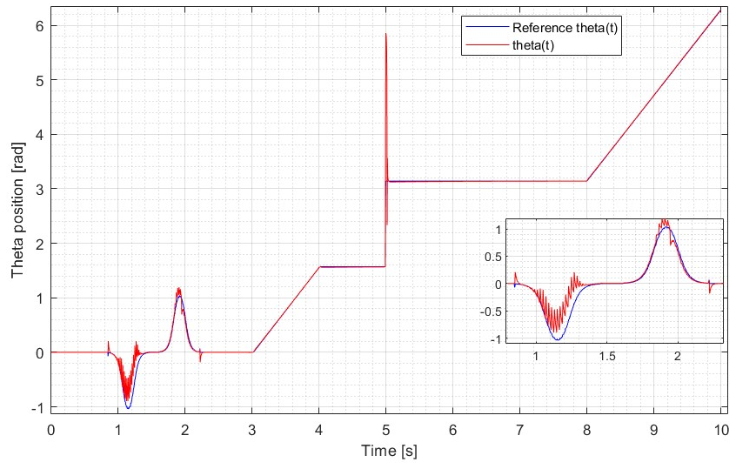
Plot

Slide 11
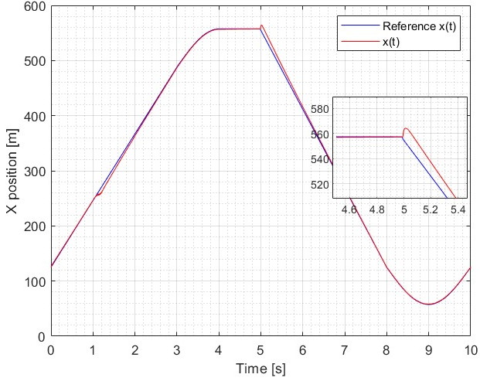
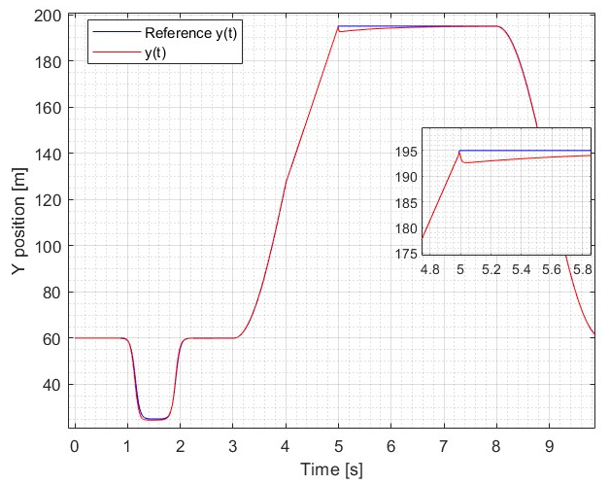
Plot

Slide 12
REGULATION

Slide 13


Cartesian regulation

Slide 14

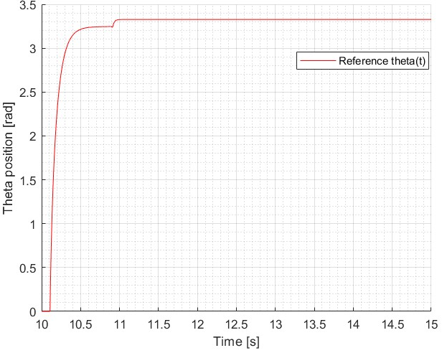

Control law

Slide 15


Pose regulation

Slide 16
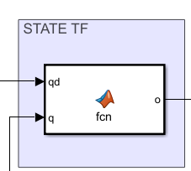
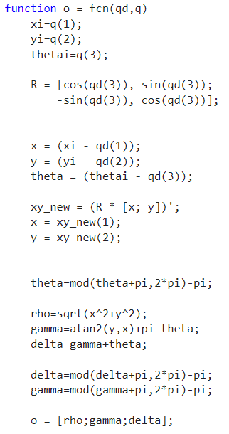
State trasformation

Slide 17
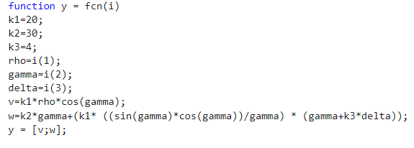
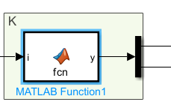
Control law

