Slide 1

Introduction: the "urban mobility challenge"
Problem: An autonomous guided vehicle (AGV) has to travel along a closed circuit avoiding the other AGVs that are parked along the path; at the completion of one lap, the AGV has to get off the circuit and park at the box
PROJECT OBJECTIVES:
Track a closed trajectory
Avoid obstacles on the trajectory
After performing one lap, reach an empty parking lot

Slide 2
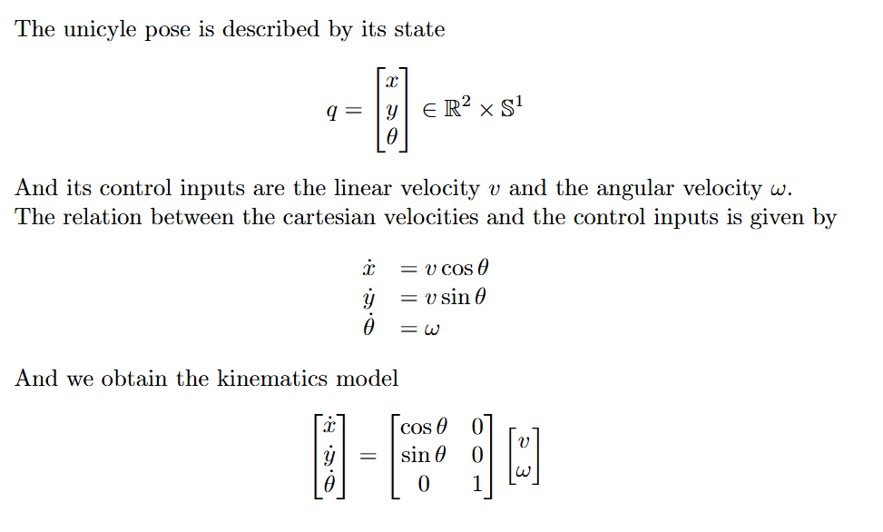
Framework: unicycle
θ
y
The AGV used in the project is a unicycle, a planar vehicle which is described by its state
x

Slide 3
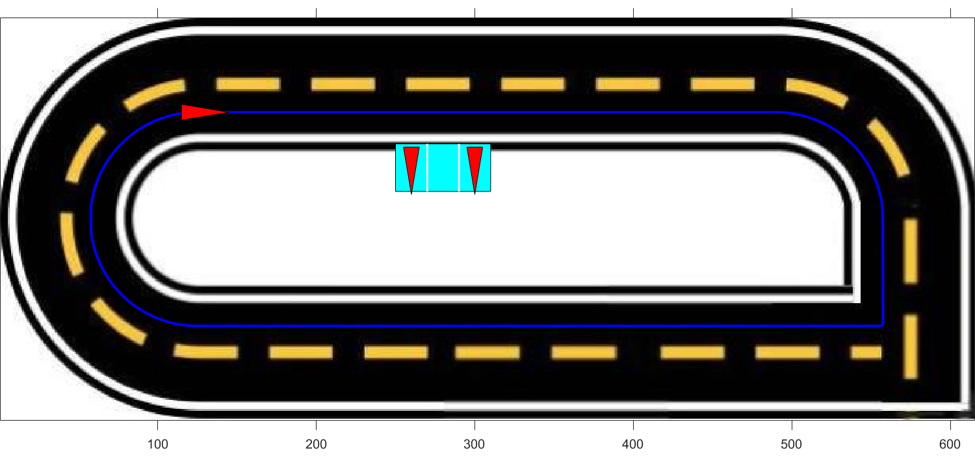
Framework: trajectory
To design the desired trajectory, a series of waypoints was defined. These waypoints were then interpolated using cubic spline interpolation to ensure a continuous path
To test controllers' functionalities on a non-continuous path, a sharp square-angle turn is added to the path

Slide 4
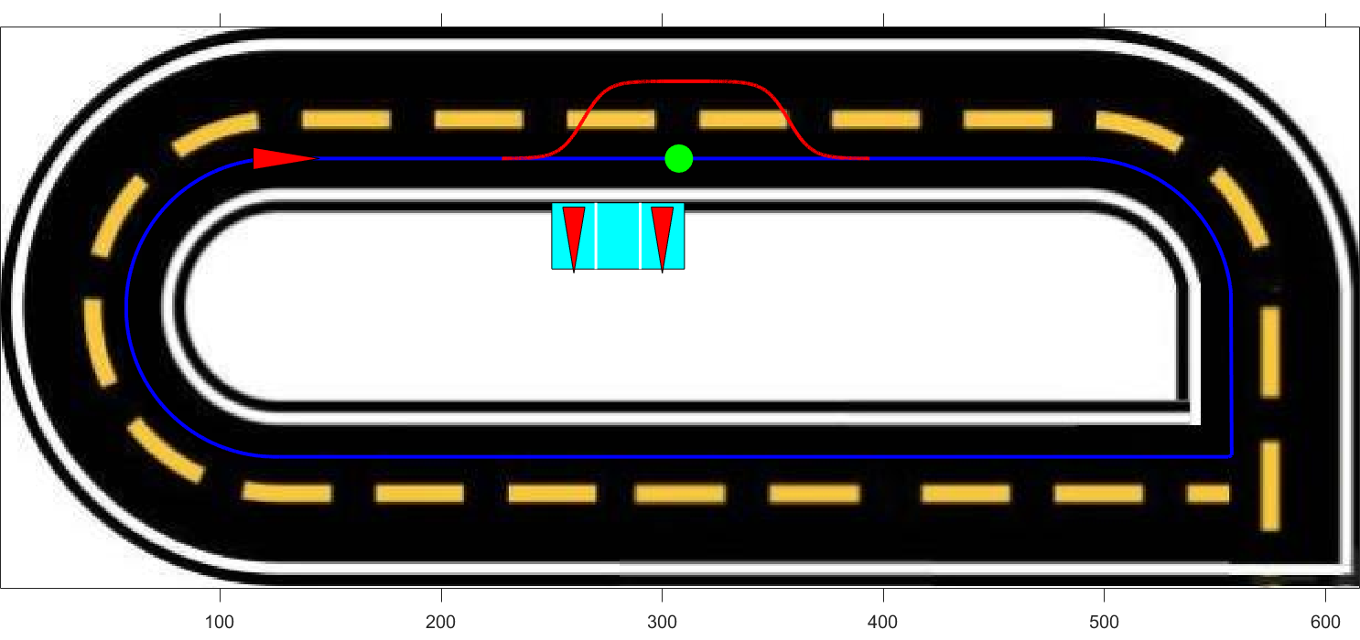
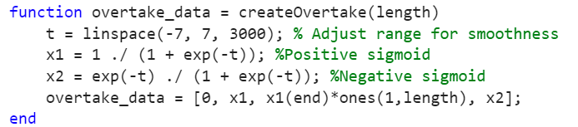
Obstacle avoidance
The unicyle after detecting the obstacle progressively reaches the second lane, after overtaking the obstacle it progressively returns to the first lane
To ensure a smooth and continuous trajectory during the changing lane procedure a sigmoid function has been used

Slide 5
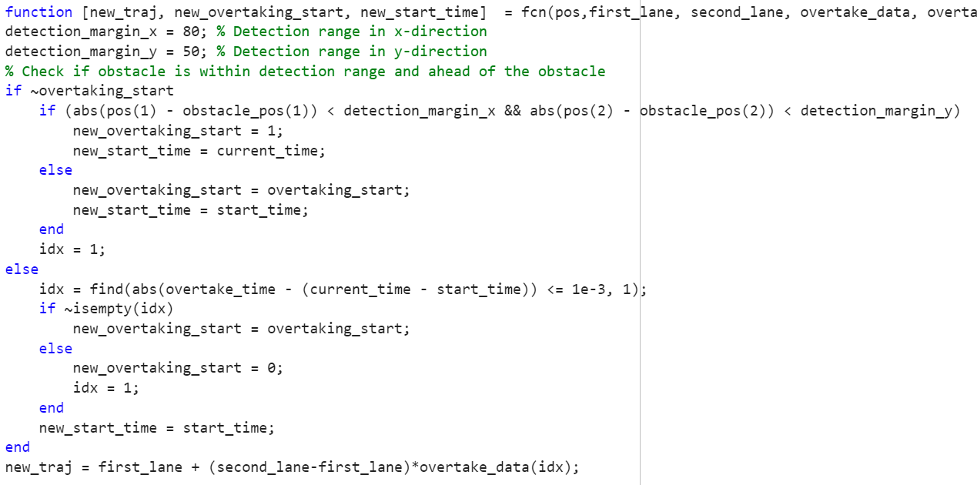
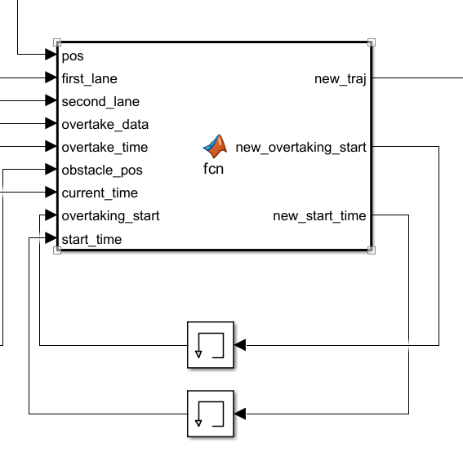
Obstacle avoidance

Slide 6
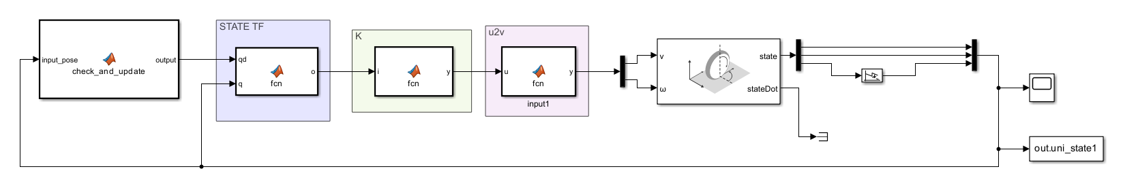

Pose regulation with change of input
To prevent the singularity on roh we perform a change of input u = v/roh

Slide 7
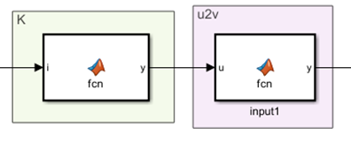
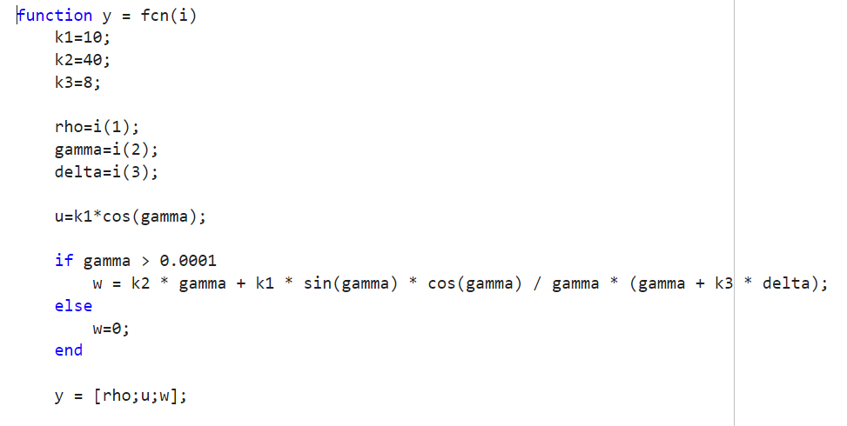
Control law
V = u*roh

Slide 8
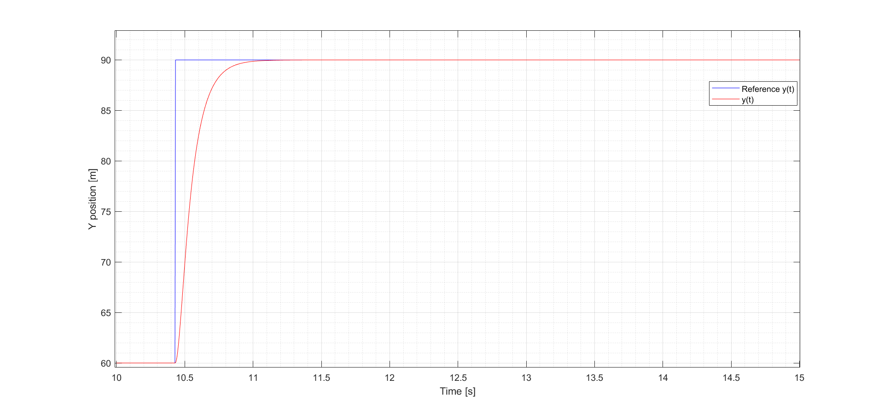
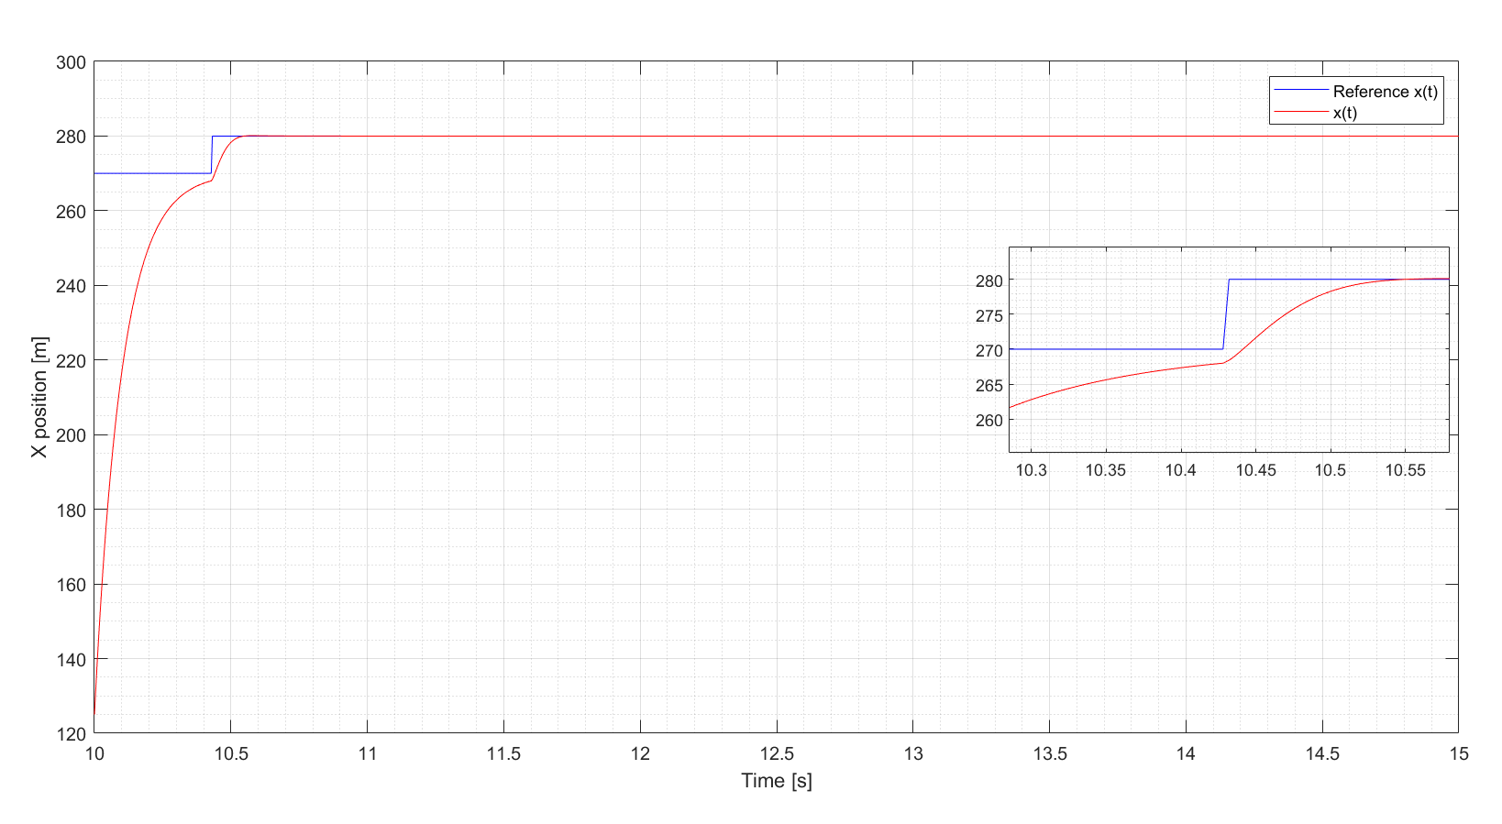
Plot
Final position in 0.5 s

Slide 9
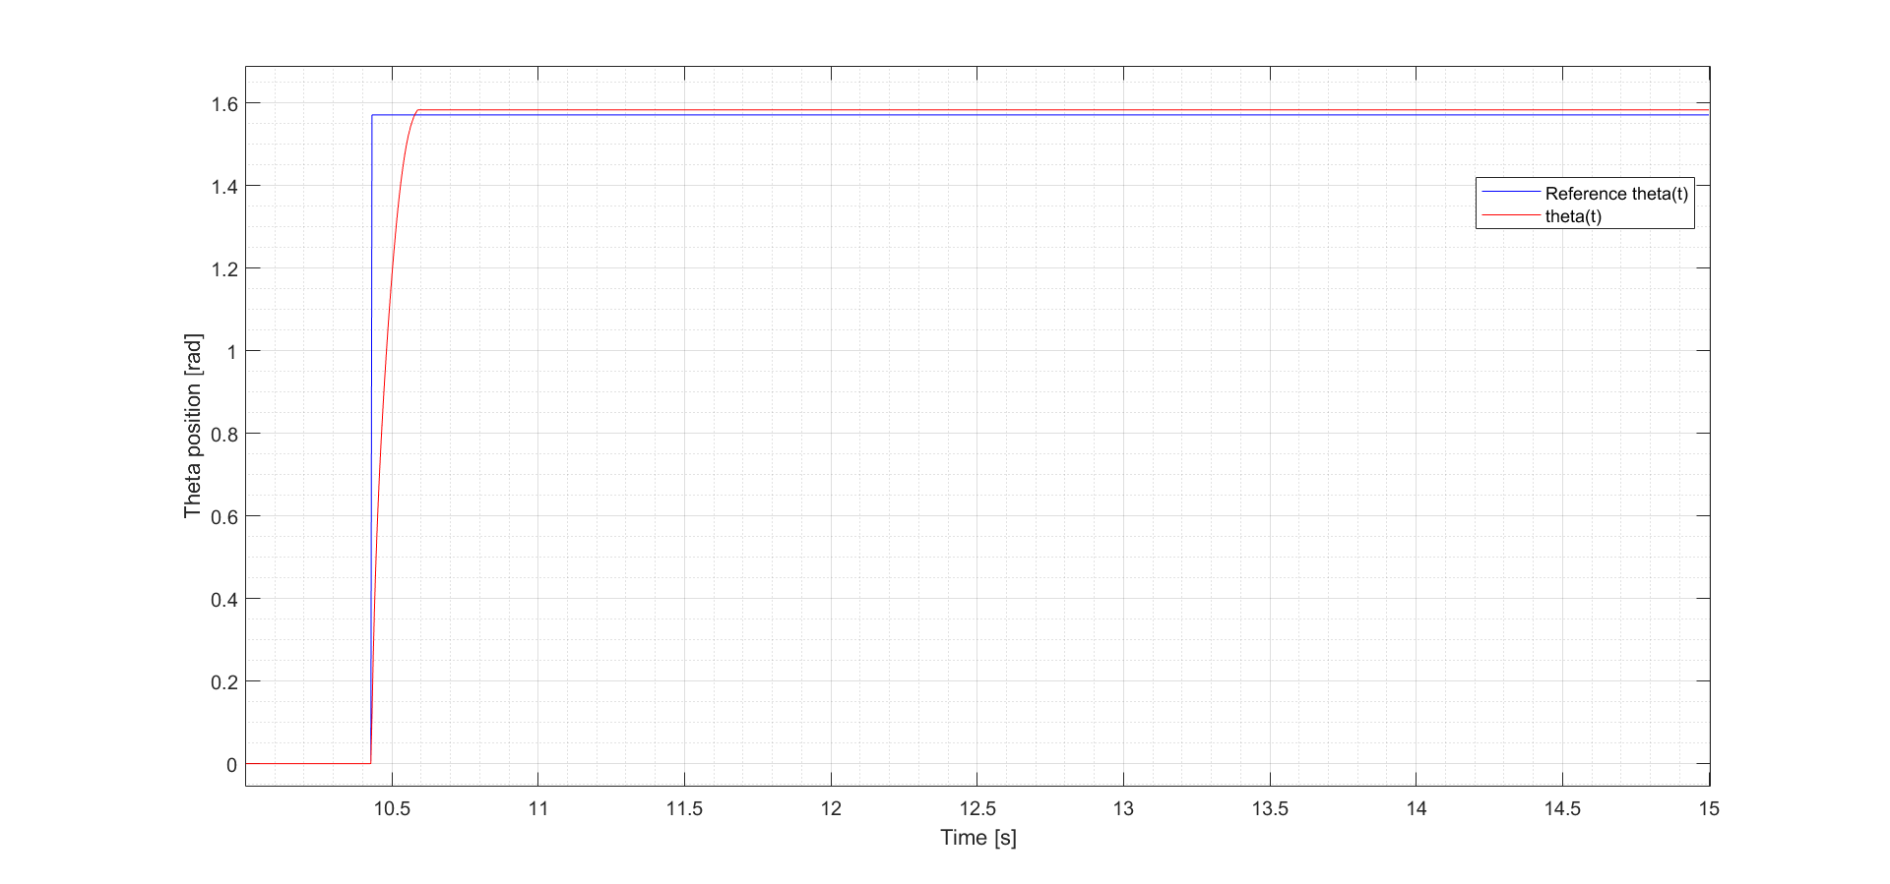
Plot

