Slide 1

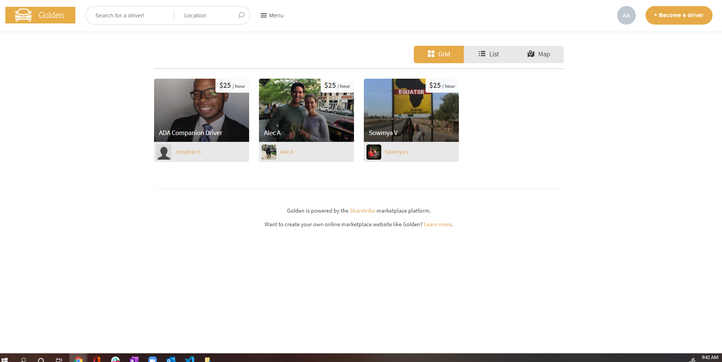










Home page
Notes:
Identification of logged in user/what that part of the page would look like for non-logged in user
Ability to become a driver
Search for a driver by name
Search for a driver by location
Available drivers are served up to you
This is where I would imagine a button to click on ride history that would display a similar page, but listing out your ride history

Slide 2
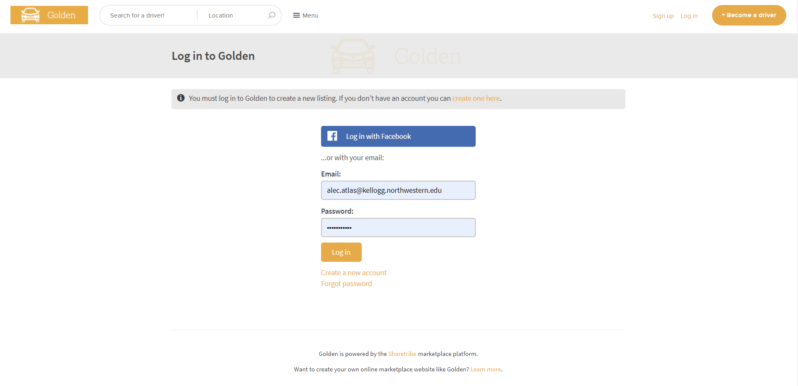
Log-in page

Slide 3
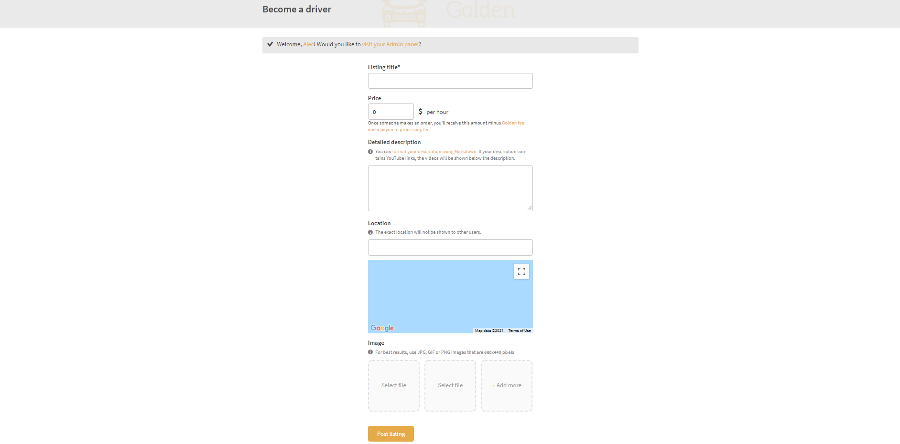
Driver registration

