Slide 1

10
The Analysis of Variance
Copyright © Cengage Learning. All rights reserved.

Slide 2
10.1
Single-Factor ANOVA
Copyright © Cengage Learning. All rights reserved.

Slide 3
Single-Factor ANOVA
Single-factor ANOVA focuses on a comparison of more than two population or treatment means. Let
l = the number of populations or treatments being compared
μ₁ = the mean of population 1 or the true average response when treatment 1 is applied
.
.
.
μ_{I} = the mean of population I or the true average response when treatment I is applied

Slide 4
Single-Factor ANOVA
The relevant hypotheses are
H₀: μ₁ = μ₂ = ··· = μ_{I}
versus
H_{a}: at least two the of the μ_{i}’s are different
If I = 4, H₀ is true only if all four μ_{i}’s are identical. H_{a} would be true, for example, if μ₁ = μ₂ ≠ μ₃ = μ₄, if μ₁ = μ₃ = μ₄ ≠ μ₂, or if all four μ_{i}’s differ from one another.

Slide 5
Single-Factor ANOVA
A test of these hypotheses requires that we have available a random sample from each population or treatment.

Slide 6
Example 10.1
The article “Compression of Single-Wall Corrugated Shipping Containers Using Fixed and Floating Test Platens” (J. Testing and Evaluation, 1992: 318–320) describes an experiment in which several different types of boxes were compared with respect to compression strength (lb).

Slide 7
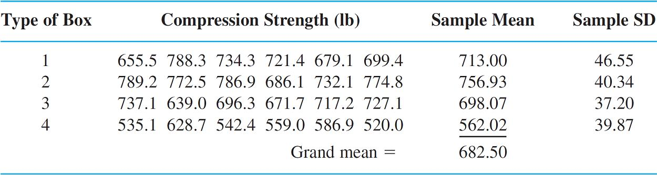
Example 10.1
cont’d
Table 10.1 presents the results of a singlefactor ANOVA experiment involving I = 4 types of boxes (the sample means and standard deviations are in good agreement with values given in the article).
The Data and Summary Quantities for Example 1
Table 10.1

Slide 8
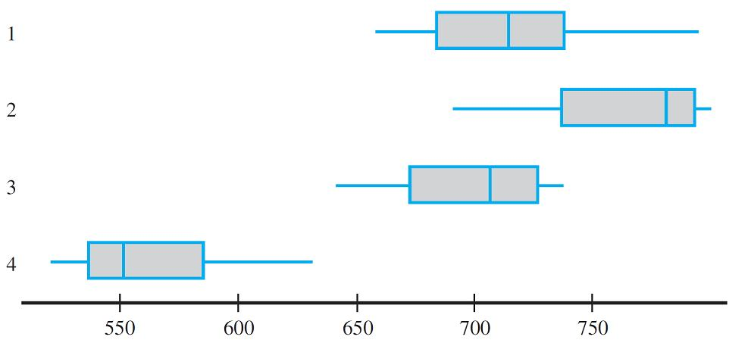
Example 10.1
cont’d
With μ_{i} denoting the true average compression strength for boxes of type i(i = 1, 2, 3, 4), the null hypothesis is H₀: μ₁ = μ₂ = μ₃ = μ₄. Figure 10.1(a) shows a comparative boxplot for the four samples.
Boxplots for Example 1: (a) original data;
Figure 10.1(a)

Slide 9
Example 10.1
cont’d
There is a substantial amount of overlap among observations on the first three types of boxes, but compression strengths for the fourth type appear considerably smaller than for the other types.
This suggests that H₀ is not true.

Slide 10
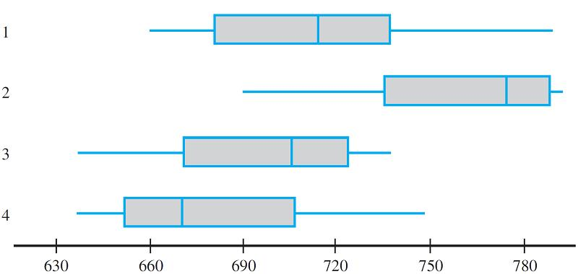
Example 10.1
cont’d
The comparative boxplot in Figure 10.1(b) is based on adding 120 to each observation in the fourth sample (giving mean 682.02 and the same standard deviation) and leaving the other observations unaltered. It is no longer obvious whether H₀ is true or false. In situations such as this, we need a formal test procedure.
Boxplots for Example 1: (b) altered data
Figure 10.1

Slide 11
Notation and Assumptions

Slide 12
Notation and Assumptions
The letters X and Y were used in two-sample problems to differentiate the observations in one sample from those in the other.
Because this is cumbersome for three or more samples, it is customary to use a single letter with two subscripts.
The first subscript identifies the sample number, corresponding to the population or treatment being sampled, and the second subscript denotes the position of the observation within that sample.

Slide 13
Notation and Assumptions
Let
x_{i, j} = the random variable (rv) that denotes the jth measurement taken from the ith population, or the measurement taken on the jth experimental unit that receives the ith treatment
x_{i, j} = the observed value of x_{i, j} when the experiment is performed

Slide 14
Notation and Assumptions
The observed data is usually displayed in a rectangular table, such as Table 10.1.
There samples from the different populations appear in different rows of the table, and x_{i, j} is the jth number in the ith row.
For example, x_{2,3} = 786.9(the third observation from the second population), and x_{4,1} = 535.1.

Slide 15
Notation and Assumptions
When there is no ambiguity, we will write x_{ij} rather than x_{i, j} (e.g., if there were 15 observations on each of 12 treatments, x₁₁₂ could mean x_{1,12} or x_{11,2} ).
It is assumed that x_{ij}’s within any particular sample are independent—a random sample from the ith population or treatment distribution—and that different samples are independent of one another.
In some experiments, different samples contain different numbers of observations.

Slide 16
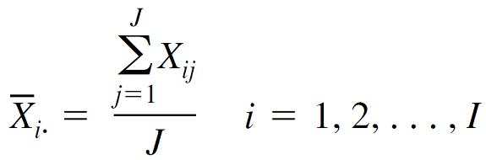
Notation and Assumptions
Here we’ll focus on the case of equal sample sizes;
Let J denote the number of observations in each sample (J = 6 in Example 10.1). The data set consists of IJ observations.
The individual sample means will be denoted by X_{1}, X_{2}, . . ., X_{I}.
That is,

Slide 17
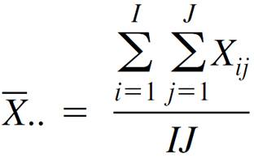
Notation and Assumptions
The dot in place of the second subscript signifies that we have added over all values of that subscript while holding the other subscript value fixed, and the horizontal bar indicates division by J to obtain an average.
Similarly, the average of all IJ observations, called the grand mean, is

Slide 18

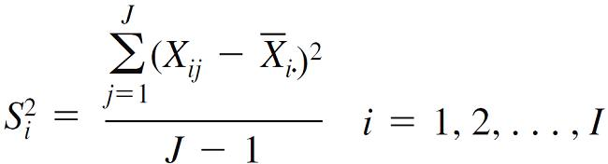
Notation and Assumptions
For the data in Table 10.1, x_{1} = 713.00, x_{2} = 756.93, x_{3} = 698.07, x_{4} = 562.02, and x = 682.50.
Additionally, let , denote the sample variances:
From Example 10.1, s₁ = 46.55, = 2166.90, and so on.

Slide 19
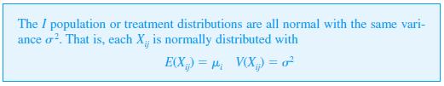
Notation and Assumptions
Assumptions
The I sample standard deviations will generally differ somewhat even when the corresponding σ’s are identical.

Slide 20
Notation and Assumptions
In Example 10.1, the largest among s₁, s₂, s₃, and s₄ is about 1.25 times the smallest.
A rough rule of thumb is that if the largest s is not much more than two times the smallest, it is reasonable to assume equal σ ²’s.
In previous chapters, a normal probability plot was suggested for checking normality. The individual sample sizes in ANOVA are typically too small for I separate plots to be informative.

Slide 21
Notation and Assumptions
A single plot can be constructed by subtracting x_{1} from each observation in the first sample, x_{2} from each observation in the second, and so on, and then plotting these IJ deviations against the z percentiles.

Slide 22
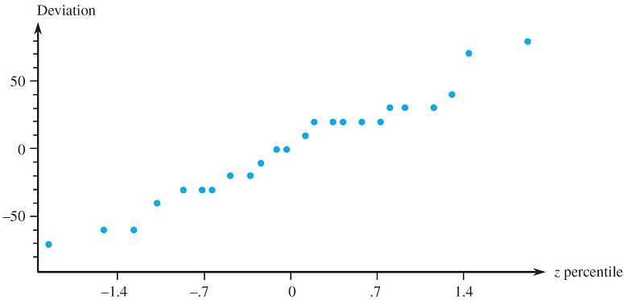
Notation and Assumptions
Figure 10.2 gives such a plot for the data of Example 10.1. The straightness of the pattern gives strong support to the normality assumption.
A normal probability plot based on the data of Example 1
Figure 10.2

Slide 23
Notation and Assumptions
If either the normality assumption or the assumption of equal variances is judged implausible, a method of analysis other than the usual F test must be employed.

Slide 24
The Test Statistic

Slide 25
The Test Statistic
If H₀ is true, the J observations in each sample come from a normal population distribution with the same mean value μ, in which case the sample means x_{1}, . . ., x_{I} should be reasonably close to one another.
The test procedure is based on comparing a measure of differences among the x_{i}’s (“between-samples” variation) to a measure of variation calculated from within each of the samples.

Slide 26
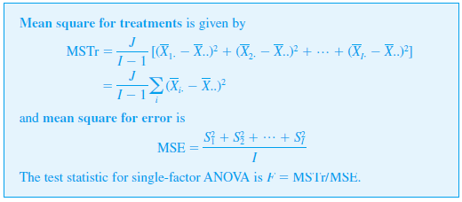
The Test Statistic
Definition

Slide 27
The Test Statistic
The terminology “mean square” will be explained shortly. Notice that uppercase X’s and S²’s are used, so MSTr and MSE are defined as statistics.
We will follow tradition and also use MSTr and MSE (rather than mstr and mse) to denote the calculated values of these statistics.
Each assesses variation within a particular sample, so MSE is a measure of within-samples variation.

Slide 28
The Test Statistic
What kind of value of F provides evidence for or against H₀? If H₀ is true (all μ_{i}’s are equal), the values of the individual sample means should be close to one another and therefore close to the grand mean, resulting in a relatively small value of MSTr.
However, if the μ_{i}’s are quite different, some x_{i}’s should differ quite a bit from x.
So the value of MSTr is affected by the status of H₀ (true or false).

Slide 29

The Test Statistic
This is not the case with MSE, because the depend only on the underlying value of σ² and not on where the various distributions are centered.
The following box presents an important property of E(MSTr) and E(MSE), the expected values of these two statistics.

Slide 30
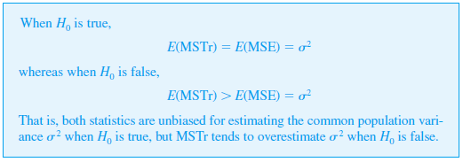
The Test Statistic
Proposition

Slide 31
The Test Statistic
The unbiasedness of MSE is a consequence of whether H₀ is true or false. When H₀ is true, each X_{i} has the same mean value μ and variance σ²/J, so the “sample variance” of the estimates σ²/J unbiasedly; multiplying this by J gives MSTr as an unbiased estimator of σ² itself.
The tend to spread out more when H₀ is false than when it is true, tending to inflate the value of MSTr in this case.

Slide 32

The Test Statistic
Thus a value of F that greatly exceeds 1, corresponding to an MSTr much larger than MSE, casts considerable doubt on H₀.
Determination of the P-value requires that the distribution of F when $H_{0}$is true be known.

Slide 33
F Distributions and the F Test

Slide 34
F Distributions and the F Test
An F distribution arises in connection with a ratio in which there is one number of degrees of freedom (df) associated with the numerator and another number of degrees of freedom associated with the denominator.
Let v₁ and v₂ denote the number of numerator and denominator degrees of freedom, respectively, for a variable with an F distribution.

Slide 35
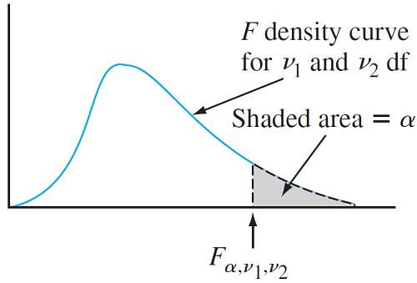
F Distributions and the F Test
Both v₁ and v₂ are positive integers. Figure 10.3 pictures an F density curve and the corresponding upper-tail critical value Appendix Table A.9 gives these critical values for α = .10, .05, .01, and .001.
Values of v₁ are identified with different columns of the table, and the rows are labeled with various values of v₂.
An F density curve and critical value
Figure 10.3

Slide 36
F Distributions and the F Test
For example, the F critical value that captures upper-tail area .05 under the F curve with v₁ = 4 and v₂ = 6 is F_{.05,4,6} = 4.53, whereas F_{.05,6,4} = 6.16.
The key theoretical result is that the test statistic F has an F distribution when H₀ is true.

Slide 37
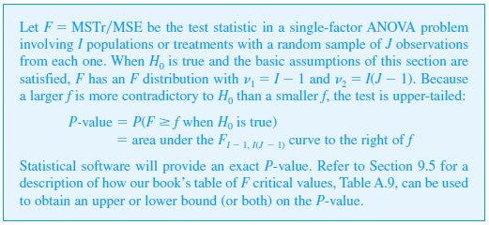
F Distributions and the F Test
Theorem

Slide 38
F Distributions and the F Test
The rationale for v₁ = I – 1 is that although MSTr is based on the I deviations X_{1} – X, . . ., X_{1} – X Σ(X_{1} – X) = 0, so only I – 1 of these are freely determined.
Because each sample contributes J – 1 df to MSE and these samples are independent,
v₂ = (J – 1) + · · · + (J – 1) = I(J – 1).

Slide 39
Example 10.2
Example 10.1 continued…
The values of I and J for the strength data are 4 and 6, respectively, so numerator df = I – 1 = 3 and denominator df = I(J – 1) = 20.
At significance level .05, H₀: μ₁ = μ₂ = μ₃ = μ₄ will be rejected in favor of the conclusion that at least two μ_{i}’s are different if f ≥ F_{.05,3,20} = 3.10.

Slide 40
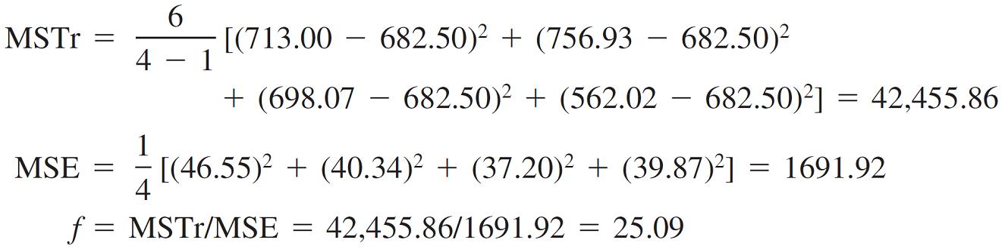
Example 10.2
cont’d
The grand mean is x = Σ Σ x_{ij} /(IJ) = 682.50,
MSTr = [(713.00 – 682.50)² + (756.93 – 682.50)²
+ (698.07 – 682.50)² + (562.02 – 682.50)²
= 42,455.86
MSE = [(46.55)² + (40.34)² + (37.20)² + (39.87)²]
= 1691.92

Slide 41
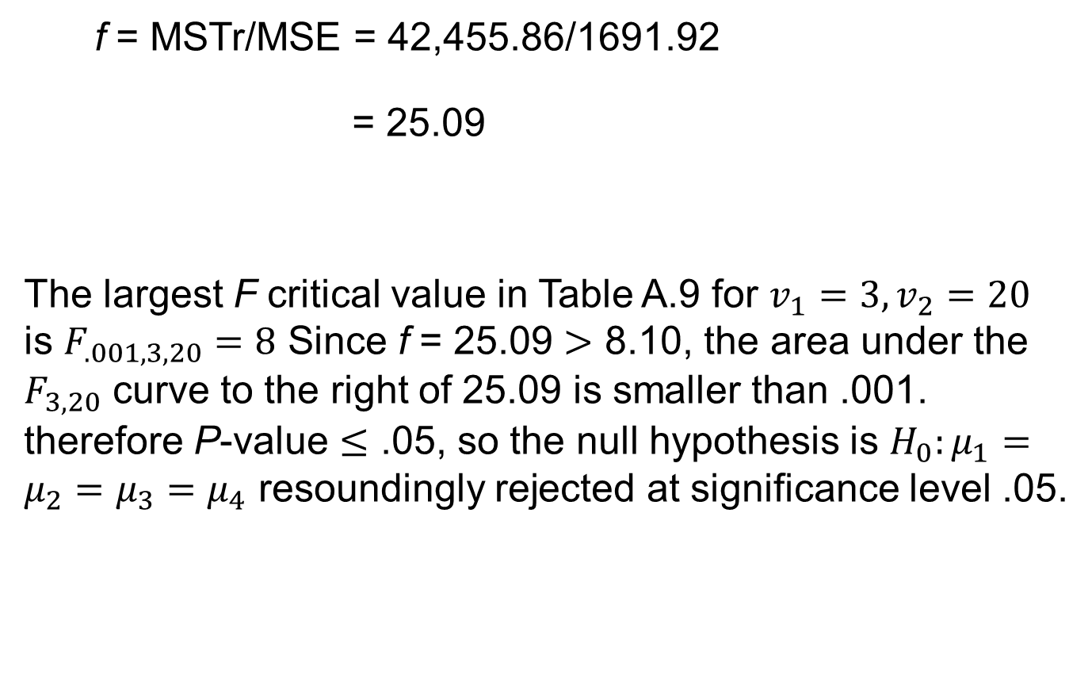
Example 10.2
cont’d
f = MSTr/MSE = 42,455.86/1691.92
= 25.09
The largest F critical value in Table A.9 for $v_{1}=3,v_{2}=20$ is $F_{.001,3,20}=8$ Since f = 25.09 $>$ 8.10, the area under the $F_{3,20}$ curve to the right of 25.09 is smaller than .001. therefore P-value $≤$ .05, so the null hypothesis is $H_{0}:μ_{1}=μ_{2}=μ_{3}=μ_{4}$ resoundingly rejected at significance level .05.

Slide 42

Example 10.2
True average compression strength does appear to depend on box type. In fact, because the P-value is so small $H_{0}$ could be rejected at any reasonable significance level.

Slide 43
Sums of Squares

Slide 44
Sums of Squares
The introduction of sums of squares facilitates developing an intuitive appreciation for the rationale underlying single-factor and multifactor ANOVAs.
Let x_{i} represent the sum (not the average, since there is no bar) of the x_{ij}’s for i fixed (sum of the numbers in the ith row of the table) and x denote the sum of all the x_{ij}’s (the grand total).

Slide 45
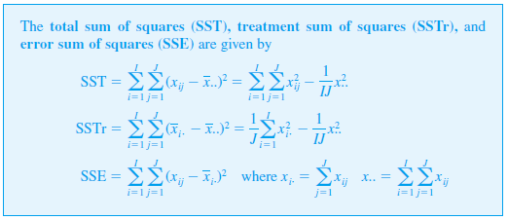
Sums of Squares
Definition

Slide 46
Sums of Squares
The sum of squares SSTr appears in the numerator of F, and SSE appears in the denominator of F; the reason for defining SST will be apparent shortly.
The expressions on the far right-hand side of SST and SSTr are convenient if ANOVA calculations will be done by hand, although the wide availability of statistical software makes this unnecessary.

Slide 47
Sums of Squares
Both SST and SSTr involve (the square of the grand total divided by IJ), which is usually called the correction factor for the mean (CF).
After the correction factor is computed, SST is obtained by squaring each number in the data table, adding these squares together, and subtracting the correction factor.
SSTr results from squaring each row total, summing them, dividing by J, and subtracting the correction factor. SSE is then easily obtained by virtue of the following relationship.

Slide 48

Sums of Squares
Thus if any two of the sums of squares are computed, the third can be obtained through (10.1); SST and SSTr are easiest to compute, and then SSE = SST – SSTr. The proof follows from squaring both sides of the relationship
x_{ij} – x = (x_{ij} – x_{i}) + (x_{i} – x) (10.2)
and summing over all i and j.

Slide 49
Sums of Squares
This gives SST on the left and SSTr and SSE as the two extreme terms on the right. The cross-product term is easily seen to be zero.
The interpretation of the fundamental identity is an important aid to an understanding of ANOVA.
SST is a measure of the total variation in the data—the sum of all squared deviations about the grand mean.

Slide 50
Sums of Squares
The identity says that this total variation can be partitioned into two pieces. SSE measures variation that would be present (within rows) whether H₀ is true or false, and is thus the part of total variation that is unexplained by the status of H₀.
SSTr is the amount of variation (between rows) that can be explained by possible differences in the μ_{i}’s. H₀ is rejected if the explained variation is large relative to unexplained variation.

Slide 51

Sums of Squares
Once SSTr and SSE are computed, each is divided by its associated df to obtain a mean square (mean in the sense of average). Then F is the ratio of the two mean squares.

Slide 52
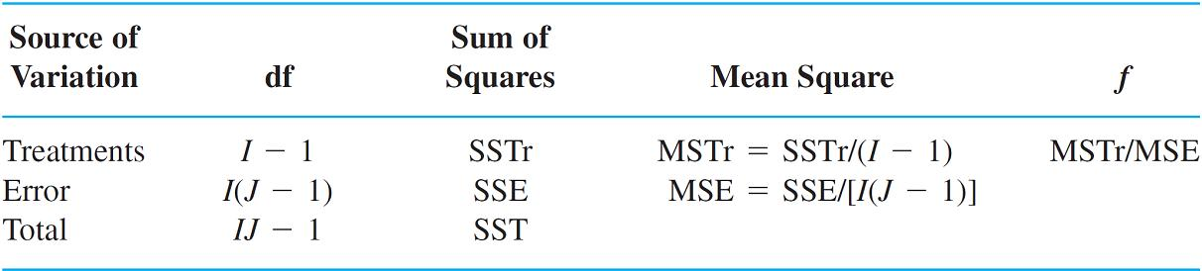
Sums of Squares
The computations are often summarized in a tabular format, called an ANOVA table, as displayed in Table 10.2.
Tables produced by statistical software customarily include a P-value column to the right of f.
An ANOVA Table
Table 10.2

Slide 53
Example 10.4
According to the article “Evaluating Fracture Behavior of Brittle Polymeric Materials Using an IASCB Specimen” (J. of Engr. Manuf., 2013: 133–140), researchers have recently proposed an improved test for the investigation of fracture toughness of brittle polymeric materials.
This new fracture test was applied to the brittle polymer polymethylmethacrylate (PMMA), more popularly known as Plexiglas, which is widely used in commercial products.

Slide 54
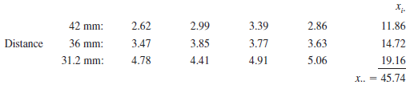
Example 10.4
The test was performed by applying asymmetric three-point bending loads on PMMA specimens. The location of one of the three loading points was then varied to determine its effect on fracture load.
In one experiment, three loading point locations based on different distances from the center of the specimen’s base were selected, resulting in the following fracture load data (kN):

Slide 55
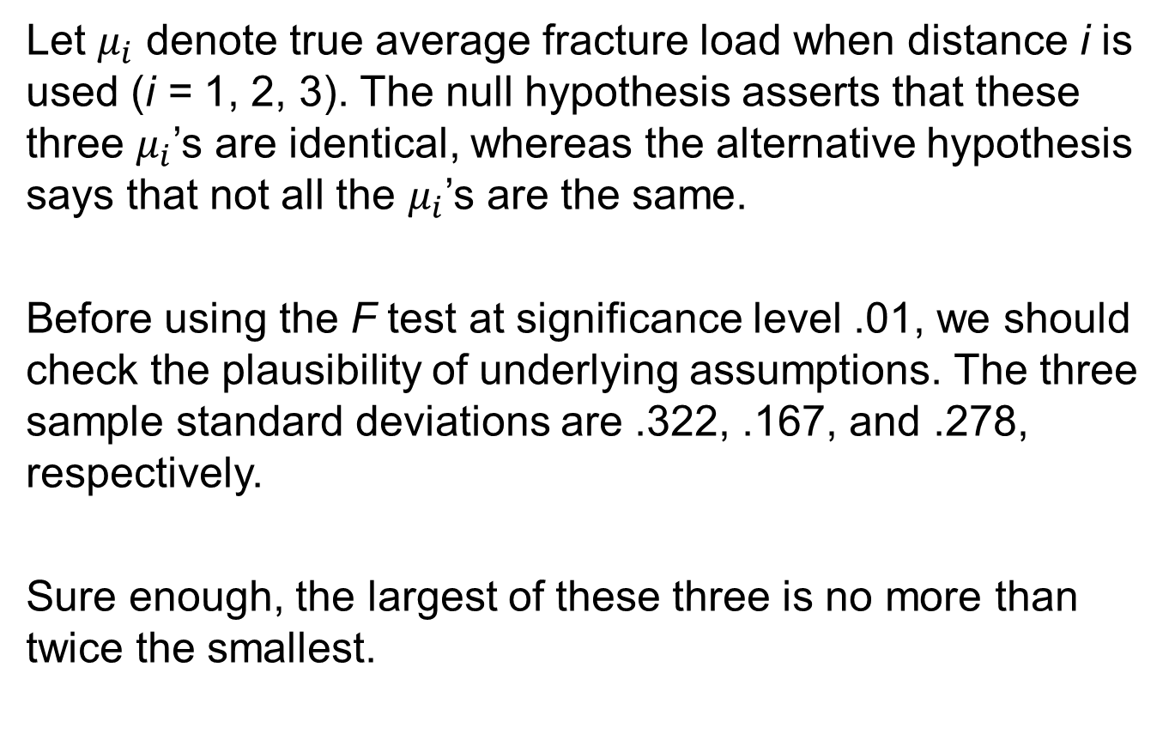
Example 10.4
Let $μ_{i}$ denote true average fracture load when distance i is used (i = 1, 2, 3). The null hypothesis asserts that these three $μ_{i}$’s are identical, whereas the alternative hypothesis says that not all the $μ_{i}$’s are the same.
Before using the F test at significance level .01, we should check the plausibility of underlying assumptions. The three sample standard deviations are .322, .167, and .278, respectively.
Sure enough, the largest of these three is no more than twice the smallest.

Slide 56
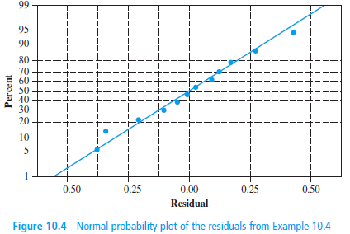
Example 10.4
So the assumption of equal variances is plausible. Figure 10.4 shows a normal probability plot of the 12 residuals obtained by subtracting the mean of each sample from the four sample observations.
They don’t come much straighter than this! It is reasonable to assume that the three fracture load distributions are normal.

Slide 57

Example 10.4
Squaring each of the 12 observations and adding gives ${∑∑}_{x_{ij}^{2}}={\left(2.62\right)}^{2}+∙∙∙+{\left(5.06\right)}^{2}=181.7376$. The values of the three sums of squares are

Slide 58

Example 10.4
The accompanying ANOVA table from Minitab summarizes the computations. With a P-value of .000, the null hypothesis can be rejected at any sensible significance level, and in particular at the chosen level .01.
There is compelling evidence for concluding that true average fracture load is not the same for all three distances.

