Slide 1

Statistical Intervals Based on a Single Sample
7
Copyright © Cengage Learning. All rights reserved.

Slide 2
7.3
Intervals Based on a Normal Population Distribution
Copyright © Cengage Learning. All rights reserved.

Slide 3
Intervals Based on a Normal Population Distribution
The CI for μ presented in Section 7.2 is valid provided that n is large. The resulting interval can be used whatever the nature of the population distribution. The CLT cannot be invoked, however, when n is small. In this case, one way to proceed is to make a specific assumption about the form of the population distribution and then derive a CI tailored to that assumption.
For example, we could develop a CI for μ when the population is described by a gamma distribution, another interval for the case of a Weibull distribution, and so on.

Slide 4

Intervals Based on a Normal Population Distribution
Statisticians have indeed carried out this program for a number of different distributional families. Because the normal distribution is more frequently appropriate as a population model than is any other type of distribution, we will focus here on a CI for this situation.
Assumption

Slide 5

Intervals Based on a Normal Population Distribution
The key result underlying the interval in Section 7.2 was that for large n, the rv has approximately a standard normal distribution.
When n is small, the additional variability in the denominator implies that the probability distribution of
will be more spread out than the standard normal distribution.
This result on which inferences are based introduces a new family of probability distributions called t distributions.

Slide 6
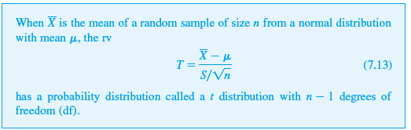
Intervals Based on a Normal Population Distribution
Theorem

Slide 7
Properties of t Distributions

Slide 8
Properties of t Distributions
Before applying this theorem, a discussion of properties of t distributions is in order. Although the variable of interest is still , we now denote it by T to emphasize that it does not have a standard normal distribution when n is small. Recall that a normal distribution is governed by two parameters; each different choice of μ in combination with σ gives a particular normal distribution. Any particular t distribution results from specifying the value of a single parameter, called the number of degrees of freedom, abbreviated df.

Slide 9
Properties of t Distributions
We’ll denote this parameter by the Greek letter ν. Possible values of ν are the positive integers 1, 2, 3, . So there is a t distribution with 1 df, another with 2 df, yet another with 3 df, and so on. For any fixed value of ν, the density function that specifies the associated t curve is even more complicated than the normal density function.
Fortunately, we need concern ourselves only with several of the more important features of these curves.

Slide 10
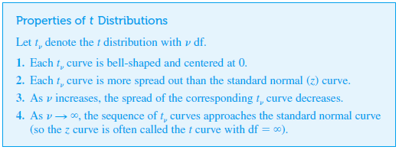
Properties of t Distributions
Properties of t Distributions

Slide 11
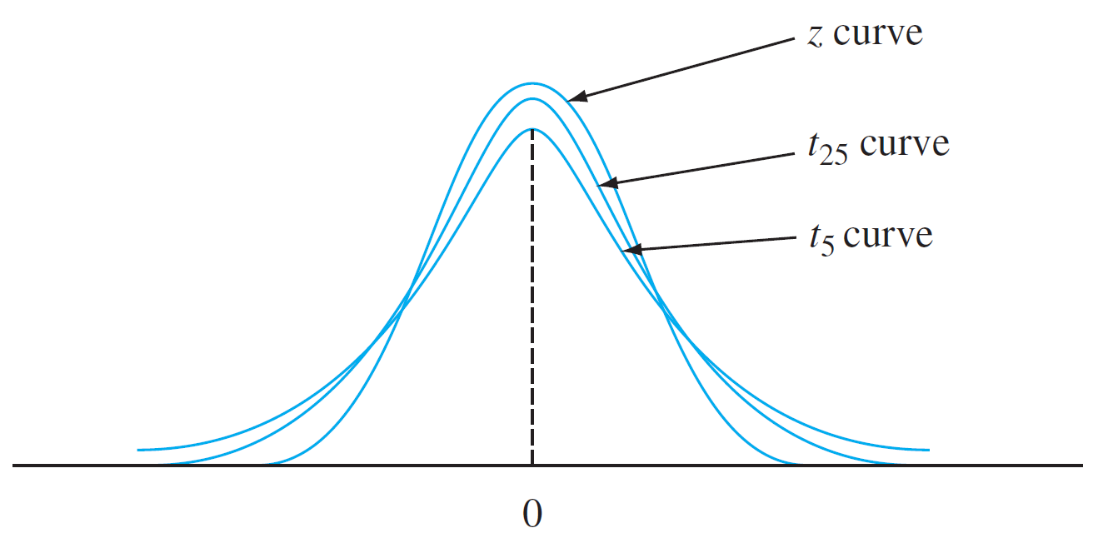
Properties of t Distributions
Figure 7.7 illustrates several of these properties for selected values of ν.
t_{ν} and z curves
Figure 7.7

Slide 12

Properties of t Distributions
The number of df for T in (7.13) is n – 1 because, although S is based on the n deviations implies that only n – 1 of these are “freely determined.”
The number of df for a t variable is the number of freely determined deviations on which the estimated standard deviation in the denominator of T is based. The use of t distribution in making inferences requires notation for capturing t-curve tail areas analogous to for the curve. You might think that t_{α} would do the trick. However, the desired value depends not only on the tail area captured but also on df.

Slide 13

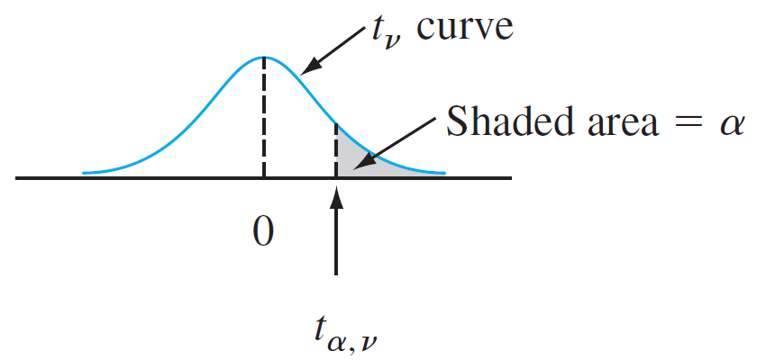
Properties of t Distributions
Notation
For example, t_{.05,6} is the t critical value that captures an upper-tail area of .05 under the t curve with 6 df. The general notation is illustrated in Figure 7.8.
Illustration of a t critical value
Figure 7.8

Slide 14
Properties of t Distributions
Because t curves are symmetric about zero, –t_{α,ν} captures lower-tail area α. Appendix Table A.5 gives t_{α,ν} for selected values of α and ν. This table also appears inside the back cover. The columns of the table correspond to different values of α. To obtain t_{.05,15}, go to the α =.05 column, look down to the ν = 15 row, and read t_{.05,15} = 1.753. Similarly, t_{.05,22} = 1.717 (.05 column, ν = 22 row), and t_{.01,22} = 2.508.

Slide 15
Properties of t Distributions
The values of t_{α,ν} exhibit regular behavior as we move across a row or down a column. For fixed ν, t_{α,ν} increases as α decreases, since we must move farther to the right of zero to capture area α in the tail. For fixed α, as ν is increased (i.e., as we look down any particular column of the t table) the value of t_{α,ν} decreases. This is because a larger value of ν implies a t distribution with smaller spread, so it is not necessary to go so far from zero to capture tail area α.

Slide 16


Properties of t Distributions
Furthermore, t_{α,ν} decreases more slowly as ν increases. Consequently, the table values are shown in increments of 2 between 30 df and 40 df and then jump to ν = 50, 60, 120 and finally . Because is the standard normal curve, the familiar values appear in the last row of the table. The rule of thumb suggested earlier for use of the large-sample CI (if n > 40) comes from the approximate equality of the standard normal and t distributions for ν ≥ 40.

Slide 17
The One-Sample t
Confidence Interval

Slide 18

The One-Sample t Confidence Interval
The standardized variable T has a t distribution with n – 1 df, and the area under the corresponding t density curve between –t_{α/2,n – 1} and t_{α/2,n – 1} is 1 – α (area α/2 lies in each tail), so
P(–t_{α/2,n – 1} < T < t_{α/2,n – 1}) = 1 – α
Expression (7.14) differs from expressions in previous sections in that T and t_{α/2,n – 1} are used in place of Z and but it can be manipulated in the same manner to obtain a confidence interval for μ.
(7.14)

Slide 19
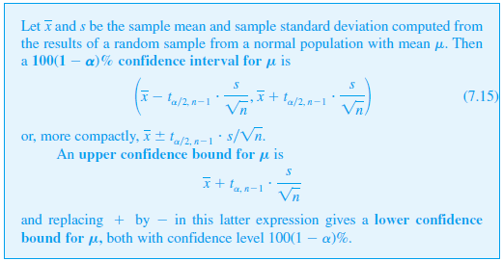
The One-Sample t Confidence Interval
Proposition

Slide 20
Example 7.11
Even as traditional markets for sweetgum lumber have declined, large section solid timbers traditionally used for construction bridges and mats have become increasingly scarce.
The article “Development of Novel Industrial Laminated Planks from Sweetgum Lumber” (J. of Bridge Engr., 2008: 64–66) described the manufacturing and testing of composite beams designed to add value to low-grade sweetgum lumber.

Slide 21
Example 7.11
cont’d
Here is data on the modulus of rupture (psi; the article contained summary data expressed in MPa):
6807.99 7637.06 6663.28 6165.03 6991.41 6992.23
6981.46 7569.75 7437.88 6872.39 7663.18 6032.28
6906.04 6617.17 6984.12 7093.71 7659.50 7378.61
7295.54 6702.76 7440.17 8053.26 8284.75 7347.95
7422.69 7886.87 6316.67 7713.65 7503.33 7674.99

Slide 22
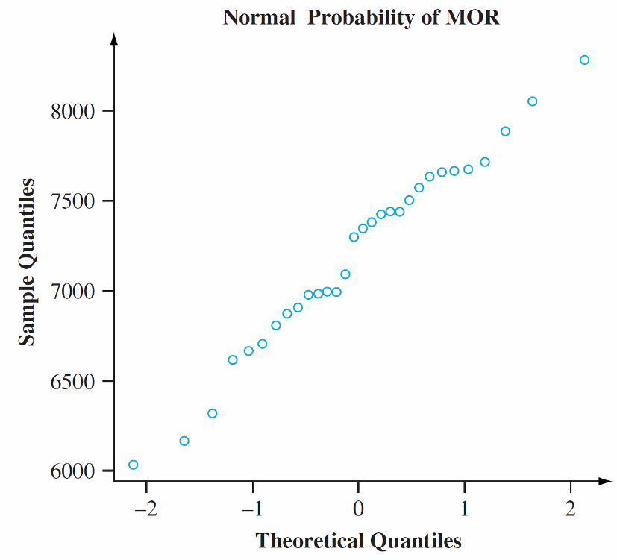
Example 7.11
cont’d
Figure 7.9 shows a normal probability plot from the R software.
A normal probability plot of the modulus of rupture data
Figure 7.9

Slide 23
Example 7.11
cont’d
The straightness of the pattern in the plot provides strong support for assuming that the population distribution of MOR is at least approximately normal.
The sample mean and sample standard deviation are 7203.191 and 543.5400, respectively (for anyone bent on doing hand calculation, the computational burden is eased a bit by subtracting 6000 from each x value to obtain y_{i} = x_{i} – 6000; then from which = 1203.191 and s_{y} = s_{x} as given).

Slide 24
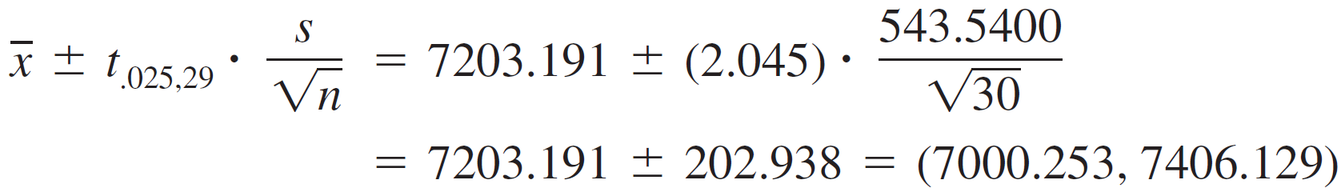
Example 7.11
cont’d
Let’s now calculate a confidence interval for true average MOR using a confidence level of 95%. The CI is based on n – 1 = 29 degrees of freedom, so the necessary t critical value is t_{.025,29} = 2.045. The interval estimate is now
We estimate 7000.253 < μ < 7406.129 that with 95% confidence.

Slide 25
Example 7.11
cont’d
If we use the same formula on sample after sample, in the long run 95% of the calculated intervals will contain μ. Since the value of μ is not available, we don’t know whether the calculated interval is one of the “good” 95% or the “bad” 5%.
Even with the moderately large sample size, our interval is rather wide. This is a consequence of the substantial amount of sample variability in MOR values.
A lower 95% confidence bound would result from retaining only the lower confidence limit (the one with –) and replacing 2.045 with t_{.05,29} = 1.699.

Slide 26
A Prediction Interval for a
Single Future Value

Slide 27
A Prediction Interval for a Single Future Value
In many applications, the objective is to predict a single value of a variable to be observed at some future time, rather than to estimate the mean value of that variable.

Slide 28
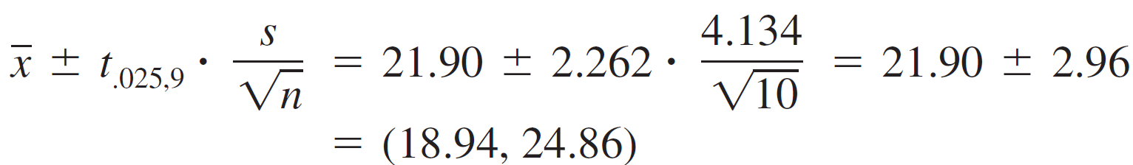
Example 7.12
Consider the following sample of fat content (in percentage) of n = 10 randomly selected hot dogs (“Sensory and Mechanical Assessment of the Quality of Frankfurters,” J. of Texture Studies, 1990: 395–409):
Assuming that these were selected from a normal population distribution, a 95% CI for (interval estimate of) the population mean fat content is

Slide 29

Example 12
cont’d
Suppose, however, you are going to eat a single hot dog of this type and want a prediction for the resulting fat content.
A point prediction, analogous to a point estimate, is just = 21.90. This prediction unfortunately gives no information about reliability or precision.

Slide 30
A Prediction Interval for a Single Future Value
The general setup is as follows: We have available a random sample X₁, X₂, … , X_{n} from a normal population distribution, and wish to predict the value of X_{n + 1}, a single future observation (e.g., the lifetime of a single lightbulb to be purchased or the fuel efficiency of a single vehicle to be rented).

Slide 31
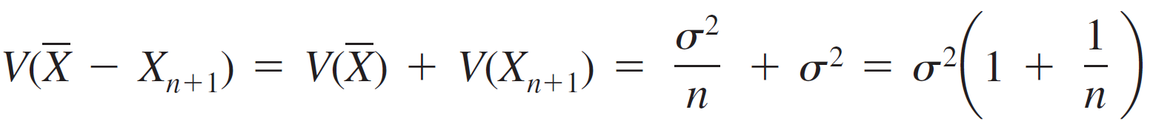
A Prediction Interval for a Single Future Value
A point predictor is , and the resulting prediction error is – X_{n + 1}. The expected value of the prediction error is
Since X_{n + 1} is independent of X₁, … , X_{n} , it is independent of , so the variance of the prediction error is

Slide 32
A Prediction Interval for a Single Future Value
The prediction error is a linear combination of independent, normally distributed rv’s, so itself is normally distributed.
Thus
has a standard normal distribution.

Slide 33
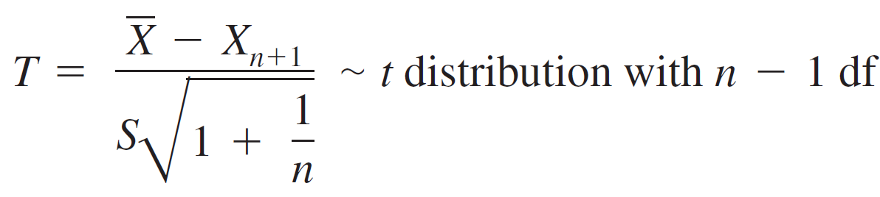

A Prediction Interval for a Single Future Value
It can be shown that replacing σ by the sample standard deviation S (of X₁, … , X_{n}) results in
Manipulating this T variable as T = was manipulated in the development of a CI gives the following result.

Slide 34
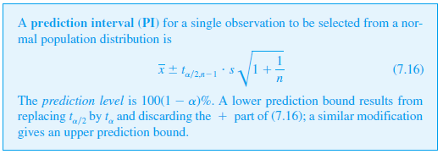
A Prediction Interval for a Single Future Value
Proposition

Slide 35

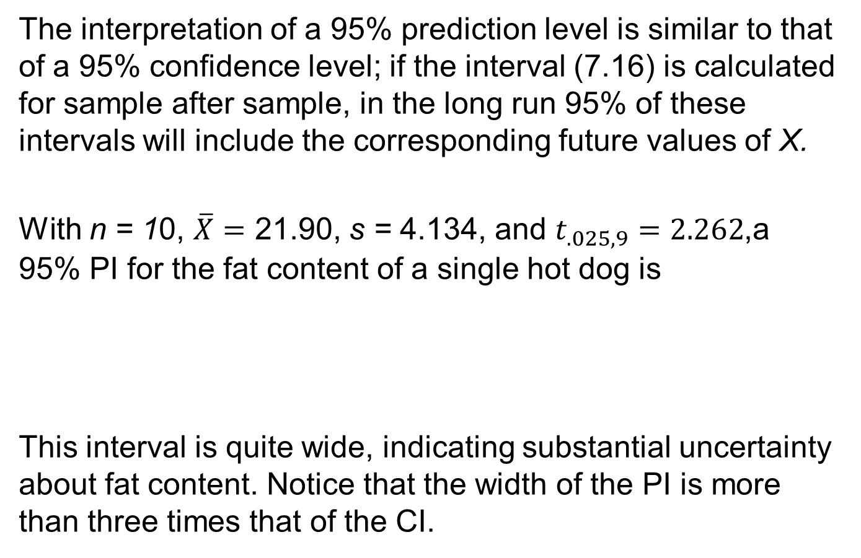
A Prediction Interval for a Single Future Value
The interpretation of a 95% prediction level is similar to that of a 95% confidence level; if the interval (7.16) is calculated for sample after sample, in the long run 95% of these intervals will include the corresponding future values of X.
With n = 10, $\overline{X}=$ 21.90, s = 4.134, and $t_{.025,9}=2.262$,a 95% PI for the fat content of a single hot dog is
This interval is quite wide, indicating substantial uncertainty about fat content. Notice that the width of the PI is more than three times that of the CI.

Slide 36

A Prediction Interval for a Single Future Value
The error of prediction is – X_{n + 1}, a difference between two random variables, whereas the estimation error is – μ, the difference between a random variable and a fixed (but unknown) value.
The PI is wider than the CI because there is more variability in the prediction error (due to X_{n + 1}) than in the estimation error.
In fact, as n gets arbitrarily large, the CI shrinks to the single value μ, and the PI approaches There is uncertainty about a single X value even when there is no need to estimate.

Slide 37
Tolerance Intervals

Slide 38
Tolerance Intervals
Consider a population of automobiles of a certain type, and suppose that under specified conditions, fuel efficiency (mpg) has a normal distribution with μ = 30 and σ = 2. Then since the interval from –1.645 to 1.645 captures 90% of the area under the z curve, 90% of all these automobiles will have fuel efficiency values between μ – 1.645σ = 26.71 and μ + 1.645σ = 33.29. But what if the values of μ and σ are not known? We can take a sample of size n, determine the fuel efficiencies, and s, and form the interval whose lower limit is – 1.645s and whose upper limit is + 1.645s.

Slide 39
Tolerance Intervals
However, because of sampling variability in the estimates of μ and σ, there is a good chance that the resulting interval will include less than 90% of the population values. Intuitively, to have an a priori 95% chance of the resulting interval including at least 90% of the population values, when and s are used in place of μ and σ we should also replace 1.645 by some larger number. For example, when n = 20, the value 2.310 is such that we can be 95% confident that the interval ± 2.310s will include at least 90% of the fuel efficiency values in the population.

Slide 40
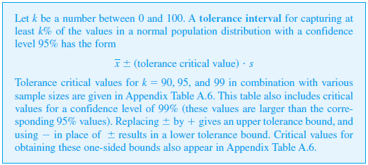
Tolerance Intervals

Slide 41
Example 7.14
As part of a larger project to study the behavior of stressed-skin panels, a structural component being used extensively in North America, the article “Time-Dependent Bending Properties of Lumber” (J. of Testing and Eval., 1996: 187–193) reported on various mechanical properties of Scotch pine lumber specimens.
Consider the following observations on modulus of elasticity (MPa) obtained 1 minute after loading in a certain configuration:

Slide 42
Example 7.14
cont’d
There is a pronounced linear pattern in a normal probability plot of the data. Relevant summary quantities are n = 16, = 14,532.5, s = 2055.67. For a confidence level of 95%, a two-sided tolerance interval for capturing at least 95% of the modulus of elasticity values for specimens of lumber in the population sampled uses the tolerance critical value of 2.903.
The resulting interval is
14,532.5 ± (2.903)(2055.67) = 14,532.5 ± 5967.6
= (8,564.9, 20,500.1)

Slide 43
Example 7.14
cont’d
We can be highly confident that at least 95% of all lumber specimens have modulus of elasticity values between 8,564.9 and 20,500.1.
The 95% CI for μ is (13,437.3, 15,627.7), and the 95% prediction interval for the modulus of elasticity of a single lumber specimen is (10,017.0, 19,048.0).
Both the prediction interval and the tolerance interval are substantially wider than the confidence interval.

Slide 44
Intervals Based on Nonnormal Population Distributions

Slide 45
Intervals Based on Nonnormal Population Distributions
The one-sample t CI for μ is robust to small or even moderate departures from normality unless n is quite small.
By this we mean that if a critical value for 95% confidence, for example, is used in calculating the interval, the actual confidence level will be reasonably close to the nominal 95% level.
If, however, n is small and the population distribution is highly nonnormal, then the actual confidence level may be considerably different from the one you think you are using when you obtain a particular critical value from the t table.

Slide 46
Intervals Based on Nonnormal Population Distributions
It would certainly be distressing to believe that your confidence level is about 95% when in fact it was really more like 88%!
The bootstrap technique, introduce in Section 7.1, has been found to be quite successful at estimating parameters in a wide variety of nonnormal situations.
In contrast to the confidence interval, the validity of the prediction and tolerance intervals described in this section is closely tied to the normality assumption.

Slide 47
Intervals Based on Nonnormal Population Distributions
These latter intervals should not be used in the absence of compelling evidence for normality.
The excellent reference Statistical Intervals, cited in the bibliography at the end of this chapter, discusses alternative procedures of this sort for various other situations.

