Slide 1

10
The Analysis of Variance
Copyright © Cengage Learning. All rights reserved.

Slide 2
10.2
Multiple Comparisons in ANOVA
Copyright © Cengage Learning. All rights reserved.

Slide 3
Multiple Comparisons in ANOVA
When the computed value of the F statistic in single-factor ANOVA is not significant, the analysis is terminated because no differences among the μ_{i}’s have been identified.
But when H₀ is rejected, the investigator will usually want to know which of the μ_{i}’s are different from one another.
A method for carrying out this further analysis is called a multiple comparisons procedure.

Slide 4
Multiple Comparisons in ANOVA
Several of the most frequently used procedures are based on the following central idea.
First calculate a confidence interval for each pairwise difference μ_{i} – μ_{j} with i < j. Thus if I = 4. the six required CIs would be for μ₁ – μ₂ (but not also for μ₂ – μ₁), μ₁ – μ₃, μ₁ – μ₄, μ₂ – μ₃, μ₂ – μ₄, and μ₃ – μ₄.
Then if the interval for μ₁ – μ₂ does not include 0, conclude that μ₁ and μ₂ differ significantly from one another; if the interval does include 0, the two μ’s are judged not significantly different.

Slide 5
Multiple Comparisons in ANOVA
Following the same line of reasoning for each of the other intervals, we end up being able to judge for each pair of μ’s whether or not they differ significantly from one another.
The procedures based on this idea differ in how the various Cls are calculated. Here we present a popular method that controls the simultaneous confidence level for all I(I – 1)/2 intervals.

Slide 6
Tukey’s Procedure (the T Method)

Slide 7
Tukey’s Procedure (the T Method)
Tukey’s procedure involves the use of another probability distribution called the Studentized range distribution. The distribution depends on two parameters: a numerator df m and a denominator df v. Let Q_{α,m,n} denote the upper-tail α critical value of the Studentized range distribution with m numerator df and v denominator df (analogous to F_{α,v1,v2}).
Values of Q_{α,m,n} are given in Appendix Table A.10.

Slide 8
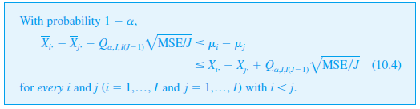
Tukey’s Procedure (the T Method)
Proposition

Slide 9
Tukey’s Procedure (the T Method)
Notice that numerator df for the appropriate Q_{α} critical value is I, the number of population or treatment means being compared, and not I – 1 as in the F test.
When the computed x_{i}, x_{j} and MSE are substituted into (10.4), the result is a collection of confidence intervals with simultaneous confidence level 100(1 – α)% for all pairwise differences of the form μ_{i} – μ_{j} with i < j.
Each interval that does not include 0 yields the conclusion that the corresponding values of μ_{i} and μ_{j} differ significantly from one another.

Slide 10
Tukey’s Procedure (the T Method)
Since we are not really interested in the lower and upper limits of the various intervals but only in which include 0 and which do not, much of the arithmetic associated with (10.4) can be avoided.
The following method gives details and describes how differences can be identified visually using an underscoring pattern.”

Slide 11
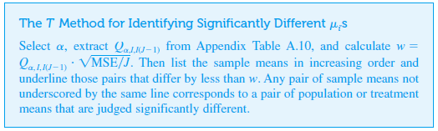
Tukey’s Procedure (the T Method)

Slide 12
Tukey’s Procedure (the T Method)
Suppose, for example, that I = 5 and that
x₂ < x₅ < x₄ < x₁ < x₃
Then
1. Consider first the smallest mean x₂. If x₅ – x₂ ≥ w, proceed to Step 2. However, if x₅ – x₂ < w, connect these first two means with a line segment. Then if possible extend this line segment even further to the right to the largest x_{i}, that differs from x₂. by less than w (so the line may connect two, three, or even more means).

Slide 13
Tukey’s Procedure (the T Method)
2. Now move to x₅ and again extend a line segment to the largest x_{i} to its right that differs from x₅, by less than w (it may not be possible to draw this line, or alternatively it may underscore just two means, or three, or even all four remaining means). 3. Continue by moving to x₄ and repeating, and then finally move to x₁.

Slide 14
Tukey’s Procedure (the T Method)
To summarize, starting from each mean in the ordered list, a line segment is extended as far to the right as possible as long as the difference between the means is smaller than w.
It is easily verified that a particular interval of the form (10.4) will contain 0 if and only if the corresponding pair of sample means is underscored by the same line segment.

Slide 15
Example 10.5
An experiment was carried out to compare five different brands of automobile oil filters with respect to their ability to capture foreign material.
Let μ_{i} denote the true average amount of material captured by brand i filters (i = 1, . . .,5) under controlled conditions.
A sample of nine filters of each brand was used, resulting in the following sample mean amounts:
x₁ = 14.5, x₂ = 13.8, x₃ = 13.3, x₄ = 14.3, and x₅ = 13.1.

Slide 16
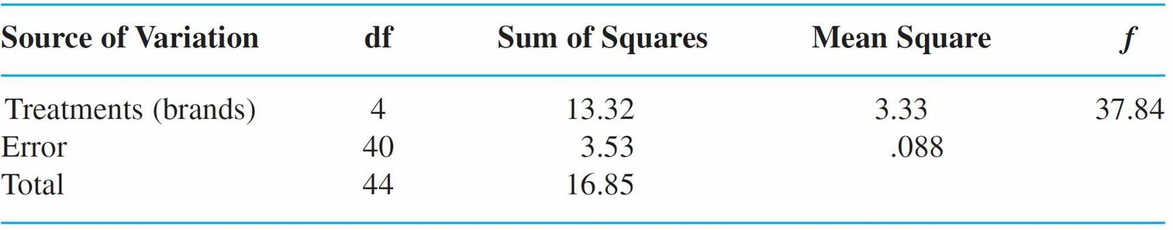
Example 10.5
cont’d
Table 10.3 is the ANOVA table summarizing the first part of the analysis.
ANOVA Table for Example 10.5
Table 10.3

Slide 17
Example 10.5
cont’d
Since F_{.001,4,40} = 5.71, the P – value is smaller than .001. Therefore, H₀ is rejected (decisively) at level .05. We now use Tukey’s procedure to look for significant differences among the μ_{i}’s.
From Appendix Table A.10, Q_{.05,5,40} = 4.04 (the second subscript on Q is I and not I – 1 as in F), so w =
After arranging the five sample means in increasing order, the two smallest can be connected by a line segment because they differ by less than .4.

Slide 18

Example 10.5
cont’d
However, this segment cannot be extended further to the right since 13.8 – 13.1 = .7 ≥ .4 .
Moving one mean to the right, the pair x₃ and x₂ cannot be underscored because these means differ by more than .4.
Again moving to the right, the next mean, 13.8, cannot be connected to any further to the right.
The last two means can be underscored with the same line segment.

Slide 19
Example 10.5
cont’d
Thus brands 1 and 4 are not significantly different from one another, but are significantly higher than the other three brands in their true average contents.
Brand 2 is significantly better than 3 and 5 but worse than 1 and 4, and brands 3 and 5 do not differ significantly.
If x₂ = 14.15 rather than 13.8 with the same computed w, then the configuration of underscored means would be

Slide 20
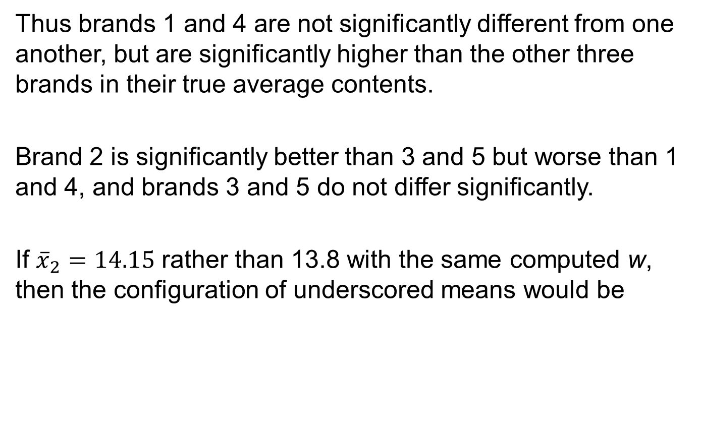
Example 10.5
Thus brands 1 and 4 are not significantly different from one another, but are significantly higher than the other three brands in their true average contents.
Brand 2 is significantly better than 3 and 5 but worse than 1 and 4, and brands 3 and 5 do not differ significantly.
If ${\overline{x}}_{2}=14.15$ rather than 13.8 with the same computed w, then the configuration of underscored means would be

Slide 21
The Interpretation of α in Tukey’s Method

Slide 22
The Interpretation of α in Tukey’s Method
We stated previously that the simultaneous confidence level is controlled by Tukey’s method. So what does “simultaneous” mean here?
Consider calculating a 95% CI for a population mean μ based on a sample from that population and then a 95% CI for a population proportion p based on another sample selected independently of the first one.

Slide 23
The Interpretation of α in Tukey’s Method
Prior to obtaining data, the probability that the first interval will include μ is .95, and this is also the probability that the second interval will include p. Because the two samples are selected independently of one another, the probability that both intervals will include the values of the respective parameters is (.95)(.95) = (.95)² ≈ .90. Thus the simultaneous or joint confidence level for the two intervals is roughly 90%—if pairs of intervals are calculated over and over again from independent samples, in the long run roughly 90% of the time the first interval will capture μ and the second will include p.

Slide 24

The Interpretation of α in Tukey’s Method
Similarly, if three CIs are calculated based on independent samples, the simultaneous confidence level will be 100(.95)³% ≈ 86%. Clearly, as the number of intervals increases, the simultaneous confidence level that all intervals capture their respective parameters will decrease.
Now suppose that we want to maintain the simultaneous confidence level at 95%. Then for two independent samples, the individual confidence level for each would have to be 100 ≈ 97.5%

Slide 25
The Interpretation of α in Tukey’s Method
The larger the number of intervals, the higher the individual confidence level would have to be to maintain the 95% simultaneous level. The tricky thing about the Tukey intervals is that they are not based on independent samples—MSE appears in every one, and various intervals share the same x_{i}’s (e.g., in the case I = 4, three different intervals all use x₁.). This implies that there is no straightforward probability argument for ascertaining the simultaneous confidence level from the individual confidence levels.

Slide 26
The Interpretation of α in Tukey’s Method
Nevertheless, it can be shown that if Q_{.05} is used, the simultaneous confidence level is controlled at 95%, whereas using Q_{.01} gives a simultaneous 99% level.
To obtain a 95% simultaneous level, the individual level for each interval must be considerably larger than 95%. Said in a slightly different way, to obtain a 5% experimentwise or family error rate, the individual or per-comparison error rate for each interval must be considerably smaller than .05. Minitab asks the user to specify the family error rate (e.g., 5%) and then includes on output the individual error rate. (see Exercise 16)

Slide 27
Confidence Intervals for Other Parametric Functions

Slide 28
Confidence Intervals for Other Parametric Functions
In some situations, a CI is desired for a function of the μ_{i}’s more complicated than a difference of μ_{i} – μ_{j}. Let θ = Σc_{i}μ_{i}, where the c_{i}’s are constants. One such function is which in the context of Example 10.5 measures the difference between the group consisting of the first two brands and that of the last three brands.
Because the X_{ij}’s are normally distributed with E(X_{ij}) = μ_{i}, and V(X_{ij}) = σ²,θ = Σc_{i}X_{i} is normally distributed, unbiased
for θ, and
^

Slide 29

Confidence Intervals for Other Parametric Functions
Estimating σ ² by MSE and forming results in a t variable (θ – θ)/ , which can be manipulated to obtain the following 100(1 – α)% confidence interval for Σc_{i}μ_{i},
^
(10.5)

Slide 30
Example 10.7
The parametric function for comparing the first two (store) brands of oil filter with the last three (national) brands is , from which
With
and MSE = .088, a 95% interval is

Slide 31
Confidence Intervals for Other Parametric Functions
Sometimes an experiment is carried out to compare each of several “new” treatments to a control treatment. In such situations, a multiple comparisons technique called Dunnett’s method is appropriate.

