Slide 1

10
The Analysis of Variance
Copyright © Cengage Learning. All rights reserved.

Slide 2
10.3
More on Single-Factor ANOVA
Copyright © Cengage Learning. All rights reserved.

Slide 3
More on Single-Factor ANOVA
We now briefly consider some additional issues relating to single-factor ANOVA.
These include an alternative description of the model parameters, β for the F test, the relationship of the test to procedures previously considered, data transformation, a random effects model, and formulas for the case of unequal sample sizes.

Slide 4
The ANOVA Model

Slide 5
The ANOVA Model
The assumptions of single-factor ANOVA can be described succinctly by means of the “model equation”
where ∈_{ij} represents a random deviation from the population or true treatment mean μ_{i}.
The ∈_{ij}’s are assumed to be independent, normally distributed rv’s (implying that the X_{y}’s are also) with E(∈_{y}) = 0 [so that E(x_{y}) = μ_{i}] and [V(∈_{ij}) = σ ² from which V(X_{ij}) = σ ² for every i and j].

Slide 6
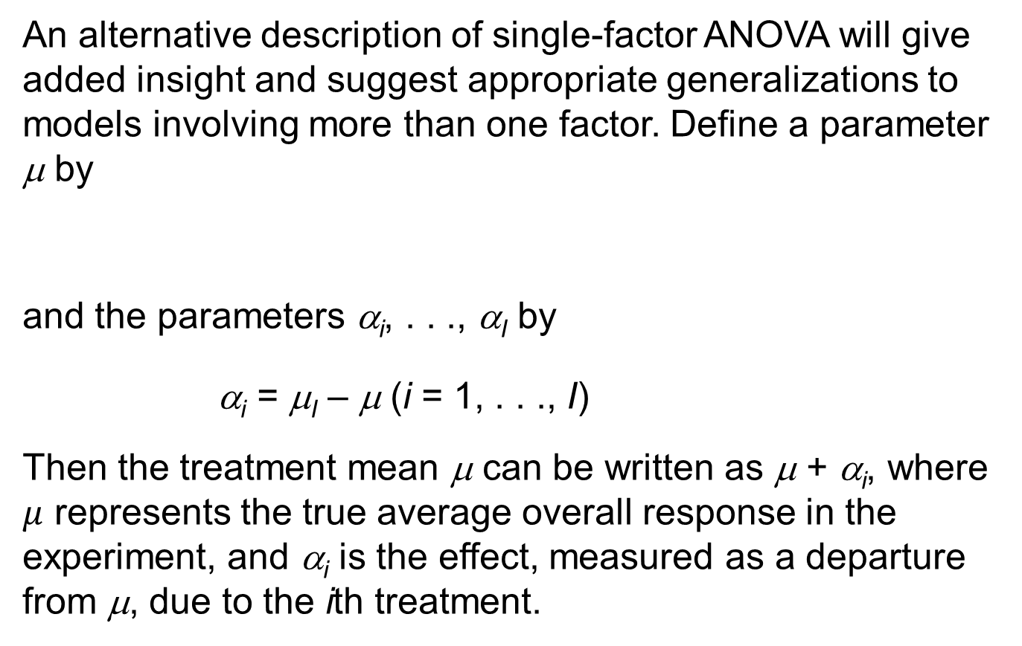
The ANOVA Model
An alternative description of single-factor ANOVA will give added insight and suggest appropriate generalizations to models involving more than one factor. Define a parameter μ by
and the parameters α_{i}, . . ., α_{I} by
α_{i} = μ_{I} – μ (i = 1, . . ., I)
Then the treatment mean μ can be written as μ + α_{i}, where $μ$ represents the true average overall response in the experiment, and α_{i} is the effect, measured as a departure from μ, due to the ith treatment.

Slide 7
The ANOVA Model
Whereas we initially had I parameters, we now have . I + 1(μ, α₁, . . ., α_{I}). However, because Σα_{i} = 0 (the average departure from the overall mean response is zero), only I of these new parameters are independently determined, so there are as many independent parameters as there were before. In terms of μ and the α_{i}’s, the model becomes
In Chapter 11, we will develop analogous models for multifactor ANOVA.

Slide 8
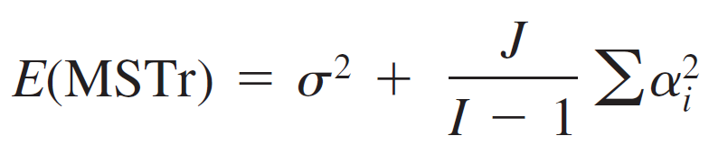
The ANOVA Model
The claim that the μ_{i}’s are identical is equivalent to the equality of the Σ α_{i}’s, and because Σ α_{i} = 0, the null hypothesis becomes
H₀: α₁ = α₂ = … = α₁ = 0
Recall that MSTr is an unbiased estimator of σ ² when H₀ is true but otherwise tends to overestimate σ ².
Here is a more precise result:

Slide 9
The ANOVA Model
When H₀ is true, so E(MSTr) = σ² (MSE is unbiased whether or not H₀ is true).
If is used as a measure of the extent to which H₀ is false, then a larger value of will result in a greater tendency for MSTr to overestimate σ ².
In the next chapter, formulas for expected mean squares for multifactor models will be used to suggest how to form F ratios to test various hypotheses.

Slide 10





The ANOVA Model
Proof of the Formula for E(MSTr) For any rv Y, E($Y^{2}$) = V(Y) +${[E\left(Y\right)]}^{2}$, so
The result then follows from the relationship MSTr = SSTr/(I -1).

Slide 11
β for the F Test

Slide 12
β for the F Test
Consider a set of parameter values α₁, α₂, . . ., α_{I} for which H₀ is not true.
The probability of a type II error, β, is the probability that H₀ is not rejected when that set is the set of true values.
One might think that β would have to be determined separately for each different configuration of α_{i}’s.
Fortunately, since β for the F test depends on the α_{i}’s and σ ² only through , it can be simultaneously evaluated for many different alternatives.

Slide 13

β for the F Test
For example, = 4 for each of the following sets of α_{i}’s for which H₀ is false, so β is identical for all three alternatives:
α₁ = –1, α₂ = –1, α₃ = 1, α₄ = 1
α₁ = – , α₂ = , α₃ = 0, α₄ = 0
α₁ = – , α₂ = , α₃ = , α₄ =

Slide 14
β for the F Test
The quantity is called the noncentrality parameter for one-way ANOVA (because when H₀ is false the test statistic has a noncentral F distribution with this as one of its parameters), and β is a decreasing function of the value of this parameter.
Thus, for fixed values of σ ² and J, the null hypothesis is more likely to be rejected for alternatives far from H₀ (large ) than for alternatives close to H₀.

Slide 15
β for the F Test
For a fixed value of , β decreases as the sample size J on each treatment increases, and it increases as the variance σ ² increases (since greater underlying variability makes it more difficult to detect any given departure from H₀).
Because hand computation of β and sample size determination for the F test are quite difficult (as in the case of t tests), statisticians have constructed sets of curves from which β can be obtained.

Slide 16
β for the F Test
Sets of curves for numerator df v₁ = 3 and v₁ = 4 are displayed in Figure 10.5 and Figure 10.6, respectively.
Power curves for the ANOVA F test (v₁ = 3)
Figure 10.5

Slide 17
β for the F Test
Power curves for the ANOVA F test (v₁ = 4)
Figure 10.6

Slide 18

β for the F Test
After the values of σ ² and the α_{i}’s for which β is desired are specified, these are used to compute the value of φ, where φ ² = .
We then enter the appropriate set of curves at the value of φ on the horizontal axis, move up to the curve associated with error df v₂, and move over to the value of power on the vertical axis. Finally, β = 1 – power.

Slide 19
Example 10.8
The effects of four different heat treatments on yield point (tons/in²) of steel ingots are to be investigated.
A total of eight ingots will be cast using each treatment. Suppose the true standard deviation of yield point for any of the four treatments is σ = 1.
How likely is it that H₀ will not be rejected at level .05 if three of the treatments have the same expected yield point and the other treatment has an expected yield point that is 1 ton/in² greater than the common value of the other three (i.e., the fourth yield is on average 1 standard deviation above those for the first three treatments)?

Slide 20
Example 10.8
cont’d
Suppose that μ₁ = μ₂ = μ₃ and μ₄ = μ₁ + 1, μ = (Σ μ_{i})/4 = μ₁ + .
Then
So
and φ = 1.22.
Degrees of freedom for the F test are v₁ = I – 1= 3 and v₂ = I(J – 1) = 28, so interpolating visually between v₂ = 20 and v₂ = 30 gives power ≈ .47 and β ≈ .53.

Slide 21
Example 10.8
cont’d
This β is rather large, so we might decide to increase the value of J.
How many ingots of each type would be required to yield β ≈ .05 for the alternative under consideration?
By trying different values of J, it can be verified that J = 24 will meet the requirement, but any smaller J will not.

Slide 22
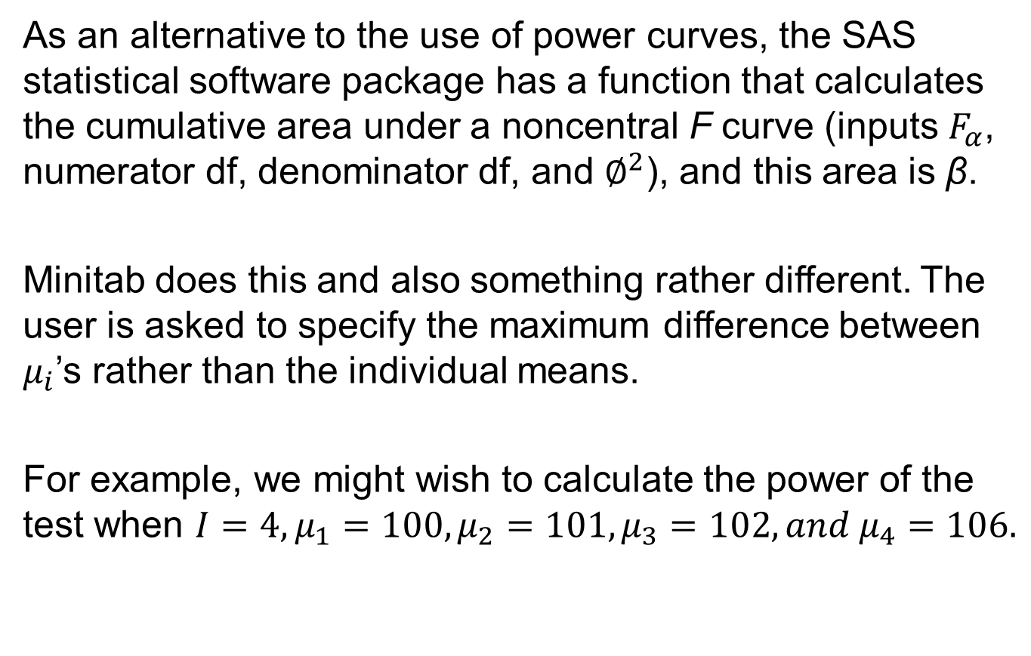
β for the F Test
As an alternative to the use of power curves, the SAS statistical software package has a function that calculates the cumulative area under a noncentral F curve (inputs $F_{α}$, numerator df, denominator df, and $∅^{2}$), and this area is β.
Minitab does this and also something rather different. The user is asked to specify the maximum difference between $μ_{i}$’s rather than the individual means.
For example, we might wish to calculate the power of the test when $I=4,μ_{1}=100,μ_{2}=101,μ_{3}=102, and μ_{4}=106.$

Slide 23
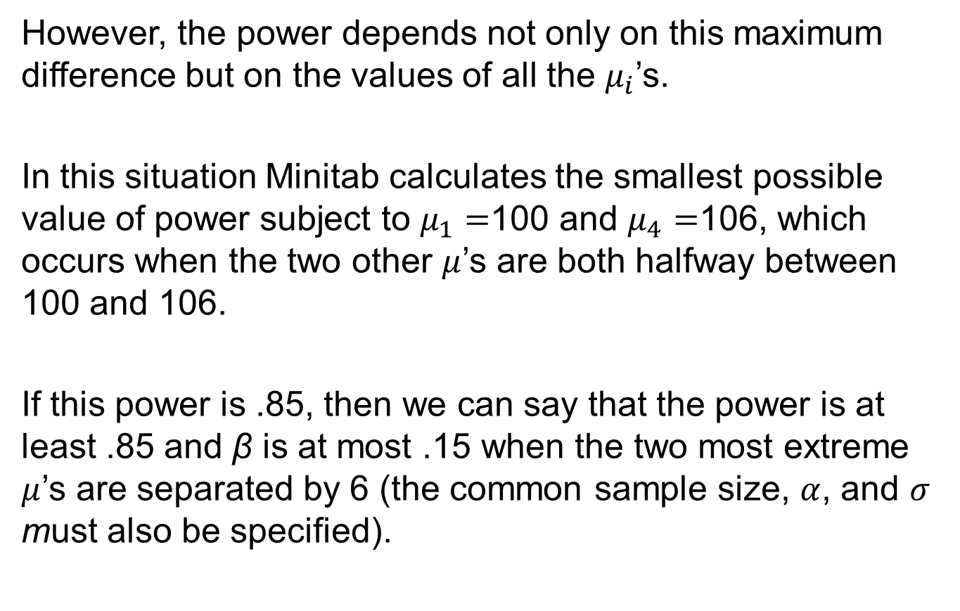
β for the F Test
However, the power depends not only on this maximum difference but on the values of all the $μ_{i}$’s.
In this situation Minitab calculates the smallest possible value of power subject to $μ_{1}=$100 and $μ_{4}=$106, which occurs when the two other $μ$’s are both halfway between 100 and 106.
If this power is .85, then we can say that the power is at least .85 and β is at most .15 when the two most extreme $μ$’s are separated by 6 (the common sample size, $α$, and $σ$ must also be specified).

Slide 24
β for the F Test
The software will also determine the necessary common sample size if maximum difference and minimum power are specified.

Slide 25
Relationship of the F Test to the t Test

Slide 26
Relationship of the F Test to the t Test
When the number of treatments or populations is I = 2, all formulas and results connected with the F test still make sense, so ANOVA can be used to test H₀: μ₁ = μ₂ versus H_{a}: μ₁ ≠ μ₂.
In this case, a two-tailed, two-sample t test can also be used.
In Section 9.3, we mentioned the pooled t test, which requires equal variances, as an alternative to the two-sample t procedure.

Slide 27
Relationship of the F Test to the t Test
It can be shown that the single-factor ANOVA F test and the two-tailed pooled t test are equivalent; for any given data set, the P-values for the two tests will be identical, so the same conclusion will be reached by either test.
The two-sample t test is more flexible than the F test when I = 2 for two reasons.
First, it is valid without the assumption that σ₁ = σ₂; second, it can be used to test H_{a}: μ₁ > μ₂ (an upper-tailed t test) or H_{a}: μ₁ < μ₂ as well as H_{a}: μ₁ ≠ μ₂.

Slide 28
Relationship of the F Test to the t Test
In the case of I ≥ 3, there is unfortunately no general test procedure known to have good properties without assuming equal variances.

Slide 29
Unequal Sample Sizes

Slide 30
Unequal Sample Sizes
When the sample sizes from each population or treatment are not equal, let j₁, j₂, . . ., j_{I} denote the I sample sizes, and let n = Σ_{i} J_{i} denote the total number of observations.
The accompanying box gives ANOVA formulas and the test procedure.

Slide 31
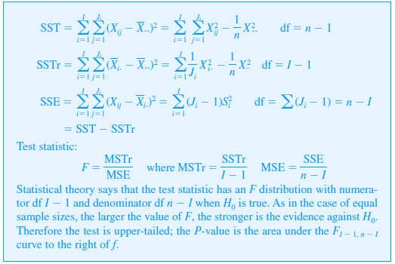
Unequal Sample Sizes

Slide 32
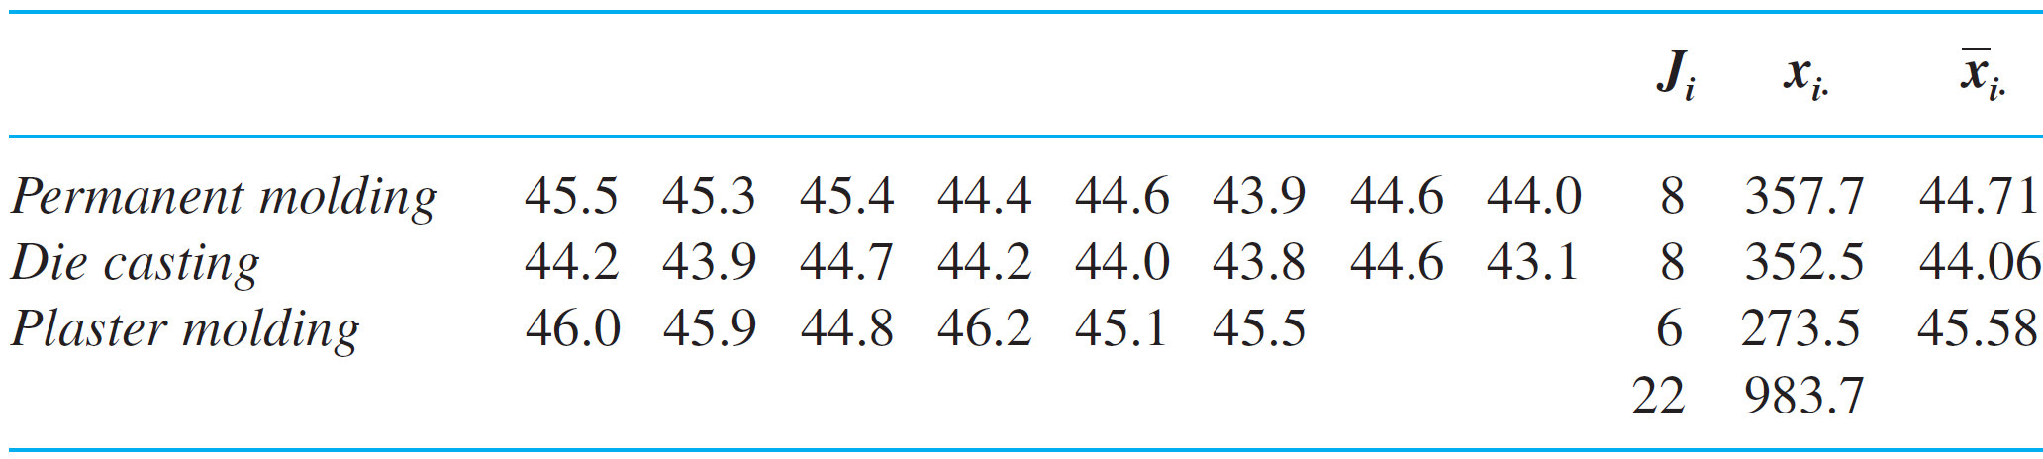
Example 10.9
The article “On the Development of a New Approach for the Determination of Yield Strength in Mg-based Alloys” (Light Metal Age, Oct. 1998: 51–53) presented the following data on elastic modulus (GPa) obtained by a new ultrasonic method for specimens of a certain alloy produced using three different casting processes.

Slide 33
Example 10.9
cont’d
Let μ₁, μ₂, and μ₃ denote the true average elastic moduli for the three different processes under the given circumstances.
The relevant hypotheses are H₀: μ₁ = μ₂ = μ₃ versus H_{a}: at least two of the μ_{i}’s are different.
The test statistic is, of course, F = MSTr/MSE, based on I – 1 = 2 numerator df and n – I = 22 – 3 = 19 denominator df. Relevant quantities include

Slide 34
Example 10.9
cont’d
SST = 43,998.73 – 43,984.80 = 13.93
SSE = 13.93 – 7.93 = 6.00
The remaining computations are displayed in the accompanying ANOVA table.
Since F_{.001,2,19} = 10.16 < 12.56 = f, the P-value is smaller than .001.

Slide 35
Example 10.9
cont’d
Thus the null hypothesis should be rejected at any reasonable significance level; there is compelling evidence for concluding that a true average elastic modulus somehow depends on which casting process is used.

Slide 36
Unequal Sample Sizes
There is more controversy among statisticians regarding which multiple comparisons procedure to use when sample sizes are unequal than there is in the case of equal sample sizes.
The procedure that we present here is recommended in the excellent book Beyond ANOVA: Basics of Applied Statistics (see the chapter bibliography) for use when the I sample sizes J₁, J₂, . . ., J_{I}, are reasonably close to one another (“mild imbalance”).
It modifies Tukey’s method by using averages of pairs of 1/J_{i}’s in place of 1/J.

Slide 37
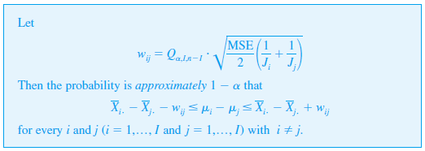
Unequal Sample Sizes

Slide 38
Unequal Sample Sizes
The simultaneous confidence level 100(1 – α)% is only approximate rather than exact as it is with equal sample sizes.
Underscoring can still be used, but now the w_{ij} factor used to decide whether x_{i} and x_{j} can be connected will depend on J_{i} and J_{j}.

Slide 39

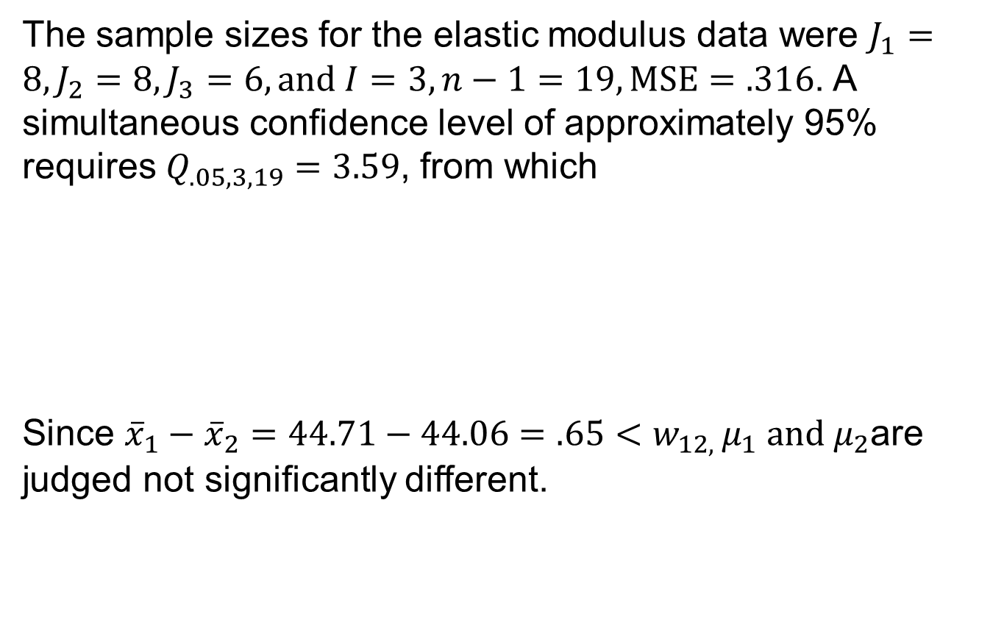
Example 10.10
The sample sizes for the elastic modulus data were $J_{1}=8,J_{2}=8,J_{3}=6, and I=3, n−1=19, MSE=.316$. A simultaneous confidence level of approximately 95% requires $Q_{.05,3,19}=3.59$, from which
Since ${\overline{x}}_{1}−{\overline{x}}_{2}=44.71−44.06=.65<w_{12, }μ_{1} and μ_{2}$are judged not significantly different.

Slide 40


Example 10.10
The accompanying underscoring scheme shows that $μ_{1}$ and $μ_{3}$ appear to differ significantly, as do $μ_{2}$ and $μ_{3}$.

Slide 41
Data Transformation

Slide 42
Data Transformation
The use of ANOVA methods can be invalidated by substantial differences in the variances (which until now have been assumed equal with common value σ ²).
It sometimes happens that V(X_{ij}) = = g(μ_{i}), a known function of μ_{i} (so that when H₀ is false, the variances are not equal).
For example, if X_{ij} has a Poisson distribution with parameter λ_{i} (approximately normal λ_{I} ≥ 10), if then μ_{i} = λ_{i} and = λ_{i}, so g(μ_{i}) = μ_{i} is the known function.

Slide 43

Data Transformation
In such cases, one can often transform the X_{ij}’s to h(X_{ij}) so that they will have approximately equal variances (while leaving the transformed variables approximately normal), and then the F test can be used on the transformed observations.
The key idea in choosing h() is that often
.
We now wish to find the function h() for which
.

Slide 44

Data Transformation
Proposition
In the Poisson case, g(x) = x, so h(x) should be proportional
to .
Thus Poisson data should be transformed to h(x_{ij}) = before the analysis.

Slide 45
A Random Effects Model

Slide 46
A Random Effects Model
The single-factor problems considered so far have all been assumed to be examples of a fixed effects ANOVA model.
By this we mean that the chosen levels of the factor under study are the only ones considered relevant by the experimenter. The single-factor fixed effects model is
X_{ij} = μ + α_{i} + ∈_{ij} Σ α_{i} = 0
where the ∈_{ij}’s are random and both μ and the α_{i}’s are fixed parameters.
(10.6)

Slide 47
A Random Effects Model
In some single-factor problems, the particular levels studied by the experimenter are chosen, either by design or through sampling, from a large population of levels.
For example, to study the effects on task performance time of using different operators on a particular machine, a sample of five operators might be chosen from a large pool of operators.
Similarly, the effect of soil pH on the yield of maize plants might be studied by using soils with four specific pH values chosen from among the many possible pH levels.

Slide 48
A Random Effects Model
When the levels used are selected at random from a larger population of possible levels, the factor is said to be random rather than fixed, and the fixed effects model (10.6) is no longer appropriate.

Slide 49
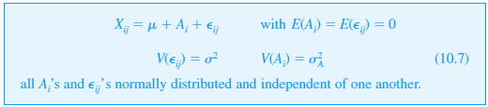
A Random Effects Model
An analogous random effects model is obtained by replacing the fixed α_{i}’s in (10.6) by random variables.
The condition E(A_{i}) = 0 in (10.7) is similar to the condition Σ α_{i} = 0 in (10.6); it states that the expected or average effect of the ith level measured as a departure from μ is zero.

Slide 50
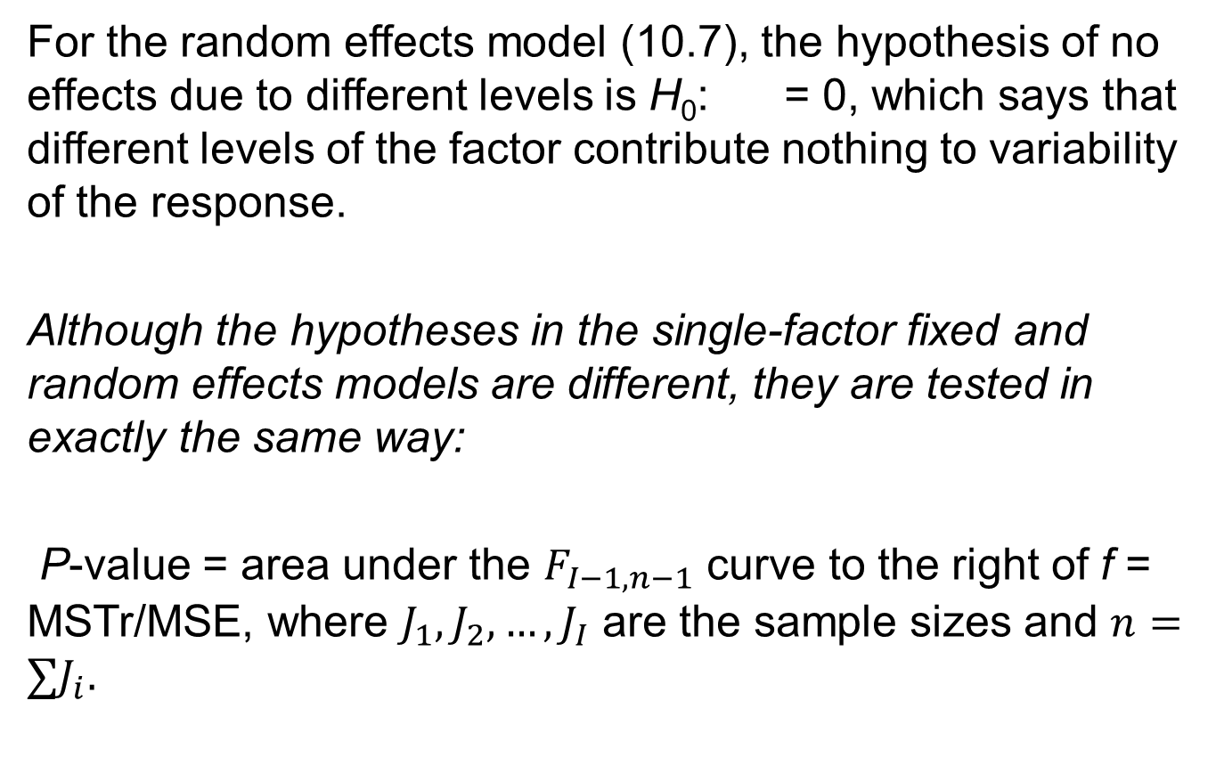
A Random Effects Model
For the random effects model (10.7), the hypothesis of no effects due to different levels is H₀: = 0, which says that different levels of the factor contribute nothing to variability of the response.
Although the hypotheses in the single-factor fixed and random effects models are different, they are tested in exactly the same way:
P-value = area under the $F_{I−1,n−1}$ curve to the right of f = MSTr/MSE, where $J_{1},J_{2},…,J_{I}$ are the sample sizes and $n={∑J}_{i}.$

Slide 51
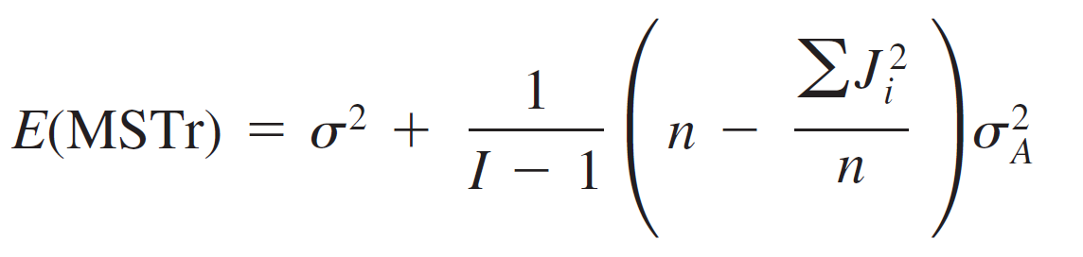
A Random Effects Model
This can be justified intuitively by noting that E(MSE) = σ² and
The factor in parentheses on the right side of (10.8) is nonnegative, so again E(MSTr) = σ ² if H₀ is true and E(MSTr) > σ ² if H₀ is false.
(10.8)

Slide 52
Example 10.11
The study of nondestructive forces and stresses in materials furnishes important information for efficient engineering design.
The article “Zero-Force Travel-Time Parameters for Ultrasonic Head-Waves in Railroad Rail” (Materials Evaluation, 1985: 854–858) reports on a study of travel time for a certain type of wave that results from longitudinal stress of rails used for railroad track.
Three measurements were made on each of six rails randomly selected from a population of rails.

Slide 53
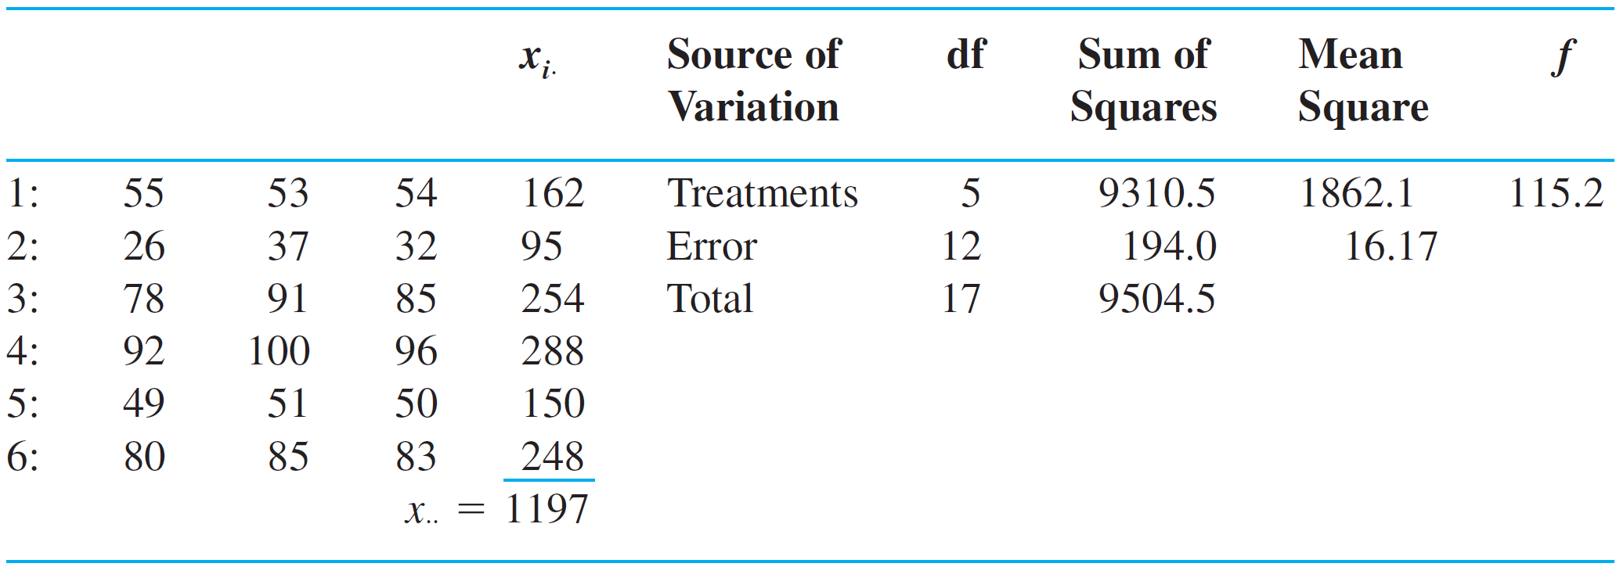
Example 10.11
cont’d
The investigators used random effects ANOVA to decide whether some variation in travel time could be attributed to “between-rail variability.”
The data is given in the accompanying table (each value, in nanoseconds, resulted from subtracting 36.1 μ’s from the original observation) along with the derived ANOVA table.

Slide 54
Example 10.11
cont’d
The value f is highly significant, so H₀: = 0 is rejected in favor of the conclusion that differences between rails is a source of travel-time variability.

