Slide 1


[NAME=Basic transparency];
[MOVEABLE];
[BORDER];[TRANSPARENT];[BOUNCING];
[AnimationSpeed=10]
Notes:
[BCKCOLOR=115,155,234];
[TESTPROPERTY]

Slide 2
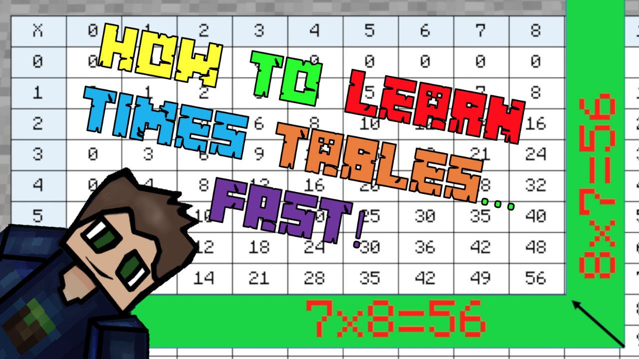
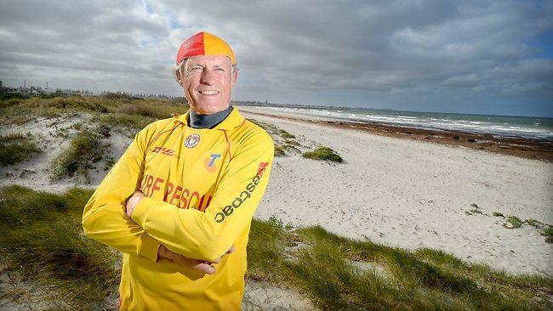


Slide 3
[NAME=Left bar]
[NAME=Low transparency];
[TRANSPARENT]
[NAME=Random Orange box]
[NAME=High transparency];
[TRANSPARENT]
[NAME=Basic transparency];
[MOVEABLE];
[BORDER];[TRANSPARENT];
[NAME=WasdBlock];
[BORDER];
[AnimationSpeed=3];
[NAME=Bottom properties];
[BORDER]
[NAME=ArrowsBlock];
[BORDER];
[MOVEABLE];
[TRANSPARENT];
[ARROWSMovement];
Notes:
[BACKCOLOR=25,45,10]

Slide 4
[NAME=Left bar]
[NAME=Low transparency];
[ADVANCEDTRANSPARENT]
[NAME=Random Orange box]
[NAME=Solid purple with transparent border];
[BORDER];
[TRANSPARENT]
[NAME=High transparency];
[ADVANCEDTRANSPARENT]
[NAME=Basic transparency];
[TRANSPARENT]
[NAME=Bottom properties];
[BORDER]
Notes:
[BACKCOLOR=255,255,255]

Slide 5
Notes:
[BACKCOLOR=#FFFFFF]

