Slide 1

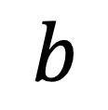

incident particle
$$v$$
Plane orthogonal to $v$
$$b$$
target particle

