Slide 1

Security Ignite
Puzzle Box
Alec-Angus Macdonald and Kay Bryson
go/alec
Notes:
Using Components With Known Vulnerabilities
.

Slide 2

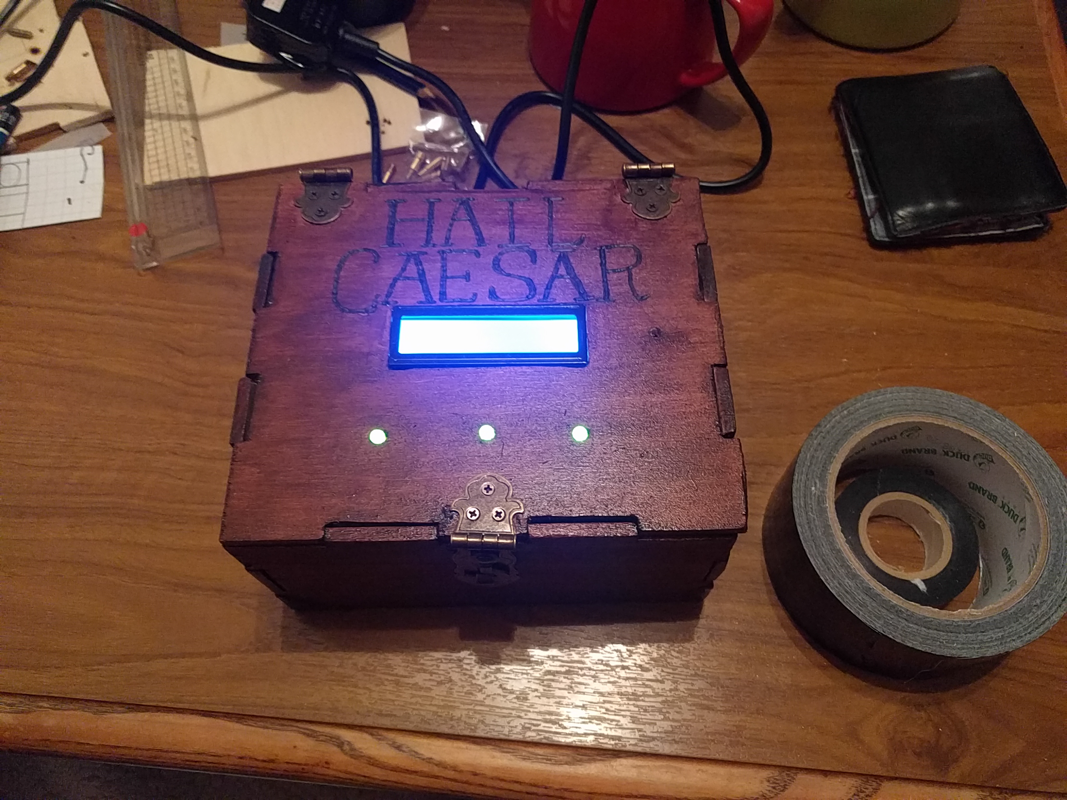
What is it?
Notes:
For me, my first foray into microprocessor programming.
*
My wife’s first foray into woodwork

Slide 3
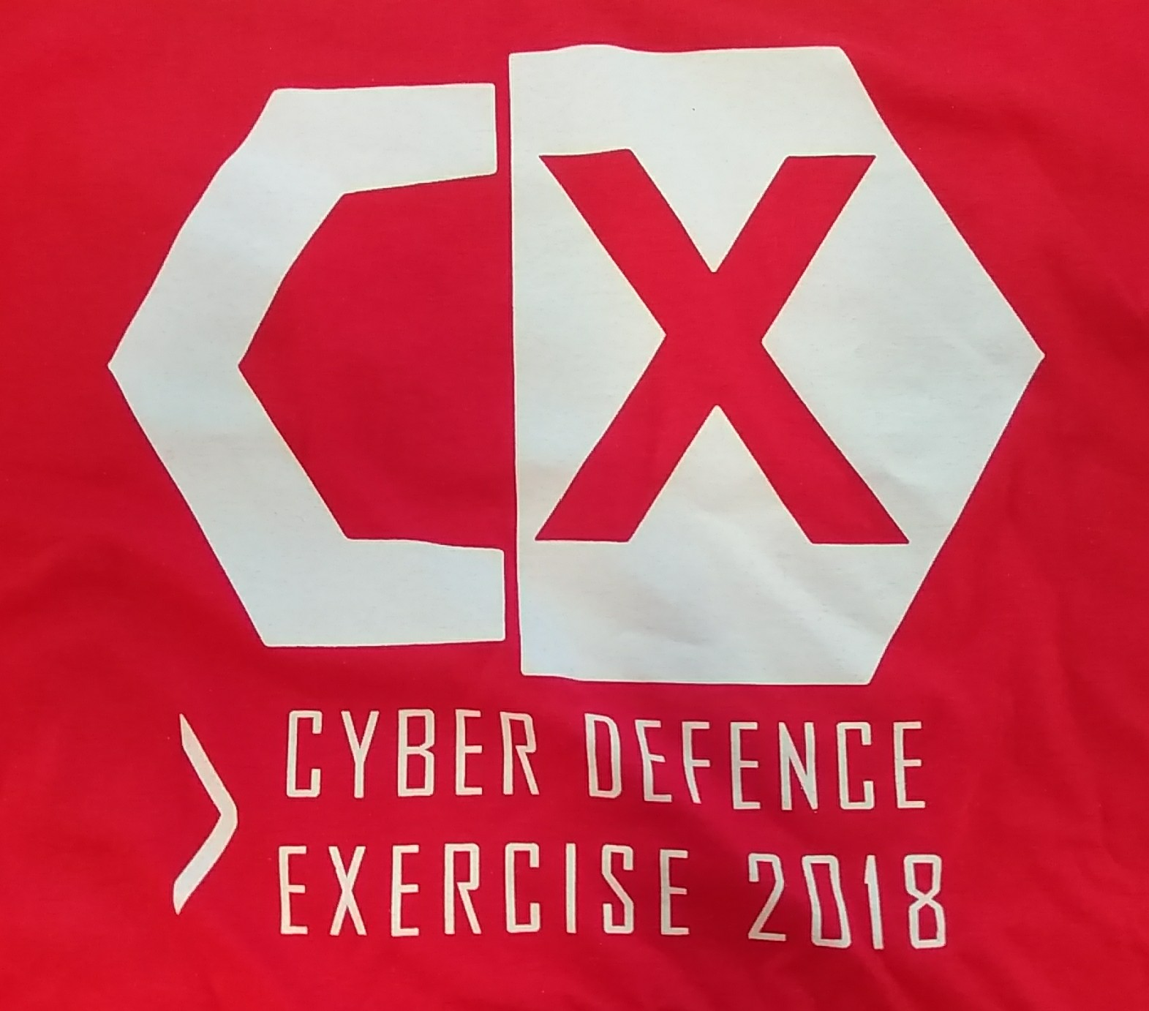
Why?
Notes:
Event at Glasgow University
*
The Premise:
*
You’re IT for a country.
*
Hackers have broken in – already compromised
*
Firesale imminent – bank, power grid and president’s computer
*
Have to harden + write new functionality

Slide 4
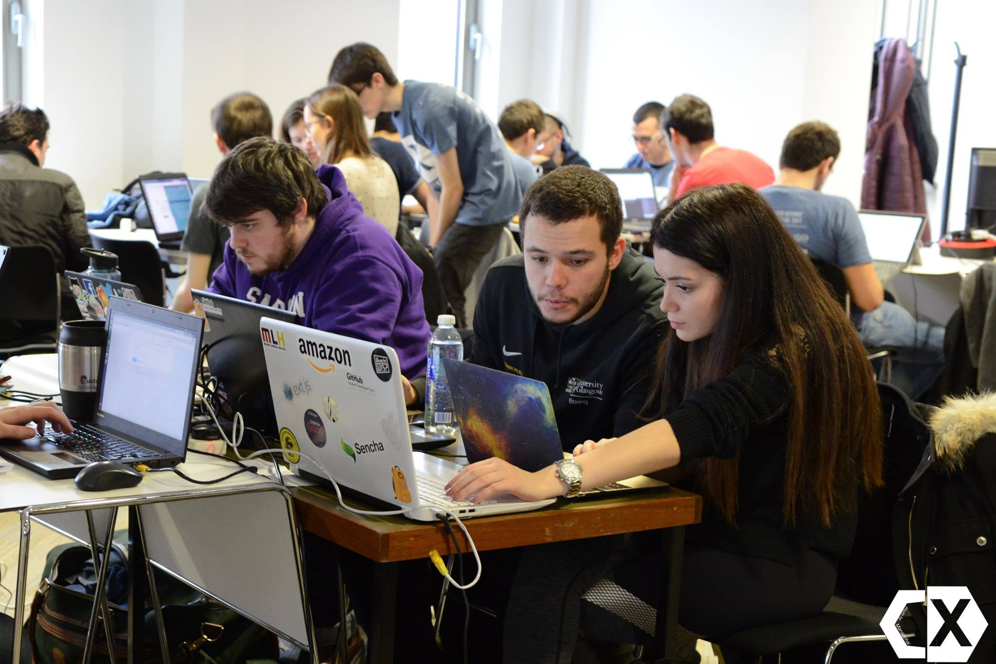
Who for?
Notes:
100+ students
*
All years welcome

Slide 5
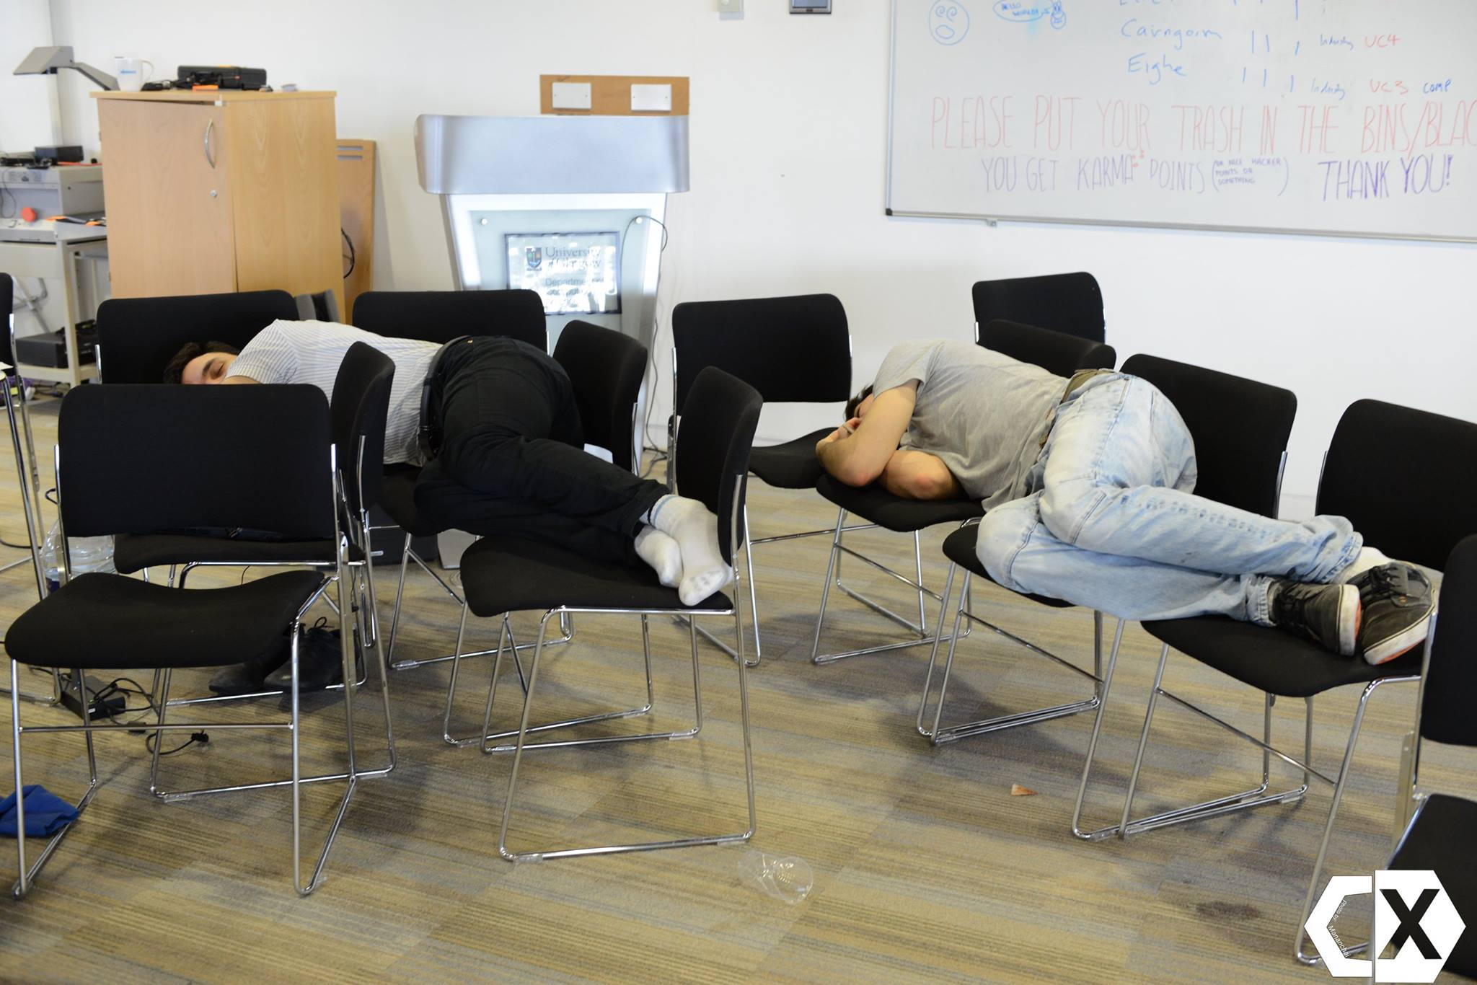
Who for?
Notes:
Arrive Friday night
*
Get access key to network with 3 boxes
*
Boxes are highly compromised
*
Have until Sunday to harden as best they can

Slide 6
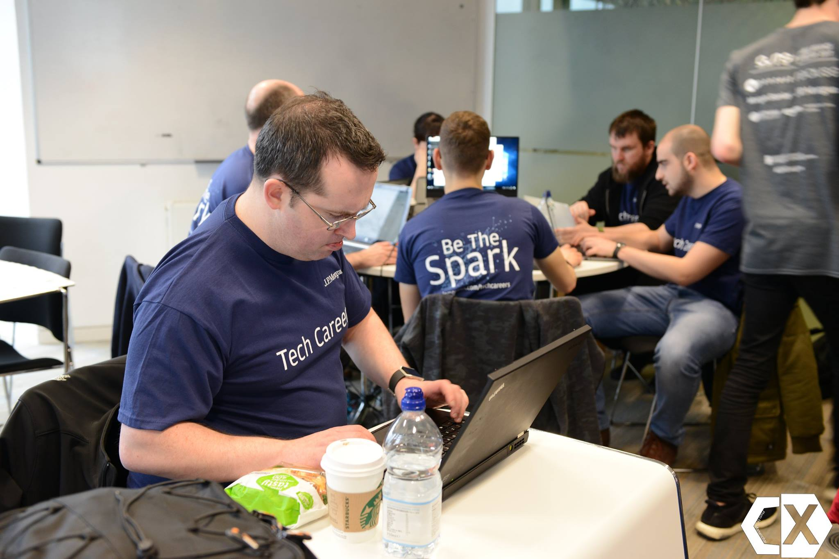
Our involvement
Notes:
Mentor on the Friday and Saturday
*
Crush on the Sunday

Slide 7
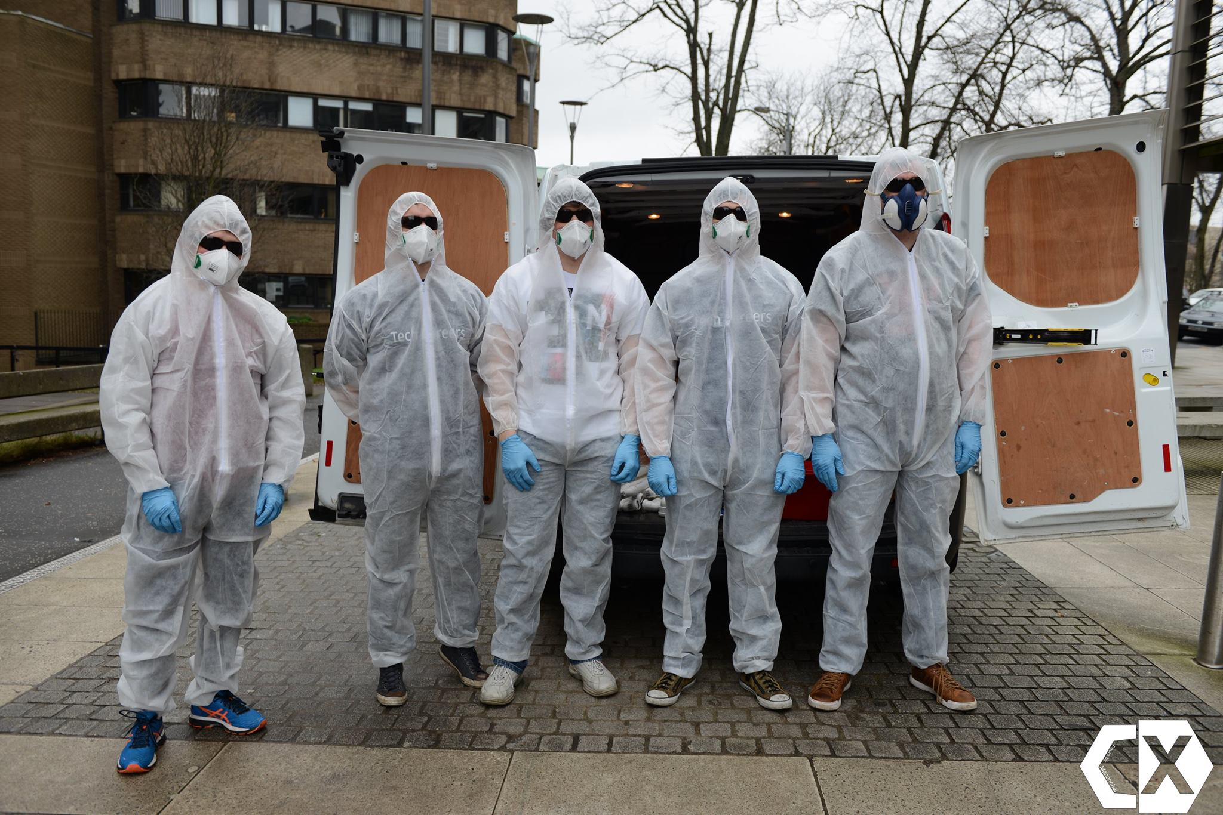
Side Quest
Notes:
As you can imagine, quite stressful.
*
So we thought we’d notch up the stress and confusion a bit further
*
Thankfully didn’t get arrested

Slide 8
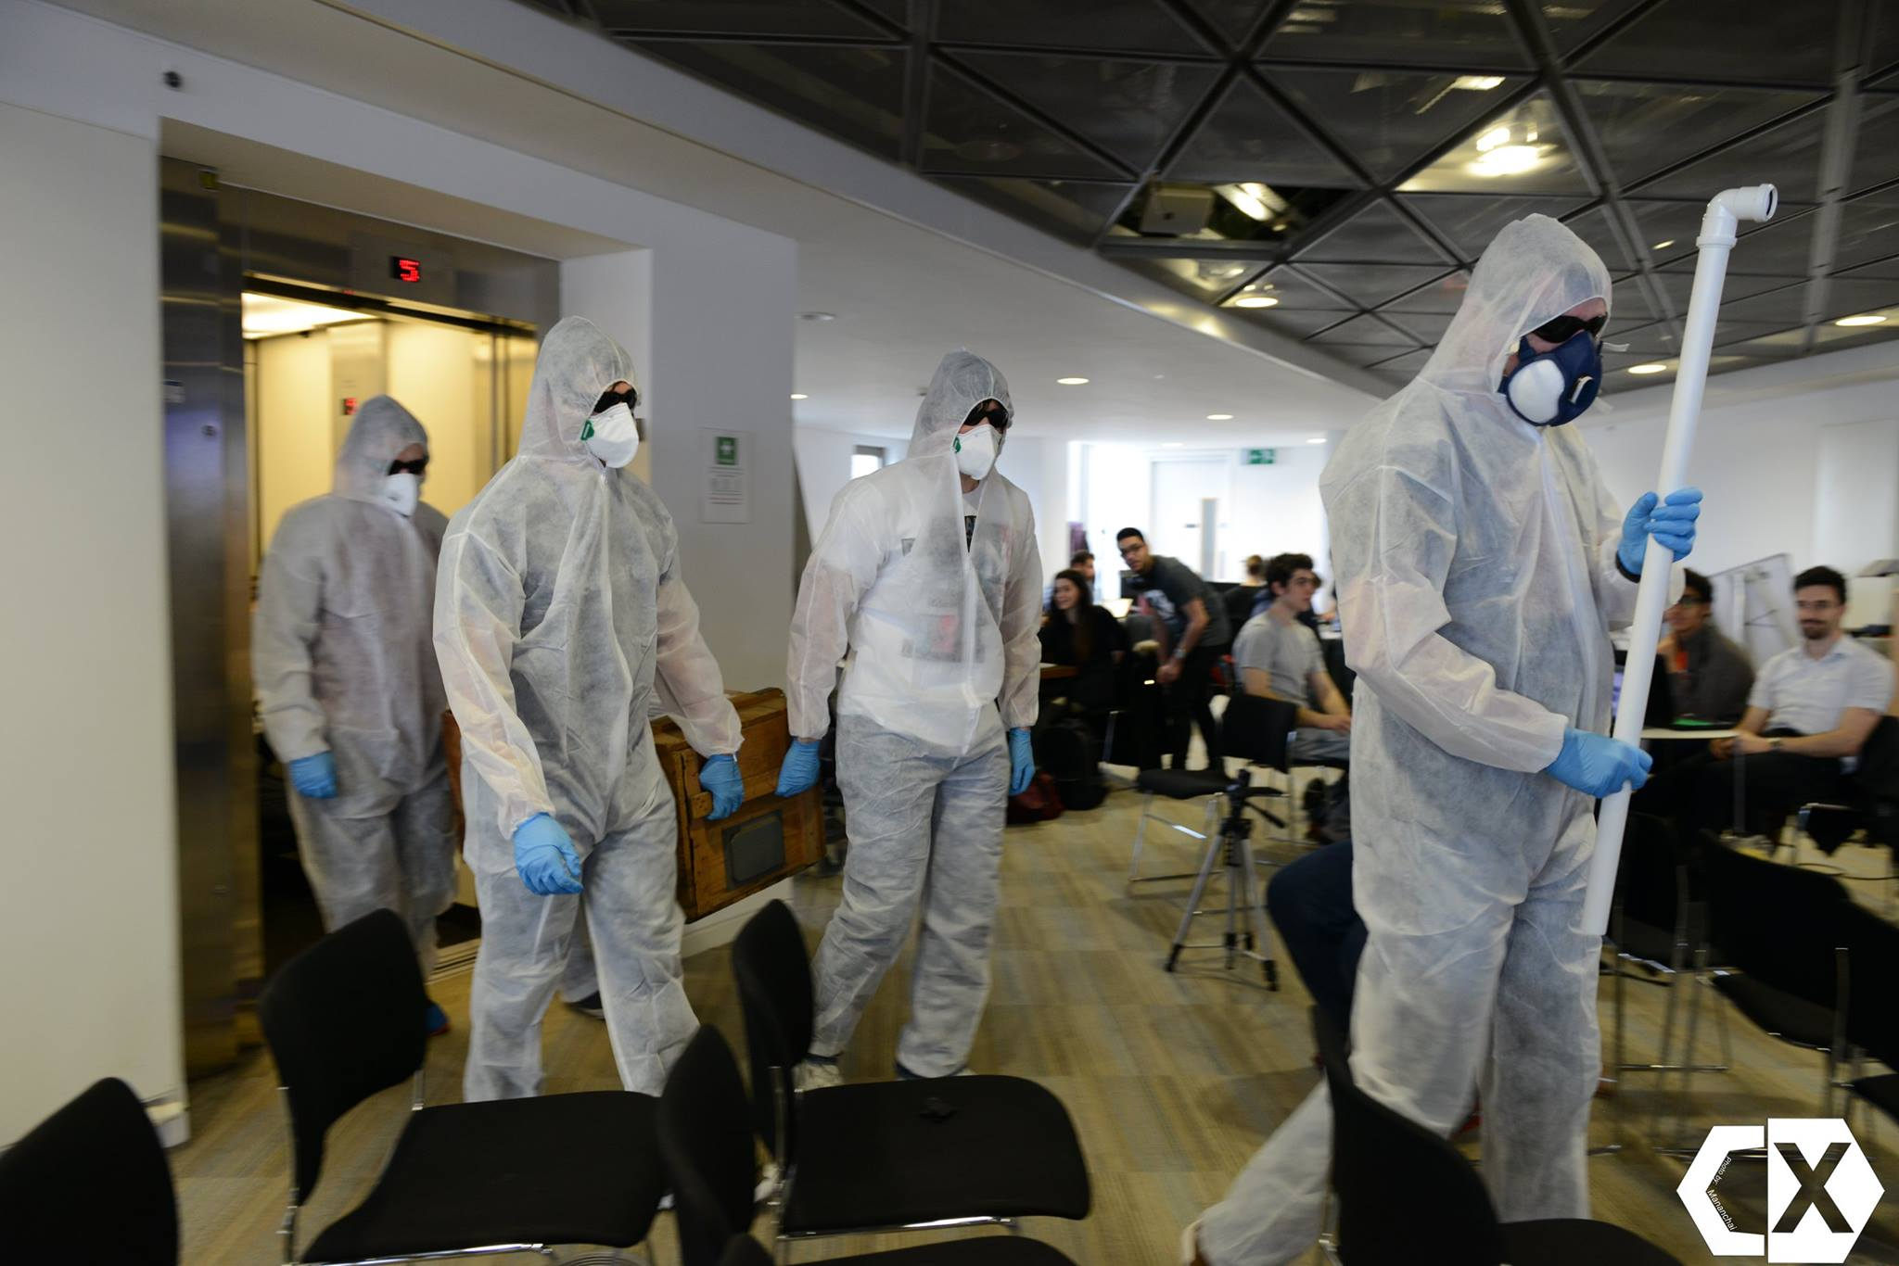
Weirdos on tour
Notes:
Along with IoT Ignite, built a set of 5 challenges

Slide 9
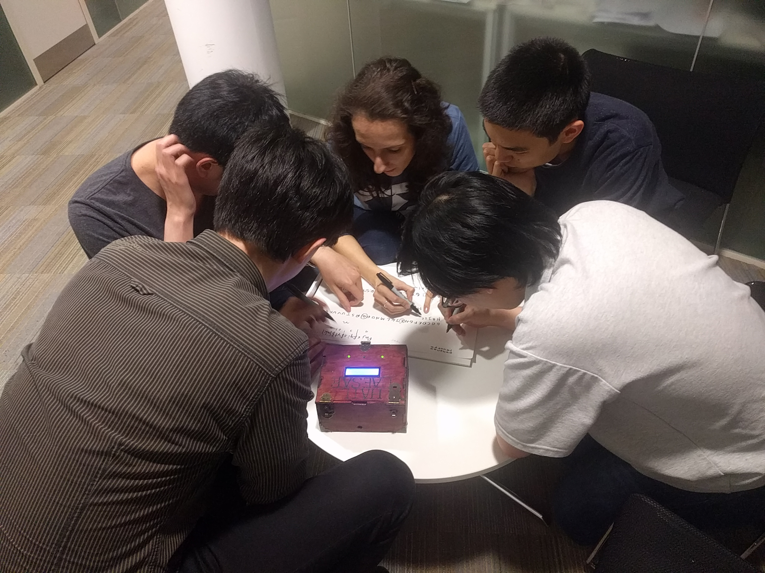
The challenge
Notes:
With it being a security weekend, this one was cryptography themed.
*
Each team had half an hour to solve it.
*
Fastest 3 teams would qualify

Slide 10
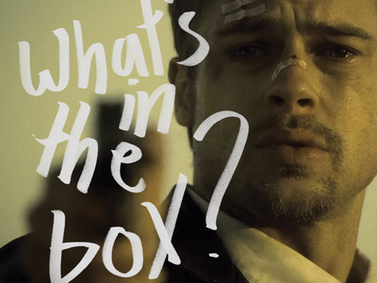
Spoilers?

Slide 11
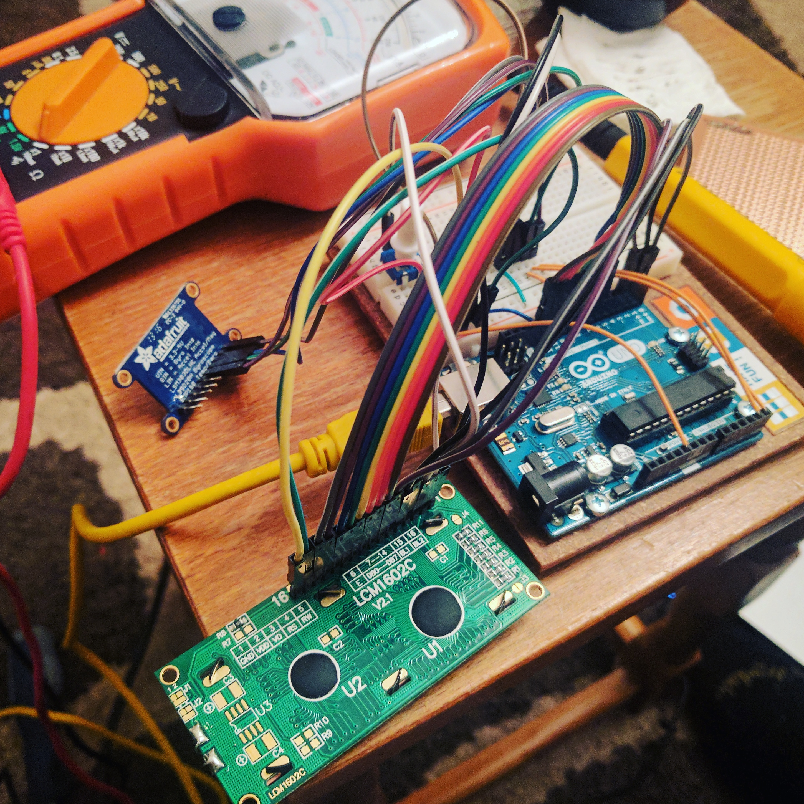
Gubbins
Notes:
Arduino Uno
2x16 LCD Screen
Piezo
Adafruit 10DOF IMU
Battery
3xLEDs

Slide 12
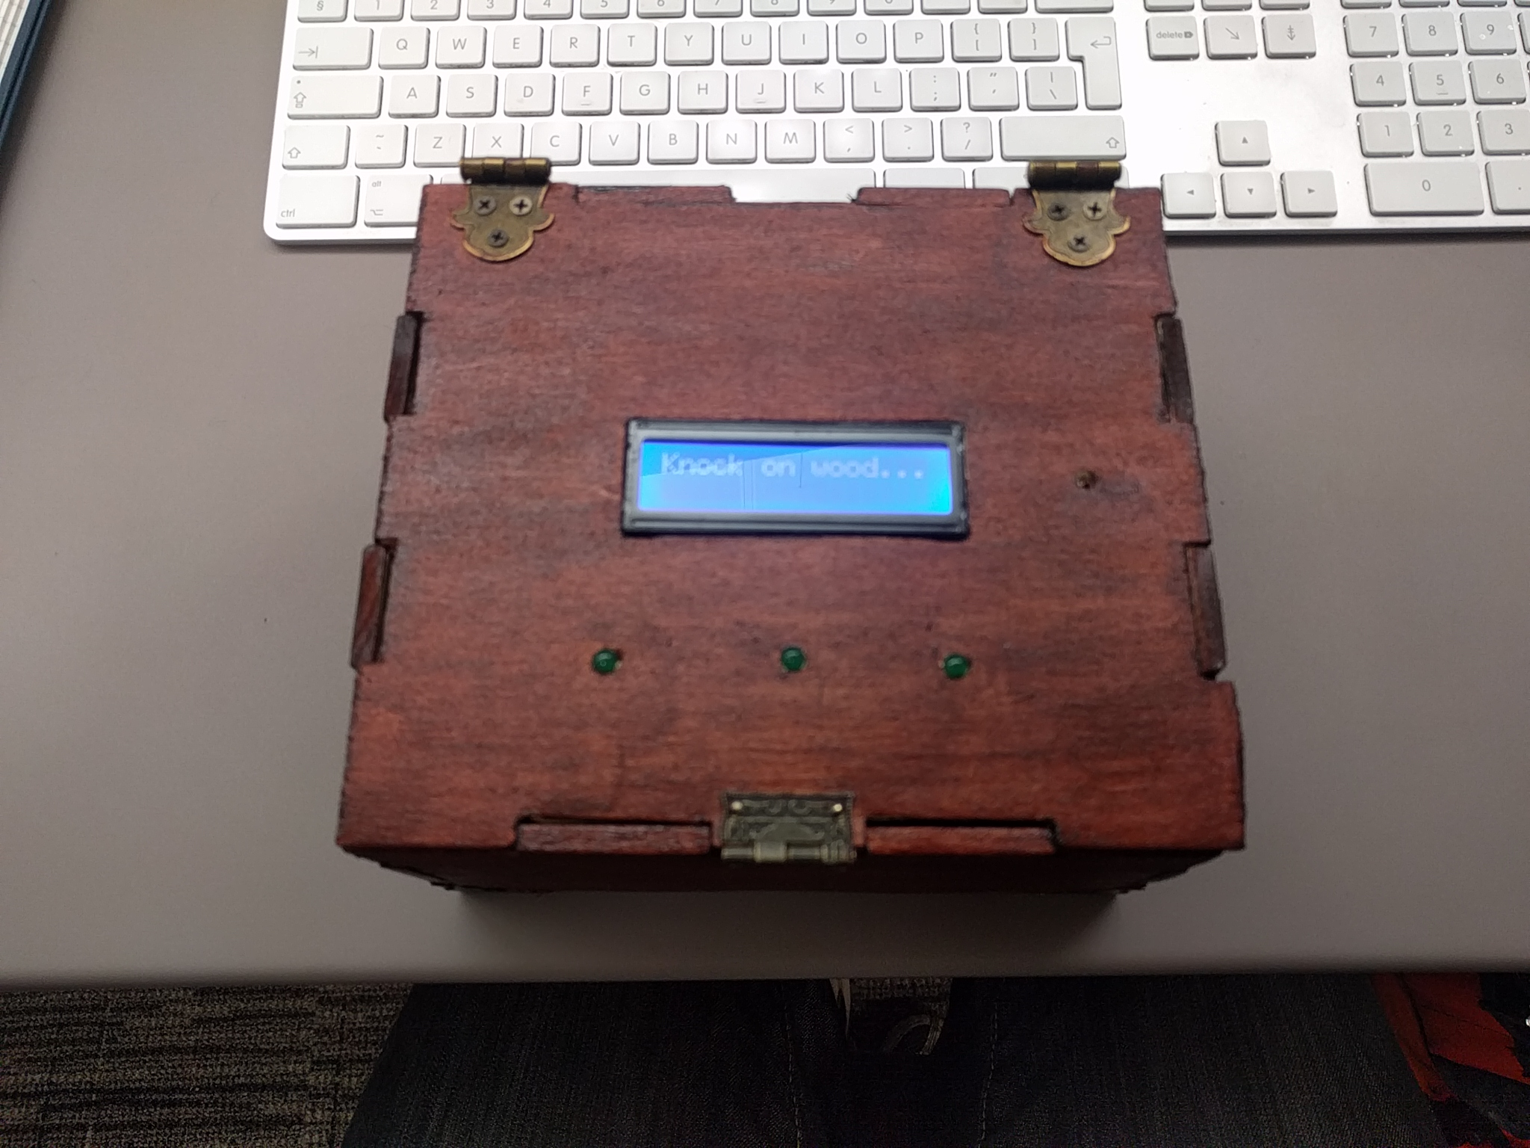
The game
Notes:
First statement draws you in
*
Gets you to recognise the box is to be interacted with

Slide 13
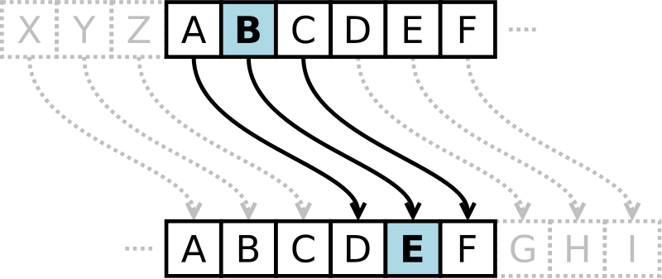
Lift me up high
Notes:
Three things to note here and they’ve cracked it:
*
1. Knocking no longer does anything
*
2. It’s a Caesar Cipher
*
3. Frequency Analysis for the key
*
Spaces and two-letter words

Slide 14

Roll me over
Notes:
If they recognise “me” is the same, they’ve essentially won by this point
*
Key is the same

Slide 15
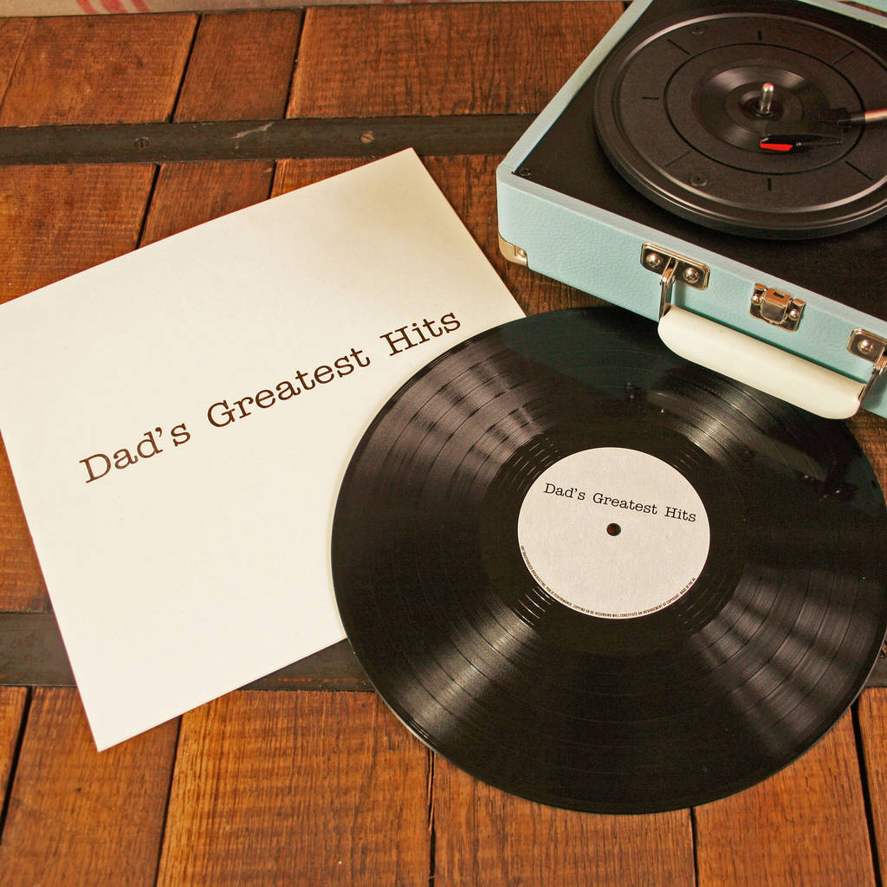
Turn me round

Slide 16

Applaud
Notes:
Should be tuned to ensure one person clapping doesn’t trigger it
*
Need the whole team

