Slide 1
Threat Modeling Workshop

Slide 2
Threat Modelling
Security is goals vs adversaries
Policy: What do you want the system to do?
Threat Model: Assumptions about the bad guys
Mechanisms: HW, SW and systems to mitigate
Notes:
"What are the possible ways in which the system, operating under a particular environment, may fail to satisfy its requirements?"
-
Define who you trust

Slide 3
Lecture Recap..
STRIDE, PASTA and DREAD

Slide 4
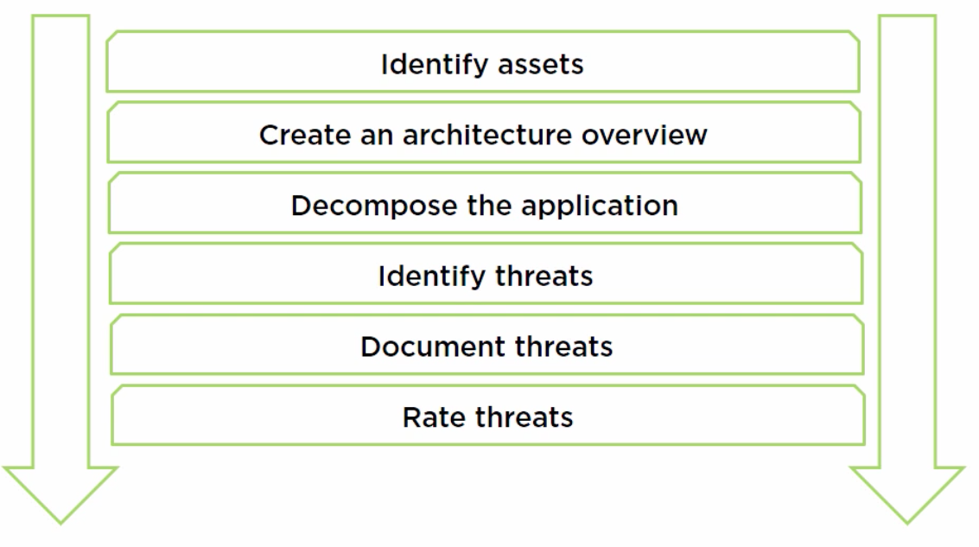
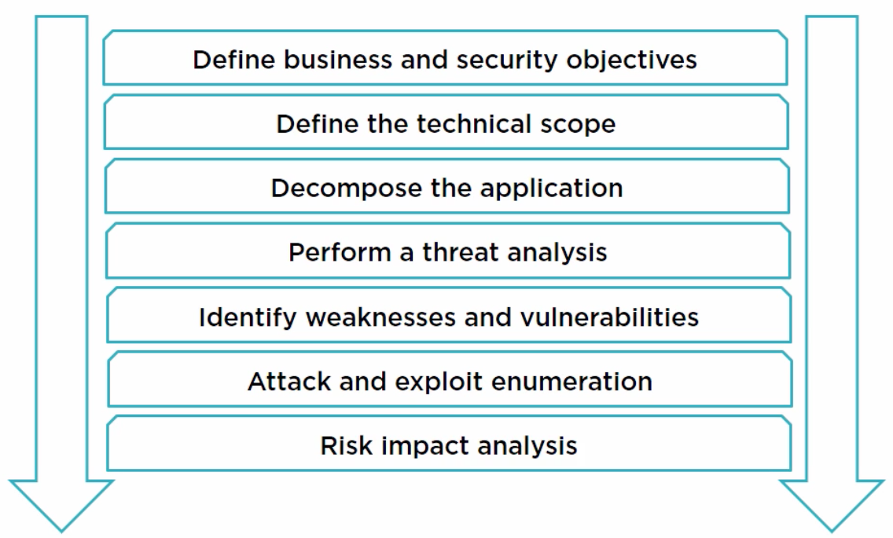
STRIDE PASTA
Notes:
<number>

Slide 5

Damage Reproducibility Exploitability Affected Users Discoverability
DREAD
None = 0 Low = 1 Medium =2 High =3
(D+R+E+A+D)/5 = RISK
Is RISK > 1:
Fix NAO
Is RISK <1:
FIX TOMORROW
(DreaD-D)

Slide 6
"All models are wrong, but some are useful"
George Box, 1976
Notes:
Negative goal => Harder to prove
-
Iterative process
-
Red team/ blue team

Slide 7



Netflix is offering user contributions!
Today’s challenge
Netflix
User submissions
Video Streaming
Facebook API
OAuth
User Identification
Amazon Web Services
Cloud storage
Microservices

Slide 8
Systems Thinking/ Trust Boundaries
Mat Honan, wired.com, 2012 - https://www.wired.com/2012/08/apple-amazon-mat-honan-hacking/
Gmail
Reset Password, sends to secondary email address
me.com (Apple)
Reset Password, requires address and last four digits of credit card
Amazon
Can add credit cards without being logged in, requires account name, email address and billing address (via phone)
Reset Password, requires credit card

