Slide 1

Capstone Project
Battle of the Neighbourhoods

Slide 2
Yo! SuSHI – International Expansion Project
YO! Sushi is a UK chain restaurants, serving mainly Sushi and other Japanese Food.
The majority of the YO! Sushi chain is in London, the capital and epicentre of the UK’s economy.
The aim of this study was to find the optimal location to build a YO! Sushi within New York City – the USA’s economic hub.

Slide 3
Data Section
Food venue locations acquired through Foursquare API.
Zip codes for New York City taken from their open data portal.
YO! Sushi restaurants found in London using a google maps search. They were further processed by geocoding them through Doogle Geocoder.

Slide 4
Methodology
The first way the data was analysed was through k-means clustering, to find locations in New York City that are similar to those around the YO! Sushi restaurants.
The second way the data was analysed was through exploratory data analysis. After processing, the data was searched to find the New York City zip codes that had the highest prevalences of Japanese or Sushi restaurants.

Slide 5
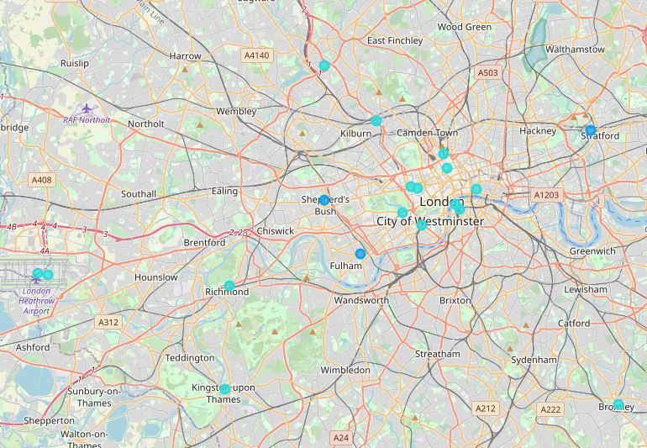
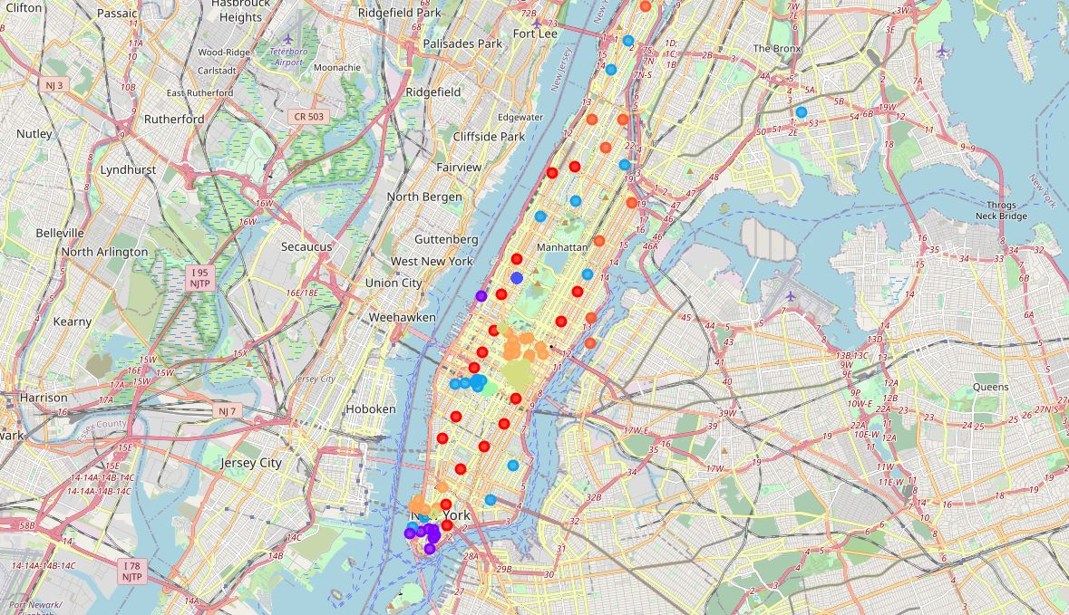
K-Means Clustering The common cluster shared by both the YO! Sushi postcodes and the New York City Zip codes is that of Cluster 3 – shown by the darker blue shaded dots on each of the maps. There is a large cluster around Madison Square garden - Pennsylvania station. This would suggest that this is the most optimal location for a new restaurant.

Slide 6
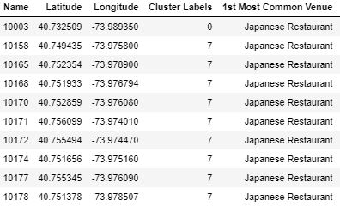
Exploratory analysis The exploratory analysis found that most zip codes with Japanese restaurants as the most common venue type, were in cluster 7. Most of cluster 7 is centred around grand central station, providing another potential location for a yo! Sushi restaurant.

Slide 7
Conclusive remarks
The combination of both forms of analysis points to the areas of clusters 3 and 7 to be the most optimal locations for the opening of a new YO! Sushi restaurant.

