Slide 1
Ames, Iowa Median Home Sale Predictors
Lets take a look at recent Ames, Iowa house sales to prove why a house will sell above or below its local median prices.
Alec Engel

Slide 2

Noteworthy Descriptive Findings
Homes with type 1 finished basement areas were missing square footage calculations.
Total Basement Square Footage
-Type 2 Basement Square Foot
-Unfinished Basement Square Foot
= Type 1 Basement Square Footage
Particularly weak variables
Garage condition and finish
Unfinished basement square footage
Street connected to property
Home functionality
Possible outliers were removed from quantitative variables.
Other sub-categories were created to combine small portions of Neighborhoods, overall quality/conditions, exterior materials, home sale types, and different types of dwellings

Slide 3
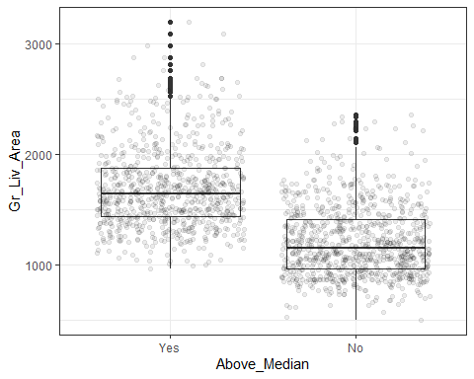
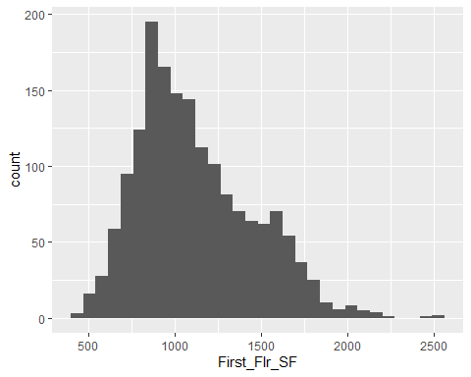
Square Feet of Above Grade Living Area
Homes with over 1,400 square feet of grade living area are much more likely to sell above the median.
The smaller a home’s first floor living space is, the more likely a home sis to sell for below median.

Slide 4
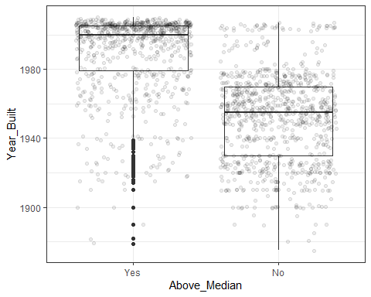
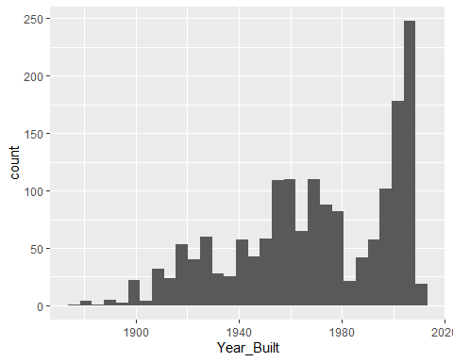
Original Home Construction Date
Homes built after 1980 are strongly correlated to a sale price above median.
The more recent a home was built, the higher the probability that a home will sell above median value.

Slide 5
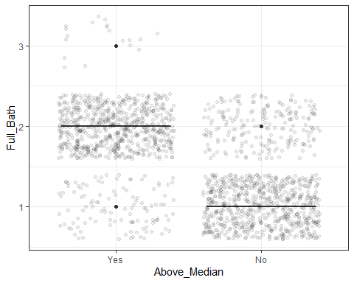
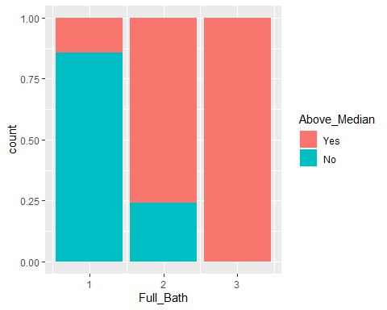
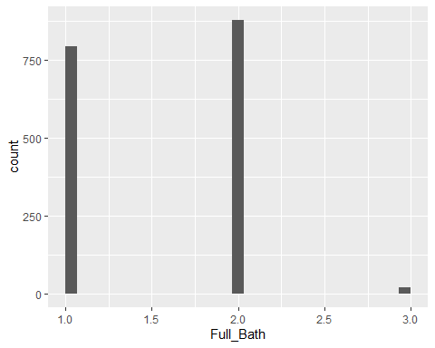
Full Bathrooms Above Grade
Homes with 2 bathrooms above grade are 76% likely to sell above median while 100% of 3 bathroom homes sell above median.
Homes with only one full bathroom above grade will sell below median price 86% of the time.
1 2 3 Yes 0.144 0.759 1.000 No 0.856 0.241 0.000

Slide 6
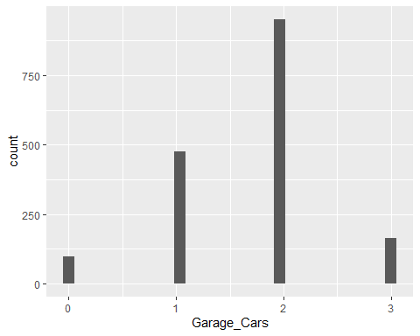
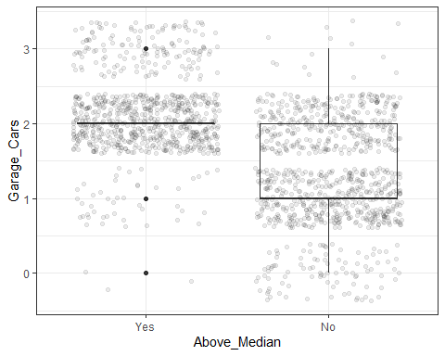
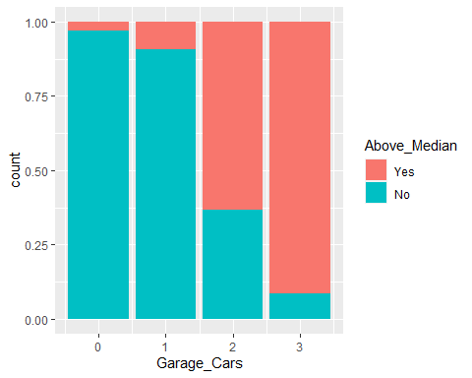
Size of Garage in Car Capacity
0 1 2 3 Yes 0.0306 0.0922 0.6334 0.9141 No 0.9694 0.9078 0.3666 0.0859
Homes with 2 car garages will sell above median 63% of the time while 3 car garages yield a home sales price above the median 91% of the time.
Homes with no garage will sell below median price 97% of the time.

Slide 7
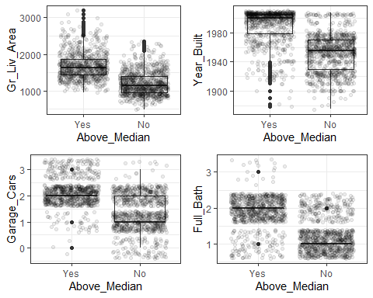
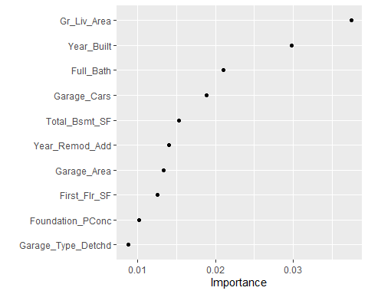
Summary
Most important predictors of a home in Ames, Iowa selling above or below it’s median home price:
Above grade living area
The year a house was built
The number of full bathrooms above grade
The amount of cars a house’s garage can fit

