Slide 1
Ames, Iowa Median Home Sale Predictions
Lets take a look at recent Ames, Iowa house sales to prove why a house will sell above or below its local median prices.
Alec Engel

Slide 2

Strongest Predictive Models Used
Strong
Tuned Neural Network Models
Tuned XGBOOST Models
Particularly Weak
Random Forest Models
Classification Tree Models
Logistic Regression Models

Slide 3
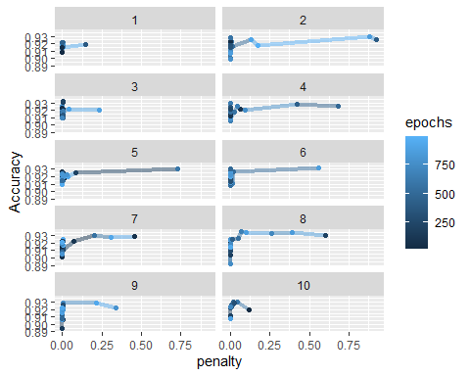
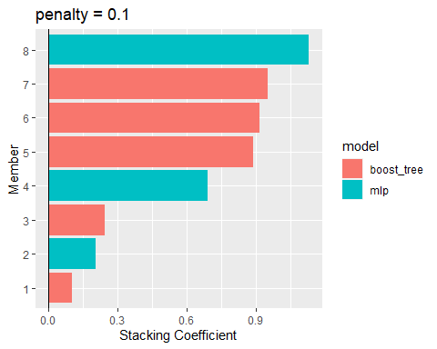
Most Significant Models
Tuned Neural Network Models
Tuned XGBOOST Tree Models

Slide 4
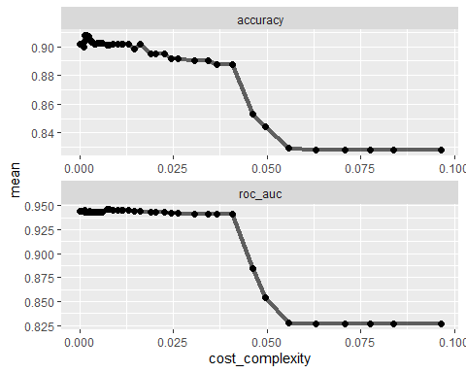
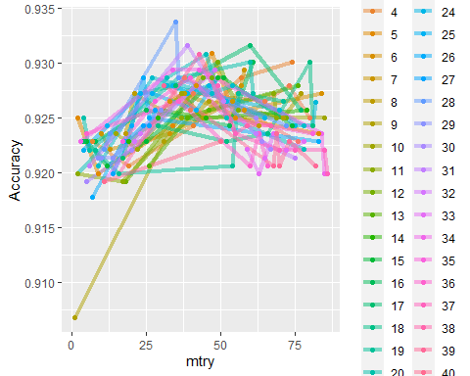
Less Significant Models
These charts along with their models are much less significant. Accuracy on the training set is well below our final stacked model of 99.49%. These models were removed from final stacked model.
Random Forest Model Accuracy Chart
Classification Tree Model Accuracy Chart

Slide 5
Stacked Model
Stacked model outperforms compared to constituent models on the testing set at 91.25%.
.metric .estimator .estimate member <chr> <chr> <dbl> <chr> 1 accuracy binary 1 Above_Median 2 accuracy binary 0.912 .pred_class 3 accuracy binary 0.906 .pred_class_xgb_res_1_11 4 accuracy binary 0.906 .pred_class_xgb_res_1_15 5 accuracy binary 0.908 .pred_class_xgb_res_1_24 6 accuracy binary 0.899 .pred_class_xgb_res_1_27 7 accuracy binary 0.902 .pred_class_xgb_res_1_53 8 accuracy binary 0.893 .pred_class_neural_tune_res_1_13 9 accuracy binary 0.906 .pred_class_neural_tune_res_1_27 10 accuracy binary 0.904 .pred_class_neural_tune_res_1_20

Slide 6
Summary
Model Performance on Train and Test Sets
Prediction Against Training Set Prediction Yes No Yes 676 3 No 4 690 Accuracy : 0.9949 95% CI : (0.9895, 0.9979) No Information Rate : 0.5047 P-Value(significance) [Acc > NIR] : <2e-16
Prediction Against Testing Set Prediction Yes No Yes 204 18 No 22 213 Accuracy : 0.9125 95% CI : (0.8827, 0.9367) No Information Rate : 0.5055 P-Value(significance) [Acc > NIR] : <2e-16
With only a drop off of 8.24% between train and test data predictions, I feel very confident in predictions submitted for any future data.

