Slide 1
NHL Contract Values for the 2020-2021 Season
We will compare advanced analytic data on NHL player performances with their salaries. This is in the hopes of finding correlations and determining what players may be worth their contracts and players are drastically overpaid.
Alec Engel

Slide 2

Hockey Analytic Terms
(CF%) Corsi % = (shot attempts for)/(shot attempts for + shot attempts against) while on the ice 5v5
Shot attempt = (shots on goal + shots blocked by defender + shots that miss the net)
(FF%) Fenwick For % = Corsi %, but excluding shots blocked by defender
(PDO) SPSV% = Off/Def Ratio of team shooting % + save % (GF/SF)+(GA/SA) while on the ice 5v5
(SCF%) Scoring Chances For % = (SCF)/(SCF + SCA) while on the ice 5v5
(HDCF%) High Danger Chances For % = (HDCF)/(HDCF + HDCA) while on the ice 5v5

Slide 3
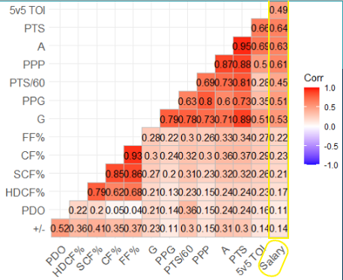
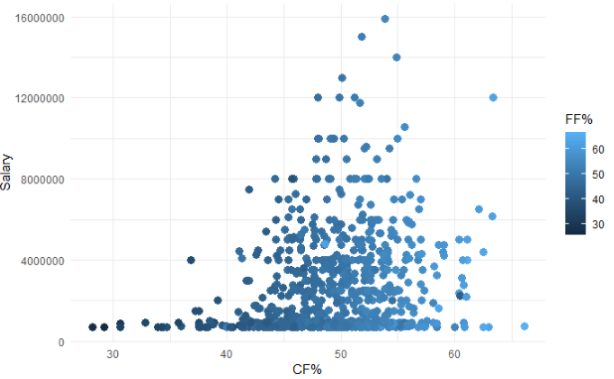
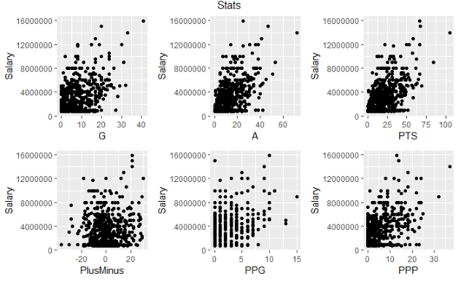
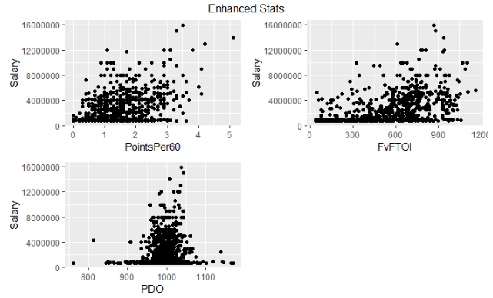
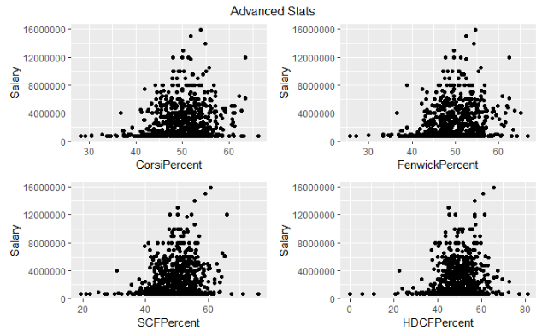
Do any advanced stat measurements provide correlation info about possible contract negotiation tactics?
Salary Correlations
Salary Per CF% & FF%
Highest salary correlations = points(Basic), five on five time on ice(Enhanced) and Corsi%(Advanced)
Lowest salary correlations = PDO, +/-, HDCF%
Corsi% highly correlated and dominant over FF% and SCF%

Slide 4
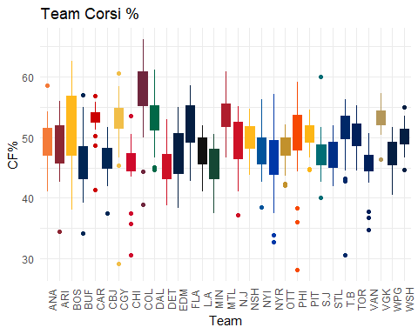
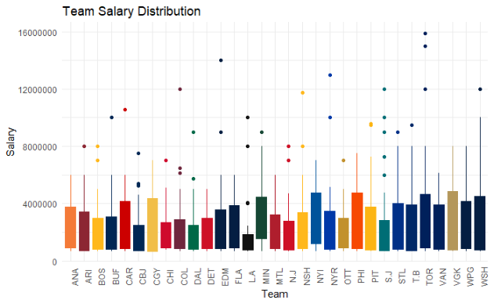
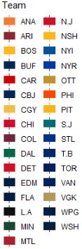
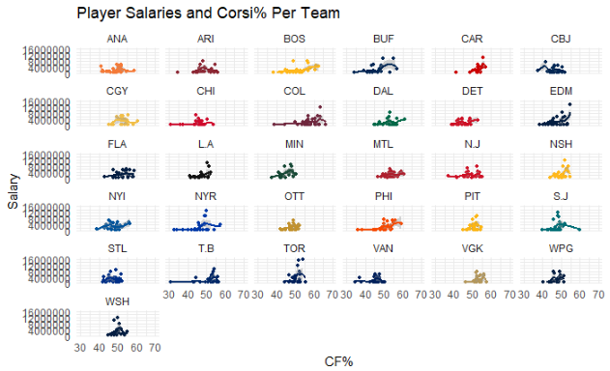
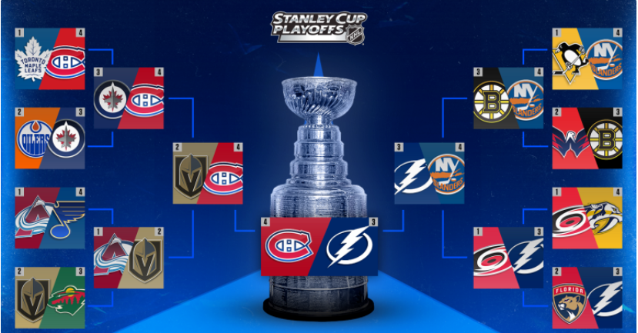
Did any teams gain a large competitive advantage by better managing their player values on contracts?
Teams without player salary outliers performed better in the 2020-2021 playoffs
Final 4 teams shows only the Islanders had a single player salary outlier
COL, T.B, MTL, VGK look to have had best team CF%
CAR, COL, EDM, NSH, PHI, T.B look to have closest salary correlations to individual player Corsi%

Slide 5
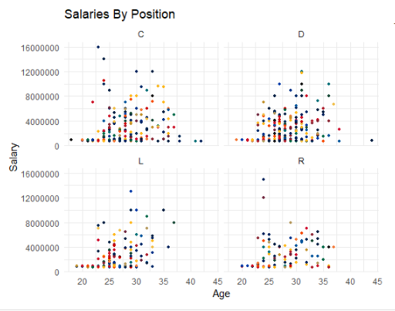

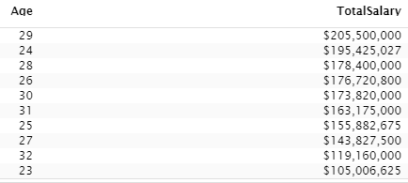
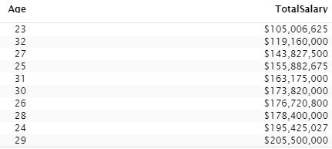
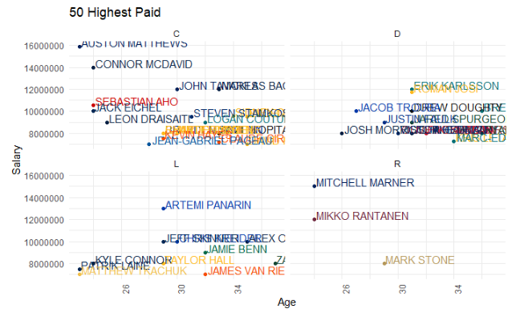
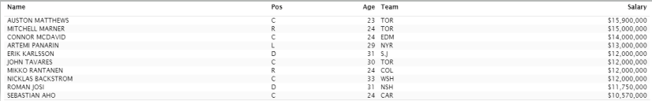
Are there any trends in the type of players or positions that receive larger contracts?
Highest contract values for players ages 24-31
Average salaries similar amongst all positions
Highest paid positions are Center and Defenseman
Right Wingers who earn large contracts are far and few between
None of the top 10 highest paid players made it past the second round of the playoffs

Slide 6
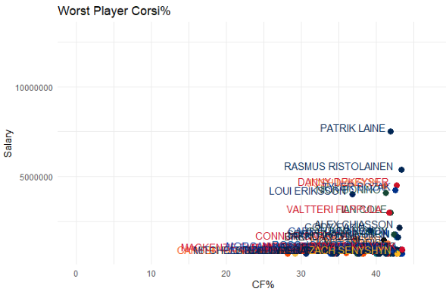
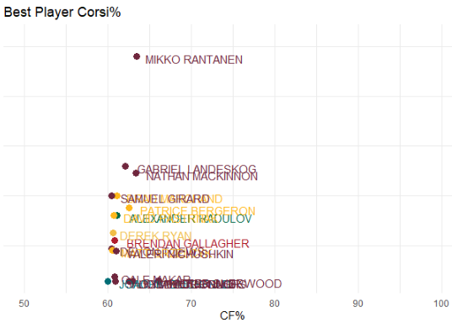
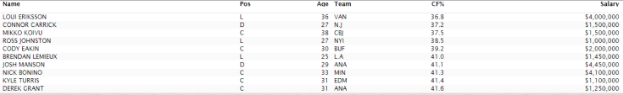
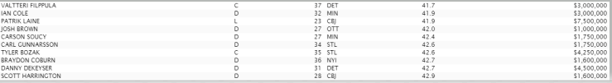
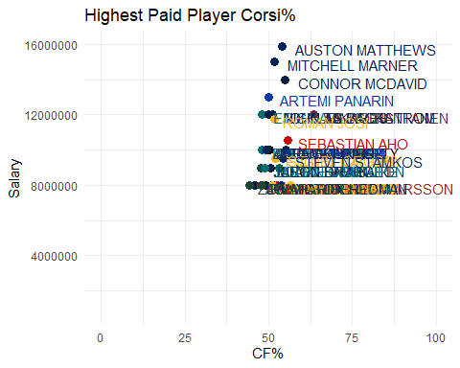
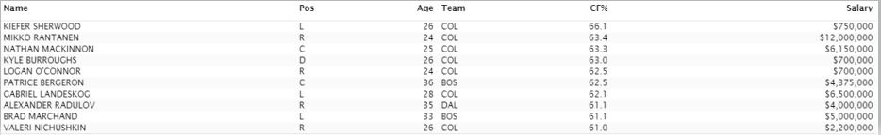
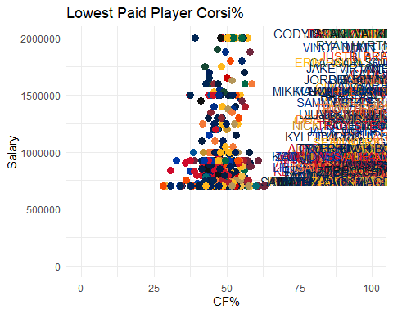

Individual Player Highs and Lows
Worst Corsi For % of player making > $1mm
Best Corsi For %

Slide 7
Summary
Hockey salaries still seem to correlate highest with simple point statistics(Points & 5v5TOI) while the NHL is still working to catch up with more progressive sports leagues and fully utilize advanced statistics such as Corsi%.
This data emphasizes that the most successful playoff teams don’t necessarily have the highest upper tiered salary players on their team. It represents how much of a team sport hockey is and the parity that exists within the league.
Teams need to focus on drafting strong Centers and Defensemen. If successful, teams should capitalize on their skill while still young and on their lower paying first or second year contracts.
High overall team Corsi% from the regular season does correlate to playoff success.
The Colorado Avalanche however are an outlier as they were by far the best performing team of the 2020-2021 regular season. Further research could be performed to see how to translate regular season success to postseason success as Colorado didn’t make it past the second round of the playoffs. The Avalanche had 11 of the top 20 Corsi% players in the entire league and with a well distributed salary which looked to rewarded players with higher Corsi%.
Resources
https://puckpedia.com/players https://www.naturalstattrick.com https://www.capfriendly.com

