Slide 1

Binary Classification Prediction for type of Breast Cancer
Machine learning project - 2022-2023 Author: Alexandros Filios - mtn2219
Supervisor: Theodoros Giannakopoulos

Slide 2
Table of Contents
Introduction
Data Processing
Feature Selection
Feature Scaling
Model Training & Evaluation

Slide 3
Introduction

Slide 4



Introduction

Slide 5
Breast Cancer
Breast cancer is a major public health concern worldwide, as it is the most common cancer among women and the second most common cancer overall.
According to the World Health Organization, breast cancer accounted for 25% of all cancer cases and affected over 2.1 million people in 2015 alone.
The disease occurs when the cells in the breast begin to grow uncontrollably, often forming tumors that can be detected through imaging or felt as lumps in the breast area.
Early detection and treatment are crucial for improving the prognosis of breast cancer patients.

Slide 6
Project Description
In this classification problem, we are given a dataset of breast cancer cases, with 30 features each . These features include measurements of the tumors.
The goal of this study is to use these features to predict whether a given case is malignant or benign, with the ultimate goal of improving the early detection and treatment of breast cancer.
The models that will be used in this study include various machine learning algorithms. These models will be trained and evaluated, in order to determine their effectiveness in predicting the type of breast cancer with and without feature engineering.

Slide 7
Goal
Identify the most relevant features for predicting breast cancer type by using various feature selection techniques such as histograms, Pearson correlation, wrapper methods, and Lasso.
Evaluate the performance of the models before and after feature engineering, in order to determine the impact of feature selection and scaling on the predictive power of the models.
Compare the performance of different models and identify which models are most effective for this classification problem and what factors contribute to their success.

Slide 8
Data Processing

Slide 9
Data Processing
X Train
Read the data
X : the feature vector
X Test
Access CSV file
Data Split
y: the target/label vector
Y Train
Class Label Imbalance
Y Test
Benign
Malignant

Slide 10
Feature Selection

Slide 11
Feature Selection Techniques
Histograms
Pearson Correlation Coefficient
Wrapper
Lasso
Method combination

Slide 12
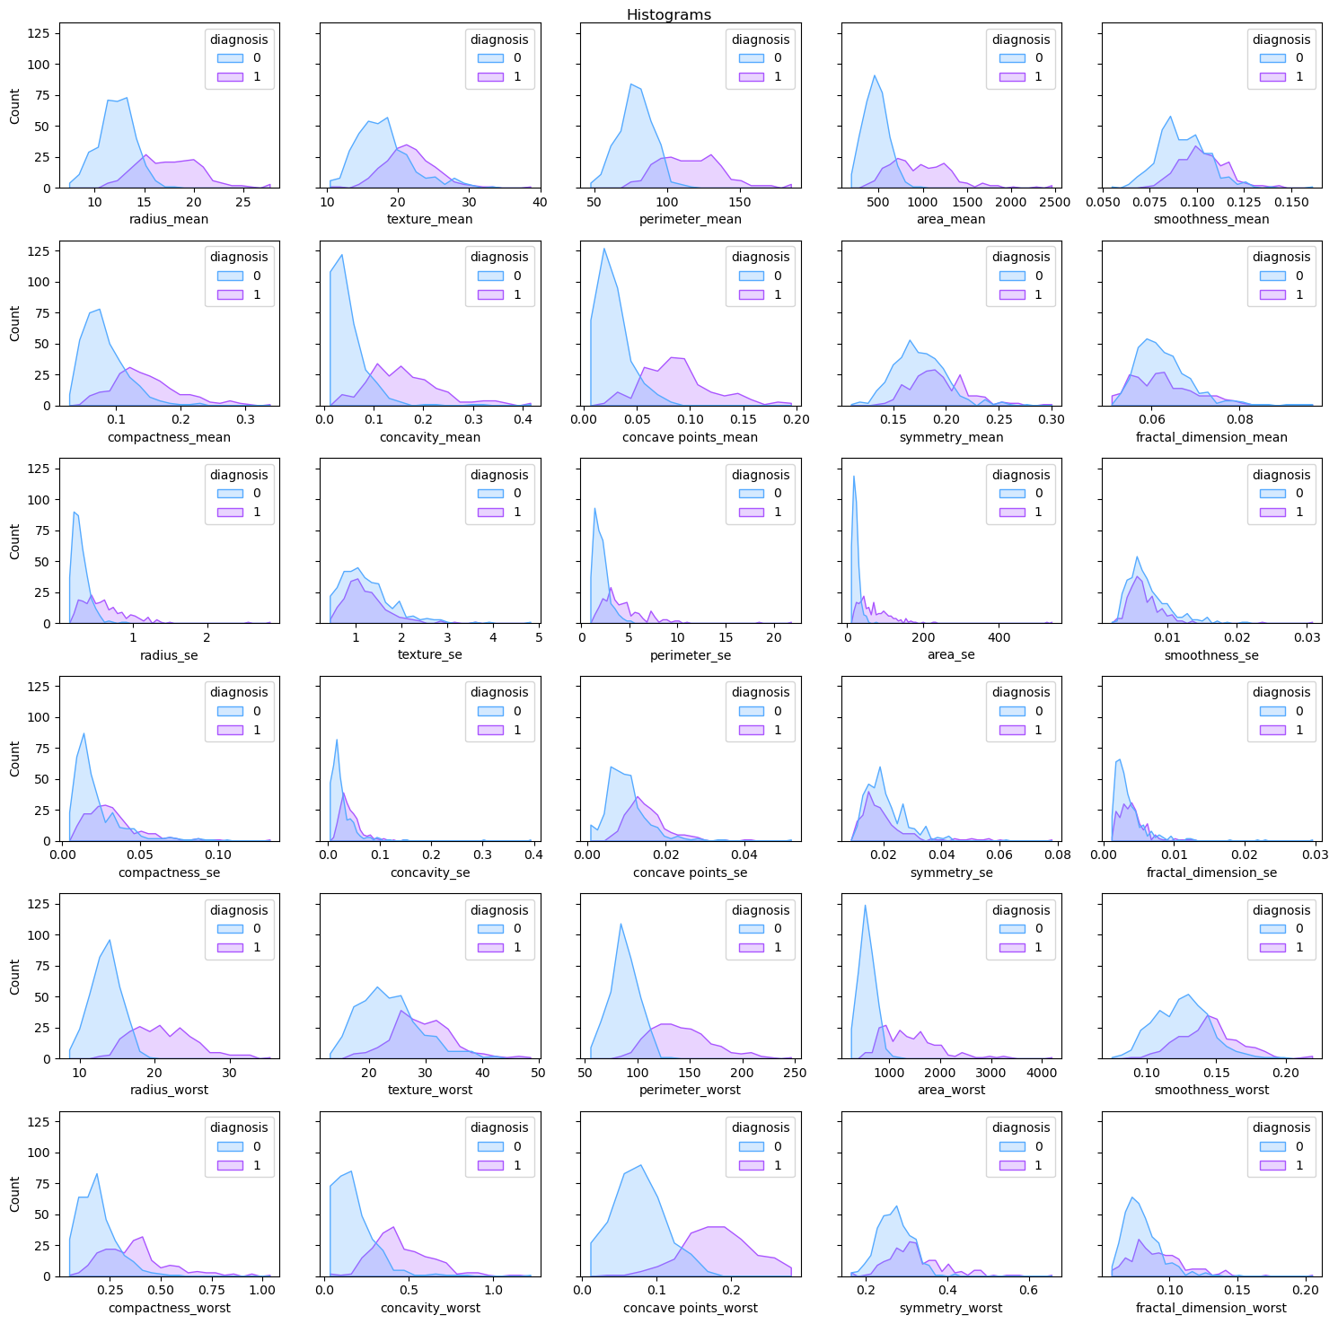
Histograms
We will keep a list of features that seem to have some correlation with the target value

Slide 13
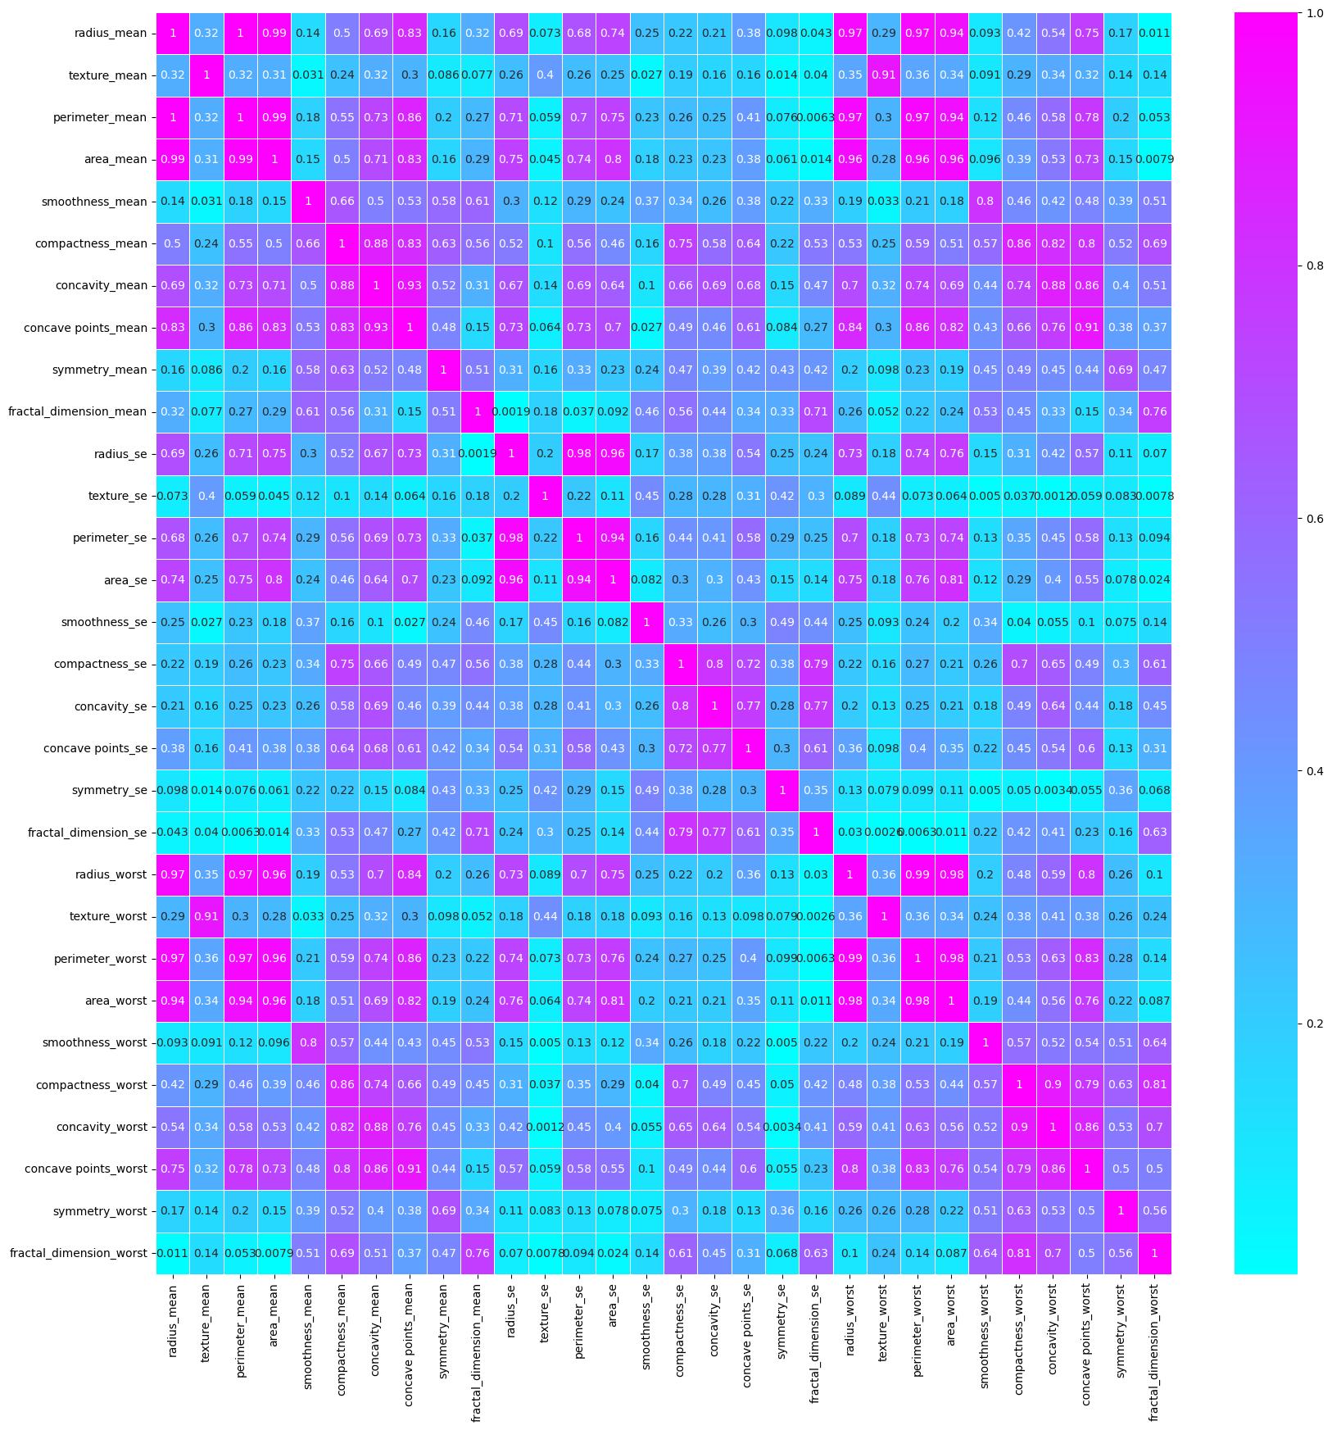
Pearson Correlation Coefficient
Kept only features that had less than 95% correlation

Slide 14
Wrapper Forward Selection
Wrapper Forward Selection is a feature selection method that involves selecting features in a stepwise manner. The process starts with an empty set of features and iteratively adds one feature at a time. At each step, the model is trained using the current set of features and the performance of the model is evaluated using a validation set. The feature that improves the performance the most is added to the set of selected features. This process is repeated until a stopping criterion is met (e.g., a maximum number of features is reached or the performance improvement is below a threshold). For this implementation we used Logistic Regression and kept half the features as a final result.

Slide 15
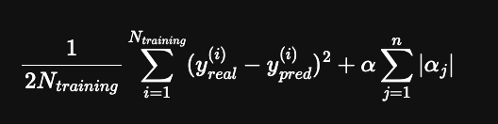
Lasso
The Lasso algorithm is a type of linear regression that is used for feature selection. It adds a penalty term to the regression objective function that penalizes the absolute values of the coefficients. This penalty term encourages many of the coefficients to be exactly zero, which has the effect of selecting a subset of the most important features. The hyperparameter α controls the strength of the penalty term and determines the trade-off between fitting the data well and keeping the model simple. The optimal value of α can be found using cross-validation.
N_training: the number of samples in the training set.
y_real(i): the true target value for the i-th sample
y_pred(i): the predicted target value for the i-th sample.
α_j is the coefficient of the j-th feature in the linear regression model.
α is the hyperparameter that controls the strength of the L1 penalty term.
n is the number of features in the dataset.

Slide 16
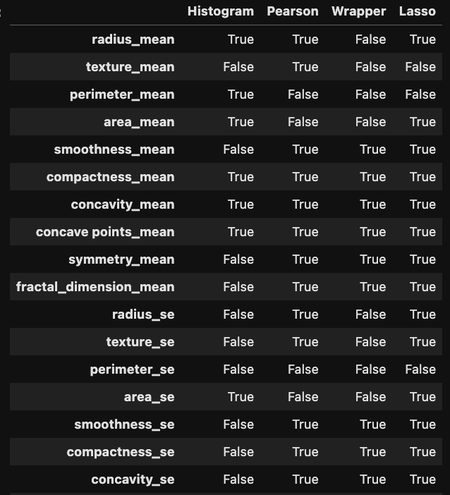
Method Combination
At this point a vote was applied by each and every method and only the features that had the majority of the votes (3 or 4) stayed for the final feature vector
. . .

Slide 17
Feature Scaling

Slide 18
Feature Scaling
More controlled range.
Avoid unwanted scenarios with numerical overflow.
Increased speed in learning, as well as, in other techniques.
The two most discussed scaling methods are Normalization and Standardization.
Normalization typically means to rescale the values into a range of [0,1].
Standardization typically means to rescale data to have a mean of 0 and a standard deviation of 1 (unit variance).
In this implementation we are going to use Standardization as it is more reliable and not that disturbed when noise occurs in the data.

Slide 19
Model Training & Evaluation

Slide 20
Model Training & Evaluation
Logistic Regression
KNN (k-nearest neighbours algorithm)
Naive Bayes classifier
Gaussian Discriminant Analysis
SVM (Support vector machine)
Decision Tree, Random Forest
Gradient Boosting
AdaBoost (Adaptive Boosting)

Slide 21
Model Training & Evaluation
Accuracy: Measures how often a model correctly predicts the target class.
F1 Score: Measures the balance between precision and recall.
Precision: Measures how often the model correctly identifies a positive instance.
Recall: Measures how often the model correctly identifies all positive instances.
Balanced Accuracy: Measures the average recall obtained on each class, useful when classes are imbalanced.

Slide 22
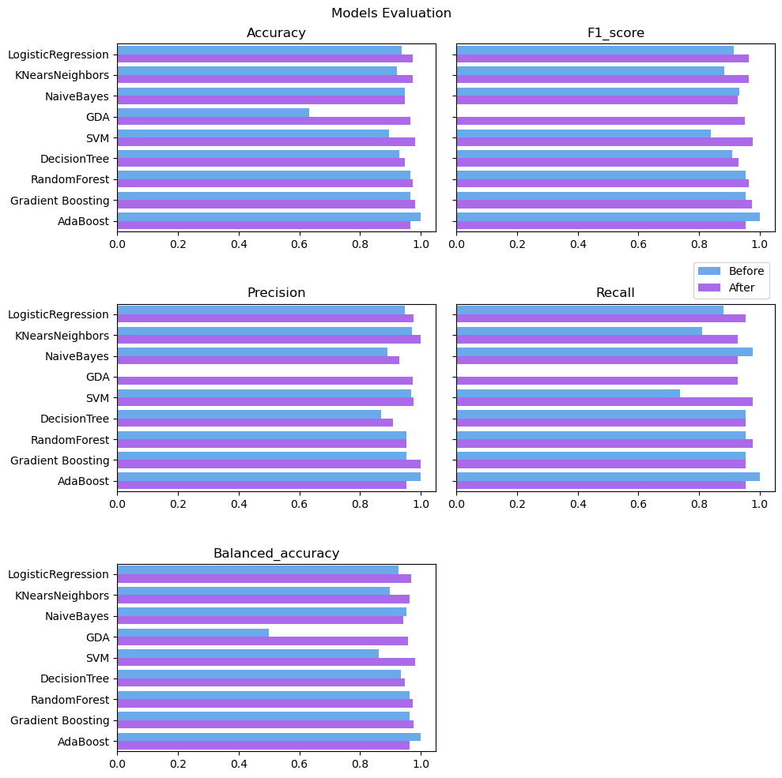
Model Training & Evaluation

Slide 23
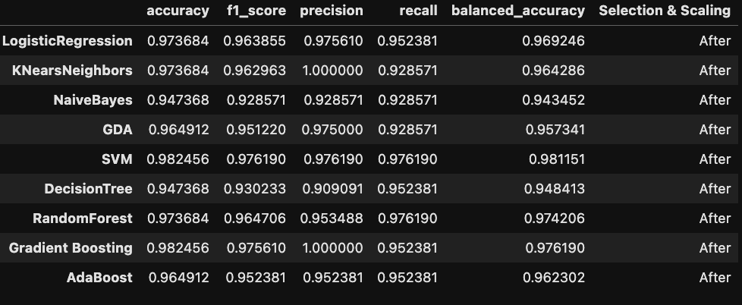
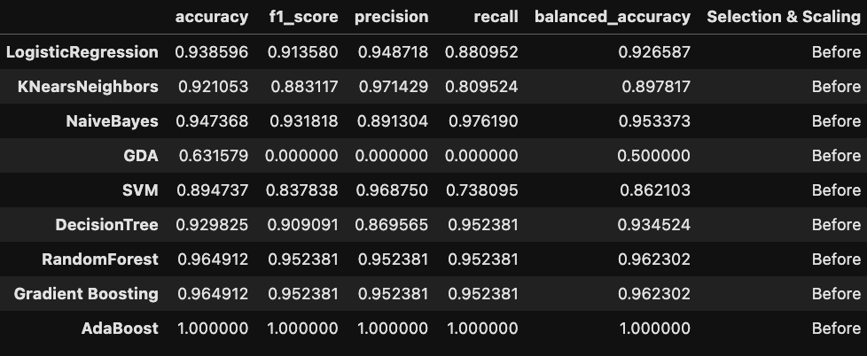
Model Training & Evaluation

Slide 24
Thank you

