Slide 1
Voicebarf. A Lightning Talk at 26C3.
7666
7666
7666
7666


(S O O N)
(S O O N)
(S O O N)
(S O O N)
8255
(T A L K)
Alexander Klink. December 27th, 2009.

Slide 2
Voicebarf. A Lightning Talk at 26C3.
Voicebarf = Pentabarf + Asterisk
  Pentabarf: conference planning
  Asterisk: VoIP server
A voice interface for conferences
Supports reminders & rating via phone
Alexander Klink. December 27th, 2009.

Slide 3
Voicebarf. A Lightning Talk at 26C3.
7666
7666
7666
7666


(S O O N)
(S O O N)
(S O O N)
(S O O N)
8255
(T A L K)

Slide 4
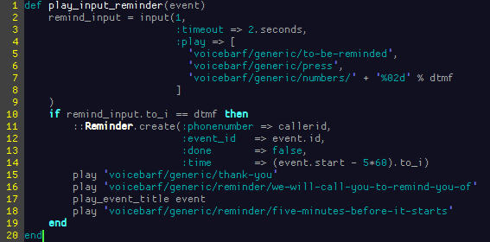
Voicebarf. A Lightning Talk at 26C3.
Implemented in Ruby using the Adhearsion framework
Alexander Klink. December 27th, 2009.

Slide 5
Voicebarf. A Lightning Talk at 26C3.
7666
7666
7666
7666


(S O O N)
(S O O N)
(S O O N)
(S O O N)
8255
(T A L K)

Slide 6
Voicebarf. A Lightning Talk at 26C3.
http://git.alech.de/?p=voicebarf.git
Talk to me if you want to run it
voicebarf@alech.de, DECT 2412
@alech on Twitter
Thanks to:
  @h1723c (coding, recordings)
  @timpritlove (last minute studio)
Alexander Klink. December 27th, 2009.

