Slide 1
Classifiying MRI Data as Demented or Nondemented
Alec Hay
Notes:
Goal: to build a model using Deep Learning and Tensorflow that can accurately classify T1-weighted MRI scans as demented or nondemented.

Slide 2
Introduction
Dementia is a syndrome – usually of a chronic or progressive nature – in which there is deterioration in cognitive function (i.e. the ability to process thought) beyond what might be expected from normal ageing.
Around 50 million people worldwide have dementia, and every year, there are nearly 10 million new cases.
Although we don't yet have a cure for dementia, early diagnosis allows optimal management of patients.
However, brain scans are time-intensive and costly
(WHO, https://www.who.int/news-room/fact-sheets/detail/dementia)
(Cedars Sinai, https://www.cedars-sinai.org/programs/imaging-center/exams/mri/brain.html)
(Affordable Scan, https://affordablescan.com/blog/brain-mri-cost/Machine)

Slide 3
Introduction
Dementia is a syndrome – usually of a chronic or progressive nature – in which there is deterioration in cognitive function (i.e. the ability to process thought) beyond what might be expected from normal ageing.
Around 50 million people worldwide have dementia, and every year, there are nearly 10 million new cases.
Although we don't yet have a cure for dementia, early diagnosis allows optimal management of patients.
However, brain scans are time-intensive and costly
How do we solve this problem? Deep learning!
(WHO, https://www.who.int/news-room/fact-sheets/detail/dementia)
(Cedars Sinai, https://www.cedars-sinai.org/programs/imaging-center/exams/mri/brain.html)
(Affordable Scan, https://affordablescan.com/blog/brain-mri-cost/Machine)

Slide 4
Data
OASIS-2 dataset
Longitudinal collection of 150 subjects aged 60 to 96
72 of the subjects were characterized as nondemented
64 of the subjects were characterized as demented
14 subjects were characterized as “converted”
OASIS: Longitudinal: Principal Investigators: D. Marcus, R, Buckner, J. Csernansky, J. Morris; P50 AG05681, P01 AG03991, P01 AG026276, R01 AG021910, P20 MH071616, U24 RR021382 (https://www.oasis-brains.org/)

Slide 5
Accessing and filtering data
Download using download_data.py = 46 GB
Filter data using filter_data.py
Removed all “converted” subjects
Kept only first scan from first visit
Result: filtered.zip = 2 GB
Upload to Google Drive, access through Google Colab
Notes:
I downloaded the data using the download_data.py script in this repository. The resulting dataset was nearly 46 GB, which was quite large given my limited computing power.
I filtered and compressed the data using filter_data.py to make the data more manageable. The resulting file, filtered_data.zip, was just under 2 GB, small enough to be uploaded to my Google Drive to be accessed in Google Colab.
To filter the data, I did the following things:
I removed all the 'converted' subjects, because it was unclear at which point they went from dementia-free to having dementia.
For each subject, I kept just the first scan from their first visit. This further cut down the file size.

Slide 6
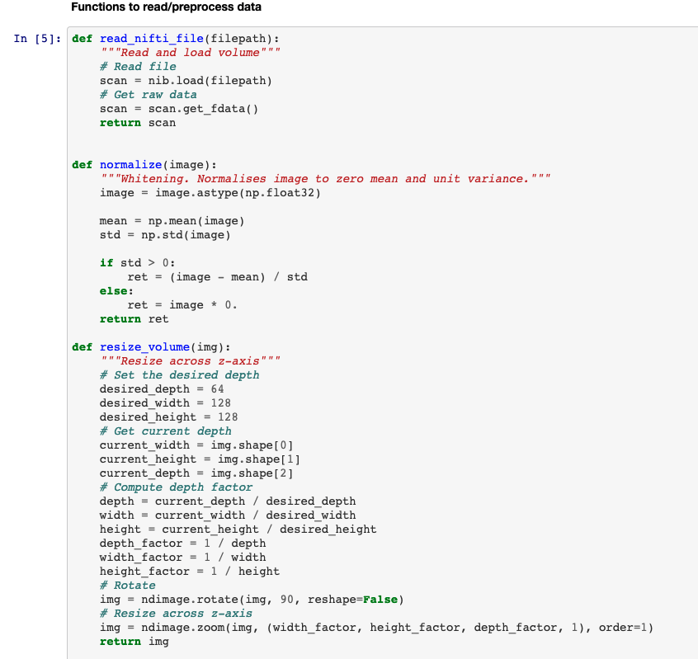
Loading data and preprocessing
Loaded the MRI data using the nibabel package
Normalized the image to zero mean and unit variance
Resized it to a smaller numpy array: (256, 256, 128) to (128, 128, 64)
Notes:
I resized the image simply because it allowed for faster training and processing speed.
Don’t show it here, but then I did a 70/30 train/validation split
136 total images
72 nondemented scans, 64 demented scans
94 train images, 42 validation images

Slide 7
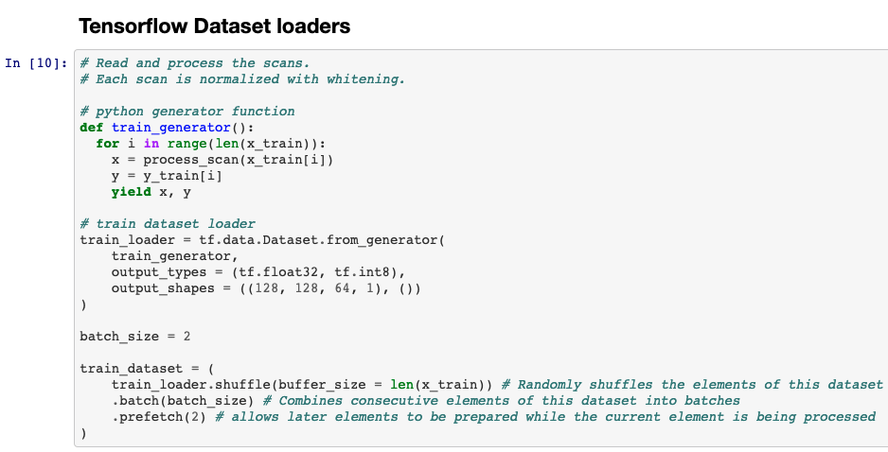
Loading data and preprocessing
Notes:
Because all of these images could not be stored in memory at once, I had to create a python generator function to continuously load data while the model was training.
This function was used in a tf.data.Dataset object.
The tf.data.Dataset was shuffled upon loading the data and fed into the model with batch sizes of 2.

Slide 8
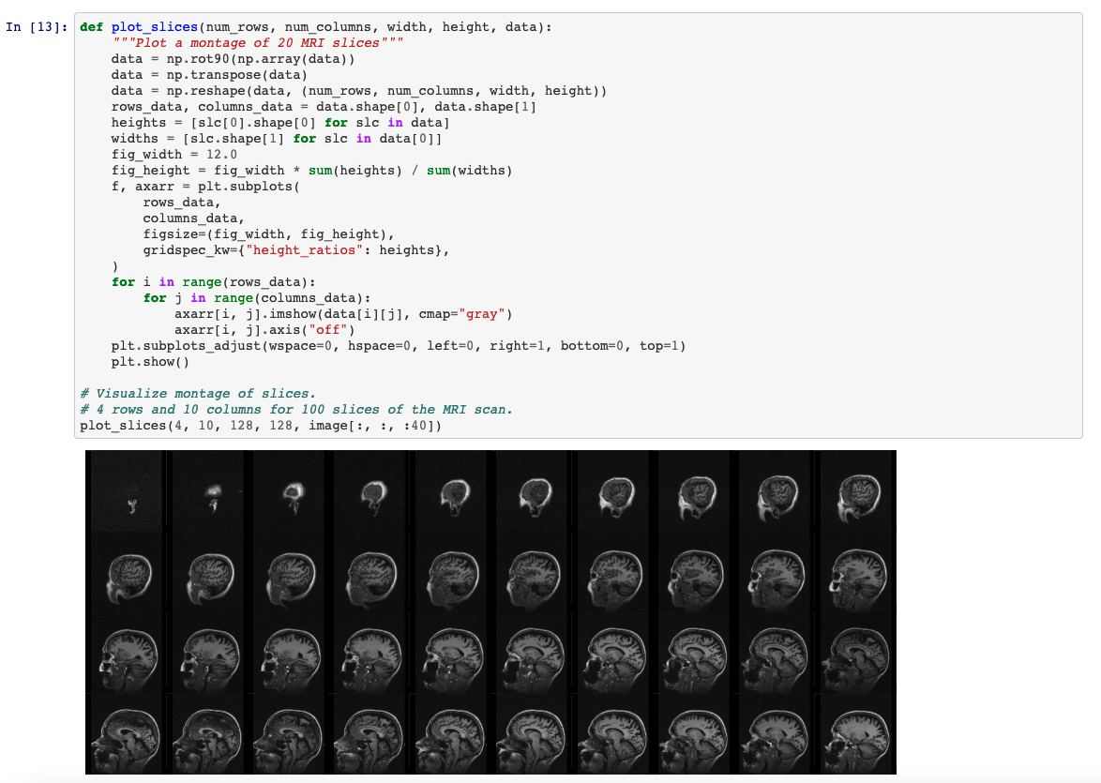
Visualize data
Notes:
I created functions that showed a montage of 20 slices. Here is an example:

Slide 9
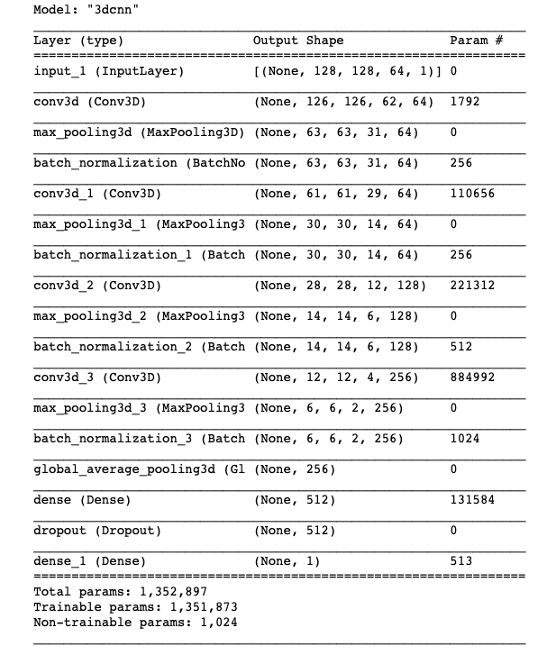
Define model
I created a model based on one by Zunair et al. 2020 (https://arxiv.org/abs/2007.13224 )
3D CNN should perform better than a 2D CNN on volumetric data, as there is important information in the depth dimension
However, the problem with feeding into a 3D CNN is that it is much more memory-intensive.
Notes:
I created a model based on one by Zunair et al. 2020 (https://arxiv.org/abs/2007.13224 ). It is predicated on the idea that a 3D CNN should perform better than a 2D CNN on volumetric data, as there is important information in the depth dimension. A 2D CNN independently deals with individual slices and therefore discards the depth information. However, the problem with feeding into a 3D CNN is that it is much more memory-intensive. That is why in the data processing step I resized my volume from (256, 256, 128) to (128, 128, 64). This downsampling allowed me to leverage the 3D information of the image without overwhelming my computer.
4 3D convolutional layers, each followed by a max pooling and batch normalization step.
I finished with a global average pooling layer, then a dense layer with 512 units, then a dropout layer to prevent overfitting.
My output layer was a 1-unit dense layer with a sigmoid activation function, which is often used in binary classification tasks.

Slide 10
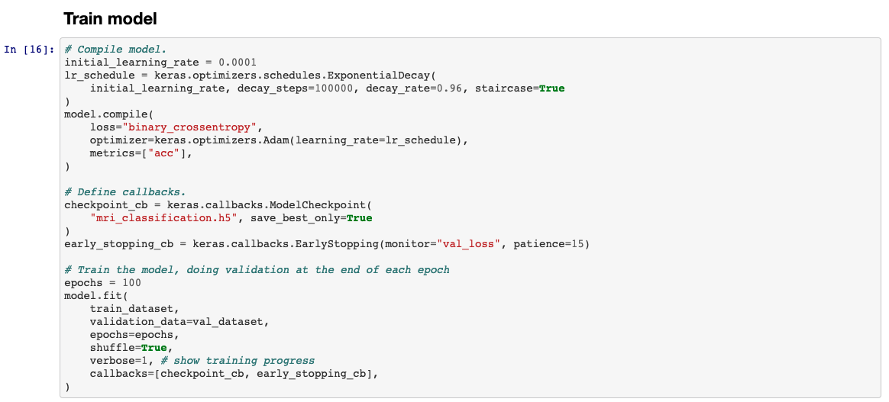
Model training
Notes:
I decided to use the 'adam' optimizer, which has proven to be effective in many image classification problems, such as MNIST digit recognition.
However, I implemented a slight twist based on the recommendation of Zunair et al., in that I set a conservative initial learning rate with an exponential decay.
I used binary cross-entropy as my loss function since it is a binary classification task.
I used accuracy as my metric, which is pretty standard.
I set a callback to stop training if the validation loss stopped improving, and a callback to save the best performing model.

Slide 11
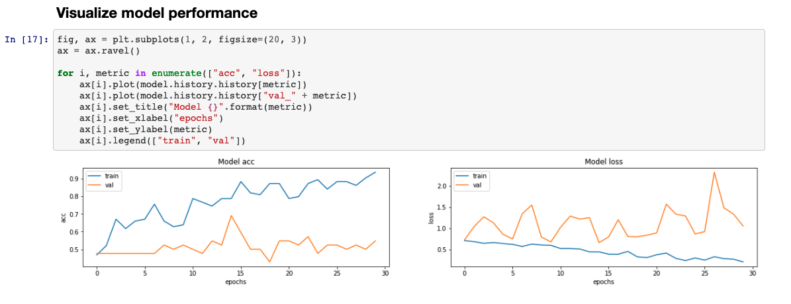
Model performance
Notes:
The model did not perform very well on the validation data. After 30 epochs, the validation loss stopped improving. The validation accuracy on the 30th epoch was actually just over 50%, but the best accuracy I achieved throughout training was 69%. Because that was the best performing model, that was the one that was saved. Here is a visualization of the model training.
Important to note: the training accuracy was actually quite high by the end, which is a sign of overfitting.
When I loaded that model and asked it to make predictions on single scans in the validation set, it was successful on the two examples that I selected.

Slide 12
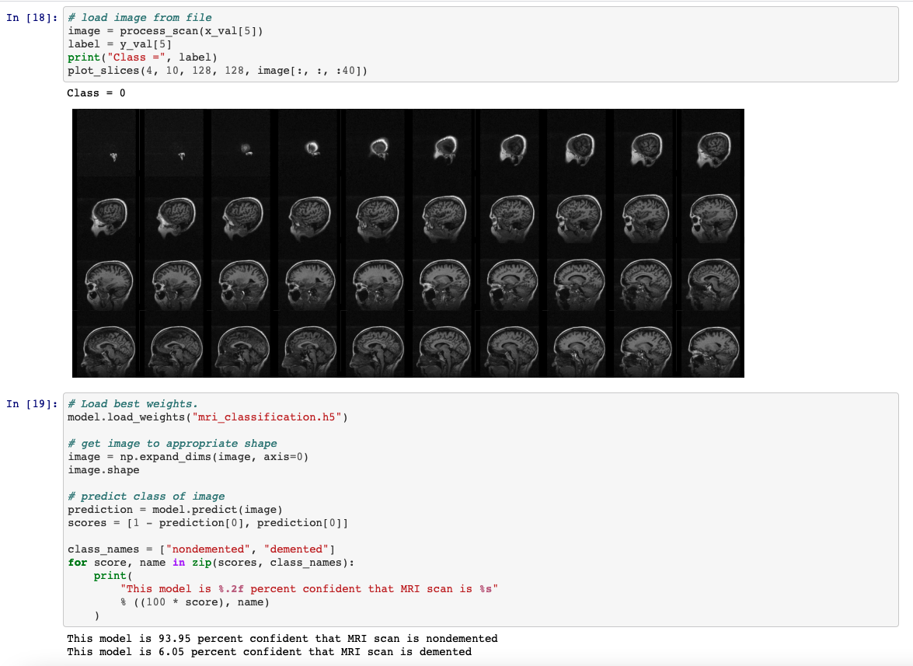
Notes:
Loaded scan from validation set. It was from class 0, or nondemented class.
Loaded the model and made a prediction.
94% confident that the scan is nondemented.

Slide 13
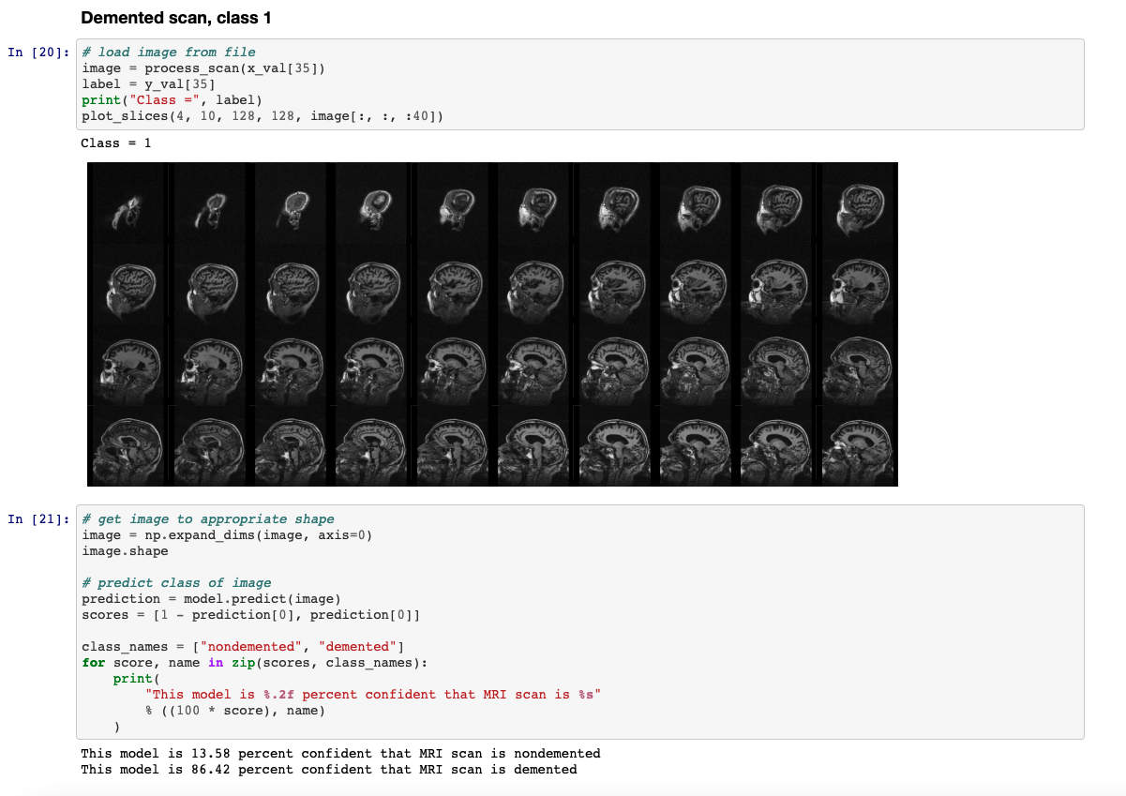
Notes:
Loaded scan from validation set. It was from class 1, or demented class.
Loaded the model and made a prediction.
86% confident that the scan is demented.

Slide 14
Discussion
In the end, the model did not perform very well on the validation data. There are a few explanations for that.
The model was trained on very few data points because training was so slow. Model was overfitted to training data.
Solution: tf.records dataset.
The data itself was flawed. Voxel intensities were normalized, but I didn’t do spatial normalization.
Solution: spatial normalization and data augmentation.
Model could have been flawed. Didn’t get to play around with hyperparameters.
For example, I want to try removing learning rate scheduler and adjust dropout.
Notes:
In the end, the model did not perform very well on the validation data. There are a few explanations for that.
The model was trained on very few data points. There were only 94 scans in the training set and 42 scans in the validation set. After 30 epochs, the model was overfitted to the training data and needed to be exposed to many more scans to become accurate on the validation set. However, as it was, the model training already took a very long time. 30 epochs of training took about 2 hours for me. This was because I had to use a generator function to load the data; I had to continuously load scans throughout training rather than just access them in memory. One solution to this problem is to create a tf.records dataset, but I simply did not have enough time to do that. A tf.records dataset allows you to train much faster because you get better use out of your GPU; Tensorflow takes care of loading more data while your GPU is crunching your numbers. As I work to improve the model, that will be my priority.
The data itself was flawed. Although I normalized the voxel intensities, I did not do spatial normalization. Therefore, the images probably had all sorts of different orientations. Some methods to counteract that are accounting for voxel spacing by resampling to an isotropic resolution or registering the images to the same space. I could also augment the dataset, adding in noise, rotations, or translations to existing images to expose the model to more examples during training. That would likely decrease overfitting.
Finally, my model could have been flawed. Because so much time was spent preparing the data and training the model, I didn't get a chance to play around with some of the model parameters. Perhaps adding or removing layers, changing the number of filters or units, adjusting the amount of dropout, or changing the loss function, etc. could have improved performance. For example, I would like to try using the 'adam' optimizer without setting a exponential decay learning rate, as that has been shown to work on many problems. I would also like to adjust the dropout, as my model was clearly overfitted to the training data. However, although these are all valid considerations, I think that first I should look to fix the data before the model.

Slide 15
Conclusion
It was good challenge to work with such a large dataset, and I learned a lot.
My goal was to build a model in Tensorflow that could accurately classify T1-weighted MRI scans as demented or nondemented.
My model did not perform very well, likely because there was not enough data, the data was flawed, and the model was not optimized.
I would like to improve performance by creating a tf.records dataset, allowing the model to see more data since it will be processed faster, and by tweaking the data and model.

Slide 16
Sources
Dataset: OASIS: Longitudinal: Principal Investigators: D. Marcus, R, Buckner, J. Csernansky, J. Morris; P50 AG05681, P01 AG03991, P01 AG026276, R01 AG021910, P20 MH071616, U24 RR021382 (https://www.oasis-brains.org/)
Model inspiration: Zunair, Hasib, et al. "Uniformizing Techniques to Process CT Scans with 3D CNNs for Tuberculosis Prediction." International Workshop on PRedictive Intelligence In MEdicine. Springer, Cham, 2020.
Other sources:
WHO (https://www.who.int/news-room/fact-sheets/detail/dementia)
Cedars Sinai (https://www.cedars-sinai.org/programs/imaging-center/exams/mri/brain.html)
AffordableScan (https://affordablescan.com/blog/brain-mri-cost/Machine)

