Slide 1

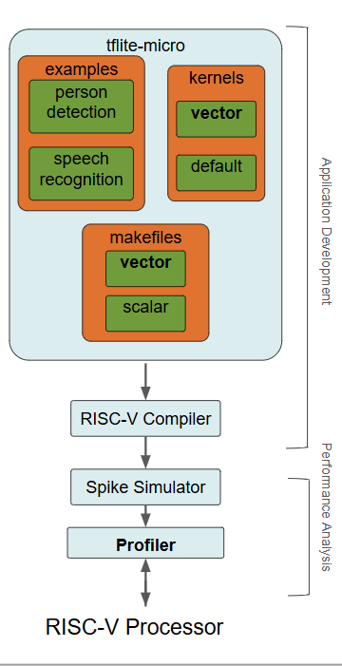
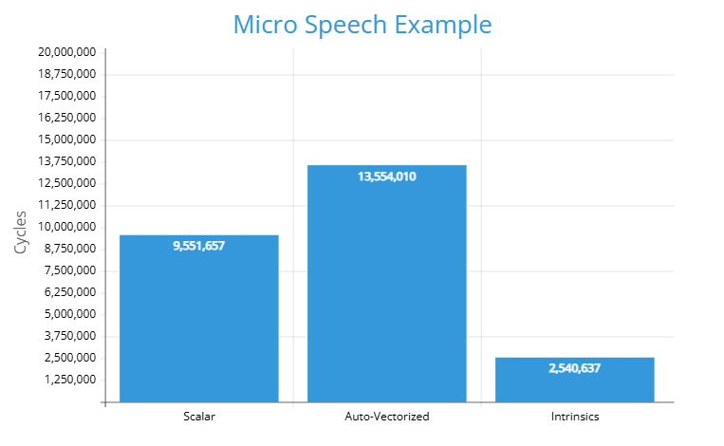
Optimization of LiteRT Micro for RISC-V
James Whitfield
Alec Freeman
Ollie Rayo
Avinash Mandala
James Dong
Jack Liau
Akhilesh Vemuri
RISC-V Processor Execution/Performance
Goal: Improve the performance of bottleneck TinyML operations by developing optimized TensorFlow Lite Micro kernels that leverage RISC-V Vector instructions to enable faster, more energy efficient edge computing machine learning
Approach:
Identified bottleneck TinyML operationsor kernels used in speech and person detection benchmarks
Implemented RISC-V vector intrinsic versions of bottleneck kernels
Evaluate performance for three different kernel code implementation or execution methods with performance script:
  Scalar, Auto-vectorized, and RISC-V intrinsic implementation
Speedup example:
Primary/Effective operations optimized in total:
Depthwise Convolution
Fully Connected
Softmax
RFFT
Filter Bank
Pooling

