Slide 1
Yubikey
Fido2 & WebAuthn

Slide 2
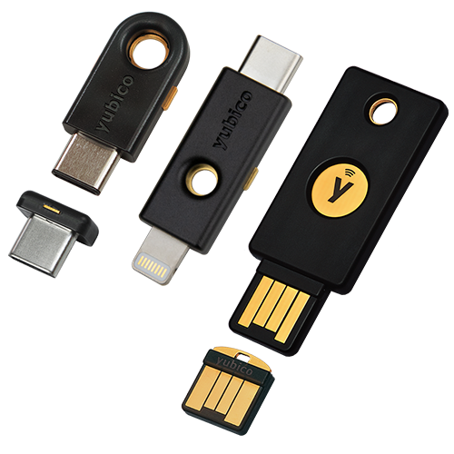
Yubikey: What is it?
Its one of many different brands
Multi-Protocol hardware security key
Allows for 2FA, MFA or even passwordless authentication

Slide 3
Fido2 & Webauthn: What is it?
Fido2
Framework that enables passwordless authentication between servers, browsers and authenticators
WebAuthn
Joint W3C and FIDO specification
An API allowing users to authenticate using asymmetric key cryptography
Chrome, Firefox and Edge support
Client-to-authenticator protocol (CTAP)
Talks over USB or NFC to a hardware authenticator

Slide 4
Terms
Challenge – Buffer of randomly generated bytes from the server to prevent replay attacks
RP (Relying Party) – Organization responsible for registering and authentication the user
Assertion – A signature created using the authenticators private key, server uses the public key retrieved during registration to verify this signature
Origin – Identifies where data should be coming from to make phishing impossible

Slide 5
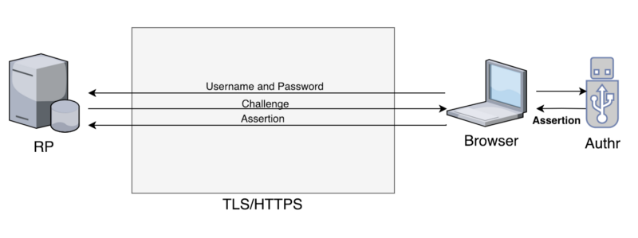
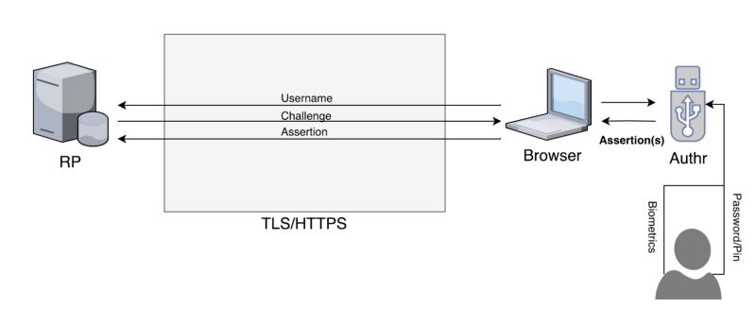
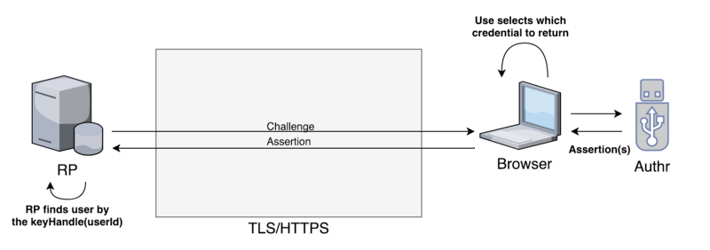
Webauthn scenarios
2FA/MFA
Passwordless
Usernameless/Passwordless

Slide 6
Building a fido2 identity project

Slide 7
Prerequisites
Targeted and tested using Yubikey series 5
Will be using Fido2 and WebAuthn
Provide a way to register and activate a Fido2 device
Allow the user to log in using the registered Fido2 device
Provide a way to deactivate and remove a Fido2 device

Slide 8
Part 1: Preparing the project

Slide 9
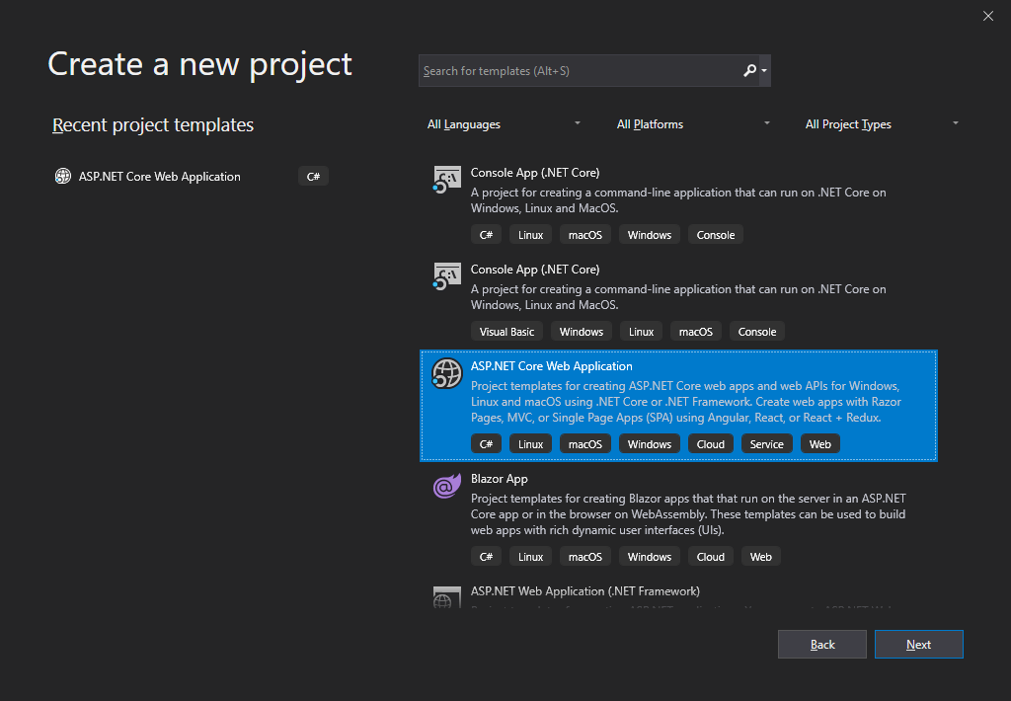
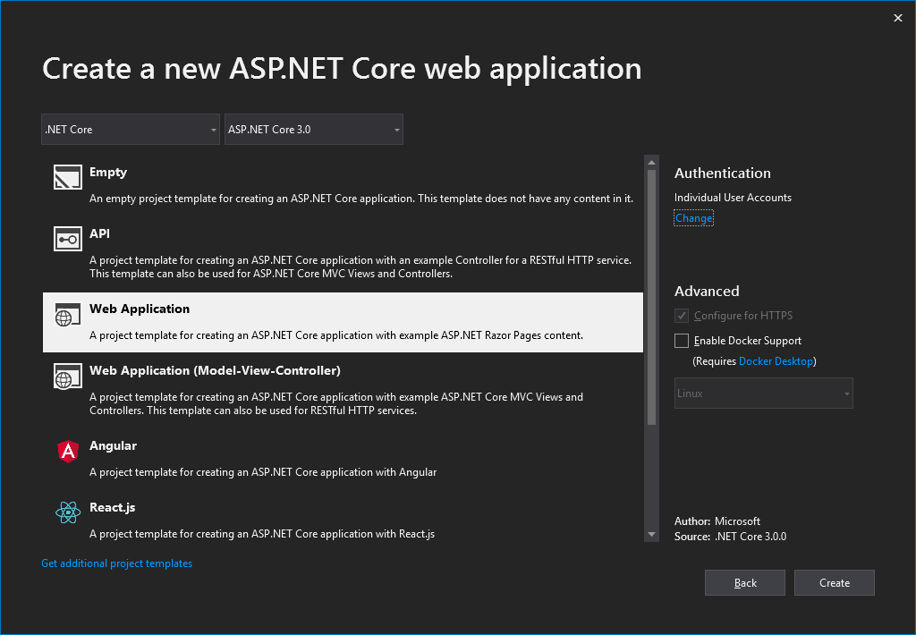
Create a new ASP.NET Core Project
Web Application with Individual User Accounts

Slide 10
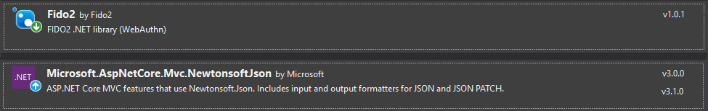
Include some NuGet packages

Slide 11
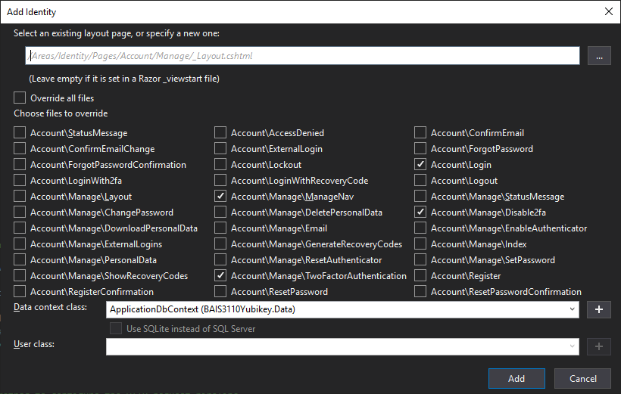
Scaffold some identity pages
Account/Manage/ ManageNav
Account/Manage/ TwoFactorAuthentication
Account/Manage/ Disable2fa
Account/Login
Data Context Class
ApplicationDbContext

Slide 12
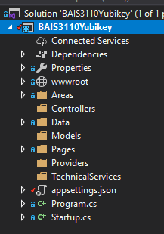
Add project folders
Controllers
Models
Providers
TechnicalServices

Slide 13
Modify appsettings.json

Slide 14
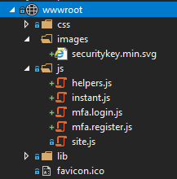
Add some static files
Js/helpers.js
Js/instant.js
Js/mfa.login.js
Js/mfa.register.js
Images/securitykey.min.svg

Slide 15
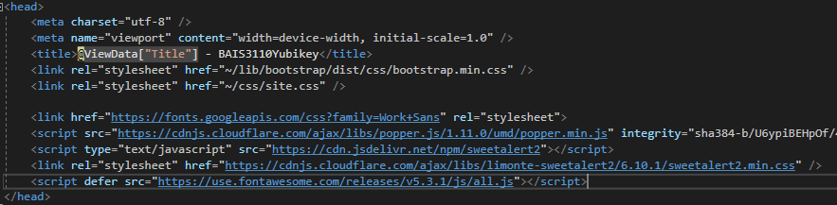
Add CDN dependencies to Pages/Shared/_Layout.cshtml

Slide 16
Part 2: Modifying the database

Slide 17
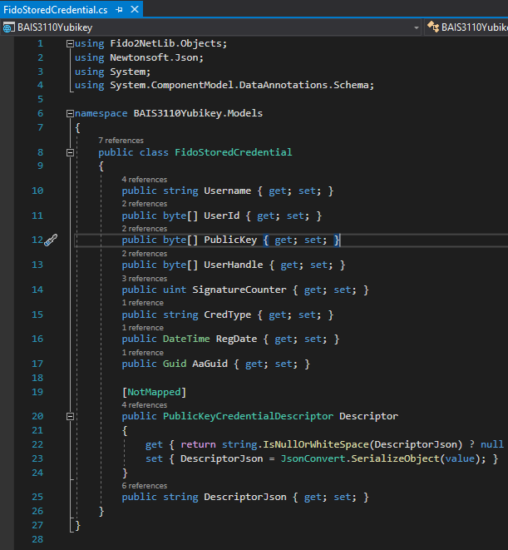
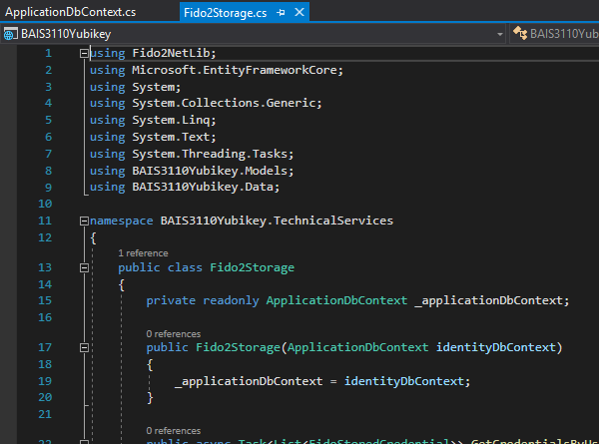
Create Models/FidoStoredCredential.cs
Create TechnicalServices/Fido2Storage.cs
* Username = user email as primary key

Slide 18
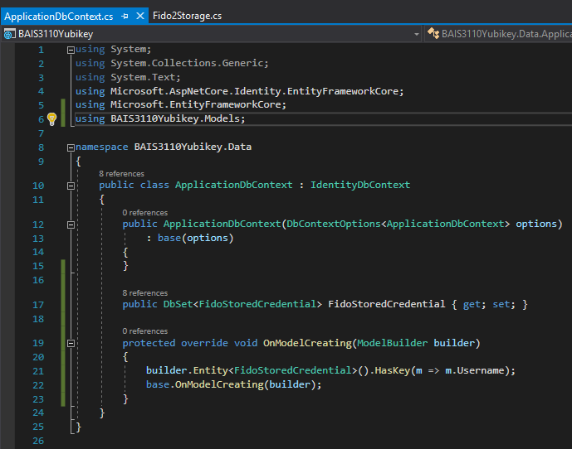

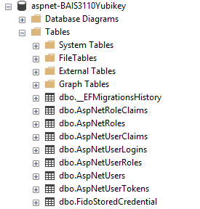
Modify Data/ApplicationDbContext.cs

Slide 19
Part 3: Controllers and custom views

Slide 20
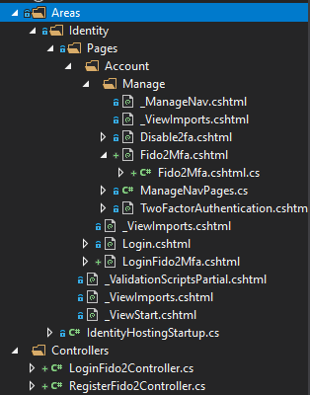
Add Fido2 controllers
RegisterFido2Controller

Slide 21
Part 4: Modify Existing files

Slide 22
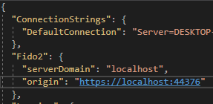
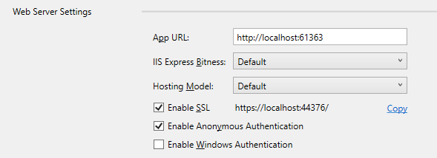
appsettings.json

Slide 23

Areas/Identity/Pages/Account/Manage/
ManageNavPages.cs
TwoFactorAuthentication.cshtml

Slide 24
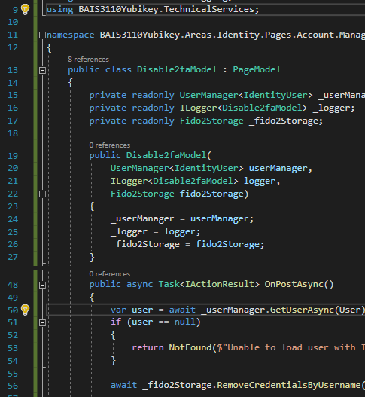
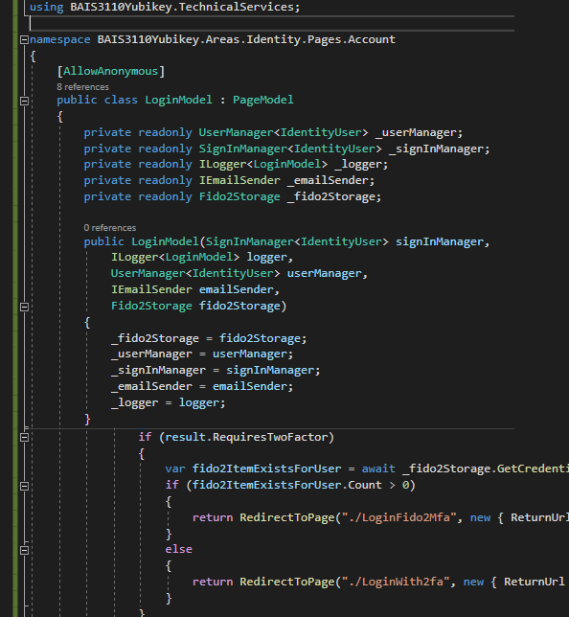
Disable2fa.cshtml.cs
Login.cshtml.cs

Slide 25
Part 5:Tying it all together

Slide 26
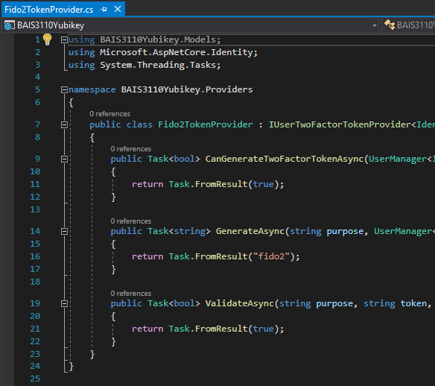
One last File to add
Providers/Fido2TokenProvider.cs

Slide 27
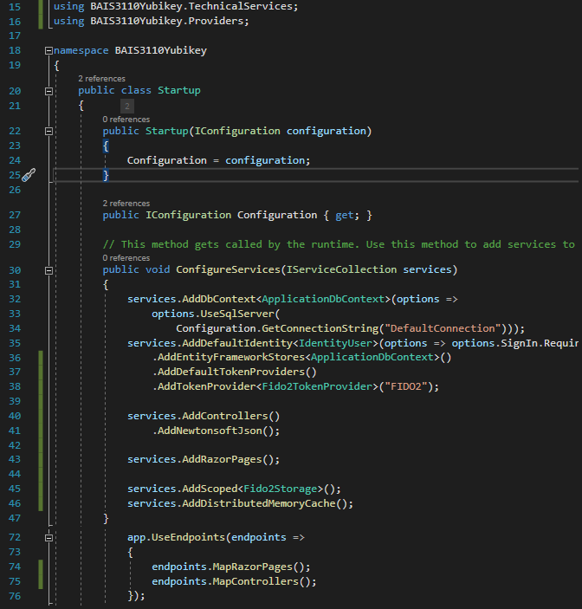
Startup.cs

Slide 28
Finished!

