Slide 1

Agenda

Slide 2

- Introduction (4 minutes):
- Welcome and Acknowledgment: Greet the audience and express gratitude for their time.
- Contextualization: Briefly explain the importance of data analysis in Cyclistic's marketing strategy.

Slide 3
- Overview and Project Objectives (5 minutes):
- Purpose of "Cycles_Keys": Maximize the number of annual memberships.
- Specific Goals: Focus on strategies to convert casual users into annual members.

Slide 4
- Data and Analysis (10 minutes):
- Temporal Patterns: Highlight weekend activity, implications for targeted campaigns.
- Casual Users vs. Members: Differences in contribution, retention, and promotional strategies.
- Key and Less Popular Stations: Identification of key stations for expansion and optimization.
- Travel Distribution and Considerations: Variability between stations and influential factors.

Slide 5
- Recommendations (3 minutes):
- Resource Optimization: Adjustments based on daily demand and average trip duration.
- Marketing Campaigns: Strategies for less popular stations.
- Membership Programs and Retention: Strengthening programs for member engagement.
- Continuous Temporal Analysis: Adaptation to temporal and seasonal patterns.
- Exploration of Additional Data: Consideration of demographic data and external influences.

Slide 6
- Actionable Steps (3 minutes):
- Continuous Temporal Analysis: Constant adjustment based on pattern changes.
- Exploration of Additional Data: Proactive incorporation of new data to enhance strategy.

Slide 7
- Questions (5 minutes):
- Interaction: Invite the audience for questions and clarifications.

Slide 8
Purpose

Slide 9






Purpose Statement:
-"Cycles_Keys": A key strategy to maximize annual memberships.
- Business Impact: Focus on service center consolidation as a cost-saving initiative.

Slide 10
Data/Analysis

Slide 11
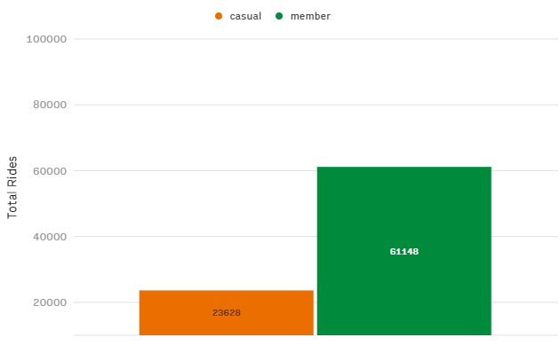
Casual Users vs. Members:
- Significant Contribution: Strategies to enhance engagement and retention.
Temporal Patterns:

Slide 12
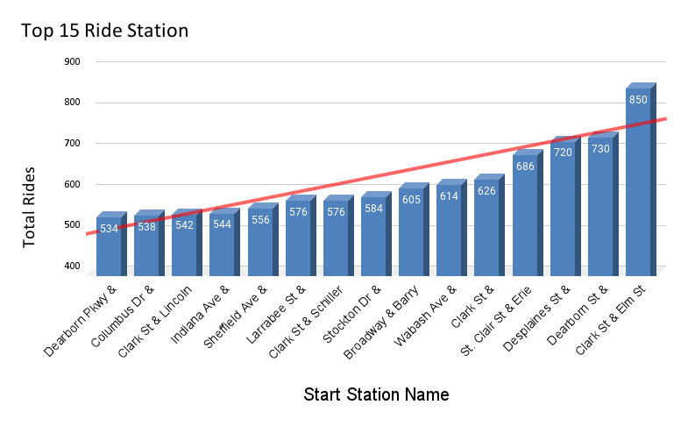
Temporal Patterns:
Key and Less Popular Stations:
- Strategic Locations: Valuable information for expansion and maintenance.

Slide 13
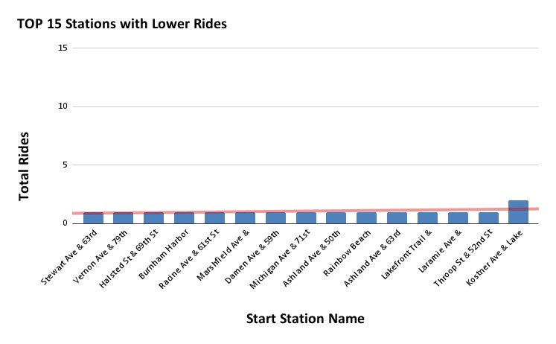
Temporal Patterns:
Key and Less Popular Stations:
- Strategic Locations: Valuable information for expansion and maintenance.

Slide 14

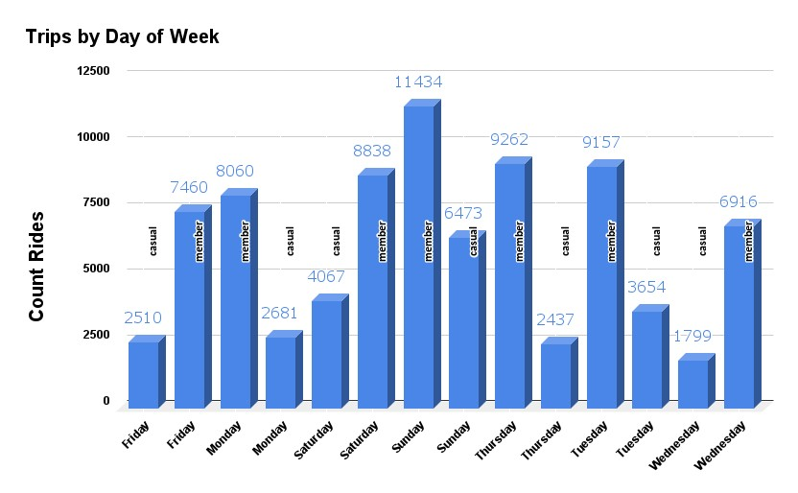
Temporal Patterns:
- Weekends: Increased activity, indicating potential recreational trends.

Slide 15
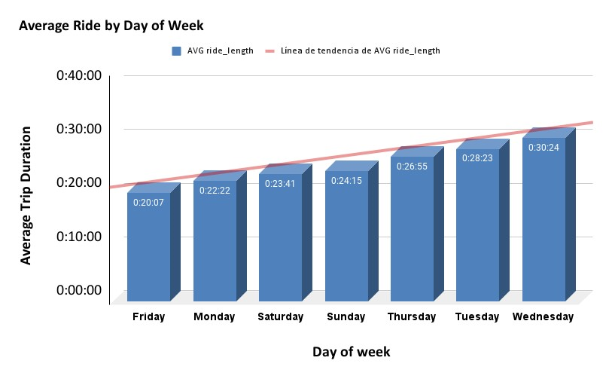
Temporal Patterns:
- Average Duration: Weekly variation, suggesting different usage patterns.

Slide 16
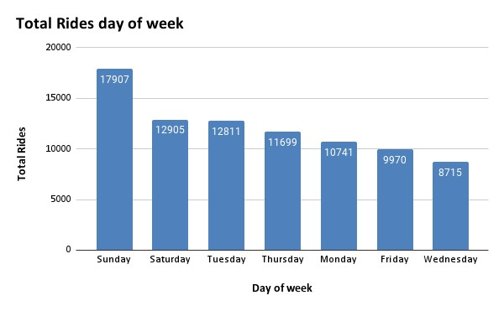
Temporal Patterns:
- Weekends: Increased activity, indicating potential recreational trends.
- Average Duration: Weekly variation, suggesting different usage patterns.
.

Slide 17
Recommendations

Slide 18



Recommendations
Resource Optimization:
- Strategic Adjustments: Consideration of daily and weekly variations.
Marketing Campaigns:
- Less Popular Stations: Specific strategies to increase awareness and participation.

Slide 19



Recommendations
Membership Programs and Retention:
- Strengthening: Incentives and promotions to retain members and convert casual users.
Continuous Temporal Analysis:
- Strategic Adaptation: Alignment with temporal and seasonal patterns.

Slide 20



Recommendations
Exploration of Additional Data:
- Data Enrichment: Incorporation of demographic and external data for comprehensive understanding.

Slide 21
Call to Action

Slide 22



Call to Action:
- Post-Consolidation Evaluation: Review processes to restore customer response times.

Slide 23
Questions

Slide 24
Audience:
Lirio Moreno (Director of Marketing):
- Focus: Strategies to maximize annual memberships.
Cyclistic Marketing Analysis Team:
- Role: Data-backed support to guide strategies.
Cyclistic Executive Team:
- Responsibility:Ensuring informative backing for strategic decisions.

