Slide 1
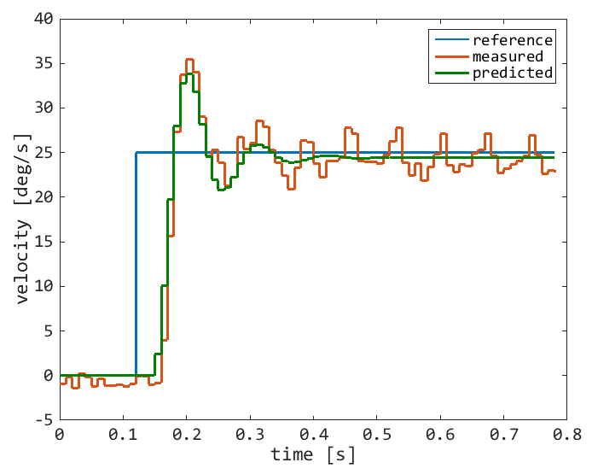
Plant Identification
FK and IK are static maps
Parameters | Values
Kp | 0.978
Tw | 0.016
ζ | 0.286
Td | 0.027
Notes:
G(s) is the process to be estimated: it is underdamped (two complex poles defined by Tw and zeta), has a gain (Kp) and a delay (Td).
Estimation is carried out by means of ident toolbox with the aim to solve the least-squares problem. The toolbox chooses the best method among Gradient-Descent, Levenberg-Marquardt, Adaptive Gauss-Newton, Trust-Regions.
Validation of the estimated process is performed on different data sets, achieving high-accuracy of the prediction (~90%).

Slide 2
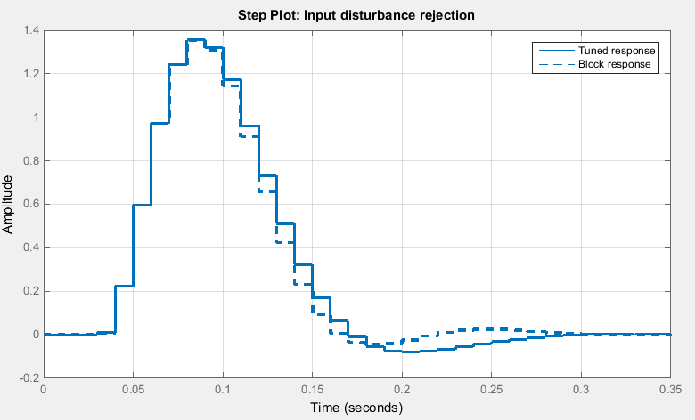
Controller Design
Integral Controller (Ki=11)
suffices to cope with
Input Disturbance Rejection, making the system Type I
Notes:
The design of the discrete PI controller (running @ 100 Hz) has the objective to minimize the response time of the plant when undergoes an input stepwise load disturbance. We employed the PID Tuner for that; it’s a GUI where the user has sliders acting on the gains to fine tune the setting proposed to meet the requirements.
It came out that, given the identified G(s), a simple I controller is sufficient.

