Slide 1
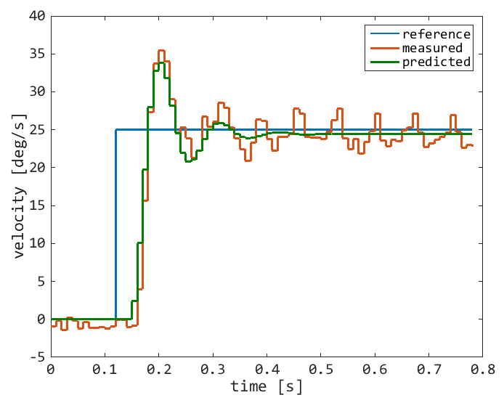
Plant Identification
Parameters | Values
Kp | 0.978
Tw | 0.016
ζ | 0.286
Td | 0.027

Slide 2
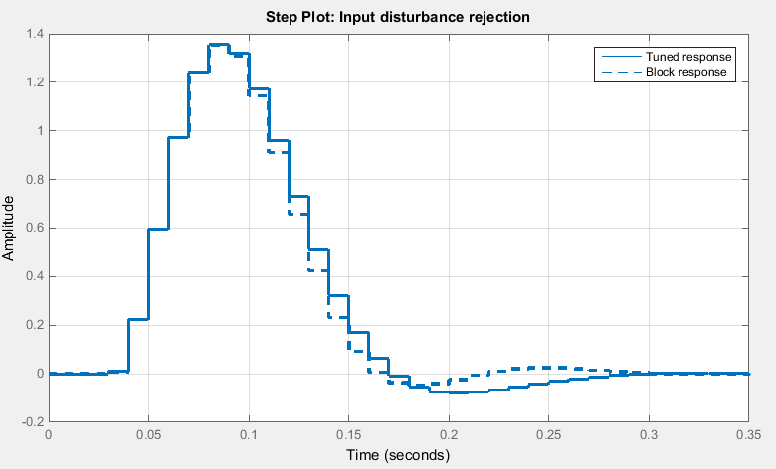
Controller Design
Integral Controller (Ki=11)
suffices to cope with
Input Disturbance Rejection, making the system Type I

