Slide 1
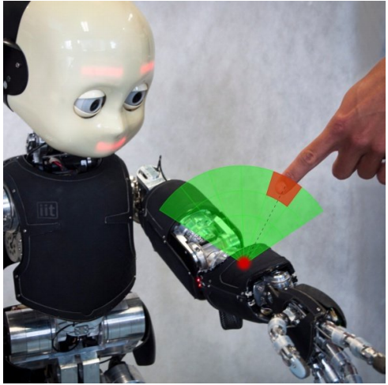
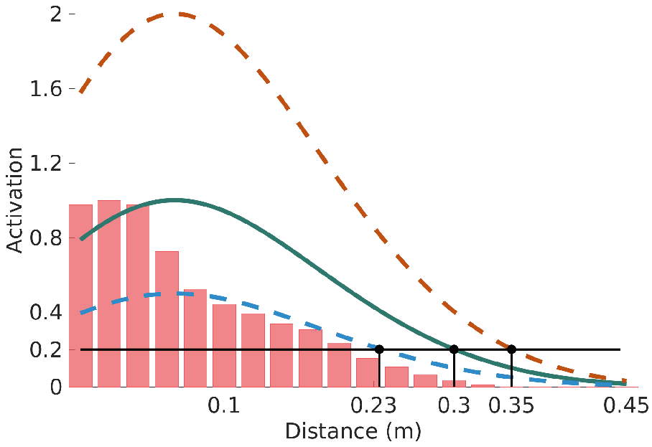
A PPS Model On iCub
Notes:
PPS is defined as the space around us, within which objects can be grasped and manipulated.
It acts as an interface between our body and the external world, for defensive purposes (margin of safety) and/or for performing actions toward objects.
PPS representation is intrinsically multimodal in that it merges information from different modalities, in particular visual and tactile cues.
With these premises, our idea was to let the robot learn the representation on the fly by building a statistical distribution of the collisions with incoming objects that relate the position and velocity of the object itself as acquired through vision with the activation of the skin taxel involved in the collision. The learning happens quite fast, almost in one shot.
The net result of this learning methodology is that the skin taxels can get activated (firing) before the physical contact occurs. To signal this we use two different colors in the GUI displaying the taxels: red for physical and green for predicted contacts.
Activation and extension of RFs in space can be then modulated wrt the valence of the oncoming stimulus.

Slide 2
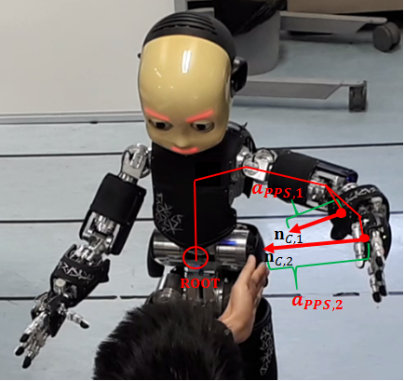
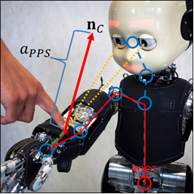
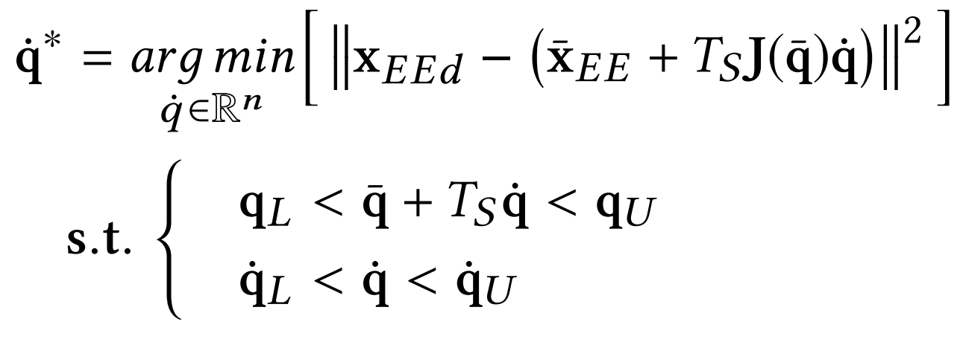
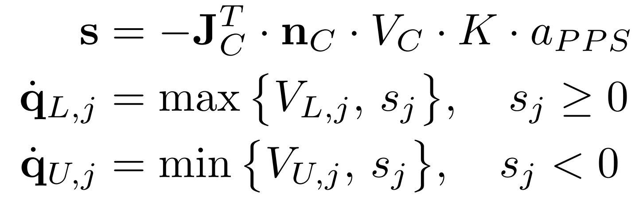
Visuo-tactile Reactive Controller for pHRI
Visual activation through PPS
Tactile activation detected with skin
Local constrained minimization
Remapping the Cartesian “repulsive vectors” into joint space
Notes:
We leverage on the PPS representation to build a mechanism that implements a reactive obstacle avoidance, capable of working both in case of physical and predicted contacts. Therefore, this component represents the building block to enable pHRI.
We do IK and solve the control problem in one step using nonlinear constrained optimization techniques that can run fast and in real-time.
We work in the joint velocities domain to find the best velocities vector that drives the robot toward the target while complying with the physical constraints given by the internal structure of the robot as well as by the external stimuli detected using the PPS representation.
In more details, we use the contact Jacobian predicted by PPS (in location and intensity) to determine the so-called degree of influence s to back-project the repulsive vector into the joint space. This degree of influence accounts for those joints that mostly contribute to the upcoming collision (essentially the joints in the chain ranging from the root up to the contact point). Thus, we do limit the velocities bounds of these particular joints during the optimization.

Slide 3
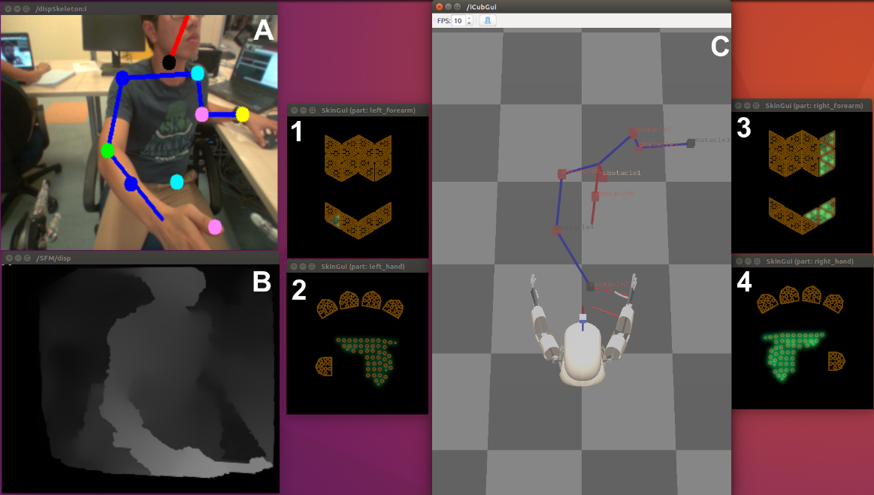
Integration with Body Pose Estimation

Slide 4
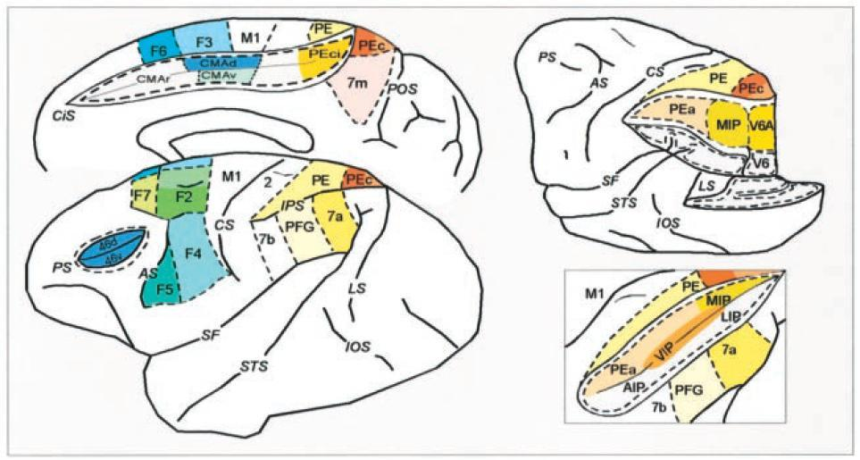
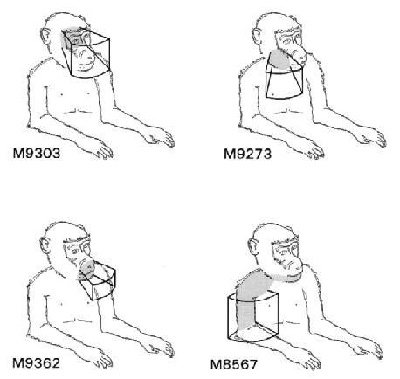
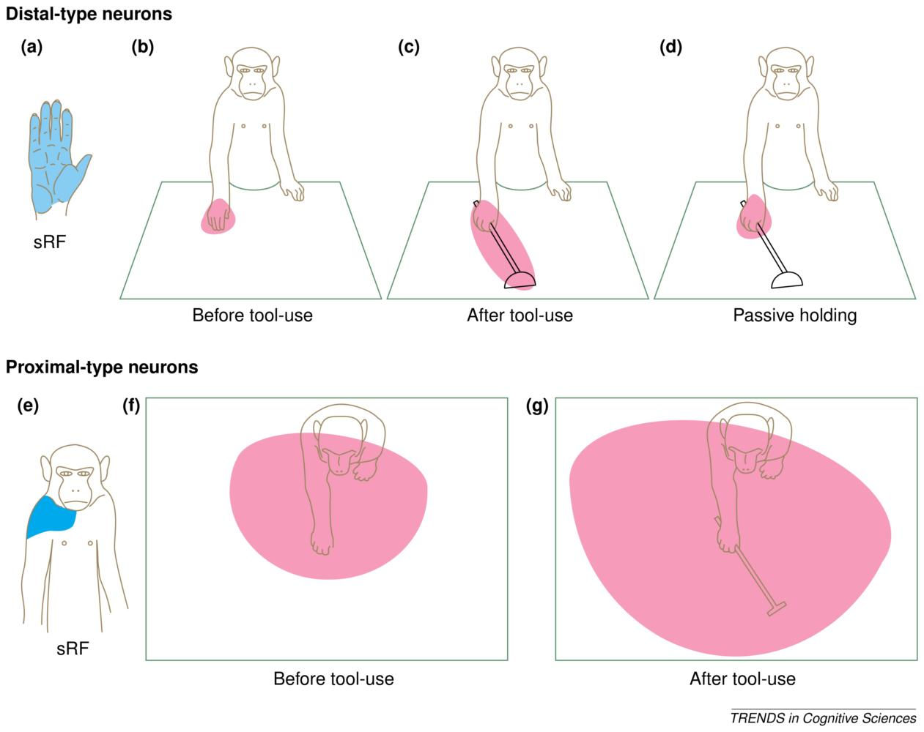
1
2
3
Fogassi (1996)
Iriki (2004)
Notes:
PPS is characterized by different reference frames (spatial maps) located in different regions of the brain, and there might be a way for the brain to switch from these different representations.
PPS benefits from a multisensory integration in order to form a coherent view of the body and the space surrounding it. Fogassi experiment (1996): found a number of so-called visuo tactile receptive fields, namely a set of neurons that fire both if stimulated in a region of the tactile domain (for example the skin) and if a visual stimulus is presented in the space surrounding that skin part.
PPS shows an intrinsic plastic behaviour, and a deep involvement with the motor system. Iriki experiment (2004): the extension of the receptive fields of these visuo-tactile neurons, after a training with a rake, has been shown to enclose the tool, as if it was part of the body.

