Slide 1





Weather briefing Kenya
August 1st, 2026

Slide 2
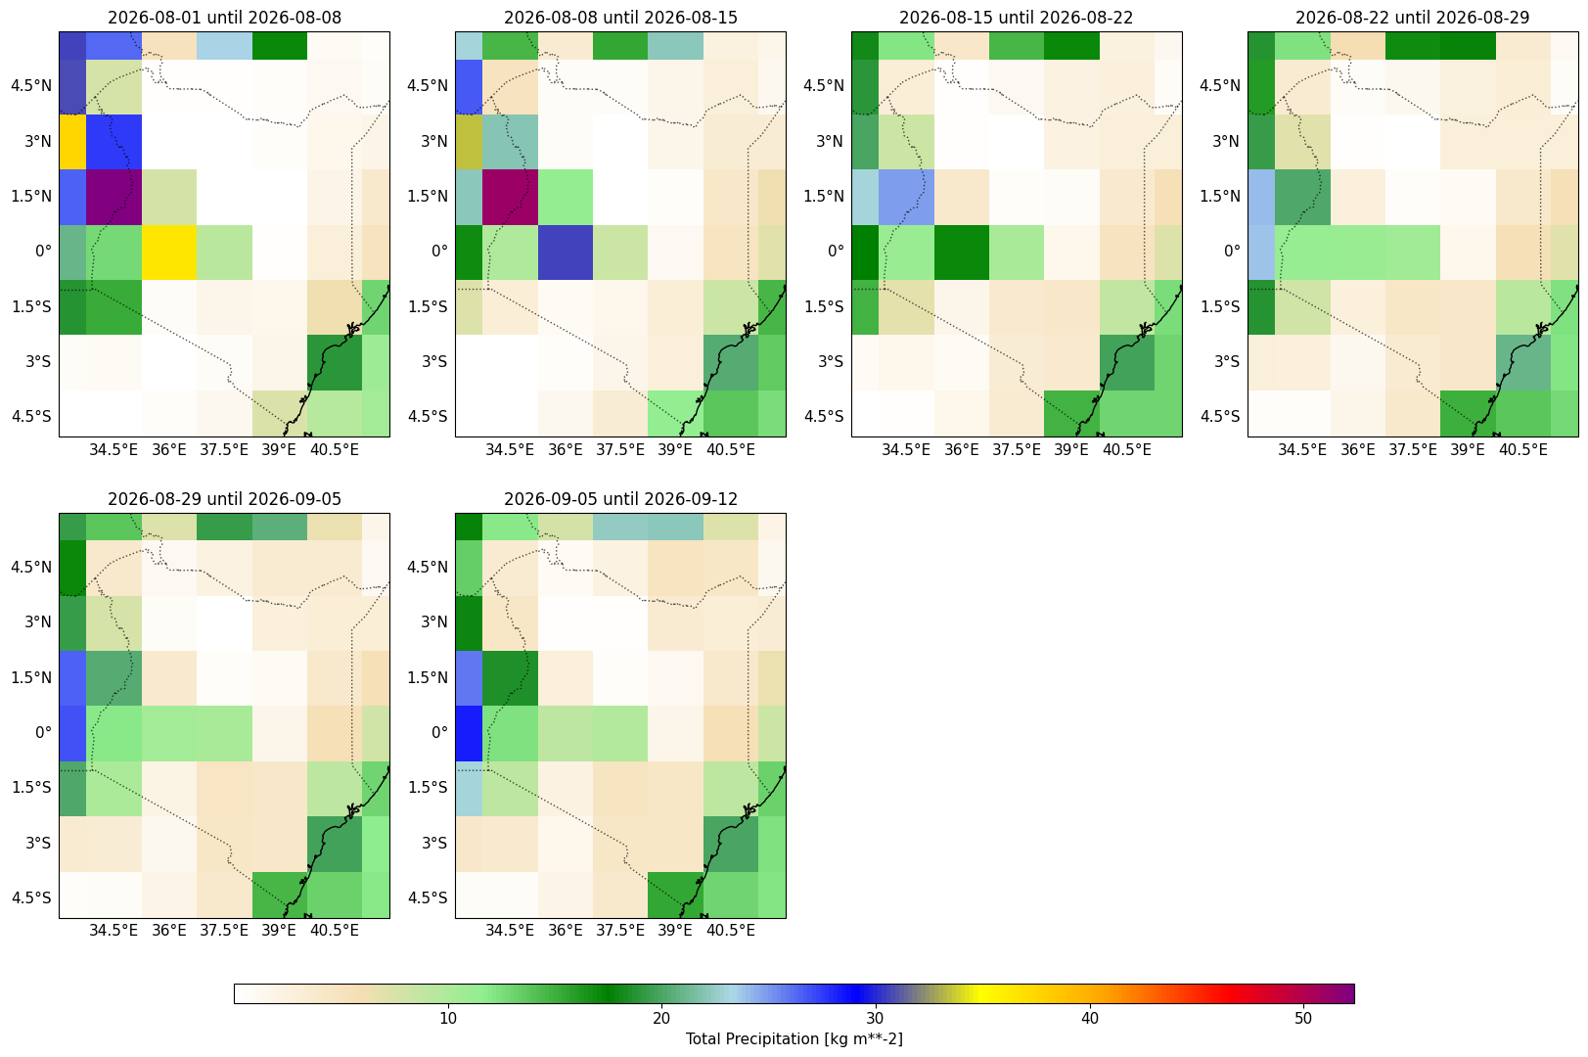
Weekly precipitation ECMWF

Slide 3
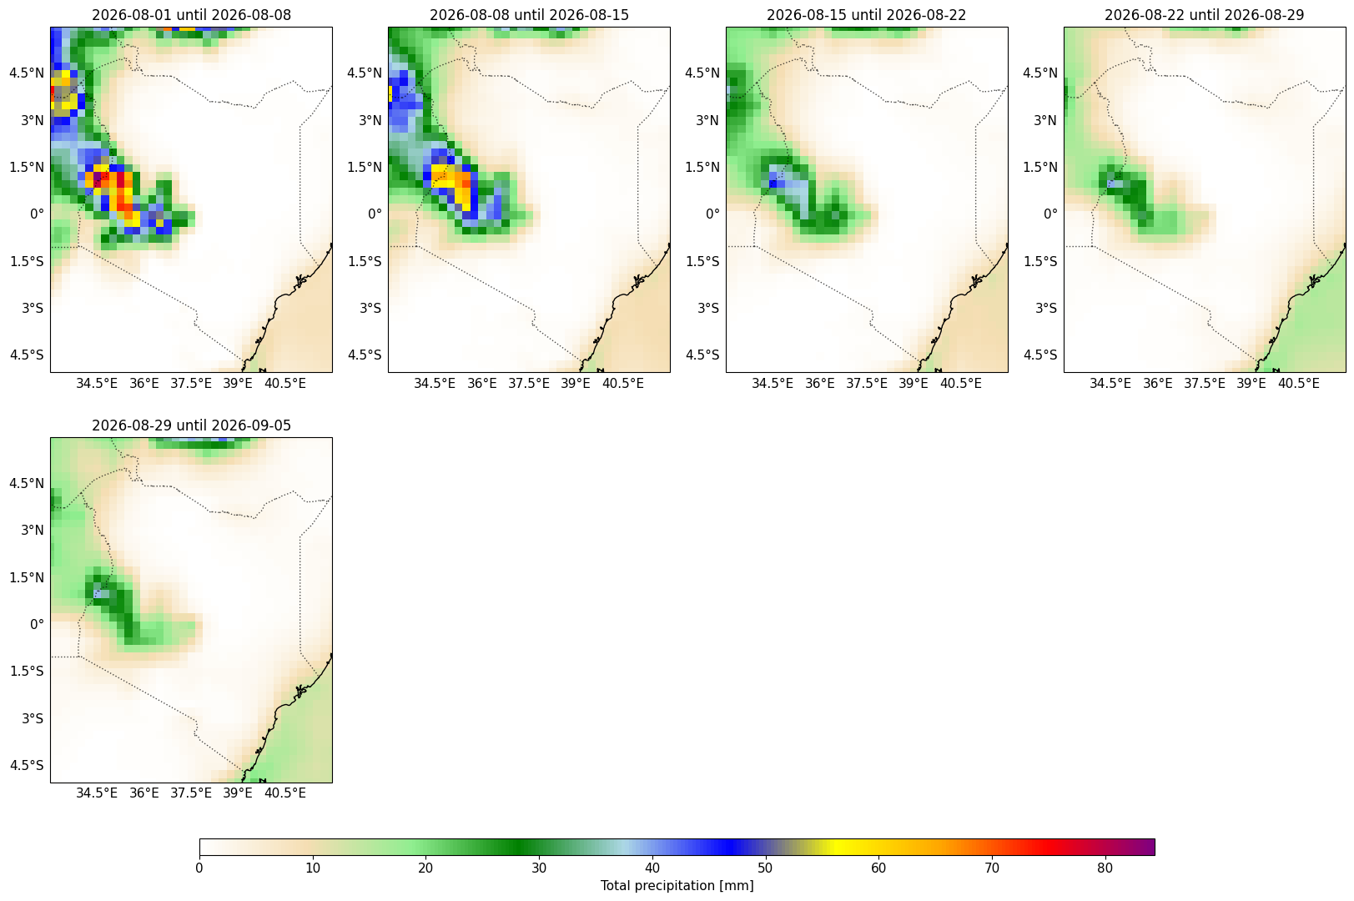
Weekly precipitation GEFS

Slide 4
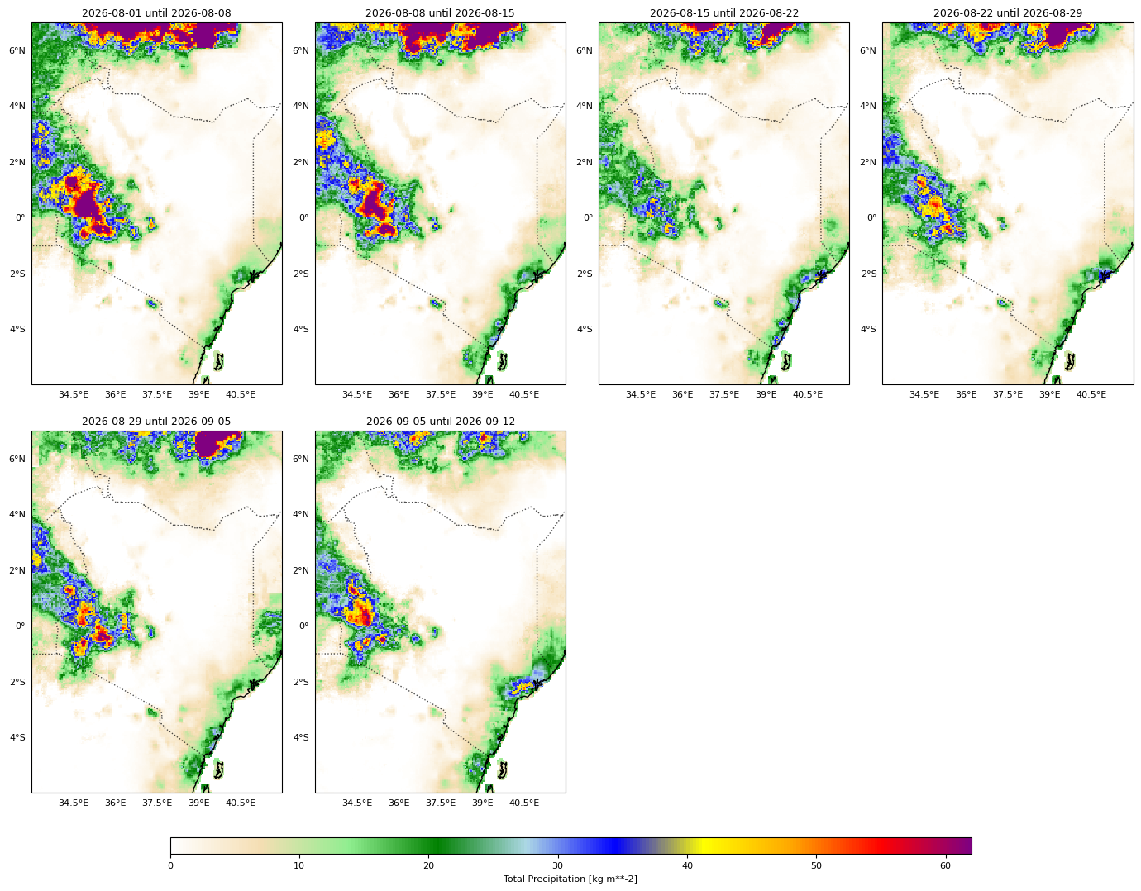
Weekly precipitation ECMWF downscaled

Slide 5
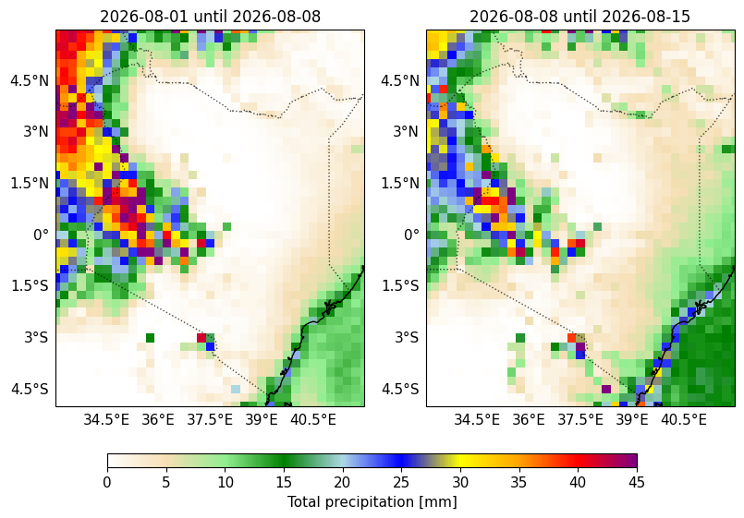
Weekly precipitation ECMWF medium range

Slide 6
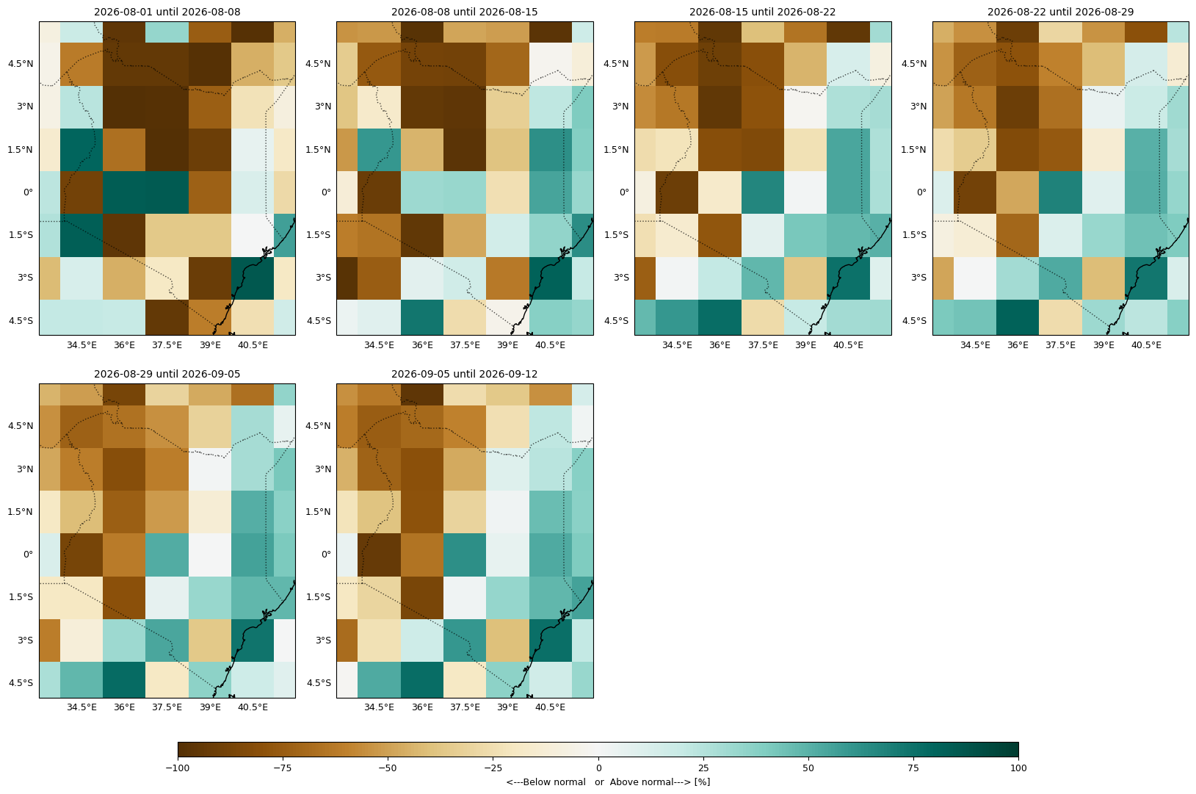
Likelihood of being above/below normal ECWMF

Slide 7
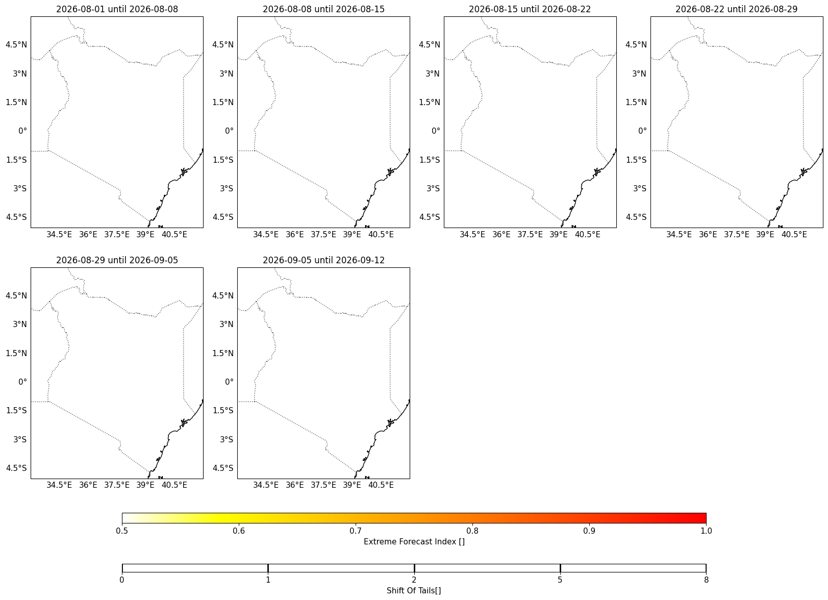
Extreme forecast index ECWMF

Slide 8
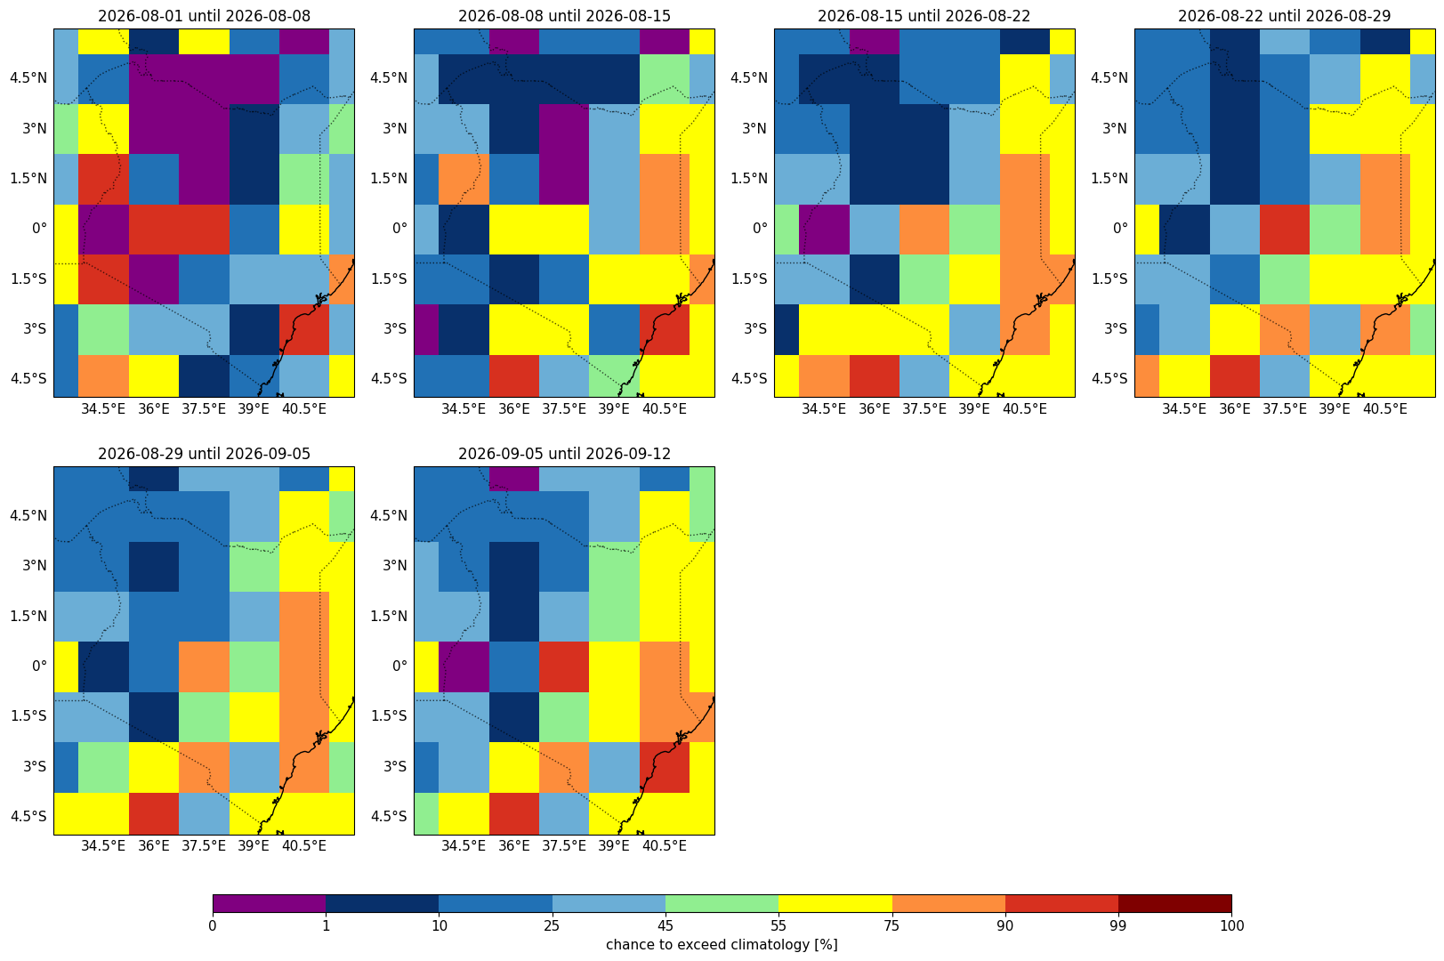
Chance of being above median ECMWF

Slide 9
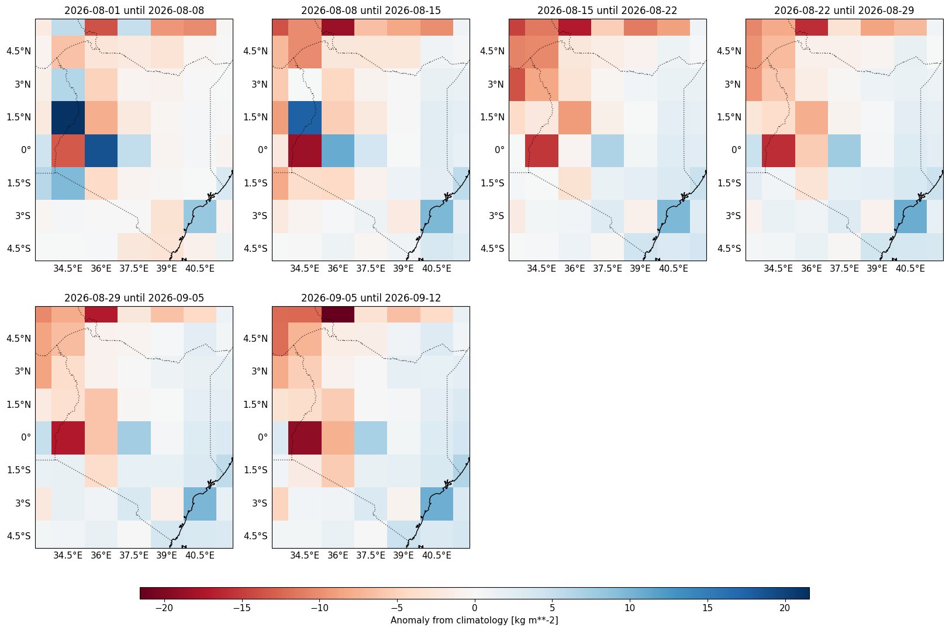
Anomaly of ensemble mean from model median

Slide 10
Forecast summary

Slide 11
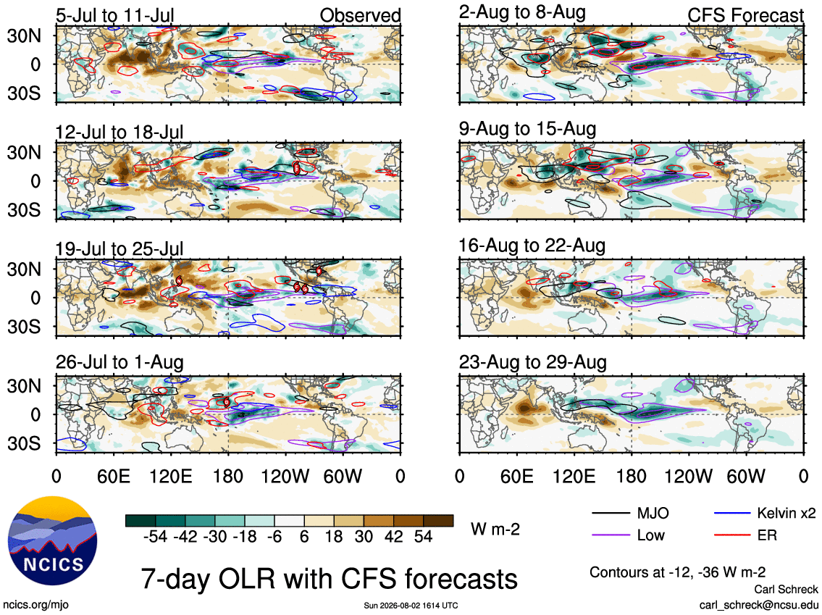
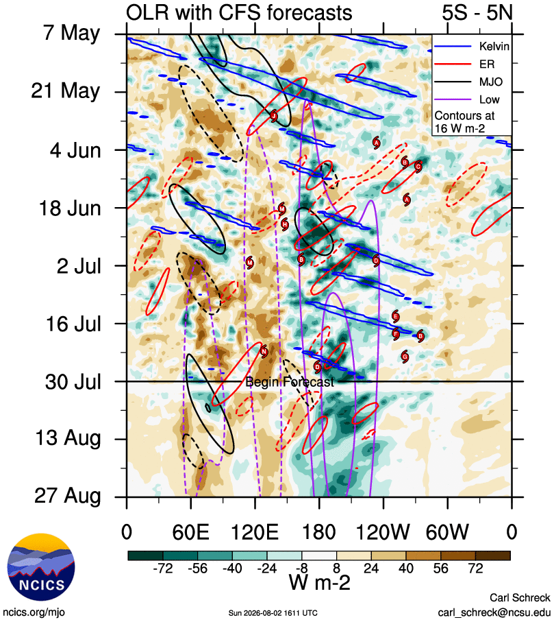
Equatorial Waves : Analyses and Forecasts

Slide 12
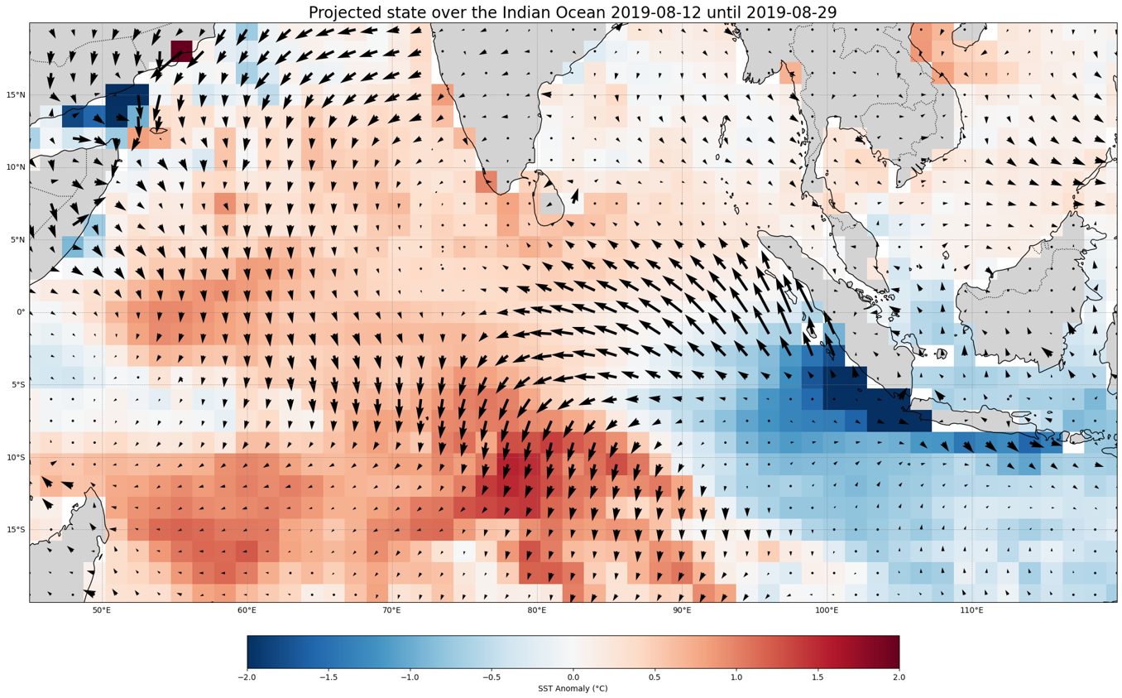

Slide 13
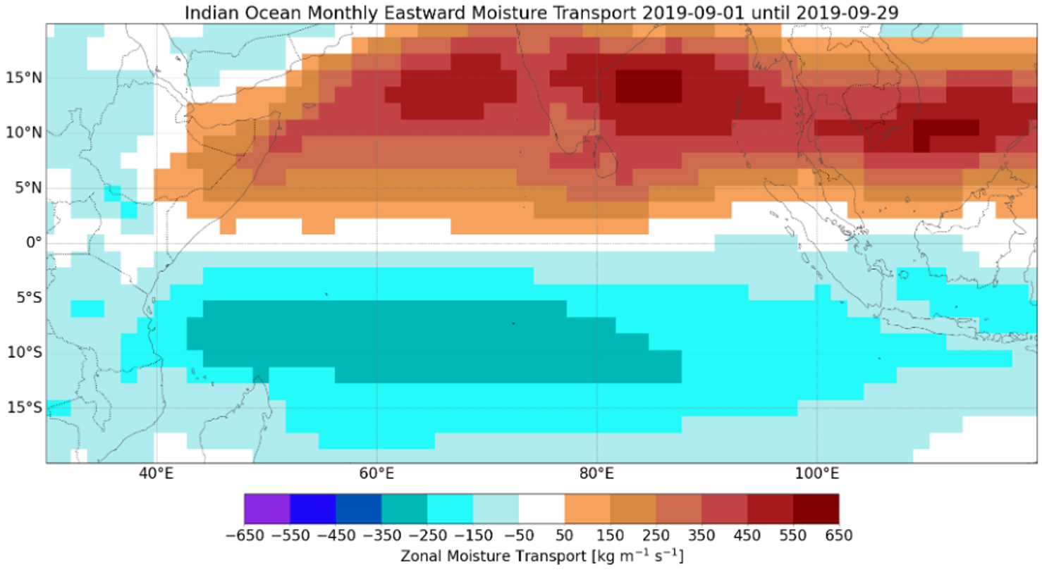

Slide 14
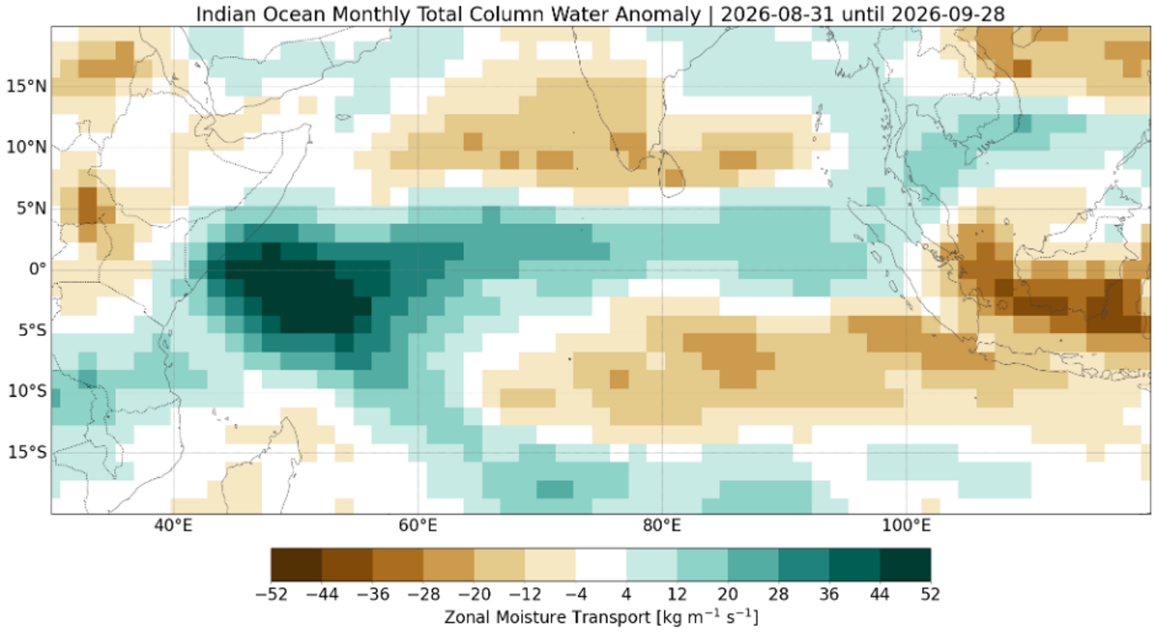

Slide 15
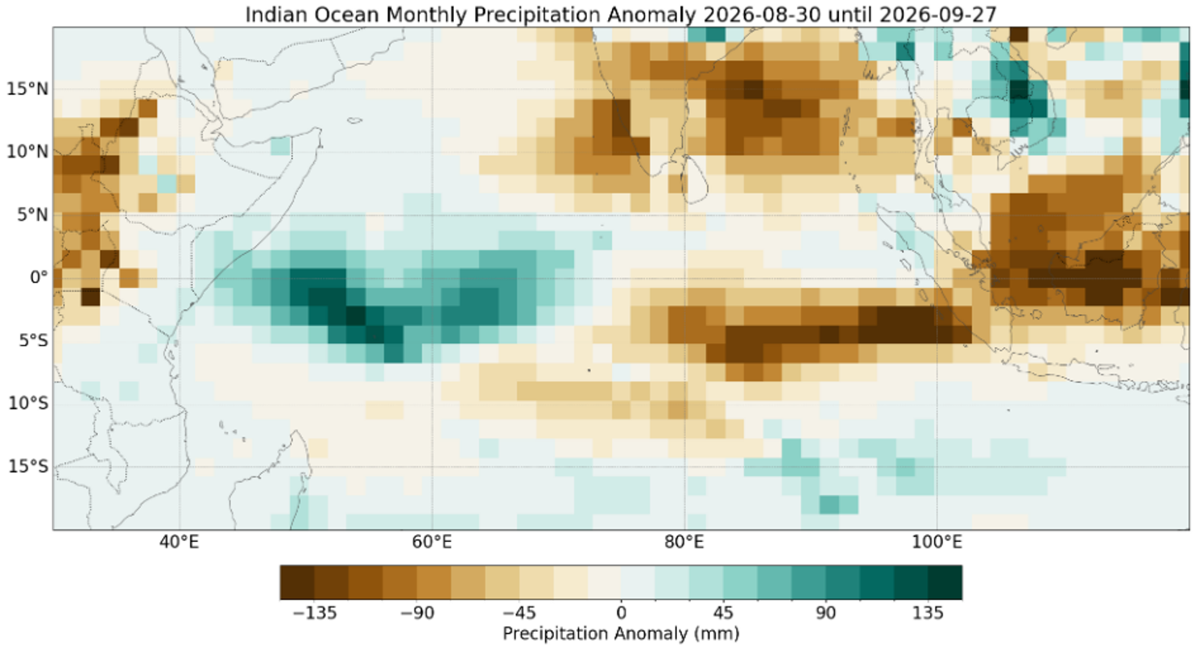

Slide 16
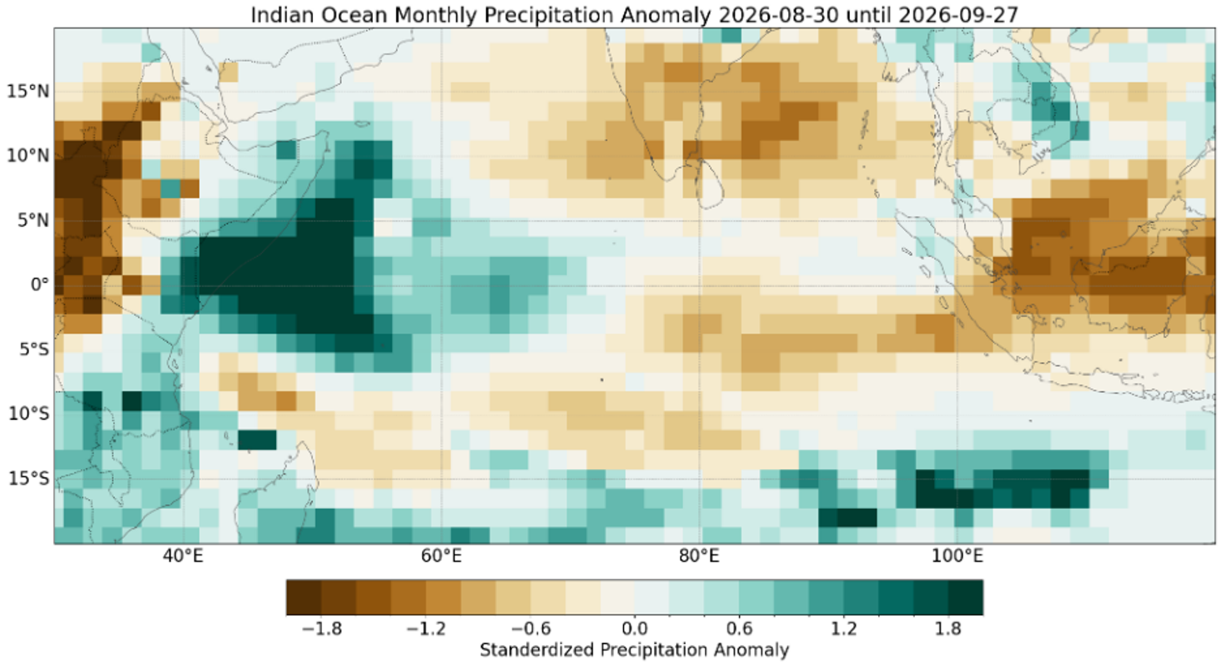

Slide 17
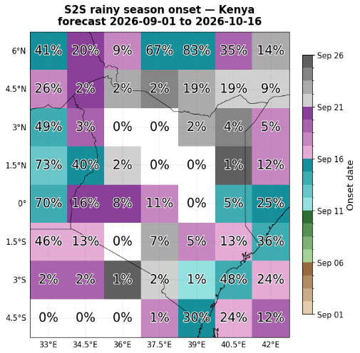
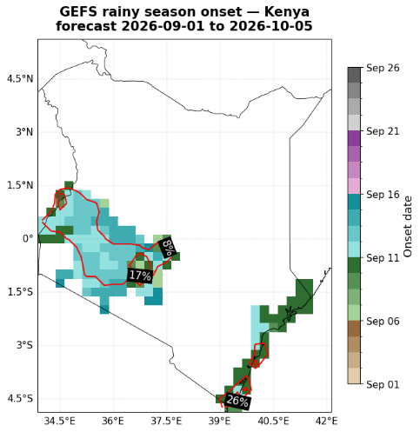
Maps show the forecasted mean onset date of the rainy season: the first 3-day wet spell with >20mm total rainfall that isn't followed by a dry spell of 7+ days within the next 21 days.
Color = ensemble-mean onset date
% labels / contours = share of ensemble members that found an onset at all within the forecast window
Note: GEFS's shorter window means it structurally can't show onsets as late as S2S

Slide 18
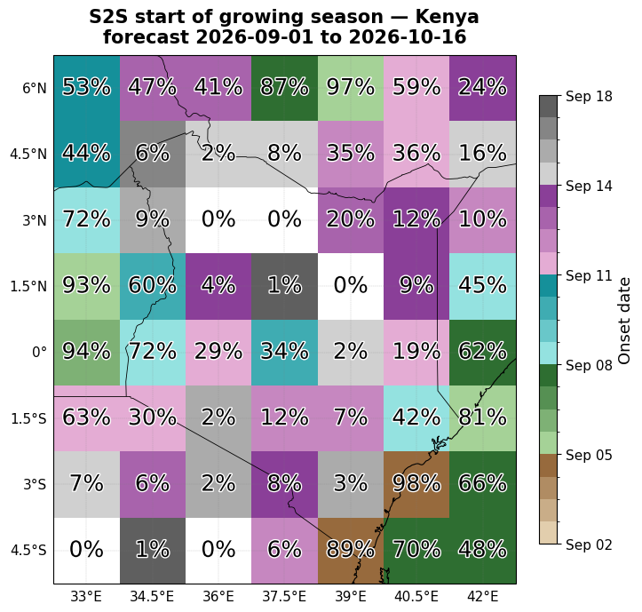
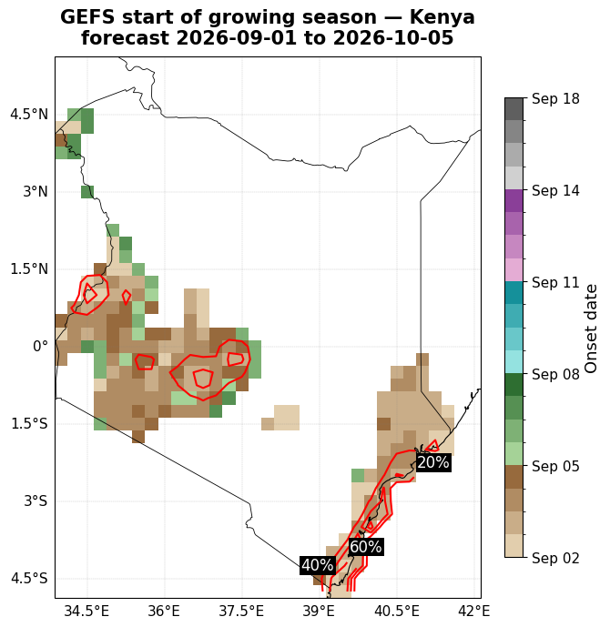
Maps show the forecasted mean start of growing season: the first day whose following 10 days accumulate at least 20mm total rainfall, followed by the next 20 days after that accumulating more than 20mm.
Color = ensemble-mean start of growing season
% labels / contours = share of ensemble members that found a start at all within the forecast window
Note: GEFS's shorter window means it structurally can't show onsets as late as S2S

Slide 19
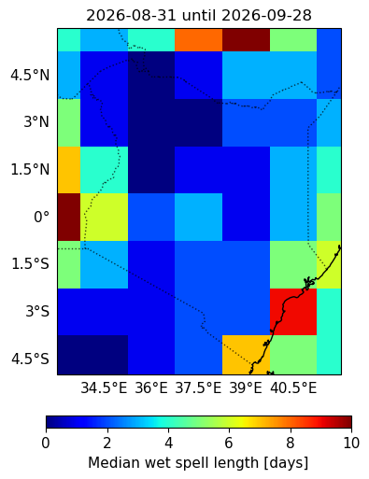
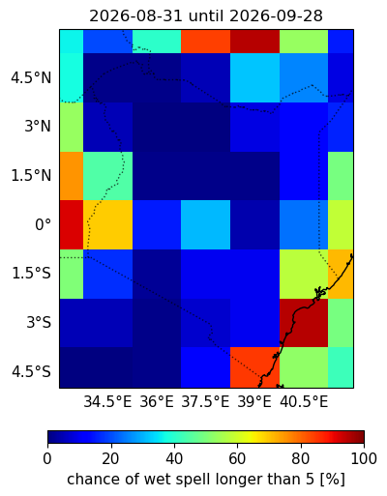
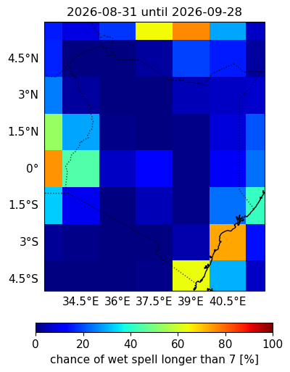
Consecutive Wet (>1mm) Days Probability

Slide 20
Consecutive Dry (<1mm) Days Probability

Slide 21
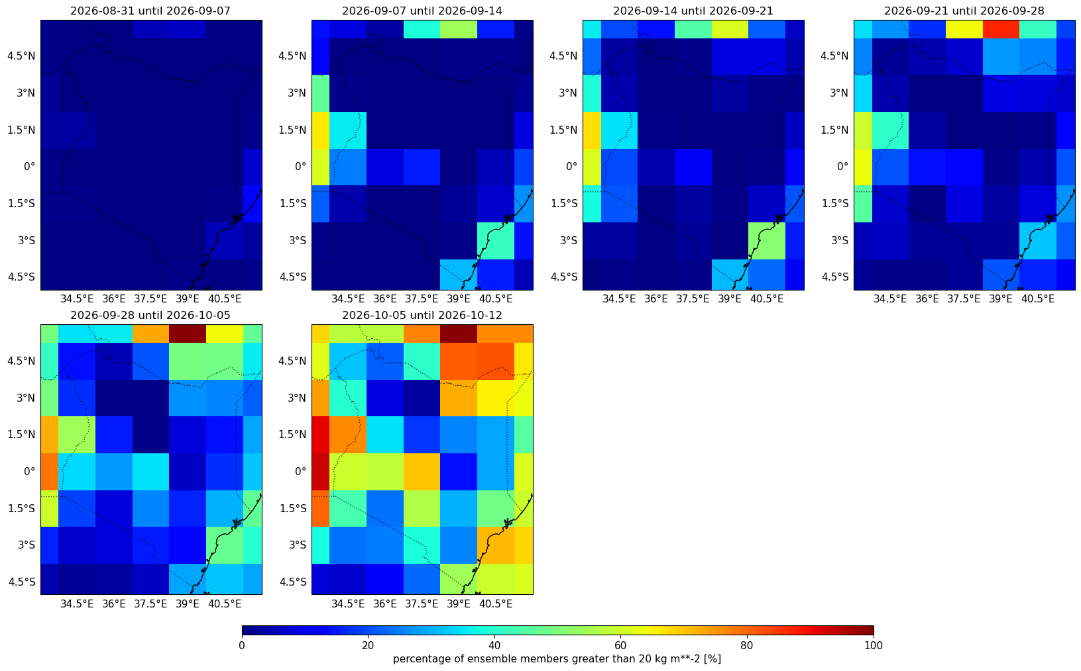
Probability of exceeding 20 mm per week

