Slide 1
The goal of this slide deck is to enable the KMSA operational forecasting team to monitor the rainy season progression during OND 2026.

Slide 2






Kenya Rainy Season Forecast Briefing
1 September 2026
Briefing Contributors:
Phillip Okello, KMSA
Chris Funk, CHC
Alec Jong, CHC
Genevieve Flaspohler, Rhiza Research
Shraddhanand Shukla, CHC
For questions, email s2skenya@rhizaresearch.org
Note: This briefing is prepared for internal use by the Kenyan Meteorological Service authority, to inform their subseasonal and start of season outlooks during the rainy season OND 2026.

Slide 3
Table of Contents
Outlook Summary
Recent Observations
Last Week’s Forecast Verification
This Week’s Forecasts
Agrometeorolgical Indicators
AI Model Forecasts [Coming Soon]
Appendices

Slide 4
Summary

Slide 5




7 Sept 2026 Outlook
Briefing outlook: The forecast is defined by a sharp contrast between the extremely dry west and northwest and the persistently wet coastal strip. This pattern is consistent across all lead times for the first two weeks, with the dry signal in the interior slowly dissipating as the month progresses.
There is strong agreement among all sources on the dry signal in the northwest and the wet signal on the coast, though the magnitude of these events varies significantly between raw ensemble output and downscaled data. The western highlands remain the most uncertain region, where downscaled products suggest much higher rainfall totals than the raw model output.
Given the substantial skill degradation beyond week 2, the current indications of a late-month moisture increase in the interior should be viewed as a tentative trend rather than a firm outlook. Forecasters should prioritize monitoring the high-intensity coastal signals for potential localized impacts, while maintaining a dry-hazard watch for the western zones.

Slide 6
Recent Observations
Generated -date- by KMSA S2S Nimbus Pilot Github workflow

Slide 7

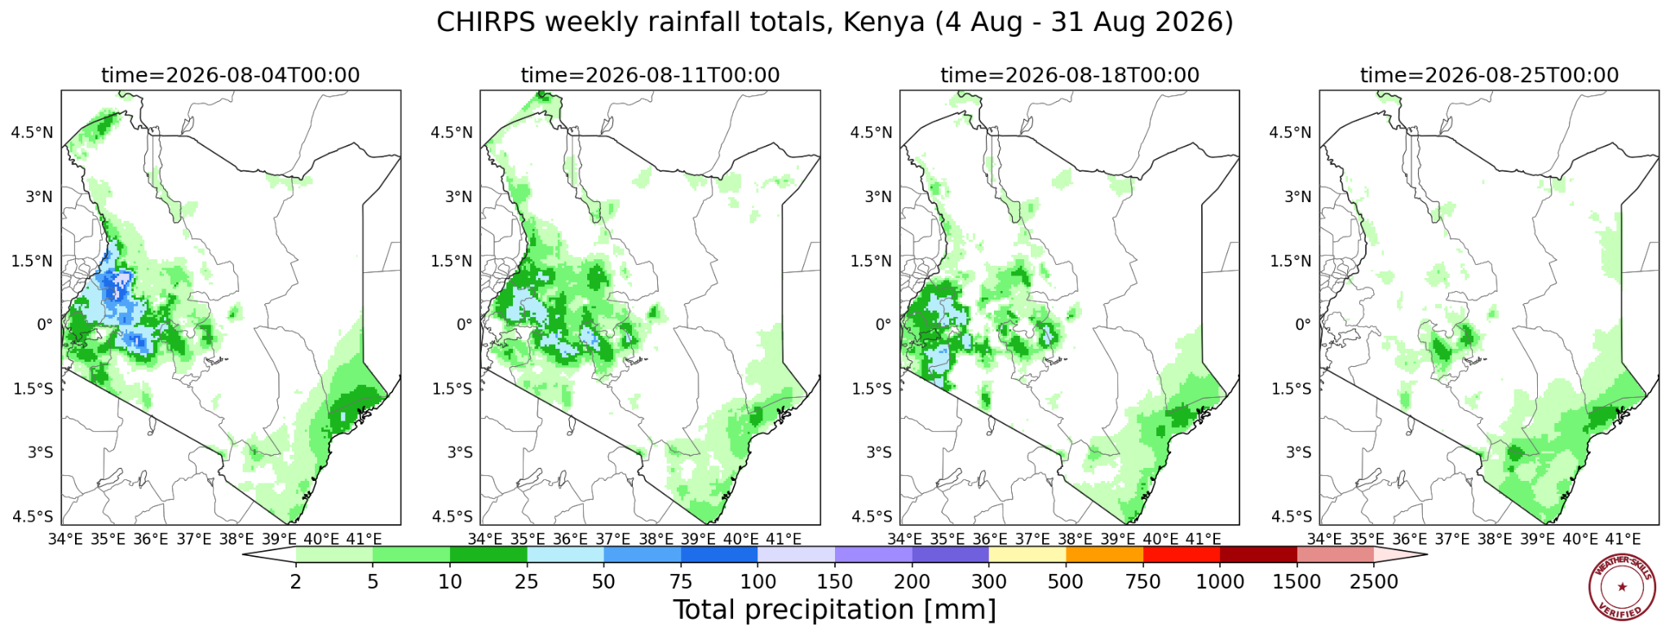
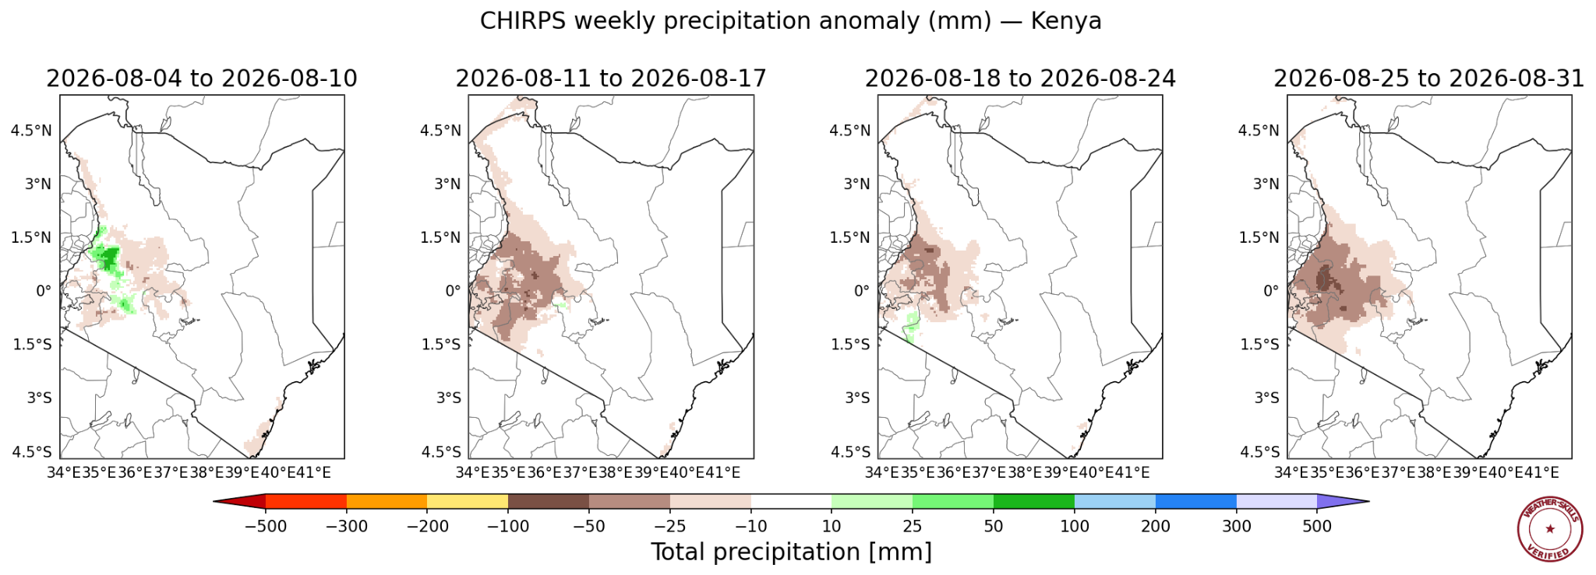
Recent Rainfall Observations: Kenya
Data from CHIRPS v3 Prelim
Notes:
Weather Skill: Can you show me the last 4 weeks of CHIRPS rainfall, clipped to Kenya? Can you show me that as anomalies?

Slide 8
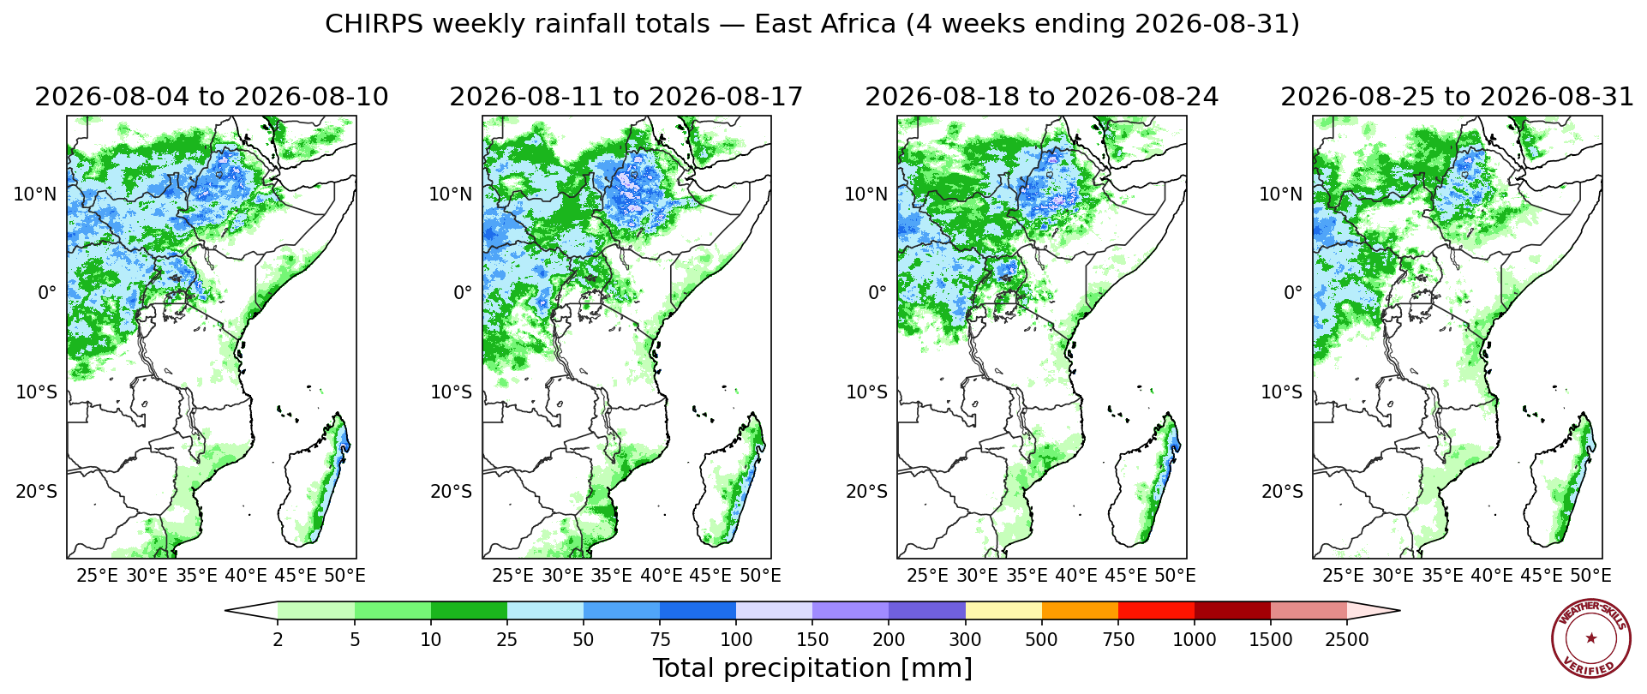
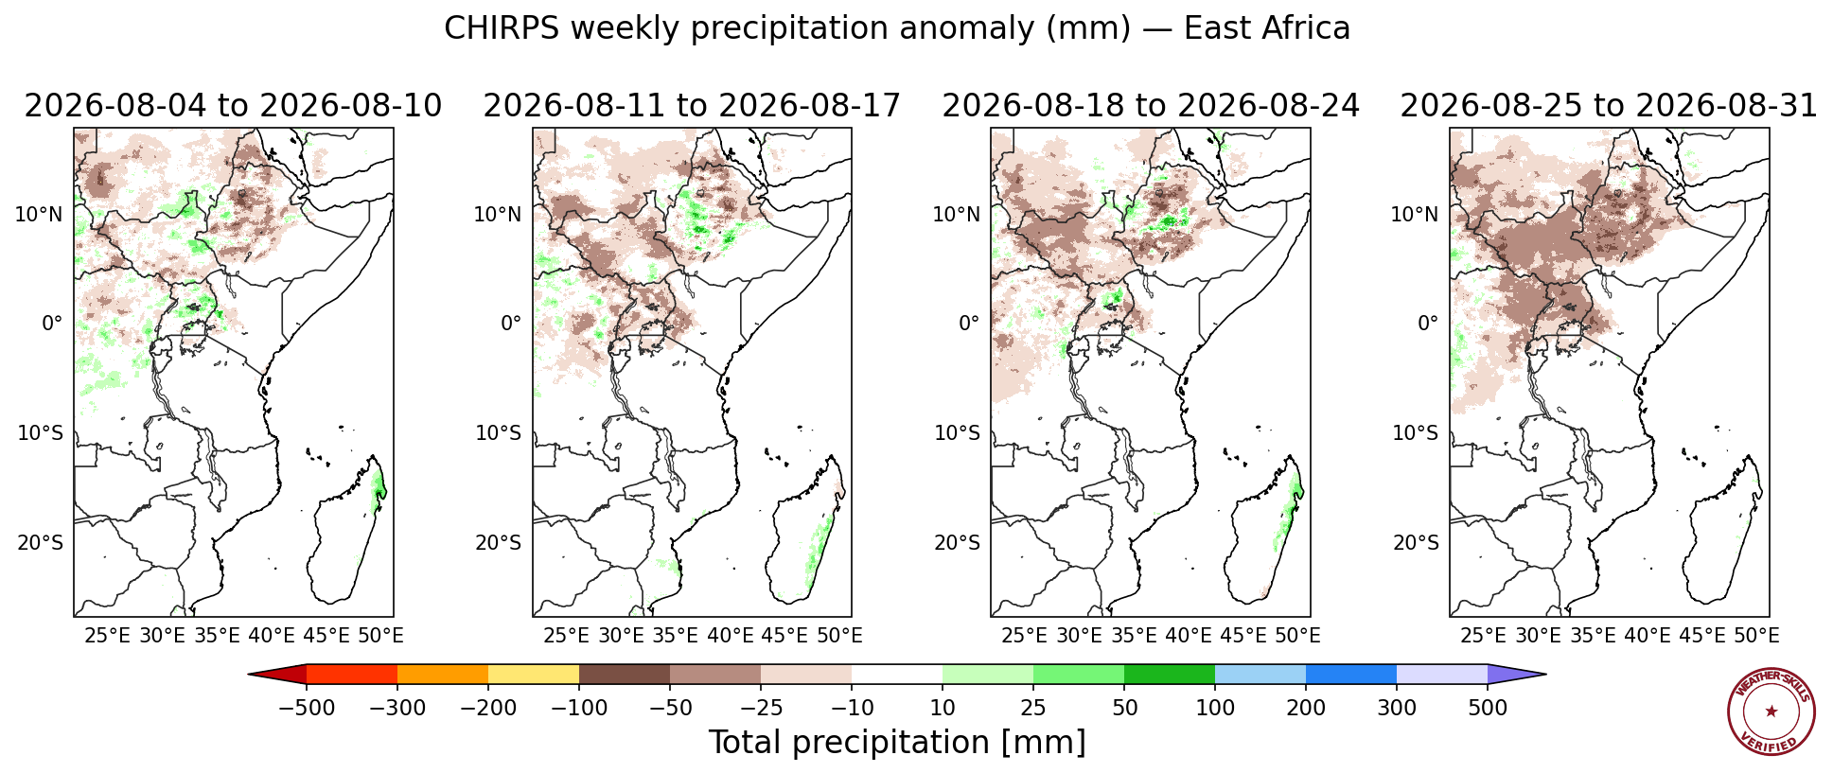
Recent Rainfall Observations: Eastern Africa
Data from CHIRPS v3 Prelim
Notes:
Weather Skill: Can you show me the last 4 weeks of CHIRPS rainfall in East Africa? Can you show me that as anomalies?

Slide 9
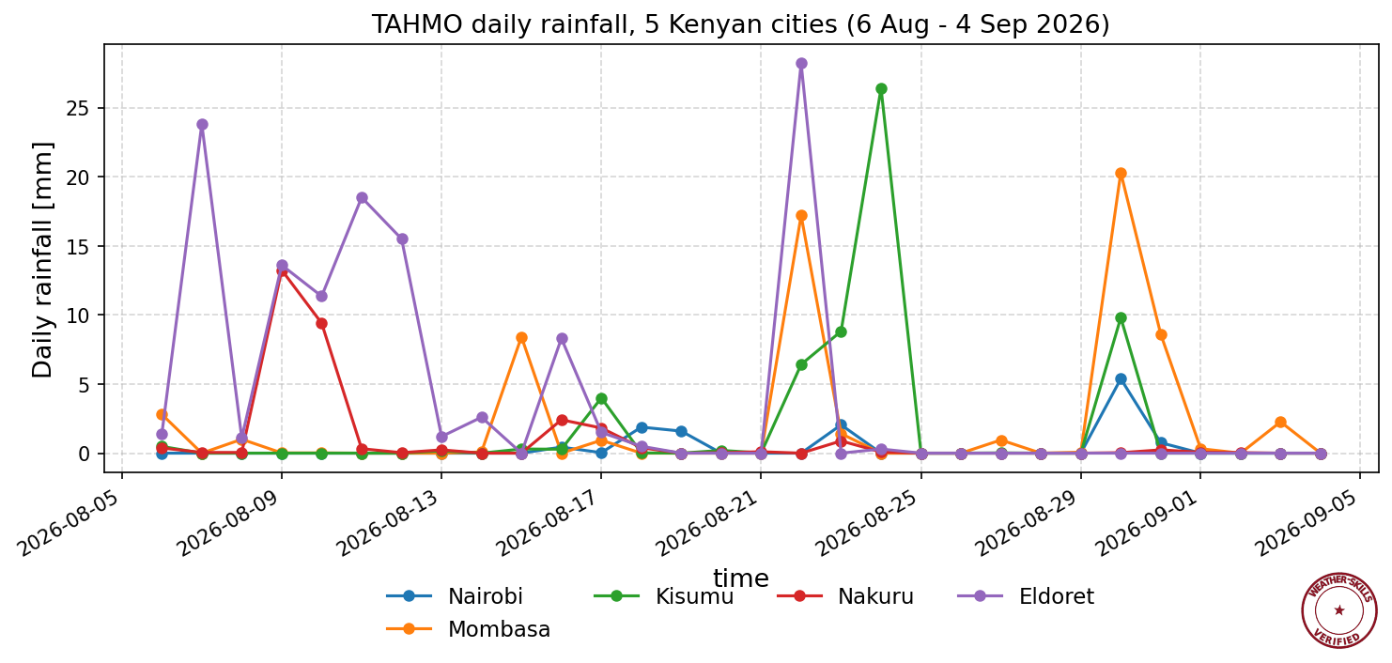
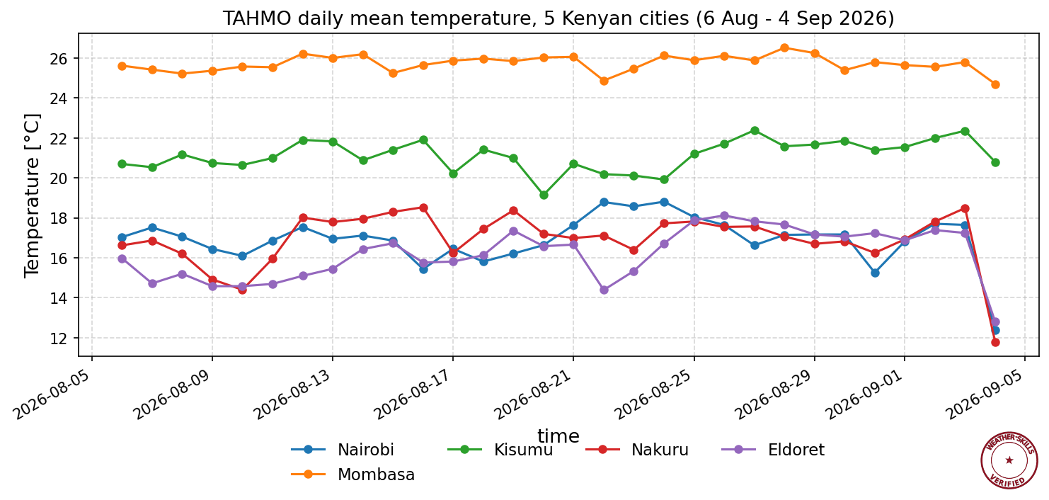
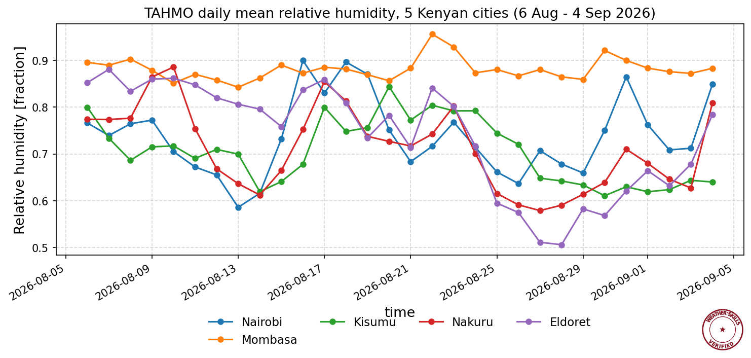
Recent Observations: Station Data
Data TAHMO Stations in 5 major cities
City | Station | ID
Nairobi | ARCUS- Kenya Meteorological Dept HQ | TA00025
Mombasa | Likoni School for the Blind | TA00072
Kisumu | ARCUS- Maseno University | TA00171
Nakuru | ARCUS- Moi Forces Academy | TA00026
Eldoret | ARCUS- Moi University | TA00274
Notes:
Weather Skill: Plot me the TAHMO station data in Nairobi, Mombasa, Kisumu, Nakuru, and Eldoret. Prefer the following station IDs: TA00025, TA00072, TA00171, TA00026, TA00274

Slide 10
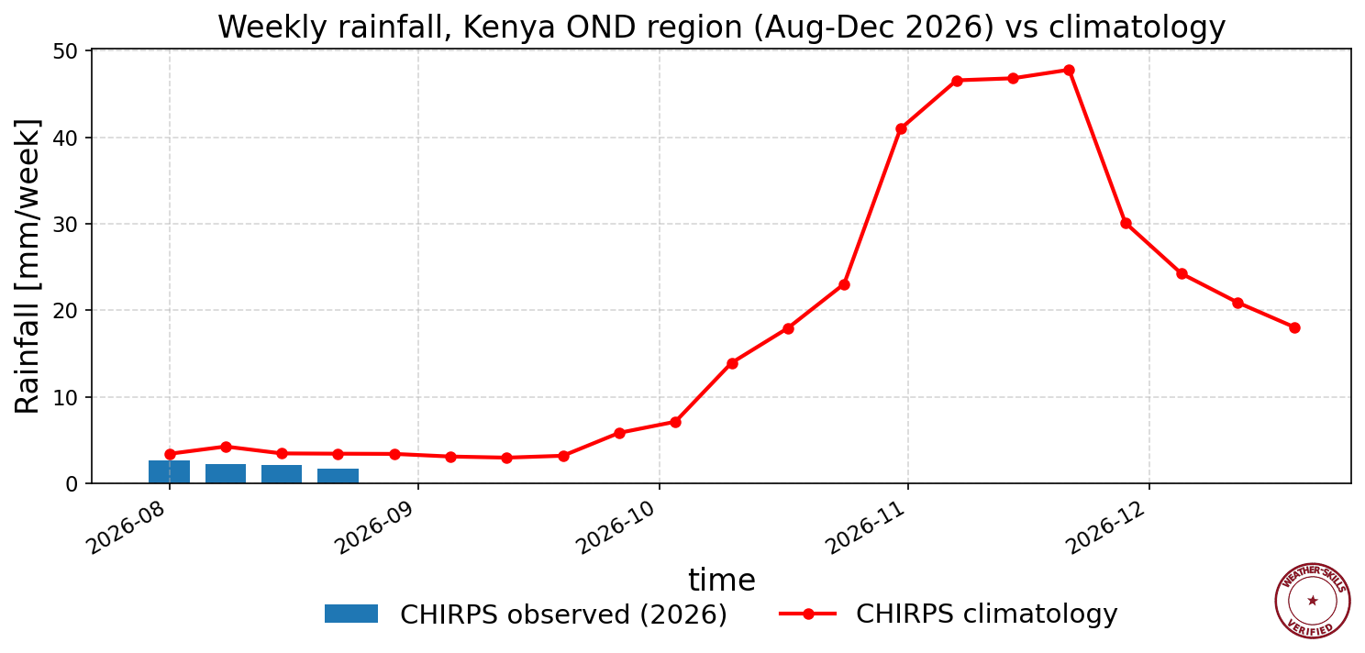
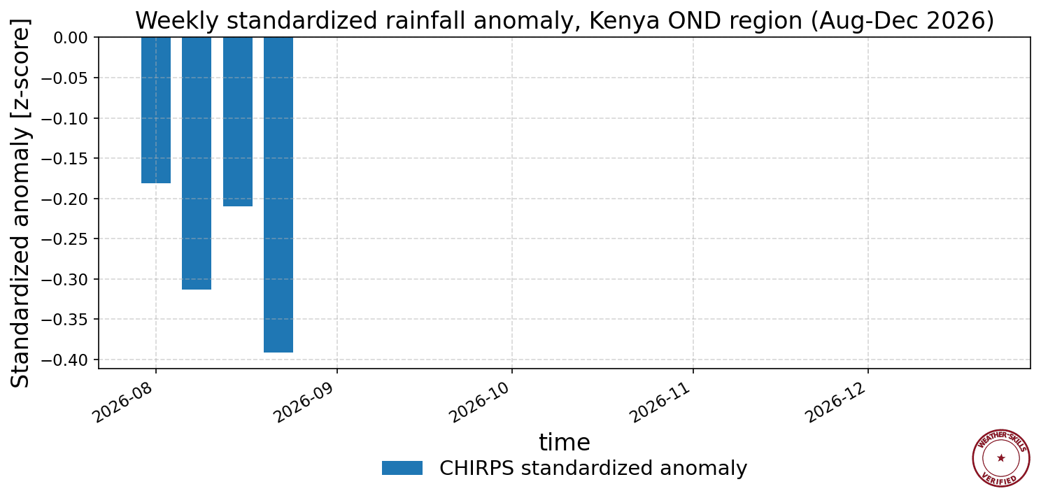
Seasonal Progression
Data from CHIRPS v3 Prelim in Central Eastern Kenya Region
Notes:
Weather Skills: Can you plot a barplot of daily rainfall in Kenya’s OND region from August - December of this year and overlay a line plot of climatology? Can you show me the standardized anomalies on that same time period, filling out the period through December where there are no observations?

Slide 11
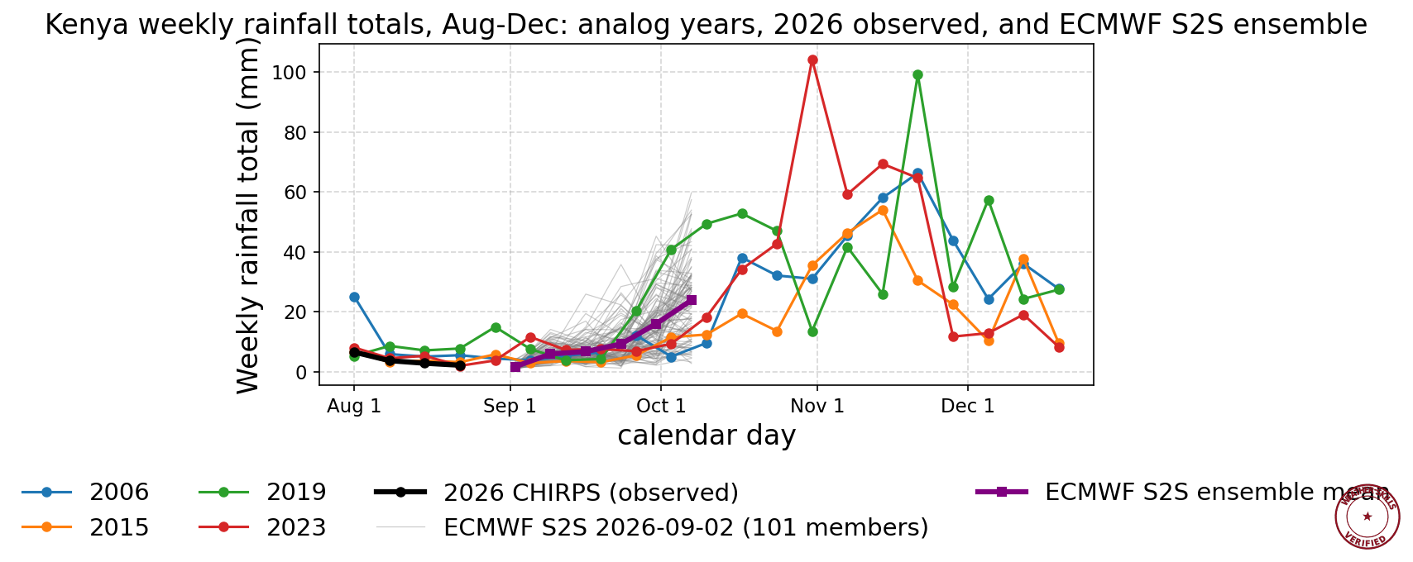
Seasonal Progression vs Analog Years
Data from CHIRPS v3 Prelim in Central Eastern Kenya Region
Notes:
Weather Skills: Can you show me the weekly rainfall totals from August to December in Kenya for each analog year and the current year from the CHIRPS data product? Can you append the ECMWF 6 week S2S forecast and show the ensemble spread as individual trajectories?

Slide 12
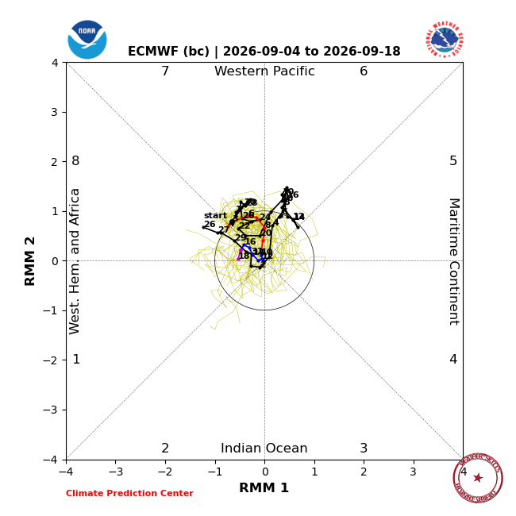
Equatorial Waves - MJO
Data from the Australian Bureau of Meteorology
Notes:
Weather Skill: Can you show me the current MJO state?
Sources
https://www.bom.gov.au/climate/mjo/
https://www.bom.gov.au/climate/mjo/#tabs=Monitoring

Slide 13
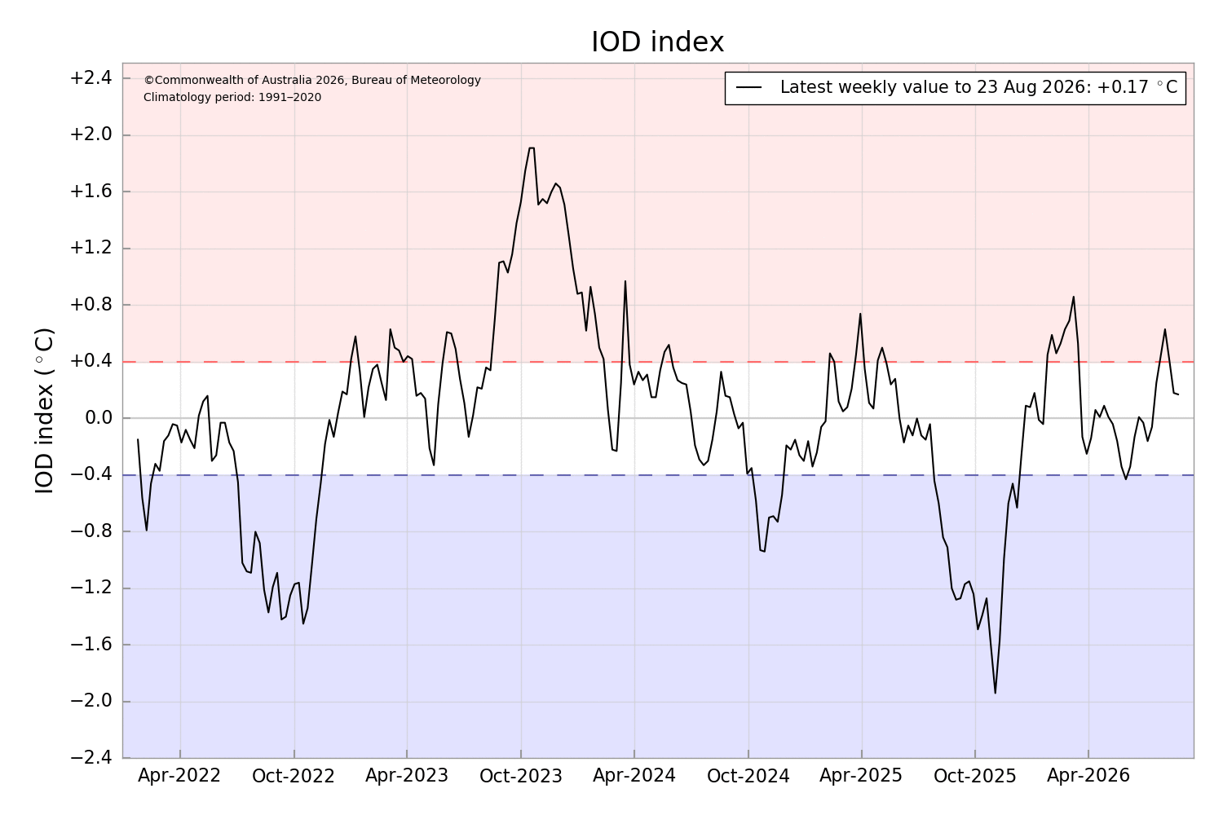
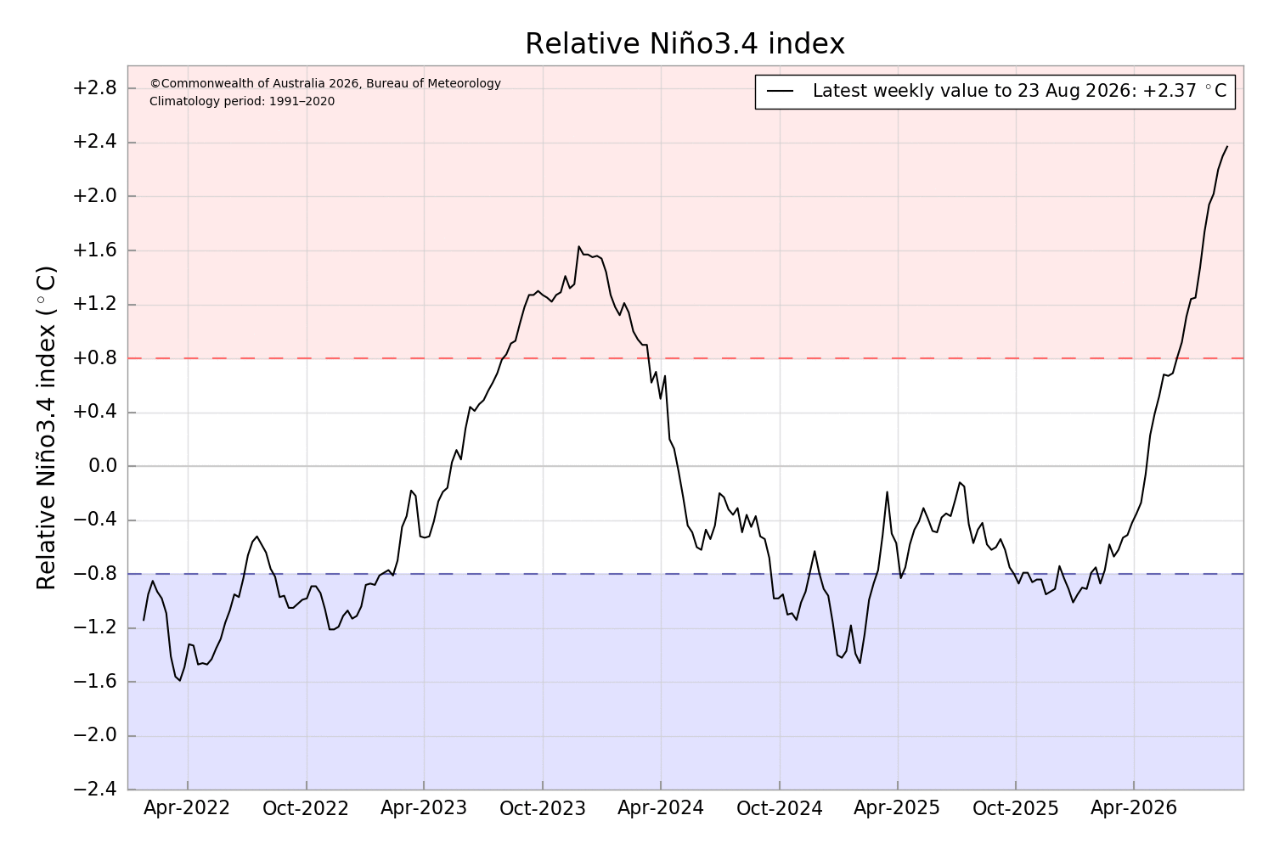
Equatorial Waves - IOD and ENSO
Notes:
Weather Skill: Can you show me the current IOD and ENSO state?
https://www.bom.gov.au/climate/enso/?ninoIndex=nino3.4&index=rnino34&period=weekly#tabs=Pacific-Ocean

Slide 14
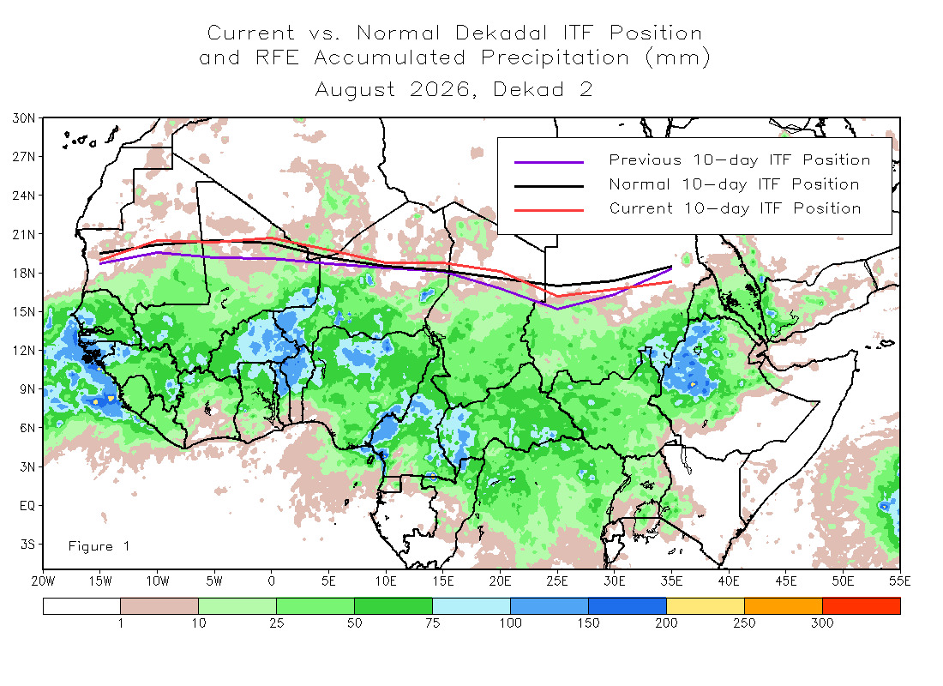
ITCZ State
Notes:
Weather Skill: Can you show me the current ITCZ state?
https://www.cpc.ncep.noaa.gov/products/international/itf/itcz.shtml

Slide 15
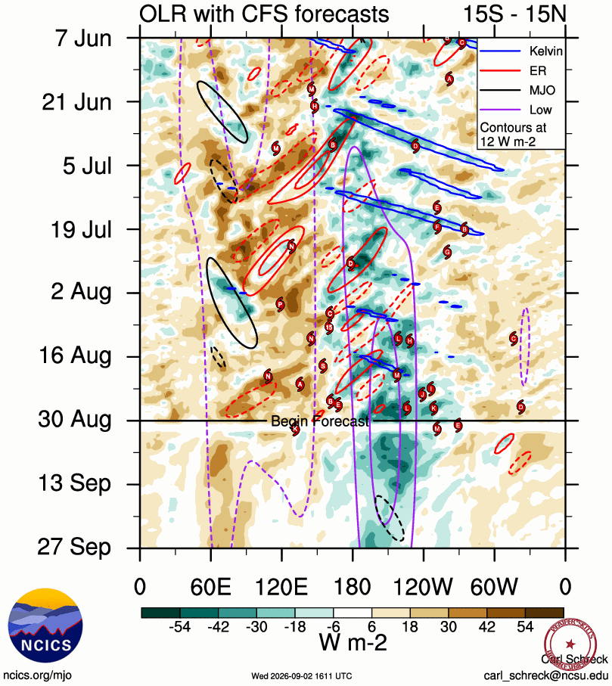
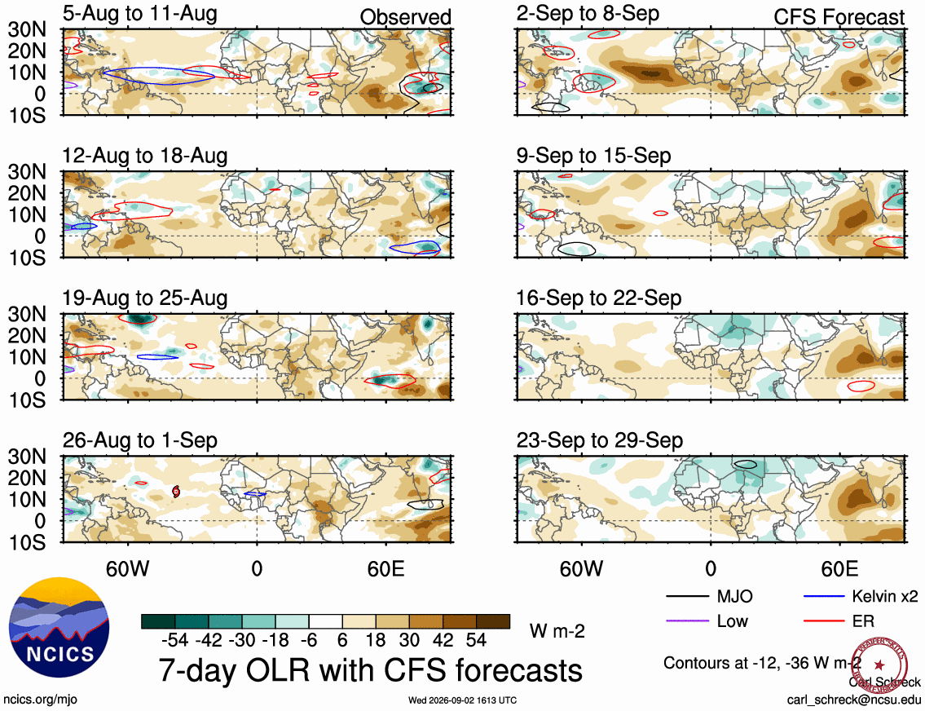
Equatorial Waves - Analyses and Forecasts
Data from Carl Schreck, ncis.org
Notes:
Weather Skill: Can you show me the current hovmoller diagram in the tropics? Can you show me that as a map focused on Africa?
https://ncics.org/portfolio/monitor/mjo/
https://ncics.org/pub/mjo/v2/map/olr.cfs.all.global.7.png
https://ncics.org/pub/mjo/v2/hov/vwnd850.orig.eqtr.png

Slide 16
Last Week’s Forecast Verification

Slide 17
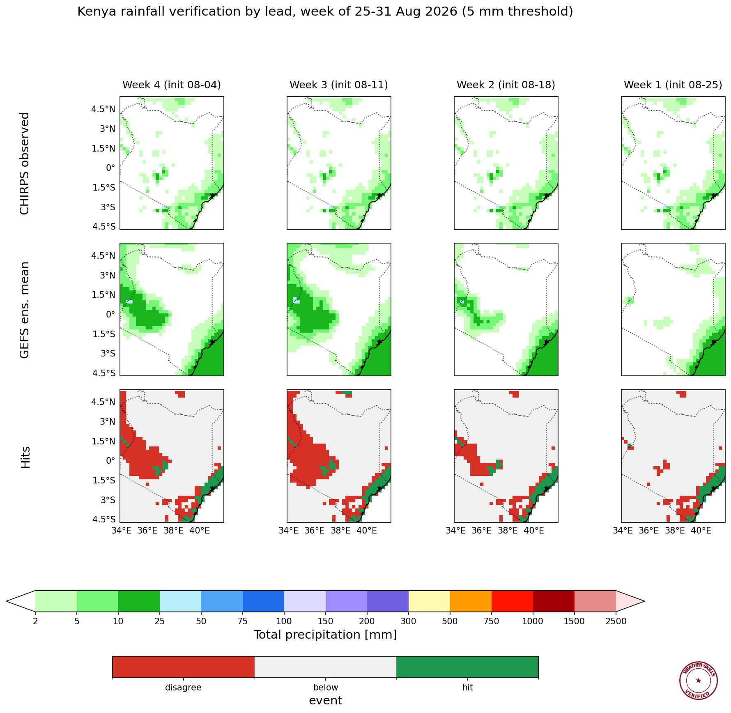
Last Weeks Forecast Verification - Hit Rate, GEFS
Data from GEFS and CHIRPS
Notes:
WeatherSkill: Can you verify the last weeks CHIRPS precip against weeks 1 -4 of the GEFS model in Kenya, with a 5mm rainfall cutoff?

Slide 18
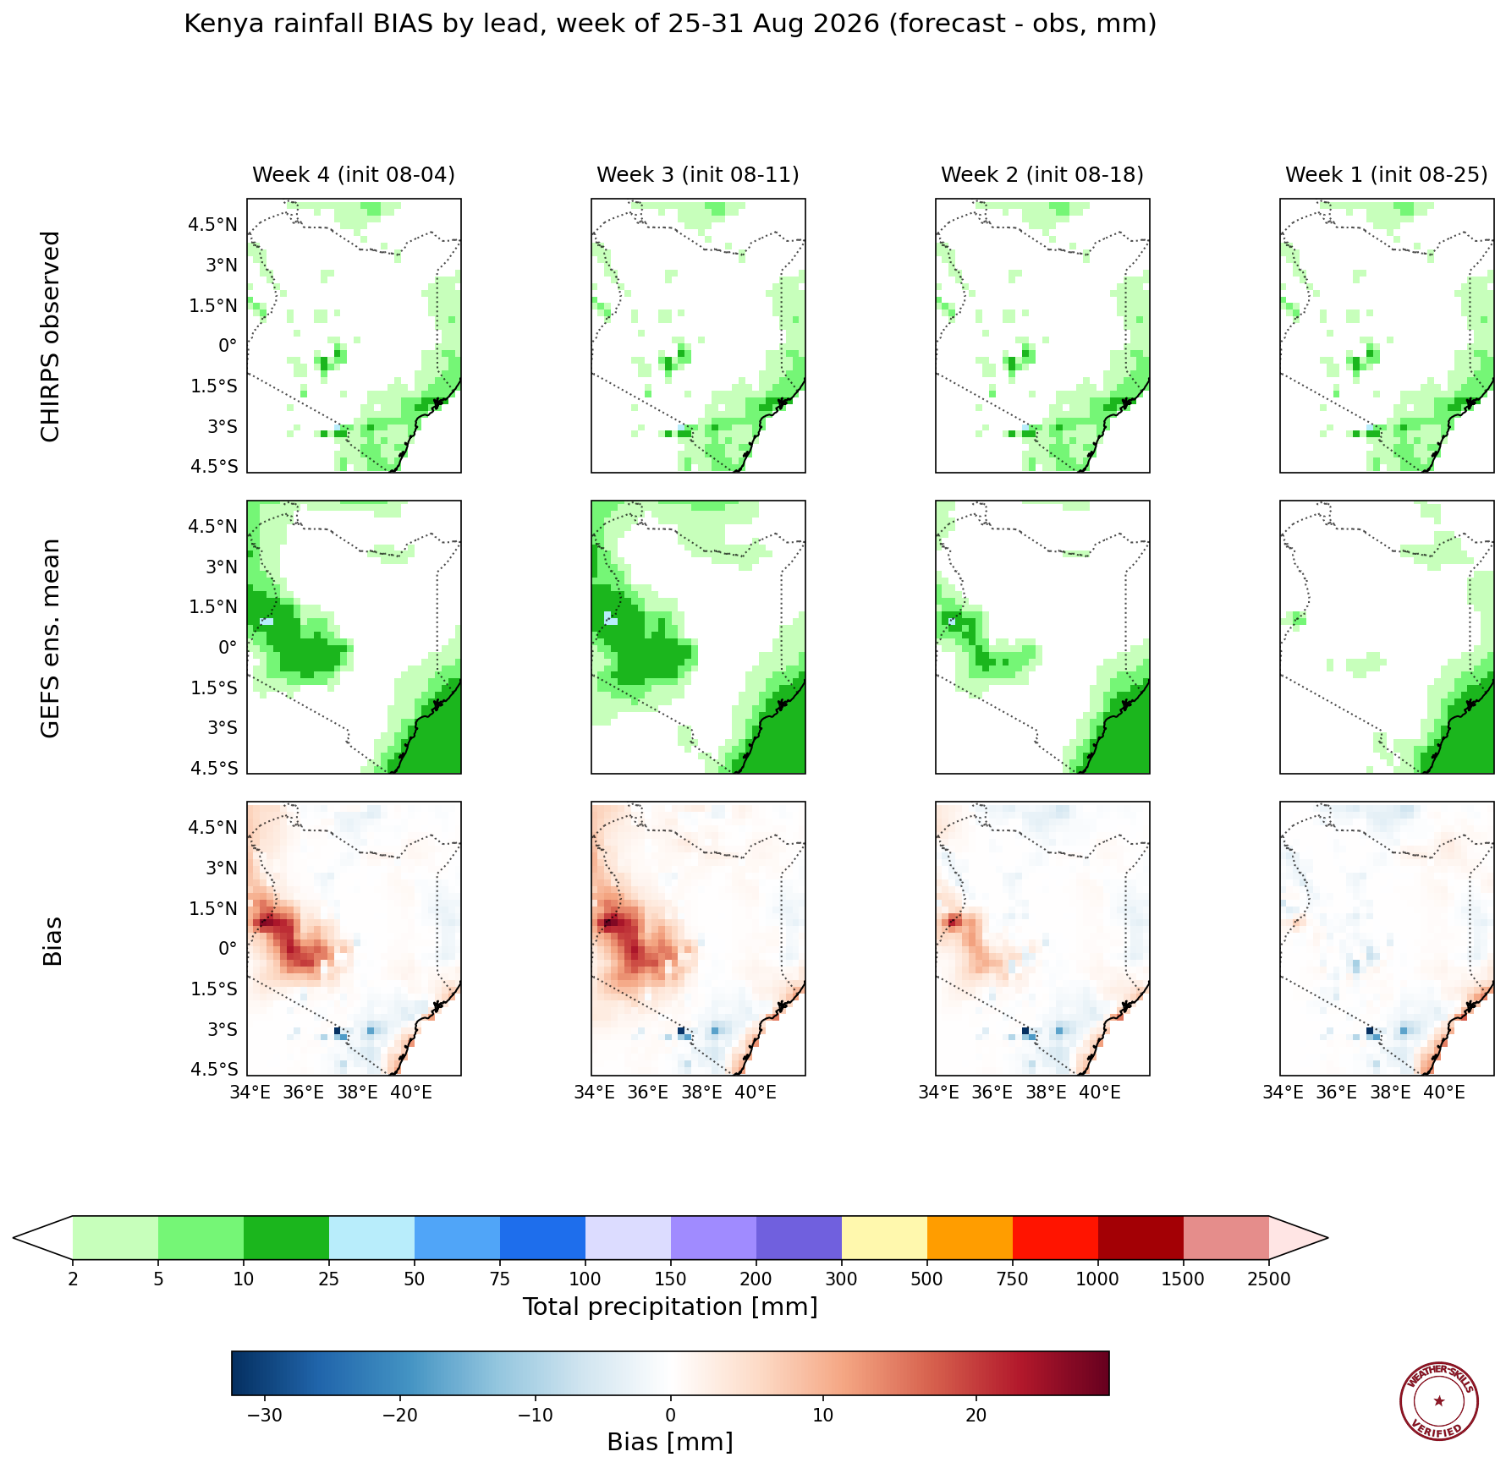
Last Weeks Forecast Verification - Bias, GEFS
Data from GEFS and CHIRPS
Notes:
WeatherSkill: Can you show me that as bias?

Slide 19
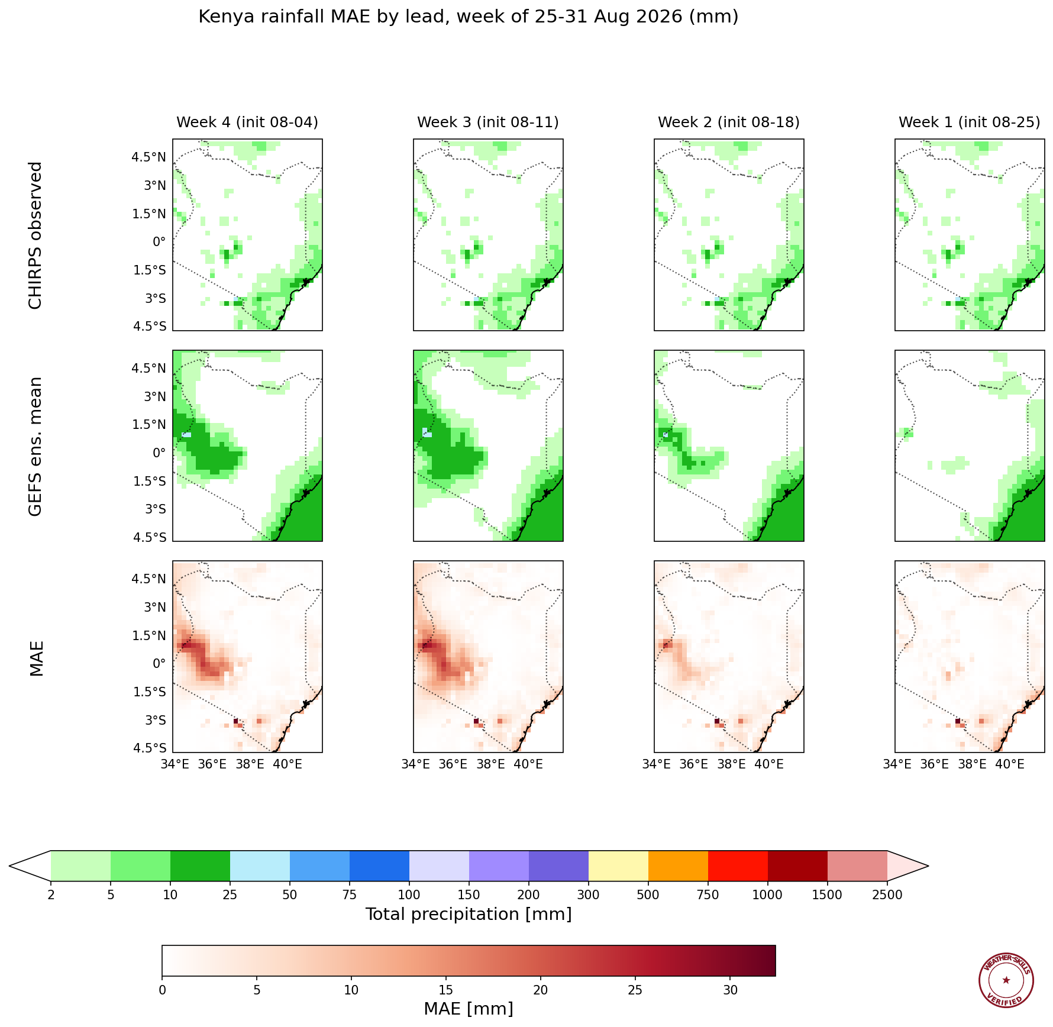
Last Weeks Forecast Verification - Bias, GEFS
Data from GEFS and CHIRPS
Notes:
WeatherSkill: Can you show me that as MAE?

Slide 20
This Week’s Forecasts

Slide 21
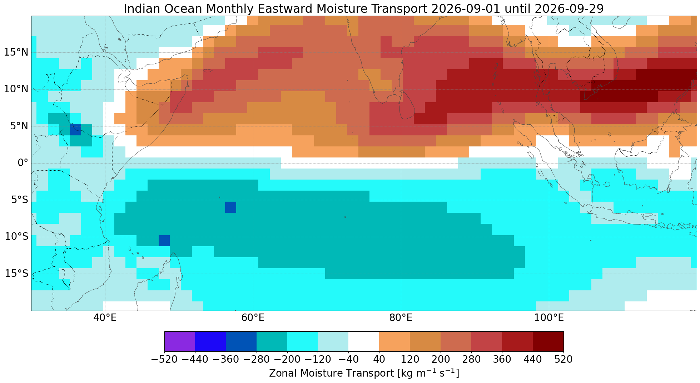
Zonal Moisture Transports
Source ECMWF extended range

Slide 22
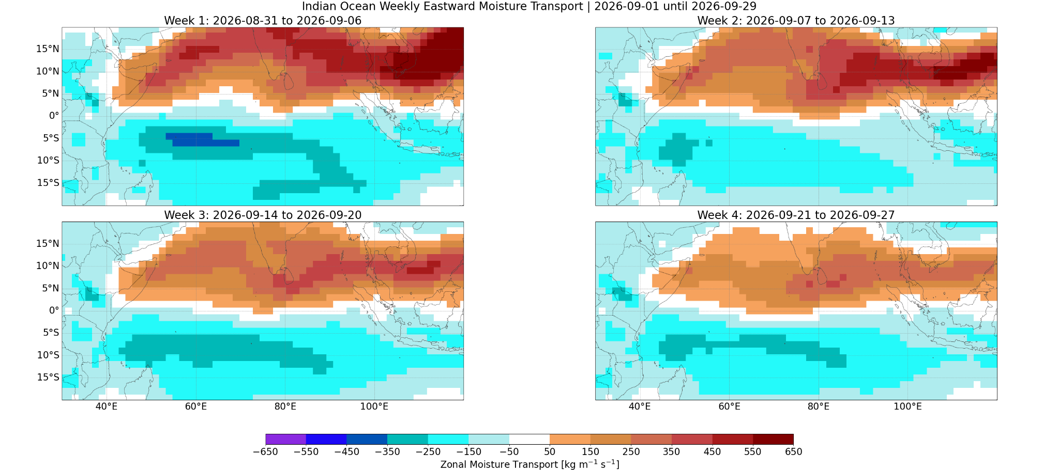
Zonal Moisture Transports
Source ECMWF extended range

Slide 23
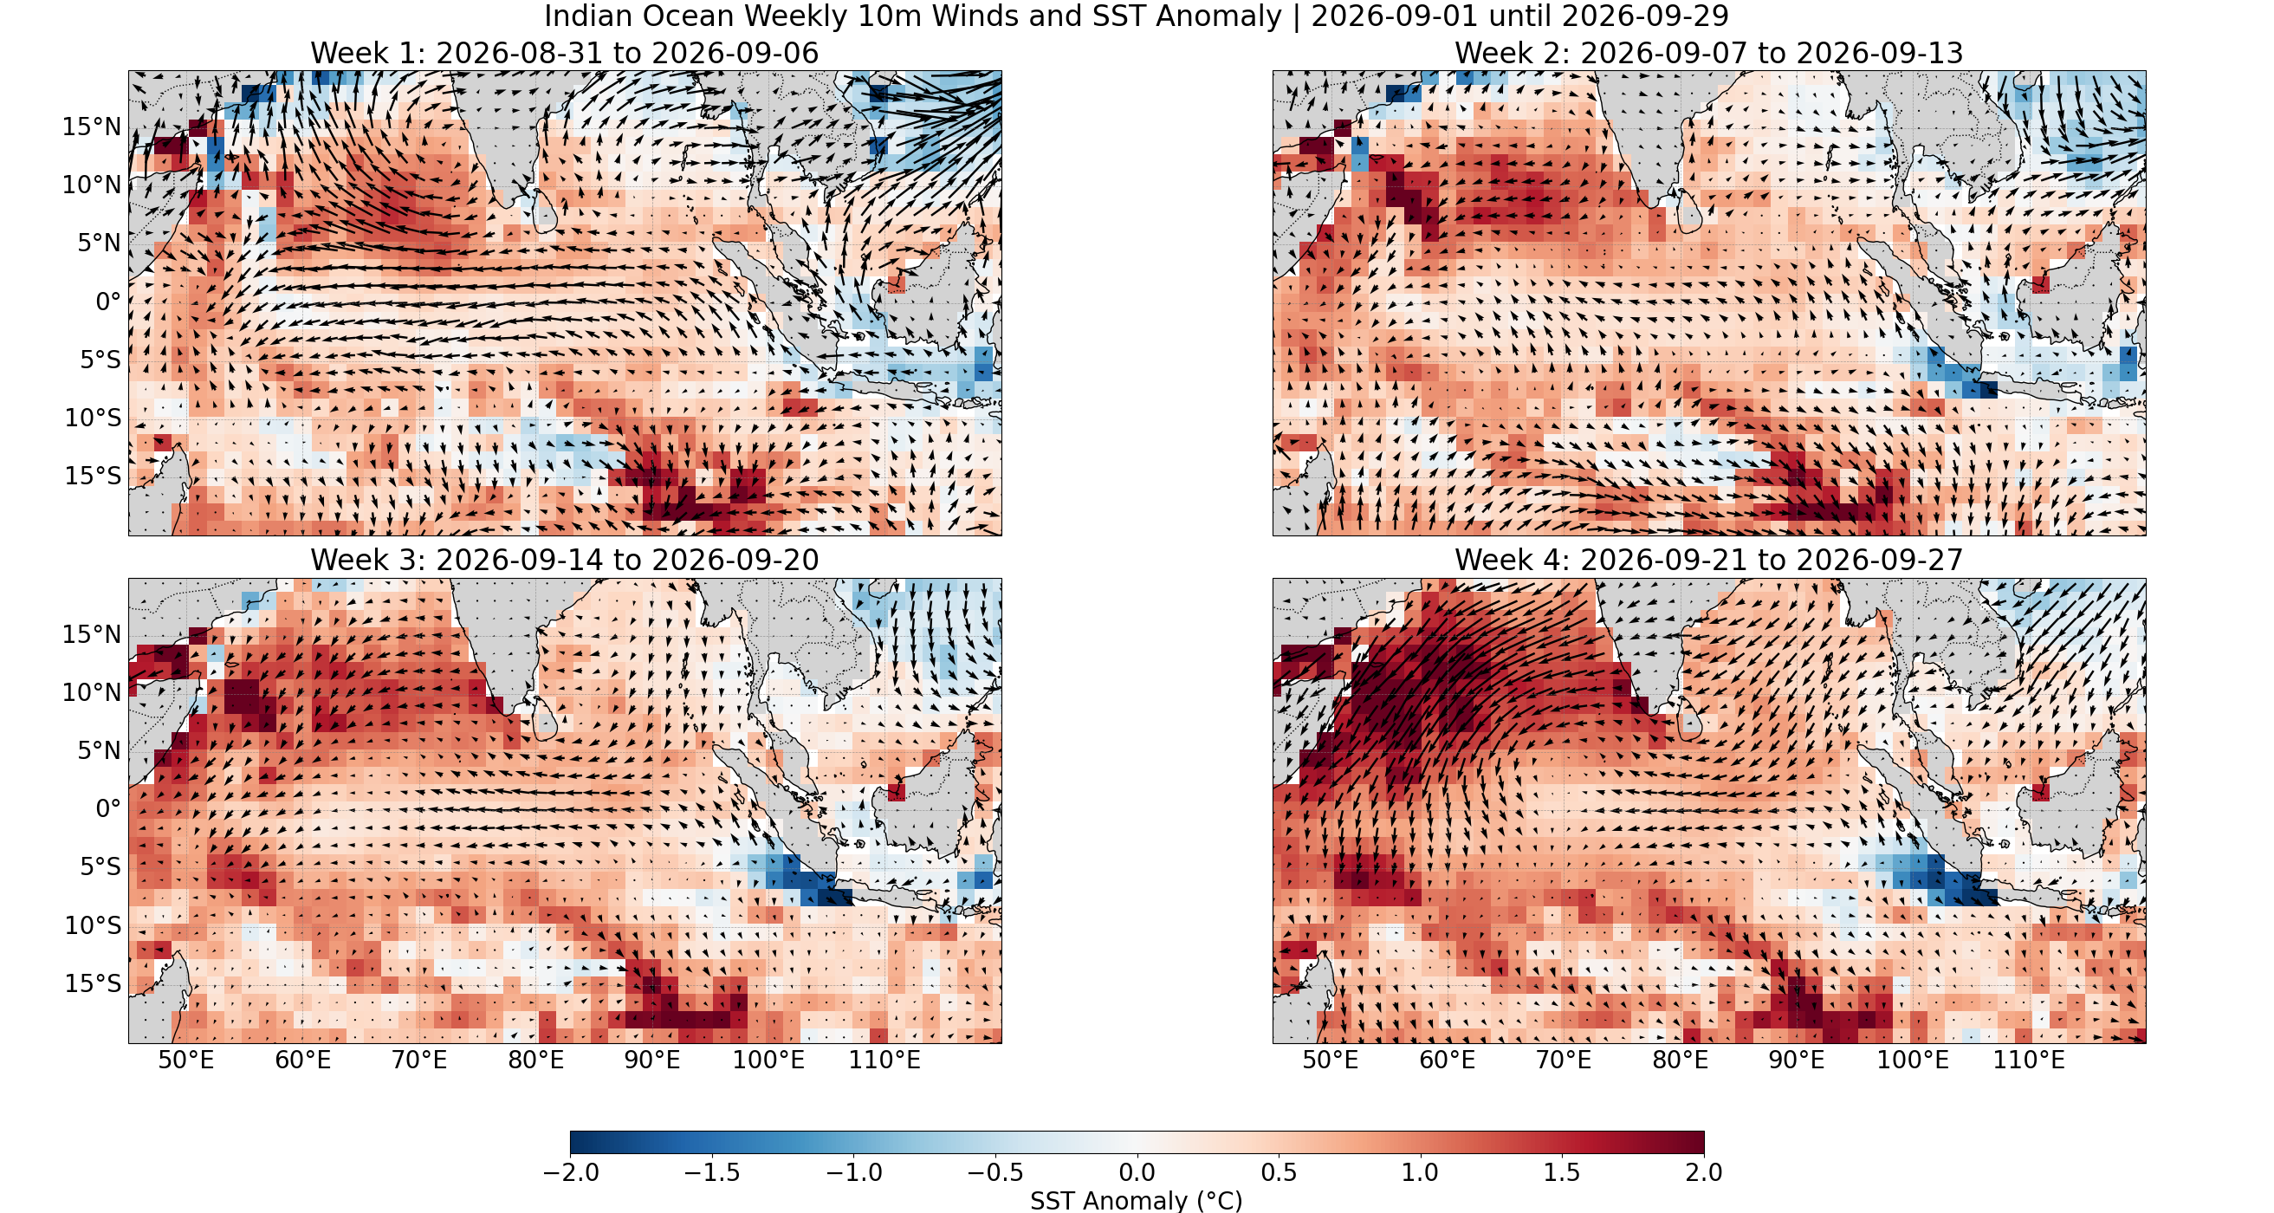
Projected State Over the Indian Ocean
Source ECMWF extended range

Slide 24
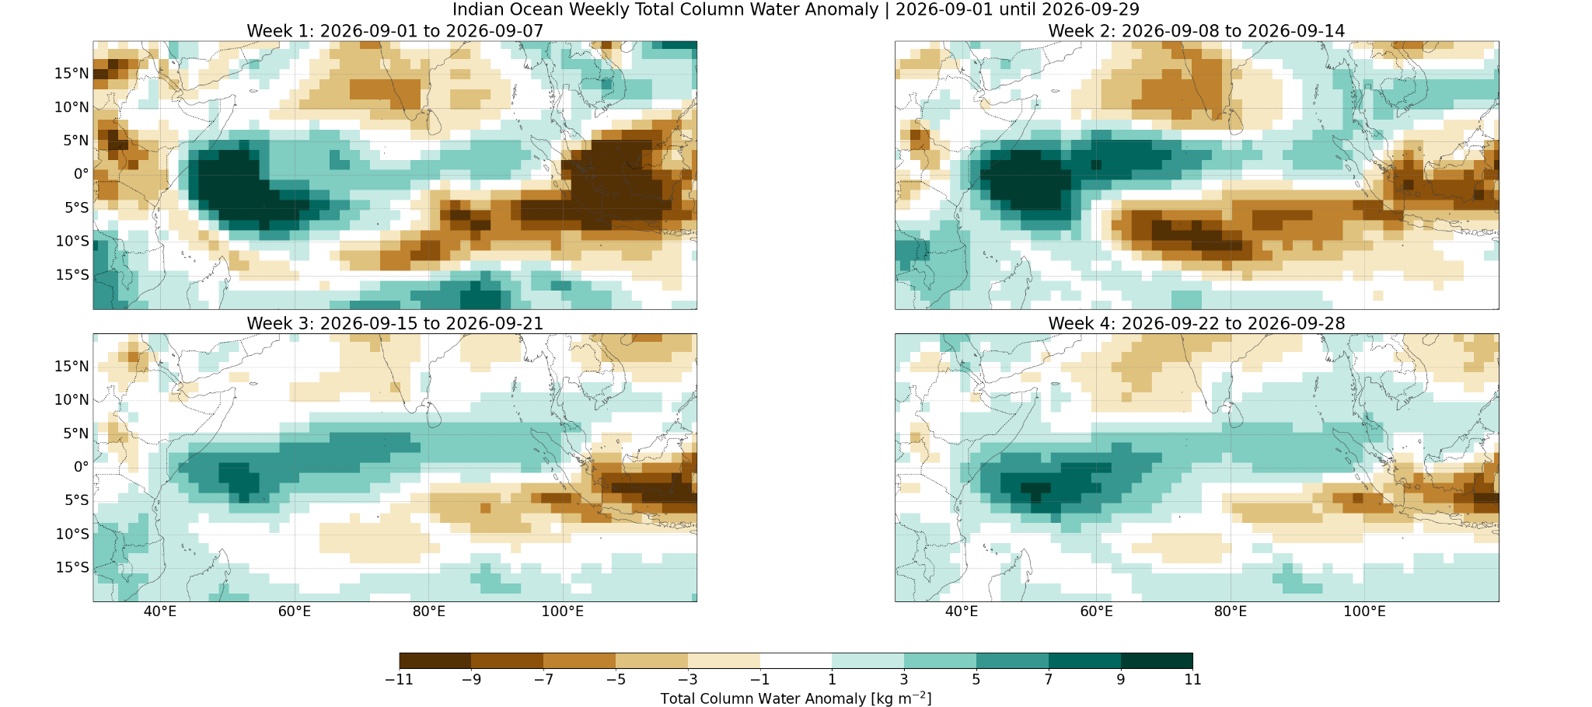
Total Column Water Anomaly
Source ECMWF extended range

Slide 25
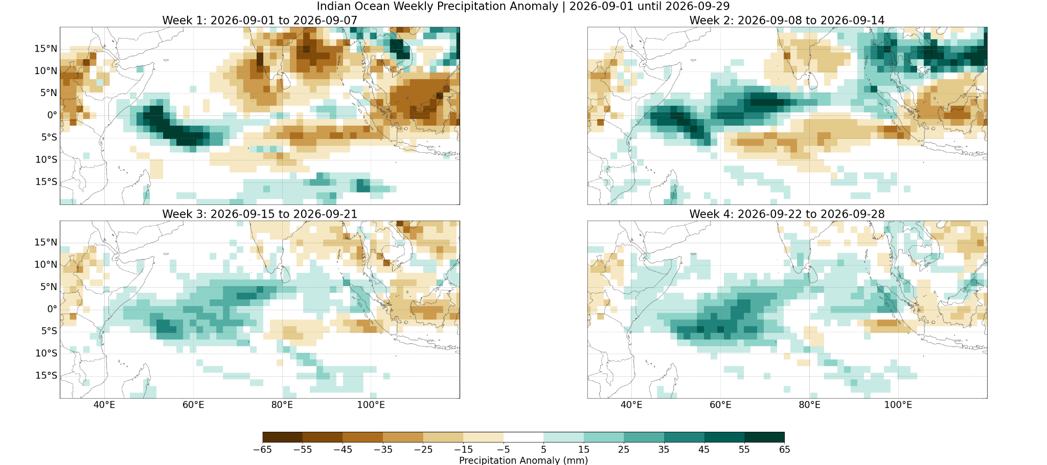
Indian Basin Monthly Precipitation anomaly
Source ECMWF extended range

Slide 26
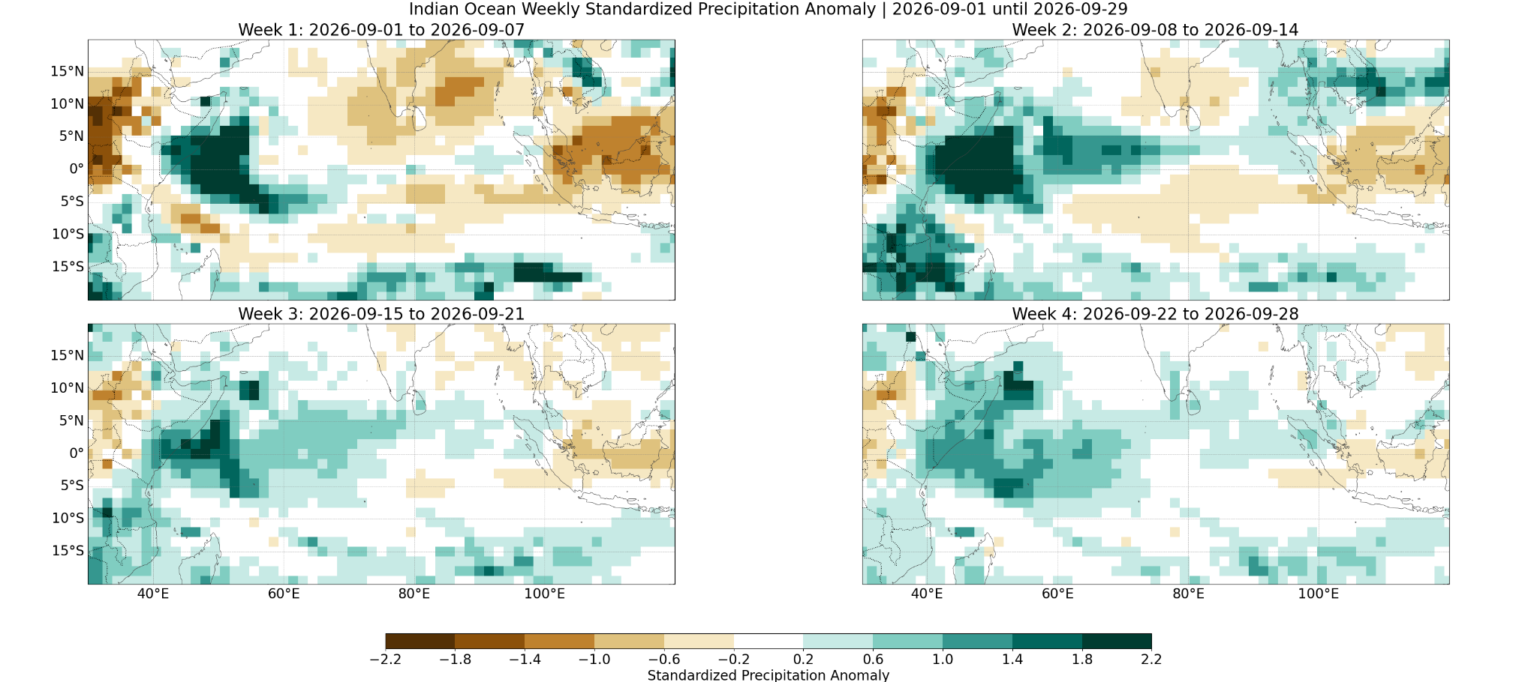
Indian Basin Standardized Monthly Precipitation Anom
Source ECMWF extended range

Slide 27
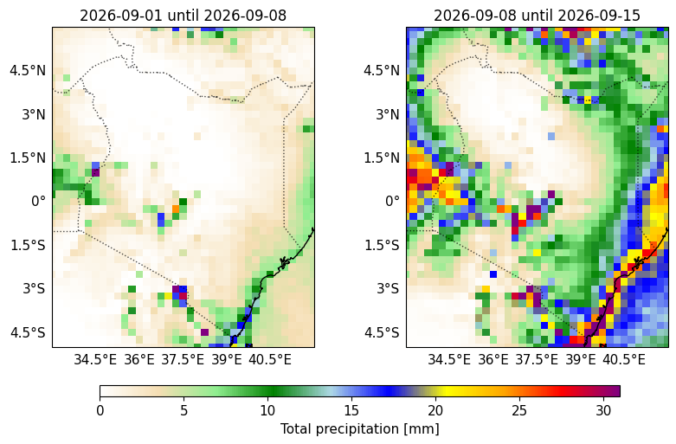
Weekly precipitation: ECMWF Medium Range
Source Nimbus Forecasting System
Coast: The medium-range forecast indicates 17.2mm in week 1 and 25.3mm in week 2, which reinforces the wet signal seen in all other products and suggests the intensity may be higher than even the downscaled output.
Highlands West of the Rift Valley and Rift Valley and Lake Victoria Basin: The medium-range values of 6.6mm and 6.3mm in week 1 are higher than the raw ECMWF values but lower than the downscaled totals, acting as a moderate middle ground for the western zones.
Highlands East of the Rift Valley, Northeastern Kenya, Southeastern Lowlands, and Northwestern Kenya: The medium-range forecast shows 7.4mm, 2.5mm, 4.6mm, and 0.6mm respectively for week 1, generally tracking closely with the raw ECMWF and GEFS, confirming the dry start for these interior regions.
Notes:
Can you plot the next two weeks of the ECMWF HRES rainfall forecast, clipped to Kenya?

Slide 28
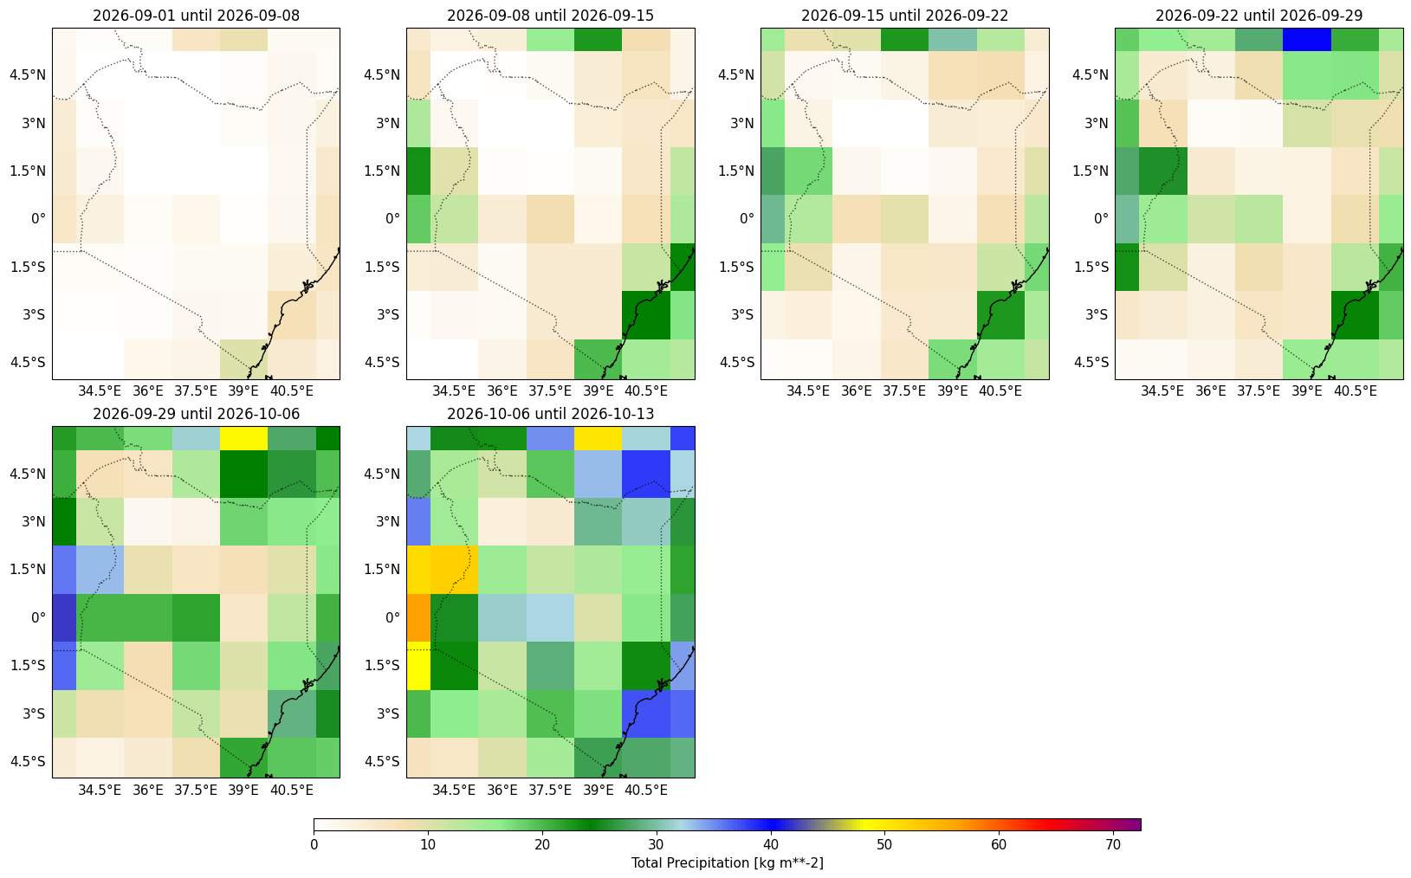
Weekly precipitation: ECMWF
Source Nimbus Forecasting System
Coast: This region shows the most significant wet signal in the forecast, with raw_precip of 13.6mm in week 1, increasing to 17.6mm by week 2. This wet tendency persists through week 3 (12.3mm) and week 4 (12.2mm), before potentially intensifying in weeks 5 and 6.
Highlands West of the Rift Valley, Rift Valley and Lake Victoria Basin, Highlands East of the Rift Valley, Northeastern Kenya, Southeastern Lowlands, and Northwestern Kenya: These regions are largely dry in week 1, with raw_precip values ranging from 0.8mm in the northwest to 5.9mm in the western highlands. This dry signal generally persists into week 2, though Southeastern Lowlands shows a slight increase to 6.5mm, and Northeastern Kenya moves toward 3.8mm. By week 3, the dry signal begins to ease across most of these zones, with western areas seeing raw_precip rise to between 2.0mm and 12.1mm by the end of week 4.
Notes:
Can you plot the next 6 weeks of the ECMWF extended range rainfall forecast, clipped to Kenya? For the ECMWF forecast, can you plot the HRES forecast for weeks 1 & 2, and the S2S forecast for weeks 3-6?

Slide 29
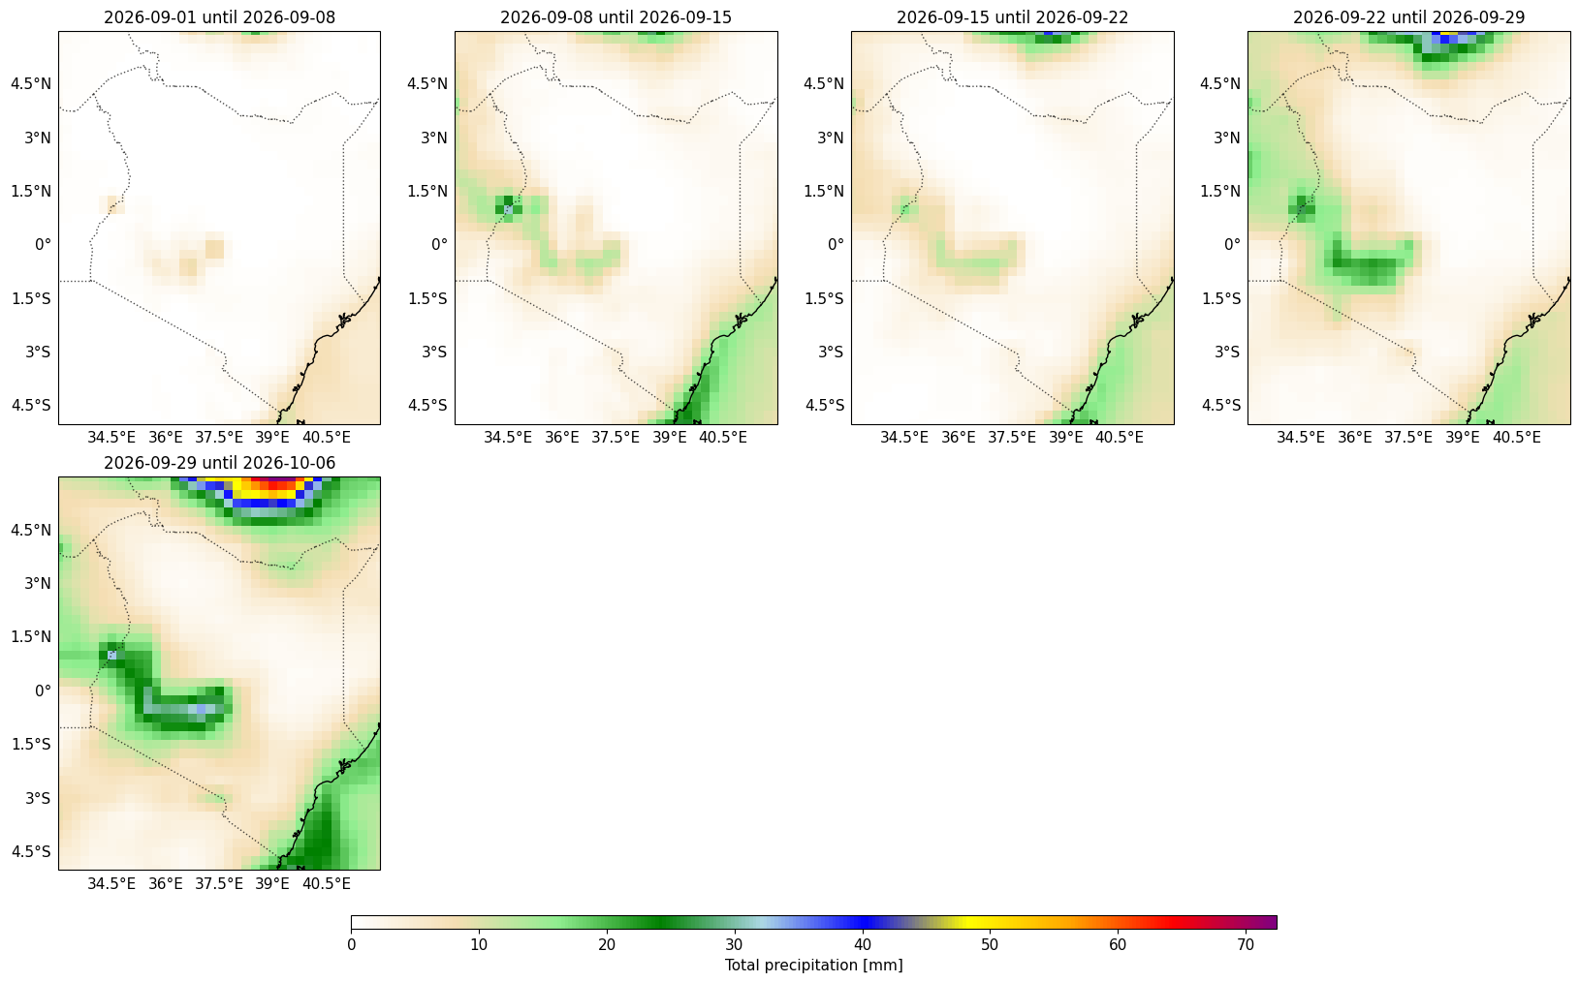
Weekly precipitation: GEFS
Source Nimbus Forecasting System
Coast: This region shows the most significant wet signal in the forecast, with raw_precip of 13.6mm in week 1, increasing to 17.6mm by week 2. This wet tendency persists through week 3 (12.3mm) and week 4 (12.2mm), before potentially intensifying in weeks 5 and 6.
Highlands West of the Rift Valley, Rift Valley and Lake Victoria Basin, Highlands East of the Rift Valley, Northeastern Kenya, Southeastern Lowlands, and Northwestern Kenya: These regions are largely dry in week 1, with raw_precip values ranging from 0.8mm in the northwest to 5.9mm in the western highlands. This dry signal generally persists into week 2, though Southeastern Lowlands shows a slight increase to 6.5mm, and Northeastern Kenya moves toward 3.8mm. By week 3, the dry signal begins to ease across most of these zones, with western areas seeing raw_precip rise to between 2.0mm and 12.1mm by the end of week 4.
Notes:
Can you plot the next 5 weeks of the GEFS extended range rainfall forecast, clipped to Kenya?

Slide 30
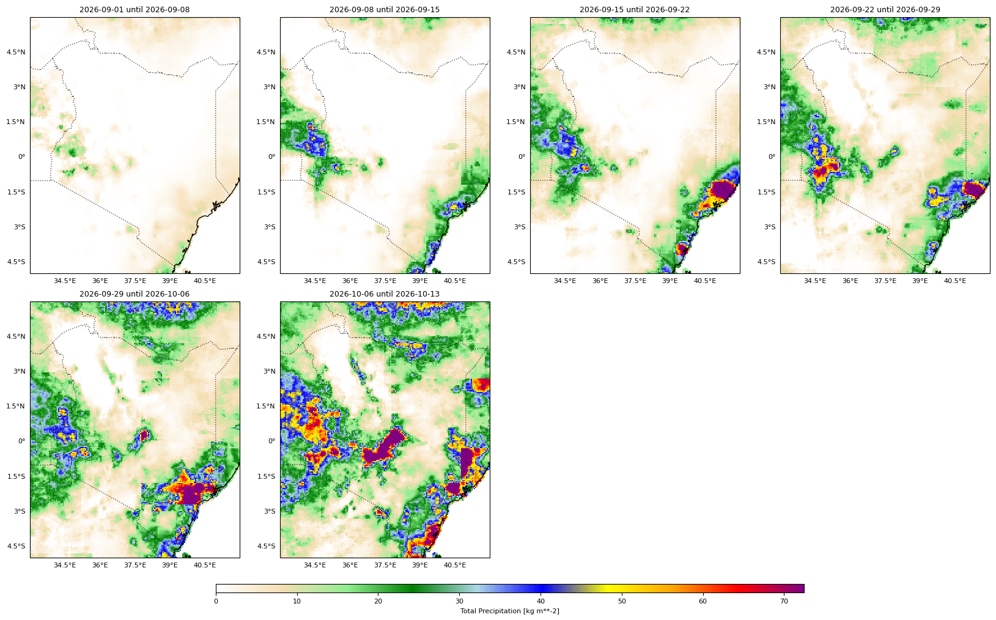
Weekly precipitation: ECMWF Downscaled
Source Nimbus Forecasting System
Coast: The downscaled product is the wettest of all sources, showing raw_precip of 15.1mm in week 1 and 20.9mm in week 2, which is higher than both the ECMWF S2S and GEFS values.
Highlands West of the Rift Valley and Rift Valley and Lake Victoria Basin: Downscaling significantly diverges from both raw models, showing much higher rainfall potential starting as early as week 1 (12.6mm and 7.5mm), suggesting that local topographic influences may be currently underestimated by the primary ensemble models.
Highlands East of the Rift Valley, Northeastern Kenya, Southeastern Lowlands, and Northwestern Kenya: Downscaled values are generally conservative in weeks 1 and 2, aligning well with the dry consensus of the ECMWF and GEFS, but show a sharper rise in moisture by week 4 compared to the raw ensemble outputs.
Notes:
Can you plot the next 6 weeks of the downscaled ECMWF extended range rainfall forecast, clipped to Kenya? Change the time titles to just show the date so they don’t overlap.

Slide 31
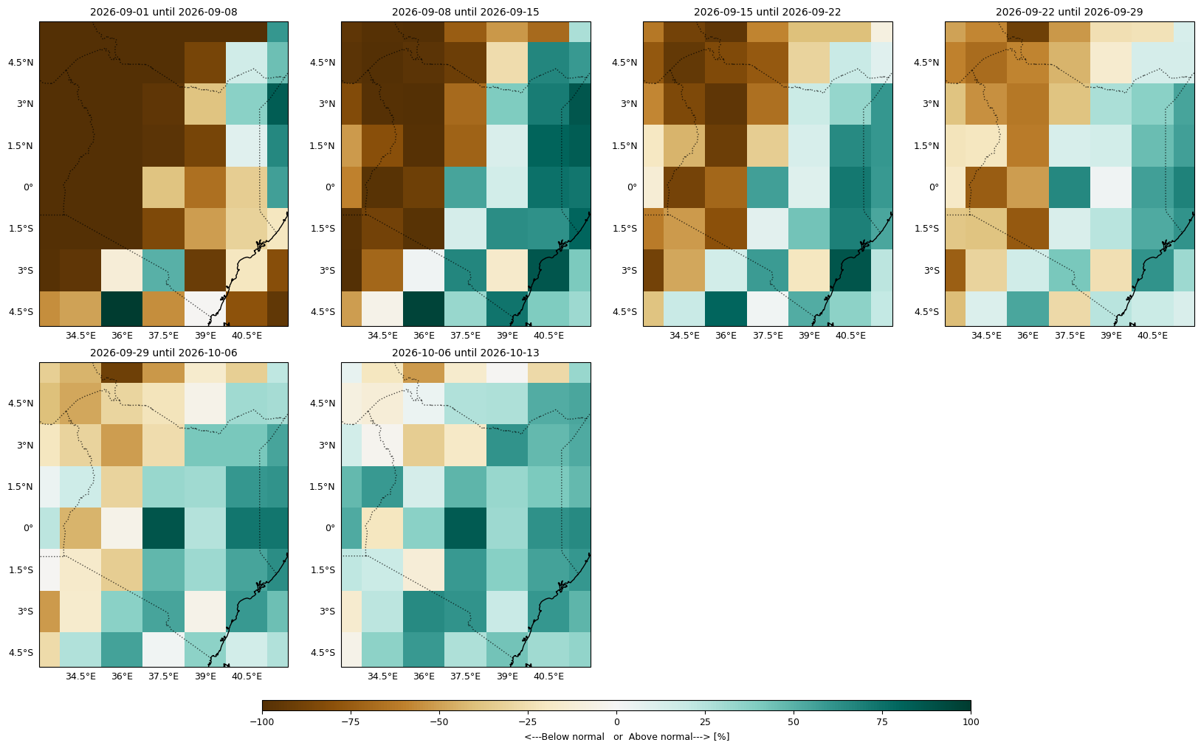
Likelihood of being above/below normal ECMWF
Source Nimbus Forecasting System
Northwestern Kenya, Highlands West of the Rift Valley, and Rift Valley and Lake Victoria Basin: A persistent dry tercile signal dominates, with p33 values at 94% to 95% in week 1, maintaining high values through week 2 (95% to 96%) and gradually easing into week 3 (76% to 85%).
Highlands East of the Rift Valley, Northeastern Kenya, and Southeastern Lowlands: These regions show a split signal in week 1, with Northeastern Kenya leaning dry (p33=57%) while the others show more uncertainty; by week 2, Southeastern Lowlands shifts to a wet signal (p66=56%).
Coast: A strong wet signal is present throughout, with p66 values of 69% in week 1 and 75% in week 2, easing slightly but remaining above normal in week 3 (p66=50%) and week 4 (p66=58%).
Notes:
Can you plot the next likelihood of being above normal for the next 6 weeks of the ECMWF extended range rainfall forecast, clipped to Kenya?

Slide 32
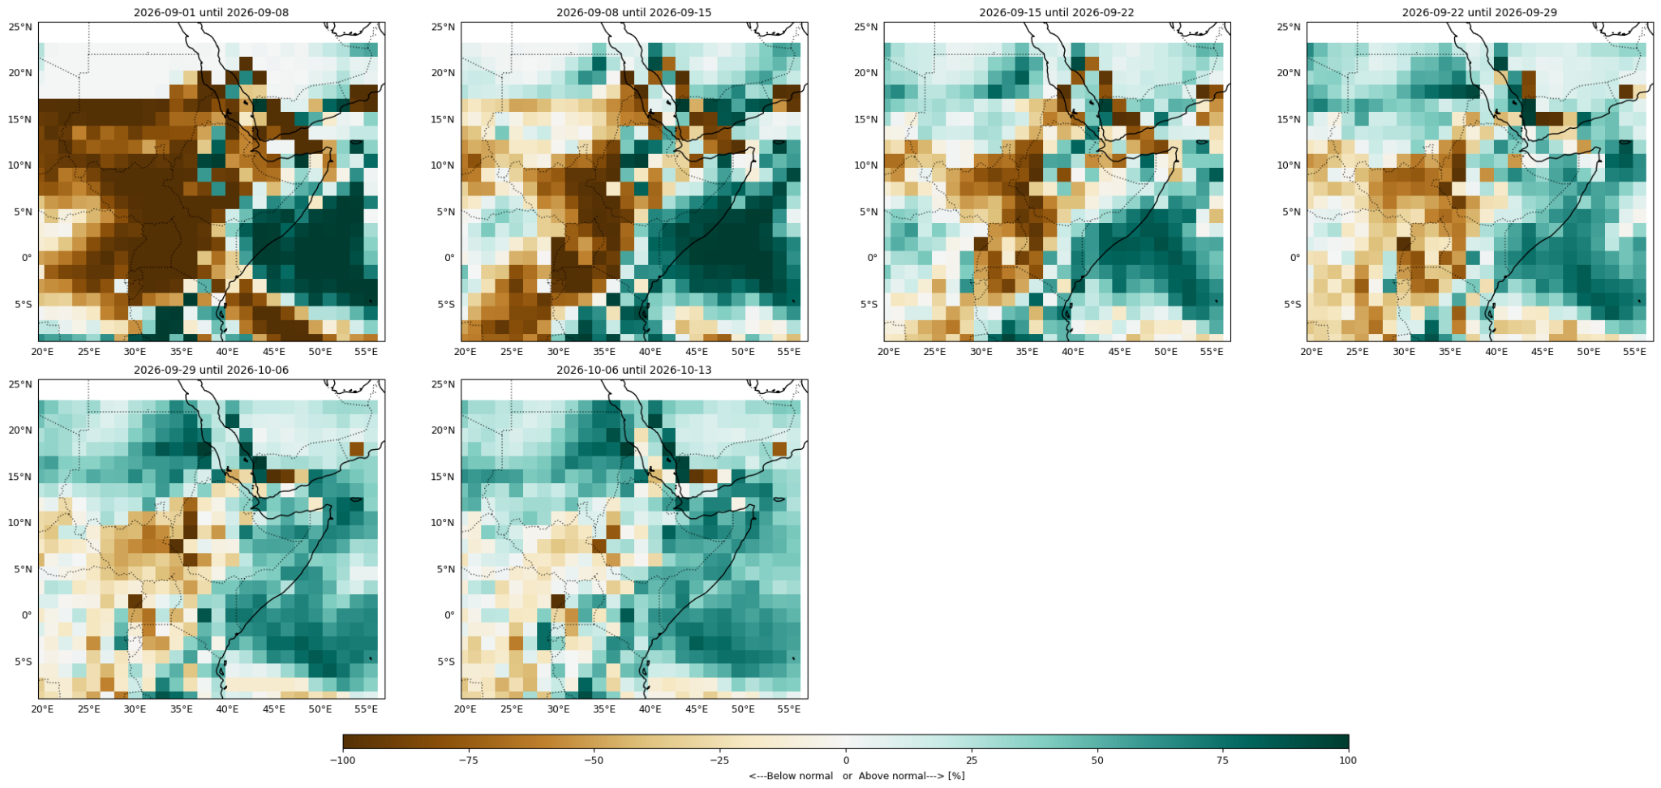
Likelihood of being above/below normal ECMWF
Source Nimbus Forecasting System
Notes:
Can you plot the next likelihood of being above normal for the next 6 weeks of the ECMWF extended range rainfall forecast, clipped to Kenya?

Slide 33
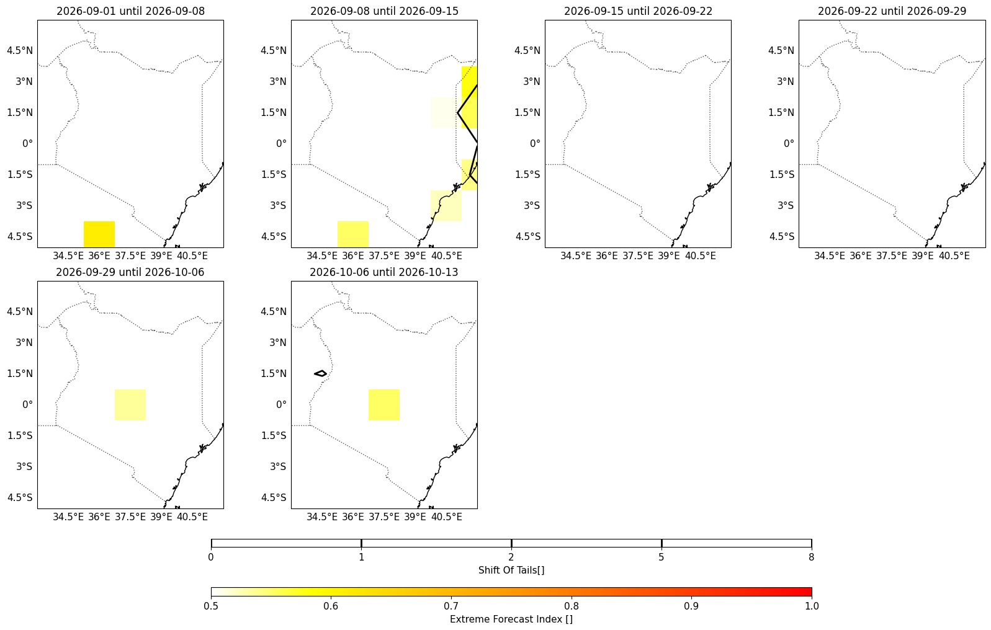
Extreme forecast index ECMWF
Source Nimbus Forecasting System
Coast: This region shows a notable extreme event risk, with 50% of grid cells exceeding EFI 0.5 in week 1 and 25% in week 2, with a max_EFI of 0.53 and 0.59 respectively.
Northeastern Kenya: An isolated extreme signal appears in week 2, where 15% of grid cells exceed EFI 0.5 with a max_EFI of 0.55, indicating a short-lived potential for unusual rainfall.
Highlands West of the Rift Valley, Rift Valley and Lake Victoria Basin, Highlands East of the Rift Valley, Southeastern Lowlands, and Northwestern Kenya: No unusual EFI signals are detected, with most regions showing negative EFI values in the west, indicating anomalously dry conditions rather than extreme events.

Slide 34
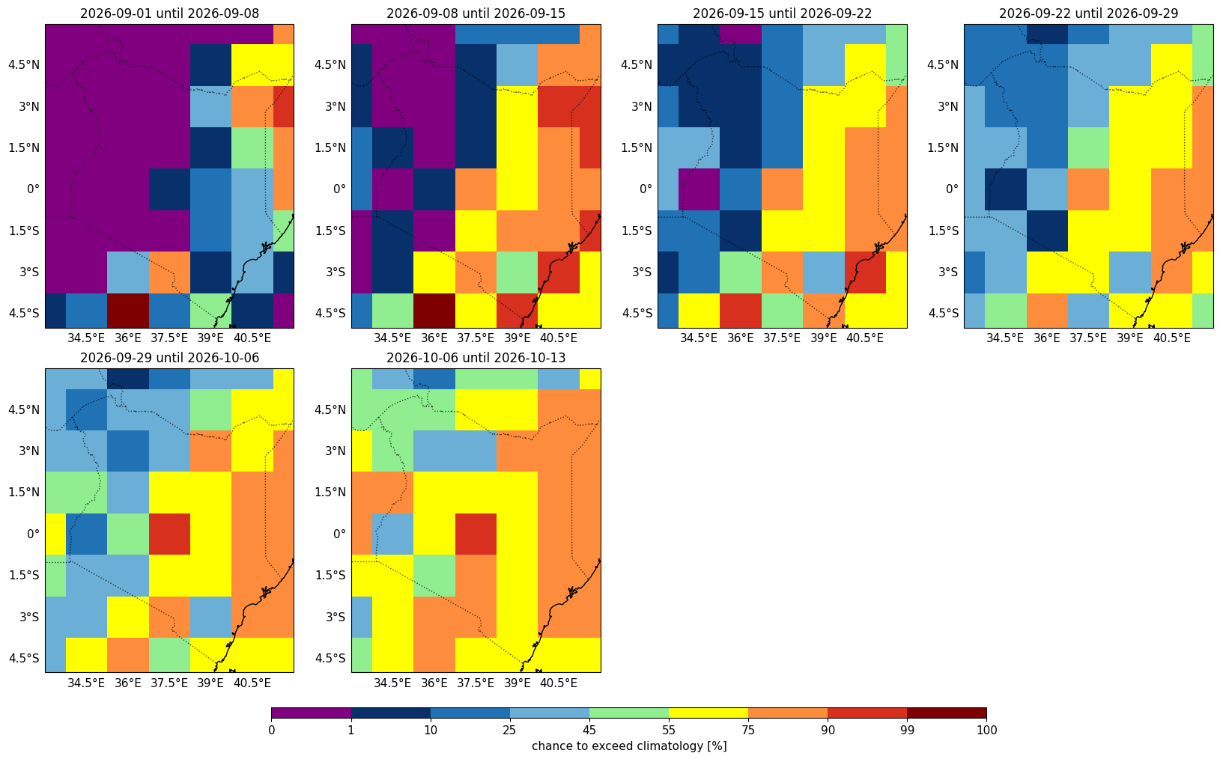
Chance of being above median ECMWF
Source Nimbus Forecasting System
Northwestern Kenya, Highlands West of the Rift Valley, and Rift Valley and Lake Victoria Basin: All three regions show very low probabilities of exceeding the median in week 1 (p50=1%, 2%, and 8% respectively), confirming a strong consensus for below-normal rainfall.
Highlands East of the Rift Valley, Northeastern Kenya, Southeastern Lowlands, and Coast: These regions show varying signals, with the Coast standing out with a high probability of exceeding the median in week 1 (p50=83%) and week 2 (p50=85%), while the others show a shift toward higher probabilities by week 2.

Slide 35
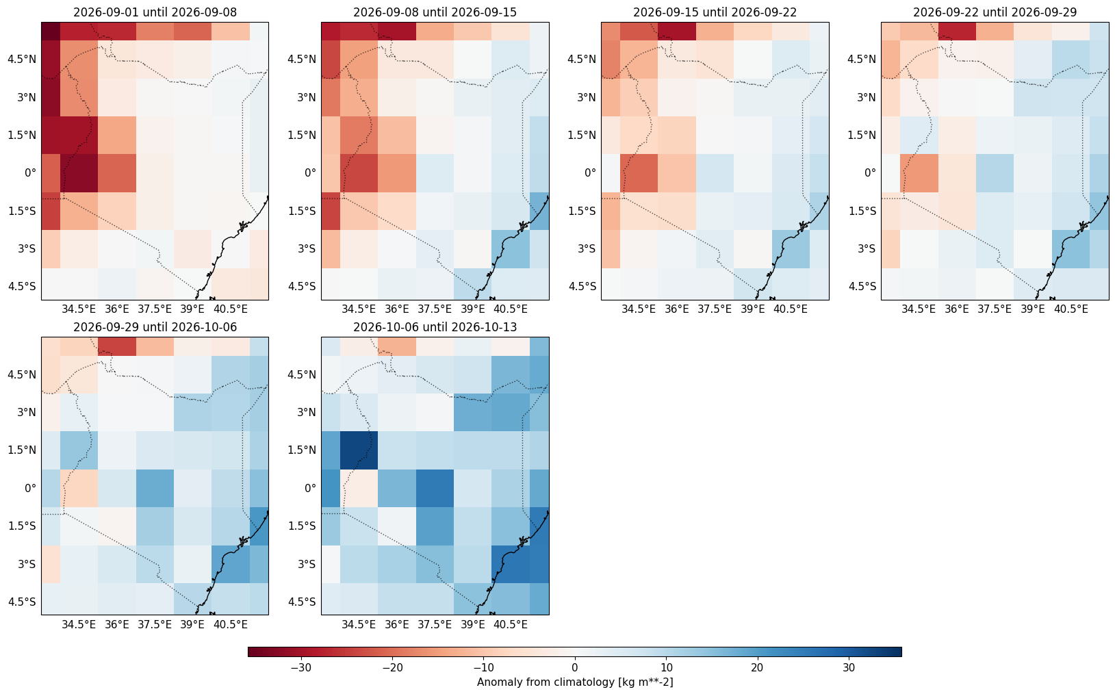
Anomaly from median ECMWF
Source Nimbus Forecasting System
Northwestern Kenya, Highlands West of the Rift Valley, and Rift Valley and Lake Victoria Basin: Strong negative anomalies persist through week 2 (p50anom=-92%, -84%, -84%), with significant deficits in millimetres that only begin to recover by week 3.
Highlands East of the Rift Valley: A gradual transition from dry conditions in week 1 (p50anom=-57%) to near-normal in week 2 (p50anom=-38%), followed by a move into positive anomaly territory by week 4.
Northeastern Kenya, Southeastern Lowlands, and Coast: These regions show a mix of anomalies, with the Coast experiencing the most significant positive anomalies (p50anom=+87%, +120%) in the first two weeks, while the other two transition from neutral or slightly dry to positive anomalies by the end of week 2.

Slide 36
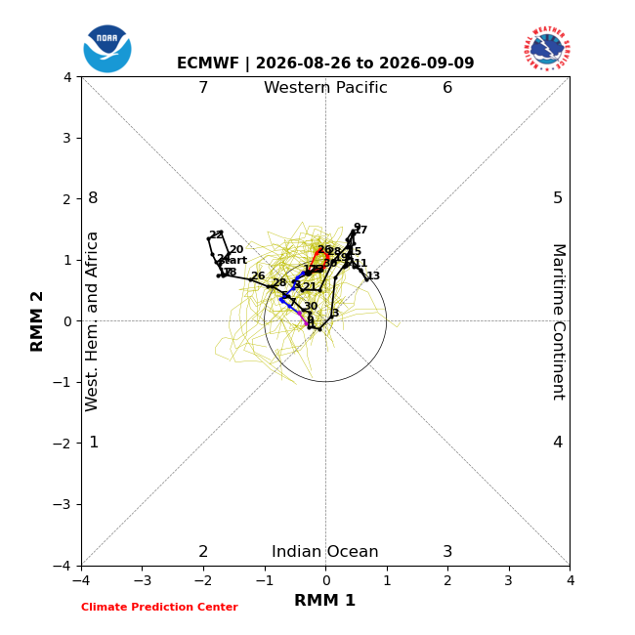
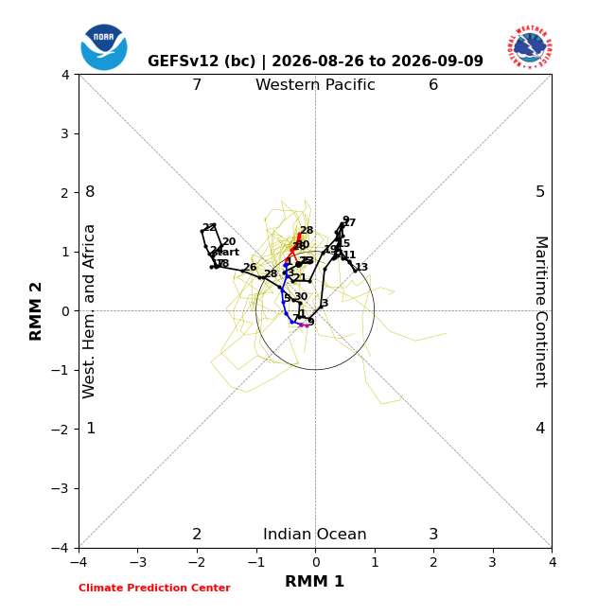
MJO Outlook
Notes:
Can you show me the MJO outlook from ECMWF and GEFS?
https://www.cpc.ncep.noaa.gov/products/precip/CWlink/MJO/foregfs.shtml
https://www.cpc.ncep.noaa.gov/products/precip/CWlink/MJO/CLIVAR/ecmf.shtml

Slide 37
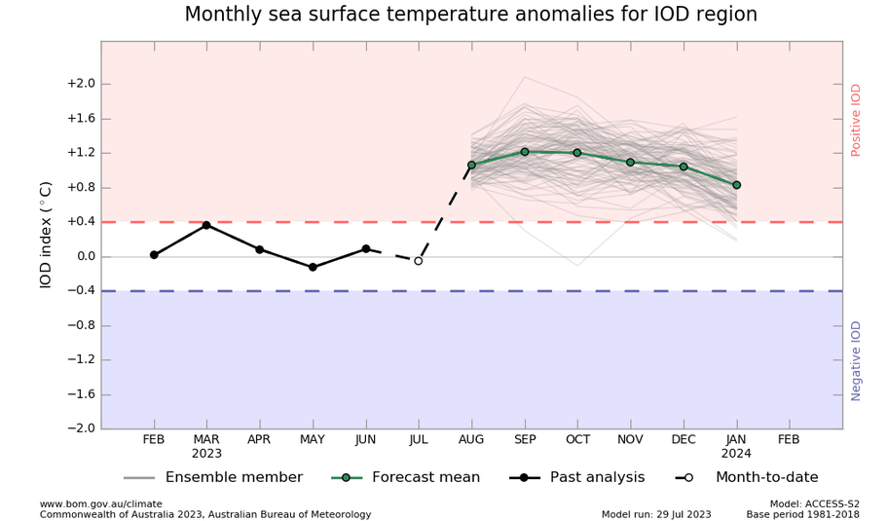
IOD Outlook
Notes:
Weather Skill: Can you show me the current IOD forecast?
https://www.bom.gov.au/climate/ocean/outlooks/?index=iod#tabs=Graphs

Slide 38
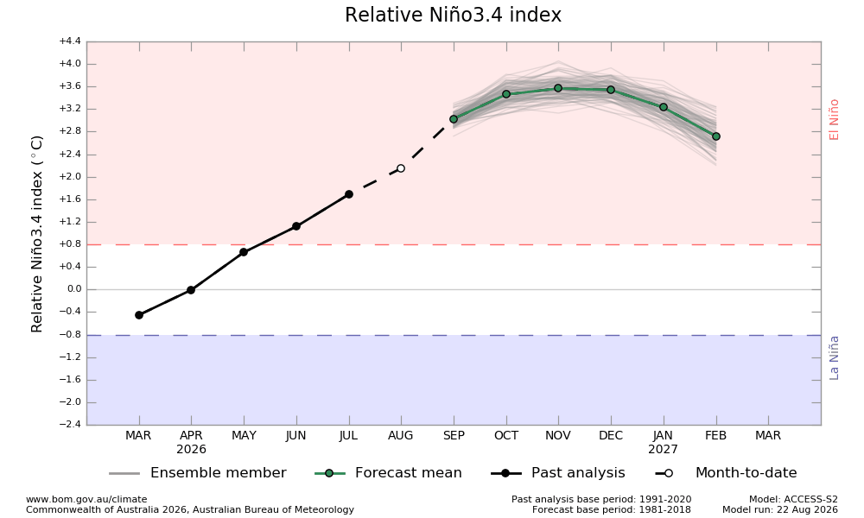
Nino 3.4 Outlook
Notes:
Weather Skill: Can you show me the current ENSO forecast?
https://www.bom.gov.au/climate/ocean/outlooks/?index=iod#tabs=Graphs

Slide 39
Agrometeorological Indicators

Slide 40
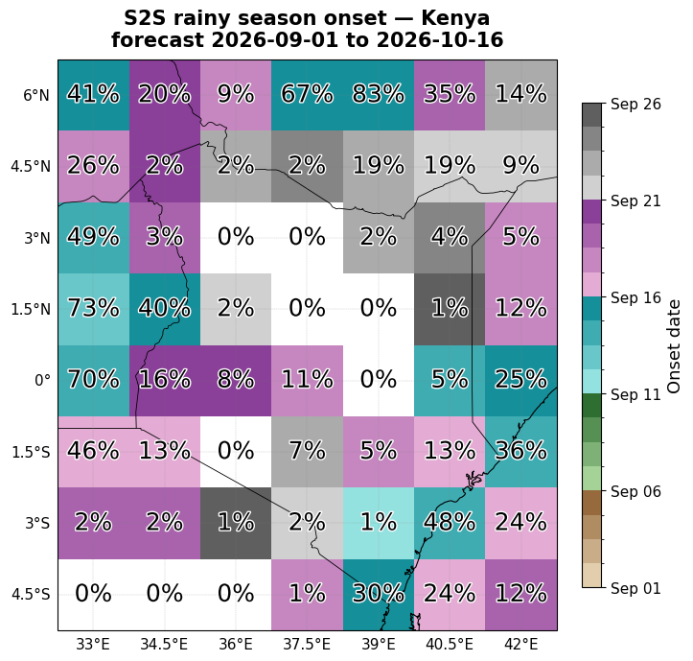
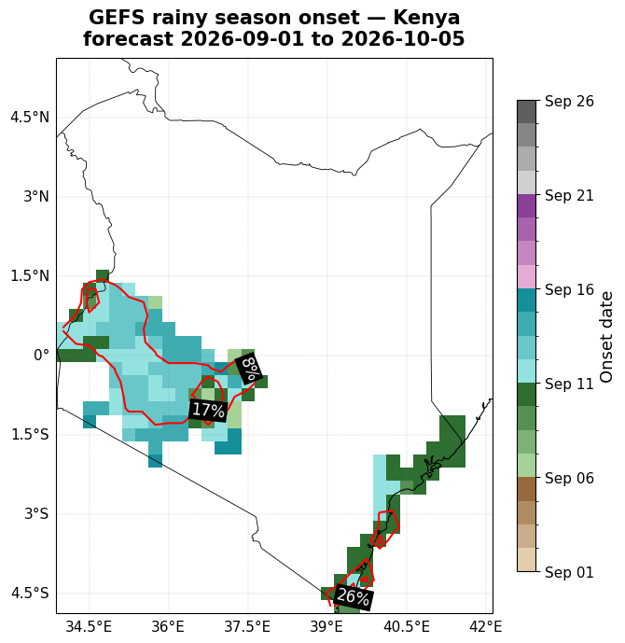
Probability of ICPAC Onset
Source ECMWF extended range
Maps show the forecasted mean onset date of the rainy season: the first 3-day wet spell with >20mm total rainfall that isn't followed by a dry spell of 7+ days within the next 21 days.
Color = ensemble-mean onset date
% labels / contours = share of ensemble members that found an onset at all within the forecast window
Note: GEFS's shorter window means it structurally can't show onsets as late as S2S
Notes:
Can you plot the probability of OND rainy season onset in Kenya in the next 6 weeks from the ECMWF extended range forecast?

Slide 41
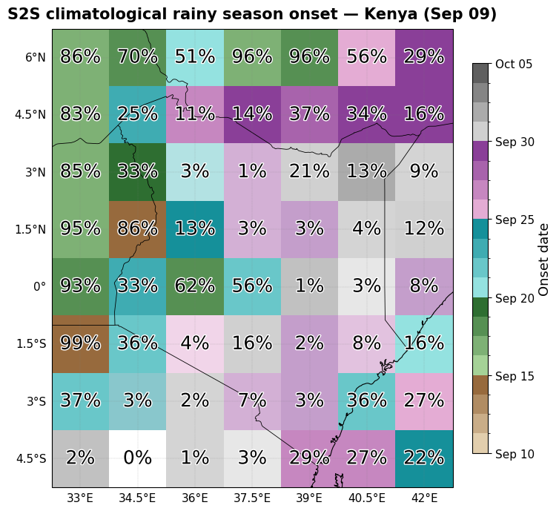
Probability of ICPAC Onset Climatology
Source ECMWF extended range
Maps show the forecasted mean onset date of the rainy season: the first 3-day wet spell with >20mm total rainfall that isn't followed by a dry spell of 7+ days within the next 21 days.
Color = ensemble-mean onset date
% labels / contours = share of ensemble members that found an onset at all within the forecast window
Note: GEFS's shorter window means it structurally can't show onsets as late as S2S
Notes:
Can you plot the probability of OND rainy season onset in Kenya in the next 6 weeks from the ECMWF extended range forecast?

Slide 42
Probability of ICPAC (10mm) Onset
Source ECMWF extended range
Maps show the forecasted mean onset date of the rainy season: the first 3-day wet spell with >10mm total rainfall that isn't followed by a dry spell of 7+ days within the next 21 days.
Color = ensemble-mean onset date
% labels / contours = share of ensemble members that found an onset at all within the forecast window
Note: GEFS's shorter window means it structurally can't show onsets as late as S2S
Notes:
Can you plot the probability of OND rainy season onset in Kenya in the next 6 weeks from the ECMWF extended range forecast?

Slide 43
Probability of ICPAC (10mm) Onset Climatology
Source ECMWF extended range
Maps show the forecasted mean onset date of the rainy season: the first 3-day wet spell with >10mm total rainfall that isn't followed by a dry spell of 7+ days within the next 21 days.
Color = ensemble-mean onset date
% labels / contours = share of ensemble members that found an onset at all within the forecast window
Note: GEFS's shorter window means it structurally can't show onsets as late as S2S
Notes:
Can you plot the probability of OND rainy season onset in Kenya in the next 6 weeks from the ECMWF extended range forecast?

Slide 44
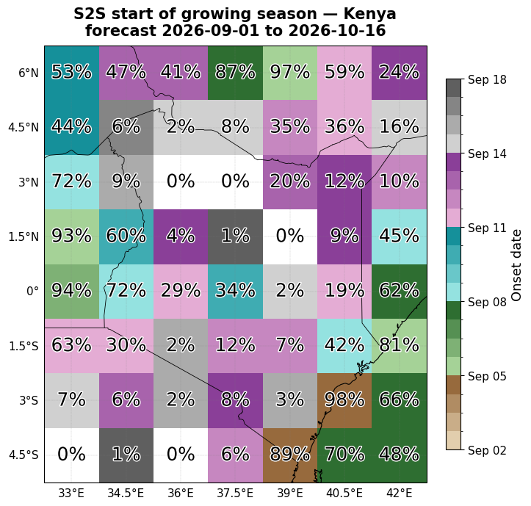
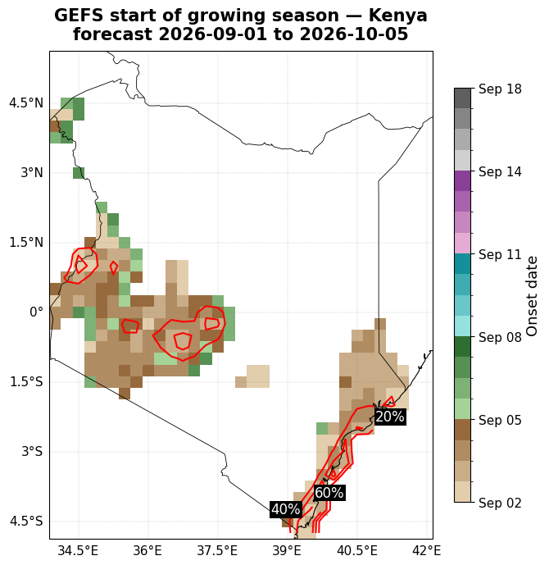
Probability of Start of Growing Season
Source Nimbus Forecasting System
Maps show the forecasted mean start of growing season: the first day who’s following 10 days accumulate at least 20mm total rainfall, followed by the next 20 days after that accumulating more than 20mm.
Color = ensemble-mean onset date
% labels / contours = share of ensemble members that found an onset at all within the forecast window
Note: GEFS's shorter window means it structurally can't show onsets as late as S2S

Slide 45
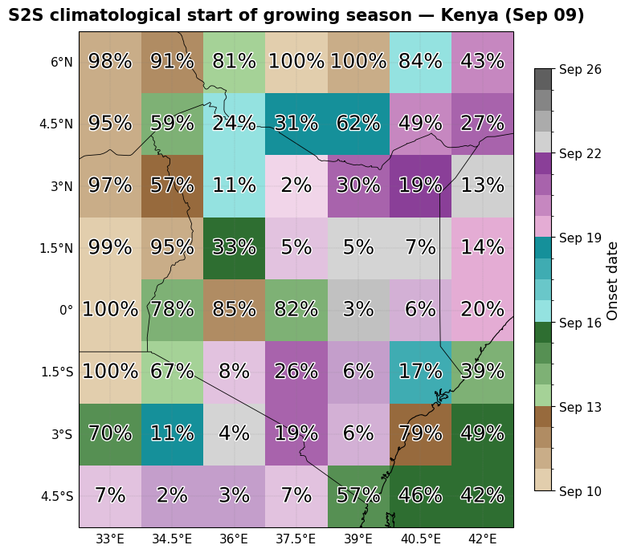
Probability of Start of Growing Season Climatology
Source Nimbus Forecasting System
Maps show the forecasted mean start of growing season: the first day who’s following 10 days accumulate at least 20mm total rainfall, followed by the next 20 days after that accumulating more than 20mm.
Color = ensemble-mean onset date
% labels / contours = share of ensemble members that found an onset at all within the forecast window
Note: GEFS's shorter window means it structurally can't show onsets as late as S2S

Slide 46
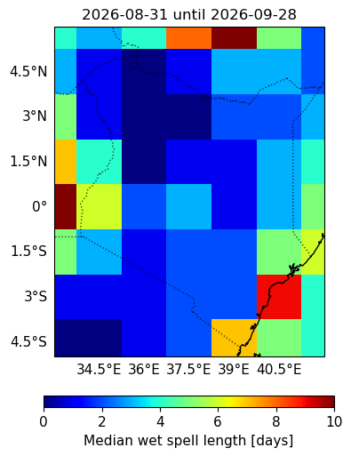
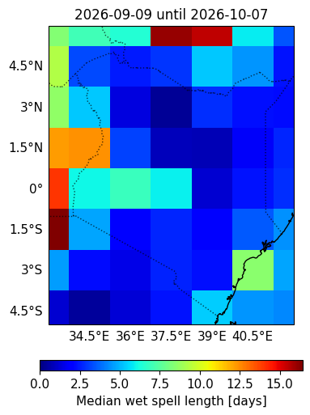
Consecutive Wet (>1mm) Days Probability
Source ECMWF extended range
Forecast
Climatology

Slide 47
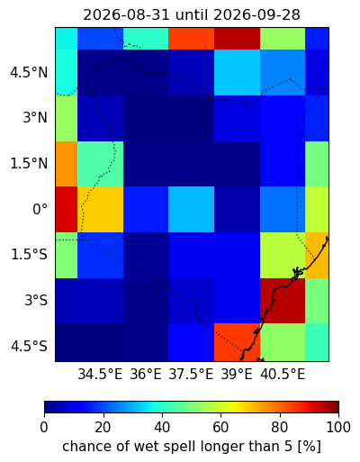
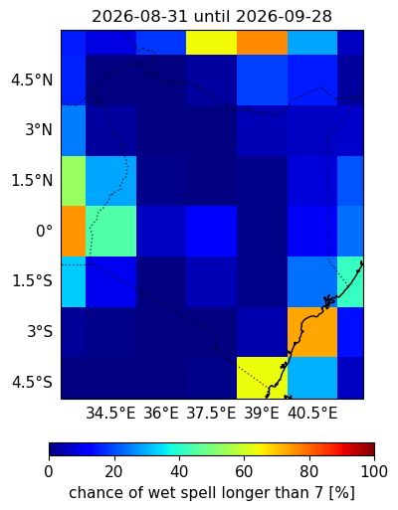
Consecutive Wet (>1mm) Days Probability
Source ECMWF extended range
Forecast
Climatology
Forecast
Climatology

Slide 48
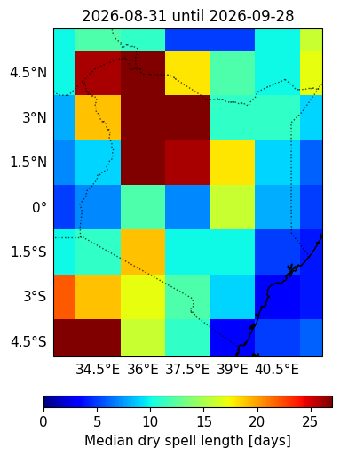
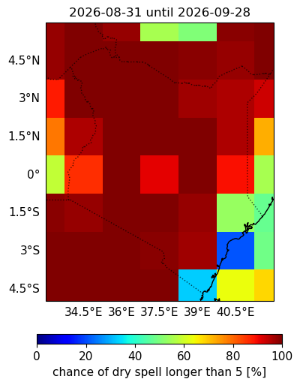

Consecutive Dry (<1mm) Days Probability
Source ECMWF extended range

Slide 49

Probability of exceeding 20 mm
Source ECMWF extended range

