Slide 1
Dual Core MIPS CPU
Mitchell Fream, Alec Felix

Slide 2
Introduction
The goal of this project was to create the simplified MIPS CPU Architecture in Verilog and verify its operation through a Testbench for the whole CPU and for the controller.

Slide 3
Project Specifications
TestBench:
External RAM with Fibonacci program to test CPU
Randomized tests to validate Controller
Design Under Test (DUT):
Dual Core Simplified MIPS CPU
8 bit memory width with 32 bit instructions (4 cycles to fetch instruction)
Arbiter to control access to bus
In-order execution with no pipelining

Slide 4
Simplified MIPS Instruction Set
There are only a small number of instruction in our instruction set
R-Type: Computes addition, subtraction, comparison, and bit shifts
ADDI: Computes arithmetic with immediate values
BEQ: Branches to an immediate relative address if two registers are equal
SB: Stores a byte to RAM
LB: Loads a byte from RAM
J: Jumps to an absolute address
WRSPEC: Stores from a general purpose register to a special purpose register, this is used for the virtual memory system

Slide 5
Instruction | Function | Type | Opcode | Func
add a,b,c | a = b+ c | R | 000000 | 100000
sub a,b,c | a = b - c | R | 000000 | 100010
and a,b,c | a = b && c | R | 000000 | 100100
or a,b,c | a = b || c | R | 000000 | 100101
slt a,b,c | a = 1 if b < c o.w: a= 0 | R | 000000 | 101010
addi a,b,# | a = b + #[15:0] | I | 001000 | n/a
beq a,b,addr | If a = b PC = PC + addr[15:0] | I | 000100 | n/a
j addr | PC = addr[25:0] | J | 000010 | n/a
Ib a, offset(b) | a = mem[b+offset] | I | 100000 | n/a
sb a, offset(b) | Mem[b+offset] = a | I | 110000 | n/a
WRSPEC a, # | special_reg[#] = a | I | 000001 | n/a

Slide 6
Architecture Overview

Slide 7
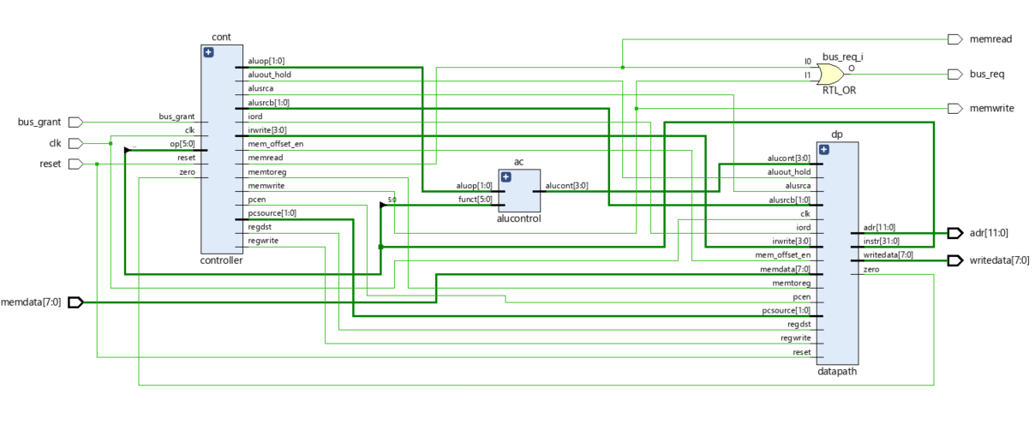
Single Core - System Diagram

Slide 8
Controller
The controller uses a finite state machine to move between 15 different execution states
In order to facilitate bus access, the controller was made to stall on memory access states while bus_grant is false
All outputs are combinatorial functions a single state variable

Slide 9
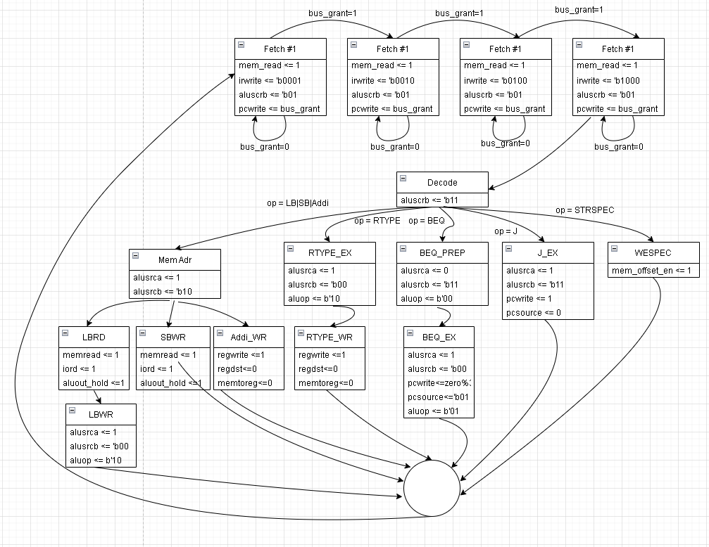
Controller
State
Diagram

Slide 10
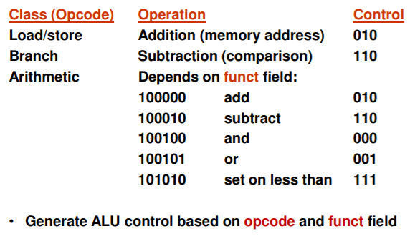
ALU Control
Used to tell ALU what operation to perform

Slide 11
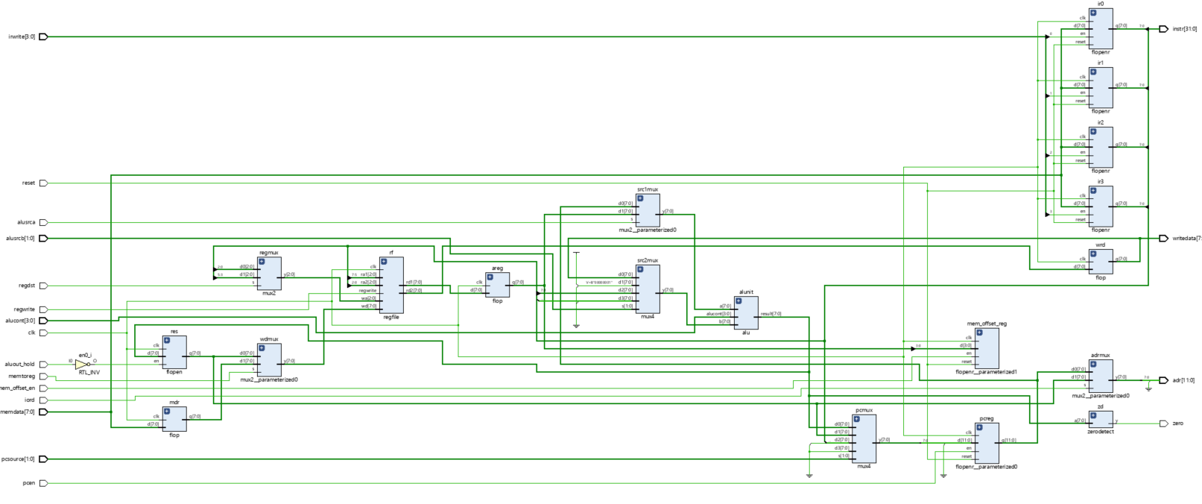
Datapath

Slide 12
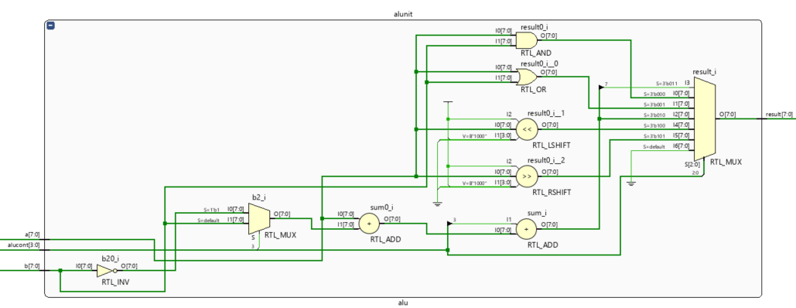
ALU

Slide 13
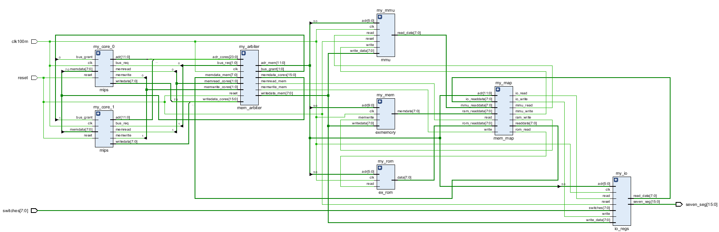
Dual Core CPU - System Diagram

Slide 14
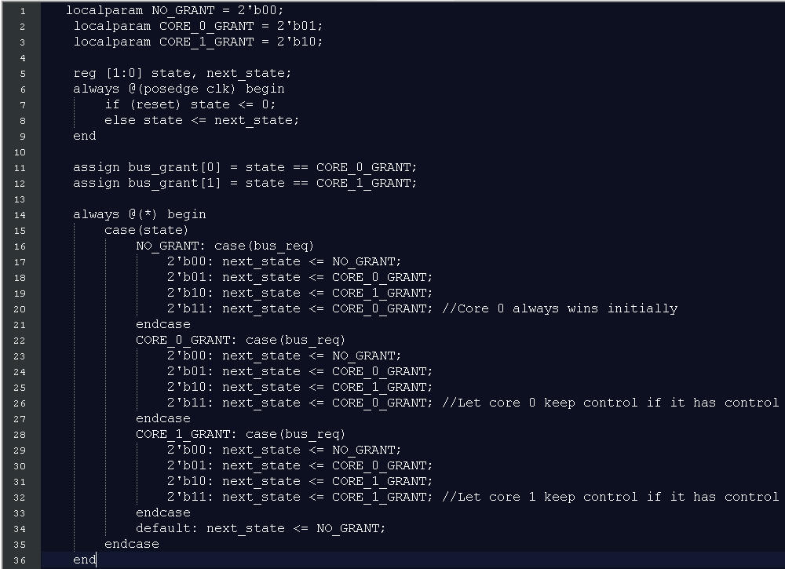
Arbiter
Used to determine which of the two CPUs will control the bus for each cycle.
adr_mux
Writedata_mux
mem_read_mux
mem_write_mux

Slide 15
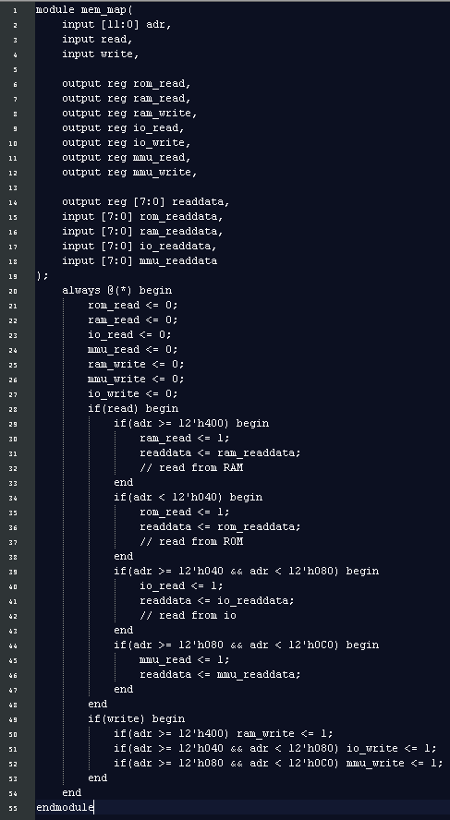
Memory Map
A small memory map module was created to route reads and write to different devices based on address
Either read/write from RAM, ROM, IO, or memory management unit

Slide 16
RAM
The RAM is 1KB large and addressable by single bytes
Every byte is accessible in a single clock cycle
Either read from a memfile.txt using $readmemh("memfile.txt", RAM); or by manually initializing RAM reg with the desired program
Contains the main code to generate the Fibonacci sequence

Slide 17
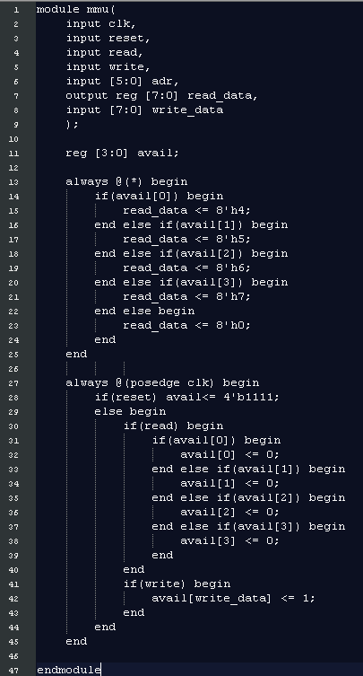
Memory Management Unit
An extremely simple MMU was built to allow each core to work independently
The 1K of RAM is split into 4 sections which can each be allocated independently
Reading from this device returns a free page, writing to it can be used to free a page

Slide 18
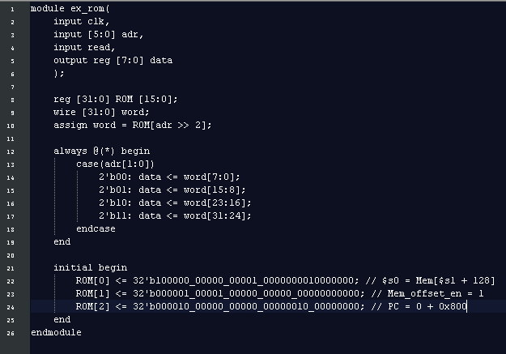
ROM
A small ROM is needed for initialization
Base address of 0x000, the reset address
Accessible in a single clock cycle

Slide 19
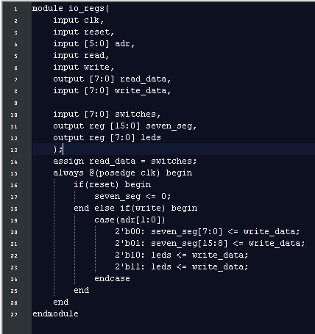
IO
Two bytes of output and one byte of input are available as memory mapped addresses
Input byte is backed by the right 8 switches on the board, output bytes are converted to hex and displayed on the seven segment display

Slide 20
Testbench Overview

Slide 21
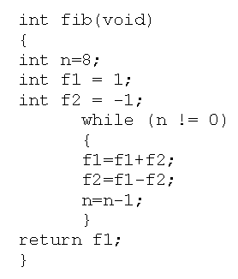
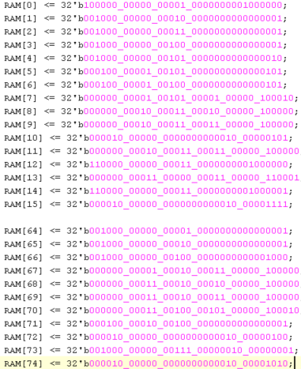
RAM - Testbench

Slide 22
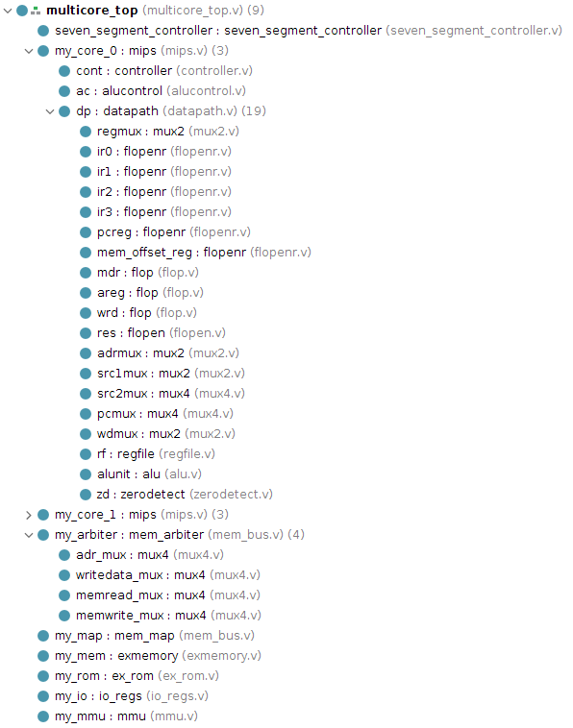
Pre Synthesis Code
Code was explicitly separated into datapath and control logic
Basic objects such as multiplexers and registers were explicitly modeled
Supporting hardware was separated into multiple modules and wired together at the top level

Slide 23
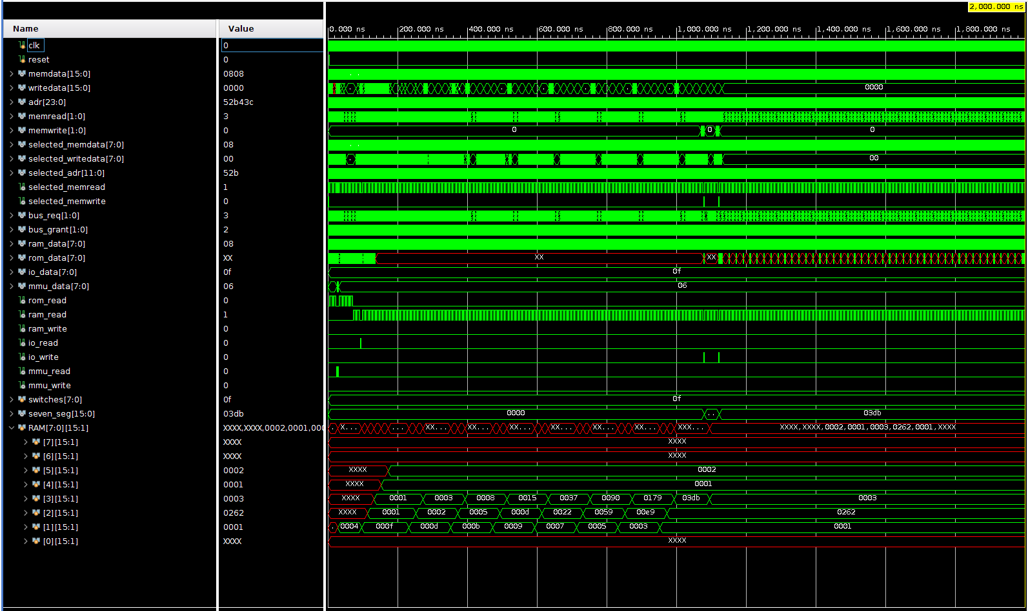
Pre Synthesis Testing
A full simulation of the multicore device was run, here it is calculating that the 15th fibonacci number is 987 = 0x3db

Slide 24
Randomized Test - To Validate Controller
To validate the design, randomized testing was used
10000 random valid instructions were generated and fed into the CPU
The CPU state (registers, program counter, etc.) was inspected before and after each instruction was run to ensure that instruction effects were as intended
The tests looked inside the CPU to see its internal state, not just at externally viable signals

Slide 25
Randomized Test
No errors or unexpected results were detected over 10000 random instructions
This included branch and jump instructions to strange addresses, comparisons with the same register for both inputs, and many arithmetic instructions
In order to ensure repeatability, all registers were initialized to zero before the test, otherwise Xs would propagate through the test and cause false positives

Slide 26
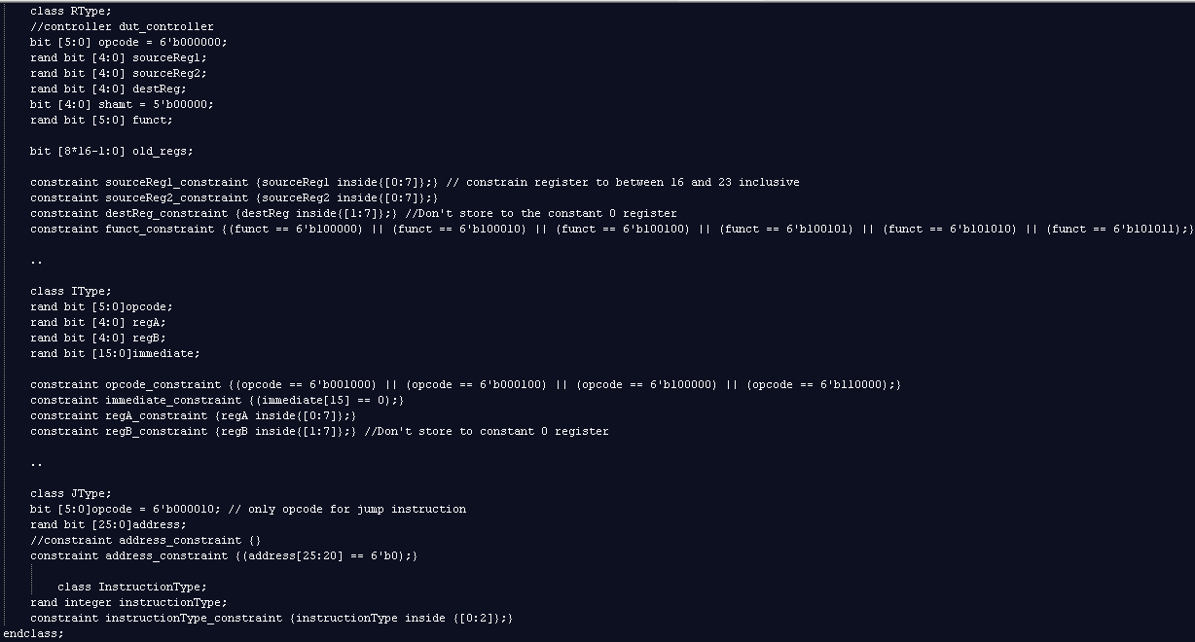
Randomized class & constraints

Slide 27
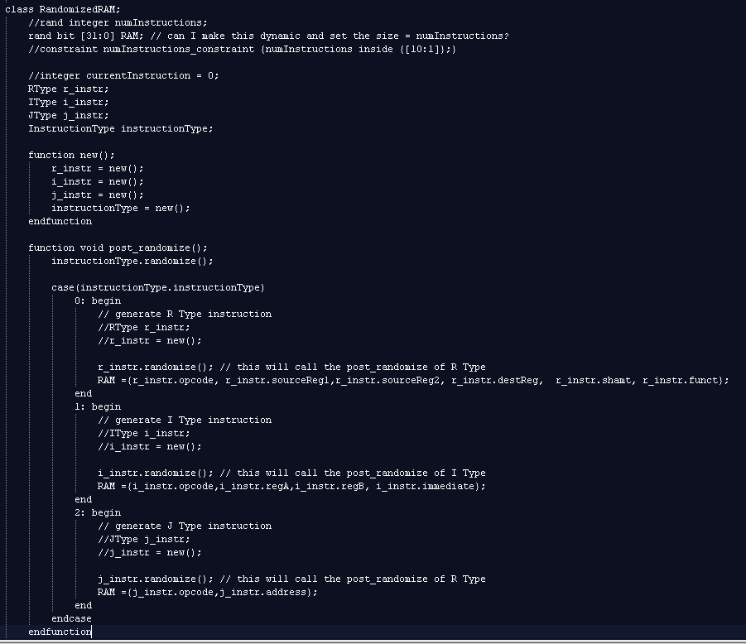
RandomizedRAM

Slide 28
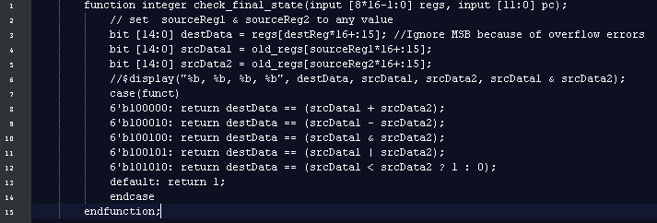
Testing Code

Slide 29
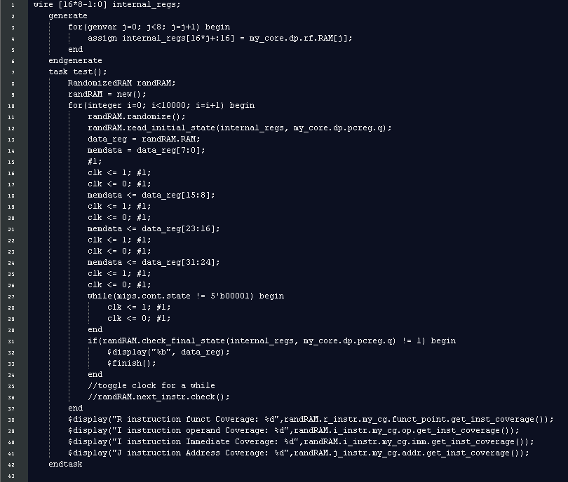
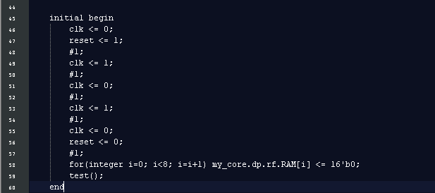
Testbench - top file

Slide 30
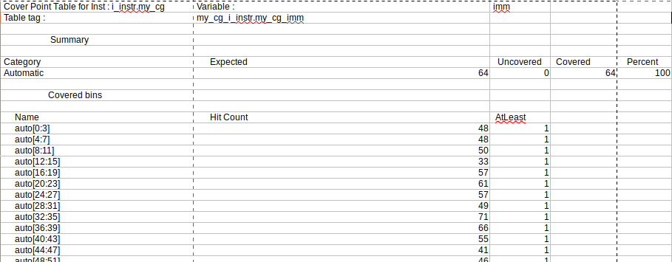
Code Coverage
100% coverage was achieved using 10000 randomized instructions
Larger fields were binned together

Slide 31
FPGA
Synthesis

Slide 32
Constraint and Synthesis
A constraint file was used to connect the top level signals to external pins
Anode and cathode to seven segment display
Switches to 8 hardware switches
clk to the internal 100MHz clock
reset to a push button
A bitstream was generated containing two cores and supporting logic

Slide 33

Fibonacci Sequence:
0th: 0x0001
1st: 0x0001
2nd: 0x0002
3rd: 0x0003
4th: 0x0005
10th: 0x0059(89)
18th: 0x1055 (4181)

