Slide 1
A Backup System built from a
Peer-to-Peer Distributed Hash Table
Russ Cox
rsc@mit.edu
joint work with
Josh Cates, Frank Dabek,
Frans Kaashoek, Robert Morris,
James Robertson, Emil Sit, Jacob Strauss
MIT LCS
http://pdos.lcs.mit.edu/chord

Slide 2
What is a P2P system?
Node
Node
Node
Internet
Node
Node
System without any central servers
  Every node is a server
  No particular node is vital to the network
  Nodes all have same functionality
Huge number of nodes, many node failures
Enabled by technology improvements
Notes:
Napster is not.

Slide 3
Robust data backup
Idea: backup on other user’s machines
Why?
  Many user machines are not backed up
  Backup requires significant manual effort now
  Many machines have lots of spare disk space
Requirements for cooperative backup:
  Don’t lose any data
  Make data highly available
  Validate integrity of data
  Store shared files once
More challenging than sharing music!
Notes:
HiveNet, mojonations, pastiche

Slide 4
The promise of P2P computing
Reliability: no central point of failure
  Many replicas
  Geographic distribution
High capacity through parallelism:
  Many disks
  Many network connections
  Many CPUs
Automatic configuration
Useful in public and proprietary settings
Notes:
Music industry cannot kill KaZaa. Company is located in Australia (different copy right protection law), nodes in different judicial area, source code was last seen Lithuiana, programmers are supposed to be in Holland, but police cannot find them
Geographic distribution seems only way to deal with disasters: backhoe cutting the primary and backup power cable (same trunk)
The human component: anything that involves humans configuring the system is a recipe for disaster.

Slide 5
Distributed hash table (DHT)
Distributed application
(Backup)
put(key, data)
get (key)
data
Distributed hash table
(DHash)
lookup(key)
node IP address
Lookup service
(Chord)
node
node
….
node
DHT distributes data storage over perhaps millions of nodes
DHT provides reliable storage abstraction for applications
Notes:
Make it simple to write decentralized, distributed applications …..

Slide 6
DHT implementation challenges
Data integrity
Scalable lookup
Handling failures
Network-awareness for performance
Coping with systems in flux
Balance load (flash crowds)
Robustness with untrusted participants
Heterogeneity
Anonymity
Indexing
  Goal: simple, provably-good algorithms
this
talk
Notes:
Other problems: such as anonimity and heterogeneity

Slide 7
1. Data integrity: self-authenticating data
Key = SHA1(data)
  after download, can use key to verify data
Use keys in other blocks as pointers
  can build arbitrary tree-like data structures
  always have key: can verify every block
Notes:
Like V7 format, but crypto Ids, not disk sector numbers.
Publisher can update root blocks, because of public keys.
Many independent file systems can co-exist in one CFS.

Slide 8
2. The lookup problem
How do you find the node responsible for a key?
N₂
N₁
N₃
Internet
?
Publisher
Client
put(key, data)
get(key)
N₄
N₆
N₅
Notes:
1000s of nodes.
Set of nodes may change…

Slide 9
Centralized lookup (Napster)
Any node can store any key
Central server knows where keys are
Simple, but O(N) state for server
Server can be attacked (lawsuit killed Napster)
N₁
N₂
N₃
Client
Publisher@
N₄
DB
Lookup(“title”)
SetLoc(“title”, N4)
N₈
N₉
N₇
N₆
Notes:
O(N) state means its hard to keep the state up to date.

Slide 10
Flooded queries (Gnutella)
Any node can store any key
Lookup by asking every node about key
Asking every node is very expensive
Asking only some nodes might not find key
N₁
N₂
Lookup(“title”)
N₃
Client
Publisher@
N₄
N₆
N₇
N₈
N₉

Slide 11
Lookup is a routing problem
Assign key ranges to nodes
Pass lookup from node to node making progress toward destination
Nodes can’t choose what they store
But DHT is easy:
  DHT put(): lookup, upload data to node
  DHT get(): lookup, download data from node

Slide 12
Routing algorithm goals
Fair (balanced) key range assignments
Small per-node routing table
Easy to maintain routing table
Small number of hops to route message
Simple algorithm

Slide 13
Chord: key assignments
Arrange nodes and keys in a circle
Node IDs are SHA1(IP address)
A node is responsible for all keys between it and the node before it on the circle
Each node is responsible for about 1/N of keys
K5
K20
N105
Circular
ID space
N32
N90
K80
N60
(N90 is responsible for keys K61 through K90)

Slide 14
Chord: routing table
Routing table lists nodes:
  ½ way around circle
  ¼ way around circle
  1/8 way around circle
  …
  next around circle
log N entries in table
Can always make a step at least halfway to destination
¼
½
1/8
1/16
1/32
1/64
1/128
N80
Notes:
Small tables, but multi-hop lookup. Table entries: IP address and Chord ID.
Navigate in ID space, route queries closer to successor. Log(n) tables, log(n) hops.
Route to a document between ¼ and ½ …

Slide 15
Lookups take O(log N) hops
Each step goes at least halfway to destination
log N steps, like binary search
N5
N110
N10
K19
N20
N99
N32
N80
N60
N32 does lookup for K19
Notes:
Chord orders all nodeIDs in one dimension, and uses a routing table for acceleration

Slide 16
3. Handling failures: redundancy
Each node knows about next r nodes on circle
Each key is stored by the r nodes after it on the circle
To save space, each node stores only a piece of the block
Collecting half the pieces is enough to reconstruct the block
N5
N110
N10
K19
N20
N99
K19
N32
N40
K19
N80
N60

Slide 17
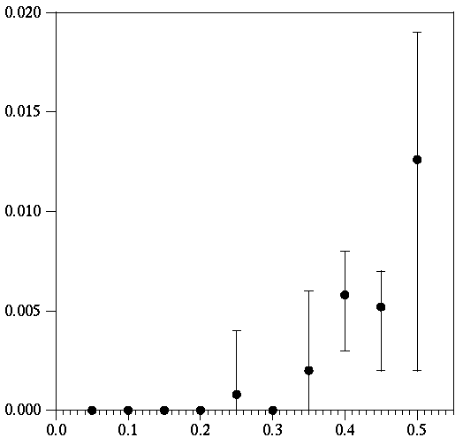
Redundancy handles failures
1000 DHT nodes
Average of 5 runs
6 replicas for each key
Kill fraction of nodes
Then measure how many lookups fail
All replicas must be killed for lookup to fail
Failed Lookups (Fraction)
Failed Nodes (Fraction)
Notes:
1000 servers. Avg/min/max of 5 experiments. 1000 lookups/experiment.
Six copies of each block, total. Run *before* stabilization.
ALL failures due to all replicas failing. No lookup problems.

Slide 18
4. Exploiting proximity
N20
N40
N80
N41
Path from N20 to N80
  might usually go through N41
  going through N40 would be faster
In general, nodes close on ring may be far apart in Internet
Knowing about proximity could help performance
Notes:
change colors of routes
better to do n20->n40->n80 than n20->n41->n80

Slide 19
Proximity possibilities
Given two nodes, how can we predict network distance (latency) accurately?
Every node pings every other node
  requires N² pings (does not scale)
Use static information about network layout
  poor predictions
  what if the network layout changes?
Every node pings some reference nodes and “triangulates” to find position on Earth
  how do you pick reference nodes?
  Earth distances and network distances do not always match

Slide 20
Vivaldi: network coordinates
Assign 2D or 3D “network coordinates” using spring algorithm. Each node:
  … starts with random coordinates
  … knows distance to recently contacted nodes and their positions
  … imagines itself connected to these other nodes by springs with rest length equal to the measured distance
  … allows the springs to push it for a small time step
Algorithm uses measurements of normal traffic: no extra measurements
Minimizes average squared prediction error

Slide 21

Vivaldi in action: Planet Lab
Simulation on “Planet Lab” network testbed
100 nodes
  mostly in USA
  some in Europe, Australia
~25 measurements per node per second in movie

Slide 22
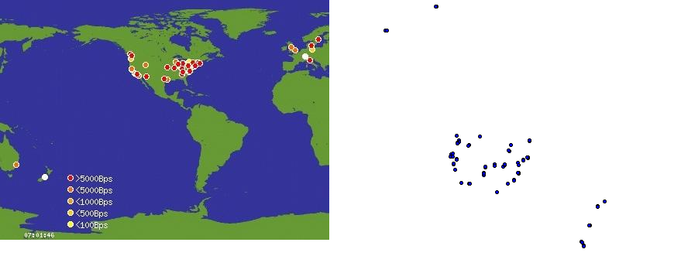
Geographic vs. network coordinates
Derived network coordinates are similar to geographic coordinates but not exactly the same
  over-sea distances shrink (faster than over-land)
  without extra hints, orientation of Australia and Europe “wrong”

Slide 23
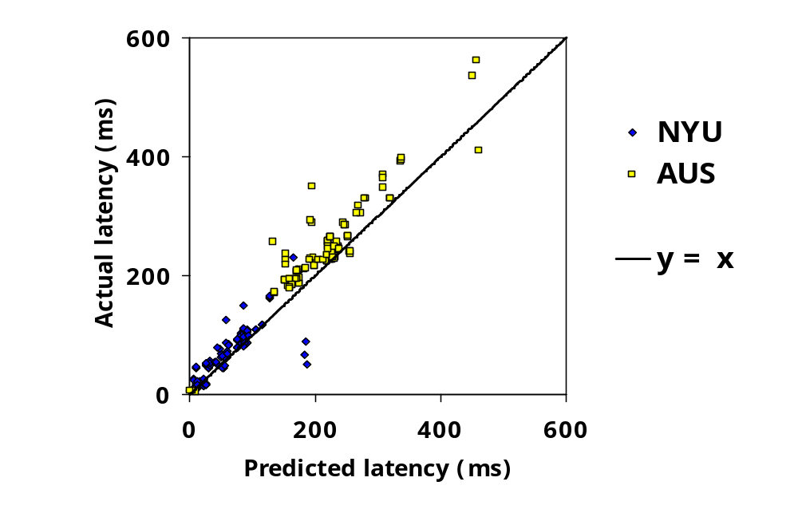
Vivaldi predicts latency well

Slide 24
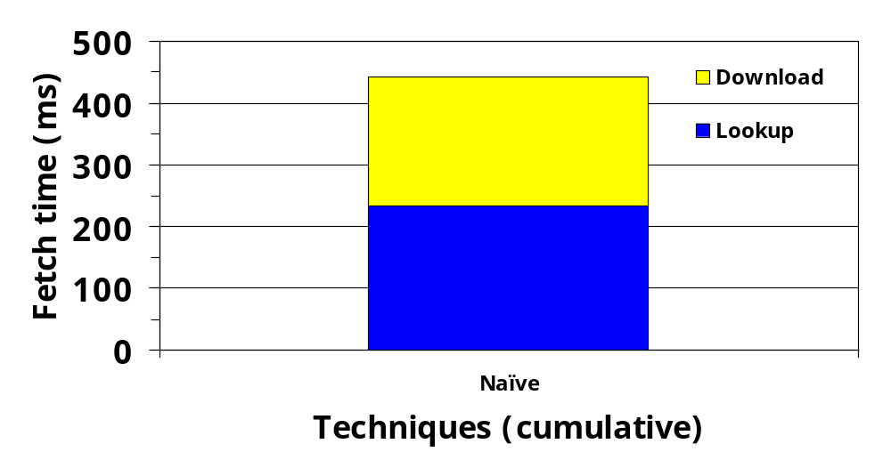
When you can predict latency…
Notes:
animate bars to match text

Slide 25
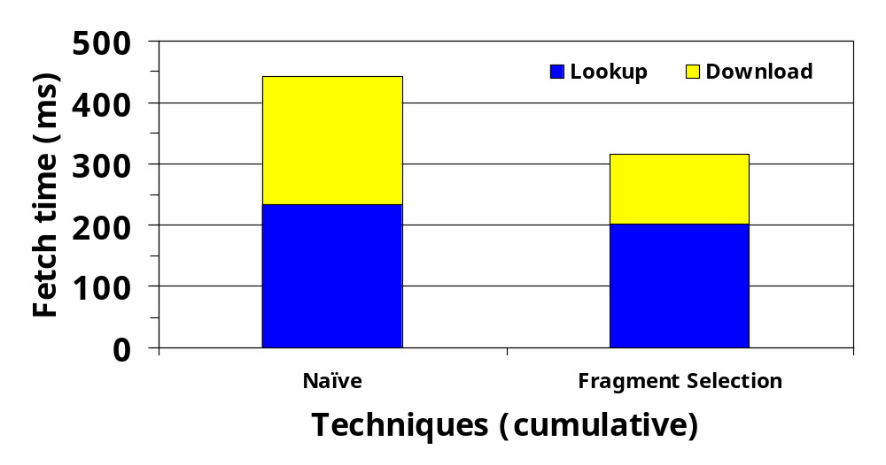
When you can predict latency…
… contact nearby replicas to download the data
Notes:
animate bars to match text

Slide 26
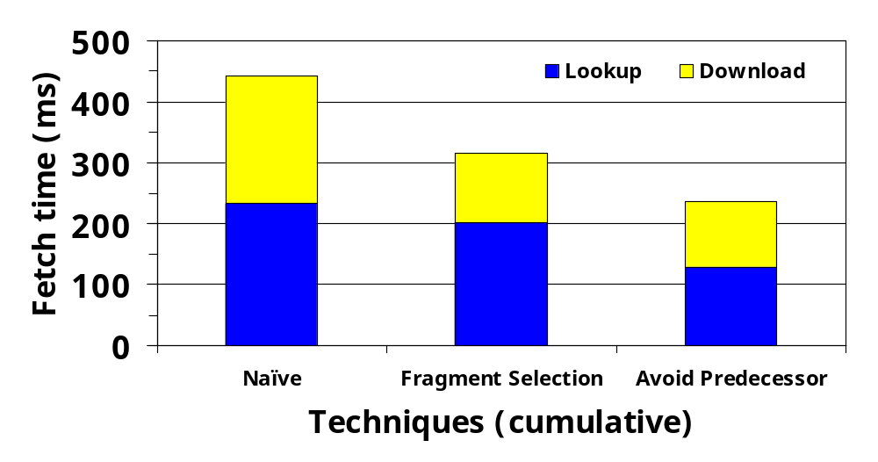
When you can predict latency…
… contact nearby replicas to download the data
… stop the lookup early once you identify nearby replicas
Notes:
animate bars to match text

Slide 27
Finding nearby nodes
Exchange neighbor sets with random neighbors
  Combine with random probes to explore
Provably-good algorithm to find nearby neighbors based on sampling [Karger and Ruhl 02]

Slide 28
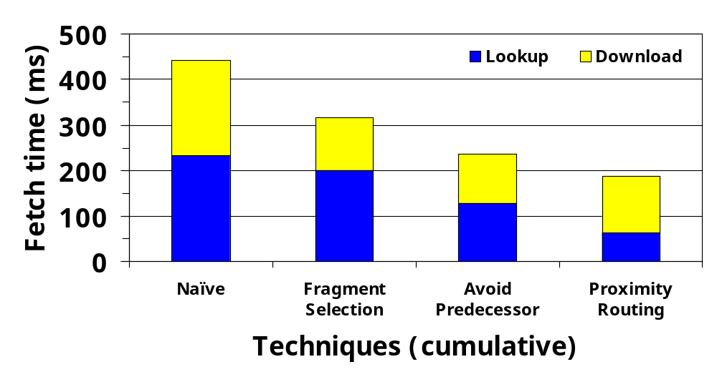
When you have many nearby nodes…
… route using nearby nodes instead of fingers

Slide 29
DHT implementation summary
Chord for looking up keys
Replication at successors for fault tolerance
Fragmentation and erasure coding to reduce storage space
Vivaldi network coordinate system for
  Server selection
  Proximity routing

Slide 30
Backup system on DHT
Store file system image snapshots as hash trees
  Can access daily images directly
  Yet images share storage for common blocks
  Only incremental storage cost
  Encrypt data
User-level NFS server parses file system images to present dump hierarchy
Application is ignorant of DHT challenges
  DHT is just a reliable block store
Notes:
maybe split slide

Slide 31
Future work
DHTs
  Improve performance
  Handle untrusted nodes
Vivaldi
  Does it scale to larger and more diverse networks?
Apps
  Need lots of interesting applications

Slide 32
Related Work
Lookup algs
  CAN, Kademlia, Koorde, Pastry, Tapestry, Viceroy, …
DHTs
  OceanStore, Past, …
Network coordinates and springs
  GNP, Hoppe’s mesh relaxation
Applications
  Ivy, OceanStore, Pastiche, Twine, …

Slide 33
Conclusions
Peer-to-peer promises some great properties
Once we have DHTs, building large-scale, distributed applications is easy
  Single, shared infrastructure for many applications
  Robust in the face of failures and attacks
  Scalable to large number of servers
  Self configuring across administrative domains
  Easy to program

Slide 34
Links
Chord home page
  http://pdos.lcs.mit.edu/chord
Project IRIS (Peer-to-peer research)
  http://project-iris.net
Email
  rsc@mit.edu

