Slide 1
Message-Locked Proofs of Retrievability with Secure Deduplication
BigSec Project
A.Y. 2018/2019
Alessandro Colucci
Pasquale Convertini
Helen Möllering
Sebastian Sanislav

Slide 2
Outline
Introduction
Message-Locked Proof of Retrievability
ML-StealthGuard
Security Analysis

Slide 3
Introduction
Introduction
Proof of Retrievability (PoR)
Deduplication
Conflict between PoR and Deduplication

Slide 4


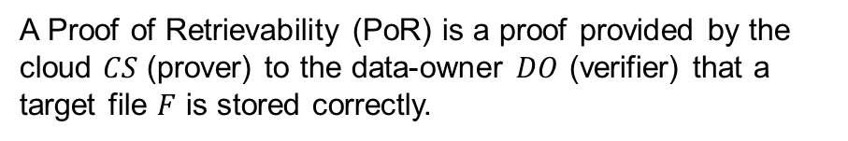
Proof of Retrievability (PoR)
A Proof of Retrievability (PoR) is a proof provided by the cloud $CS$ (prover) to the data-owner $DO$ (verifier) that a target file $F$ is stored correctly.
Is my data still there?
PoR

Slide 5
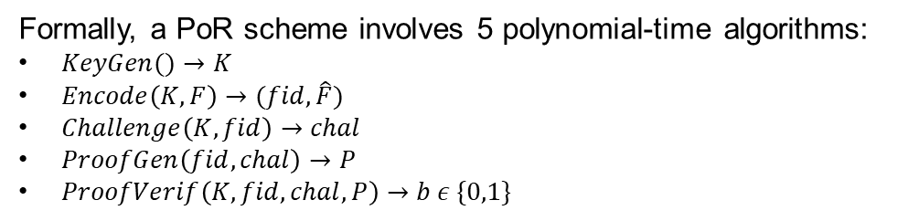
Proof of Retrievability (PoR)
Formally, a PoR scheme involves 5 polynomial-time algorithms:
$KeyGen()→K$
$Encode\left(K,F\right)→(fid,\hat{F})$
$Challenge\left(K,fid\right)→chal$
$ProofGen\left(fid, chal\right)→P$
$ProofVerif\left(K, fid, chal, P\right)→b ε \{0,1\}$
Is my data still there?
PoR
Notes:
This slide can be also deleted if time is not enough

Slide 6




PoR solutions
PoR solution can be divided in 2 families:
Watchdog-based PoR
Tag-based PoR
Upload
Block #i?
?
=
?
Verification
Notes:
Doubt: shall I insert PoR solutions in the previous slide as just mentions?
If we briefly introduce here Watchdogs based solution then in Stealthguard only the keygen (at max encode if there’s time)

Slide 7
PoR solutions
PoR solution can be divided in 2 families:
Watchdog-based PoR
Tag-based PoR
Upload
Block #i?
Tag( )
=
Verification
Notes:
Doubt: shall I insert PoR solutions in the previous slide as just mentions?
If we briefly introduce here Watchdogs based solution then in Stealthguard only the keygen (at max encode if there’s time)

Slide 8
Deduplication
Data object #1
Data object #1
Deduplication is a technique for eliminating duplicated copies of repeating data.
It can be performed at:
File-level
Block-level
Sub-block level
Data saved on cloud

Slide 9



Conflict between PoR and Deduplication
PoR solutions and deduplication are intrinsically in conflict since:
In watchdog-based solutions data is securely encrypted before the upload, preventing the detection of duplicate data segments;
In tag-based solutions, even when the file is stored separately and can be duplicated, the tags generated by different users cannot be duplicated.
$$≠$$
Deduplication

Slide 10
Message-Locked PoR (ML-PoR)
Message-Locked PoR
Bilinear Pairing
ML-KeyGen algorithm

Slide 11

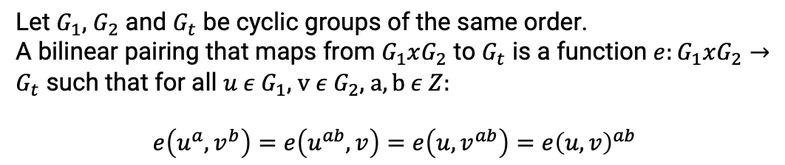

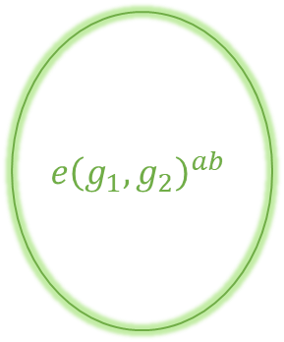
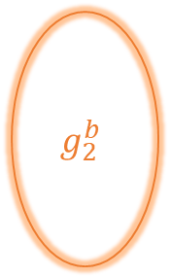
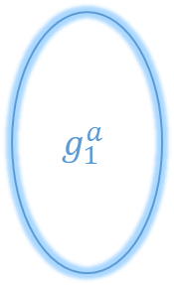

Bilinear Pairing
$$g_{1}^{a}$$
Let $G_{1}$, $G_{2}$ and $G_{t}$ be cyclic groups of the same order.
A bilinear pairing that maps from $G_{1}xG_{2}$ to $G_{t}$ is a function ${e:G}_{1}xG_{2}→G_{t}$ such that for all $u ε G_{1}$, $v ε G_{2}$, $a,b ε Z:$
$$e\left(u^{a},v^{b}\right)=e\left(u^{ab},v\right)=e\left(u,v^{ab}\right)=e{\left(u,v\right)}^{ab}$$
$$e{\left(g_{1},g_{2}\right)}^{ab}$$
$$G_{1}$$
$$g_{2}^{b}$$
$$G_{t}$$
$$G_{2}$$
Notes:
Bilinear maps are called pairings because they associate pairs
of elements from G1 and G2 with elements in Gt.

Slide 12

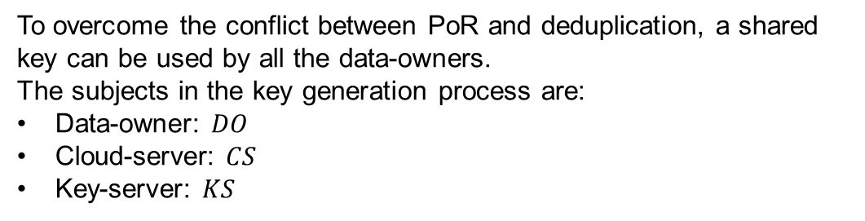



ML-KeyGen algorithm
To overcome the conflict between PoR and deduplication, a shared key can be used by all the data-owners.
The subjects in the key generation process are:
Data-owner: $DO$
Cloud-server: $CS$
Key-server: $KS$
$$DO$$
$$CS$$
$$KS$$
Notes:
Mention convergent cryptograhy.
Explain why we need a third-trusted party as the keyserver (avoid dictionary attacks from both CS and KS)

Slide 13
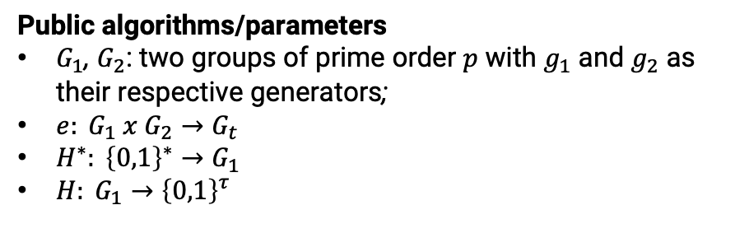
ML-KeyGen algorithm
Public algorithms/parameters
$G_{1}$, $G_{2}$: two groups of prime order $p$ with $g_{1}$ and $g_{2}$ as their respective generators;
$e: G_{1} x G_{2}→G_{t}$
$H^{∗}: {\left\{0,1\right\}}^{∗}→G_{1}$
$H: G_{1}→{\left\{0,1\right\}}^{τ}$

Slide 14




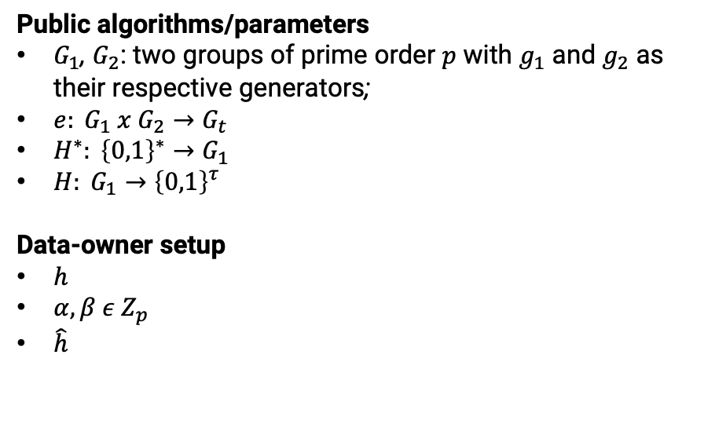





ML-KeyGen algorithm
Public algorithms/parameters
$G_{1}$, $G_{2}$: two groups of prime order $p$ with $g_{1}$ and $g_{2}$ as their respective generators;
$e: G_{1} x G_{2}→G_{t}$
$H^{∗}: {\left\{0,1\right\}}^{∗}→G_{1}$
$H: G_{1}→{\left\{0,1\right\}}^{τ}$
Data-owner setup
$h$
$α,β ε Z_{p}$
$\hat{h}$
$$DO$$
$$H^{∗}(F)$$
F
$$h$$
$$R$$
$$Z_{p}$$
$$α,β$$
$h∙g_{1}^{α}$
$$h$$
$$\hat{h}$$

Slide 15


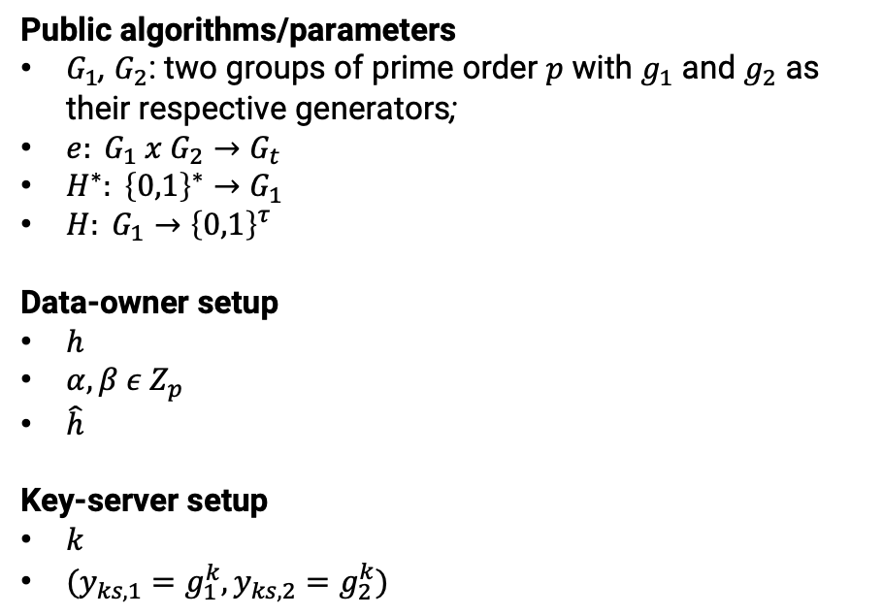


ML-KeyGen algorithm
Public algorithms/parameters
$G_{1}$, $G_{2}$: two groups of prime order $p$ with $g_{1}$ and $g_{2}$ as their respective generators;
$e: G_{1} x G_{2}→G_{t}$
$H^{∗}: {\left\{0,1\right\}}^{∗}→G_{1}$
$H: G_{1}→{\left\{0,1\right\}}^{τ}$
Data-owner setup
$h$
$α,β ε Z_{p}$
$\hat{h}$
Key-server setup
$k$
$(y_{ks,1}=g_{1}^{k},y_{ks,2}=g_{2}^{k})$
$$KS$$
$$R$$
$$Z_{p}$$
$$k$$

Slide 16


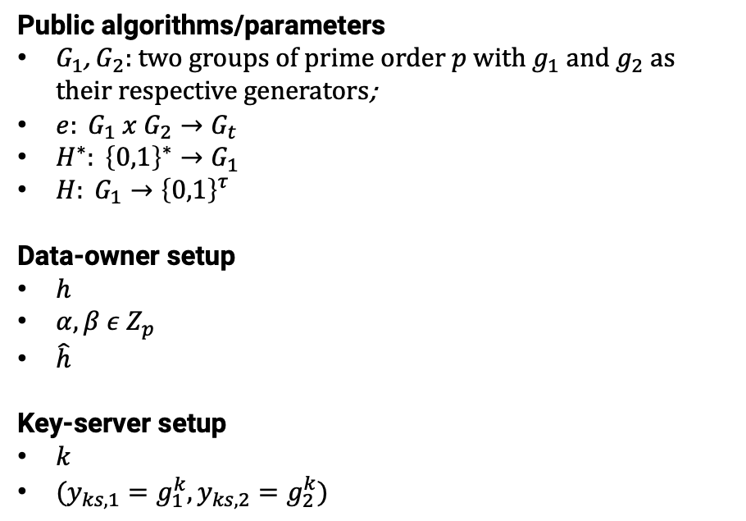
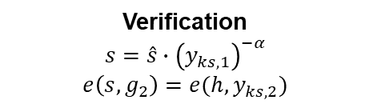


ML-KeyGen algorithm
Public algorithms/parameters
$G_{1}$, $G_{2}$: two groups of prime order $p$ with $g_{1}$ and $g_{2}$ as their respective generators;
$e: G_{1} x G_{2}→G_{t}$
$H^{∗}: {\left\{0,1\right\}}^{∗}→G_{1}$
$H: G_{1}→{\left\{0,1\right\}}^{τ}$
Data-owner setup
$h$
$α,β ε Z_{p}$
$\hat{h}$
Key-server setup
$k$
$(y_{ks,1}=g_{1}^{k},y_{ks,2}=g_{2}^{k})$
$$\hat{h}$$
$$\hat{s}={\left(\hat{h}\right)}^{k}$$
$$DO$$
$$KS$$
Verification
$$s=\hat{s}∙{\left(y_{ks,1}\right)}^{−α}$$
$$e\left(s,g_{2}\right)=e(h,y_{ks,2})$$

Slide 17


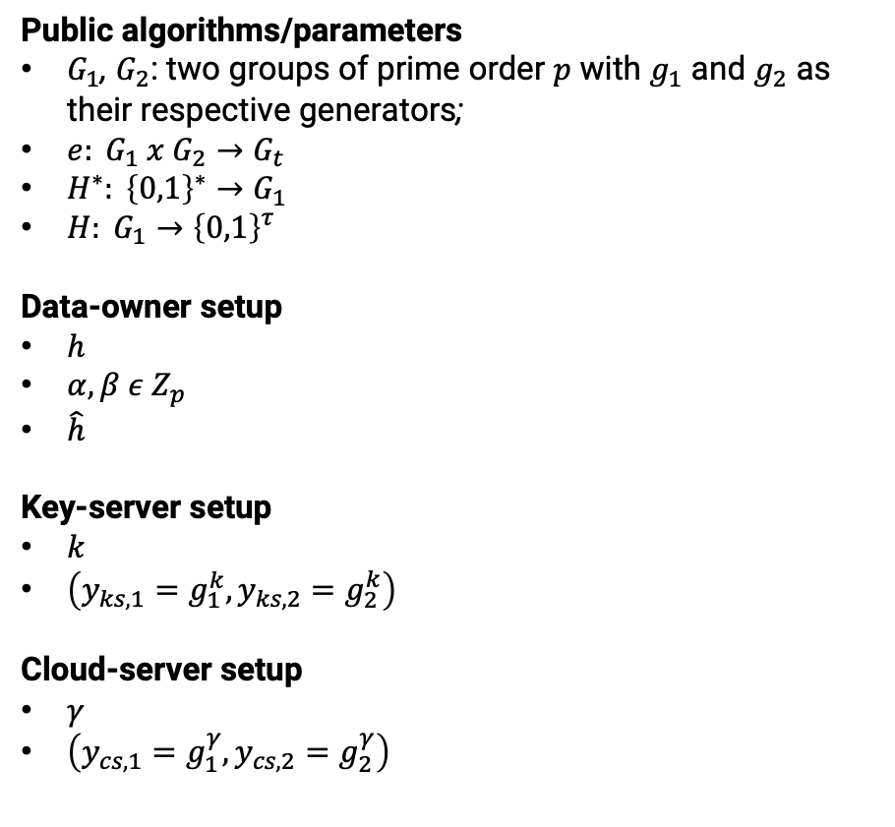


ML-KeyGen algorithm
Public algorithms/parameters
$G_{1}$, $G_{2}$: two groups of prime order $p$ with $g_{1}$ and $g_{2}$ as their respective generators;
$e: G_{1} x G_{2}→G_{t}$
$H^{∗}: {\left\{0,1\right\}}^{∗}→G_{1}$
$H: G_{1}→{\left\{0,1\right\}}^{τ}$
Data-owner setup
$h$
$α,β ε Z_{p}$
$\hat{h}$
Key-server setup
$k$
$\left(y_{ks,1}=g_{1}^{k},y_{ks,2}=g_{2}^{k}\right)$
Cloud-server setup
$γ$
$\left(y_{cs,1}=g_{1}^{γ},y_{cs,2}=g_{2}^{γ}\right)$
$$CS$$
$$R$$
$$Z_{p}$$
$$γ$$

Slide 18
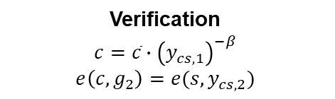
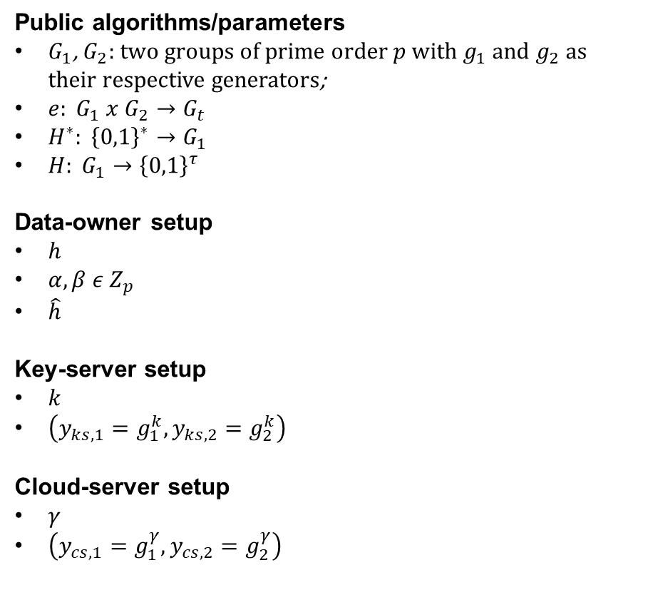






ML-KeyGen algorithm
Public algorithms/parameters
$G_{1}$, $G_{2}$: two groups of prime order $p$ with $g_{1}$ and $g_{2}$ as their respective generators;
$e: G_{1} x G_{2}→G_{t}$
$H^{∗}: {\left\{0,1\right\}}^{∗}→G_{1}$
$H: G_{1}→{\left\{0,1\right\}}^{τ}$
Data-owner setup
$h$
$α,β ε Z_{p}$
$\hat{h}$
Key-server setup
$k$
$\left(y_{ks,1}=g_{1}^{k},y_{ks,2}=g_{2}^{k}\right)$
Cloud-server setup
$γ$
$\left(y_{cs,1}=g_{1}^{γ},y_{cs,2}=g_{2}^{γ}\right)$
$$\overline{s}=s∙g_{1}^{β}$$
$$\overline{s}$$
$\overline{c}={\left(\overline{s}\right)}^{γ}$
$$DO$$
$$CS$$
Verification
$$c=\overline{c}∙{\left(y_{cs,1}\right)}^{−β}$$
$$e\left(c,g_{2}\right)=e(s,y_{cs,2})$$
$$K_{F}=H(c)$$

Slide 19
ML-StealthGuard
ML-StealthGuard
Example of application: ML-StealthGuard

Slide 20

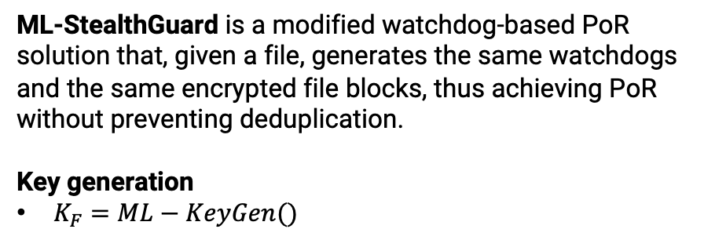
Example of application: ML-StealthGuard
ML-StealthGuard is a modified watchdog-based PoR solution that, given a file, generates the same watchdogs and the same encrypted file blocks, thus achieving PoR without preventing deduplication.
Key generation
$K_{F}=ML−KeyGen()$
$$K_{F}$$

Slide 21
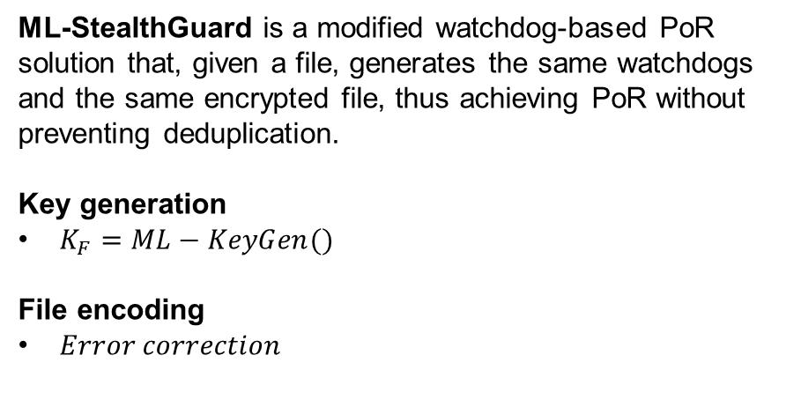




Example of application: ML-StealthGuard
$$F$$
ML-StealthGuard is a modified watchdog-based PoR solution that, given a file, generates the same watchdogs and the same encrypted file, thus achieving PoR without preventing deduplication.
Key generation
$K_{F}=ML−KeyGen()$
File encoding
$Error correction$
$$S_{i}$$
$${ECC(S}_{i})$$
$$\hat{F}$$
Notes:
File split in n splits Si;
Si is a split of length m blocks, each block is long l.

Slide 22

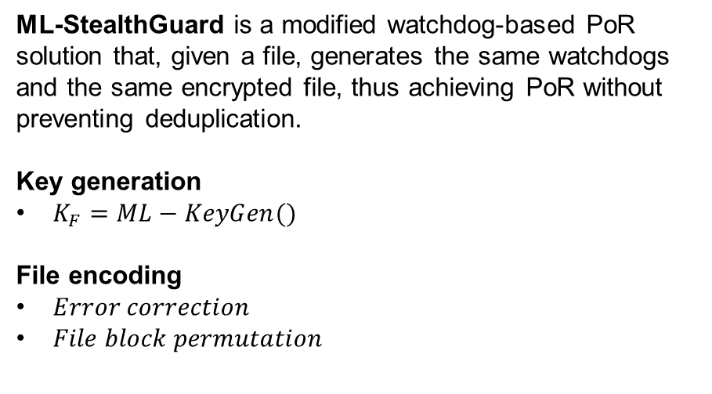
Example of application: ML-StealthGuard
ML-StealthGuard is a modified watchdog-based PoR solution that, given a file, generates the same watchdogs and the same encrypted file, thus achieving PoR without preventing deduplication.
Key generation
$K_{F}=ML−KeyGen()$
File encoding
$Error correction$
$File block permutation$
$$K_{perm}=H_{perm}(K_{F})$$

Slide 23
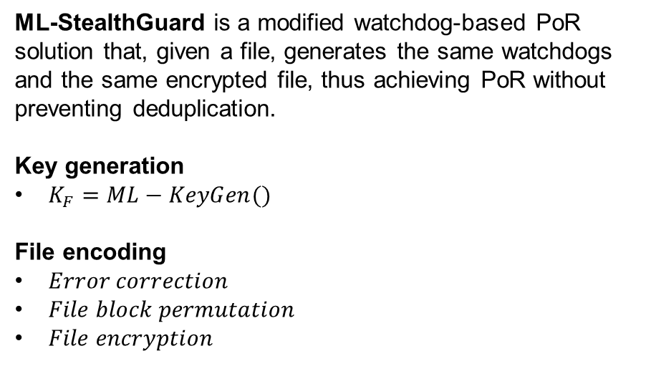

Example of application: ML-StealthGuard
ML-StealthGuard is a modified watchdog-based PoR solution that, given a file, generates the same watchdogs and the same encrypted file, thus achieving PoR without preventing deduplication.
Key generation
$K_{F}=ML−KeyGen()$
File encoding
$Error correction$
$File block permutation$
$File encryption$
$$K_{perm}=H_{perm}(K_{F})$$
$$K_{enc}=H_{enc}(K_{F})$$

Slide 24
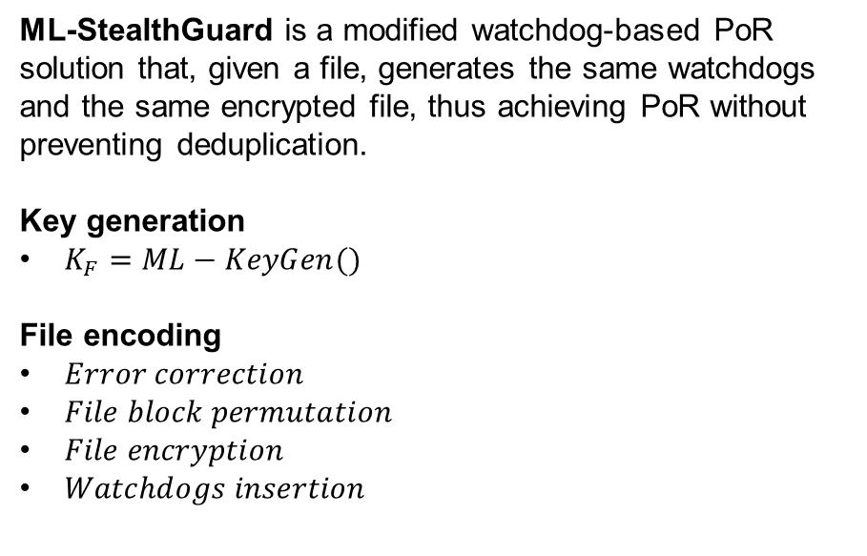


Example of application: ML-StealthGuard
ML-StealthGuard is a modified watchdog-based PoR solution that, given a file, generates the same watchdogs and the same encrypted file, thus achieving PoR without preventing deduplication.
Key generation
$K_{F}=ML−KeyGen()$
File encoding
$Error correction$
$File block permutation$
$File encryption$
$Watchdogs insertion$
$$K_{perm}=H_{perm}(K_{F})$$
$$K_{enc}=H_{enc}(K_{F})$$
$$K_{wdog}=H_{wdog}(K_{F})$$
$$K_{perm_{S,i}}=H_{perm_{S,i}}(K_{F})$$

Slide 25
Security Analysis
Security Analysis
Security guarantees of PoR
Server-side VS Client-side deduplication

Slide 26

Security guarantees of ML-PoR
ML-PoR achieves the following points in terms of security analysis:
No dictionary attacks can be performed neither by the cloud-server nor by the key-server;
Rate Limiting to limit the threat of online attacks.
1
2
…
100
$$KS$$

Slide 27
Possible improvements
The following improvements can be performed in order to increase the performances:
Client-side deduplication
Proof of Ownership (PoW)
PoW
F
Notes:
Client-side deduplication: save bandwitdh by uploading the file only if the file is not already on the cloud: in this way only keygen and encode are necessary. However, Client-side deduplication is exposed to the following attack: if an attacker finds the file identifier fid, then it can claim possession for the file… To solve this problem implement a proof of ownership, useful for the CS to verify that the user has possession of the file

Slide 28
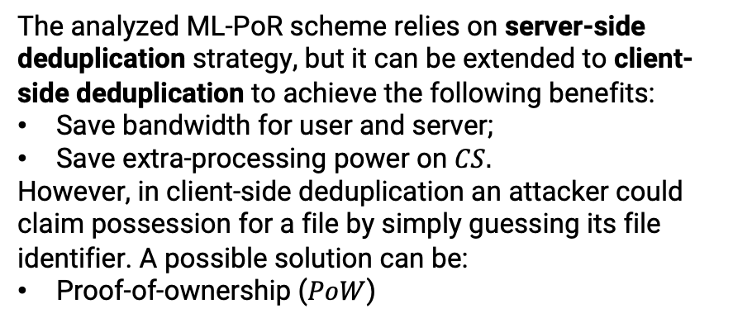
Server-side VS Client-side deduplication
The analyzed ML-PoR scheme relies on server-side deduplication strategy, but it can be extended to client-side deduplication to achieve the following benefits:
Save bandwidth for user and server;
Save extra-processing power on $CS.$
However, in client-side deduplication an attacker could claim possession for a file by simply guessing its file identifier. A possible solution can be:
Proof-of-ownership ($PoW$)
PoW
F
Notes:
Client-side deduplication: save bandwitdh by uploading the file only if the file is not already on the cloud: in this way only keygen and encode are necessary. However, Client-side deduplication is exposed to the following attack: if an attacker finds the file identifier fid, then it can claim possession for the file… To solve this problem implement a proof of ownership, useful for the CS to verify that the user has possession of the file

Slide 29
References
Vasilopoulos, D., Önen, M., Elkhiyaoui, K., Molva, R., Message-Locked Proofs of Retrievability with Secure Deduplication, In Proc. of ACM CCSW ’16. 73–83, 2016.
Azraoui, M., Elkhiyaoui, K., Molva, R., Önen, M., StealthGuard: Proofs of Retrievability with Hidden Watchdogs, In Proceedings of the 19th European Symposium on Research in Computer Security (ESORICS) , pages 239–256, 2014.

Slide 30

It’s time for questions!

