Slide 1
Message-Locked Proofs of Retrievability with Secure Deduplication
BigSec Project
A.Y. 2018/2019
Alessandro Colucci
Pasquale Convertini
Helen Möllering
Sebastian Sanislav
Notes:
Vasilopulos

Slide 2
Outline
Introduction
Message-Locked Proof of Retrievability
ML-StealthGuard
Security Analysis
Notes:
Alessandro
Pasquale
Sebastian

Slide 3
Introduction
Introduction
Proof of Retrievability (PoR)
Deduplication
Conflict between PoR and Deduplication

Slide 4


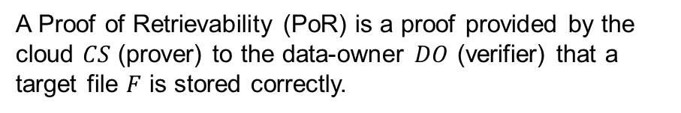
Proof of Retrievability (PoR)
A Proof of Retrievability (PoR) is a proof provided by the cloud $CS$ (prover) to the data-owner $DO$ (verifier) that a target file $F$ is stored correctly.
Is my data still there?
PoR
Notes:
Outsourcing -> loss of control
Data sensitive: business secrets or sensitive information as for example health information
integrity

Slide 5
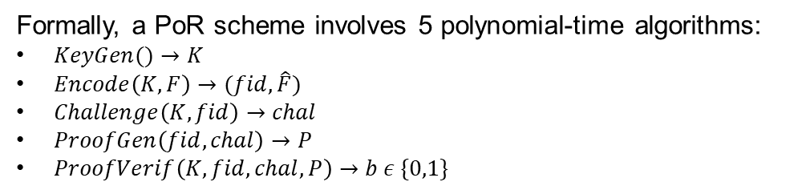
Proof of Retrievability (PoR)
Formally, a PoR scheme involves 5 polynomial-time algorithms:
$KeyGen()→K$
$Encode\left(K,F\right)→(fid,\hat{F})$
$Challenge\left(K,fid\right)→chal$
$ProofGen\left(fid, chal\right)→P$
$ProofVerif\left(K, fid, chal, P\right)→b ε \{0,1\}$
Is my data still there?
PoR
Notes:
generates key
Prepares the files for outsourcing: adds verification material, identifier etc
To request PoR
Cloud generates the PoR
User checks if PoR is valid

Slide 6




PoR solutions
PoR solution can be divided in 2 families:
Watchdog-based PoR
Tag-based PoR
Upload
Block #i?
?
=
?
Verification

Slide 7
PoR solutions
PoR solution can be divided in 2 families:
Watchdog-based PoR
Tag-based PoR
Upload
Block #i?
Tag( )
=
Verification

Slide 8
Deduplication
Data object #1
Data object #2
Deduplication is a technique for eliminating duplicated copies of repeated data.
It can be performed at:
File-level
Block-level
Sub-block level
Data saved on cloud
Notes:
Elimination of storing more than one copy, Vasilopulos

Slide 9



Conflict between PoR and Deduplication
PoR solutions and deduplication are intrinsically in conflict since:
In watchdog-based solutions data is securely encrypted before the upload, preventing the detection of duplicated data segments;
In tag-based solutions, even when the file is stored separately and can be duplicated, the tags generated by different users cannot be duplicated.
$$≠$$
Deduplication
Notes:
Alessandro

Slide 10
Message-Locked PoR (ML-PoR)
Message-Locked PoR
Bilinear Pairing
ML-KeyGen algorithm

Slide 11

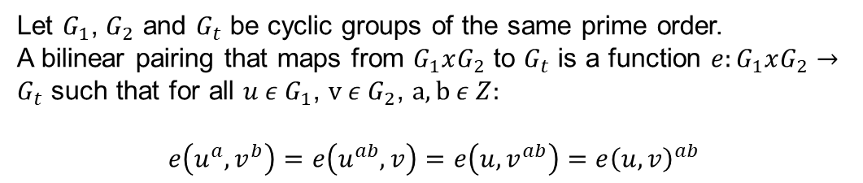

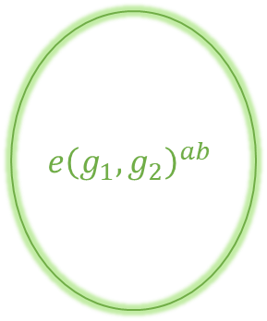
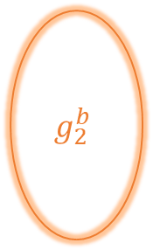
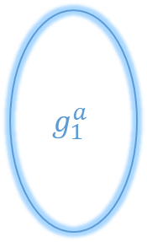

Bilinear Pairing
$$g_{1}^{a}$$
Let $G_{1}$, $G_{2}$ and $G_{t}$ be cyclic groups of the same prime order.
A bilinear pairing that maps from $G_{1}xG_{2}$ to $G_{t}$ is a function ${e:G}_{1}xG_{2}→G_{t}$ such that for all $u ε G_{1}$, $v ε G_{2}$, $a,b ε Z:$
$$e\left(u^{a},v^{b}\right)=e\left(u^{ab},v\right)=e\left(u,v^{ab}\right)=e{\left(u,v\right)}^{ab}$$
$$e{\left(g_{1},g_{2}\right)}^{ab}$$
$$G_{1}$$
$$g_{2}^{b}$$
$$G_{t}$$
$$G_{2}$$
Notes:
Bilinear maps are called pairings because they associate pairs
of elements from G1 and G2 with elements in Gt.

Slide 12

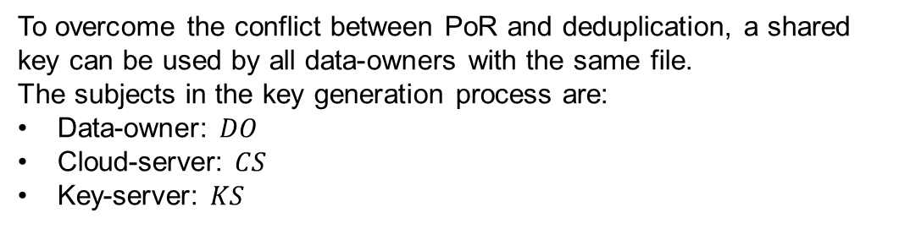



ML-KeyGen algorithm
To overcome the conflict between PoR and deduplication, a shared key can be used by all data-owners with the same file.
The subjects in the key generation process are:
Data-owner: $DO$
Cloud-server: $CS$
Key-server: $KS$
$$DO$$
$$CS$$
$$KS$$
Notes:
Mention convergent cryptograhy.
Explain why we need a third-trusted party as the keyserver (avoid dictionary attacks from both CS and KS)

Slide 13
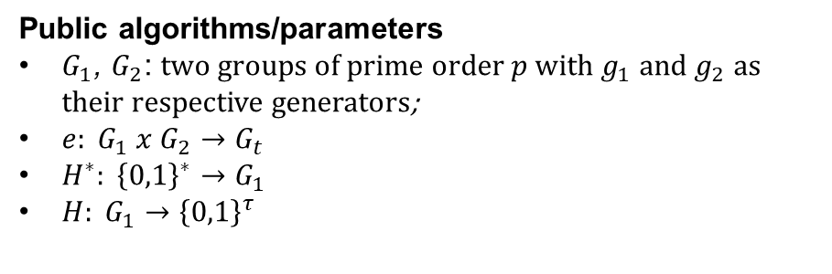
ML-KeyGen algorithm
Public algorithms/parameters
$G_{1}$, $G_{2}$: two groups of prime order $p$ with $g_{1}$ and $g_{2}$ as their respective generators;
$e: G_{1} x G_{2}→G_{t}$
$H^{∗}: {\left\{0,1\right\}}^{∗}→G_{1}$
$H: G_{1}→{\left\{0,1\right\}}^{τ}$

Slide 14




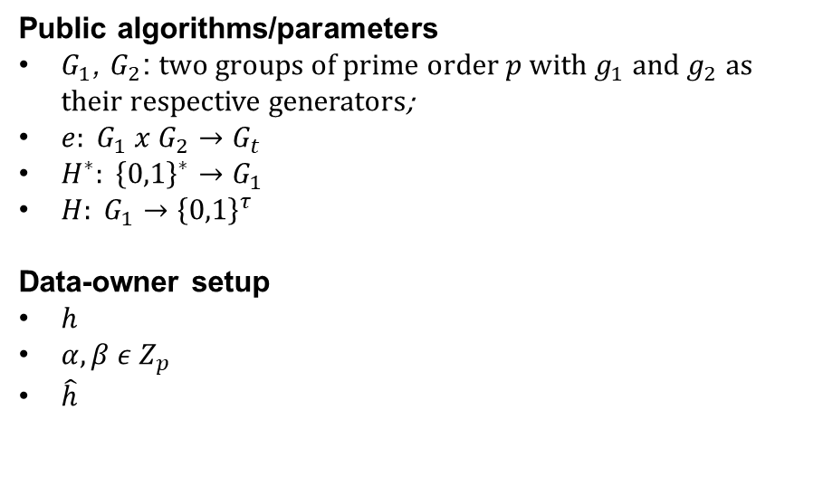





ML-KeyGen algorithm
Public algorithms/parameters
$G_{1}$, $G_{2}$: two groups of prime order $p$ with $g_{1}$ and $g_{2}$ as their respective generators;
$e: G_{1} x G_{2}→G_{t}$
$H^{∗}: {\left\{0,1\right\}}^{∗}→G_{1}$
$H: G_{1}→{\left\{0,1\right\}}^{τ}$
Data-owner setup
$h$
$α,β ε Z_{p}$
$\hat{h}$
$$DO$$
$$H^{∗}(F)$$
F
$$h$$
$$R$$
$$Z_{p}$$
$$α,β$$
$h∙g_{1}^{α}$
$$h$$
$$\hat{h}$$

Slide 15


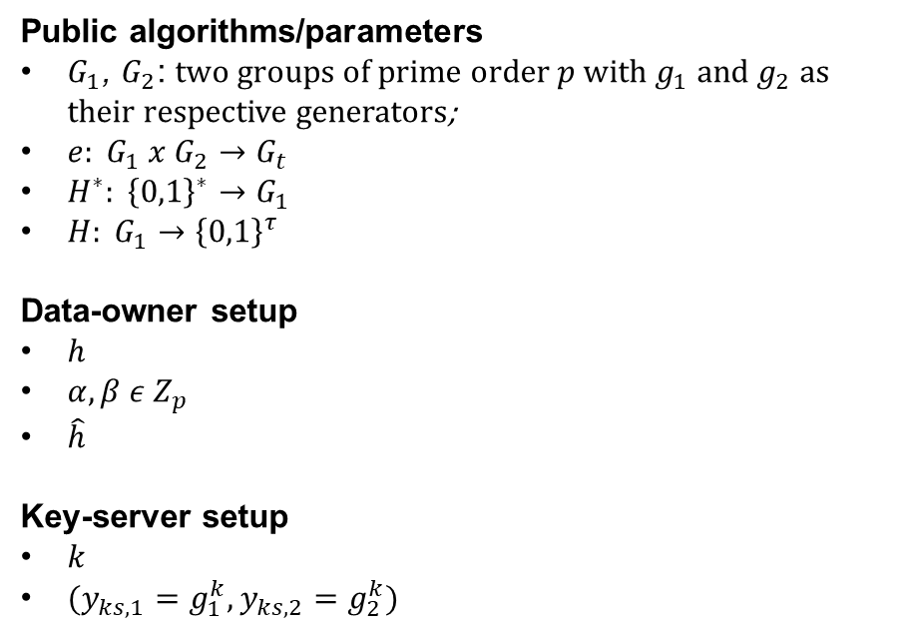


ML-KeyGen algorithm
Public algorithms/parameters
$G_{1}$, $G_{2}$: two groups of prime order $p$ with $g_{1}$ and $g_{2}$ as their respective generators;
$e: G_{1} x G_{2}→G_{t}$
$H^{∗}: {\left\{0,1\right\}}^{∗}→G_{1}$
$H: G_{1}→{\left\{0,1\right\}}^{τ}$
Data-owner setup
$h$
$α,β ε Z_{p}$
$\hat{h}$
Key-server setup
$k$
$(y_{ks,1}=g_{1}^{k},y_{ks,2}=g_{2}^{k})$
$$KS$$
$$R$$
$$Z_{p}$$
$$k$$

Slide 16


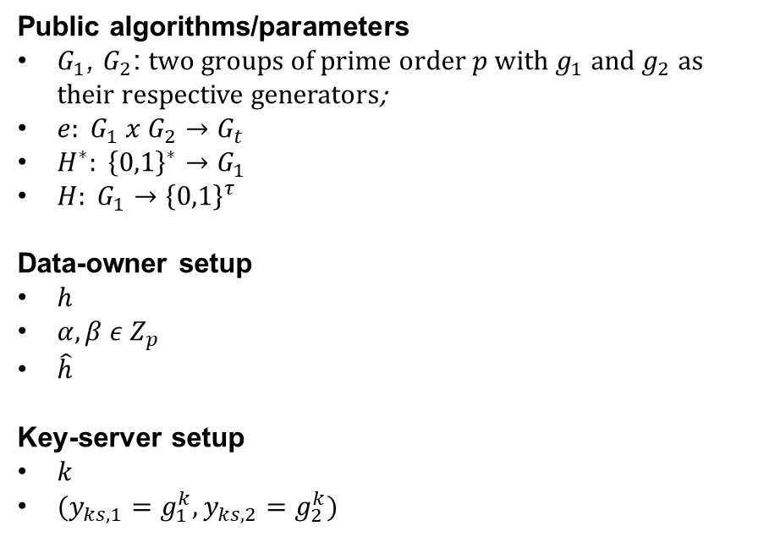
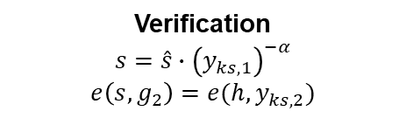


ML-KeyGen algorithm
Public algorithms/parameters
$G_{1}$, $G_{2}$: two groups of prime order $p$ with $g_{1}$ and $g_{2}$ as their respective generators;
$e: G_{1} x G_{2}→G_{t}$
$H^{∗}: {\left\{0,1\right\}}^{∗}→G_{1}$
$H: G_{1}→{\left\{0,1\right\}}^{τ}$
Data-owner setup
$h$
$α,β ε Z_{p}$
$\hat{h}$
Key-server setup
$k$
$(y_{ks,1}=g_{1}^{k},y_{ks,2}=g_{2}^{k})$
$$\hat{h}$$
$$\hat{s}={\left(\hat{h}\right)}^{k}$$
$$DO$$
$$KS$$
Verification
$$s=\hat{s}∙{\left(y_{ks,1}\right)}^{−α}$$
$$e\left(s,g_{2}\right)=e(h,y_{ks,2})$$

Slide 17


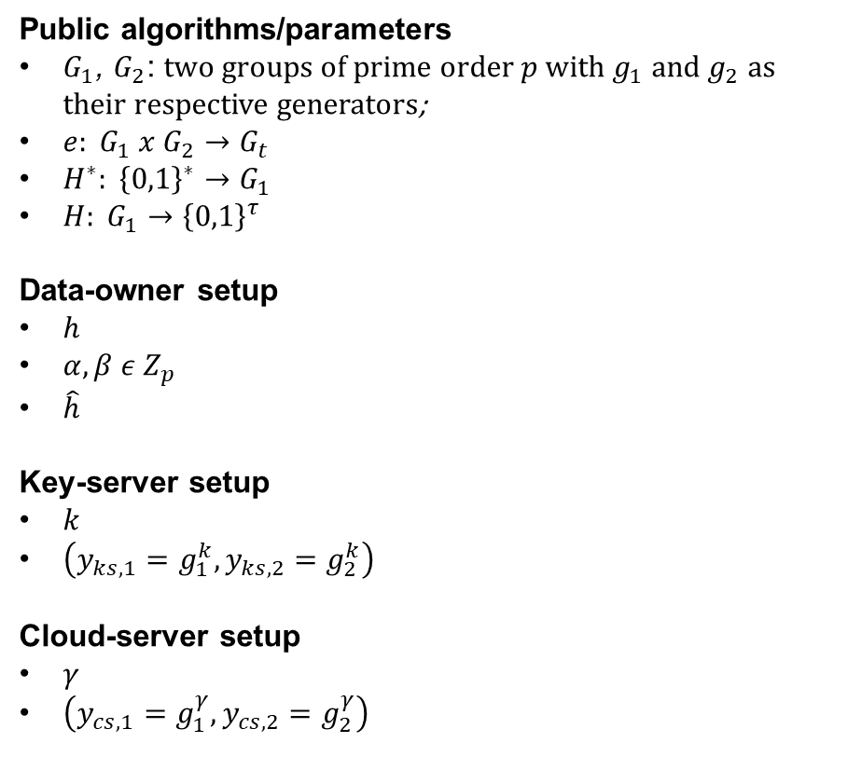


ML-KeyGen algorithm
Public algorithms/parameters
$G_{1}$, $G_{2}$: two groups of prime order $p$ with $g_{1}$ and $g_{2}$ as their respective generators;
$e: G_{1} x G_{2}→G_{t}$
$H^{∗}: {\left\{0,1\right\}}^{∗}→G_{1}$
$H: G_{1}→{\left\{0,1\right\}}^{τ}$
Data-owner setup
$h$
$α,β ε Z_{p}$
$\hat{h}$
Key-server setup
$k$
$\left(y_{ks,1}=g_{1}^{k},y_{ks,2}=g_{2}^{k}\right)$
Cloud-server setup
$γ$
$\left(y_{cs,1}=g_{1}^{γ},y_{cs,2}=g_{2}^{γ}\right)$
$$CS$$
$$R$$
$$Z_{p}$$
$$γ$$

Slide 18
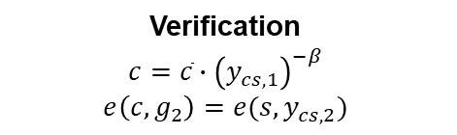
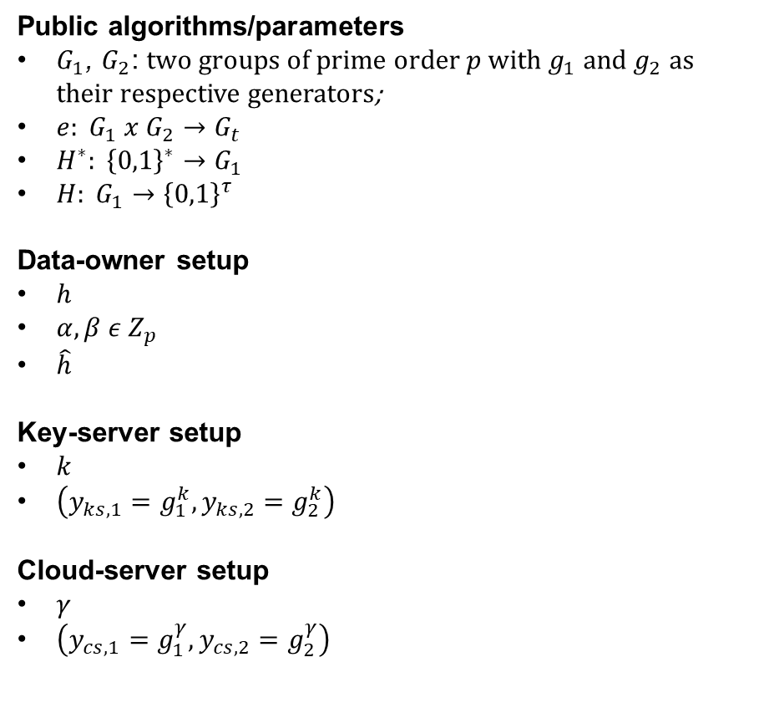






ML-KeyGen algorithm
Public algorithms/parameters
$G_{1}$, $G_{2}$: two groups of prime order $p$ with $g_{1}$ and $g_{2}$ as their respective generators;
$e: G_{1} x G_{2}→G_{t}$
$H^{∗}: {\left\{0,1\right\}}^{∗}→G_{1}$
$H: G_{1}→{\left\{0,1\right\}}^{τ}$
Data-owner setup
$h$
$α,β ε Z_{p}$
$\hat{h}$
Key-server setup
$k$
$\left(y_{ks,1}=g_{1}^{k},y_{ks,2}=g_{2}^{k}\right)$
Cloud-server setup
$γ$
$\left(y_{cs,1}=g_{1}^{γ},y_{cs,2}=g_{2}^{γ}\right)$
$$\overline{s}=s∙g_{1}^{β}$$
$$\overline{s}$$
$\overline{c}={\left(\overline{s}\right)}^{γ}$
$$DO$$
$$CS$$
Verification
$$c=\overline{c}∙{\left(y_{cs,1}\right)}^{−β}$$
$$e\left(c,g_{2}\right)=e(s,y_{cs,2})$$
$$K_{F}=H(c)$$

Slide 19
ML-StealthGuard
ML-StealthGuard
Example of application: ML-StealthGuard

Slide 20

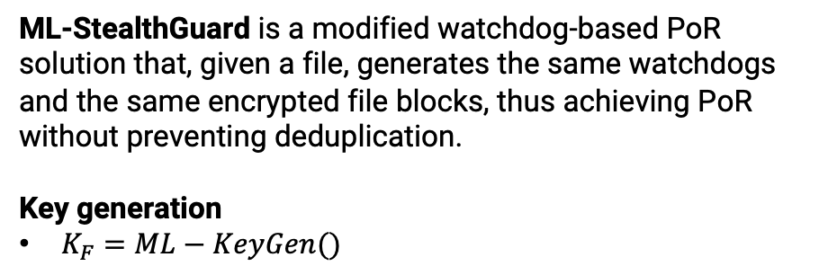
Example of application: ML-StealthGuard
ML-StealthGuard is a modified watchdog-based PoR solution that, given a file, generates the same watchdogs and the same encrypted file blocks, thus achieving PoR without preventing deduplication.
Key generation
$K_{F}=ML−KeyGen()$
$$K_{F}$$

Slide 21
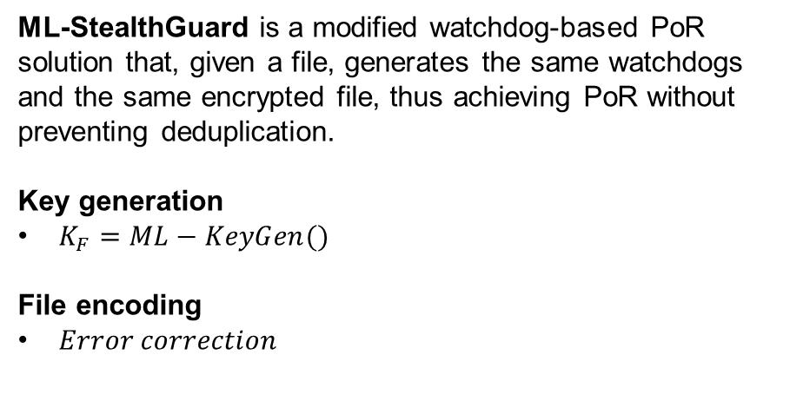




Example of application: ML-StealthGuard
$$F$$
ML-StealthGuard is a modified watchdog-based PoR solution that, given a file, generates the same watchdogs and the same encrypted file, thus achieving PoR without preventing deduplication.
Key generation
$K_{F}=ML−KeyGen()$
File encoding
$Error correction$
$$S_{i}$$
$${ECC(S}_{i})$$
$$\hat{F}$$
Notes:
File split in n splits Si;
Si is a split of length m blocks, each block is long l.

Slide 22

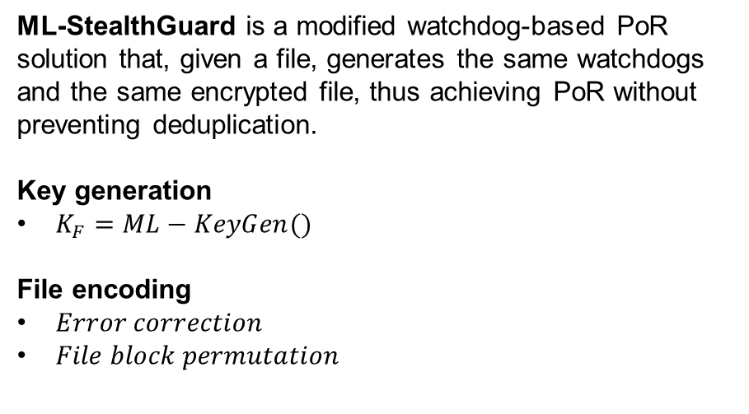
Example of application: ML-StealthGuard
ML-StealthGuard is a modified watchdog-based PoR solution that, given a file, generates the same watchdogs and the same encrypted file, thus achieving PoR without preventing deduplication.
Key generation
$K_{F}=ML−KeyGen()$
File encoding
$Error correction$
$File block permutation$
$$K_{perm}=H_{perm}(K_{F})$$

Slide 23
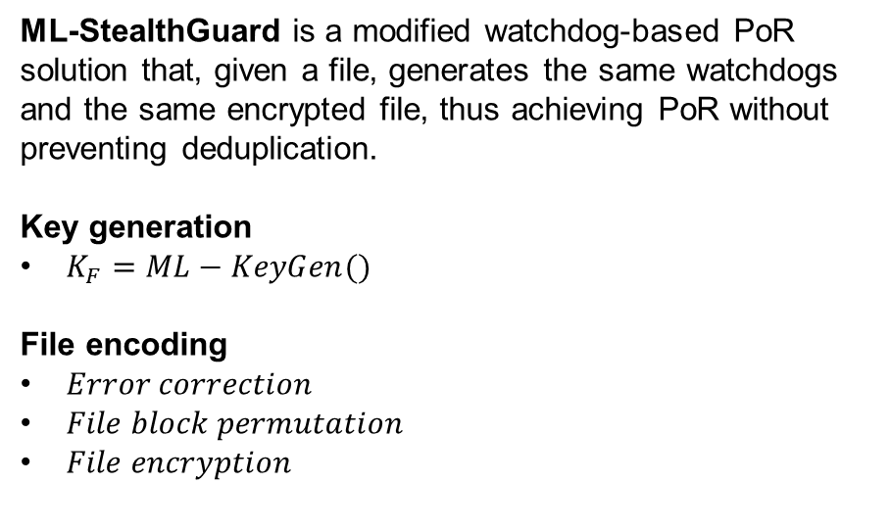

Example of application: ML-StealthGuard
ML-StealthGuard is a modified watchdog-based PoR solution that, given a file, generates the same watchdogs and the same encrypted file, thus achieving PoR without preventing deduplication.
Key generation
$K_{F}=ML−KeyGen()$
File encoding
$Error correction$
$File block permutation$
$File encryption$
$$K_{perm}=H_{perm}(K_{F})$$
$$K_{enc}=H_{enc}(K_{F})$$

Slide 24
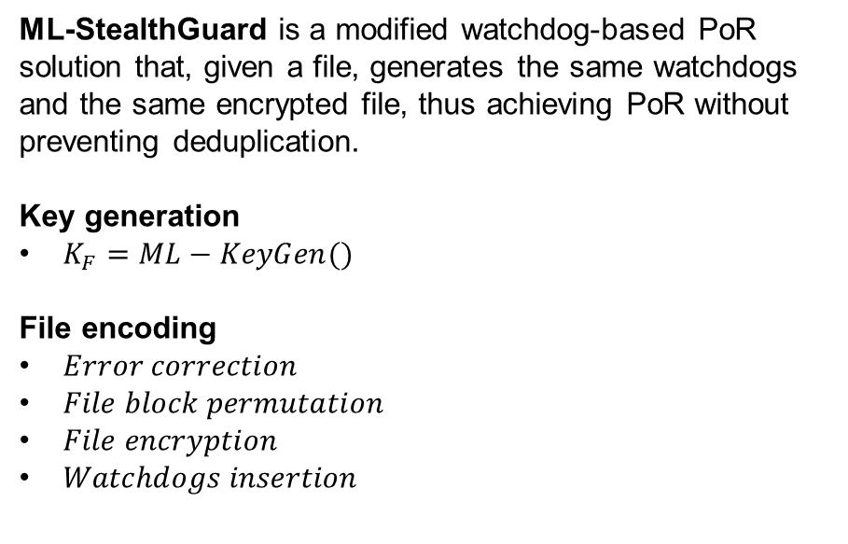


Example of application: ML-StealthGuard
ML-StealthGuard is a modified watchdog-based PoR solution that, given a file, generates the same watchdogs and the same encrypted file, thus achieving PoR without preventing deduplication.
Key generation
$K_{F}=ML−KeyGen()$
File encoding
$Error correction$
$File block permutation$
$File encryption$
$Watchdogs insertion$
$$K_{perm}=H_{perm}(K_{F})$$
$$K_{enc}=H_{enc}(K_{F})$$
$$K_{wdog}=H_{wdog}(K_{F})$$
$$K_{perm_{S,i}}=H_{perm_{S,i}}(K_{F})$$

Slide 25
Security Analysis
Security Analysis
Security guarantees of PoR
Server-side VS Client-side deduplication

Slide 26

Security guarantees of ML-PoR
ML-PoR achieves the following points in terms of security analysis:
No dictionary attacks can be performed neither by the cloud-server nor by the key-server;
Rate Limiting to limit the threat of online attacks.
1
2
…
100
$$KS$$

Slide 27
Possible improvements
The following improvements can be performed in order to increase the performances:
Client-side deduplication
Proof of Ownership (PoW)
PoW
F
Notes:
Client-side deduplication: save bandwitdh by uploading the file only if the file is not already on the cloud: in this way only keygen and encode are necessary. However, Client-side deduplication is exposed to the following attack: if an attacker finds the file identifier fid, then it can claim possession for the file… To solve this problem implement a proof of ownership, useful for the CS to verify that the user has possession of the file

Slide 28
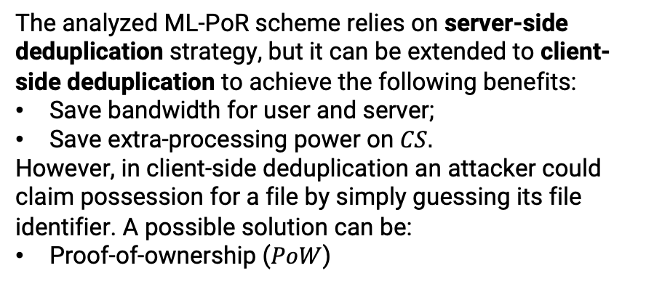
Server-side VS Client-side deduplication
The analyzed ML-PoR scheme relies on server-side deduplication strategy, but it can be extended to client-side deduplication to achieve the following benefits:
Save bandwidth for user and server;
Save extra-processing power on $CS.$
However, in client-side deduplication an attacker could claim possession for a file by simply guessing its file identifier. A possible solution can be:
Proof-of-ownership ($PoW$)
PoW
F
Notes:
Client-side deduplication: save bandwitdh by uploading the file only if the file is not already on the cloud: in this way only keygen and encode are necessary. However, Client-side deduplication is exposed to the following attack: if an attacker finds the file identifier fid, then it can claim possession for the file… To solve this problem implement a proof of ownership, useful for the CS to verify that the user has possession of the file

Slide 29
References
Vasilopoulos, D., Önen, M., Elkhiyaoui, K., Molva, R., Message-Locked Proofs of Retrievability with Secure Deduplication, In Proc. of ACM CCSW ’16. 73–83, 2016.
Azraoui, M., Elkhiyaoui, K., Molva, R., Önen, M., StealthGuard: Proofs of Retrievability with Hidden Watchdogs, In Proceedings of the 19th European Symposium on Research in Computer Security (ESORICS) , pages 239–256, 2014.

Slide 30

It’s time for questions!

