Slide 1

Aviation Data Analysis
Phase 1 Project

Slide 2
Overview and Recommendation
Project Prompt
Your company is expanding into new industries to diversify its portfolio. Specifically, they are interested in purchasing and operating airplanes for commercial and private enterprises, but do not know anything about the potential risks of aircraft.
You are charged with determining which aircraft are the lowest risk for the company to start this new business endeavor.
Goal
Translate your findings into actionable insights that the head of the new aviation division can use to help decide which aircraft to purchase.

Slide 3
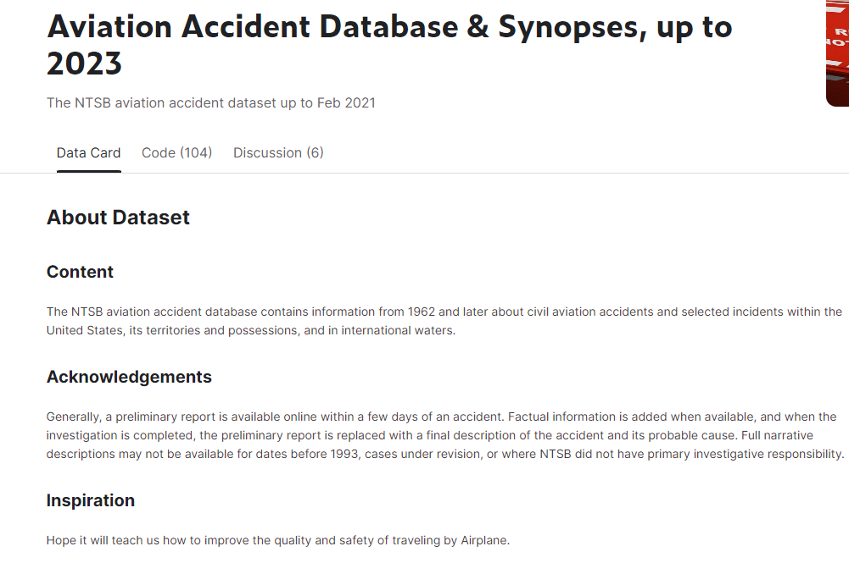
Datasets Utilized
Database Overview
The NTSB aviation accident database contains information from 1962 and later about civil aviation accidents and selected incidents within the United States, its territories and possessions, and in international waters.

Slide 4
Data Understanding
Key Data Fields | Data Contained | Business Questions
Aircraft.Damage | The severity of damage to the aircraft: Destroyed / Substantial / Minor | Which aircrafts are the most durable?
Make | The manufacturer of the aircraft | Which manufacturer makes the safest planes?
Model | The model of the aircraft | Which model is the safest?
Injury Columns Total Fatal / Serious / Minor Injuries | How many passengers were injured and how serious were there injuries
Engine.Type | The type of engine used in the aircraft | Is there a correlation between engine type and severity of the accident?
Num.of.Engines | The number of engines on the aircraft | Is there a correlation between the # of engines and severity of the accident?

Slide 5
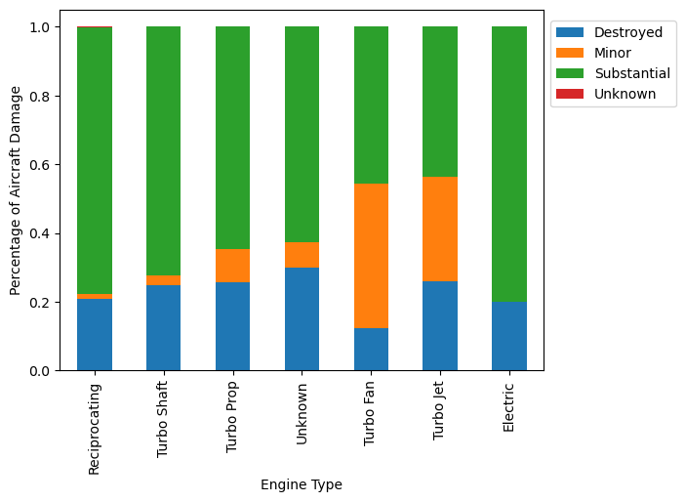
Aircraft Damage by Engine Type
Aircraft Damage by Engine Type
Key Insights
Turbo Fan and Turbo Jet have by far the highest percentage of minor aircraft damage
Electric engines seem the most dangerous with the highest percentage of substantial damage

Slide 6
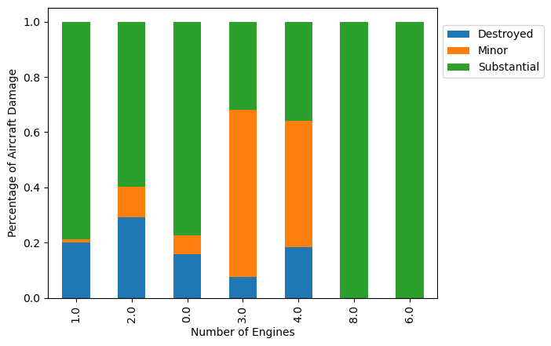
Aircraft Damage by # of Engines
Aircraft Damage by Engine Type
Key Insights
Turbo Fan and Turbo Jet have by far the highest percentage of minor aircraft damage
Electric engines seem the most dangerous with the highest percentage of substantial damage

Slide 7
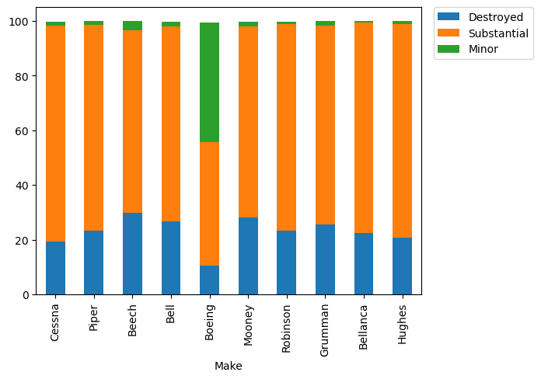
Aircraft Damage by Make
Aircraft Damage by Make
Key Insights
Bell has the highest % of destroyed and substantial damage
Beech has the highest % of destroyed aircrafts
Boeing has the safest planes with by far the highest % of minor damage

Slide 8
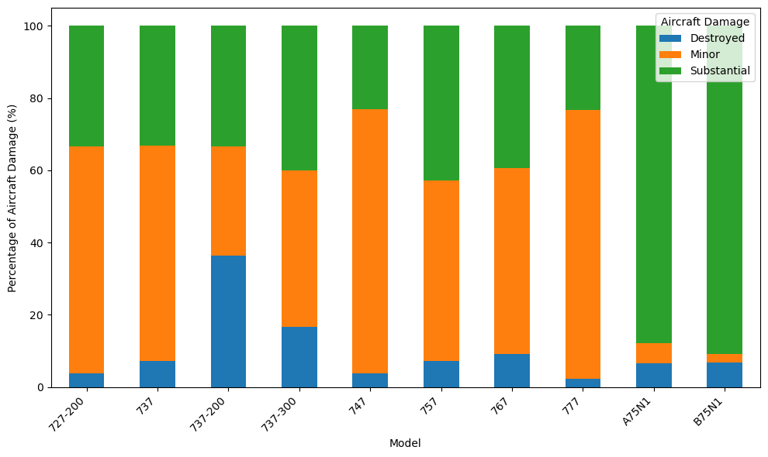
Exploring Boeing Deeper
Boeing Aircraft Damage % By Model
Key Insights
The 777 model has the highest % of minor damage
The 747 model has the 2nd highest % of minor damage
The 737-200 model has the highest destroyed %

Slide 9
Recommendations
My recommendation is to look for Boeing made airplanes, specifically the 777 and 747 models, preferably with The Turbo Fan and Turbo Jet engine, and 3-4 engines.
This recommendation is supported by 4 key pieces of data found during analysis.
1. Boeing has the lowest percentage of destroyed aircrafts when compared to other Makes.
2. The 777 and 747 models have the lowest destroyed and substantial percentage compared to other Boeing models.
3. Turbo Fan and Jet engines have the lowest destroyed percentage damage
4. Planes with 3-4 engines have the lowest percentage of destroyed / substanstial damage.

