Slide 1

Aviation Data Analysis
Phase 1 Project

Slide 2
Overview
Project Prompt
Your company is expanding into new industries to diversify its portfolio. Specifically, they are interested in purchasing and operating airplanes for commercial and private enterprises, but do not know anything about the potential risks of aircraft.
You are charged with determining which aircraft are the lowest risk for the company to start this new business endeavor.
Goal
Translate your findings into actionable insights that the head of the new aviation division can use to help decide which aircraft to purchase.

Slide 3
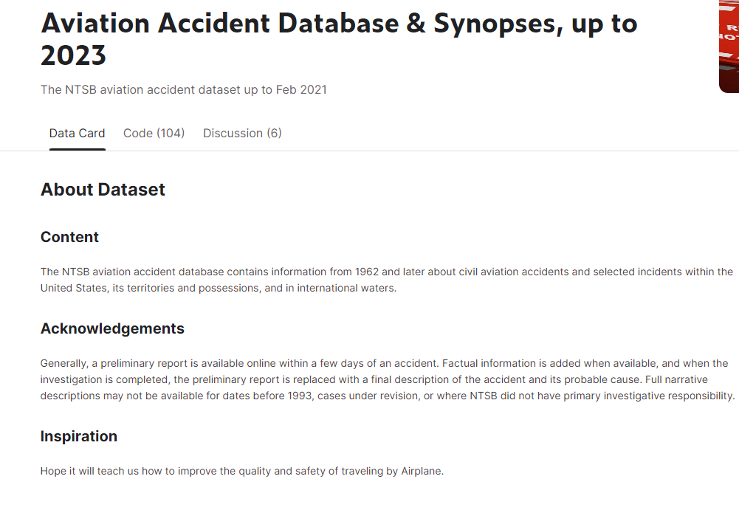
Datasets Utilized
Database Overview
The NTSB aviation accident database contains information from 1962 and later about civil aviation accidents and selected incidents within the United States, its territories and possessions, and in international waters.

Slide 4
Data Understanding
Key Data Fields | Data Contained | Business Questions
Aircraft.Damage | The severity of damage to the aircraft: Destroyed / Substantial / Minor / Unknown | Which aircrafts are the most durable?
Make | The manufacturer of the aircraft | Which manufacturer makes the safest planes?
Model | The model of the aircraft | Which model is the safest?
Injury Columns Total Fatal Injuries Total Serious Injuries Total Minor Injuries Total Uninjured | How many passengers were injured and how serious were there injuries
Weather.Condition | Weather conditions during time of the flight | Is there a correlation between weather and the severity of the accident?

Slide 5
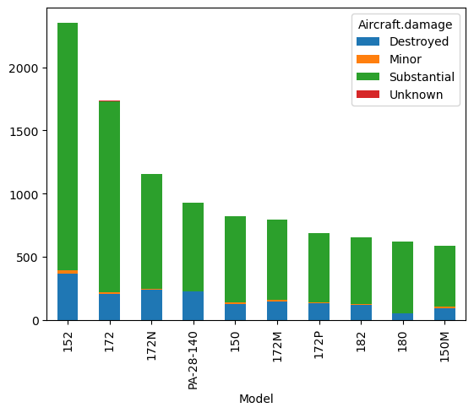
Aircraft Damage by Model
Aircraft Damage by Model
Database Overview
The NTSB aviation accident database contains information from 1962 and later about civil aviation accidents and selected incidents within the United States, its territories and possessions, and in international waters.

Slide 6
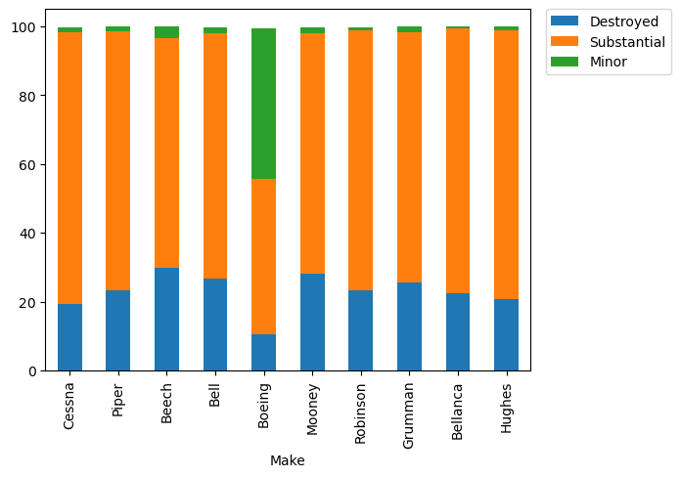
Aircraft Damage by Make
Aircraft Damage by Make
Key Insights
Bell has the highest % of destroyed and substantial damage
Beech has the highest % of destroyed aircrafts
Boeing has the safest planes with by far the highest % of minor damage

Slide 7
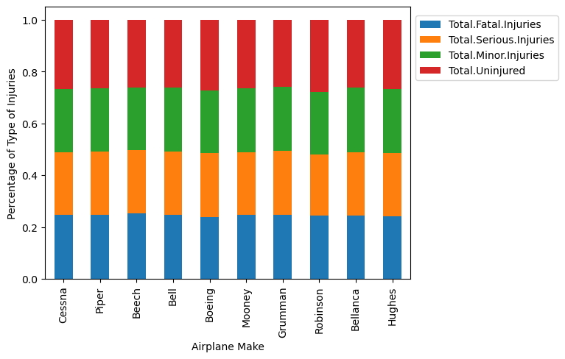
Aircraft Injuries by Make
Aircraft Injuries by Model
Key Insights
There is little difference in percentage of types of injuries across models

Slide 8
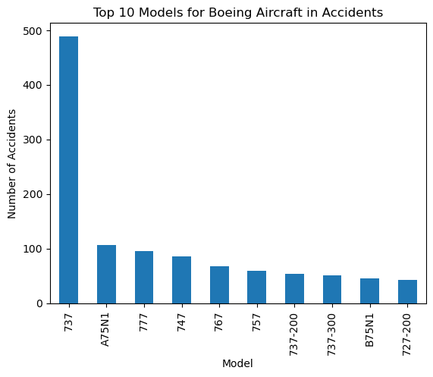
Exploring Boeing Deeper
Key Insights
The 737 is the most popular and commonly used Boeing plane

Slide 9
Boeing Model Value Counts Table
Aircraft.damage | Destroyed | Minor | Substantial
Model
727-200 | 1 | 17 | 9
737 | 15 | 124 | 69
737-200 | 12 | 10 | 11
737-300 | 5 | 13 | 12
747 | 2 | 38 | 12
757 | 2 | 14 | 12
767 | 3 | 17 | 13
777 | 1 | 32 | 10
A75N1 | 7 | 6 | 94
B75N1 | 3 | 1 | 40

Slide 10
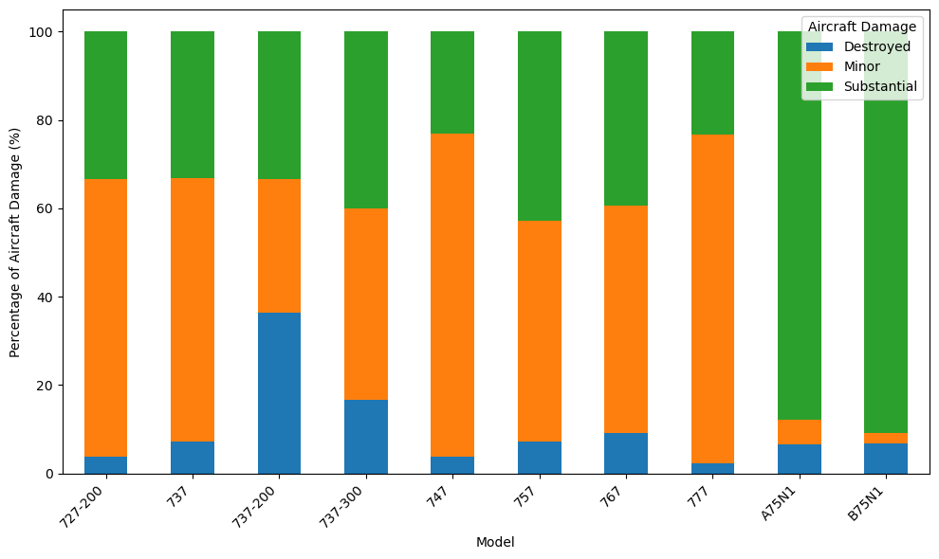
Boeing Analysis
Boeing Aircraft Damage % By Model
Key Insights
The 777 model has the highest % of minor damage
A75N1 model has the highest substantial damage %
The 737-200 model has the highest destroyed %

Slide 11
Recommendations
Recommendation: Based on the data we recommend using Boeing 777 and 747 models for this venture. Due to Boeing having the safest and most durable planes we believe it is the safest bet.
Supporting Data:
Boeing has the lowest percentage of destroyed aircrafts when compared to other Makes.
The 777 and 747 models have the lowest destroyed percentage out of all Boeing models.

