Slide 1

Movie Analysis

Slide 2
Overview and Recommendation
Project Prompt: Your company wants to capitalize on the trend of big media companies creating original content and needs to understand movie varaibles to determine what type of films to create
Goal: Analyze important movie attributes (genre, director, writer) to decide on strategy for building out an in-house film studio

Slide 3
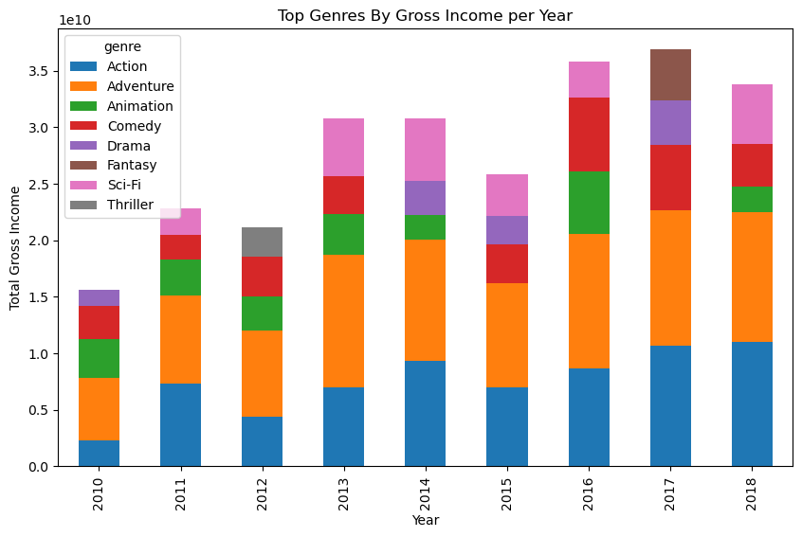
Datasets Utilized
IMDB
Contains data on the year, director, writers, length, ratings, number of votes, and more
Movie Gross
Gross income data broken down by foreign and domestic

Slide 4
Key Variables Analyzed
Variable | Analysis
Average Rating
Number of Votes
Movie Length
Director
Writer
Domestic Income
Foreign Income

Slide 5
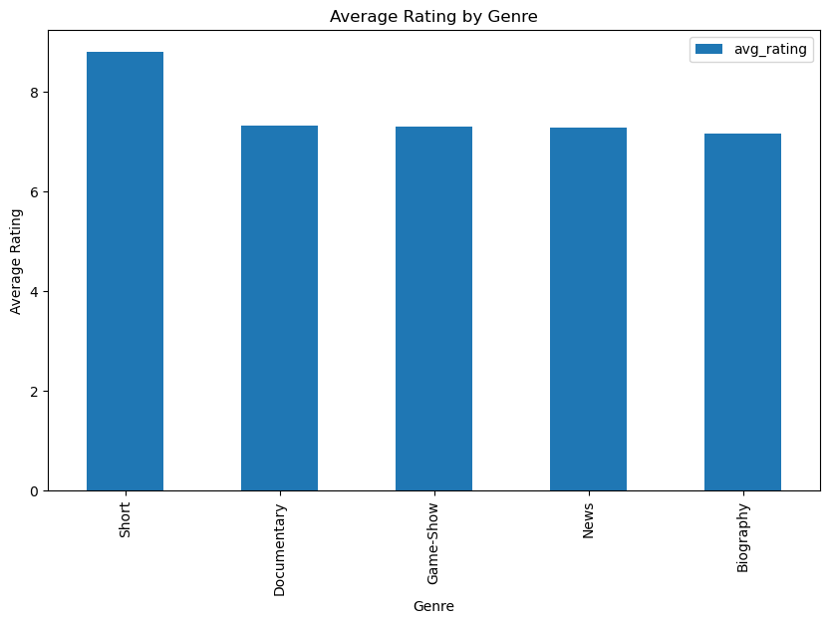
Average Rating
Takeaways
The top 5 genres by average rating are:
Short
Documentary
Game-Show
News
Biography

Slide 6
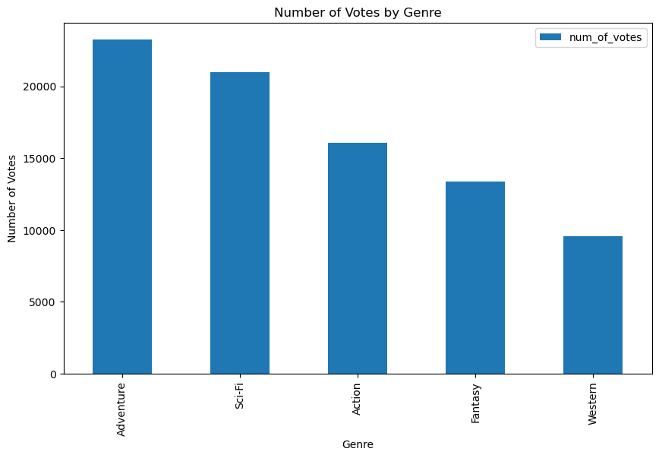
Number of Votes
Takeaways
The top 5 genres by number of votes are:
Adventure
Sci-Fi
Action
Fantasy
Western

Slide 7
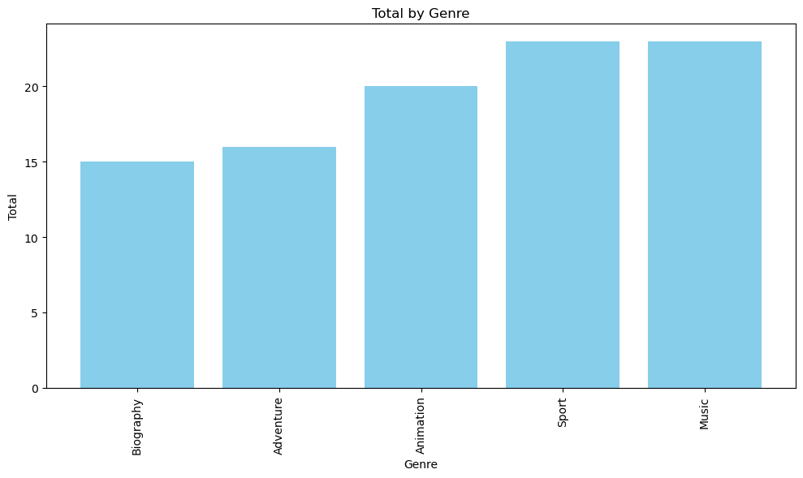
Combined Rating Metrics
Takeaways
This graph combines the rankings for number of votes and average rating to factor both rating metrics (lower score = higher rating)
The top 5 genres are:
Biography
Adventure
Animation
Sport
Music

Slide 8
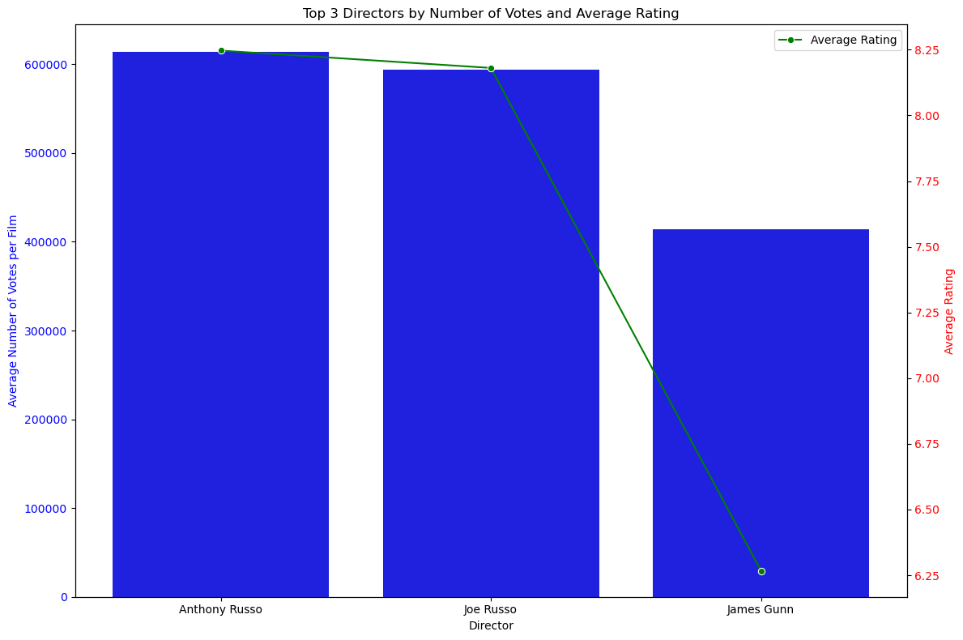
Top Directors
Takeaways
Top Directors based on average rating and number of votes are:
Anthony Russo
Joe Russo
James Gunn
*Director must have directed more than 20 films

Slide 9
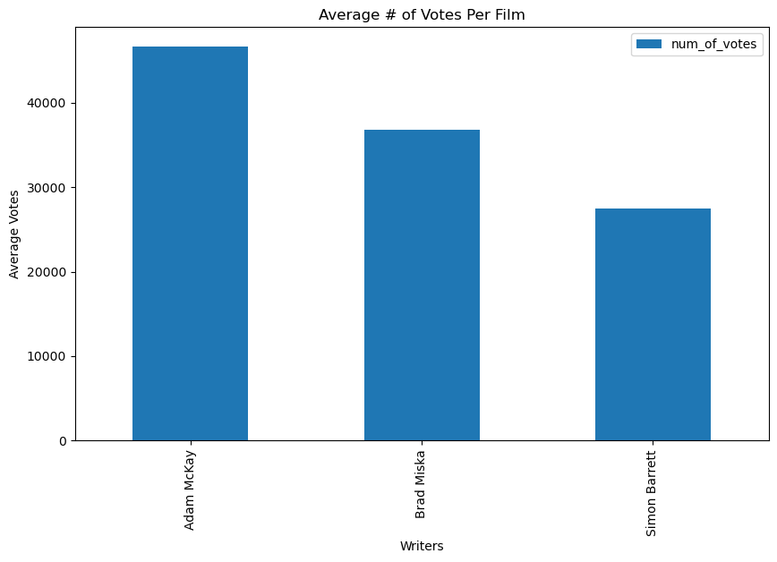
Top Writers
Takeaways
Top Writers based on average number of votes:
Adam McKay
Brad Miska
Simon Barrett
*Writer must have written more than 20 films

Slide 10
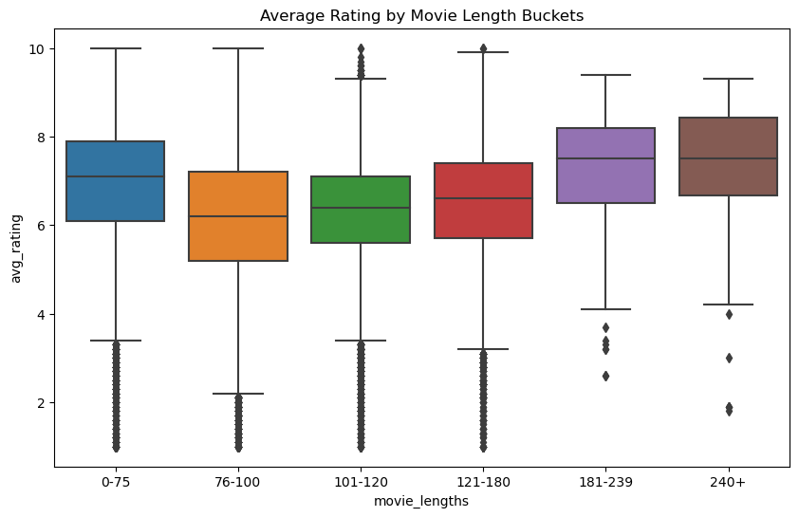
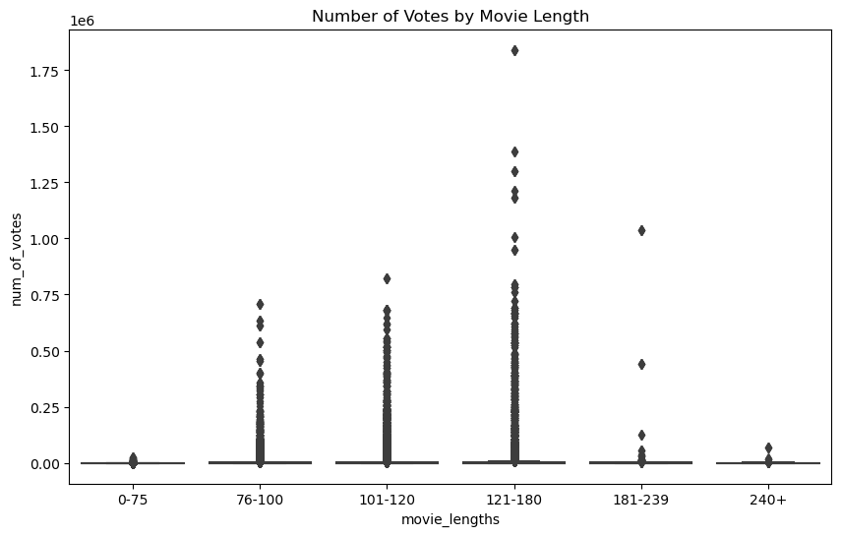
Movie Length
Takeaways
Movie length seems to be a factor with movies 121 – 180 minutes registering the highest number of average votes per film

Slide 11
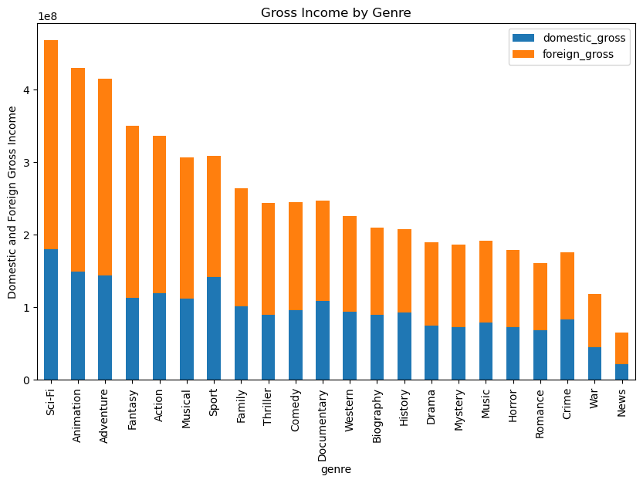
Gross Income
Takeaways
The Genres that produced the most gross income are
Sci-Fi
Animation
Adventure
Fantasy
Action

Slide 12
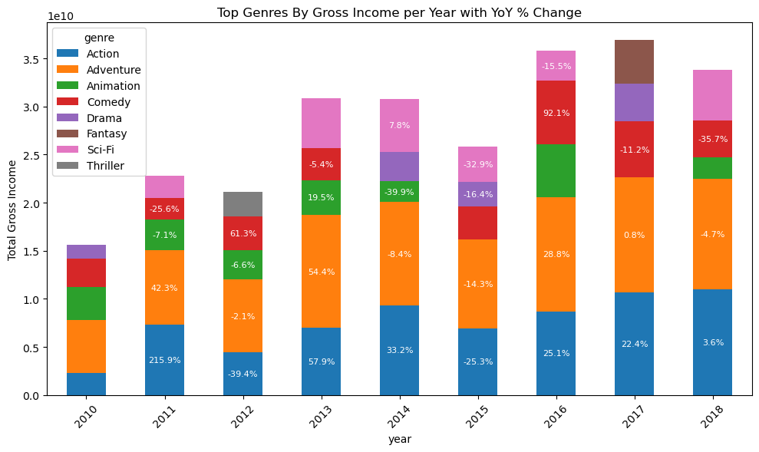
Genre Gross Income YoY
This graph shows the YoY % change in gross income across each genre and allows us to see recent trends
Takeaways
From 2010-2018 gross income for
Action increased 74.5%
Adventure increased 46.8%
Comedy increased 7.8%
*Writer must have written more than 20 films

Slide 13
Recommendations
My recommendation is to focus on a narrow subset of films with genres being Action, Adventure, and/or Sci-Fi, movie length should be around 120 minutes, and directors / writers should have 20 movies under their belt and in top 2/3 of average rating.
Supporting Data:
Action, Adventure, and Sci-Fi films have the highest gross income, average rating, and number of votes
Movie lengths in the 120 minute bucket received the highest number of votes
The difference between writers / directors in the top 2/3 versus the bottom 1/3 is substantial

