Slide 1
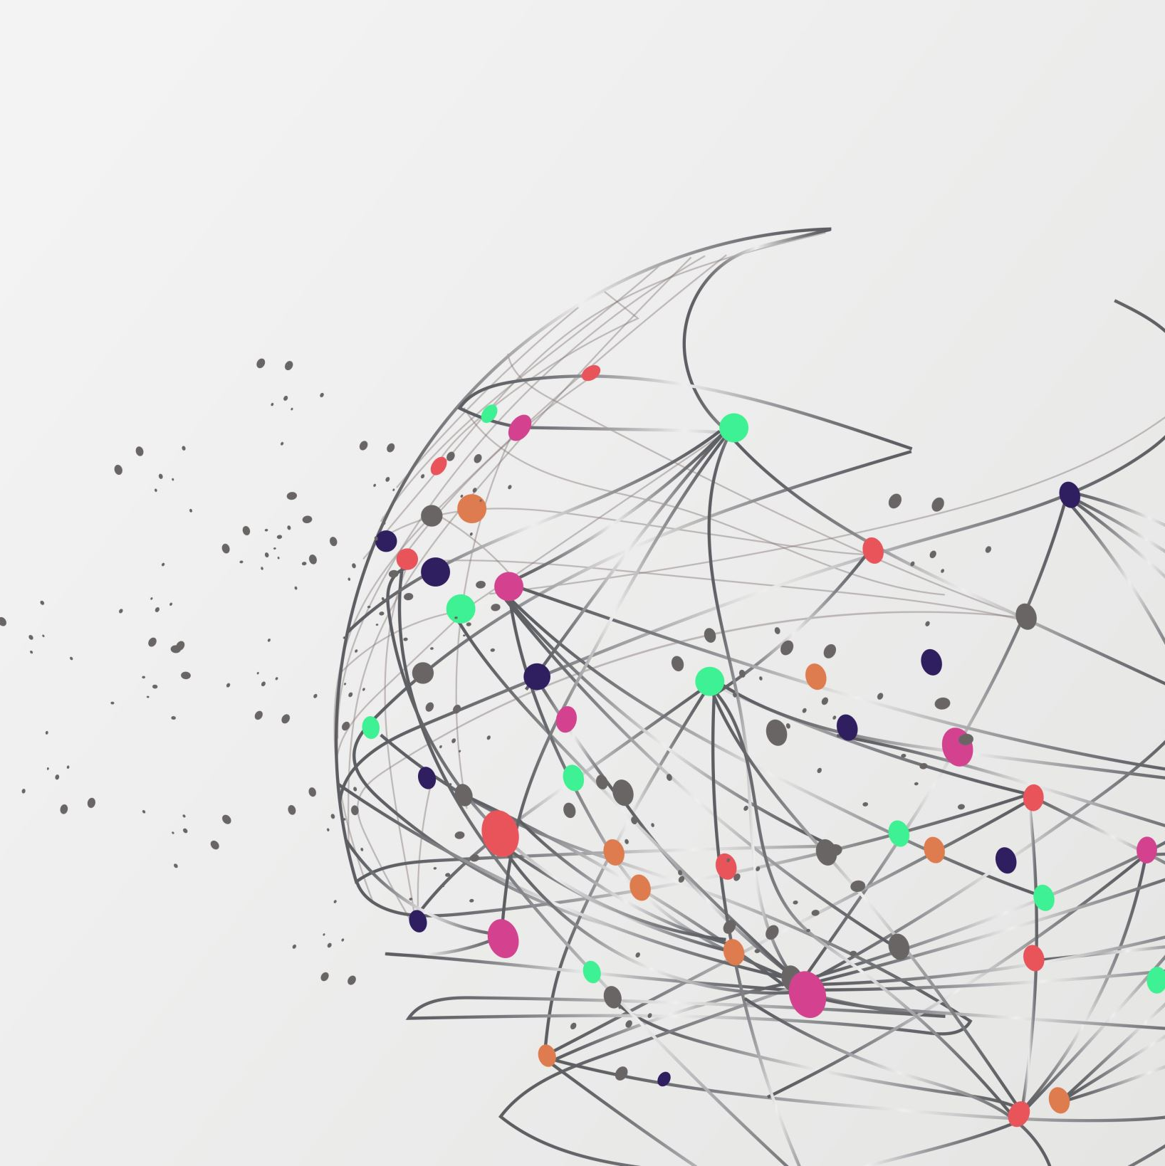
Customer Churn Analysis

Slide 2
Overview & Goal
Overview:
Analyze a telecom company’s dataset to determine what variables cause customers to churn
Goal:
Identify key variables impacting customer churn and provide recommendations to lower this in the future

Slide 3
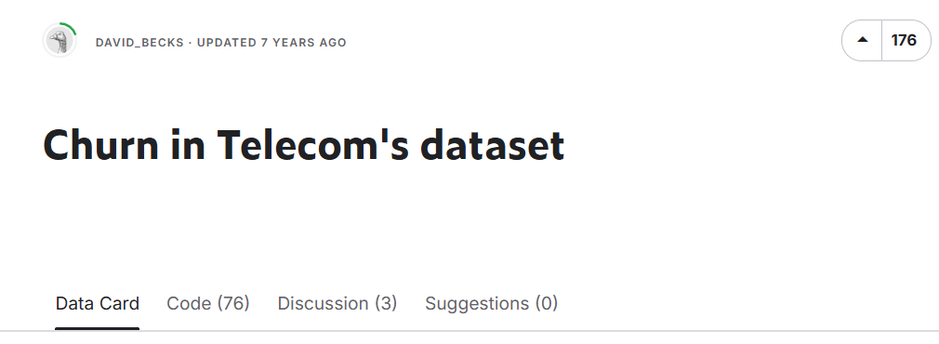
Data Utilized
Dataset
Churn in Telecom’s Dataset
Target Variable = Churn
Key Features
Customer Service Calls
Customer usage metrics (calls, charges, etc…)
International Plan
Voice Mail Plan
State

Slide 4
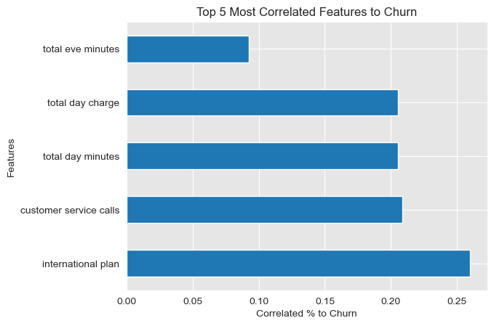
Correlation to Churn
Key Takeaways
Customer service calls is 20% correlated to predicting churn
Total day minutes and charge are slightly lower

Slide 5
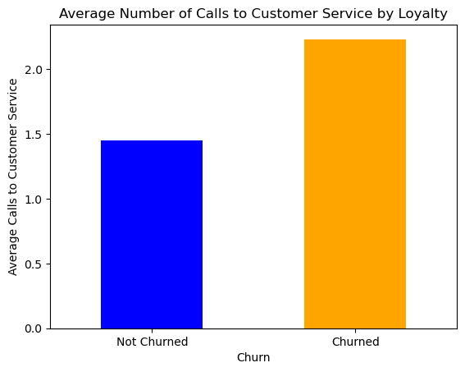
Customer Service Calls
Key Takeaways
Customers who churn have an average of over 2 customer service calls
Users who do not churn average around 1.5 calls

Slide 6
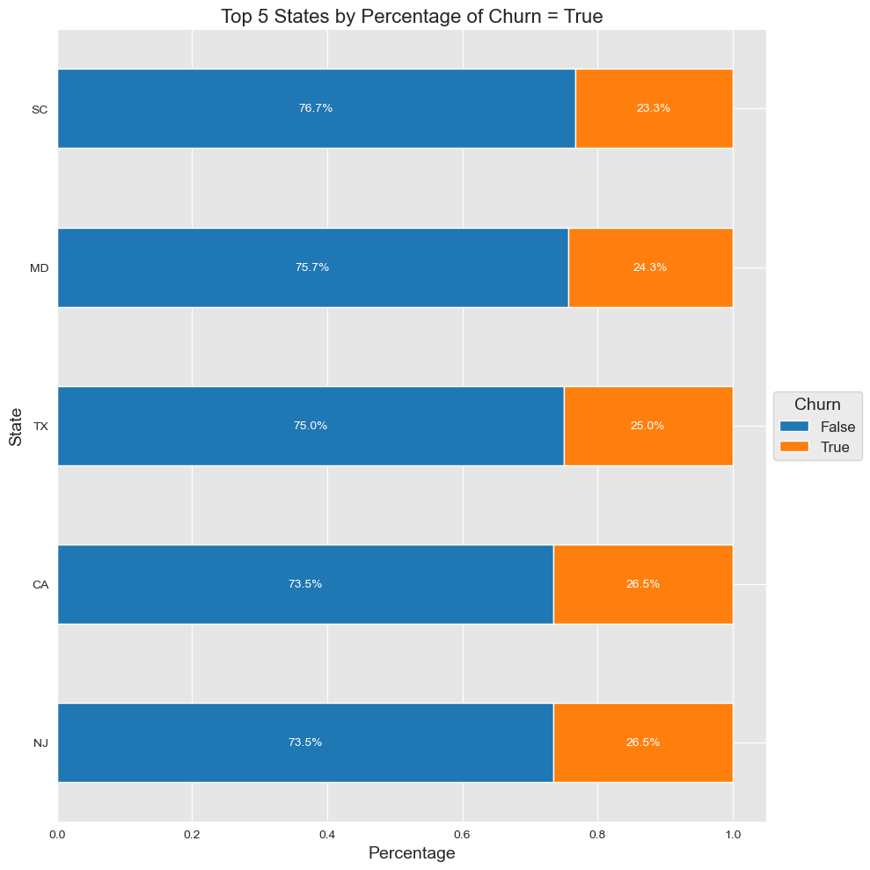
Highest Churn by State
Key Takeaways
NJ, CA, and TX all have churn rates 25% or higher
Three of the most populous states have the highest churn rate

Slide 7
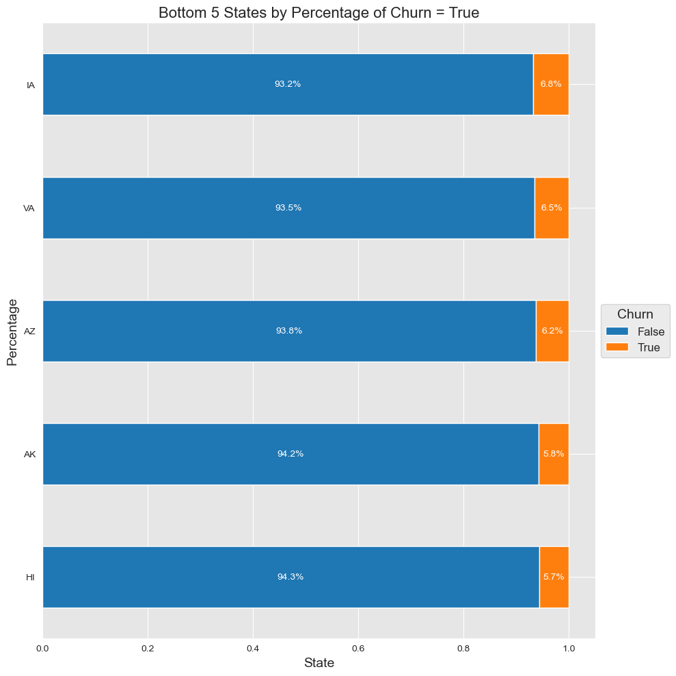
Lowest Churn by State
Key Takeaways
HI, AK, and AZ have the lowest churn % rates at 6.2% or lower

Slide 8
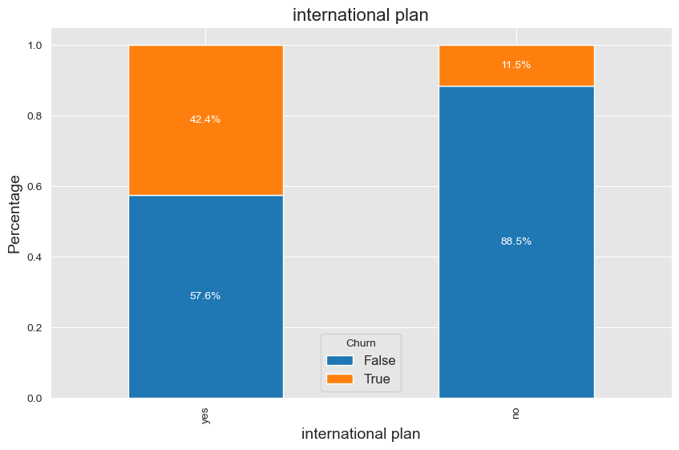
International Plan Churn
Key Takeaways
People with an international plan churn 42.4% of the time
People without an international plan only churn 11.5% of the time
Significant 30.9% difference between having a plan vs not

Slide 9
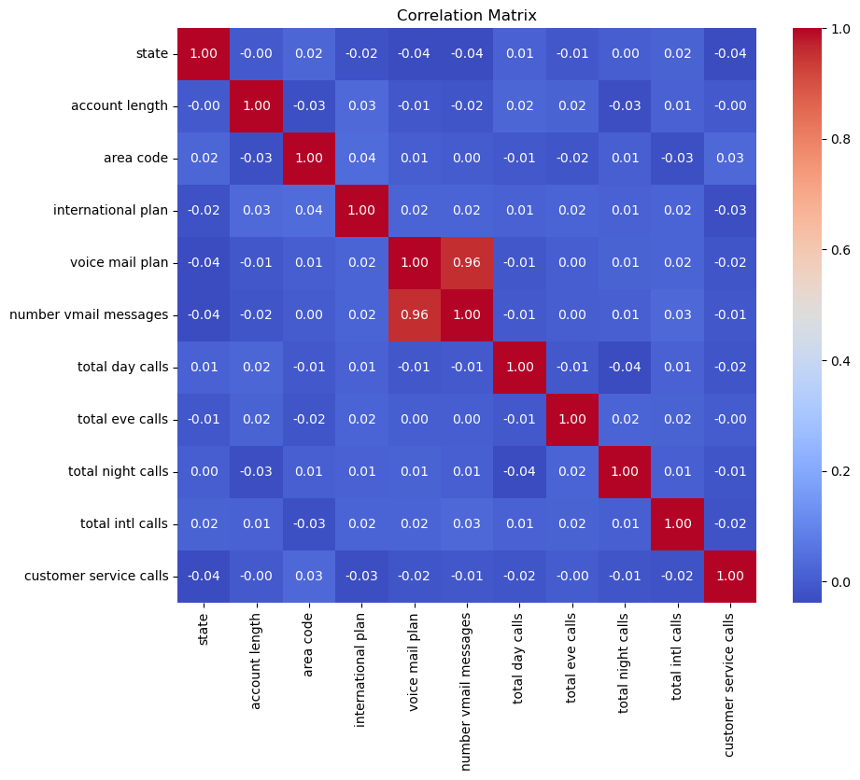
Correlation Matrix
Confirmed there is no collinearity between features

Slide 10
Model Evaluation Using Statsmodels (1/2)
Model | Features | Updates from Previous Model | Key Metrics
Baseline Model | 11 Features State, account length, area code, international plan, voice mail plan, # vmail messages, total day / eve / night / intl calls, customer service calls | N/A | R-squared: 6.25%
Optimized Model | 4 features Customer service calls, international plan, voice mail plan, total intl calls | Limit features to those that have high correlation to churn | R-squared: 13.5%
Optimized Model #2 | 6 Features Customer service calls, international plan, voice mail plan, total intl calls | Added categorical features such as intl plan and voice mail plan | R-squared 19.1%
Statsmodels Overview
Focus: Statistical analysis.
Provides detailed statistical summaries and hypothesis testing (e.g., p-values, confidence intervals).
Ideal for understanding the relationships between variables in-depth.

Slide 11
Model Evaluation Using SciKitLearn
Model | Features | Updates from Previous Model | Key Metrics
LogReg Baseline Model | 7 Features customer service calls', 'international plan', 'voice mail plan', 'total intl calls', 'total day charge', 'total day minutes' | N/A | AUC 64.5%
LogReg Baseline Model #2 | 7 Features customer service calls', 'international plan', 'voice mail plan', 'total intl calls', 'total day charge', 'total day minutes' | Added an intercept to the model | AUC 65.2%
Decision Tree Model | 7 Features customer service calls', 'international plan', 'voice mail plan', 'total intl calls', 'total day charge', 'total day minutes' | Adjust several hyperparameters based on analysis Max features, max depth, min splits, min leafs | AUC 59.2%
AUC Overview
AUC is a score between 0.5 and 1.0 that shows how well the model separates different groups.
The higher the AUC, the better the model at making accurate predictions.
AUC helps us decide if the model is good enough to act on, ensuring we focus on the right people or items.

Slide 12
Model Results – Recommendations
Customer Service Calls is the Strongest Predictor
The more frequently a customer contacts customer service, the higher the likelihood of churn. This suggests that resolving customer complaints efficiently could reduce churn.
Customers with an International Plan are at Higher Risk
These customers may be dissatisfied with the cost or quality of the international calling plan. Improving this service could improve retention.
Voice Mail Plan is Predictive
While less obvious, whether a customer has a voicemail plan or not may relate to overall service usage or satisfaction. This could be worth exploring further.
Total International Calls Adds Context
Customers making frequent international calls may represent a specific customer segment. Understanding their unique needs (e.g., better international rates or service quality) could reduce churn.

Slide 13
Model Results – Recommendations
Takeaways from the Decision Classifier Model
The decision classifier model helps us predict churn by learning patterns in these selected features. Here’s what we learned:
Customer Service Calls is the Strongest Predictor:
The more frequently a customer contacts customer service, the higher the likelihood of churn. This suggests that resolving customer complaints efficiently could reduce churn.
Customers with an International Plan are at Higher Risk:
These customers may be dissatisfied with the cost or quality of the international calling plan. Improving this service could improve retention.
Voice Mail Plan is Predictive:
While less obvious, whether a customer has a voicemail plan or not may relate to overall service usage or satisfaction. This could be worth exploring further.
Total International Calls Adds Context:
Customers making frequent international calls may represent a specific customer segment. Understanding their unique needs (e.g., better international rates or service quality) could reduce churn.

