Slide 1
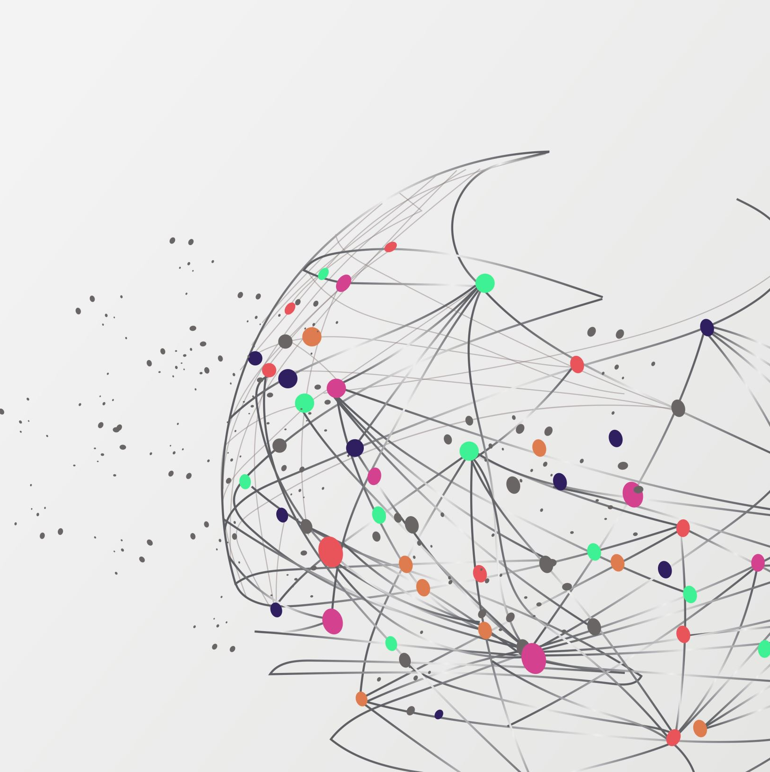
Customer Churn Analysis

Slide 2
Overview & Goal
Overview:
We are analyzing a telecom company’s dataset to determine what variables cause customers to churn
Goal:
Identify key variables impacting customer churn and provide recommendations to lower this in the future

Slide 3
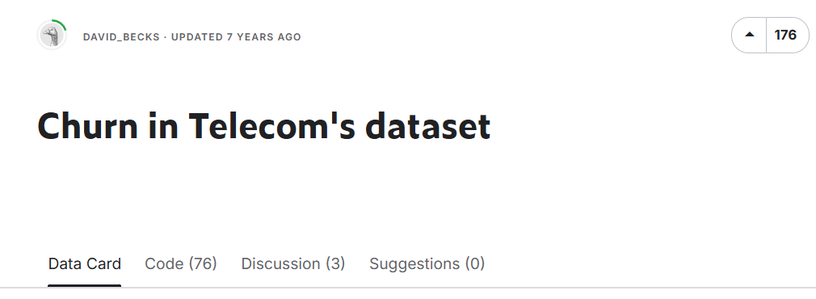
Data Utilized
Dataset
Churn in Telecom’s Dataset
Target Variable = Churn
Key Features
Customer Service Calls
Customer usage metrics (calls, charges, etc…)
International Plan
Voice Mail Plan
State

Slide 4
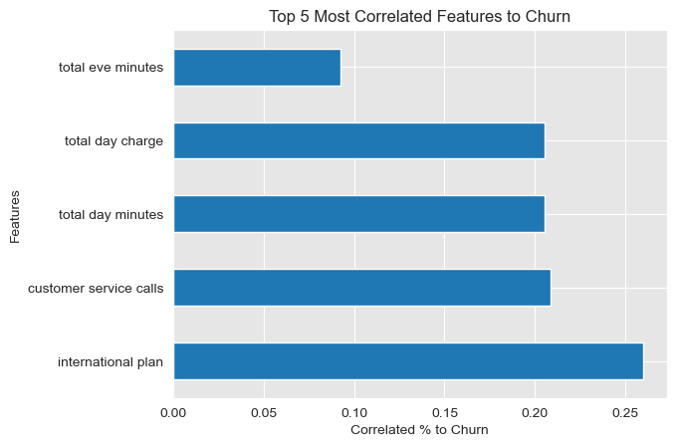
Correlation to Churn
Key Takeaways
Customer service calls is 20% correlated to predicting churn
Total day minutes and charge are slightly lower

Slide 5
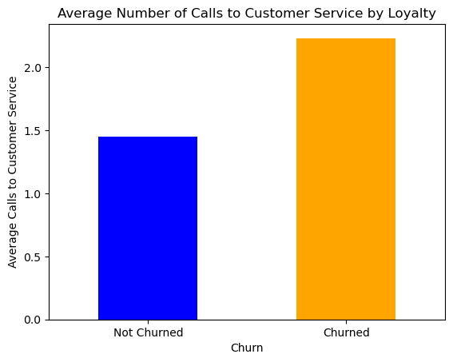
Customer Service Calls
Key Takeaways
Customers who churn have an average of over 2 customer service calls
Users who do not churn average around 1.5 calls

Slide 6
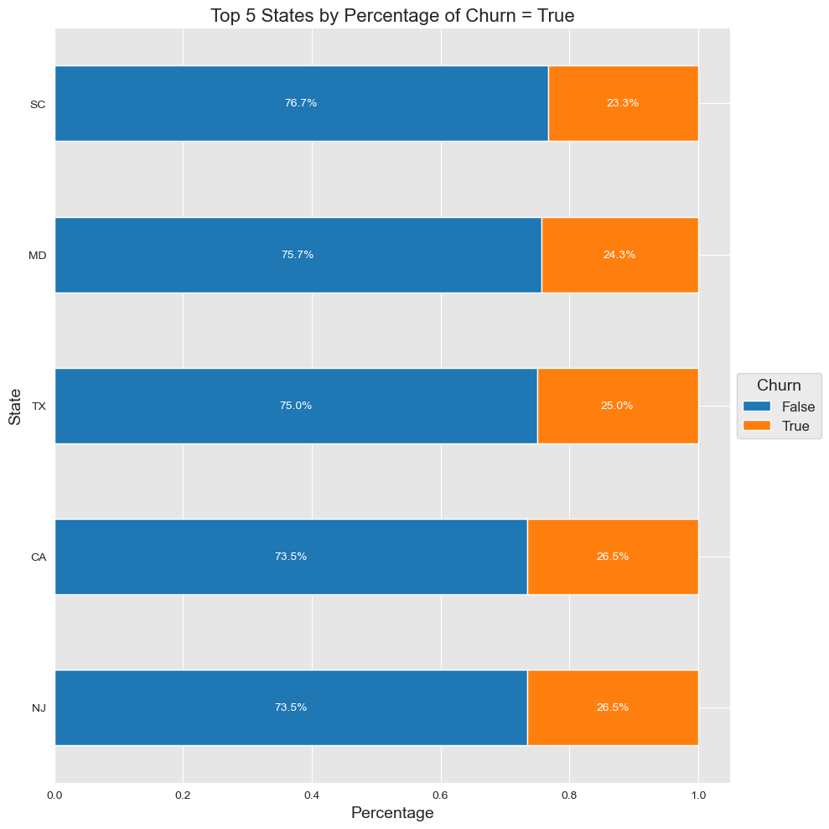
Highest Churn by State
Key Takeaways
NJ, CA, and TX all have churn rates 25% or higher
Three of the most populous states have the highest churn rate

Slide 7
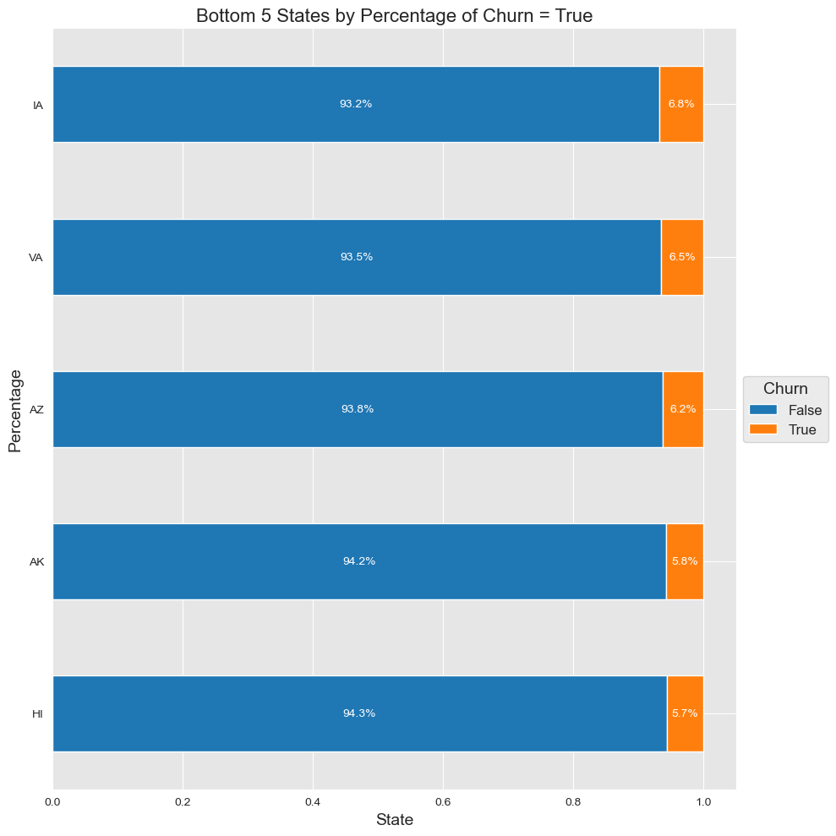
Lowest Churn by State
Key Takeaways
HI, AK, and AZ have the lowest churn % rates at 6.2% or lower

Slide 8
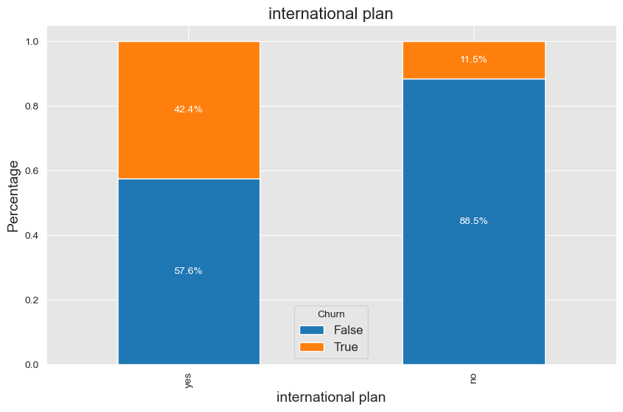
International Plan Churn
Key Takeaways
People with an international plan churn 42.4% of the time
People without an international plan only churn 11.5% of the time
Significant 30.9% difference between having a plan vs not

Slide 9
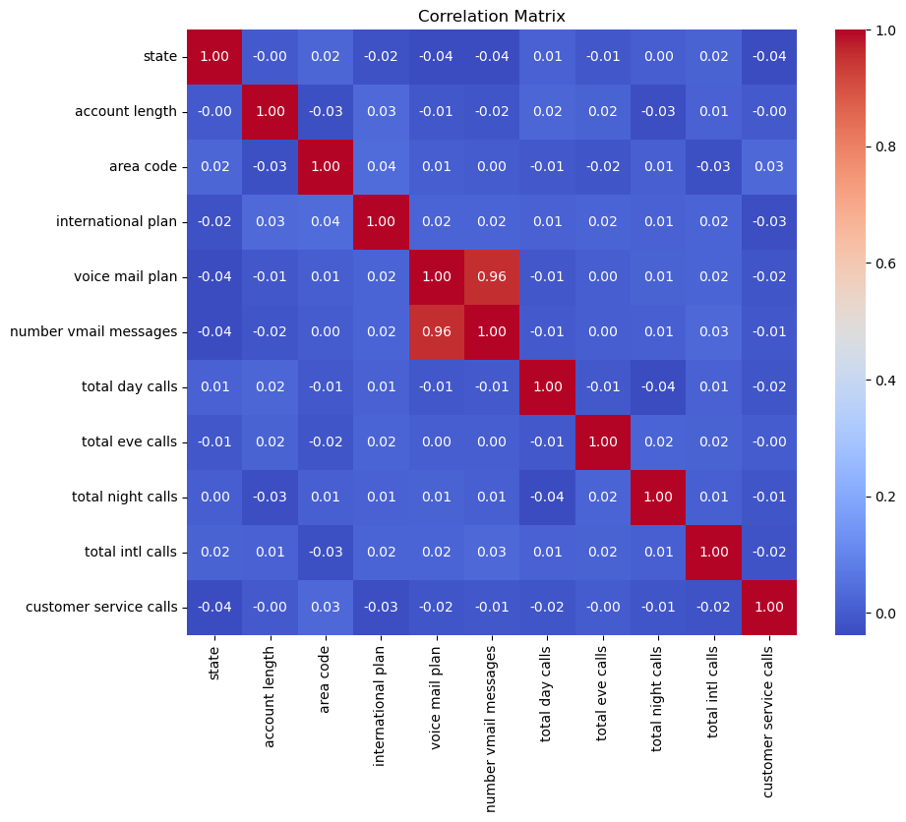
Correlation Matrix
Confirm there is no collinearity between features

Slide 10
Model Evaluation
Model | Features | Key Metrics | Next Steps
Baseline Model | 11 Features State, account length, area code, international plan, voice mail plan, # vmail messages, total day / eve / night / intl calls, customer service calls | R-squared: 6.25%
Optimized Model | 4 features Customer service calls, international plan, voice mail plan, total intl calls | R-squared: 13.5%
Feature-less Model | 6 Features Customer service calls, international plan, voice mail plan, total intl calls

Slide 11
Model Explanation - Feature Selection
We selected features with the highest correlation with our target Churn variable
Customer Service Calls: Customers who make frequent calls to customer service are more likely to churn. This suggests dissatisfaction or unresolved issues.
International Plan: Customers with an international calling plan are more likely to churn. This might indicate dissatisfaction with international service pricing or competitors offering better deals.
Voice Mail Plan: The presence or absence of a voicemail plan also contributes to predicting churn. It could reflect usage patterns or preferences.
Total International Calls: The number of international calls made could signal specific customer behaviors or service usage patterns that relate to churn.

Slide 12
Model Results – Recommendations
Customer Service Calls is the Strongest Predictor
The more frequently a customer contacts customer service, the higher the likelihood of churn. This suggests that resolving customer complaints efficiently could reduce churn.
Customers with an International Plan are at Higher Risk
These customers may be dissatisfied with the cost or quality of the international calling plan. Improving this service could improve retention.
Voice Mail Plan is Predictive
While less obvious, whether a customer has a voicemail plan or not may relate to overall service usage or satisfaction. This could be worth exploring further.
Total International Calls Adds Context
Customers making frequent international calls may represent a specific customer segment. Understanding their unique needs (e.g., better international rates or service quality) could reduce churn.

