Slide 1
Data App
FYY Leather Case with Mirror for Samsung Galaxy S8 Plus, Leather Wallet Flip Folio Case with Mirror and Wrist Strap for Samsung Galaxy S8 Plus Black

Slide 2
Description
Product Description Premium PU Leather Top quality. Made with Premium PU Leather. Receiver design. Accurate cut-out for receiver. Convenient to Answer the phone without open the case. Hand strap makes it easy to carry around. RFID Technique RFID Technique: Radio Frequency Identification technology, through radio signals to identify specific targets and to read and copy electronic data. Most Credit Cards, Debit Cards, ID Cards are set-in the RFID chip, the RFID reader can easily read the cards information within 10 feet(about 3m) without touching them. This case is designed to protect your cards information from stealing with blocking material of RFID shielding technology. 100% Handmade 100% Handmade. Perfect craftmanship and reinforced stitching makes it even more durable. Sleek, practical and elegant with a variety of dashing colors. Multiple Functions Card slots are designed for you to put your photo, debit card, credit card or ID card while on the go. Unique design. Cosmetic Mirror inside made for your makeup and beauty. Perfect Viewing Angle. Kickstand function is convenient for movie-watching or video-chatting. Space amplification, convenient to unlock. Kickstand function is convenient for movie-watching or video-chatting.

Slide 3
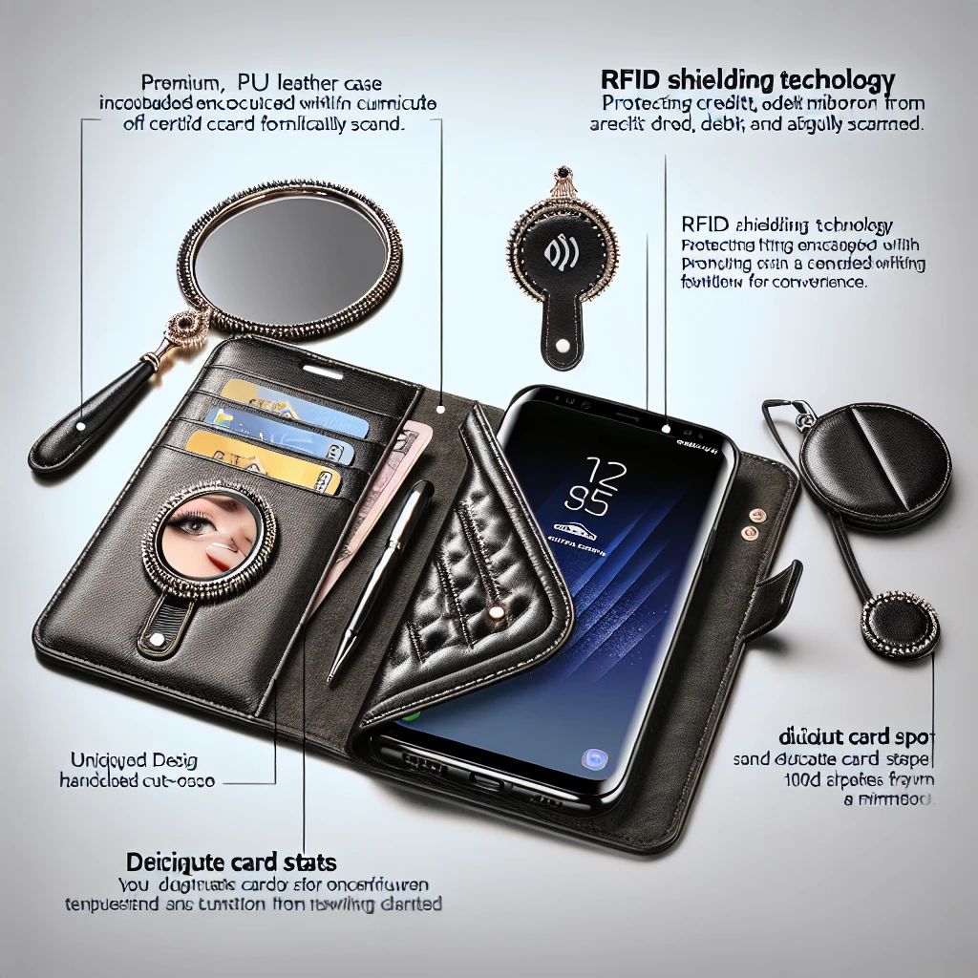
Features
Receiver design: Accurate cut-out for receiver. Convenient to answer the phone without opening the case.
Hand strap: Makes it easy to carry around.
RFID Technique: Protects cards information from stealing with RFID shielding technology.
100% Handmade: Perfect craftsmanship and reinforced stitching for durability.
Multiple Functions: Card slots for photo, debit/credit/ID cards. Cosmetic mirror for makeup. Kickstand function for movie-watching or video-chatting. Space amplification for convenient unlocking.
Perfect Viewing Angle: Kickstand function provides a convenient viewing angle.

